Slide 1

EMPLOYEE MANAGEMENT SYSTEM
Presented by
Simran Mulani-816026
Sayali Chavhan-814922

Slide 2
Employee Management System
Employee management system is a distributed application, developed to maintain the details of employees working in any organization.
This employee management system project application stores all the employees information in a in memory mysql database.
It contains the information like employee id, first name, surname, and email. It is an easy to use application and has a user-friendly interface.
It is totally built at the administrative end which means that only the admin has access rights to change or modify any records.
So this makes it safe and reliable application was to reduce the errors that occur in the manual system
It maintains the information about the personal details of the employees.
It is developed to override the problems prevailing in the practicing manual system.
Employee Management System is a distributed application, developed to maintain the details of employees
working in any organization.

Slide 3
OBJECTIVES OF OUR PROJECT
This projects aims to simplify the task of maintaining records of the employees of company.
To develop a well-designed database to store employee information.
Provides full functional reports to management of company.
The objective of this project is to provide a comprehensive approach towards the management of employee information.
The main objective of the application is to maintain the details of employees.
The working in any organization, objective of this project is to provide a comprehensive approach towards the management of employee.

Slide 4
Existing system
Earlier systems were manual where there was no way of properly storing information.
Employee records were stored manually which lead to errors. There was no proper way of tracking employee records.
It is very difficult and required a lot of paperwork which makes the application time consuming and not secured.
There was no administrator which could handle the records. So there was the need to develop a system which could manage all these things and reduce the paperwork

Slide 5
Proposed system
Employee management system is easy to use application which is created to manage the employee data. It is created to record the details of the employees. This reduces the dependency on the manual system which could create errors.
This system can easily help in tracking employee records. There is an administrator which can add, edit, delete and save records in a database. Administrator can view all the employees present in the database.
This employee management system is created completely on the administrative end which means only the admin has access rights to change or modify any records.
So this makes it safe and reliable application to use.

Slide 6
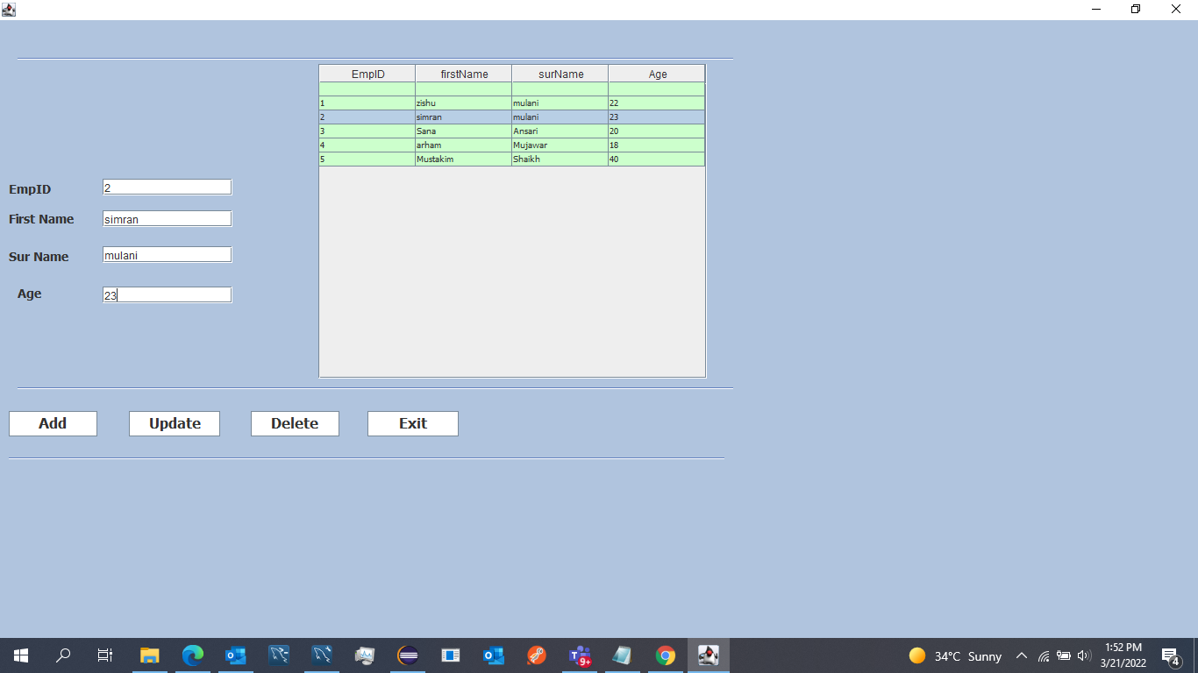
ScreenShots

Slide 7
Thank you

