Slide 1

Faculty : Mr. Thaneshwara
SIMRAN MULANI
Emp-id:- 816026

Slide 2
About Project
Vehicle Management system is the simple application where the CRUD (Create, Read, Update and Delete) Operations are used.
Users : Here we have two types of users first is Admin which can use CRUD operations on Customers, Services and Vehicles. On other hand Service advisor can only use CRUD operation for Services only. ( Services advisor is restricted to use CRUD operations on Customers and vehicles. )

Slide 3
About Technologies
We’ve developed this application on Spring boot, Hibernate and use of Thymeleaf, where Hibernate is used for to put data into database with no more extra efforts with the help of @Entity it can automatically create table but we have to specify the database name in application.properties.
Thymeleaf is also great library for the full integration with spring framework.
Spring Data JPA, part of the larger Spring Data family, makes it easy to easily implement JPA based repositories.

Slide 4

Spring Boot
Spring Boot is an open source Java-based framework used to create a micro Service. It is developed by Pivotal Team and is used to build stand-alone and production ready spring applications. This chapter will give you an introduction to Spring Boot and familiarizes you with its basic concepts.

Slide 5
Spring Data JPA
Spring Data JPA, part of the larger Spring Data family, makes it easy to easily implement JPA based repositories. This module deals with enhanced support for JPA based data access layers. It makes it easier to build Spring-powered applications that use data access technologies.

Slide 6

Hibernate
Hibernate ORM is an object–relational mapping tool for the Java programming language. It provides a framework for mapping an object-oriented domain model to a relational database.

Slide 7

Thymeleaf
Thymeleaf is a modern server-side Java template engine for both web and standalone environments.
Thymeleaf's main goal is to bring elegant natural templates to your development workflow — HTML that can be correctly displayed in browsers and also work as static prototypes, allowing for stronger collaboration in development teams.

Slide 8
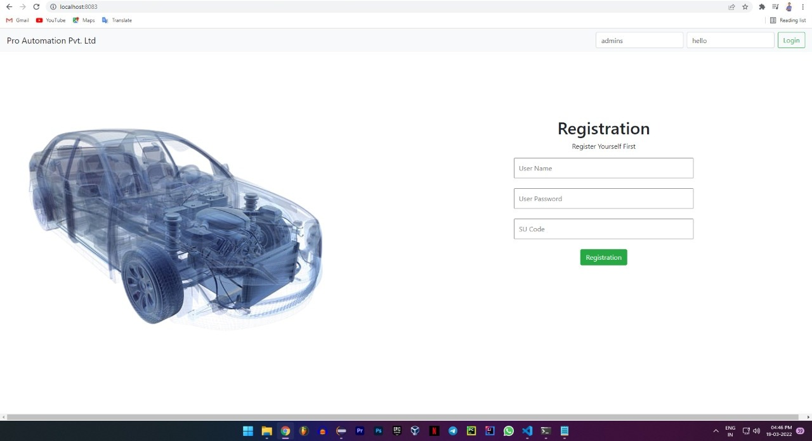
Screenshots

Slide 9
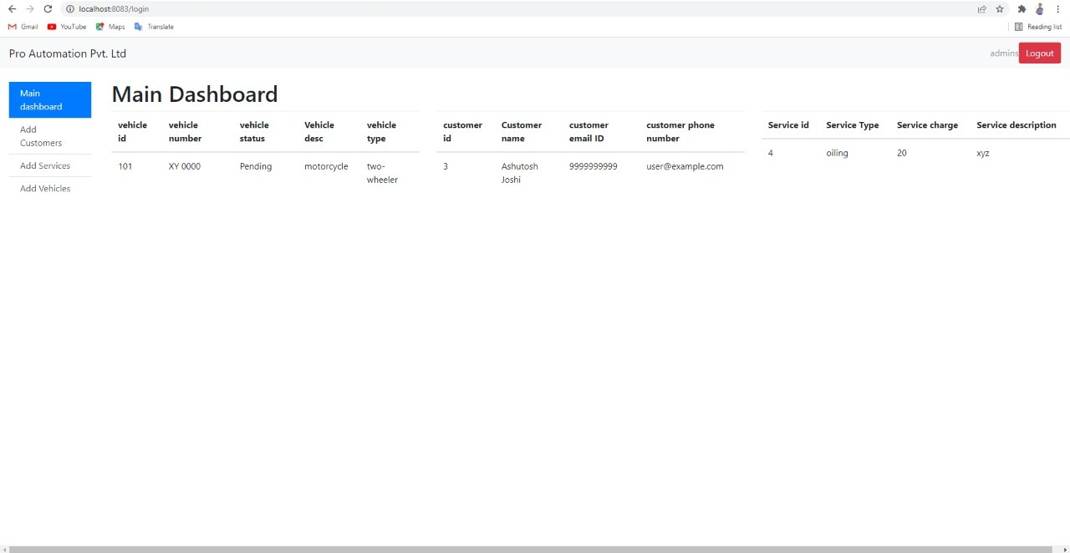
Screenshots

Slide 10
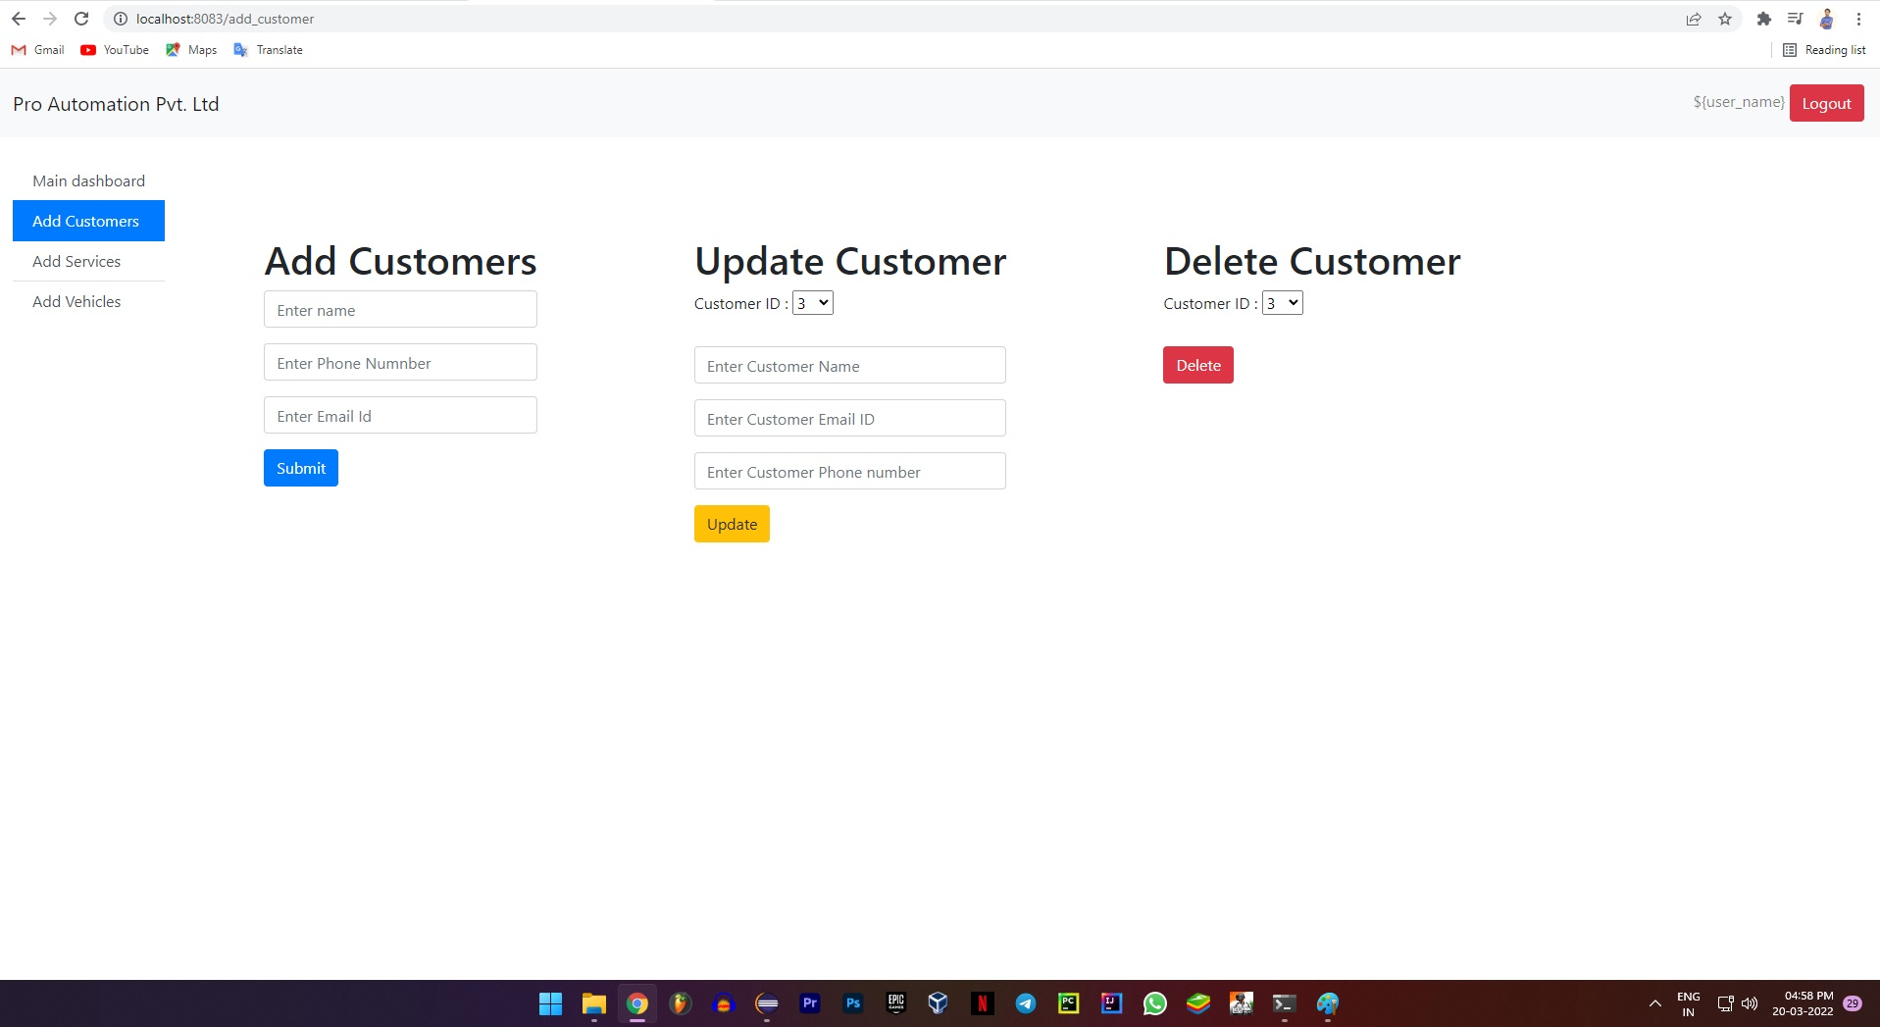
Screenshots

Slide 11
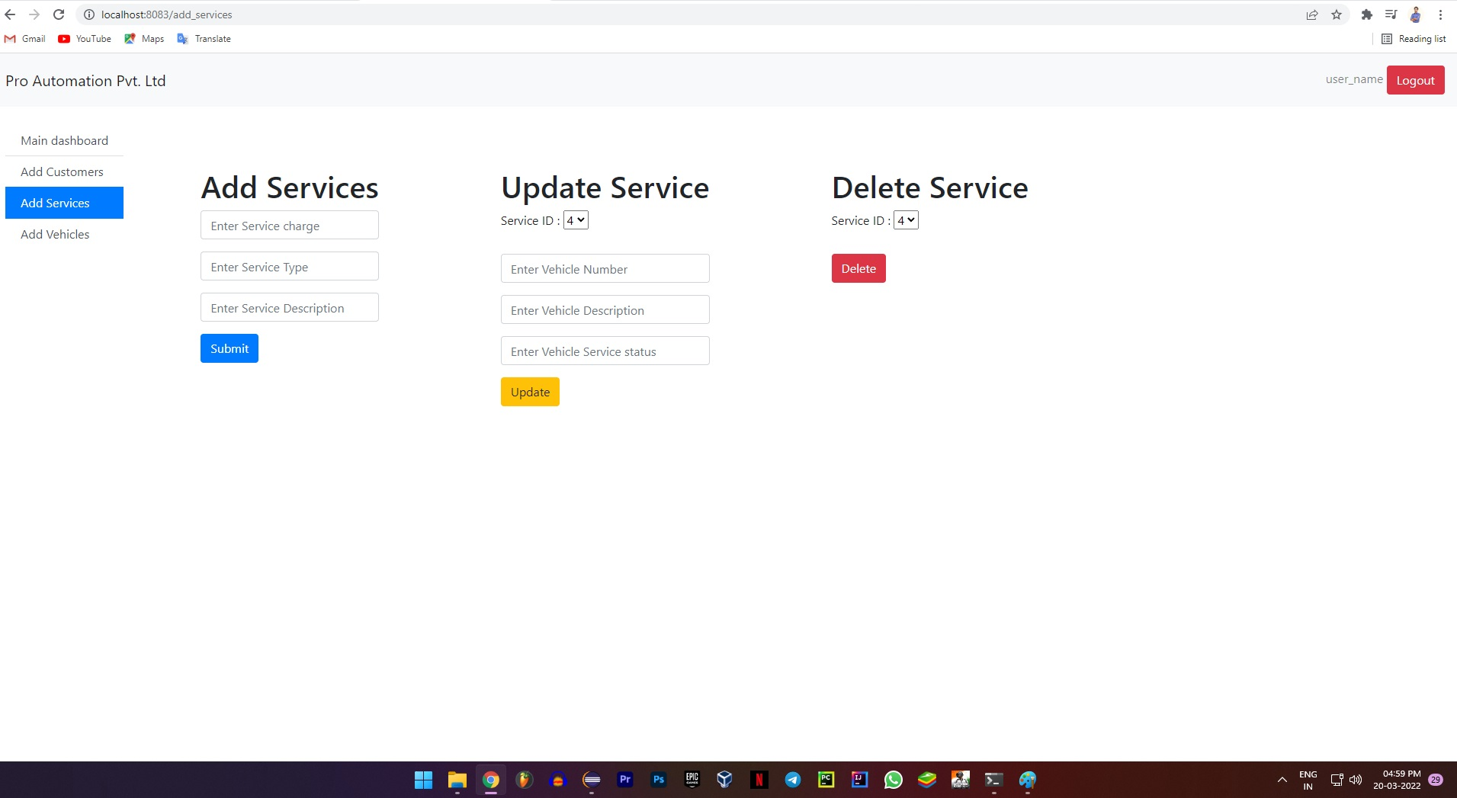
Screenshots

Slide 12
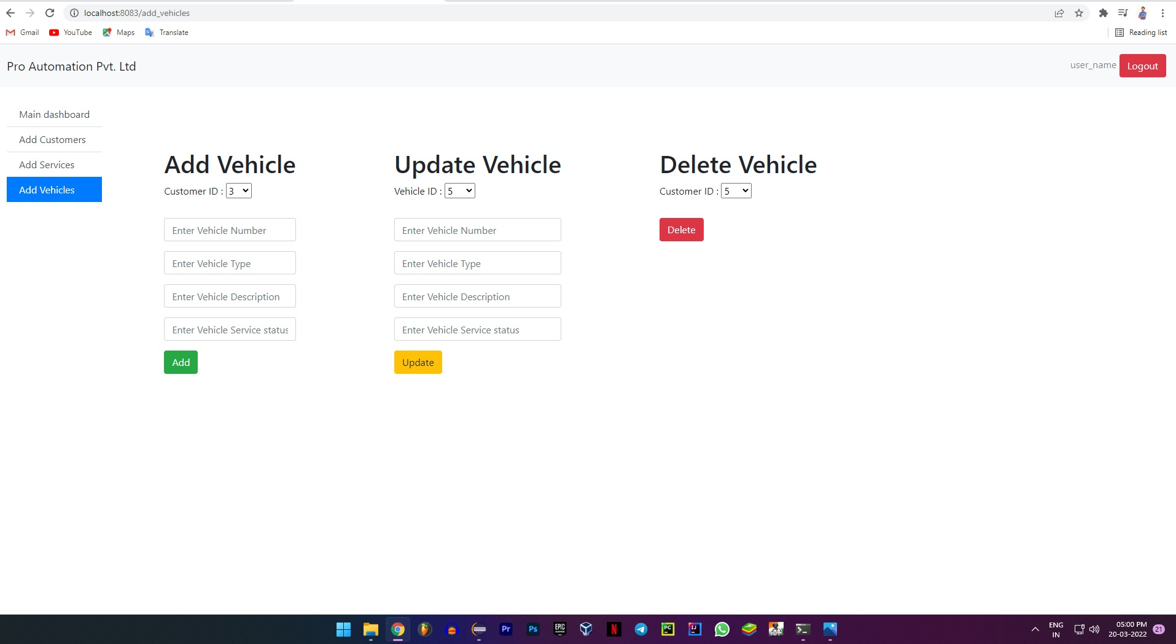
Screenshots

Slide 13
Thank You

