Slide 1


ImageCampus - TP 1 - Gabriel Campo

Slide 2
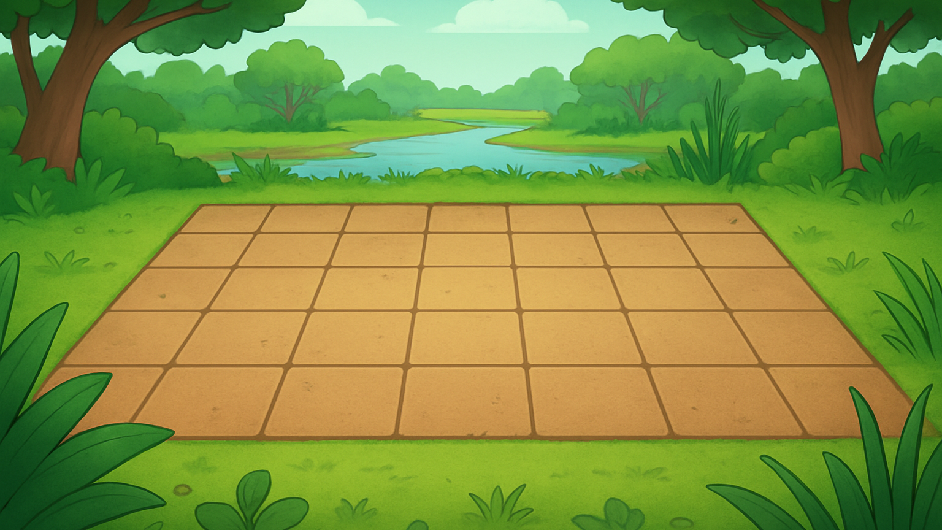

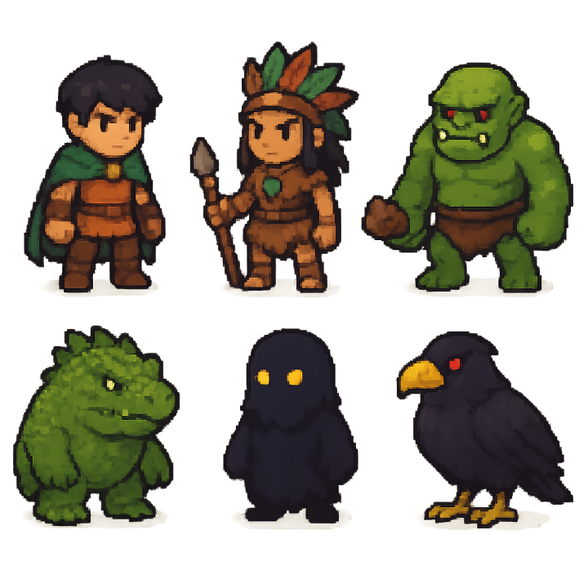
ImageCampus - TP 1 - Gabriel Campo

Slide 4
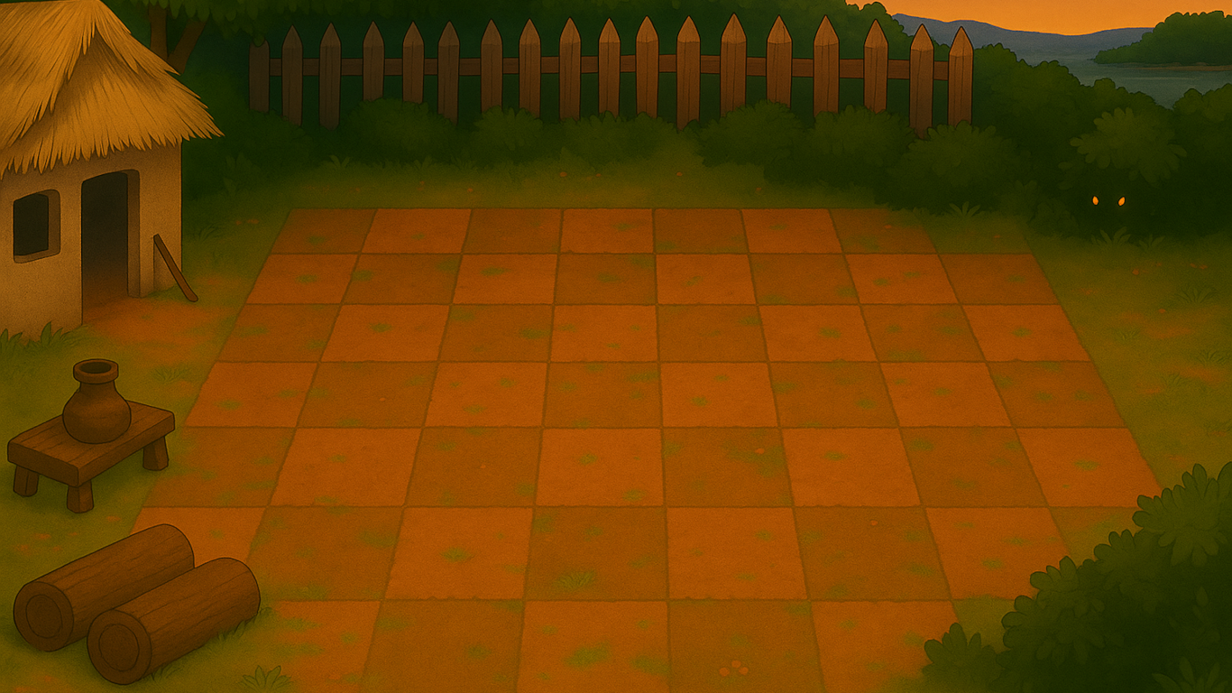
ImageCampus - TP 1 - Gabriel Campo

Slide 5



Slide 6
