Slide 1
UNRAVELING THE SILVER SCREEN A Data Analysis Journey through IMDb Data
Alice Langone

Slide 2



Analisi progetto diapositiva 3
Data Analysis Phases
EXPLORE, CLEAN AND TRANSFORM DATA
INTERPRET THE RESULTS OF THE ANALYSIS
CREATE DATA VISUALIZATIONS AND DASHBOARDS
COLLECT DATA
ANALYZE DATA
The use of Python’s libraries like Pandas, Seaborn, and Matplotlib was essential for analyzing the data.
The analysis also utilizes MySQL's capabilities, including CTEs, JOIN, subqueries, and aggregate functions.
The dataset used for this analysis was sourced from Kaggle.
The dataset was obtained in CSV.
The following data cleaning steps were performed:
- Handling Missing Values
- Dropping Duplicates
- Formatting the Data
Summarize the most important and interesting insights that emerged from the analysis acknowledging any limitations.
Tableau was used to create interactive dashboards that breathe life into the IMDB dataset

Slide 3
Analisi progetto diapositiva 2
Data Cleaning
1
4
REMOVE IRRELEVANT DATA
DEAL WITH MISSING DATA
2
5
REMOVE DUPLICATES
FILTER OUT OUTLIERS
3
6
FIX STRUCTURAL ERRORS
DATA VALIDATION

Slide 4
Data Analysis
In our initial analysis, we extracted the following key insights:
Number of Movies for each Year
Relationship Between Rating and Revenue
Top 5 Longest Movies
These initial findings serve as a foundation for further exploration and deeper understanding of the IMDb dataset.

Slide 5
Data Analysis
We can observe that among the top 10 movies with the highest revenue and the top 10 movies with the highest rating, only two movies, "The Dark Knight" and "The Dark Knight Rises," appear in both lists. These films stand out as exceptional cases, achieving both commercial success and critical acclaim.
"The Dark Knight," directed by Christopher Nolan, falls under the genres of Action, Crime, and Drama. It features Christian Bale as the iconic Batman, along with other notable actors like Heath Ledger, who delivered an unforgettable performance as the Joker.
Similarly, "The Dark Knight Rises," also directed by Christopher Nolan, belongs to the Action and Thriller genres. Christian Bale reprised his role as Batman, and the film boasts a stellar ensemble cast, including Anne Hathaway as Catwoman and Tom Hardy as the formidable villain, Bane.

Slide 6
Conclusions
Christopher Nolan ranks among the top directors in terms of movie ratings, demonstrating his notable skill and creativity in filmmaking. Additionally, he is the most frequently featured directors in the top 10 movies with the highest revenue, sharing this distinction with Joss Whedon. Furthermore, Christopher Nolan's directorial work is prominently represented in the top 10 movies with the highest rating, as he has produced an impressive 5 out of the top 10 films in this category.
His achievements in consistently delivering successful movies have earned him recognition and acclaim within the film industry. Christopher Nolan's influence on the cinematic landscape is evident, and his contributions continue to shape the art of storytelling in the realm of filmmaking.

Slide 7
Conclusions
Christian Bale emerges as one of the most frequently featured actor in the top 10 movies with the highest revenue and he is also the most starred actor in the top 10 movies with the highest rating. His remarkable presence in these critically acclaimed and commercially successful films underscores his exceptional acting prowess and ability to captivate audiences across diverse cinematic genres.
As a versatile and highly esteemed actor, Christian Bale continues to leave an indelible mark on the world of cinema through his exceptional contributions to the art of acting.

Slide 8
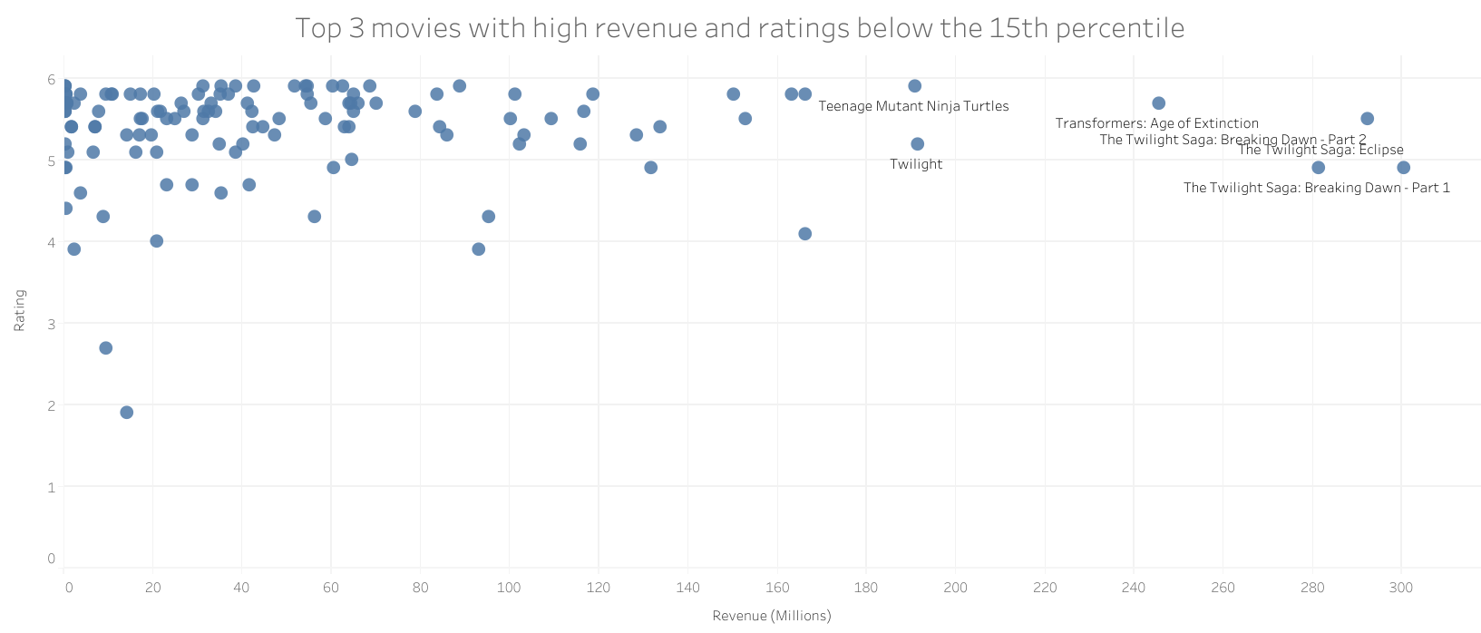
Conclusions
At the conclusion of our analysis, an intriguing trend in the top 3 movies with high revenue but ratings below the 15th percentile was discovered. All three movies belong to the popular 'Twilight Saga.' It is noteworthy that these movies, despite receiving lower ratings, achieved significant success at the box office.
Upon further examination, we observed a recurring pattern wherein movies catering to a younger audience or associated with the 'Twilight Saga,' tend to generate substantial revenue, even when accompanied by relatively negative ratings. This finding suggests that the target audience for these films might not actively contribute to ratings, potentially skewing the overall perception.
The scatter plot below showcases movies that exhibit high revenue despite their lower ratings, offering further insights.

Slide 9
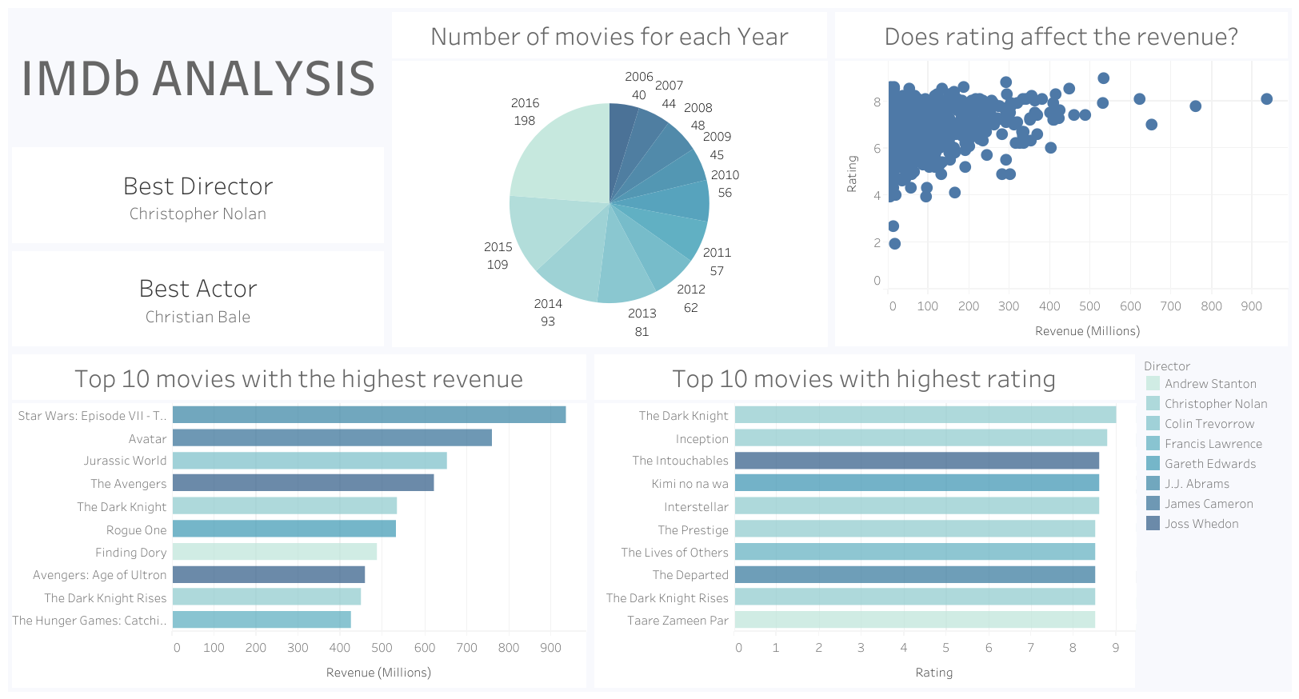
Tableau Dashboard
To explore the interactive Tableau dashboard with detailed movie insights, please click on the link below:
https://public.tableau.com/views/IMDB_16907340540630/Dashboard?:language=it-IT&:display_count=n&:origin=viz_share_link
Note: Internet access is required to view the dashboard.

Slide 10
Thank you all

