Slide 1
Facebook Comment Volume Analysis
Group 5 蔡漢龍 林賦安 方品謙 杜明軒 徐安安

Slide 2

Group 5
Goal
1. Goal
Data： Facebook po文相關資料集
紀錄了大約60萬則po文的資訊，像是讚數留言數等等。
Motion：
眾多報導顯示，如今按讚數已經不是首要，Facebook的演算法更重視的是 「有意義互動」(Meaningful interactions)。即po文若能吸引留言討論，代表用戶願意付出更多時間在該則貼文上，也將會被演算法優先排序在動態消息。
Goal：
預測留言數的多寡
建立評估某一粉專po文成效的依據
Data Introduction
Shiny App Demo
Data Processing
Model Building
Application
Notes:
新聞來源:
https://buzzorange.com/techorange/2018/11/15/facebook-enhance-interaction/

Slide 3
Group 5
Data Introduction
Goal
Fans Page?
Comment?
What else?
2. Data Introduction
Likes
Checkins
Talking about
Category
Comments no. (DateTime~24/24~48/48~72)
Collecting time
H Local & Target Variable
Total no.
Length
Share count
Promotion status
Published weekday
Datetime weekday
Shiny App Demo
Data Processing
Model Building
Application

Slide 4
Group 5
Shiny App Demo
Goal
Data Introduction
3. Shiny App Demo
Link:
Data Processing
Model Building
Application

Slide 5



Group 5
Fans Page Category Selection
Goal
為了避免不同種類的粉絲專頁留言數有極大的差距，因此我們選擇了以人為主體的粉絲專頁。
Data Introduction
Shiny App Demo
Actor/director
Public figure
Personal blog
Writer
Photographer
Author
Artist
4. Data Processing
Athlete
Coach
Professional sports team
Model Building
Application
Politician
Political party

Slide 6
Group 5
Feature Importance Analysis
boruta
Goal
Data Introduction
Shiny App Demo
4. Data Processing
Model Building
Application

Slide 7
Group 5
Feature Selection
Goal
我們所選擇的變數
Page Likes
Page Category
Content Length
Share Count
Collecting Time
Published Weekday
V2-10/V12-15/V17-25
Data Introduction
Shiny App Demo
4. Data Processing
Model Building
Application

Slide 8
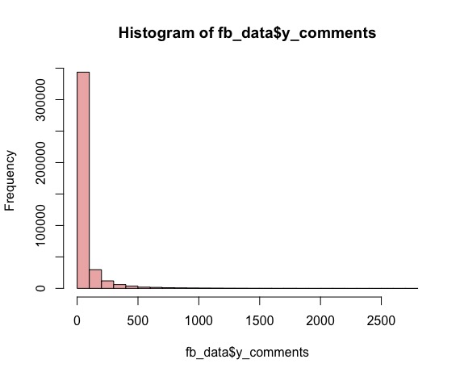
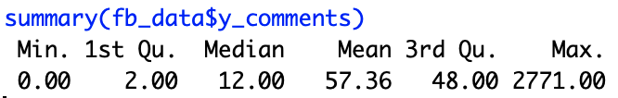
Group 5
Comment Classification
Goal
Data Introduction
Shiny App Demo
4. Data Processing
Model Building
Application

Slide 9
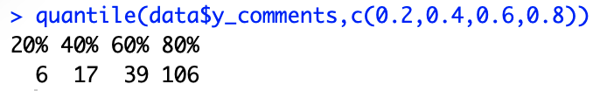
Group 5
Total Comment Classification
Goal
Data Introduction
去探討留言的確切數量似乎並沒有太大意義， 從剛剛的圖也可以看到留言的分佈並不均勻
因此我們藉由查看quantile來將留言分類：
Shiny App Demo
4. Data Processing
Model Building
Application

Slide 10
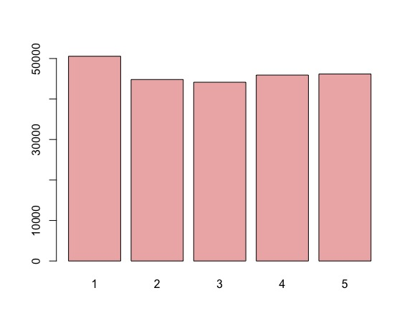
Group 5
Total Comment Classification
Goal
Data Introduction
第一類
第二類
第三類
第四類
第五類
0~6
7~17
18~39
40~106
>106
Shiny App Demo
4. Data Processing
Model Building
Application

Slide 11
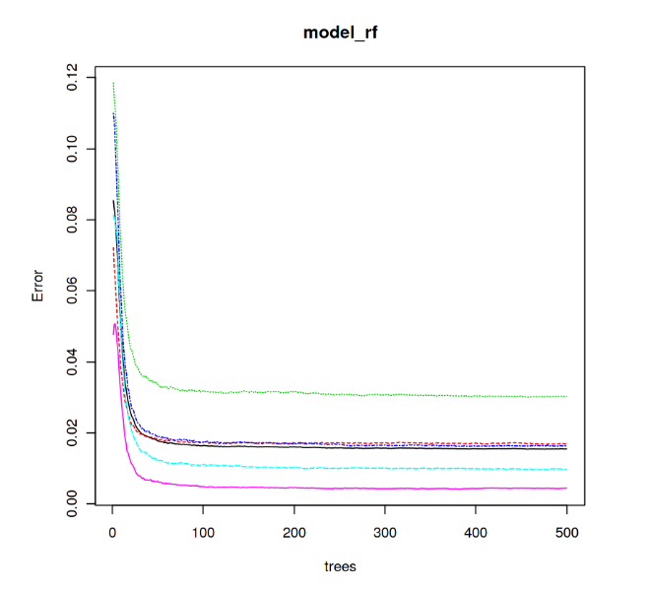
Group 5
Random Forests-ntree
Goal
Data Introduction
Shiny App Demo
由右圖可以看出model在ntree不到一百便趨於穩定，因此我們設定ntree=100
Data Processing
5. Model Building
Application

Slide 12
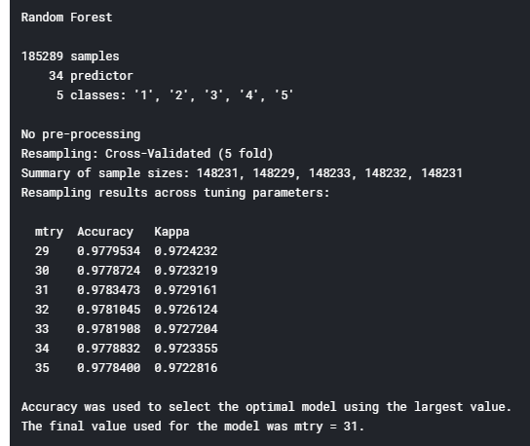
Group 5
Random Forests-mtry
Goal
Data Introduction
Shiny App Demo
Data Processing
5. Model Building
跑了1-35
發現mtry=31時會有最高的準確率
因此mtry設為31
Application

Slide 13
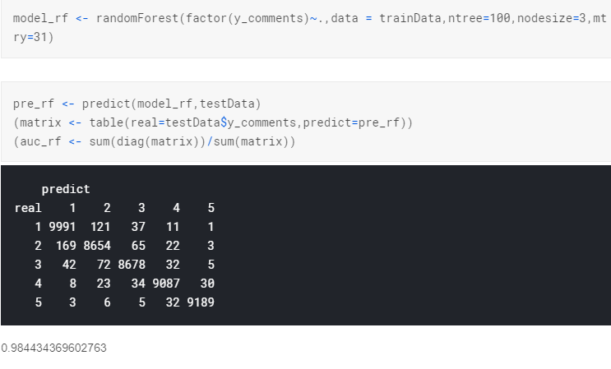
Group 5
Random Forests-Accuracy
Goal
Data Introduction
Shiny App Demo
Data Processing
5. Model Building
Application

Slide 14
Group 5
Application
Goal
Data Introduction
利用Random Forests的模型，我們除了可以預測某一po文的留言數量，更可以對po文進行評估。
直觀而言，若是該po文的留言數比我們預測的還要多，那麼我們便可以大致判斷此po文的成效不錯；若是該po文的留言數比預測的來得少，我們便可以大致判斷此po文成效不佳。
Data Processing
Shiny App Demo
Model Building
6. Application

Slide 15

Group 5
Application
Goal
Data Introduction
Data Processing
Shiny App Demo
Model Building
6. Application
How to evaluate?

Slide 16
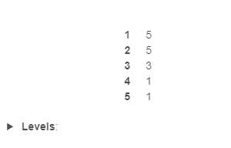
Group 5
Application
Goal
Data Introduction
'Page_likes' | 'Page_Category' | 'total_time' | 'Post_length' | 'Post.Share.Count' | 'sun' | 'mon' | 'tue' | 'wed' | 'thu' | 'fri' | 'sat' | 'y_comments'
776880 | 25 | 24 | 72 | 1489 | 0 | 1 | 0 | 0 | 0 | 0 | 0 | 5
1057377 | 28 | 24 | 17 | 249 | 0 | 1 | 0 | 0 | 0 | 0 | 0 | 5
268563 | 4 | 24 | 8 | 19 | 0 | 0 | 0 | 1 | 0 | 0 | 0 | 3
9303 | 8 | 24 | 704 | 2 | 0 | 1 | 0 | 0 | 0 | 0 | 0 | 1
26691 | 18 | 24 | 413 | 3 | 0 | 1 | 0 | 0 | 0 | 0 | 0 | 2
Data Processing
Shiny App Demo
Model Building
第一則到第四則的po文留言數都如我們預期
第五則po文雖和預測的不一致， 但就此次分析資料而言卻是超出預期的好
6. Application

Slide 17
Q&A

