Slide 1
Landing page
Tech Stack :
ReactJs
Vercel

Slide 2
Home page
Consist of multiple sections:
The intro section
About us section
The team section
And contact us
The navbar links also takes you to their respective sections

Slide 3
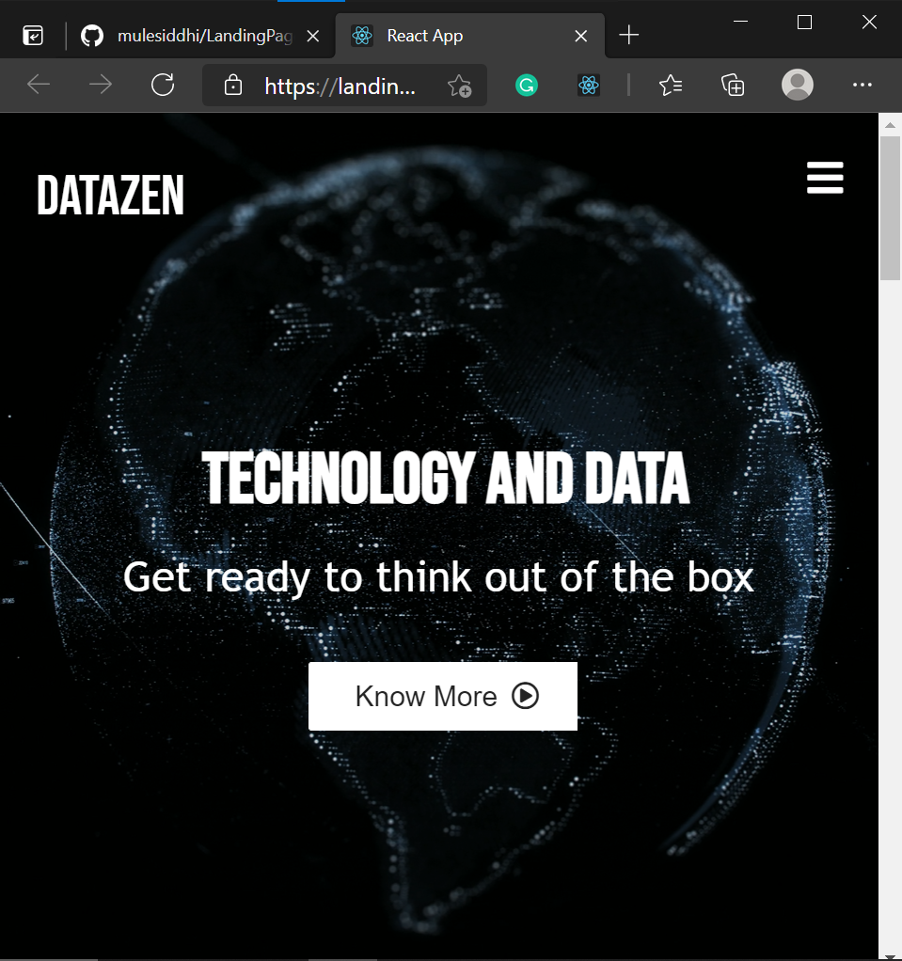
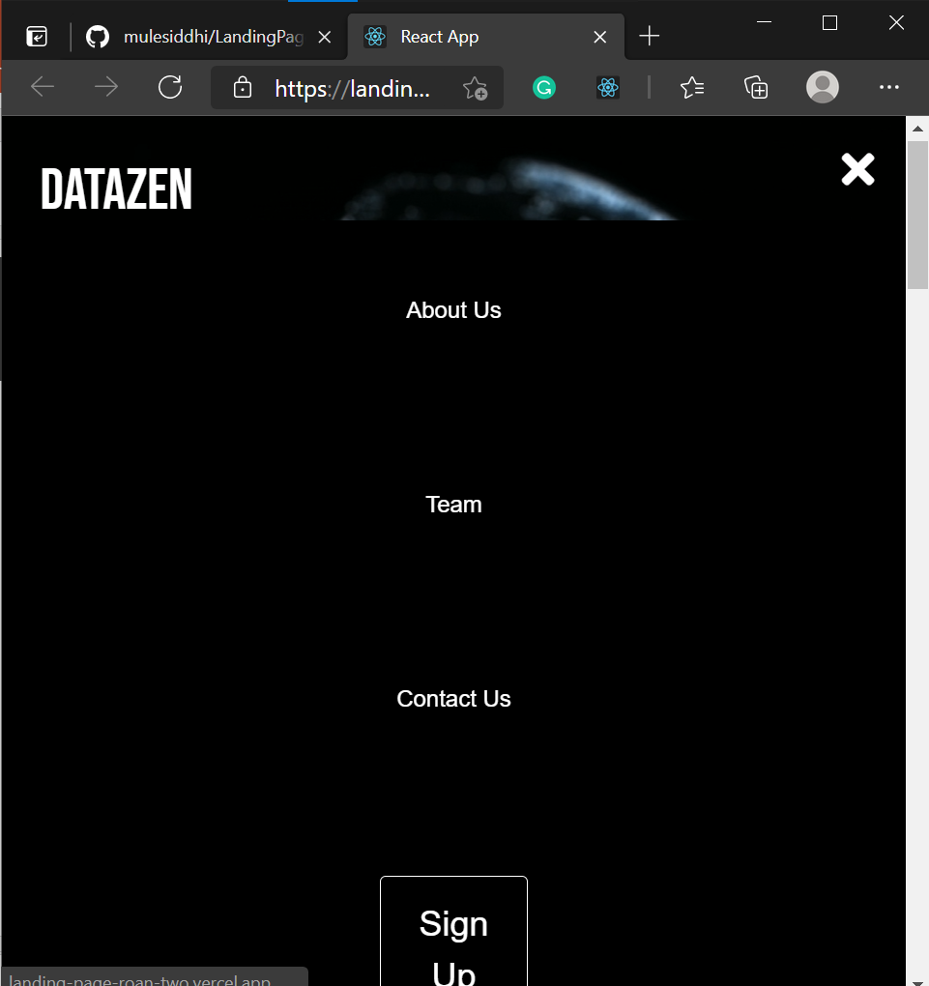
Responsive

Slide 4
Sign-up
Consists of a form for signing up
Has form validation for the inputs
On submit redirects the page back to Home page

Slide 5
Deployment
Used Vercel to deploy the web application
Checkout the live application : React App (landing-page-roan-two.vercel.app)

Slide 6
Ideas:
Using google maps API
Dark theme option for the signup page
Adding more responsiveness
Converting the whole application into a NextJs application

