Slide 1
CONNECT IBM MQ USING CLINET CHANNEL TABLE
Tarun sai Gundepalli
Junior Software Developer
Miracle Software Systems, Inc.

Slide 2
Connecting the IBM MQ using Client channel Definition table
Follow the Coming Steps to achieve the MQ Connection.

Slide 3
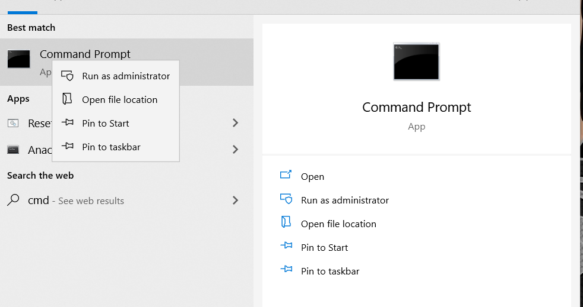
1. Open the CMD with Administrative privileges

Slide 4
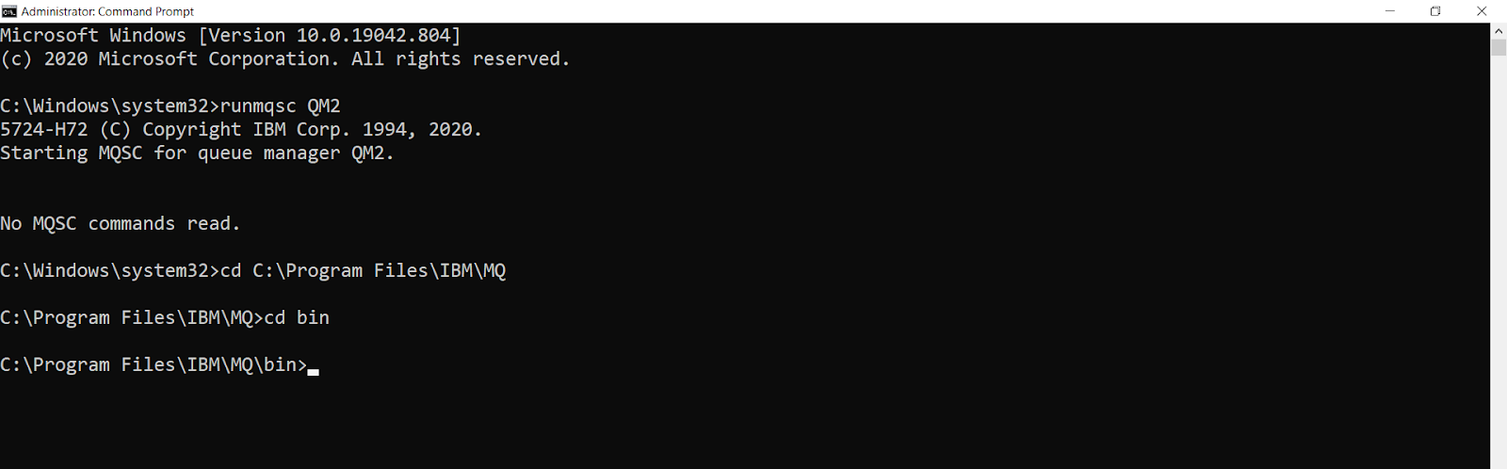
2. Change the path in cmd to ibm mq installed path

Slide 5
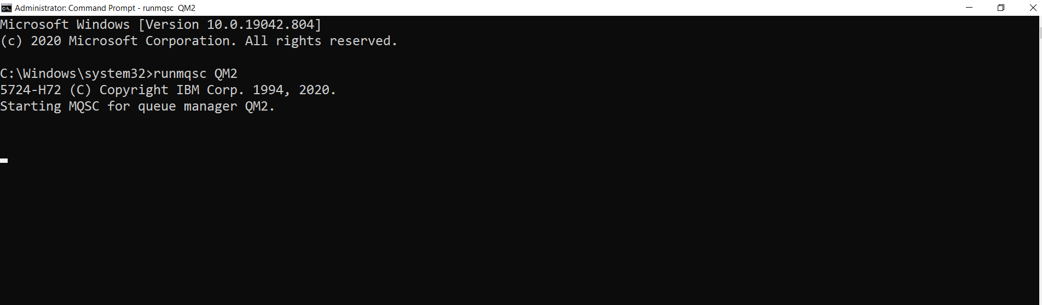
3. Run the queue manager using following command
Syntax runmqsc <queuemanager_name>

Slide 6
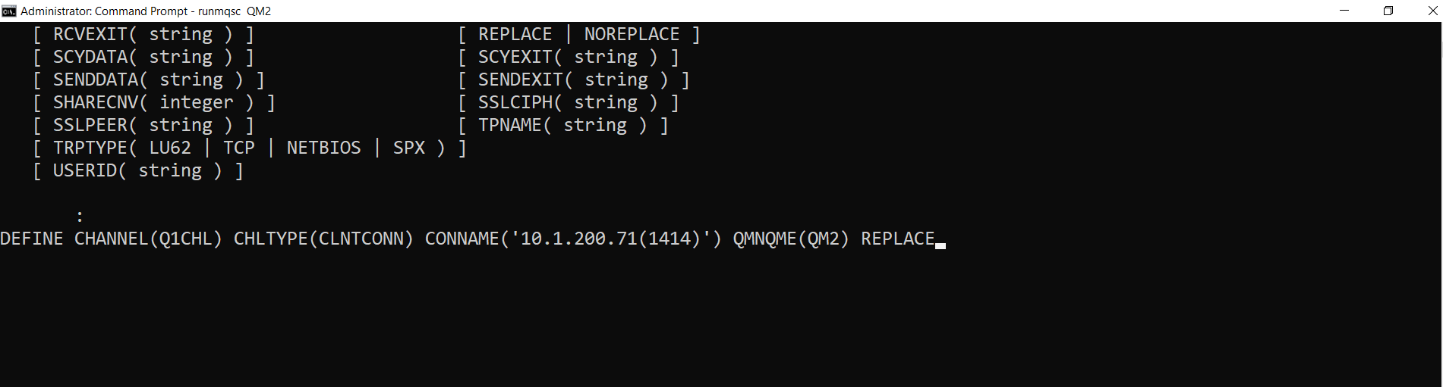
4. Creation of CCDT using following command
Syntax DEFINE CHANNEL(<channel_name>) CHLTYPE(<channel_type>) CONNAME(<websphere MQ_server_IP_addess>) QMNAME(<queue_manager_name>).

Slide 7
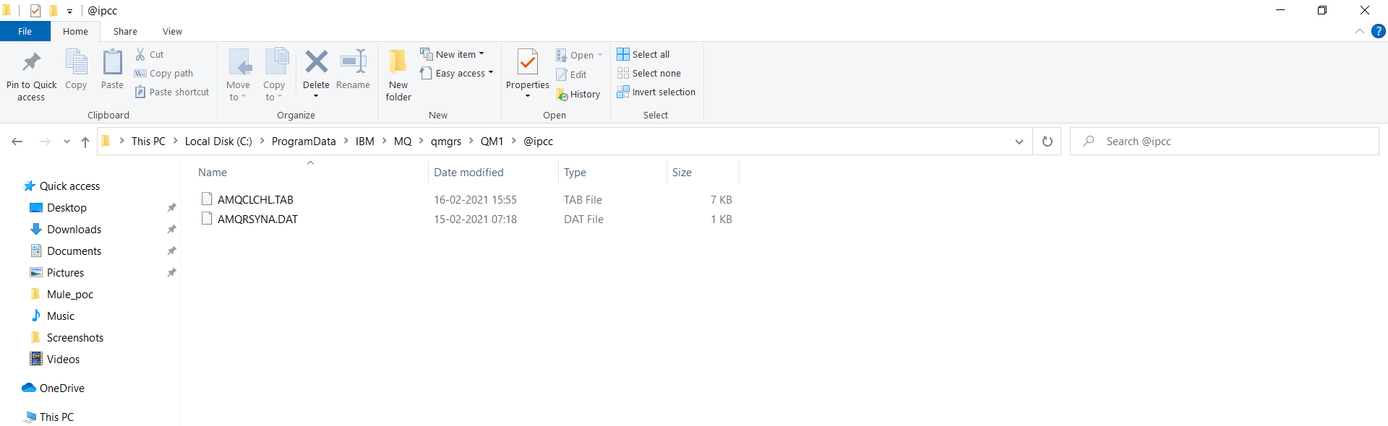
5. After Creating the channel we can see the following files in MQ folder

Slide 8
5. After Creating the channel we can see the following files in MQ folder

Slide 9
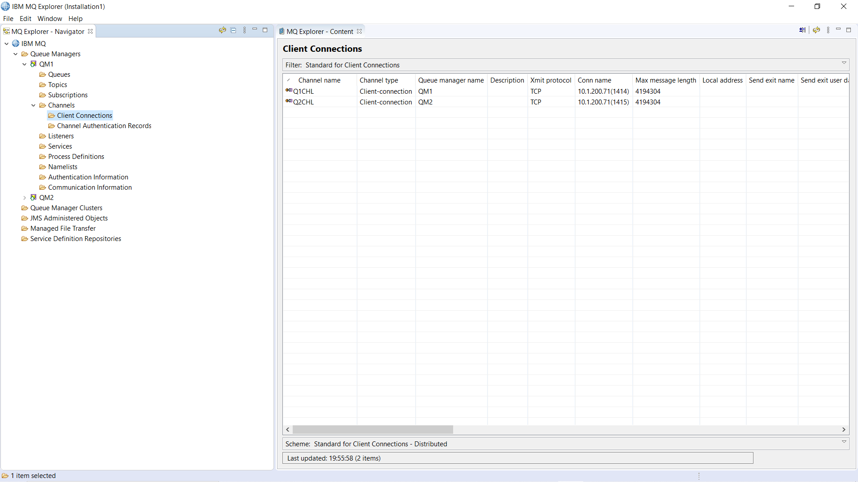
6. We can see the channels in IBM explorer under channels folder.

Slide 10
Our teams are dedicated to innovating with IT and redefining solutions for customer excellence.

