Slide 1
Explainability Audit of Plant Disease Classifiers
Background Shortcut Learning with Grad-CAM and a Background-Suppression Training Strategy
Presented by
Under the guidance of
Amogh Narendra Mulik (2417022)
Smruti Abhijit Shinde (2417029)
Atharv Sanjay Chendake (2417033)
Prof. Prerna P. Nayakal
Prof. Ashvini Sandip Patil
Department of CSE (AIML) Engineering · Rajarambapu Institute of Technology, Rajaramnagar · 2026-27

Slide 2
The Problem
AI models detect tomato leaf diseases almost perfectly in the lab, but fail on real farm photos.
99%+
~27%
accuracy on lab images (PlantVillage)
accuracy on real farm photos (PlantDoc)
Question: is the model looking at the disease, or at the background?

Slide 3
Why? Shortcut Learning
1
2
3
4
Lab photo
Model learns
Shortcut
Farm photo
Leaf on a plain background, same setup per class
Background colour and lighting are easy clues
Predicts from the background, not the disease spots
New background, so the clue fails
PS5: Use Grad-CAM to show whether models look at the lesion or the background, and propose a background-suppression training strategy.

Slide 4





Objectives
Compare 3 deep learning models
ResNet-50, EfficientNet-B0, ViT-S/16 · 30 epochs each
Measure where models look
Grad-CAM → Lesion Focus Score
Prove the background shortcut
Background-only and background-swap tests
Fix it with BG-Suppress
A new background-suppression training strategy
Test on real farm photos
744 PlantDoc field images

Slide 5
Research Gap
What earlier work did
What this project adds
Reported 99%+ lab accuracy
Showed a few Grad-CAM pictures
Found a big drop on field photos
Compared accuracy only
Attention measured as a number (LFS)
Shortcut proven with counterfactual tests
A training fix: BG-Suppress
CNN vs. transformer background reliance
Measure → Prove → Fix → Test in the field

Slide 6
Methodology

Slide 7
Dataset
18,155
10
744
PlantVillage tomato images
classes: 9 diseases + healthy
real farm photos (PlantDoc), test only
Data split
Train 70% · 12,708
Val 15% · 2,723
Test 15% · 2,724
Leaf masks were made from the segmented copy of each image, so we know which pixels are leaf and which are background.

Slide 8
System Architecture
Data preparation
Training · 30 epochs
3 models
Images + leaf masks
70/15/15 split
Baseline
or BG-Suppress
ResNet-50
EfficientNet-B0
ViT-S/16
Every trained model is tested 4 ways
Lab test
Grad-CAM audit
Shortcut tests
Field test
Accuracy, F1
Lesion Focus Score
Leaf removed / background swapped
744 farm photos
PlantDoc farm photos are never used for training.

Slide 9



Deep Learning Models Compared
ResNet-50
EfficientNet-B0
ViT-S/16
Residual CNN
Lightweight CNN
Vision Transformer
25.6M parameters
5.3M parameters
22M parameters
Skip connections let a deep network train well. The most used backbone.
Small and fast. Suited to mobile phones.
Splits the image into 16×16 patches and uses self-attention.
All start from ImageNet weights (timm) with a 10-class output layer.

Slide 10
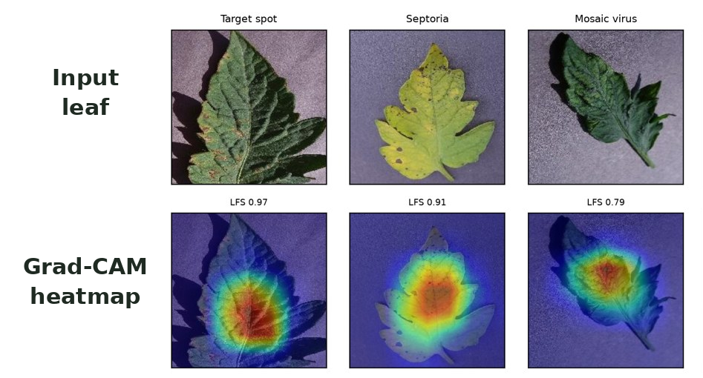
Grad-CAM and Lesion Focus Score
Grad-CAM shows which pixels the model used for its answer.
LFS = heat on leaf ÷ total heat
using the leaf mask
1.0 = all attention on the leaf
0.52 = attention spread randomly
Shortcut tests: remove the leaf, or paste it on another class's background, and see if the answer changes.
Grad-CAM output from our models

Slide 11


Proposed Method: BG-Suppress
1. Background randomisation
2. Attention-alignment loss
80% of training images get a random new background, so the background stops being a useful clue.
+
A penalty when Grad-CAM attention falls outside the leaf mask tells the model: look at the leaf.
Loss = Cross-entropy + λ × Alignment loss (λ = 1)

Slide 12




Experimental Setup
Hardware
Software
RTX 5060 Laptop GPU, 8 GB
Python 3.12, PyTorch 2.11, timm
Training
Selection
30 epochs, batch 32, AdamW
Best validation macro-F1 checkpoint
6 runs in total: 3 models × 2 training modes (Baseline, BG-Suppress)

Slide 13
Results

Slide 14
Lab Accuracy: All Models Above 99%
≤ 0.37
points lost by BG-Suppress
Lab accuracy alone cannot tell the models apart, or show whether they cheat.
Axis starts at 98%

Slide 15
The Shortcut Is Real
22–28%
13.8 pts
0.60
accuracy with NO leaf at all
(guessing = 10%)
accuracy lost when the background is swapped (ViT)
ViT leaf focus score:
close to random (0.52)
All 3 baseline models partly use the background. The transformer (ViT) relies on it the most.

Slide 16
BG-Suppress Moves Attention onto the Leaf
0.98–0.99
leaf focus for all 3 models after BG-Suppress
≤ 0.3 pts
accuracy lost on swapped backgrounds (was up to 13.8)

Slide 17
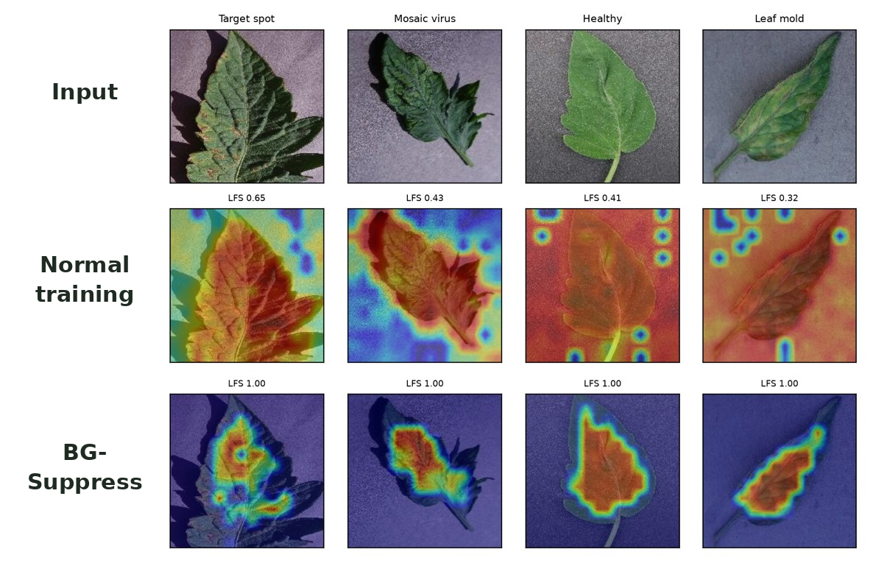
Before vs. After: Grad-CAM
Normal training
Heat spreads onto the background and corners
BG-Suppress
Heat stays on the leaf
Real Grad-CAM maps from our ViT-S/16 models; number = Lesion Focus Score

Slide 18
Field Test: Lab vs. Farm Photos
25–29%
field accuracy, with or without BG-Suppress
Farm photos also differ in zoom, light, blur and number of leaves. Background is only one of the problems.

Slide 19
Comparison of the 3 Models
 | ResNet-50 | EfficientNet-B0 | ViT-S/16
Parameters | 25.6M | 5.3M | 22M
Lab accuracy | 99.23% | 99.82% | 99.85%
Leaf focus: before → after | 0.91 → 0.99 | 0.84 → 0.99 | 0.60 → 0.98
Shortcut gap: before → after | 3.3 → 0.1 | 12.3 → 0.3 | 13.8 → 0.3
Field accuracy | 28.6% | 25.3% | 26.5%
Best at | Least shortcut | Smallest model | Biggest gain from fix
Before → after = Baseline → BG-Suppress. Shortcut gap in percentage points.

Slide 20



Conclusion
99% lab accuracy can hide cheating
All 3 models partly used the background
BG-Suppress removes the shortcut
Leaf focus 0.98–0.99, almost no accuracy cost
Accuracy alone is not enough
ViT was most accurate but most background-reliant
Farm accuracy needs more
Background is one of several differences

Slide 21
Future Work
Repeat with more seeds
Fine-tune on farm photos
1
2
Confirm small differences
Add real field images to training
Focus on the lesion
Mobile app
3
4
Use lesion-level masks, not whole leaf
Deploy EfficientNet-B0 on a phone

Slide 22
Key References
Mohanty et al., Using deep learning for image-based plant disease detection, Front. Plant Sci., 2016
Singh et al., PlantDoc: A dataset for visual plant disease detection, CoDS-COMAD, 2020
Selvaraju et al., Grad-CAM: Visual explanations from deep networks, ICCV, 2017
Geirhos et al., Shortcut learning in deep neural networks, Nature Mach. Intell., 2020
Xiao et al., Noise or signal: The role of image backgrounds in object recognition, ICLR, 2021
Noyan, Uncovering bias in the PlantVillage dataset, arXiv, 2022

Slide 23
Thank You
Questions?
Amogh Narendra Mulik · Smruti Abhijit Shinde · Atharv Sanjay Chendake
Guides: Prof. Prerna P. Nayakal · Prof. Ashvini Sandip Patil

