Slide 1
Explainability Audit of Plant Disease Classifiers
Background Shortcut Learning with Grad-CAM and a Background-Suppression Training Strategy
Presented by
Under the guidance of
Amogh Narendra Mulik (2417022)
Smruti Abhijit Shinde (2417029)
Atharv Sanjay Chendake (2417033)
Prof. Prerna P. Nayakal
Prof. Ashvini Sandip Patil
Department of CSE (AIML) Engineering · Rajarambapu Institute of Technology, Rajaramnagar · 2026-27

Slide 2
The Problem: Lab vs. Farm
99%+
~27%
Is the model looking at the disease, or at the background?
accuracy on lab photos
accuracy on real farm photos
Why? Shortcut learning
1. Lab photo
2. Model learns
3. Shortcut
4. Farm photo
Plain background, same setup per class
Background is an easy clue
Predicts from background, not disease
New background, clue fails
PS5: Use Grad-CAM to show whether models look at the lesion or the background, and propose a background-suppression training strategy.

Slide 3





Objectives and Research Gap
Compare 3 deep learning models
Earlier work
30 epochs each
99%+ lab accuracy reported
Grad-CAM shown as a few pictures
Big drop on field photos found
Models compared on accuracy only
Measure where models look
Grad-CAM → Lesion Focus Score
Prove the background shortcut
Leaf-removed and background-swap tests
This project adds
Fix it with BG-Suppress
Attention measured as a number (LFS)
Shortcut proven with counterfactual tests
A training fix: BG-Suppress
CNN vs. transformer background reliance
New training strategy
Test on real farm photos
744 PlantDoc images

Slide 4
Dataset
18,155
10
744
PlantVillage tomato images
classes: 9 diseases + healthy
real farm photos (PlantDoc), test only
Data split
Train 70% · 12,708
Val 15% · 2,723
Test 15% · 2,724
Leaf masks were made from the segmented copy of each image, so we know which pixels are leaf and which are background.

Slide 5
System Architecture
Data preparation
Training · 30 epochs
3 models
Images + leaf masks
70/15/15 split
Baseline
or BG-Suppress
ResNet-50
EfficientNet-B0
ViT-S/16
Every trained model is tested 4 ways
Lab test
Grad-CAM audit
Shortcut tests
Field test
Accuracy, F1
Lesion Focus Score
Leaf removed / background swapped
744 farm photos
PlantDoc farm photos are never used for training.

Slide 6







Models and Experimental Setup
ResNet-50
EfficientNet-B0
ViT-S/16
Residual CNN · 25.6M
Lightweight CNN · 5.3M
Transformer · 22M
Skip connections; the most used backbone
Small and fast; suited to phones
16×16 patches + self-attention
RTX 5060 GPU, 8 GB
Python 3.12, PyTorch 2.11, timm
30 epochs · batch 32 · AdamW
Best validation-F1 checkpoint
6 runs = 3 models × 2 modes (Baseline, BG-Suppress) · ImageNet-pretrained

Slide 7
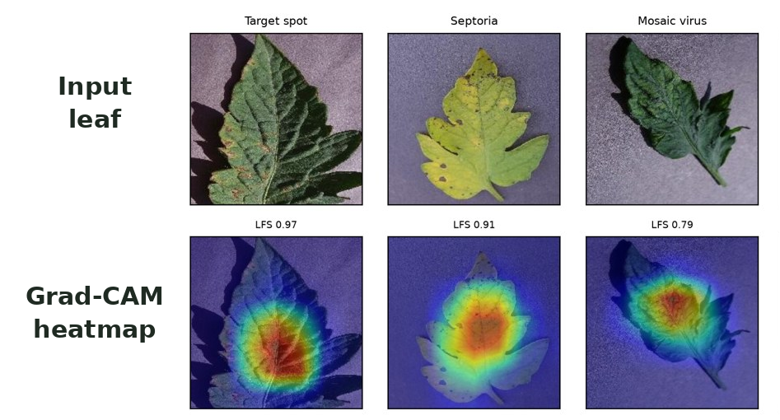
Grad-CAM and Lesion Focus Score
Grad-CAM shows which pixels the model used for its answer.
LFS = heat on leaf ÷ total heat
using the leaf mask
1.0 = all attention on the leaf
0.52 = attention spread randomly
Shortcut tests: remove the leaf, or paste it on another class's background, and see if the answer changes.
Grad-CAM output from our models

Slide 8


Proposed Method: BG-Suppress
1. Background randomisation
2. Attention-alignment loss
80% of training images get a random new background, so the background stops being a useful clue.
+
A penalty when Grad-CAM attention falls outside the leaf mask tells the model: look at the leaf.
Loss = Cross-entropy + λ × Alignment loss (λ = 1)

Slide 9
99% Accurate, but Using the Background
22–28%
correct with NO leaf at all (guessing = 10%)
13.8 pts
lost when the background is swapped (ViT)
0.60
ViT leaf focus: close to random (0.52)
BG-Suppress costs ≤ 0.37 points of lab accuracy

Slide 10
BG-Suppress Moves Attention onto the Leaf
0.98–0.99
leaf focus for all 3 models after BG-Suppress
≤ 0.3 pts
lost on swapped backgrounds (was up to 13.8)

Slide 11
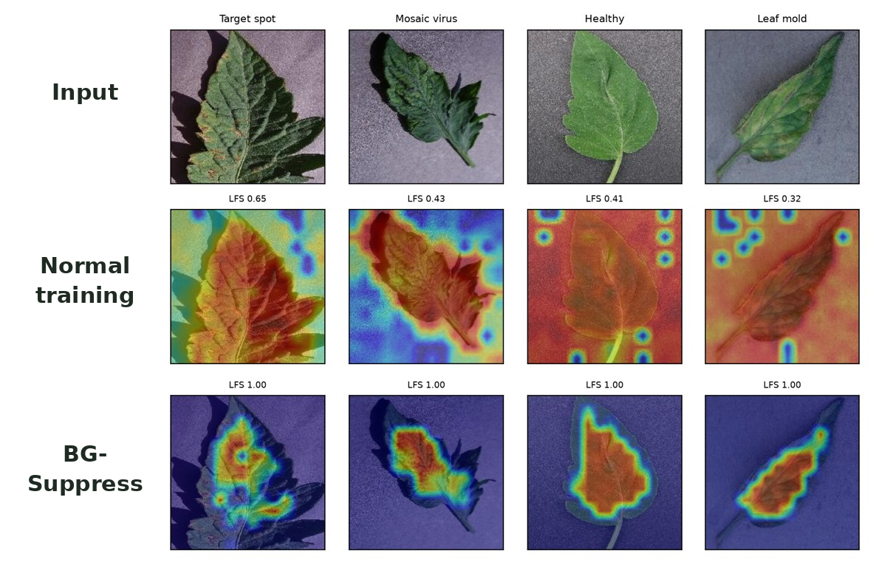
Before vs. After: Grad-CAM
Normal training
Heat spreads onto the background and corners
BG-Suppress
Heat stays on the leaf
Real Grad-CAM maps from our ViT-S/16 models; number = Lesion Focus Score

Slide 12
Field Test and Model Comparison
 | ResNet-50 | EfficientNet-B0 | ViT-S/16
Parameters | 25.6M | 5.3M | 22M
Lab accuracy | 99.23% | 99.82% | 99.85%
Farm accuracy | 28.6% | 25.3% | 26.5%
Leaf focus: before → after | 0.91 → 0.99 | 0.84 → 0.99 | 0.60 → 0.98
Shortcut gap: before → after | 3.3 → 0.1 | 12.3 → 0.3 | 13.8 → 0.3
Best at | Least shortcut | Smallest model | Biggest gain from fix
25–29%
farm accuracy, with or without BG-Suppress
Farm photos also differ in zoom, light, blur and number of leaves.
Before → after = Baseline → BG-Suppress; gap in percentage points.

Slide 13



Conclusion and Future Work
99% lab accuracy can hide cheating
Future work
All 3 models partly used the background
1
Repeat with more seeds
BG-Suppress removes the shortcut
Leaf focus 0.98–0.99, almost no accuracy cost
2
Fine-tune on farm photos
Accuracy alone is not enough
3
Focus on the lesion, not the whole leaf
ViT: most accurate, most background-reliant
Farm accuracy needs more
4
Mobile app with EfficientNet-B0
Background is one of several differences

Slide 14
Thank You
Questions?
Amogh Narendra Mulik · Smruti Abhijit Shinde · Atharv Sanjay Chendake
Guides: Prof. Prerna P. Nayakal · Prof. Ashvini Sandip Patil
Key references
Mohanty et al., Front. Plant Sci., 2016 · Singh et al., PlantDoc, CoDS-COMAD, 2020 · Selvaraju et al., Grad-CAM, ICCV, 2017
Geirhos et al., Shortcut learning, Nature Mach. Intell., 2020 · Xiao et al., Image backgrounds, ICLR, 2021 · Noyan, PlantVillage bias, arXiv, 2022

