Slide 1
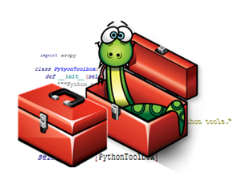
Python - Arcpy

Slide 2
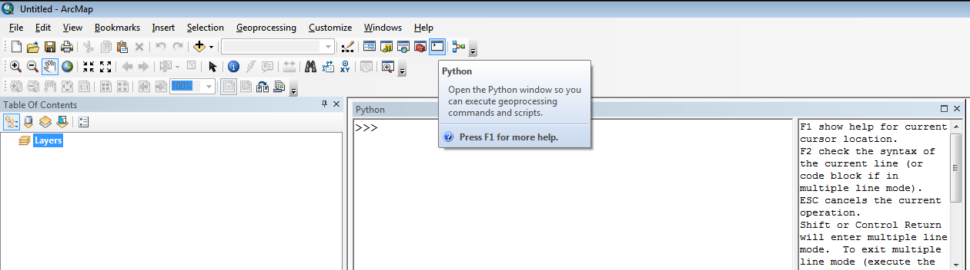

Python – Arcpy
Arcpy is a Python module that provides access to ArcGIS geoprocessing tools as well as additional functions, classes, and modules that allow you to create simple or complex workflows quickly and easily
Using Python console in ArcGIS:
Or using menus: Geoprocessing → Python
A shortcut button for using Python console

Slide 3
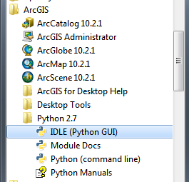
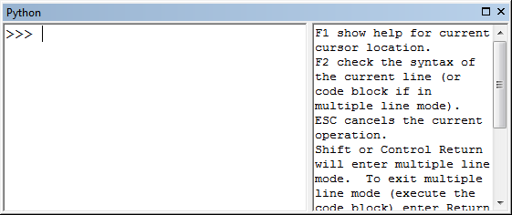
Python – Arcpy
Even though ArcGIS provides its own Python console with nice Syntax infobar it is more practical and recommendable to write your code using Python IDLE bundled in ArcGIS
You cannot save your code easily using Python console in ArcGIS
ArcGIS Python console is, however, good for testing specific geoprocessing functions of arcpy
Python console within ArcGIS Desktop is the same thing as Python IDLE of ArcGIS found in All programs:
=

Slide 4
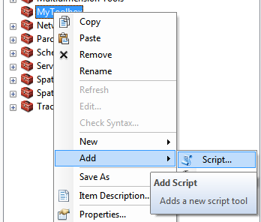
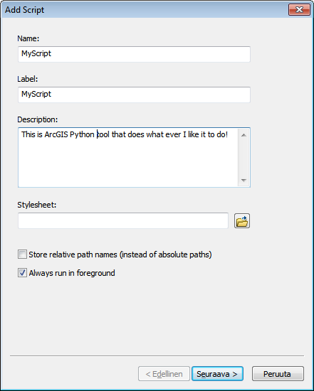
Creating a Toolbox for Python script
Defining input/output files and additional parameters for your own Python script can be done by creating a user interface into your self-made ArcGIS toolbox
Done in a similar manner as with ModelBuilder
1. Create a new script tool inside a toolbox:
Ignore last two dialogs
at this point:
Click Next
Click Finish

Slide 5
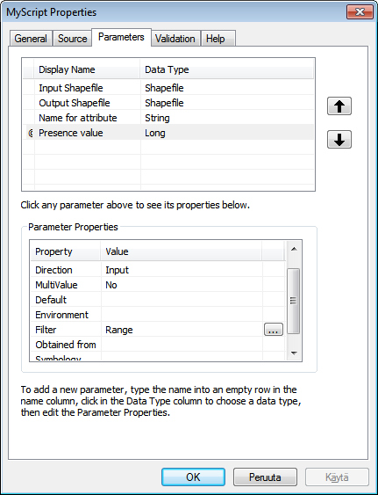
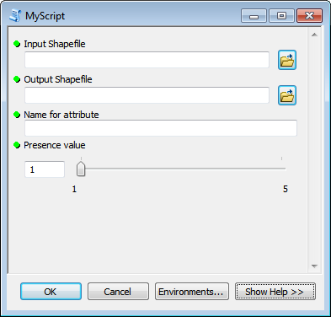
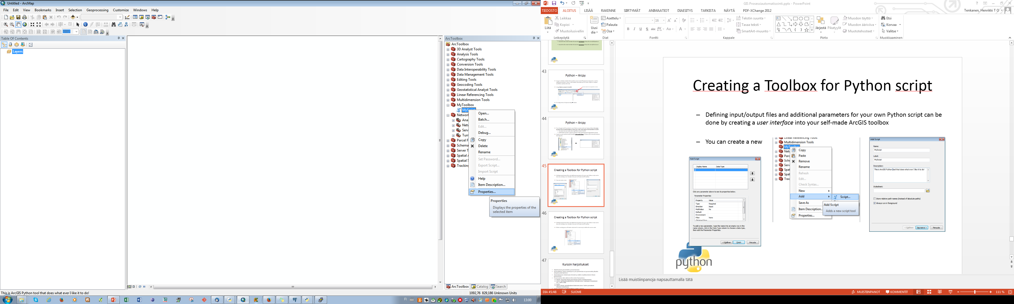
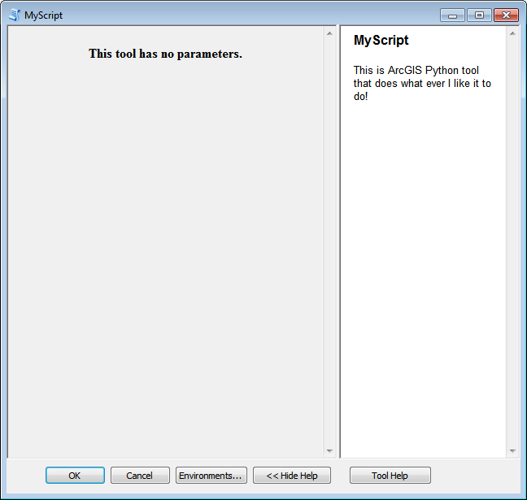
Creating a Toolbox for Python script
2. Define the script tool parameters for the tool:
Empty script tool
without any parameters
Choose Properties..
to manage your
tools parameters
In Parameters tab it is
possible to add as
many parameters as
you like with specific datatypes
As an output you have a working script tool that can be used to pass information for your script

Slide 6
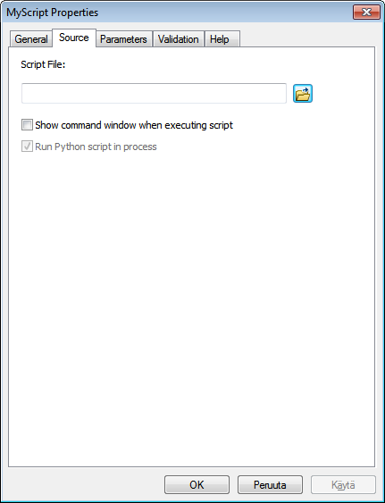
Creating a Toolbox for Python script
3. Before running your self-made script tool it is necessary to define the source code (i.e. *.py file that you have written):

Slide 7
Writing script for ArcGIS
3. Before running your self-made script tool it is necessary to define the source code (i.e. *.py file that you have written):

