Slide 1

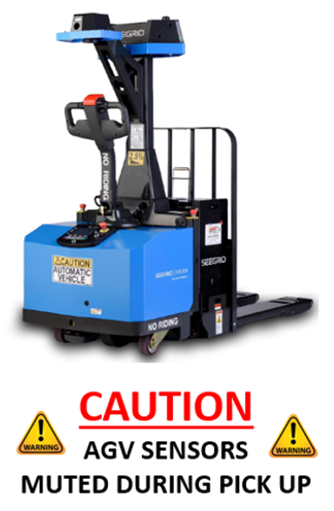

AGP00A016035050PIC

Slide 2

AGP00A016042050PIC

Slide 3

AGP00B016036033PIC

Slide 4

AGP00B016045043PIC

Slide 5

AGP00C019010046PIC

Slide 6

AGP00G018025046PIC

Slide 7

AGP00K019043046PIC

Slide 8

AGP00N018046046PIC

Slide 9

AGP00N019051028PIC

Slide 10

AGP00R013023037PIC

Slide 11

AGP00R019045030PIC

Slide 12

AGP00R019045036PIC

Slide 13

AGP00R019045040PIC

Slide 14

AGP00S013041009PIC

Slide 15

AGP00S013047007PIC

Slide 16

AGP00S013054007PIC

Slide 17

AGP00S019013046PIC

Slide 18

AGP00T011026043PIC

Slide 19

AGP00T011029049PIC

Slide 20

AGP00T012026034PIC

Slide 21

AGP00T012028041PIC

Slide 22

AGP00T012028049PIC

Slide 23

AGP00T013027022PIC

Slide 24

AGP00T013030016PIC

Slide 25

AGP00V012042006PIC

Slide 26

AGP00V012042014PIC

Slide 27

AGP00V012044021PIC

Slide 28

AGP00V012044027PIC

Slide 29

AGP00V013042006PIC

Slide 30

AGP00V013042014PIC

Slide 31

AGP00V013044021PIC

Slide 32

AGP00V013044027PIC

Slide 33

AGP00V014042006PIC

Slide 34

AGP00V014042014PIC

Slide 35

AGP00V014044021PIC

Slide 36

AGP00V014044027PIC

Slide 37

AGP00V015042004PIC

Slide 38

AGP00V015042012PIC

Slide 39

AGP00V015044021PIC

Slide 40

AGP00V015044027PIC

