Slide 1
Smart Contract Development with JASON BDI Agents
Mullick, Mostakim
Chair of Software Technology
Institute of Software and Multimedia Technology
Master’s Thesis Defence
First reviewer: Prof. Dr. rer. nat. Uwe Aßmann
Second reviewer: Dr.-Ing. Sebastian Götz
Supervisor: M. Sc. Orçun Oruç
Dresden, 01.01.2023

Slide 2
Outline
Motivation​ and Background
Related Work
Design​ and Implementation​
Evaluation​
Discussion
Conclusion
Future Work​​
Demo​

Slide 3
Motivation
and Background

Slide 4

Supply Chain
Checks Warehouse (No Stock)
Orders Productss
Receives Productss
Checks warehouse (No Stock)
Checks warehouse ( Stock Available)
Order Productss
Sell Products
Receives Productss
Restock
Checks warehouse ( Stock Available)
Order Products
Restock
Sell and Ship Products
Retailer
Wholesaler
Manufacture and Package Products
Sell Products
Purchase Products
Ship Products
Receive Products
Checks warehouse (No Stock)
Manufacture and package Products
Smart Contracts
Checks warehouse ( Stock Available)
Restock
Sell and Ship Products
Blockchain Network
BDI AGENTS
Manufacturer

Slide 5


Characteristics of an agent
What is an AGENT?
Autonomy
Proactiveness
Reactivity
Social ability
Multiple Agent System(MAS)

Slide 6
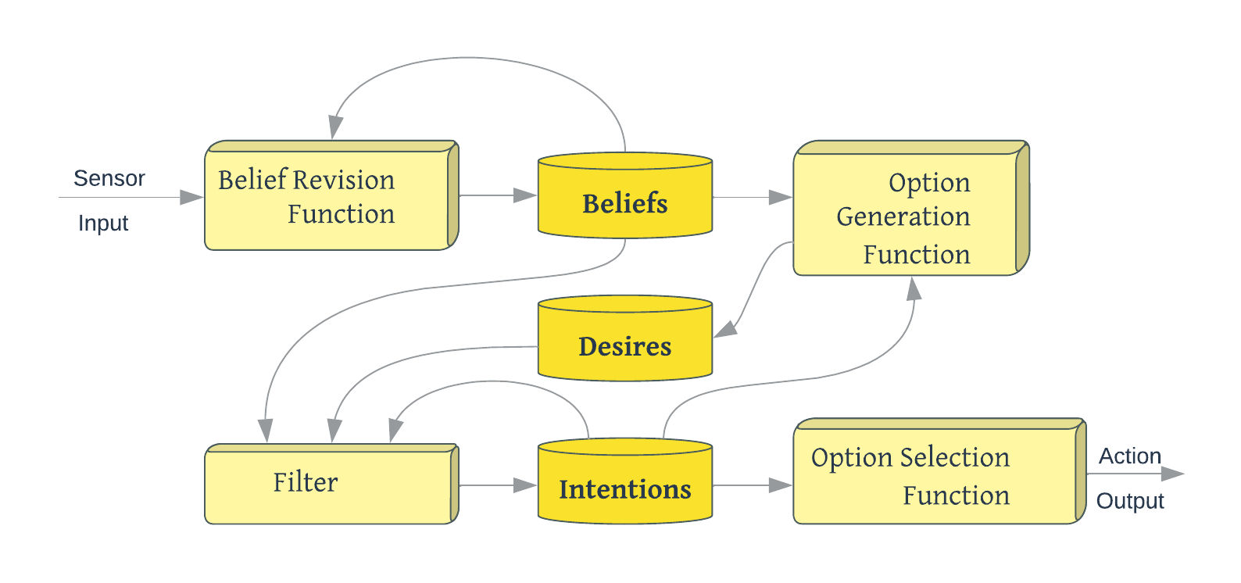
BDI Model
Beliefs
                Belief set
Desires
                Goals​
Intentions
                Plans
Events

Slide 7

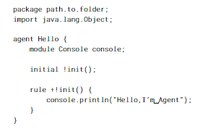
AgentSpeak(L)
: a simplified version of PRS and dMARS
Frameworks
Jason
ASTRA

Slide 8
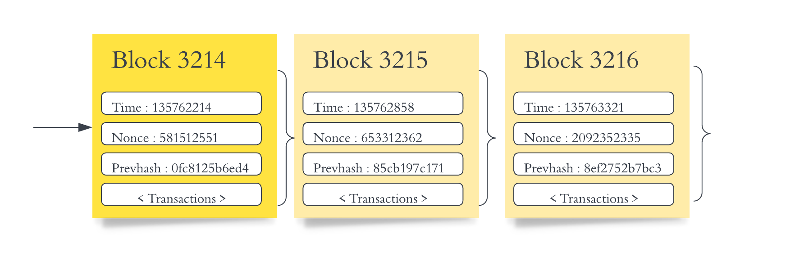
Blockchain
WEB 3.0
Individualized
Ubiquity
Efficinent
: Decentralized ledger system to store data across numerous cluster nodes
Smart Contract

Slide 9
Motivation
Decentralized decision-making
Transparency
Improve co-ordination
Improve Security​
Scalability
Flexbility

Slide 10
Related Work

Slide 11
LRQs
Jason for BDI Agent Programming in AgentSpeak
A Multi-agent System for Optimizing Urban Traffic
Decision Making in Multiagent Systems: A Survey
Agent-Oriented Supply-Chain Management
Exploring AOP from an OOP perspective
How to build intelligent agents within MAS using AOP language while comparing it with Object Oriented Programming (OOP)?
Basis | AOP | OOP
Focus | Autonomous agents | Objects
Structure | Multi-agent systems | Class hierarchies
Interaction | Agent-to-agent communication | Object-to-object interaction
Execution | Concurrent execution of agents | Sequential execution of objects
Autonomy | High degree of autonomy for agents | Limited autonomy for objects

Slide 12
LRQs
Languages for Programming BDI-style Agents: an Overview
A Review of Agent Platforms
Domain specific agent-oriented programming language based on the Xtext framework
A Survey of Agent Platforms
Multi-agent oriented programming with JaCaMo
Brahms: A multiagent modelling environment for simulating work processes and practices
Jadex: A BDI-Agent System Combining Middleware and Reasoning
LightJason, a Highly Scalable and Concurrent Agent Framework: Overview and Application
How to build intelligent agents within MAS using AOP language while comparing it with Object Oriented Programming (OOP)?
What are the frameworks available for creating agents using the BDI model?

Slide 13
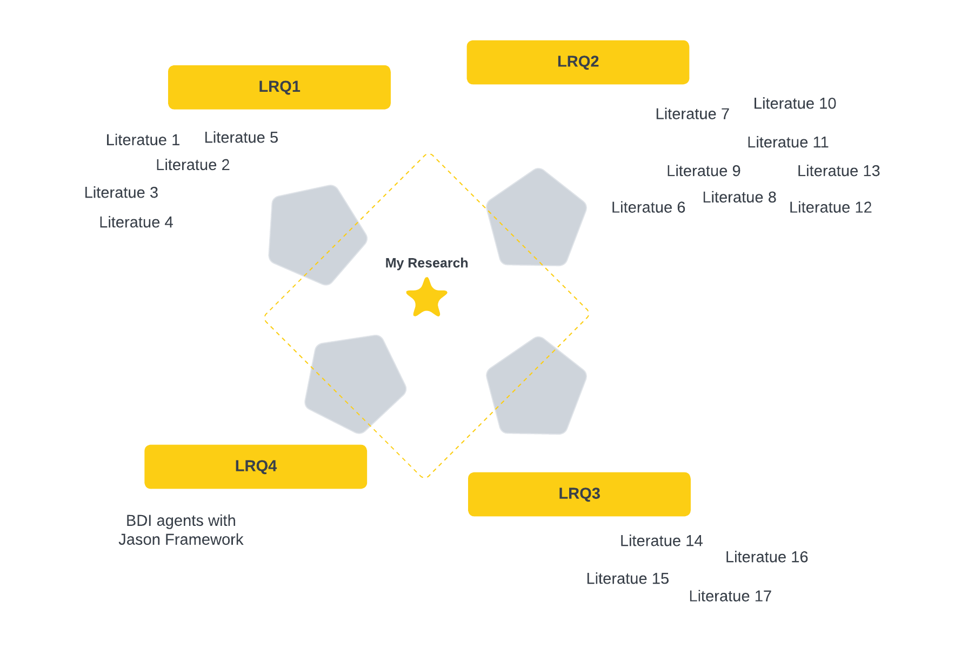
LRQs
From Agents to Blockchain: Stairway to Integration
Decentralized Execution of Smart Contracts: Agent Model Perspective and Its Implications
MAS and Blockchain: Results from a Systematic Literature Review
Self-Aware Smart Contracts with Legal Relevance
How to build intelligent agents within MAS using AOP language while comparing it with Object Oriented Programming (OOP)?
What are the frameworks available for creating agents using the BDI model?
How to include smart contracts into MAS in order to store transactions on a blockchain?
What is the purpose of conducting further study when considerable research has already been done on the decentralized execution of smart contracts using the agent model?

Slide 14
Design
and Implementation

Slide 15
Design Goals
Decentralization
Autonomous
Transparency
Efficiency
Flexibility
Reactiveness
Scalability

Slide 16
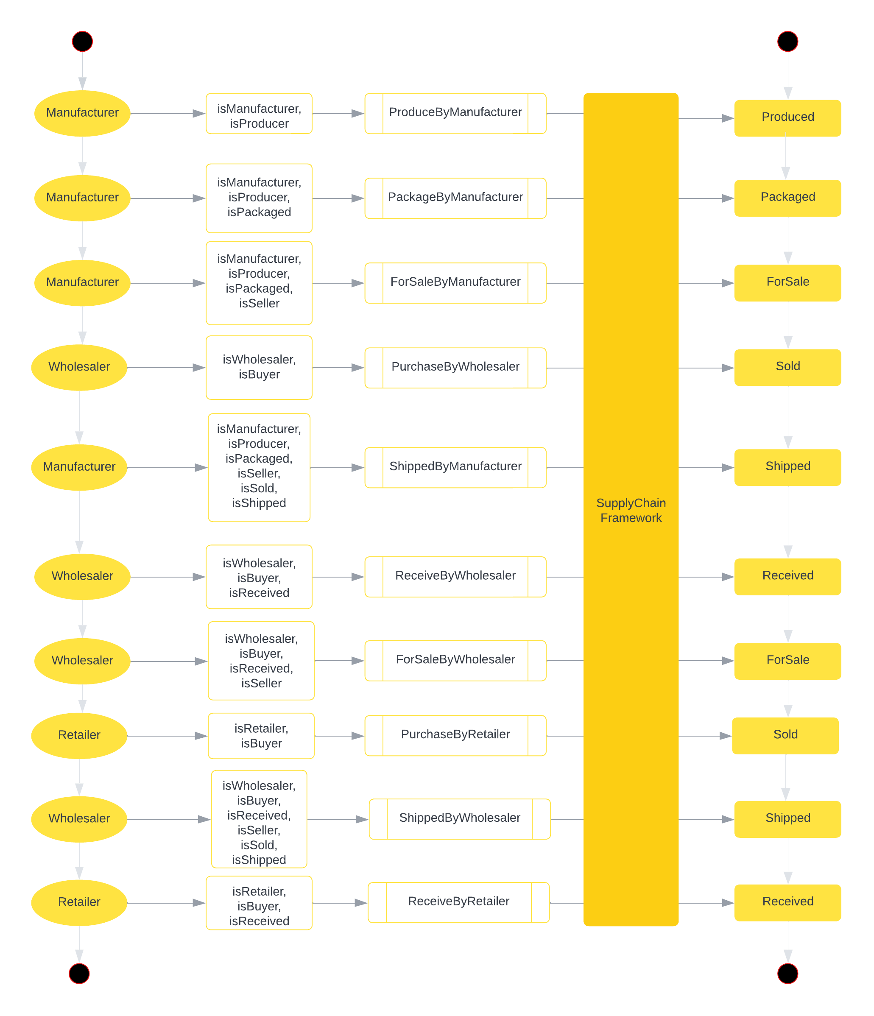
Smart Contract Development
Language: Solidity

Slide 17
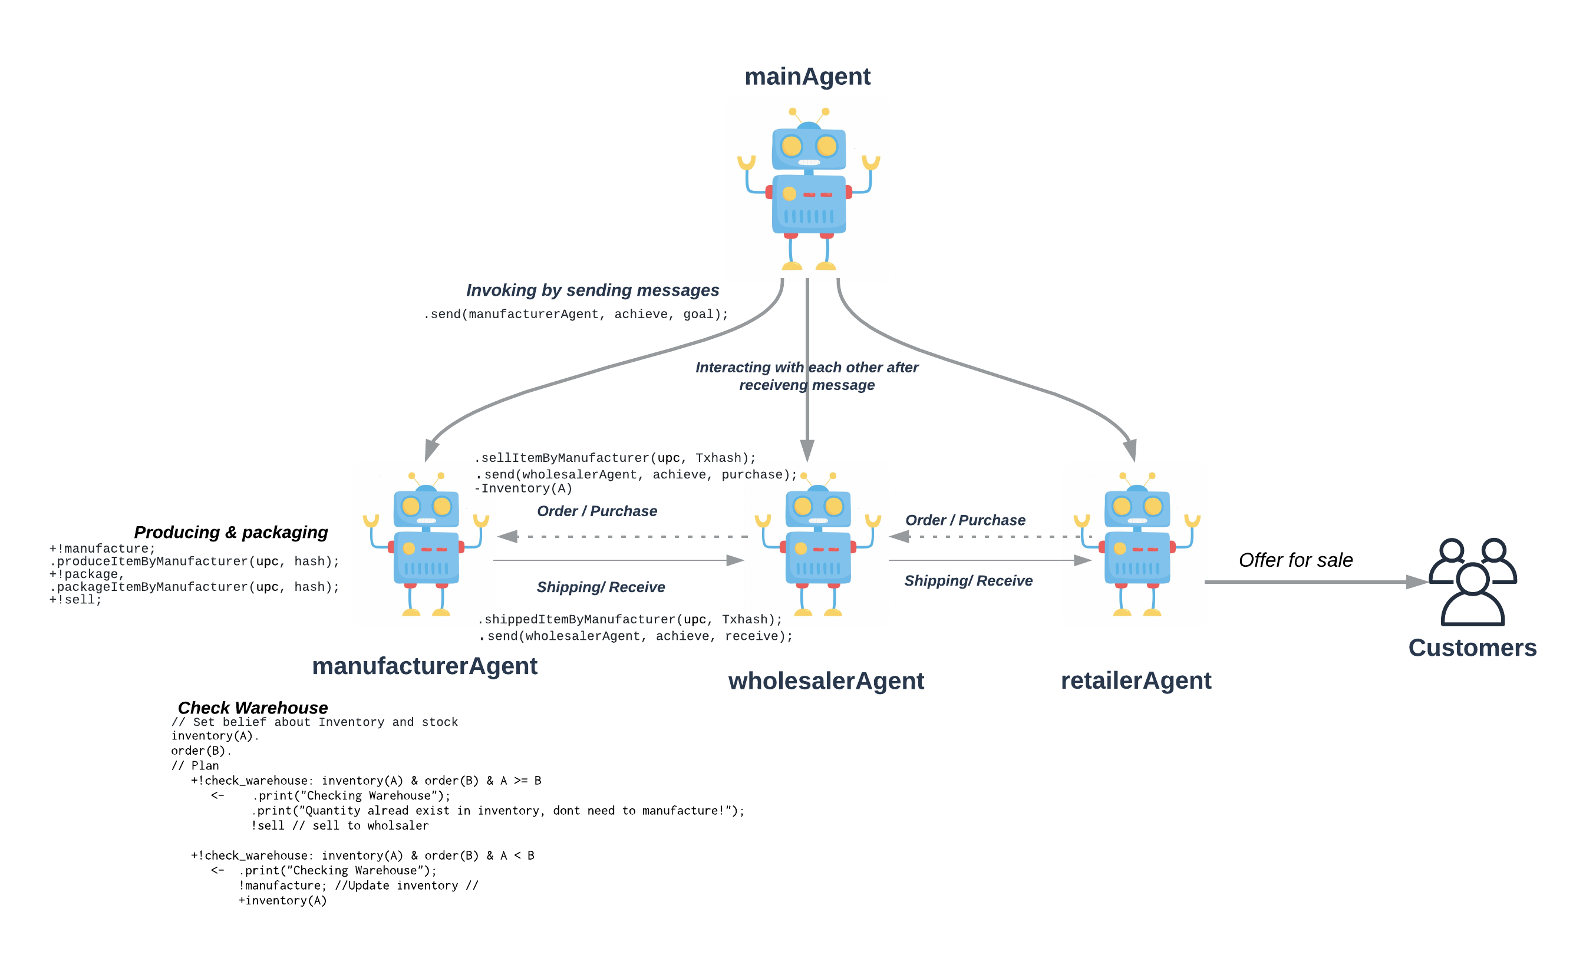
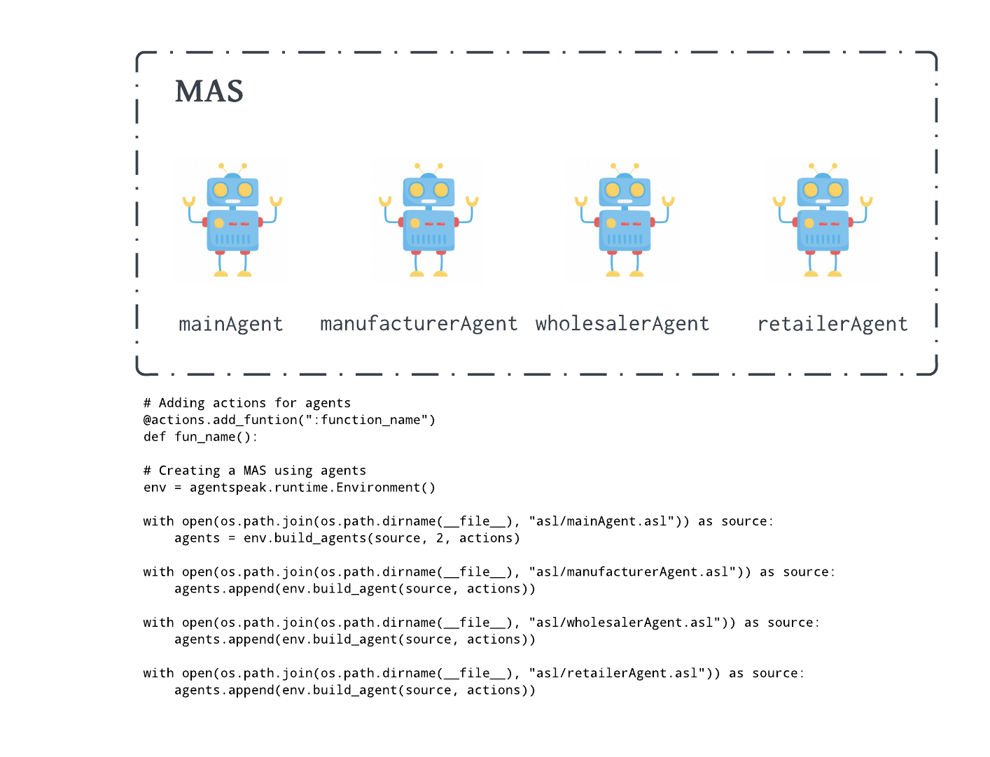
Agent Implementation
Framework
Jason (Python-based interpreter)

Slide 18

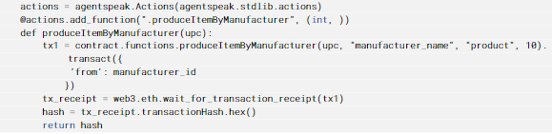

Agent-Contract Collaboration
Jason and web3.py

Slide 19
Evaluation

Slide 20
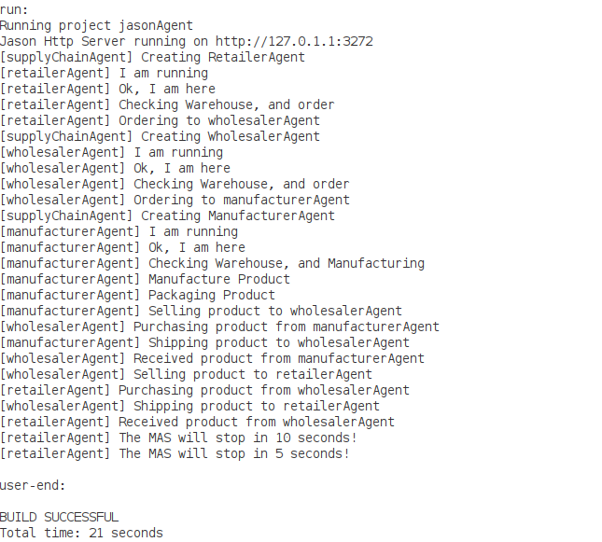
MAS Development

Slide 21

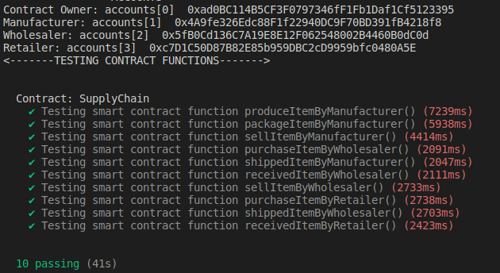
Smart Contract Implementation

Slide 22
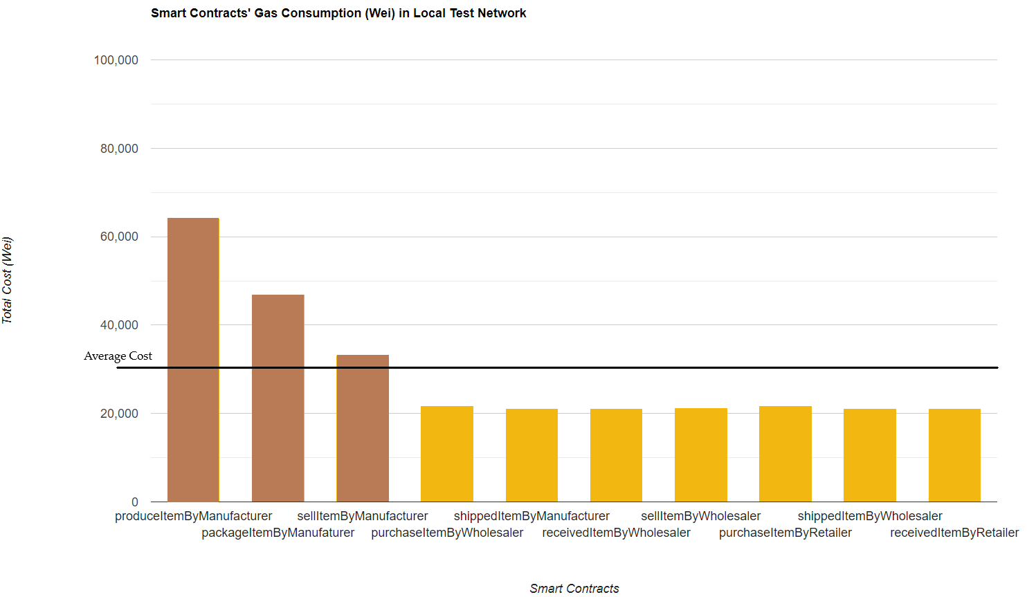
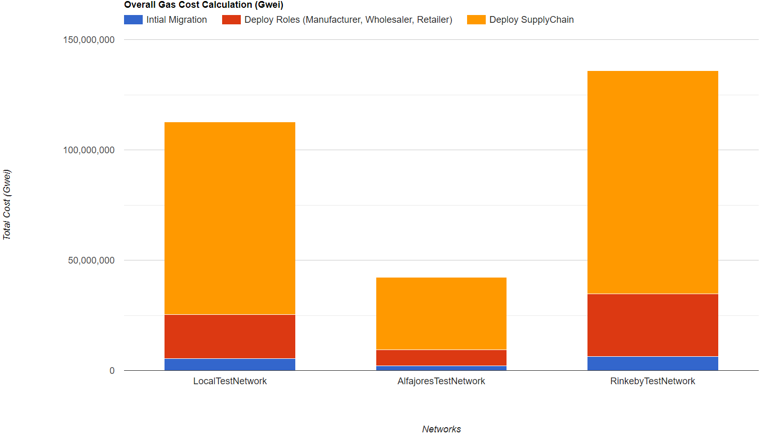
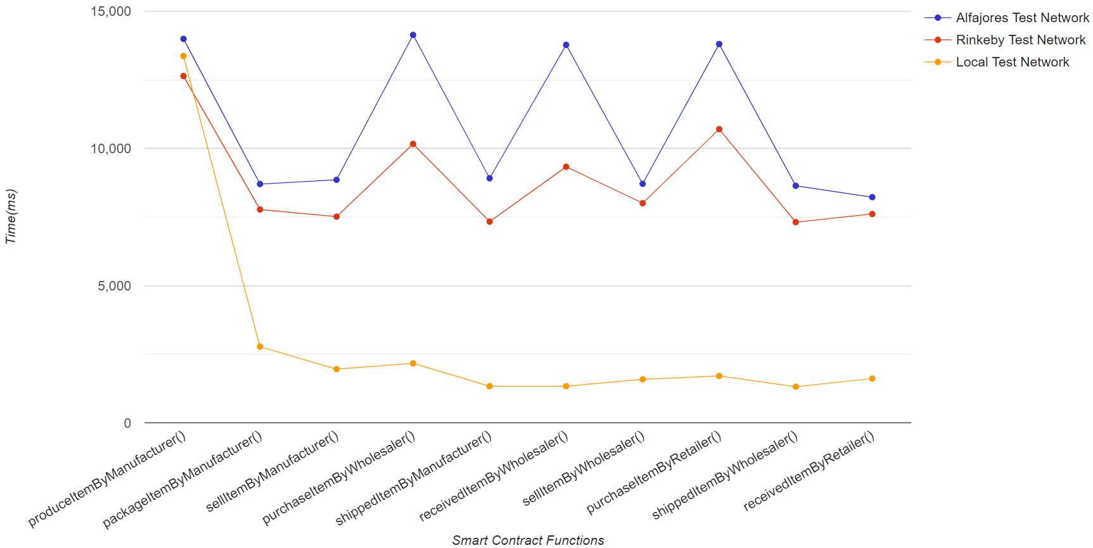
Smart Contract Implementation
Comparing between different networks
Overall deployment gas cost
Gas consumed by each smart contract

Slide 23
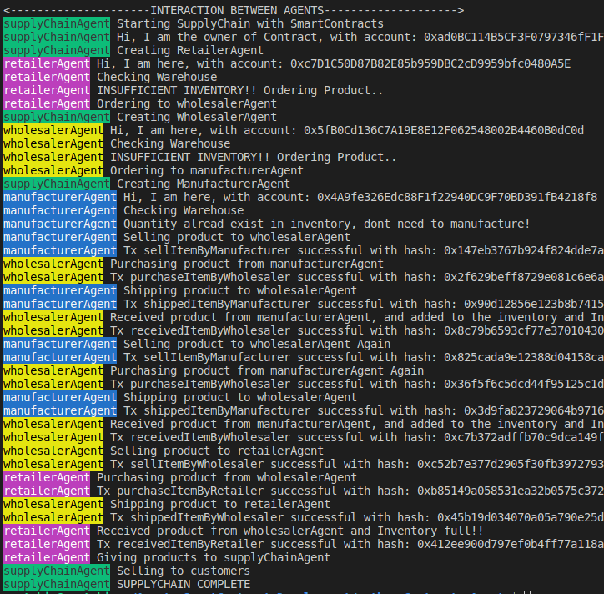
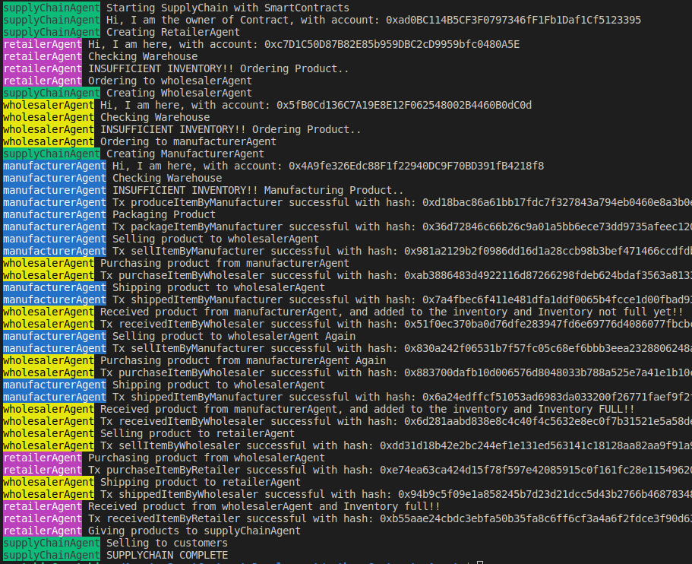
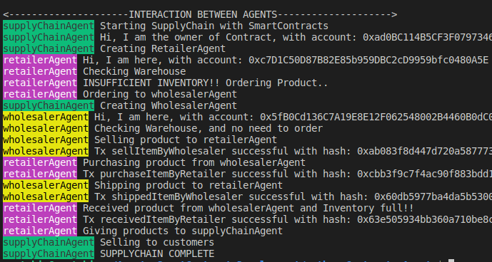
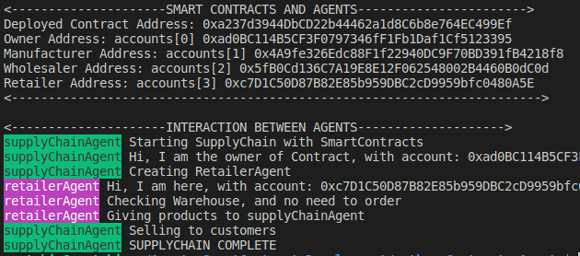
MAS with Blockchain
Jason(python) and web3.py
Scenarios:
Retailer’s warehouse has sufficient product, so RetailerAgent doesn’t need to order from WholesalerAgent.
Retailer’s warehouse has insufficient product, so RetailerAgent need to order from WholesalerAgent and Wholesaler’s warehouse has sufficient product, so WholesalerAgent doesn’t need to order from ManufactureAgent.
Retailer’s warehouse has insufficient product, so RetailerAgent need to order from WholesalerAgent, Wholesaler’s warehouse has also insufficient product, so WholesalerAgent need to order from ManufactureAgent and Manufacture’s warehouse has sufficient product, so ManufactureAgent doesn’t need to manufacture product.
Retailer’s warehouse has insufficient product, so RetailerAgent need to order from WholesalerAgent, Wholesaler’s warehouse has also insufficient product, so WholesalerAgent need to order from ManufactureAgent and Manufacture’s warehouse has also insuffi-
cient product, so ManufactureAgent needs to manufacture product.

Slide 24
Conclusion

Slide 25
BDI model provides a strong foundation for developing intelligent agents capable of making decisions based on their beliefs, desires, and intentions
Smart contracts provide a safe and decentralized platform on which these agents can interact.
Possibility of merging BDI-based multi-agent systems with blockchain technology, specifically smart contracts.
Supply chain process would be more transparent, traceable, and effective.

Slide 26
Future Work

Slide 27
Enhance the functionality of our application and build an interactive user interface
Experiment with BDI frameworks for developing agents and connecting them with blockchain technology like smart contracts.
Investigating influence of various BDI frameworks on system security and the capacity to deal with malicious agents
Check other blockchains outside Ethereum to see how well the method works with various blockchains.
Examine integration of other future technologies with the proposed system
Notes:
One can experiment with \ac{BDI} frameworks built using Java such as LightJason, JACK, or 2APL for developing agents in \ac{MAS} and connecting them with blockchain technology like smart contracts. We also anticipate having a successful implementation of our program using the web3j library, maybe after a significant upgrade to Jason or ASTRA, so that the application can operate using these Java-based frameworks too.

Slide 28
DEMO

Slide 29
Questions..

