Slide 1
Predictors of Pancreatic Cancer Survival

Slide 2
AGENDA
Research Question
Academic Papers
Chosen Dataset
Model Selection
Discussion

Slide 3
What is Cancer?
The word “cancer” imposes great fear and uncertainty to the patient recently diagnosed with it. Known for being a slow and painful killer, those who survived the disease must live their lives with disfigurement, and even then, many still pass away due to recurrence.
Cancer actually refers to a whole group of very different aliments that share a commonality: the uncontrolled proliferation of cells that have accumulated mutations. One cancer stands above all else…

Slide 4
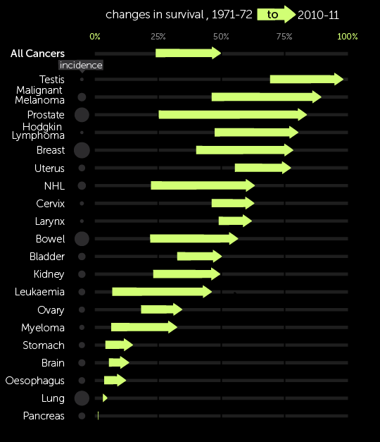
Why Pancreatic Cancer?
Cancers are often specified by the affected organ. Of all the cancers, one trumps above all the others (by a considerable margin). Pancreatic cancer.
Which cancer is known for evading all means of reliable detection before it spreads? That is pancreatic cancer. The five-year overall survival rate of pancreatic cancer currently hovers at around 10%, just half of the next biggest major killer, liver cancer.

Slide 5
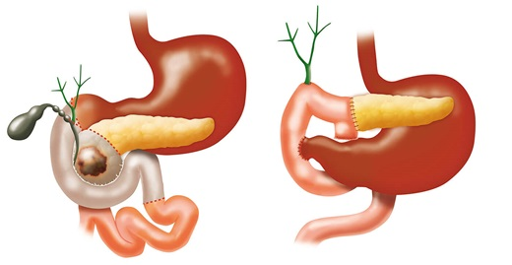
But that is not all…
The prognosis of the remaining patients detected before this cancer spreads still remains dismal. Only around a sixth of all pancreatic cancer patients are eligible for surgery, the only curative therapy. Even then, this surgery is notoriously complicated, rife with complications and failure. The success rate of this surgery (characterized by a clear resection margin) hovers around 60%.
Worst of all, the prognosis of pancreatic cancer patients that undergone successful surgery remains unsatisfactory with a five-year overall survival (after surgery) being around 15% to 20%.

Slide 6
Data analysis
Question
What is the prognosis of pancreatic cancer patients that undergone a successful resection?
Factors
Which factors are predictors of how long the patient will live, overall or disease-free?
Propose T, N, G numbers, age, and year of diagnosis
Dataset
Which dataset did we source from, and what are the limitations of our dataset?
Model Selection
How can we transform our dataset, so it is compatible with linear regression?

Slide 7
Why is this important?
The R-word, recurrence, underlies why the fear of cancer is justified.
The great majority of the pancreatic cancer patients that undergone successful curative surgery still passed away from recurrence.

Slide 8
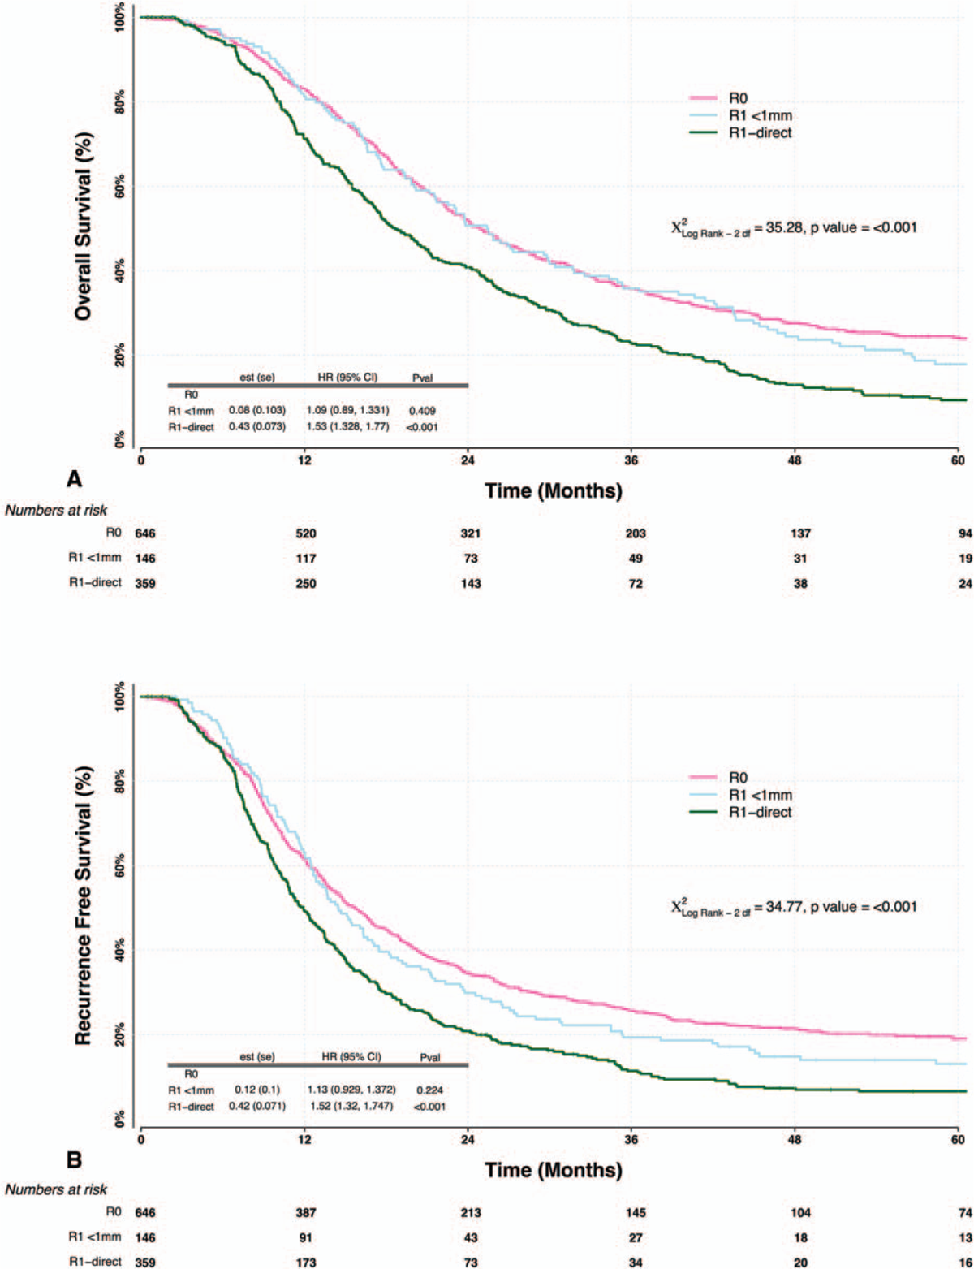
article I
Resection margin is an important predictor on survival.
A 2019 Wolters Kluwer Health journal reported that a resection which left cancer cells on the margin is a significant negative predictor of pancreatic cancer survival. We will consider these resections, called Ra resections unsuccessful.
The proportion of the patients that underwent successful (R0) surgery have a noticeably better survival. We will only consider patients that undergone successful surgery.

Slide 9
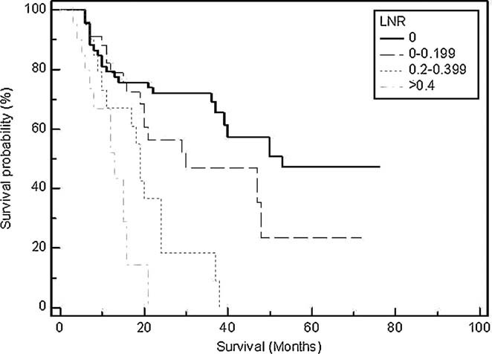
article II
Lymph Node Ratio is the best predictor for predicting survival based on nodal involvement.
Actuarial overall survival by lymph node ratio
Many malignancies first spread to the lymph nodes before they are able to spread to other organs, the point where the patient can no longer be cured.
Lymph node status is too vague to reliably predict the patient survival. Instead, we will refine lymph node status to a numeric lymph node ratio, the ratio of affected lymph nodes over all the lymph nodes harvested during the surgery.

Slide 10
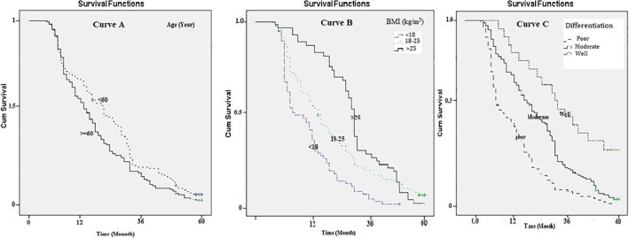
article III
Patient Characteristics
Predictors of Survival
In a retrospective cohort study involving 556 patients between September 2007 to September 2020, multivariate Cox regression reveals that older age, low body mass index, high tumor grade, large tumor size, and lymph node ratio are significant negative predictors of pancreatic cancer survival.
Our project is to demonstrate whether these factors apply for the tenth of these patients undergoing successful surgery.

Slide 11
Procedure
We will source our data from a patient-level database reporting the patient status and the patient and tumor characteristics.
Then we observe the predictors and deduce if the predictors match the statements from the articles.

Slide 12
Procedure
Dataset from The Cancer Genome Atlas via www.cbioportal.org
185 patients
Failed or Unknown Resection
62 patients
Successful Resection (R0)
108 patients
Failed Resection (R1 or R2)
53 (R1), 5 (R2)
Status Unknown (RX or missing)
4 (RX), 12 (NA)
Ductal Adenocarcinoma
87 patients
Other Malignancy
6 PNET, 11 Other Exocrine, 2 Colloid, 1 Undifferentiated
Deceased
50 patients
Alive
37 patients
From PDAC
23 patients
Not Reported
24 patients
From Other
2 complications, 1 other
Recurred
27 patients
Disease-Free
10 patients

Slide 13
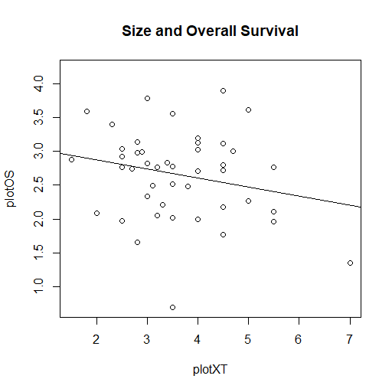
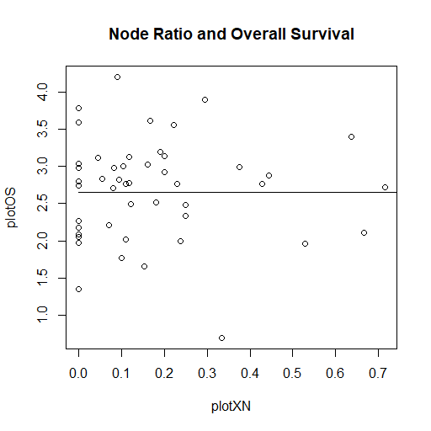
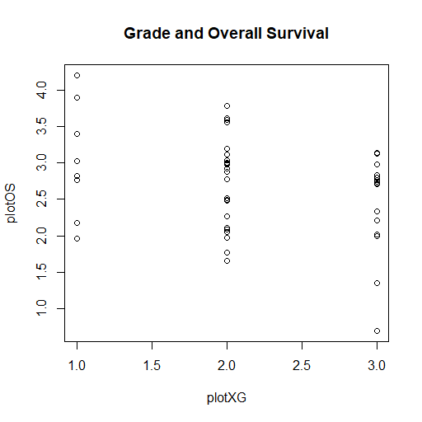
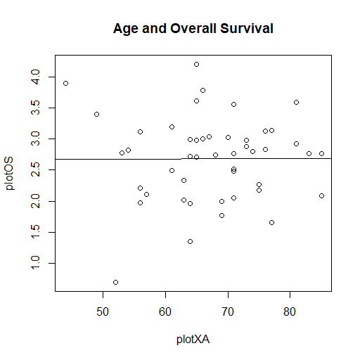
Ln Survival given attributes
We assume that the patient’s risk of passing away is constant throughout.
Thus, the patient’s survival follows and exponential distribution with parameters influenced by the predictors. We will check if log survival is linearly correlated.
Tumor Size (T)
Node Ratio (N)
Tumor Grade (G)
Age At Diagnosis
Negative, linear
No strong correlation N0 might miss nodes
Higher grades is a negative predictor
No strong correlation

Slide 14
Discussion and Limitations
Since we are filtering our dataset to a small group of patients who undergone successful resection but passed away from recurrence, we will discuss whether these predictors are consistent with what we observed from the articles.

Slide 15
Discussion
Log survival
We will assume that the risk of recurrence or death is uniform within the first five years but respond to the predictors. We will see if linear regression is suitable.
Bias
Our dataset is quite limited, and the majority of the patients are of the White ethnicity. We must factor if race has an effect on survival.
Sample Size
Since our final dataset contains less than fifty datapoints, and that two of our predictors are refuted in our study, we may need to consider another dataset.
Assumptions
We must assume that the conditions for linear regression holds, by observation. The survival is exponentially distributed given tumor attributes.

Slide 16
Next Steps…
Our dataset successfully captures some of the linear relationship between the conditional survival rate (and thus the log-survival), but we need to consider a larger dataset to ensure the other predictors match our predictions.

