Slide 1


WISER Quantum Project 2:
Quantum for Portfolio Optimization
Prepared by: Hao Mack Yang Li

Slide 2

AGENDA
Problem Statement (0:10)
Our Solution (0:45)
Results & Impact (1:40)
Future Scope (2:40)
WISER Quantum Project

Slide 3
Problem Statement
We are implementing the simplified OneOpto optimization model.
The objective function is a binary quadratic model.
Entities include securities, set of risk buckets, set of characteristics, and a set of guardrails.
You are to minimize the sum of the squared difference between the target and the current portfolio contribution across all baskets and characteristics.
Squared Difference
Squared Difference
Squared Difference
Transportation
Investment
Capital Goods
Sum:2.642
Tgt: 5.803
Diff: -3.161
Sq:9.992
Tgt:5.179
Sum:3.531
Diff:-1.648
Sq:2.716
Sum:2.698
Tgt: 1.285
Diff: 1.413
Sq: 1.997
WISER Quantum Project

Slide 4
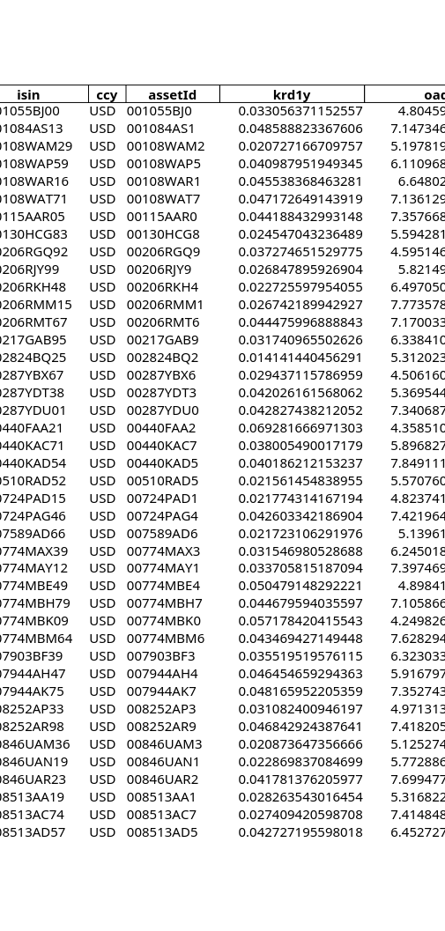
Why does it matter
Numerous trades occur during the day at very high rates, think about high frequency trading.
The optimization problem becomes computationally infeasible classically.
The brute force approach is exponential to the number of securities.
Local optima and multiple optima can cause optimizers to fail.
Even GUROBI may fail to find a global optima within ten minutes, especially with hundreds of risk buckets and tens of characteristics.
The optimization problem is of a matrix form, and is well suited for quantum algorithms, such as QAOA.
WISER Quantum Project

Slide 5
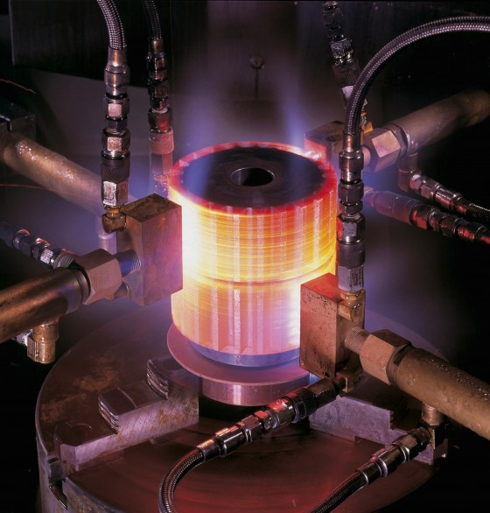
A quantum annealing approach
WISER Quantum Project

Slide 6
The Variables
Input Variables
Constraint variables
Let C denote the set of securities.
Each element c is internally indexed.
Each element is expressed as a quintuple:
Market price p, Trade range (min, max, inventory), Minimum increment δ
Let L denote the set of risk buckets
Can be a rating or an industry.
Let J denote the set of characteristics
Can be any numeric field in the dataframe.
There is a guardrail and target K^{target}, K^{low}, K^{up} for each l in L and j in J.
There are thus |L||J| such targets, guardrails, and quadratic terms in the objective.
Let K[l] denote the subset of bonds belonging to risk bucket l.
Total bonds N, residual cash guardrail R.
Output is the y, the included bonds.
WISER Quantum Project | Part 1

Slide 7
The Equation
Reduced dataset
Optimization and constraints
|C| = 31
L = {'Capital Goods', 'Investment', 'Transportation'}
J = {'PMV'}
|K| = 3
K_{Capital Goods, PMV} = [4.758, 5.803, 6.847]
K_{Investment, PMV} = [4.134, 5.178, 6.223]
K_{Transportation, PMV} = [0.240, 1.284, 2.329]
x_{c} is a fixed multiple of y_{c} depending on the minimum and maximum trade amounts.
ϱ_{j} and β_{j,c} are contribution weights.
min_{y} Σ_{l}Σ_{j} ϱ_{j} (Σ_{c ∈ K[l]} β_{j,c}x_{c} - K^{target})²
Σ_{c} y_{c} ≤ N, Σ_{c} p_{c}δ_{c}β_{j,c}x_{c} ∈ R
∀j∀l Σ_{c ∈ K[l]} p_{c}δ_{c}β_{j,c}x_{c} ∈ K_{l,j}
WISER Quantum Project | Part 1
Notes:
Times New Roman does not support the "element of" and "for all" symbols.

Slide 8
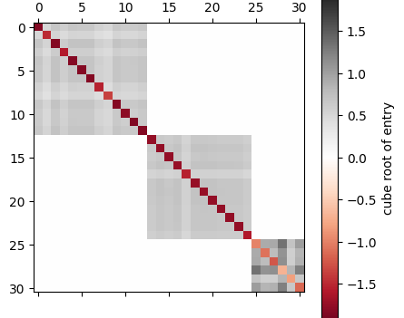
Our D-WAVE Solution
We implemented our solution in Python, using the dwave-system package.
The optimization equation is converted to expanded form, and then to the format compatible with D-WAVE.
Each element of y is named after the bond.
Sorted by the risk bucket, so block-diagonal if the buckets do not overlap.
To the right is the QAOA matrix.
Red entries negative, gray entries positive.
The off-diagonal entries have much lower magnitudes (order of 0.2 to 1.5) against the diagonal entries (order of –5).
WISER Quantum Project | Part 1, 2

Slide 9
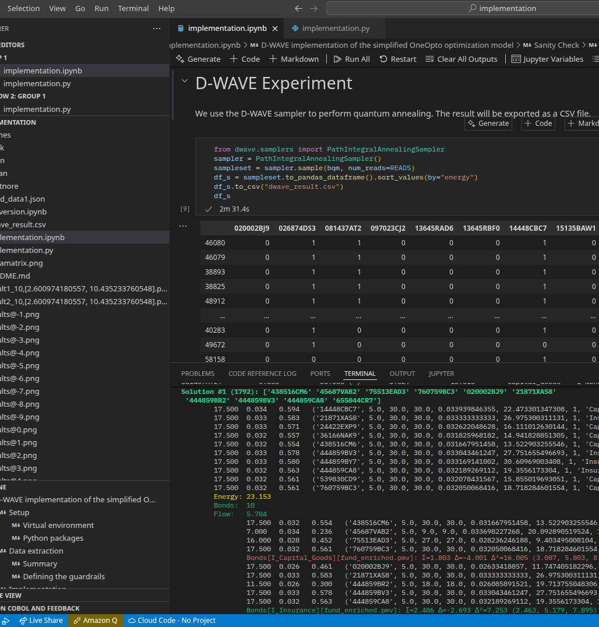
Our Results
WISER Quantum Project

Slide 10
Summary
We are able to successfully implement the minimization of the objective function while enforcing the guardrail conditions.
Unfortunately, we are not able to gain access to the actual quantum resource via LEAP.
The simulated annealer can provide a rapidly convergent solution. Even with 65536 runs, it only takes three minutes on the 31-bond dataset and three guardrails.
The next slide will show the animation of the samples, with the best one by energy listed first.
D-WAVE energy, QAOA energy
Cashflow
Bond selection (by internal index) overlaid with total bonds
Values and guardrail (assume target is midpoint)
Solution #1 (-48): ['081437AT2' '097023CJ2' '14448CBC7' '24422EWZ8' '438516CM6' '443201AC2' '45687VAB2' '539830CD9' '75513EAD3' '760759BC3' '020002BJ9' '026874DS3' '15135BAW1' '21871XAS8' '444859BR2' '444859BV3' '444859BY7' '444859CA8' '56501RAN6' '91324PEJ7' '13645RBF0' '314353AA1'] 17.500 0.026 0.461 ('020002BJ9', 5.0, 30.0, 30.0, 0.02633418857, 11.747405182296, 1, 'Insurance', [1]) 17.500 0.032 0.563 ('026874DS3', 5.0, 30.0, 30.0, 0.032168634542, 19.306390960602, 1, 'Insurance', [1]) 17.500 0.029 0.499 ('081437AT2', 5.0, 30.0, 30.0, 0.028510851146, 13.316192340035, 1, 'Capital_Goods', [1]) 9.000 0.027 0.246 ('097023CJ2', 5.0, 13.0, 13.0, 0.027298851045, 34.461503917596, 1, 'Capital_Goods', [1]) 17.500 0.034 0.594 ('14448CBC7', 5.0, 30.0, 30.0, 0.033939846355, 22.473301347308, 1, 'Capital_Goods', [1]) 17.500 0.028 0.487 ('15135BAW1', 5.0, 30.0, 30.0, 0.027845453268, 21.626486622322, 1, 'Insurance', [1]) 17.500 0.033 0.583 ('21871XAS8', 5.0, 30.0, 30.0, 0.033333333333, 26.975300311131, 1, 'Insurance', [1]) 11.000 0.033 0.360 ('24422EWZ8', 5.0, 17.0, 17.0, 0.032714779285, 7.4190547577, 1, 'Capital_Goods', [1]) 17.500 0.033 0.571 ('24422EXP9', 5.0, 30.0, 30.0, 0.032622048628, 16.111012630144, 1, 'Capital_Goods', [1]) 17.500 0.032 0.557 ('36166NAK9', 5.0, 30.0, 30.0, 0.031825968182, 14.941828851305, 1, 'Capital_Goods', [1]) 17.500 0.032 0.554 ('438516CM6', 5.0, 30.0, 30.0, 0.031667951458, 13.522903255546, 1, 'Capital_Goods', [1]) 10.000 0.032 0.319 ('443201AC2', 5.0, 15.0, 15.0, 0.031871754859, 14.154534858858, 1, 'Capital_Goods', [1]) 11.500 0.026 0.300 ('444859BR2', 5.0, 18.0, 18.0, 0.026085891521, 19.713755048306, 1, 'Insurance', [1]) 17.500 0.033 0.578 ('444859BV3', 5.0, 30.0, 30.0, 0.033043461247, 27.751655496693, 1, 'Insurance', [1]) 17.500 0.033 0.580 ('444859BY7', 5.0, 30.0, 30.0, 0.033169141002, 30.60969003408, 1, 'Insurance', [1]) 17.500 0.032 0.563 ('444859CA8', 5.0, 30.0, 30.0, 0.032189269112, 19.3556173304, 1, 'Insurance', [1]) 7.000 0.034 0.236 ('45687VAB2', 5.0, 9.0, 9.0, 0.033698227268, 20.092890519524, 1, 'Capital_Goods', [1]) 17.500 0.032 0.561 ('539830CD9', 5.0, 30.0, 30.0, 0.032078431567, 15.855019693051, 1, 'Capital_Goods', [1]) 17.500 0.030 0.522 ('56501RAN6', 5.0, 30.0, 30.0, 0.029814829851, 13.086051978345, 1, 'Insurance', [1]) 8.500 0.034 0.285 ('655844CT3', 5.0, 12.0, 12.0, 0.033512025872, 0.033512025872, 1, 'Transportation', [1]) 17.500 0.030 0.517 ('759351AP4', 5.0, 30.0, 30.0, 0.029540913811, 11.974870385817, 1, 'Insurance', [1]) 17.500 0.026 0.462 ('760759BA7', 5.0, 30.0, 30.0, 0.026425255721, 15.388018208694, 1, 'Capital_Goods', [1]) Energy: -1.228 Bonds: 22 Flow: 10.399 17.500 0.029 0.499 ('081437AT2', 5.0, 30.0, 30.0, 0.028510851146, 13.316192340035, 1, 'Capital_Goods', [1]) 9.000 0.027 0.246 ('097023CJ2', 5.0, 13.0, 13.0, 0.027298851045, 34.461503917596, 1, 'Capital_Goods', [1]) 17.500 0.034 0.594 ('14448CBC7', 5.0, 30.0, 30.0, 0.033939846355, 22.473301347308, 1, 'Capital_Goods', [1]) 11.000 0.033 0.360 ('24422EWZ8', 5.0, 17.0, 17.0, 0.032714779285, 7.4190547577, 1, 'Capital_Goods', [1]) 17.500 0.032 0.554 ('438516CM6', 5.0, 30.0, 30.0, 0.031667951458, 13.522903255546, 1, 'Capital_Goods', [1]) 10.000 0.032 0.319 ('443201AC2', 5.0, 15.0, 15.0, 0.031871754859, 14.154534858858, 1, 'Capital_Goods', [1]) 7.000 0.034 0.236 ('45687VAB2', 5.0, 9.0, 9.0, 0.033698227268, 20.092890519524, 1, 'Capital_Goods', [1]) 17.500 0.032 0.561 ('539830CD9', 5.0, 30.0, 30.0, 0.032078431567, 15.855019693051, 1, 'Capital_Goods', [1]) 16.000 0.028 0.452 ('75513EAD3', 5.0, 27.0, 27.0, 0.028236246188, 9.403495008104, 1, 'Capital_Goods', [1]) 17.500 0.032 0.561 ('760759BC3', 5.0, 30.0, 30.0, 0.032050068416, 18.718284601554, 1, 'Capital_Goods', [1]) Bonds[I_Capital_Goods][fund_enriched.pmv]: Σ=4.381 Δ=-1.422 Δ²=2.022 (4.759, 5.803, 6.848) 17.500 0.026 0.461 ('020002BJ9', 5.0, 30.0, 30.0, 0.02633418857, 11.747405182296, 1, 'Insurance', [1]) 17.500 0.032 0.563 ('026874DS3', 5.0, 30.0, 30.0, 0.032168634542, 19.306390960602, 1, 'Insurance', [1]) 17.500 0.028 0.487 ('15135BAW1', 5.0, 30.0, 30.0, 0.027845453268, 21.626486622322, 1, 'Insurance', [1]) 17.500 0.033 0.583 ('21871XAS8', 5.0, 30.0, 30.0, 0.033333333333, 26.975300311131, 1, 'Insurance', [1]) 11.500 0.026 0.300 ('444859BR2', 5.0, 18.0, 18.0, 0.026085891521, 19.713755048306, 1, 'Insurance', [1]) 17.500 0.033 0.578 ('444859BV3', 5.0, 30.0, 30.0, 0.033043461247, 27.751655496693, 1, 'Insurance', [1]) 17.500 0.033 0.580 ('444859BY7', 5.0, 30.0, 30.0, 0.033169141002, 30.60969003408, 1, 'Insurance', [1]) 17.500 0.032 0.563 ('444859CA8', 5.0, 30.0, 30.0, 0.032189269112, 19.3556173304, 1, 'Insurance', [1]) 17.500 0.030 0.522 ('56501RAN6', 5.0, 30.0, 30.0, 0.029814829851, 13.086051978345, 1, 'Insurance', [1]) 13.000 0.031 0.408 ('91324PEJ7', 5.0, 21.0, 21.0, 0.031401384436, 11.756014097259, 1, 'Insurance', [1]) Bonds[I_Insurance][fund_enriched.pmv]: Σ=5.046 Δ=-0.133 Δ²=0.018 (4.134, 5.179, 6.224) 23.000 0.028 0.641 ('13645RBF0', 5.0, 41.0, 41.0, 0.027884438059, 0.027884438059, 1, 'Transportation', [1]) 32.500 0.021 0.695 ('314353AA1', 5.0, 60.0, 60.0, 0.021396294681, 0.021396294681, 1, 'Transportation', [1]) Bonds[I_Transportation][fund_enriched.pmv]: Σ=1.337 Δ=0.052 Δ²=0.003 (0.240, 1.285, 2.329)
WISER Quantum Project | Part 3, 4

Slide 11
Changing bond limit (30m)
WISER Quantum Project | Part 4

Slide 12
Changing guardrails (2h)
WISER Quantum Project | Part 4

Slide 13
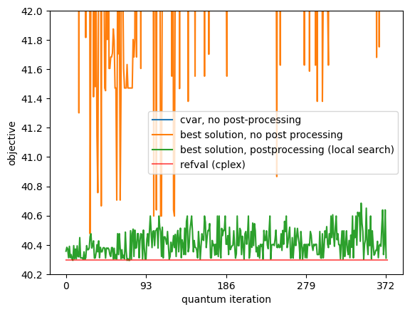
Scalability and Classical
The reference run uses a real Qiskit run with or without postprocessing.
In the small dataset, the reference optimal value has an energy of 40.3.
The actual Qiskit quantum run without postprocessing considerably misses the goal.
With postprocessing, it misses the goal by 0.15 units on average.
D-WAVE energy is separate, but correlated with QAOA energy; D-WAVE energy factors in guardrails as well.
WISER Quantum Project | Part 5

Slide 14
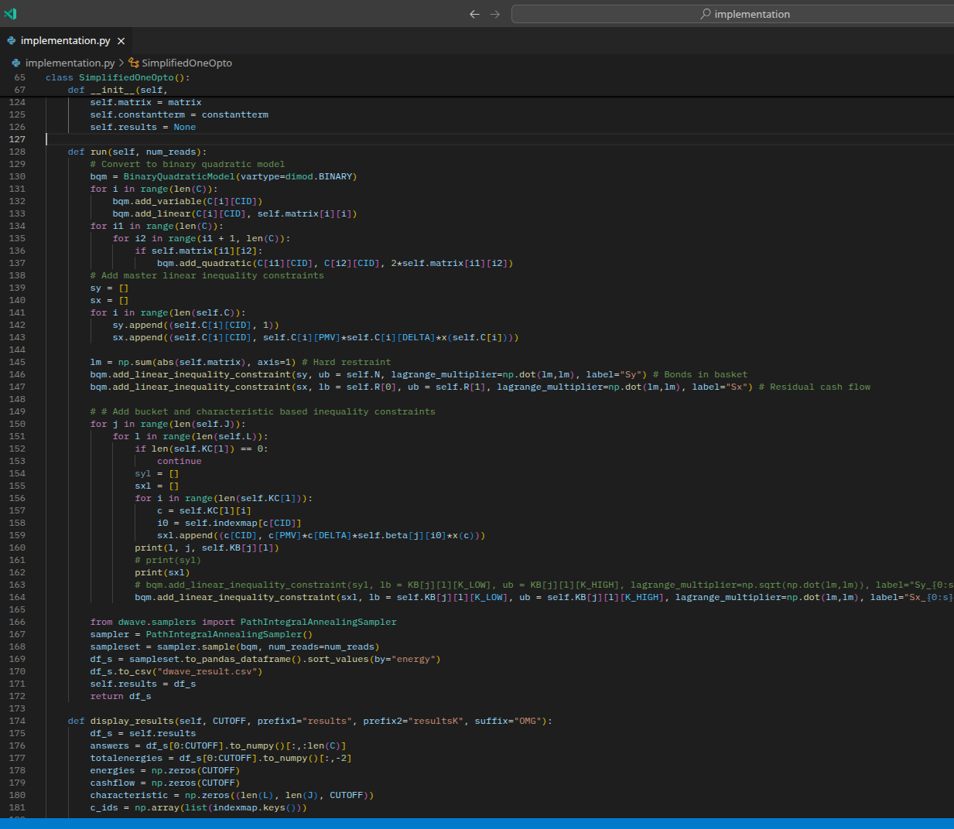
Future Roadmap
Software engineering
Scalability
Different datasets
D-WAVE
WISER Quantum Project

Slide 15
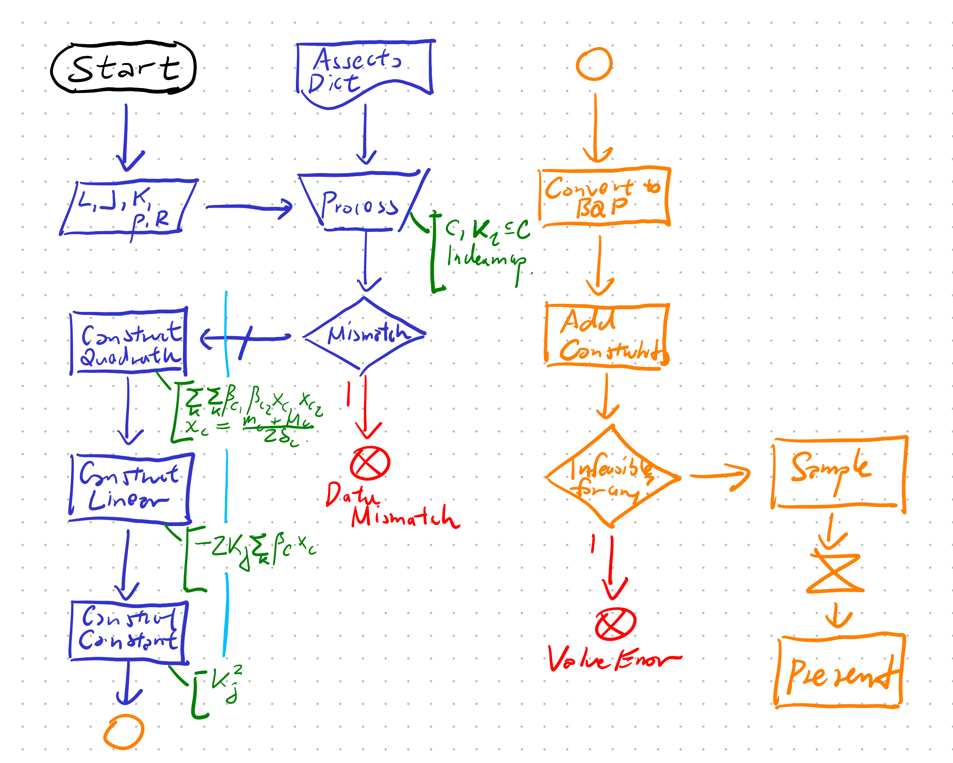
Code maintenance
Much time spent on coding instead visits the theory by providing test examples to affirm or refute the correctness of the program, and to refactor code to adhere to software engineering principles.
Object-oriented programming
A dedicated C and K object.
Architecture to repeatedly run the procedure while varying some of the values.
Exception handling
Prevents harder to trace exceptions.
Code reusability
Allows easy inspection, avoids code smells.
WISER Quantum Project

Slide 16
Limitations
To conclude this presentation, we will address the limitations encountered during the submission period.
We did not get our LEAP application approved within the timeframe, so we cannot measure our progress using a real quantum annealer, which can support up to thousands of variables.
We mostly discussed the smallest dataset.
Though software engineering best practices have been follows and we are able to see results, we need to scrutinize our code again to resolve any anomalies, such as
Negative values of the optimization function.
The constant bias between different quantum and classical optimization process.
Potentially confusing the variables and guardrails they officially provided versus my implementation.
It is important to manage time, and ensure a smooth progression.
WISER Quantum Project

Slide 17


THANK YOU
Comment below for any questions!
WISER Quantum Project
WISER Quantum Project
WISER Quantum Project
WISER Quantum Project
WISER Quantum Project

