Slide 1
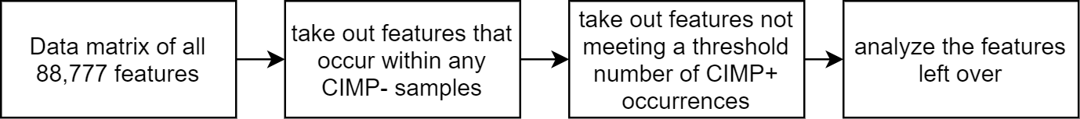
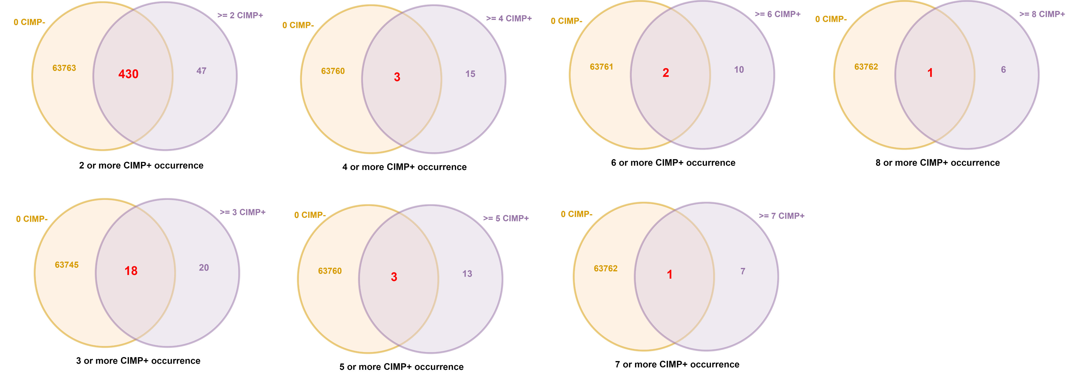
Overview

Slide 2
Comparing different CIMP+ occurrence thresholds
Data Table:
Top features with 0 CIMP-:

Slide 3
Analyzing 18 Features from >= 3 CIMP+ Constraint

Slide 4
Analyzing 18 Features from >= 3 CIMP+ Constraint
Feature (18 total) | True Positive | False Postive | True Negative | False Negative | Accuracy | CIMP+ Coverage
GRB14_GRCh37_2:165365288-165365296_In_Frame_Del_DEL_TTTTTTTTT_-_- | 8 | 0 | 159 | 57 | 0.74554 | 12.30769231
PRDM2_GRCh37_1:14108749-14108757_In_Frame_Del_DEL_AAAAAAAAA_-_- | 6 | 0 | 159 | 59 | 0.73661 | 9.230769231
ATR_GRCh37_3:142274740-142274749_Frame_Shift_Del_DEL_TTTTTTTTTT_-_- | 5 | 0 | 159 | 60 | 0.73214 | 7.692307692
MSH6_GRCh37_2:48030640-48030647_Frame_Shift_Del_DEL_CCCCCCCC_-_- | 3 | 0 | 159 | 62 | 0.72321 | 4.615384615
ICA1_GRCh37_7:8198251-8198251_Frame_Shift_Del_DEL_T_-_- | 3 | 0 | 159 | 62 | 0.72321 | 4.615384615
SAT1_GRCh37_X:23802147-23802147_Intron_DEL_A_-_- | 3 | 0 | 159 | 62 | 0.72321 | 4.615384615
CTNND2_GRCh37_5:11117571-11117571_Silent_SNP_G_A_A | 3 | 0 | 159 | 62 | 0.72321 | 4.615384615
TP53_GRCh37_17:7577120-7577120_Missense_Mutation_SNP_C_T_T | 3 | 0 | 159 | 62 | 0.72321 | 4.615384615
MYO3A_GRCh37_10:26446395-26446395_Nonsense_Mutation_SNP_C_T_T | 3 | 0 | 159 | 62 | 0.72321 | 4.615384615
PTEN_GRCh37_10:89692905-89692905_Missense_Mutation_SNP_G_A_A | 3 | 0 | 159 | 62 | 0.72321 | 4.615384615
ZNF491_GRCh37_19:11917796-11917796_Missense_Mutation_SNP_G_A_A | 3 | 0 | 159 | 62 | 0.72321 | 4.615384615
KIF14_GRCh37_1:200573037-200573037_Missense_Mutation_SNP_C_T_T | 3 | 0 | 159 | 62 | 0.72321 | 4.615384615
SGSM1_GRCh37_22:25315953-25315953_Missense_Mutation_SNP_C_A_A | 3 | 0 | 159 | 62 | 0.72321 | 4.615384615
USP34_GRCh37_2:61546367-61546367_Nonsense_Mutation_SNP_G_A_A | 3 | 0 | 159 | 62 | 0.72321 | 4.615384615
LPHN3_GRCh37_4:62910205-62910205_Missense_Mutation_SNP_G_A_A | 3 | 0 | 159 | 62 | 0.72321 | 4.615384615
CDYL_GRCh37_6:4943786-4943786_Silent_SNP_C_T_T | 3 | 0 | 159 | 62 | 0.72321 | 4.615384615
KIF20B_GRCh37_10:91497569-91497569_Missense_Mutation_SNP_G_A_A | 3 | 0 | 159 | 62 | 0.72321 | 4.615384615
KIF18A_GRCh37_11:28119446-28119446_Missense_Mutation_SNP_G_A_A | 3 | 0 | 159 | 62 | 0.72321 | 4.615384615

Slide 5
Overall Accuracy and Statistics
CIMP+ Samples Correctly Picked
Using all 18 features to classify
CIMP+ Samples NOT Picked
'TCGA-A6-2676',
'TCGA-AA-3516',
'TCGA-AA-3525',
'TCGA-AA-3672',
'TCGA-AA-3710',
'TCGA-AA-3715',
'TCGA-AA-3811',
'TCGA-AA-3821',
'TCGA-AA-3833',
'TCGA-AA-3864',
'TCGA-AA-3877',
'TCGA-AA-3947',
'TCGA-AA-3949',
'TCGA-AA-3966',
'TCGA-AA-3977',
'TCGA-AA-A00E',
'TCGA-AA-A00J',
'TCGA-AA-A00N',
'TCGA-AA-A010',
'TCGA-AA-A01D',
'TCGA-AG-3902',
'TCGA-AG-A002'
'TCGA-A6-2672',
'TCGA-A6-2674',
'TCGA-A6-3807',
'TCGA-A6-3808',
'TCGA-A6-3810',
'TCGA-AA-3514',
'TCGA-AA-3518',
'TCGA-AA-3526',
'TCGA-AA-3532',
'TCGA-AA-3543',
'TCGA-AA-3554',
'TCGA-AA-3555',
'TCGA-AA-3556',
'TCGA-AA-3664',
'TCGA-AA-3681',
'TCGA-AA-3684',
'TCGA-AA-3812',
'TCGA-AA-3814',
'TCGA-AA-3842',
'TCGA-AA-3845',
'TCGA-AA-3852',
'TCGA-AA-3860',
False Positives: 0
False Negatives: 43
True Positives: 22
True Negatives: 159
Proportion of false positives: 0.0
Proportion of false negatives:0.19111111111111112
Accuracy: 0.8080357142857143
Error rate: 0.19196428571428573
Sensitivity: 0.3384615384615385
Specificity: 1.0
'TCGA-AA-3866',
'TCGA-AA-3870',
'TCGA-AA-3872',
'TCGA-AA-3930',
'TCGA-AA-3952',
'TCGA-AA-3994',
'TCGA-AA-A004',
'TCGA-AA-A00A',
'TCGA-AA-A00D',
'TCGA-AA-A00R',
'TCGA-AA-A01K',
'TCGA-AA-A01Q',
'TCGA-AF-3400',
'TCGA-AG-3575',
'TCGA-AG-3594',
'TCGA-AG-3600',
'TCGA-AG-3609',
'TCGA-AG-3878',
'TCGA-AG-3881',
'TCGA-AG-3883',
'TCGA-AG-3901'

Slide 6
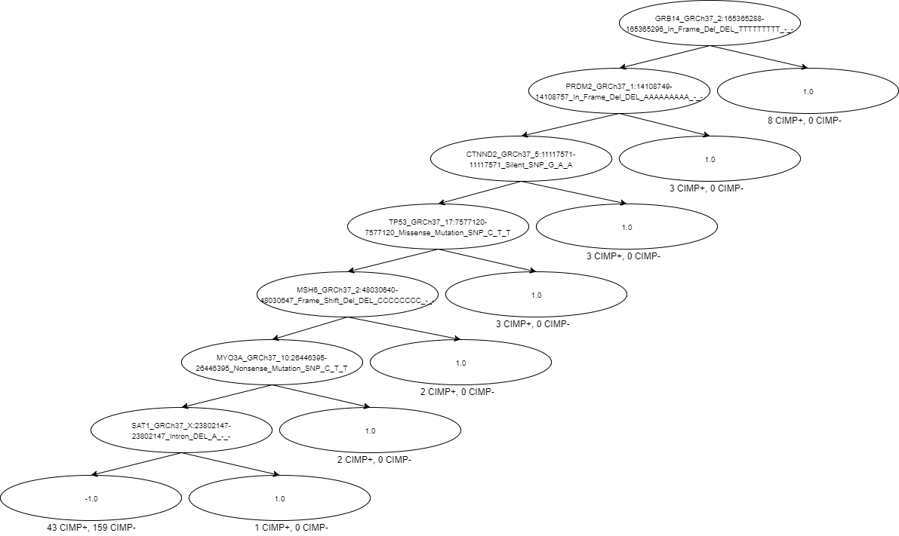
Using Decision Tree with 18 Features
False Positives: 0 False Negatives: 43 True Positives: 22 True Negatives: 159 Proportion of false positives: 0.0 Proportion of false negatives:0.19196428571428573 Accuracy: 0.8080357142857143 Error rate: 0.19196428571428573 Sensitivity: 0.3384615384615385 Specificity: 1.0

Slide 7
Relaxing constraints (>= 3 CIMP+ and <= 1 CIMP-)

Slide 8
Relaxing constraints (>= 3 CIMP+ and <= 1 CIMP-)
Feature (26 total) | True Positive | False Positive | True Negative | False Negative | Accuracy | CIMP+ Coverage
SEC63_GRCh37_6:108214755-108214764_Frame_Shift_Del_DEL_TTTTTTTTTT_-_- | 10 | 1 | 158 | 55 | 0.75 | 15.38461538
MSH3_GRCh37_5:79970915-79970922_Frame_Shift_Del_DEL_AAAAAAAA_-_- | 10 | 1 | 158 | 55 | 0.75 | 15.38461538
AIM2_GRCh37_1:159032487-159032496_Frame_Shift_Del_DEL_TTTTTTTTTT_-_- | 9 | 1 | 158 | 56 | 0.745536 | 13.84615385
GRB14_GRCh37_2:165365288-165365296_In_Frame_Del_DEL_TTTTTTTTT_-_- | 8 | 0 | 159 | 57 | 0.745536 | 12.30769231
BRAF_GRCh37_7:140453136-140453136_Missense_Mutation_SNP_A_A_T | 7 | 1 | 158 | 58 | 0.736607 | 10.76923077
PRDM2_GRCh37_1:14108749-14108757_In_Frame_Del_DEL_AAAAAAAAA_-_- | 6 | 0 | 159 | 59 | 0.736607 | 9.230769231
CASP5_GRCh37_11:104878041-104878050_Frame_Shift_Del_DEL_TTTTTTTTTT_-_- | 6 | 1 | 158 | 59 | 0.732143 | 9.230769231
ATR_GRCh37_3:142274740-142274749_Frame_Shift_Del_DEL_TTTTTTTTTT_-_- | 5 | 0 | 159 | 60 | 0.732143 | 7.692307692
PIK3CA_GRCh37_3:178952085-178952085_Missense_Mutation_SNP_A_G_G | 4 | 1 | 158 | 61 | 0.723214 | 6.153846154
MSH6_GRCh37_2:48030640-48030647_Frame_Shift_Del_DEL_CCCCCCCC_-_- | 3 | 0 | 159 | 62 | 0.723214 | 4.615384615
WISP3_GRCh37_6:112389434-112389442_In_Frame_Del_DEL_AAAAAAAAA_-_- | 3 | 1 | 158 | 62 | 0.71875 | 4.615384615
ICA1_GRCh37_7:8198251-8198251_Frame_Shift_Del_DEL_T_-_- | 3 | 0 | 159 | 62 | 0.723214 | 4.615384615
SAT1_GRCh37_X:23802147-23802147_Intron_DEL_A_-_- | 3 | 0 | 159 | 62 | 0.723214 | 4.615384615
CTNND2_GRCh37_5:11117571-11117571_Silent_SNP_G_A_A | 3 | 0 | 159 | 62 | 0.723214 | 4.615384615
TP53_GRCh37_17:7577120-7577120_Missense_Mutation_SNP_C_T_T | 3 | 0 | 159 | 62 | 0.723214 | 4.615384615
MYO3A_GRCh37_10:26446395-26446395_Nonsense_Mutation_SNP_C_T_T | 3 | 0 | 159 | 62 | 0.723214 | 4.615384615
PTEN_GRCh37_10:89692905-89692905_Missense_Mutation_SNP_G_A_A | 3 | 0 | 159 | 62 | 0.723214 | 4.615384615
ZNF491_GRCh37_19:11917796-11917796_Missense_Mutation_SNP_G_A_A | 3 | 0 | 159 | 62 | 0.723214 | 4.615384615
EMR3_GRCh37_19:14772866-14772866_Silent_SNP_G_A_A | 3 | 1 | 158 | 62 | 0.71875 | 4.615384615
KIF14_GRCh37_1:200573037-200573037_Missense_Mutation_SNP_C_T_T | 3 | 0 | 159 | 62 | 0.723214 | 4.615384615
SGSM1_GRCh37_22:25315953-25315953_Missense_Mutation_SNP_C_A_A | 3 | 0 | 159 | 62 | 0.723214 | 4.615384615
USP34_GRCh37_2:61546367-61546367_Nonsense_Mutation_SNP_G_A_A | 3 | 0 | 159 | 62 | 0.723214 | 4.615384615
LPHN3_GRCh37_4:62910205-62910205_Missense_Mutation_SNP_G_A_A | 3 | 0 | 159 | 62 | 0.723214 | 4.615384615
CDYL_GRCh37_6:4943786-4943786_Silent_SNP_C_T_T | 3 | 0 | 159 | 62 | 0.723214 | 4.615384615
KIF20B_GRCh37_10:91497569-91497569_Missense_Mutation_SNP_G_A_A | 3 | 0 | 159 | 62 | 0.723214 | 4.615384615
KIF18A_GRCh37_11:28119446-28119446_Missense_Mutation_SNP_G_A_A | 3 | 0 | 159 | 62 | 0.723214 | 4.615384615

Slide 9
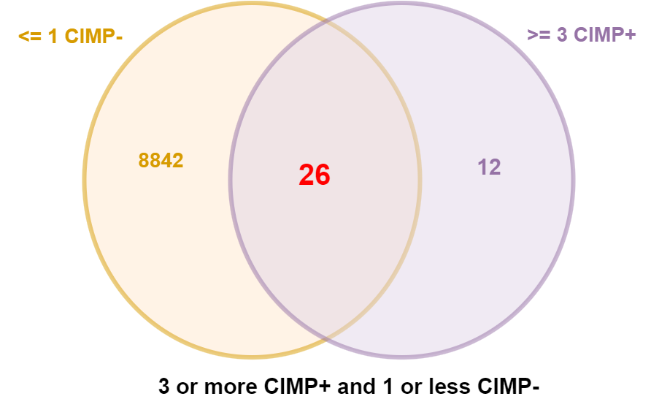
Overall Accuracy and Statistics
CIMP+ Samples Correctly Picked
Using all 26 features to classify
CIMP+ Samples NOT Picked
'TCGA-A6-2672',
'TCGA-A6-2676',
'TCGA-A6-3808',
'TCGA-AA-3516',
'TCGA-AA-3518',
'TCGA-AA-3525',
'TCGA-AA-3543',
'TCGA-AA-3554',
'TCGA-AA-3672',
'TCGA-AA-3710',
'TCGA-AA-3715',
'TCGA-AA-3811',
'TCGA-AA-3821',
'TCGA-AA-3833',
'TCGA-AA-3845',
'TCGA-AA-3864',
'TCGA-AA-3877',
'TCGA-AA-3947',
'TCGA-AA-3949',
'TCGA-AA-3966',
'TCGA-AA-3977',
'TCGA-AA-A00A',
'TCGA-AA-A00D',
'TCGA-AA-A00E',
'TCGA-AA-A00J',
'TCGA-AA-A00N',
'TCGA-AA-A010',
'TCGA-AA-A01D',
'TCGA-AA-A01Q',
'TCGA-AG-3902',
'TCGA-AG-A002’
'TCGA-A6-2674',
'TCGA-A6-3807',
'TCGA-A6-3810',
'TCGA-AA-3514',
'TCGA-AA-3526',
'TCGA-AA-3532',
'TCGA-AA-3555',
'TCGA-AA-3556',
'TCGA-AA-3664',
'TCGA-AA-3681',
'TCGA-AA-3684',
'TCGA-AA-3812',
'TCGA-AA-3814',
'TCGA-AA-3842',
'TCGA-AA-3852',
'TCGA-AA-3860',
'TCGA-AA-3866',
'TCGA-AA-3870',
'TCGA-AA-3872',
'TCGA-AA-3930',
'TCGA-AA-3952',
'TCGA-AA-3994',
False Positives: 6
False Negatives: 34
True Positives: 31
True Negatives: 153
Proportion of false positives: 0.02666666666666667
Proportion of false negatives:0.1511111111111111
Accuracy: 0.8214285714285714
Error rate: 0.17857142857142858
Sensitivity: 0.47692307692307695
Specificity: 0.9622641509433962
'TCGA-AA-A004',
'TCGA-AA-A00R',
'TCGA-AA-A01K',
'TCGA-AF-3400',
'TCGA-AG-3575',
'TCGA-AG-3594',
'TCGA-AG-3600',
'TCGA-AG-3609',
'TCGA-AG-3878',
'TCGA-AG-3881',
'TCGA-AG-3883',
'TCGA-AG-3901'

Slide 10
Relaxing constraints (>= 3 CIMP+ and <= 2 CIMP-)

Slide 11
Relaxing constraints (>= 3 CIMP+ and <= 2 CIMP-)
Feature (31 total) | True Positive | False Positive | True Negative | False Negative | Accuracy | CIMP+ Coverage
SEC63_GRCh37_6:108214755-108214764_Frame_Shift_Del_DEL_TTTTTTTTTT_-_- | 10 | 1 | 158 | 55 | 0.75 | 15.38461538
MSH3_GRCh37_5:79970915-79970922_Frame_Shift_Del_DEL_AAAAAAAA_-_- | 10 | 1 | 158 | 55 | 0.75 | 15.38461538
BRAF_GRCh37_7:140453136-140453136_Missense_Mutation_SNP_A_T_T | 10 | 2 | 157 | 55 | 0.745536 | 15.38461538
AIM2_GRCh37_1:159032487-159032496_Frame_Shift_Del_DEL_TTTTTTTTTT_-_- | 9 | 1 | 158 | 56 | 0.745536 | 13.84615385
GRB14_GRCh37_2:165365288-165365296_In_Frame_Del_DEL_TTTTTTTTT_-_- | 8 | 0 | 159 | 57 | 0.745536 | 12.30769231
BRAF_GRCh37_7:140453136-140453136_Missense_Mutation_SNP_A_A_T | 7 | 1 | 158 | 58 | 0.736607 | 10.76923077
PRDM2_GRCh37_1:14108749-14108757_In_Frame_Del_DEL_AAAAAAAAA_-_- | 6 | 0 | 159 | 59 | 0.736607 | 9.230769231
CASP5_GRCh37_11:104878041-104878050_Frame_Shift_Del_DEL_TTTTTTTTTT_-_- | 6 | 1 | 158 | 59 | 0.732143 | 9.230769231
TCF7L2_GRCh37_10:114925317-114925325_In_Frame_Del_DEL_AAAAAAAAA_-_- | 6 | 2 | 157 | 59 | 0.727679 | 9.230769231
RAD50_GRCh37_5:131931452-131931460_In_Frame_Del_DEL_AAAAAAAAA_-_- | 5 | 2 | 157 | 60 | 0.723214 | 7.692307692
ATR_GRCh37_3:142274740-142274749_Frame_Shift_Del_DEL_TTTTTTTTTT_-_- | 5 | 0 | 159 | 60 | 0.732143 | 7.692307692
HMMR_GRCh37_5:162917426-162917434_In_Frame_Del_DEL_AAAAAAAAA_-_- | 4 | 2 | 157 | 61 | 0.71875 | 6.153846154
PIK3CA_GRCh37_3:178952085-178952085_Missense_Mutation_SNP_A_G_G | 4 | 1 | 158 | 61 | 0.723214 | 6.153846154
MSH6_GRCh37_2:48030640-48030647_Frame_Shift_Del_DEL_CCCCCCCC_-_- | 3 | 0 | 159 | 62 | 0.723214 | 4.615384615
WISP3_GRCh37_6:112389434-112389442_In_Frame_Del_DEL_AAAAAAAAA_-_- | 3 | 1 | 158 | 62 | 0.71875 | 4.615384615
ICA1_GRCh37_7:8198251-8198251_Frame_Shift_Del_DEL_T_-_- | 3 | 0 | 159 | 62 | 0.723214 | 4.615384615
FBXW7_GRCh37_4:153249384-153249384_Missense_Mutation_SNP_C_T_T | 3 | 2 | 157 | 62 | 0.714286 | 4.615384615
SAT1_GRCh37_X:23802147-23802147_Intron_DEL_A_-_- | 3 | 0 | 159 | 62 | 0.723214 | 4.615384615
CTNND2_GRCh37_5:11117571-11117571_Silent_SNP_G_A_A | 3 | 0 | 159 | 62 | 0.723214 | 4.615384615
TP53_GRCh37_17:7577120-7577120_Missense_Mutation_SNP_C_T_T | 3 | 0 | 159 | 62 | 0.723214 | 4.615384615
MYO3A_GRCh37_10:26446395-26446395_Nonsense_Mutation_SNP_C_T_T | 3 | 0 | 159 | 62 | 0.723214 | 4.615384615
PTEN_GRCh37_10:89692905-89692905_Missense_Mutation_SNP_G_A_A | 3 | 0 | 159 | 62 | 0.723214 | 4.615384615
ZNF491_GRCh37_19:11917796-11917796_Missense_Mutation_SNP_G_A_A | 3 | 0 | 159 | 62 | 0.723214 | 4.615384615
EMR3_GRCh37_19:14772866-14772866_Silent_SNP_G_A_A | 3 | 1 | 158 | 62 | 0.71875 | 4.615384615
KIF14_GRCh37_1:200573037-200573037_Missense_Mutation_SNP_C_T_T | 3 | 0 | 159 | 62 | 0.723214 | 4.615384615
SGSM1_GRCh37_22:25315953-25315953_Missense_Mutation_SNP_C_A_A | 3 | 0 | 159 | 62 | 0.723214 | 4.615384615
USP34_GRCh37_2:61546367-61546367_Nonsense_Mutation_SNP_G_A_A | 3 | 0 | 159 | 62 | 0.723214 | 4.615384615
LPHN3_GRCh37_4:62910205-62910205_Missense_Mutation_SNP_G_A_A | 3 | 0 | 159 | 62 | 0.723214 | 4.615384615
CDYL_GRCh37_6:4943786-4943786_Silent_SNP_C_T_T | 3 | 0 | 159 | 62 | 0.723214 | 4.615384615
KIF20B_GRCh37_10:91497569-91497569_Missense_Mutation_SNP_G_A_A | 3 | 0 | 159 | 62 | 0.723214 | 4.615384615
KIF18A_GRCh37_11:28119446-28119446_Missense_Mutation_SNP_G_A_A | 3 | 0 | 159 | 62 | 0.723214 | 4.615384615

Slide 12
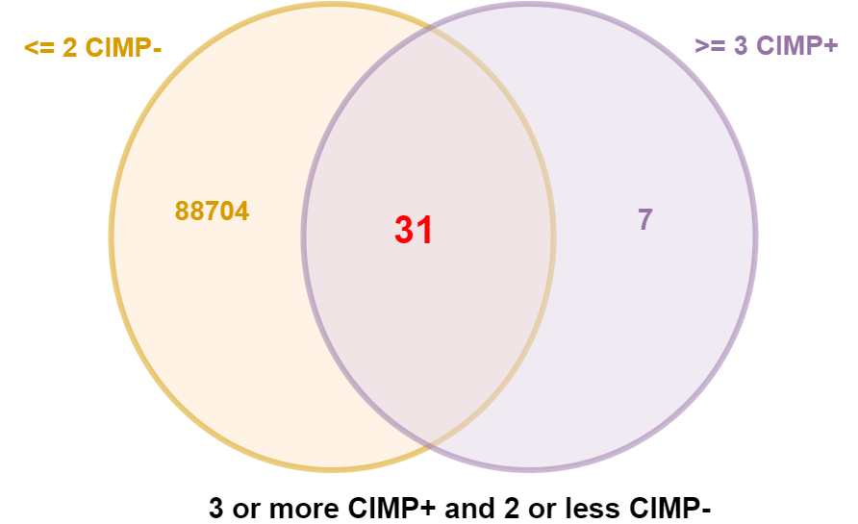
Overall Accuracy and Statistics
CIMP+ Samples Correctly Picked
Using all 31 features to classify
CIMP+ Samples NOT Picked
'TCGA-A6-2672',
'TCGA-A6-2676',
'TCGA-A6-3808',
'TCGA-AA-3516',
'TCGA-AA-3518',
'TCGA-AA-3525',
'TCGA-AA-3543',
'TCGA-AA-3554',
'TCGA-AA-3664',
'TCGA-AA-3672',
'TCGA-AA-3681',
'TCGA-AA-3684',
'TCGA-AA-3710',
'TCGA-AA-3715',
'TCGA-AA-3811',
'TCGA-AA-3821',
'TCGA-AA-3833',
'TCGA-AA-3845',
'TCGA-AA-3852',
'TCGA-AA-3864',
'TCGA-AA-3877',
'TCGA-AA-3947'
'TCGA-AA-3949',
'TCGA-AA-3966’,
'TCGA-AA-3977',
'TCGA-AA-A00A',
'TCGA-AA-A00D',
'TCGA-AA-A00E',
'TCGA-AA-A00J',
'TCGA-AA-A00N',
'TCGA-AA-A00R',
'TCGA-AA-A010',
'TCGA-AA-A01D',
'TCGA-AA-A01Q',
'TCGA-AG-3594',
'TCGA-AG-3881',
'TCGA-AG-3902',
'TCGA-AG-A002'
'TCGA-A6-2674',
'TCGA-A6-3807',
'TCGA-A6-3810',
'TCGA-AA-3514',
'TCGA-AA-3526',
'TCGA-AA-3532',
'TCGA-AA-3555',
'TCGA-AA-3556',
'TCGA-AA-3812',
'TCGA-AA-3814',
'TCGA-AA-3842',
'TCGA-AA-3860',
'TCGA-AA-3866',
'TCGA-AA-3870',
'TCGA-AA-3872',
'TCGA-AA-3930',
'TCGA-AA-3952',
'TCGA-AA-3994',
'TCGA-AA-A004',
'TCGA-AA-A01K',
'TCGA-AF-3400',
'TCGA-AG-3575',
False Positives: 9
False Negatives: 27
True Positives: 38
True Negatives: 150
Proportion of false positives: 0.04
Proportion of false negatives:0.12
Accuracy: 0.8392857142857143
Error rate: 0.16071428571428573
Sensitivity: 0.5846153846153846
Specificity: 0.9433962264150944
'TCGA-AG-3600',
'TCGA-AG-3609',
'TCGA-AG-3878',
'TCGA-AG-3883',
'TCGA-AG-3901'

Slide 13
Relaxing constraints (>= 3 CIMP+ and <= 3 CIMP-)

Slide 14
Relaxing constraints (>= 3 CIMP+ and <= 3 CIMP-)
Feature (32 total) | True Positive | False Positive | True Negative | False Negative | Accuracy | CIMP+ Coverage
SEC63_GRCh37_6:108214755-108214764_Frame_Shift_Del_DEL_TTTTTTTTTT_-_- | 10 | 1 | 158 | 55 | 0.75 | 15.38461538
MSH3_GRCh37_5:79970915-79970922_Frame_Shift_Del_DEL_AAAAAAAA_-_- | 10 | 1 | 158 | 55 | 0.75 | 15.38461538
BRAF_GRCh37_7:140453136-140453136_Missense_Mutation_SNP_A_T_T | 10 | 2 | 157 | 55 | 0.745536 | 15.38461538
AIM2_GRCh37_1:159032487-159032496_Frame_Shift_Del_DEL_TTTTTTTTTT_-_- | 9 | 1 | 158 | 56 | 0.745536 | 13.84615385
GRB14_GRCh37_2:165365288-165365296_In_Frame_Del_DEL_TTTTTTTTT_-_- | 8 | 0 | 159 | 57 | 0.745536 | 12.30769231
BRAF_GRCh37_7:140453136-140453136_Missense_Mutation_SNP_A_A_T | 7 | 1 | 158 | 58 | 0.736607 | 10.76923077
PRDM2_GRCh37_1:14108749-14108757_In_Frame_Del_DEL_AAAAAAAAA_-_- | 6 | 0 | 159 | 59 | 0.736607 | 9.230769231
CASP5_GRCh37_11:104878041-104878050_Frame_Shift_Del_DEL_TTTTTTTTTT_-_- | 6 | 1 | 158 | 59 | 0.732143 | 9.230769231
TCF7L2_GRCh37_10:114925317-114925325_In_Frame_Del_DEL_AAAAAAAAA_-_- | 6 | 2 | 157 | 59 | 0.727679 | 9.230769231
MBD4_GRCh37_3:129155548-129155557_Frame_Shift_Del_DEL_TTTTTTTTTT_-_- | 5 | 3 | 156 | 60 | 0.71875 | 7.692307692
RAD50_GRCh37_5:131931452-131931460_In_Frame_Del_DEL_AAAAAAAAA_-_- | 5 | 2 | 157 | 60 | 0.723214 | 7.692307692
ATR_GRCh37_3:142274740-142274749_Frame_Shift_Del_DEL_TTTTTTTTTT_-_- | 5 | 0 | 159 | 60 | 0.732143 | 7.692307692
HMMR_GRCh37_5:162917426-162917434_In_Frame_Del_DEL_AAAAAAAAA_-_- | 4 | 2 | 157 | 61 | 0.71875 | 6.153846154
PIK3CA_GRCh37_3:178952085-178952085_Missense_Mutation_SNP_A_G_G | 4 | 1 | 158 | 61 | 0.723214 | 6.153846154
MSH6_GRCh37_2:48030640-48030647_Frame_Shift_Del_DEL_CCCCCCCC_-_- | 3 | 0 | 159 | 62 | 0.723214 | 4.615384615
WISP3_GRCh37_6:112389434-112389442_In_Frame_Del_DEL_AAAAAAAAA_-_- | 3 | 1 | 158 | 62 | 0.71875 | 4.615384615
ICA1_GRCh37_7:8198251-8198251_Frame_Shift_Del_DEL_T_-_- | 3 | 0 | 159 | 62 | 0.723214 | 4.615384615
FBXW7_GRCh37_4:153249384-153249384_Missense_Mutation_SNP_C_T_T | 3 | 2 | 157 | 62 | 0.714286 | 4.615384615
SAT1_GRCh37_X:23802147-23802147_Intron_DEL_A_-_- | 3 | 0 | 159 | 62 | 0.723214 | 4.615384615
CTNND2_GRCh37_5:11117571-11117571_Silent_SNP_G_A_A | 3 | 0 | 159 | 62 | 0.723214 | 4.615384615
TP53_GRCh37_17:7577120-7577120_Missense_Mutation_SNP_C_T_T | 3 | 0 | 159 | 62 | 0.723214 | 4.615384615
MYO3A_GRCh37_10:26446395-26446395_Nonsense_Mutation_SNP_C_T_T | 3 | 0 | 159 | 62 | 0.723214 | 4.615384615
PTEN_GRCh37_10:89692905-89692905_Missense_Mutation_SNP_G_A_A | 3 | 0 | 159 | 62 | 0.723214 | 4.615384615
ZNF491_GRCh37_19:11917796-11917796_Missense_Mutation_SNP_G_A_A | 3 | 0 | 159 | 62 | 0.723214 | 4.615384615
EMR3_GRCh37_19:14772866-14772866_Silent_SNP_G_A_A | 3 | 1 | 158 | 62 | 0.71875 | 4.615384615
KIF14_GRCh37_1:200573037-200573037_Missense_Mutation_SNP_C_T_T | 3 | 0 | 159 | 62 | 0.723214 | 4.615384615
SGSM1_GRCh37_22:25315953-25315953_Missense_Mutation_SNP_C_A_A | 3 | 0 | 159 | 62 | 0.723214 | 4.615384615
USP34_GRCh37_2:61546367-61546367_Nonsense_Mutation_SNP_G_A_A | 3 | 0 | 159 | 62 | 0.723214 | 4.615384615
LPHN3_GRCh37_4:62910205-62910205_Missense_Mutation_SNP_G_A_A | 3 | 0 | 159 | 62 | 0.723214 | 4.615384615
CDYL_GRCh37_6:4943786-4943786_Silent_SNP_C_T_T | 3 | 0 | 159 | 62 | 0.723214 | 4.615384615
KIF20B_GRCh37_10:91497569-91497569_Missense_Mutation_SNP_G_A_A | 3 | 0 | 159 | 62 | 0.723214 | 4.615384615
KIF18A_GRCh37_11:28119446-28119446_Missense_Mutation_SNP_G_A_A | 3 | 0 | 159 | 62 | 0.723214 | 4.615384615

Slide 15
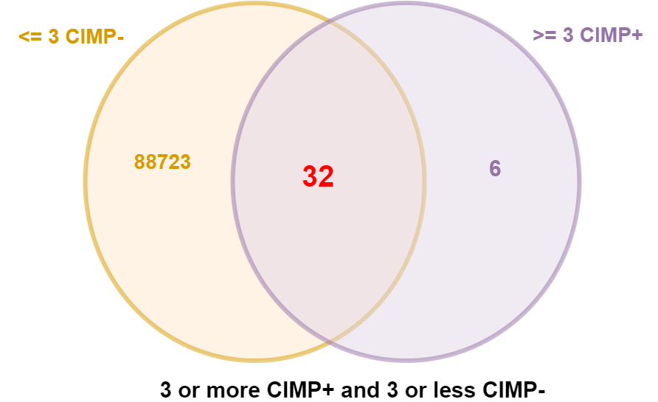
Overall Accuracy and Statistics
CIMP+ Samples Correctly Picked
Using all 32 features to classify
CIMP+ Samples NOT Picked
'TCGA-A6-2672',
'TCGA-A6-2676',
'TCGA-A6-3808',
'TCGA-AA-3516',
'TCGA-AA-3518',
'TCGA-AA-3525',
'TCGA-AA-3543',
'TCGA-AA-3554',
'TCGA-AA-3664',
'TCGA-AA-3672',
'TCGA-AA-3681',
'TCGA-AA-3684',
'TCGA-AA-3710',
'TCGA-AA-3715',
'TCGA-AA-3811',
'TCGA-AA-3821',
'TCGA-AA-3833',
'TCGA-AA-3845',
'TCGA-AA-3852',
'TCGA-AA-3864',
'TCGA-AA-3877',
'TCGA-AA-3947',
'TCGA-AA-3949',
'TCGA-AA-3966',
'TCGA-AA-3977',
'TCGA-AA-A00A',
'TCGA-AA-A00D',
'TCGA-AA-A00E',
'TCGA-AA-A00J',
'TCGA-AA-A00N',
'TCGA-AA-A00R',
'TCGA-AA-A010',
'TCGA-AA-A01D',
'TCGA-AA-A01Q',
'TCGA-AG-3575',
'TCGA-AG-3594',
'TCGA-AG-3881',
'TCGA-AG-3902',
'TCGA-AG-A002'
'TCGA-A6-2674',
'TCGA-A6-3807',
'TCGA-A6-3810',
'TCGA-AA-3514',
'TCGA-AA-3526',
'TCGA-AA-3532',
'TCGA-AA-3555',
'TCGA-AA-3556',
'TCGA-AA-3812',
'TCGA-AA-3814',
'TCGA-AA-3842',
'TCGA-AA-3860',
'TCGA-AA-3866',
'TCGA-AA-3870',
'TCGA-AA-3872',
'TCGA-AA-3930',
'TCGA-AA-3952',
'TCGA-AA-3994',
'TCGA-AA-A004',
'TCGA-AA-A01K',
'TCGA-AF-3400',
'TCGA-AG-3600',
False Positives: 9
False Negatives: 26
True Positives: 39
True Negatives: 150
Proportion of false positives: 0.04
Proportion of false negatives:0.11555555555555555
Accuracy: 0.84375
Error rate: 0.15625
Sensitivity: 0.6
Specificity: 0.9433962264150944
'TCGA-AG-3609',
'TCGA-AG-3878',
'TCGA-AG-3883',
'TCGA-AG-3901'

Slide 16
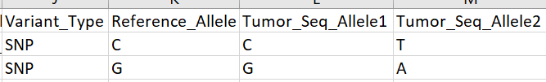
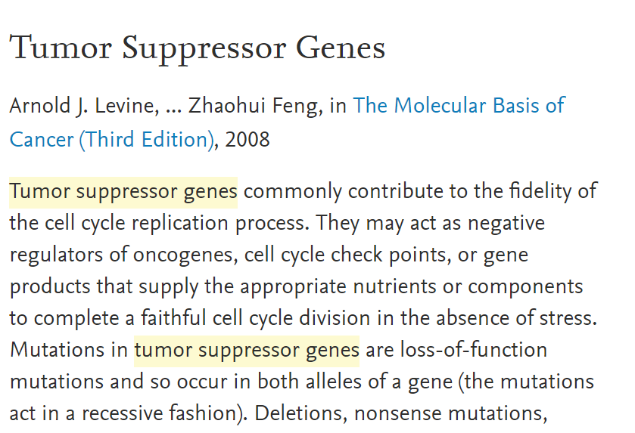
Can some features be combined?
Some features are in the same place in the genome, but have different Tumor_Seq_Alleles.
Examples:
When this occurs it seems to follow the same pattern. One of the features has an allele that conserves the reference allele, and one of the features has two mutated alleles.
SLC6A13_GRCh37_12:335654-335654_Missense_Mutation_SNP_T_T_C
SLC6A13_GRCh37_12:335654-335654_Missense_Mutation_SNP_T_C_C
RXFP2_GRCh37_13:32351551-32351551_Missense_Mutation_SNP_G_G_A
RXFP2_GRCh37_13:32351551-32351551_Missense_Mutation_SNP_G_A_A
SLITRK1_GRCh37_13:84454465-84454465_Missense_Mutation_SNP_G_G_A
SLITRK1_GRCh37_13:84454465-84454465_Missense_Mutation_SNP_G_A_A
SLITRK5_GRCh37_13:88327927-88327927_Missense_Mutation_SNP_G_G_A
SLITRK5_GRCh37_13:88327927-88327927_Missense_Mutation_SNP_G_A_A
How we interpret this may vary from gene to gene. In Tumor suppressor genes, the alleles act in “recessive fashion” according to Arnold J. Levine, ... Zhaohui Feng, in The Molecular Basis of Cancer (Third Edition), 2008
In other genes, however, it may not make a difference. There may be no real distinction between “GA” and “AA”, for example, if the mutation “A” is dominant to begin with.

