Slide 1
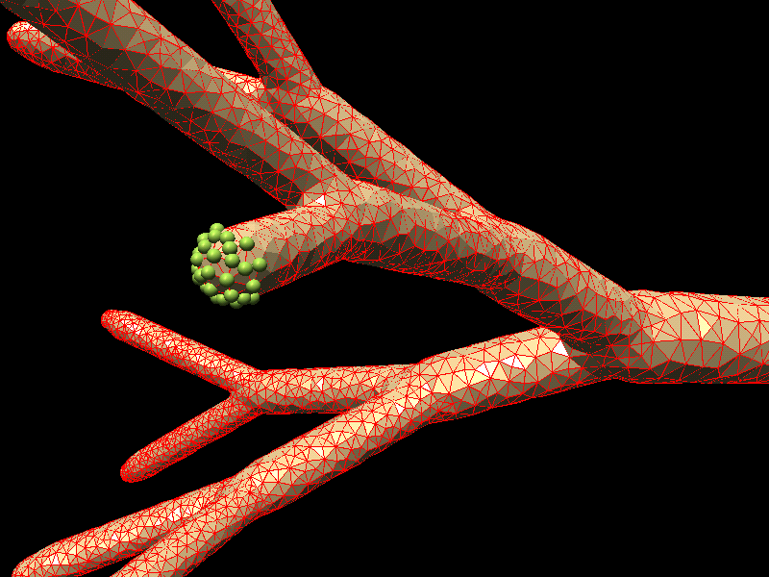

Data Structures for Efficient and Integrated Simulation of Multi-Physics Processes in Complex Geometries
A.Smirnov
MulPhys LLC
github/mulphys
www.mulphys.com

Slide 2
Generalized Elements
Element: geometrical/physical primitive
Type:
Physical component
Dimension:
0: Node, 1: Edge, 2: Face, 3: Cell,
4: Hyper-cell (space-time element)
Rank:
3: Triangle, 4: Quad, ... N: Polygon
4: Tetrahedron, ... N: Polyhedron
Order:
Discretization, interpolation (FEM)
Connections:
Neighbors, parents, children,
super/sub-elements, boundaries
mulphys.com

Slide 3
Models
Model is defined by the types of elements and
the law of Interaction between the elements.
Continuum problems
Class
CFD: FD, CV, FEM
Elasticity, Heat transfer: FEM
Radiation: FD, FEM, BEM
Discrete problems
Plugin
Lagrangian Particle Dynamics
Particle-in-Cell Methods
Monte-Carlo
Grid generator is just another model !
mulphys.com

Slide 4
Domains
Collection of elements of the same model
Changes in shape and topology are given by the user or determined by the law of motion
Moving boundaries and domains
By model: solution to PDE
By scenario: prescribed motion
Changing geometry
By model: solution to system dynamics
By user: mesh generation
Mesh adaption to the solution is part of the solution!
mulphys.com

Slide 5
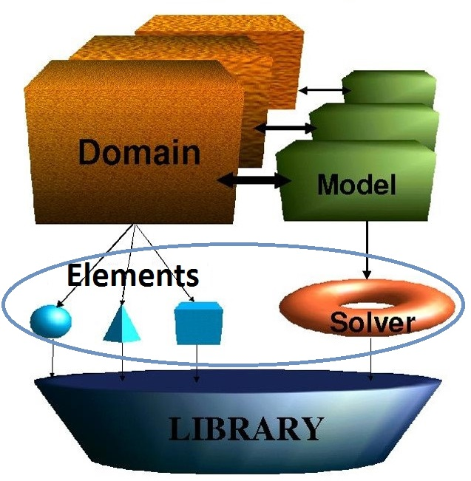
Single Physics Paradigm
Element
Good for tightly coupled physics
Container for variables
Solver
Implements physics for a set of elements
Domain
Model instance +
Collection of elements
Model
Applies solvers to a domain
mulphys.com

Slide 6
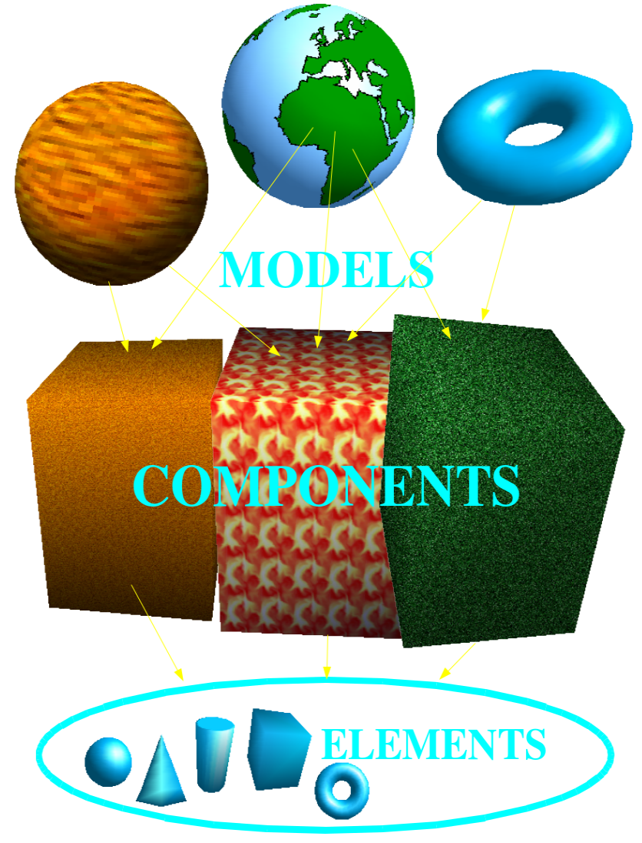
Multi-Physics Paradigm
Many models for one domain
Good when a domain can have multiple loosely coupled physics with different time-scales
Multi-physics domain is a physical component
Many models for
one domain
One domain for
each element
Many elements for
one domain
mulphys.com

Slide 7
Execution Sequence
Model-by-model
Loosely coupled physics within the same domain
Different time scales between physics
Flow + acoustics, plasma, radiation …
Domain-by-domain
Loosely coupled domains
Different time-scales between domains
Sharp interfaces
Fluid – solid interactions, conjugate heat transfer, fuel cells …
mulphys.com

Slide 8
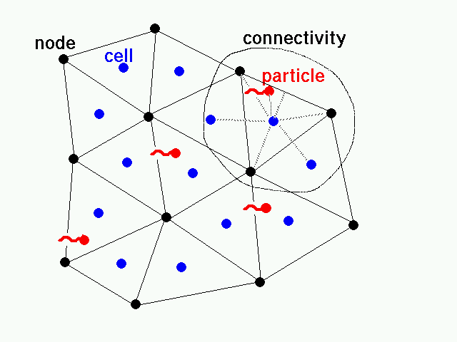
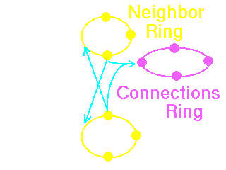
Continuum & Discrete
All elements are connected in dynamic
loops (rings):
mulphys.com

Slide 9
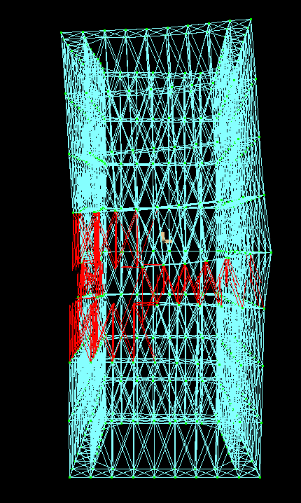
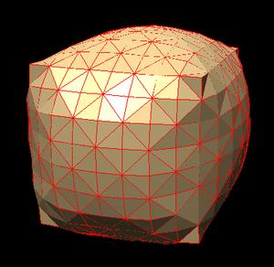
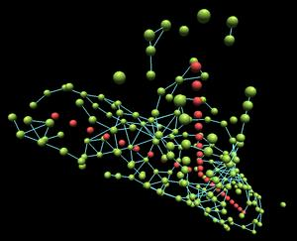
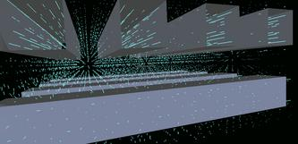
Applications
Structures
Elastic shells
Continuum and discrete systems are handled in the same manner.
Plugged-in models can describe a wide range of multi-scale phenomena.
Nano Systems
Porous media
mulphys.com

Slide 10
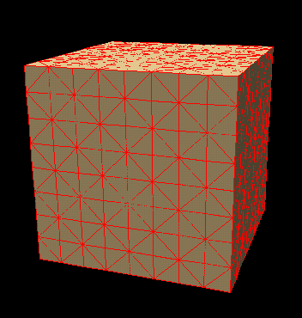
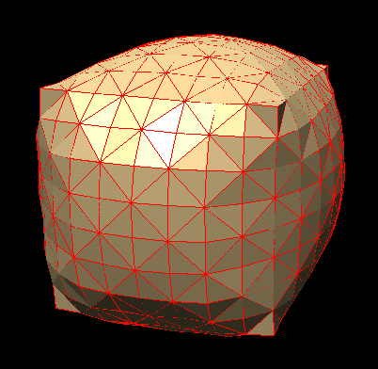
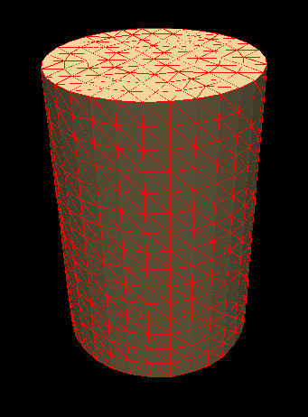
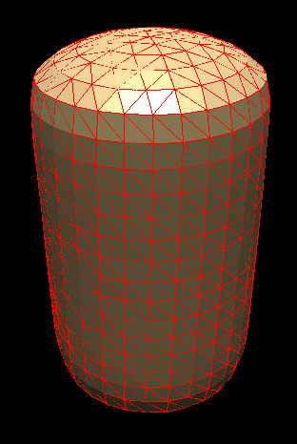
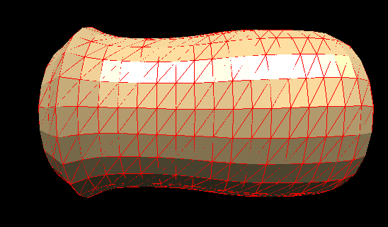
Fluid-Boundary Interactions
Static and dynamic interactions of fluid with flexible boundaries (compressible / incompressible).
mulphys.com

Slide 11
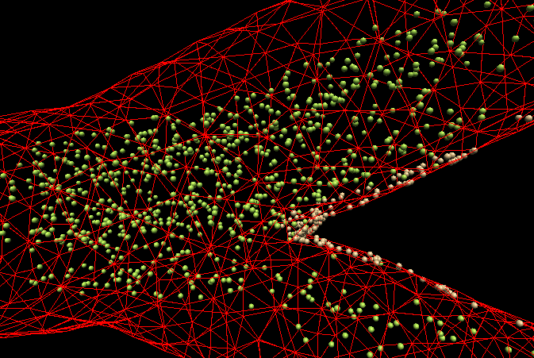
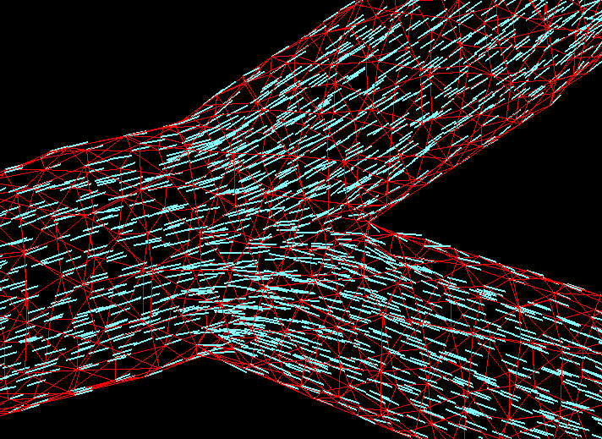
Biomedical
Flows
Particle deposition
Flow in bifurcating
ducts
mulphys.com

Slide 12
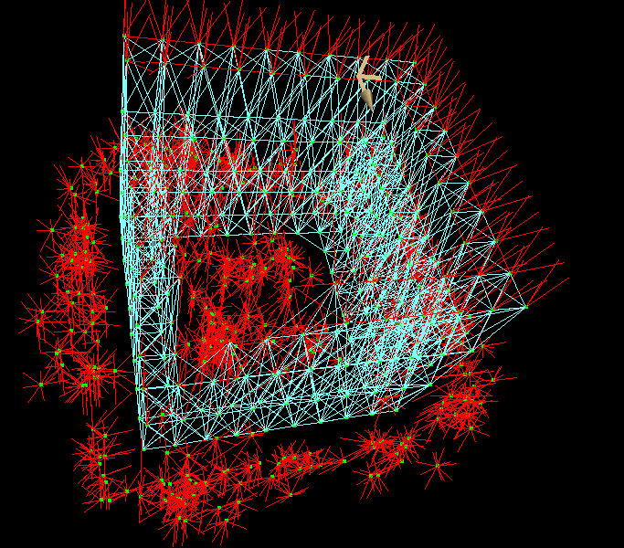
Macro-Structure dynamics
Collapse of a damaged structure
mulphys.com

Slide 13
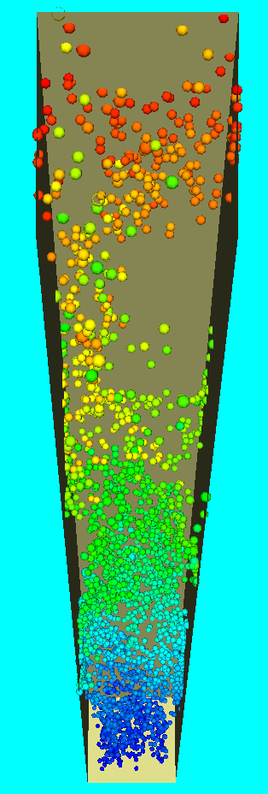
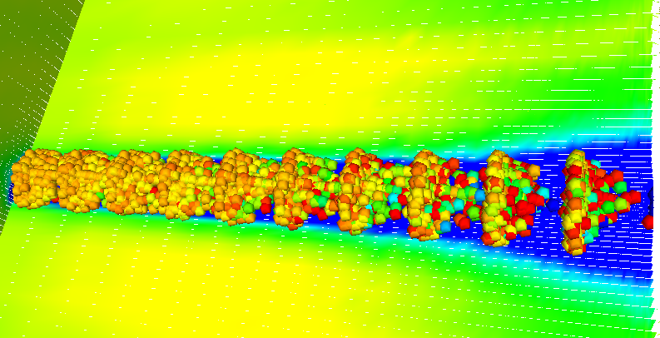
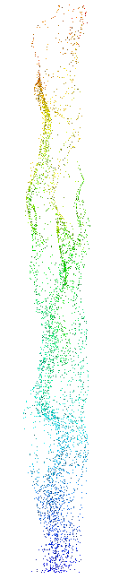

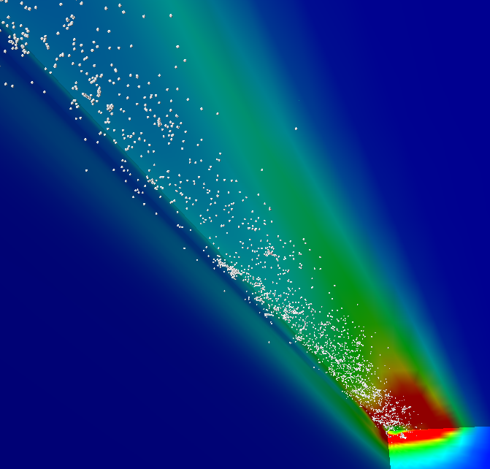
Particles & Jets:
PII Scheme
Sprays
Bubbles
Turbulent wakes
mulphys.com

Slide 14
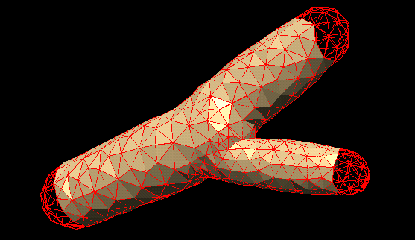
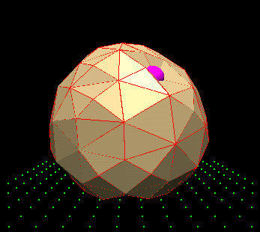
Micro-Fluidics
Blood vessels
Cell deformations
mulphys.com

Slide 15
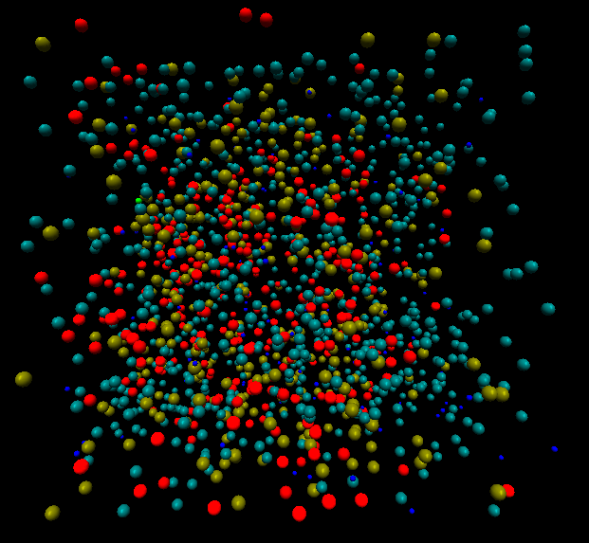
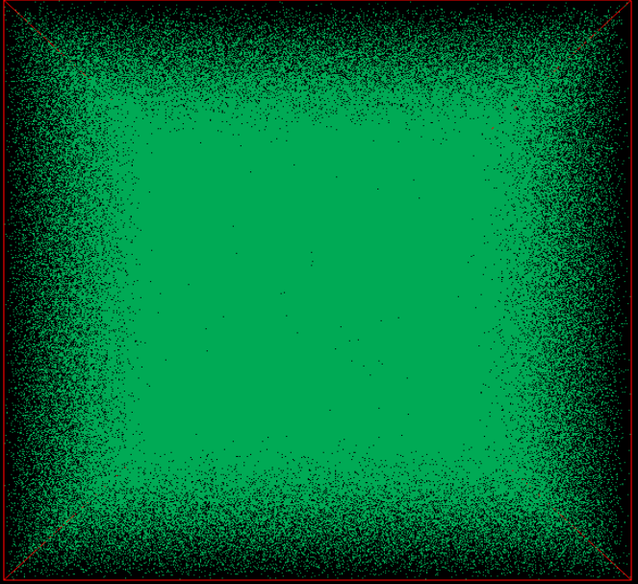
Reactive Molecular Dynamics
Over 10 mil molecules on a single processor with 100 milsec per iteration
Binary kinetic reactions.
Ten million molecules.
mulphys.com

Slide 16
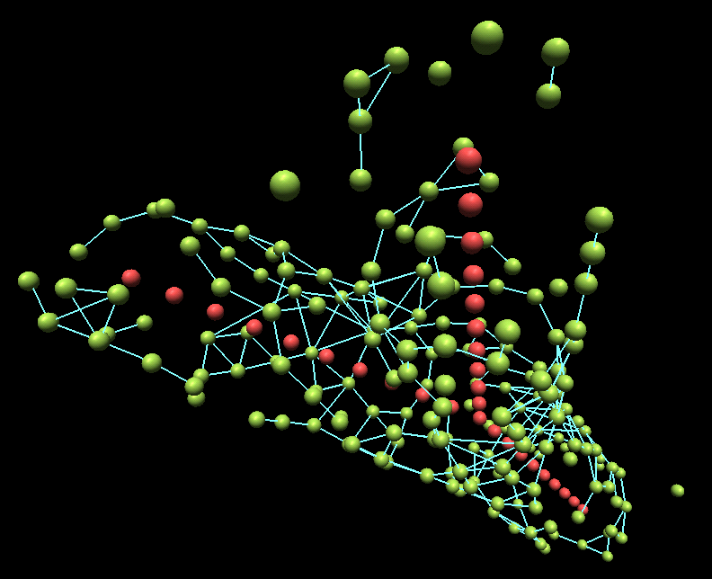
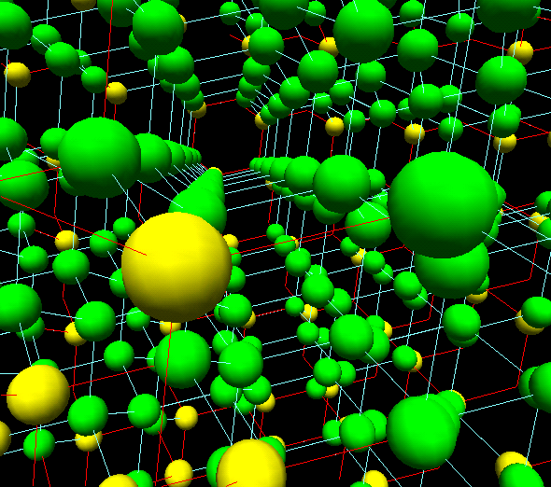
Nano-Scale Atomistic Modeling
Crystal structures
Molecular self-assembly
mulphys.com

Slide 17
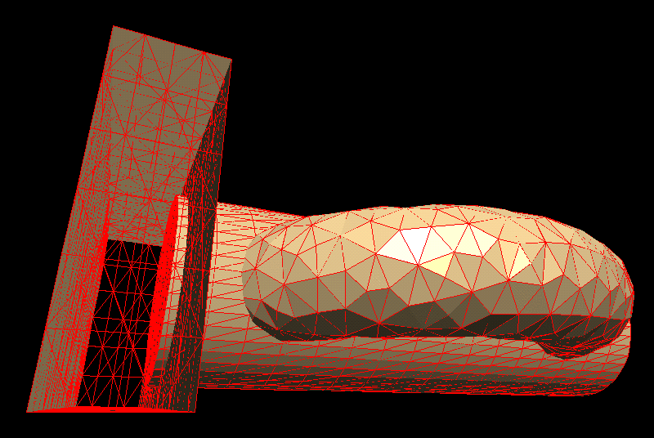
Parallel Implementation
Domain Coupling Scheme
Single processor: multi-block
Multi-processor: message passing
MulPhys.com

Slide 18
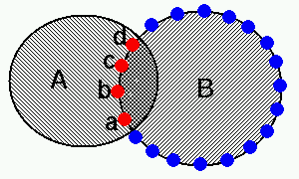
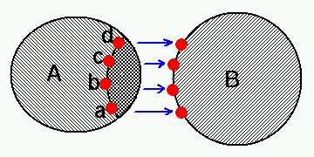
DOVE Scheme: Domain Overlap Identification
Automatic detection and setting-up of domain overlaps:
Communicating variables across the overlaps by preserving the accuracy of the discretization:

Slide 19
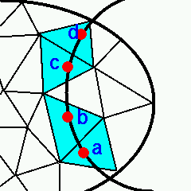
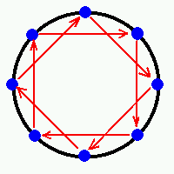
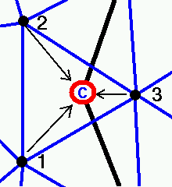
Setting up Overlaps
Boundary cell detection
and coupling
Deferred boundary exchange
Interpolation

Slide 20
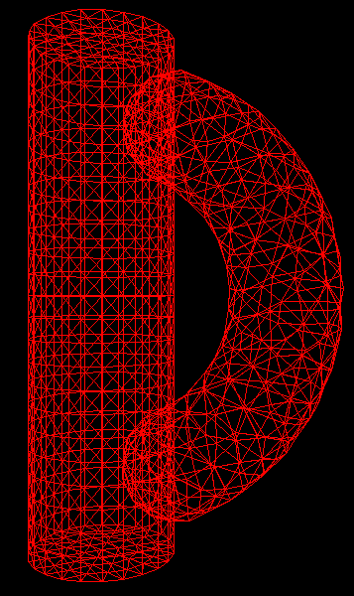
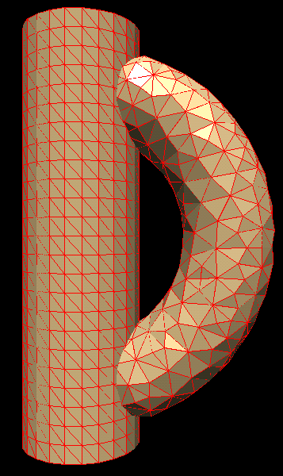
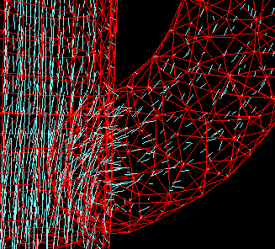
Automatic coupling
Flow in a bypass duct
mulphys.com

Slide 21
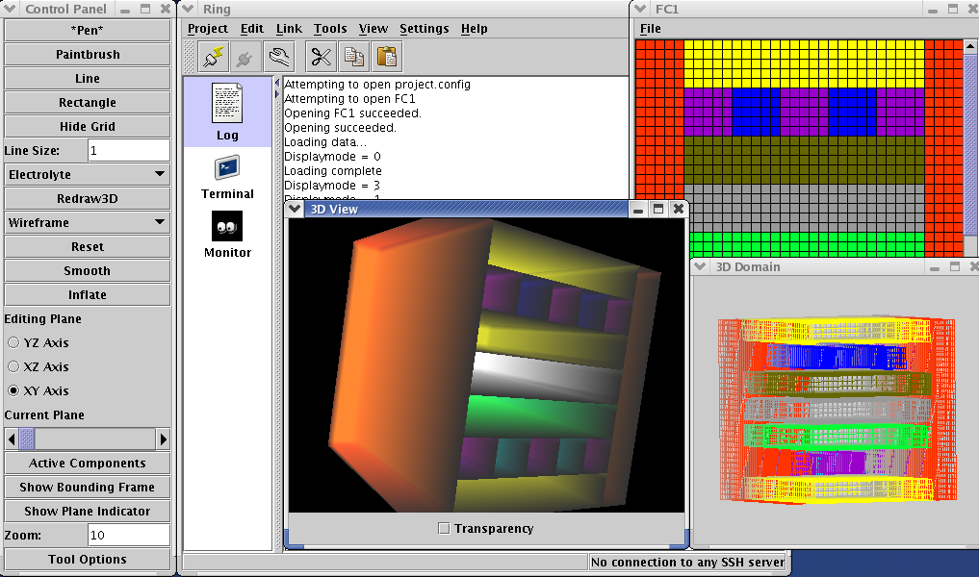
Remote simulation control GUI
Java Swing Client + ssh server
mulphys.com

