Slide 1
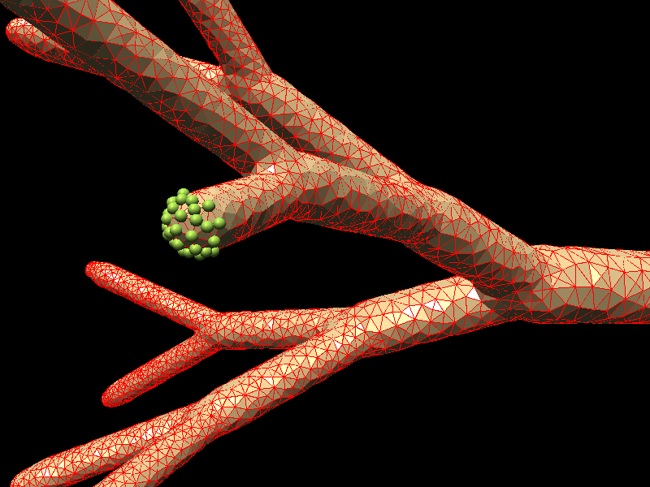

Data Structures for Efficient and Integrated Simulation of Multi-Physics Processes in Complex Geometries
A.Smirnov
MulPhys
smirnov.mae.wvu.edu
www.mulphys.com

Slide 2
Multi-Physics PDE Solvers
Physics types / Equation classes:
Hyperbolic, Parabolic, Elliptic
Continuum problems
CFD: FD, CV, FEM
Elasticity, Heat transfer: FEM
Radiation: FD, FEM, BEM
Discrete problems
Lagrangian Particle Dynamics
Particle-in-Cell Methods
Monte-Carlo
mulphys.com

Slide 3
Multi-Physics PDE Solvers
Geometry
Structured, Unstructured
Static: fixed shape and topology
Dynamic: changing shape and topology
Moving boundaries and domains
By model: solution to PDE
By scenario: prescribed motion
Changing geometry
By model: solution to system dynamics
By user: mesh generation
mulphys.com

Slide 4
Multi-Physics PDE Solvers
Variables
Placement:
Nodes, Edges, Faces, Cells
Access:
Local: element based
Global: domain based
Operations
(numerical
schemes):
Jacobi, Gauss-Seidel
Conjugate Gradient
Multigrid, AMG
High-order time stepping
Methods:
FD, CV, FEM
Models:
Poisson, Navier-Stokes, Maxwell, ...
mulphys.com

Slide 5
Generalized Elements
Element: geometrical primitive
Type:
Physical component
Dimension:
Node, Edge, Face, Cell,
Hyper-cell (space-time element)
Rank:
Triangle, Quad, ... Polygon
Tetrahedron, ... Polyhedron
Order:
Discretization, interpolation (FEM)
Connections:
Neighbors, parents, children,
super/sub-elements, boundaries
mulphys.com

Slide 6
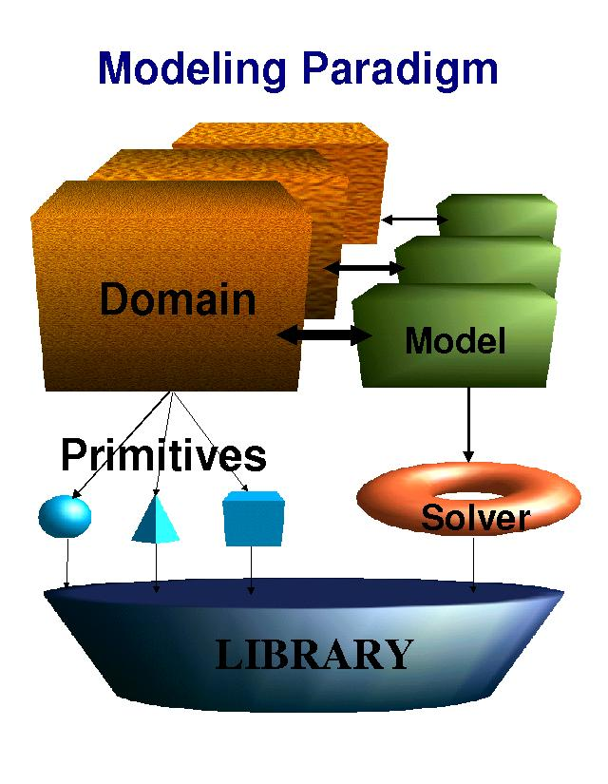
mulphys.com

Slide 7
Components
Many models for
one component
One component for
each element
Many elements for
one component
mulphys.com

Slide 8
Solvers
Model-by-model
Loosely coupled models:
different time scales
Component-by-component
Tightly coupled models
Loosely coupled components
Domain-by-domain
Tightly coupled models
Tightly coupled components
mulphys.com

Slide 9
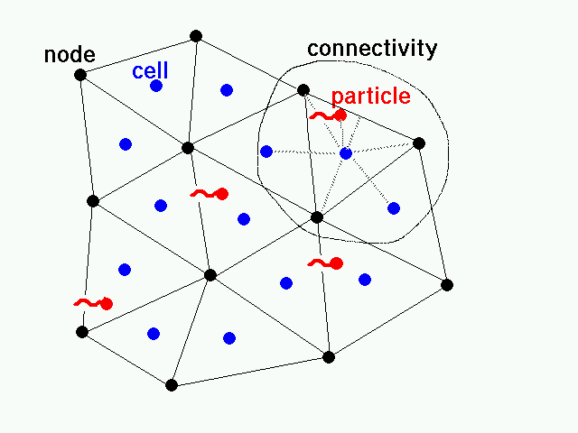
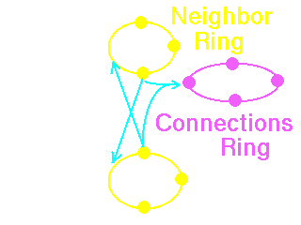
Continuum & Discrete
All elements are are connected as dynamic
ring lists:
mulphys.com

Slide 10
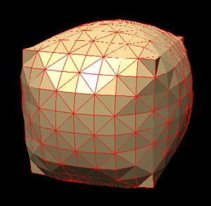
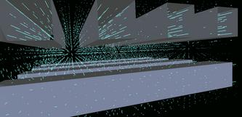
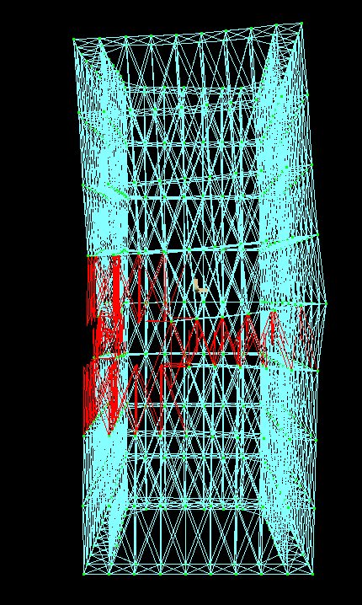
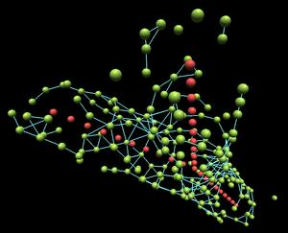
Porous media
Shells
Structures
Nano Systems
And more:
mulphys.com

Slide 11
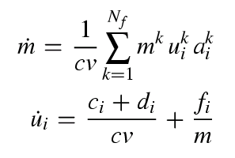
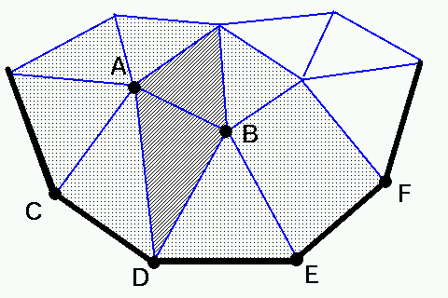
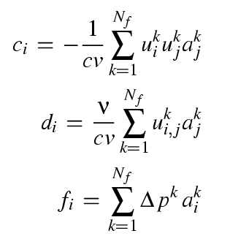
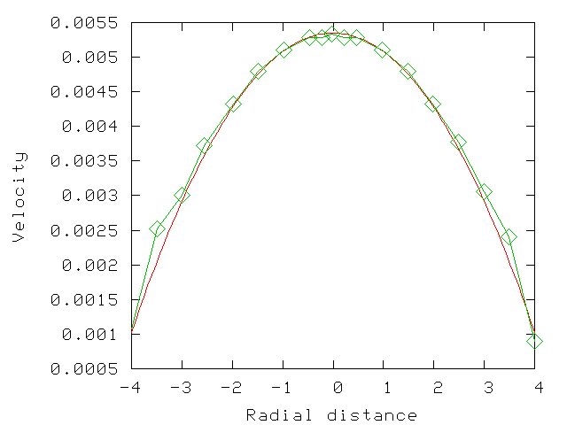
Discretized Equations
www.mulphys.com

Slide 12
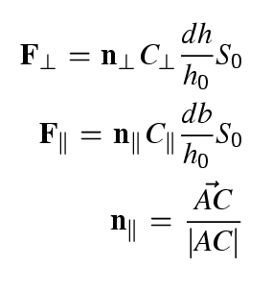
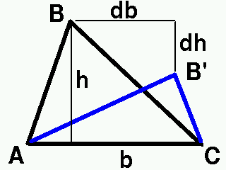
Elasticity Solver
mulphys.com

Slide 13
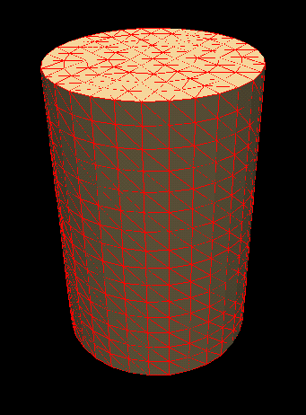
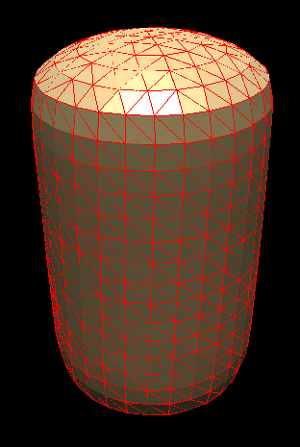
Fluid-Shell Interactions
Before
After
mulphys.com

Slide 14
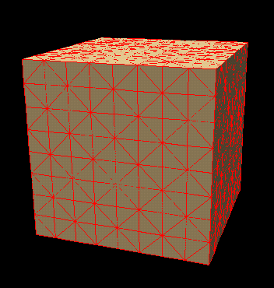
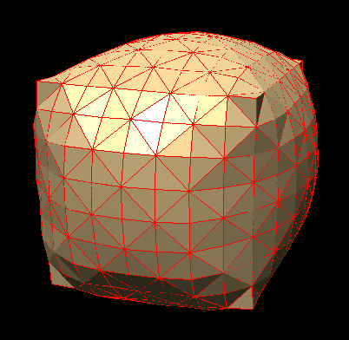
Static Fluid-Membrane Interactions
Before
After
mulphys.com

Slide 15
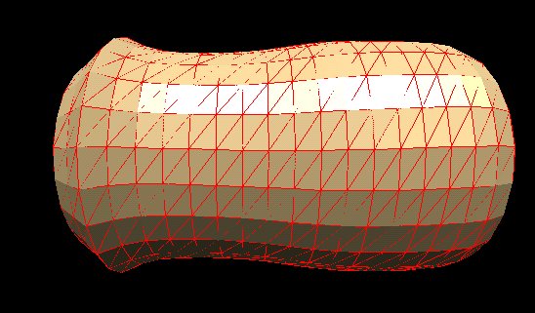
Compressible flow
Deformations of the pipe with a passage of compressed gas.
mulphys.com

Slide 16
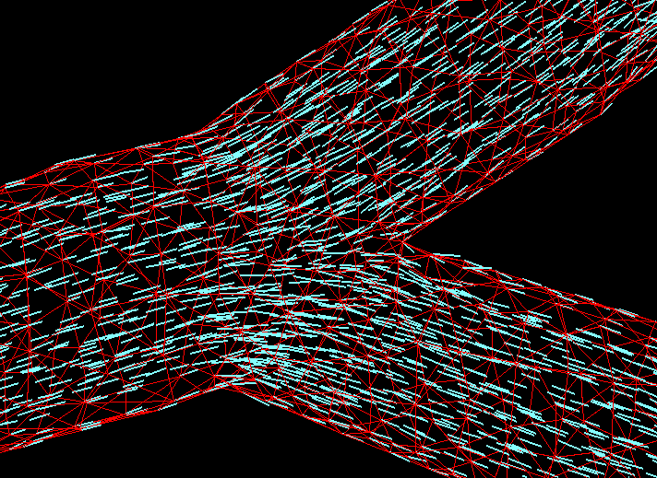
Biomedical Flows

Slide 17
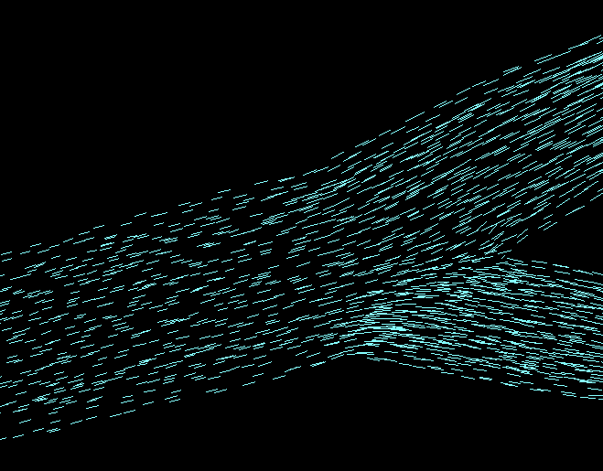
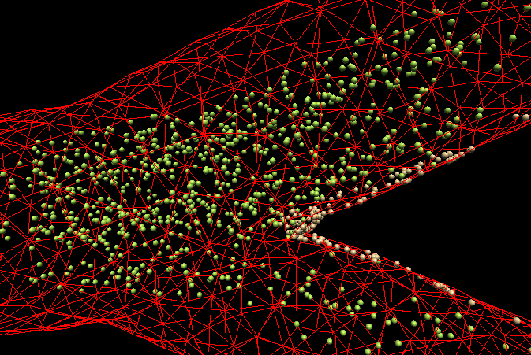
Flow in bifurcating
ducts:
Particle deposition:
MulPhys.com

Slide 18
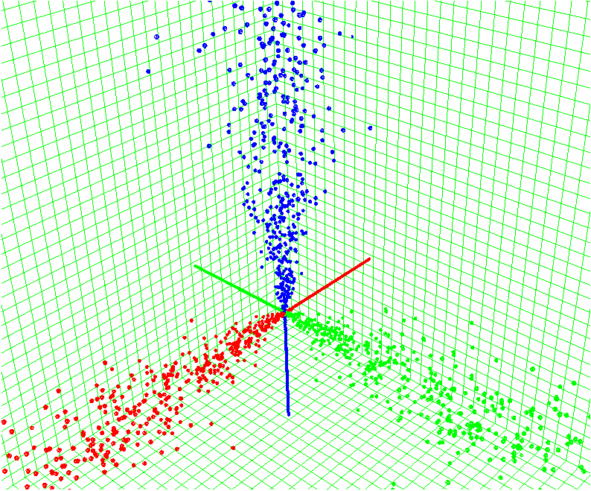
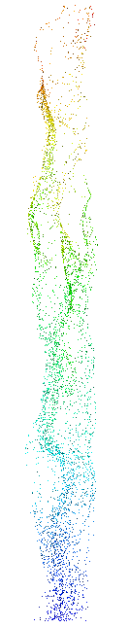

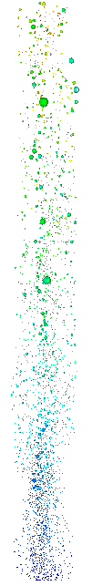

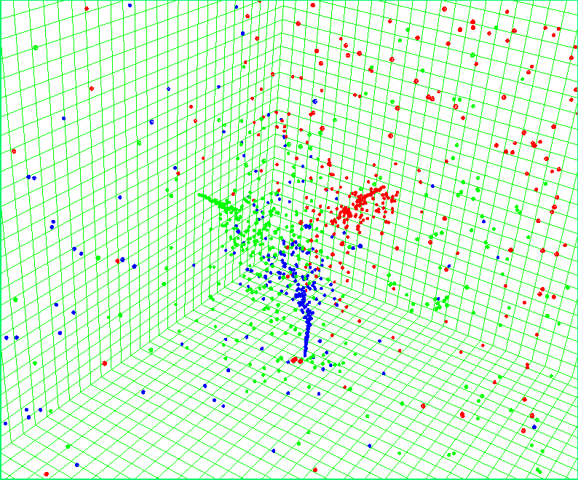
Particles & Jets:
PII Scheme
mulphys.com

Slide 19
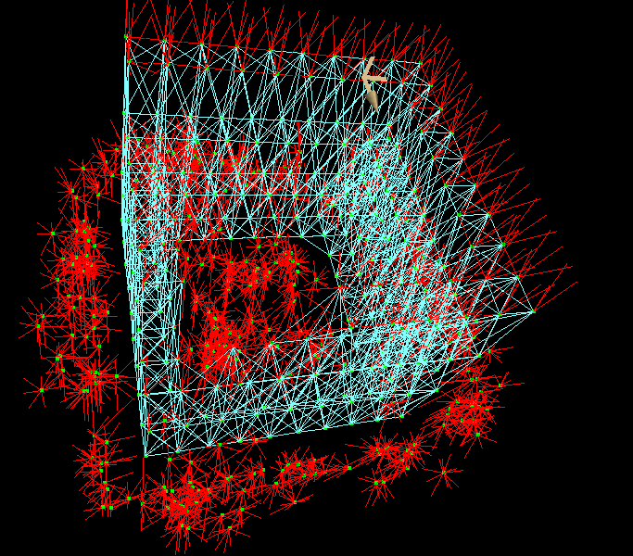
Macro-Structure dynamics
Collapse of a damaged structure
mulphys.com

Slide 20
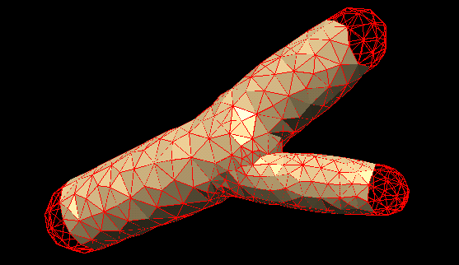
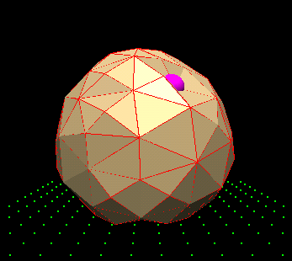
Micro-Fluidics
Bifurcating channels
Cell deformations

Slide 21
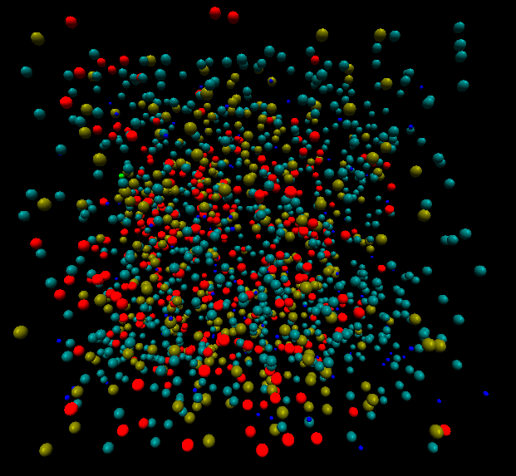
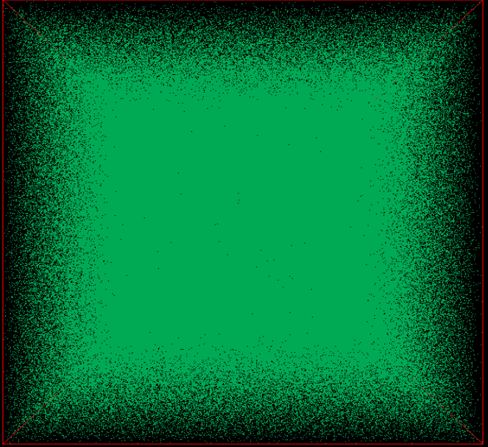
Reactive Molecular Dynamics
Over 10 mil molecules on a single processor with 100 milsec per iteration
1000 molecules: H2+O2 reaction.
One million molecules.
mulphys.com

Slide 22
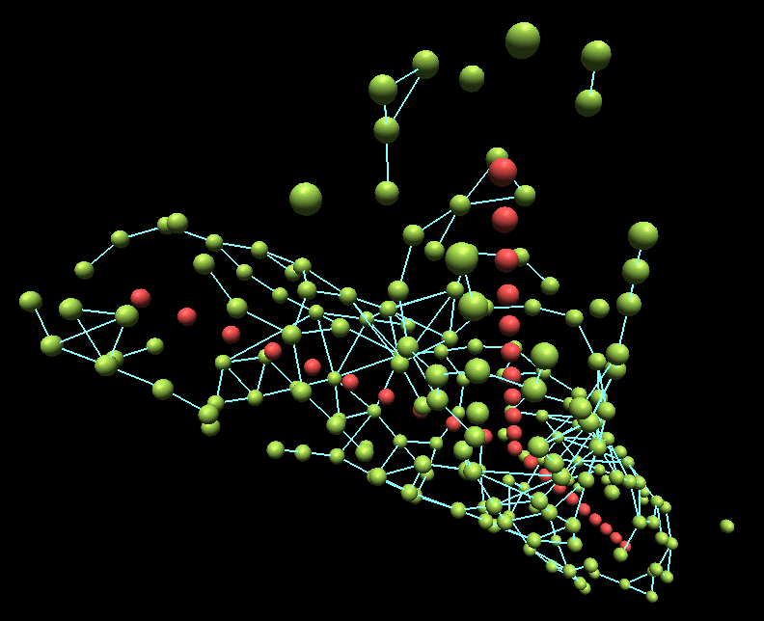
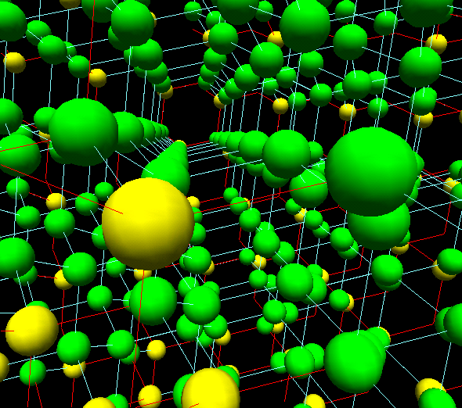
Nano-Scale Atomistic Modeling
Molecular self-assembly
Crystal structures
mulphys.com

Slide 23
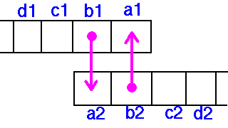
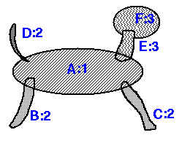
DOVE = Domain Overlap
Conformal mapping:
Non-conformal mapping:
Overlapping domains

Slide 24
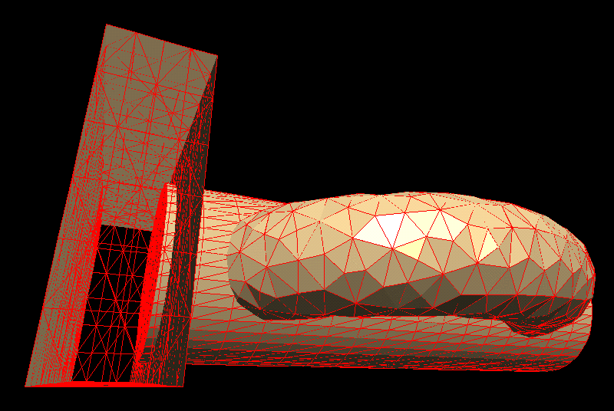
Domain Coupling Scheme for PDE Solvers
Single processor: multi-block
Multi-processor: message passing
MulPhys.com

Slide 25
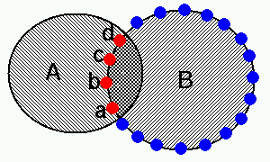
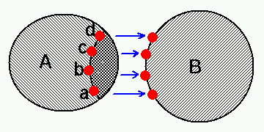
Overlap Identification & Passing
Setting-up overlaps:
Communicating overlaps:

Slide 26
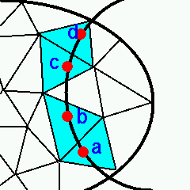
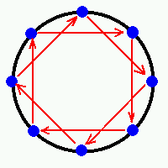
Setting up Overlaps
Boundary cell detection
and coupling
Deferred boundary exchange
Do jump=1:Np-1
Do ip=0:Np-1
next=(ip+jump)%Np
prev=(ip+Np-jump)%Np
Send (proc, next)
Receive (proc, prev)

Slide 27
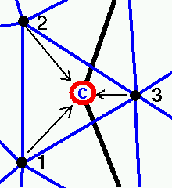
Communicating Overlap Variables
Interpolation
Message passing
MulPhys.com

Slide 28
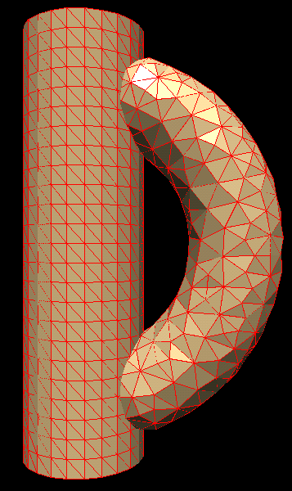
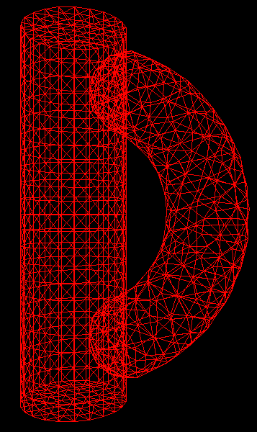
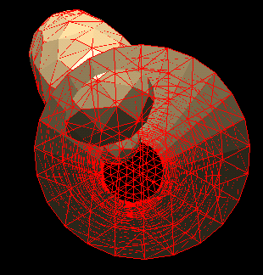
Test Cases
MulPhys.com

Slide 29
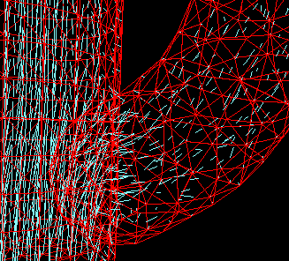
Continuous PDE solution:
Coupling to flow solvers
MulPhys.com

Slide 30
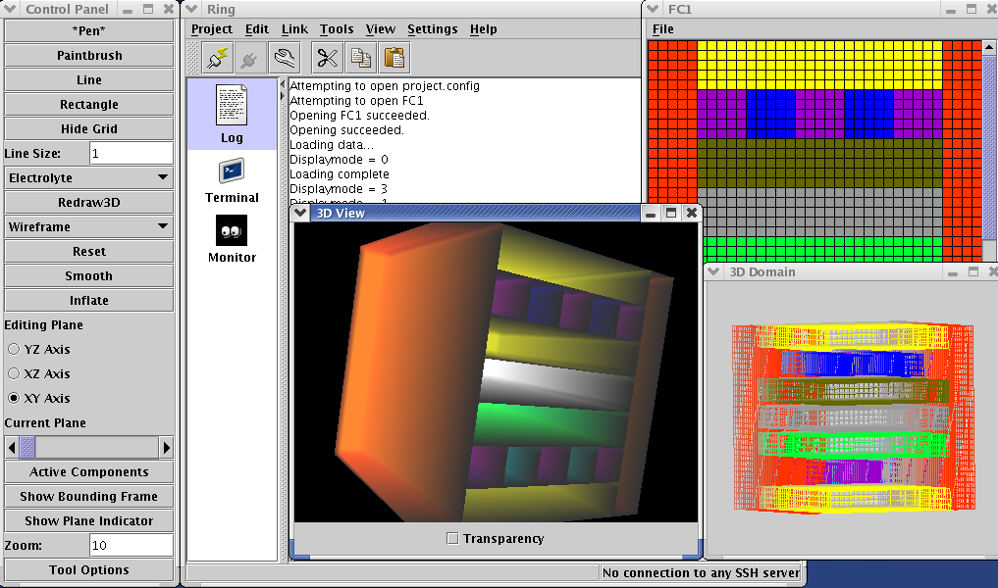
Remote simulation control GUI
mulphys.com/ring

