Slide 1
Reactive Molecular Dynamics
Andrei Smirnov
Rolando A. Carreno-Chavez
Jaggu Nanduri http://nift.wvu.edu/remody

Slide 2
Reactive Molecular Dynamics
Problem and objective, relation to the long term goal
Methodology
Problems, issues, and solutions
Accomplishments and results
Future work and direction

Slide 3
Problem and Objective
Bridging the Nano and Macro Scales:
Atomistic Modeling: <1nm – 1nm
Molecular Dynamics: 1nm – 1mc
Continuum Modeling: 1mc - 1cm
Reducing the number of empirical constants:
Predicting kinetic reaction rates
Porous medium diffusion constants
Capturing new effects:
In-pore kinetic reactions at microscale
Transient concentration polarization effects

Slide 4
Methodology
Kinetic/Collision Theory:
http://en.wikipedia.org/wiki/Collision_theory
Nwall = 0.25 v_{avg} N/V = 0.25*den/m*(8kT/pi*m)^(1/2)‏
Reactions in the bulk
Reactions on the surface
YSZ
Ni, O--

Slide 5
Input Parameters
Species:
Atomic mass
Size
Heat capacity: DOF
Reactions:
Activation energy
Enthalpy
Species and reactions data above can be specified both on the boundaries and in the bulk.

Slide 6
Problems and Solutions
Memory Efficient Implementation
Advanced data structures to accommodate
several million molecules on a single processor
vs. several hundred in QM calculations.
Time-efficient Execution Algorithm
Space segmentation algorithm to exploit the local
nature of the interaction potential.
Adaptive time-stepping.

Slide 7
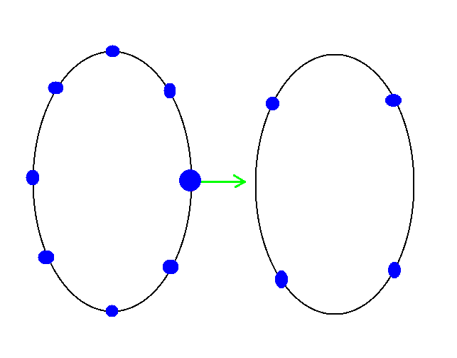
Looped Lined Lists
Enable to avoid memory allocations and deallocations.
Instead.

Slide 8
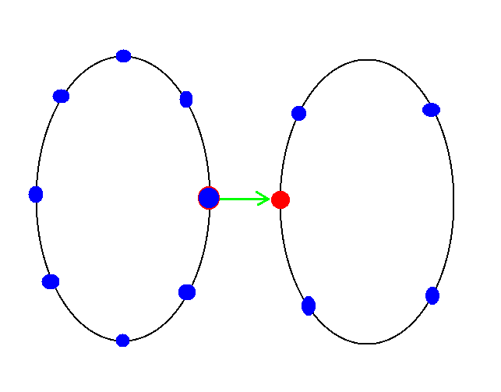
Looped Lined Lists
Enable to avoid memory allocations and deallocations.
Instead.

Slide 9
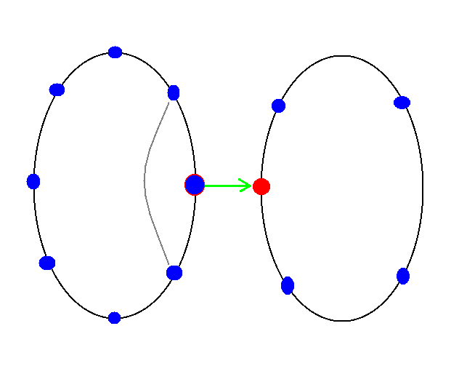
Looped Lined Lists
Enable to avoid memory allocations and deallocations.
Instead new links are created.

Slide 10
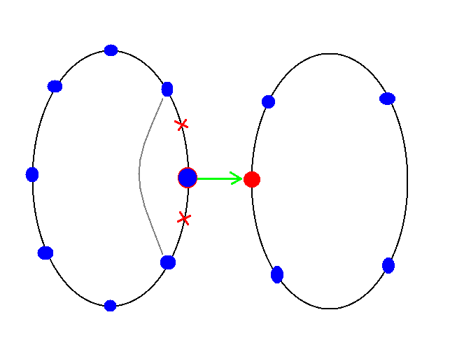
Looped Lined Lists
Enable to avoid memory allocations and deallocations.
Instead new links are created and old links are reassigned.

Slide 11
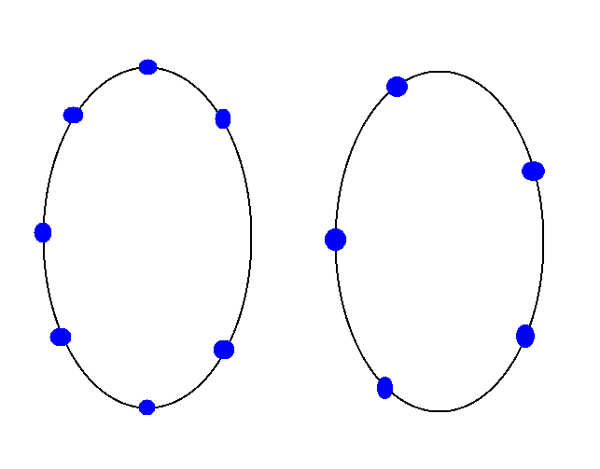
Looped Lined Lists
Enable to avoid memory allocations and deallocations.
Instead new links are created and old links are reassigned.

Slide 12
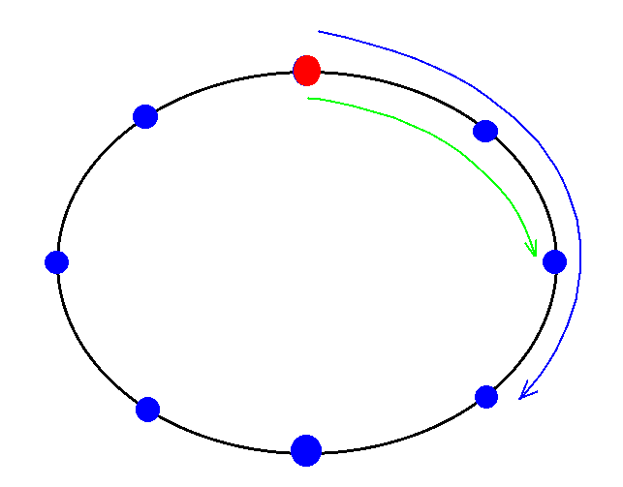
Looped Lined Lists
Enables more efficient nested looping over neighboring particles.

Slide 13
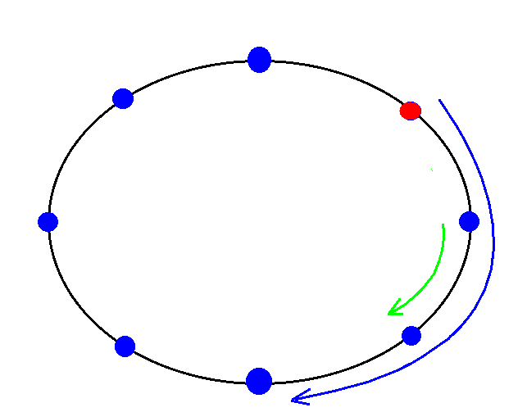
Looped Lined Lists
Enables more efficient nested looping over neighboring particles.

Slide 14
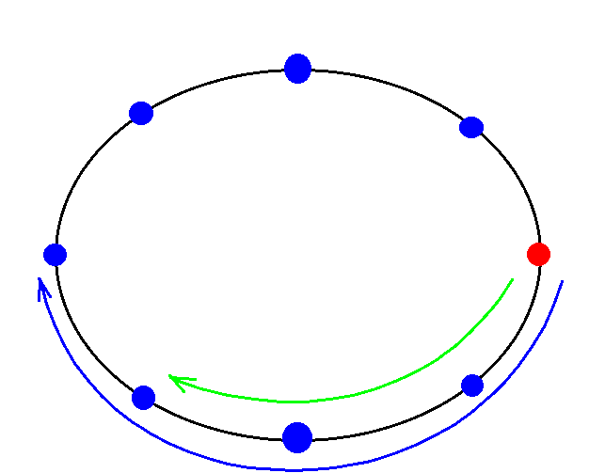
Looped Lined Lists
Enables more efficient nested looping over neighboring particles.

Slide 15
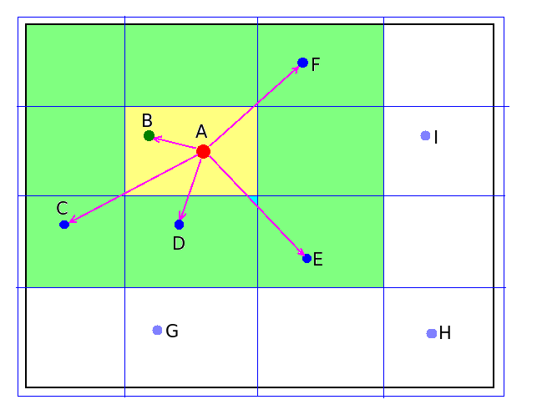
Interaction Acceleration
Space segmentation
scheme
Enables to achieve near linear dependence of execution time on the number of molecules.

Slide 16
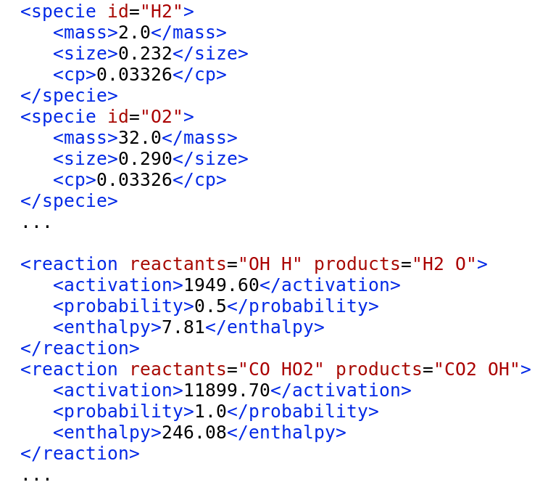
Species/Reactions
OOP Approach
Implementing classes of Atoms, Molecules, Species, and Reactions in a object-oriented framework enabled flexible data input and problem setup for hundreds of species and reactions.

Slide 17
Syngas Gas Phase Reactions
OH+OH=H2O+O
OH+OH=HO2+H
OH+O2=HO2+O
OH+O=O2+H
OH+H2=H2O+H
OH+H=H2+O
OH+H=H2O
OH+HO2=H2O+O2
O2+H2O=OH+HO2
O2+H2=OH+OH
O2+H2=HO2+H
O2+H=OH+O
O2+H=HO2
H2+CH3=CH4+H
CH4+O=OH+CH3
OH+CH3=CH4+O
CH4+O2=HO2+CH3
HO2+CH3=CH4+O2
CH4+OH=H2O+CH3
H2O+CH3=CH4+OH
CO2+H=OH+CO
OH+CO=CO2+H
CO2+O=O2+CO
CO+O=CO2
CO+O2=CO2+O
CO+HO2=CO2+OH
O+H2=OH+H
O+H=OH
O+HO2=OH+O2
O+O=O2
H+H=H2
H2O+H=H2+OH
H2O+O=HO2+H
H2O+O=OH+OH
HO2+H=H2+O2
HO2+H=H2O+O
HO2+H=OH+OH
CH4+H=H2+CH3

Slide 18
Syngas Surface Reactions
OH->H2O+O
OH->HO2+H
O2->HO2+O
OH->O2+H
H2->H2O+H
OH->H2+O
OH->H2O
OH->H2O+O2
O2->OH+HO2
O2->OH+OH
O2->HO2+H
O2->OH+O
O2->HO2
H2->OH+H
H2O->OH+CH
O->O2
H->H2
H2O->H2+OH
H2O->HO2+H
H2O->OH+OH
HO2->H2+O2
HO2->H2O+O
HO2->OH+OH
CH4->H2+CH3
H2->CH4+H
CH4->OH+CH3
OH->CH4+O
CH4->HO2+CH3
HO2->CH4+O2
CH4->H2O+CH3
H2O->CH4+OH
CO2->OH+CO
OH->CO2+H
CO2->O2+CO
CO->CO2
O2->CO2+O
HO2->CO2+OH
O->CO
CO2->CO+CO
H2O->OH+CH

Slide 19
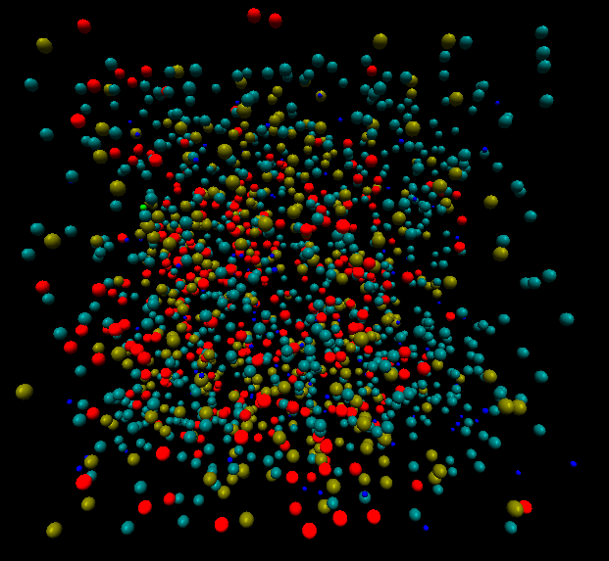

Accomplishments & Results
10 mil/GB molecules on a single processor: Simulations in 1mc^3 pore
1000 molecules: H2+O2 reaction.
15 mil: H2 + O(s) = H2O

Slide 20
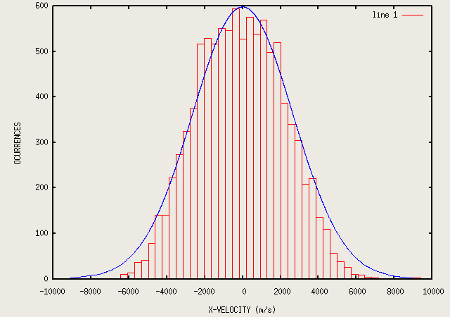
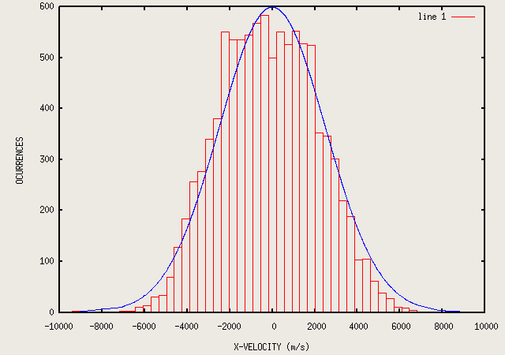
VALIDATION
First validation of the Remody program (histogram) with Maxwell Boltzmann Velocity distribution for 10000 molecules of hydrogen at 850 K.
Validation of the Remody program (histogram) with Maxwell Boltzmann Velocity distribution for 10000 molecules of helium at 3000 K.

Slide 21
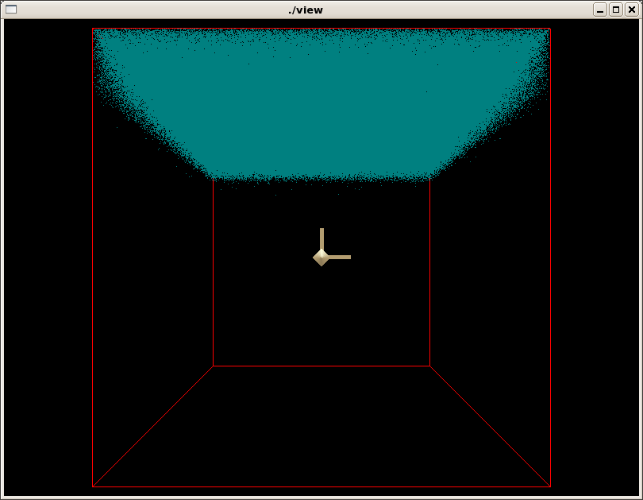
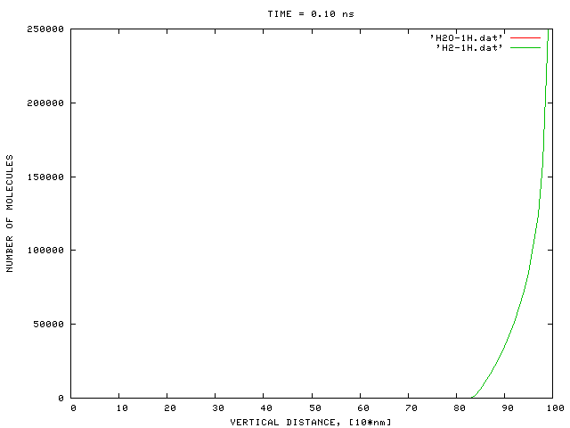
1 million - molecules

Slide 22
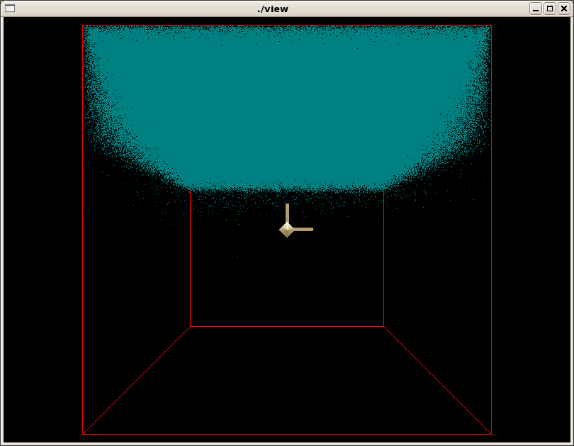
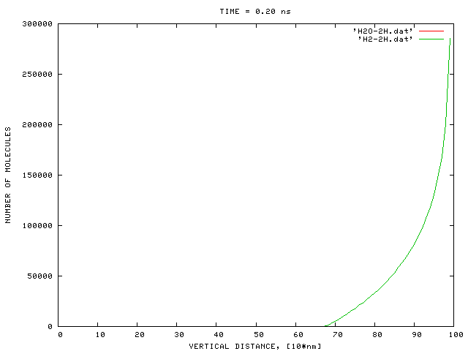
2 millions - molecules

Slide 23
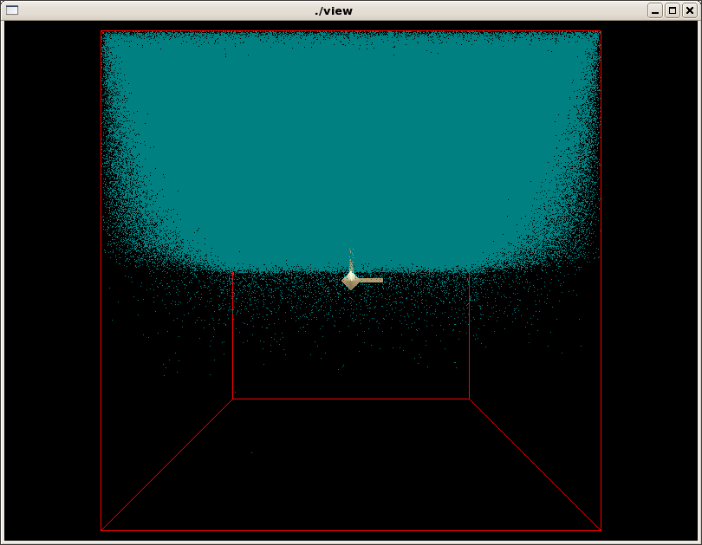
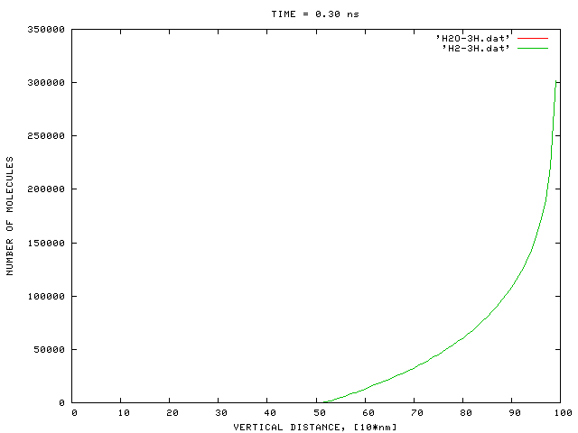
3 millions - molecules

Slide 24
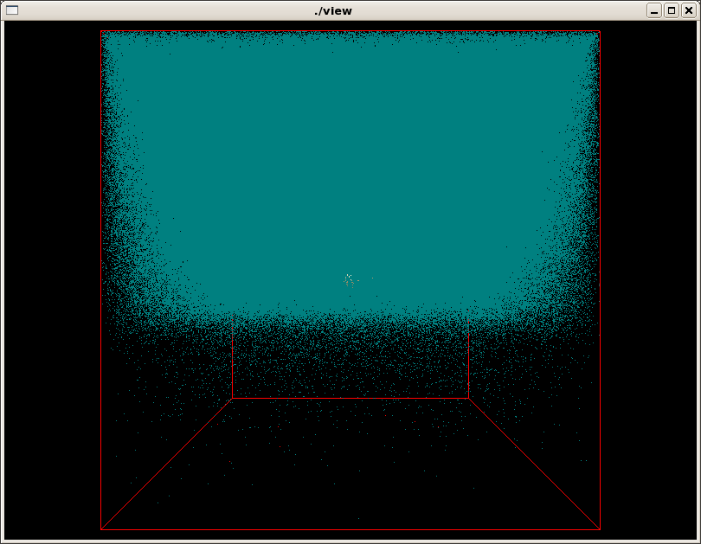
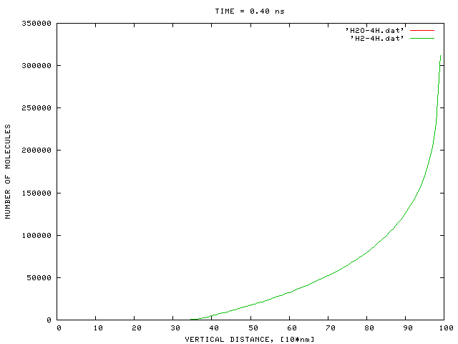
4 millions - molecules

Slide 25
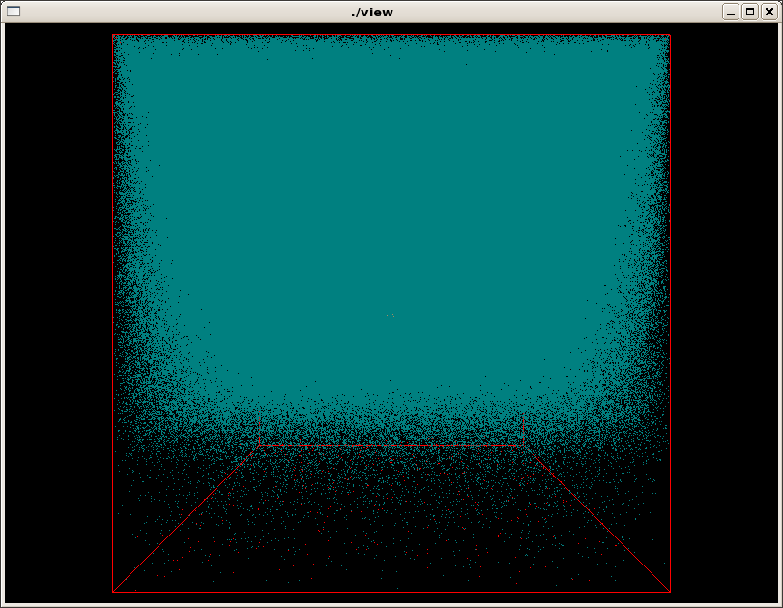
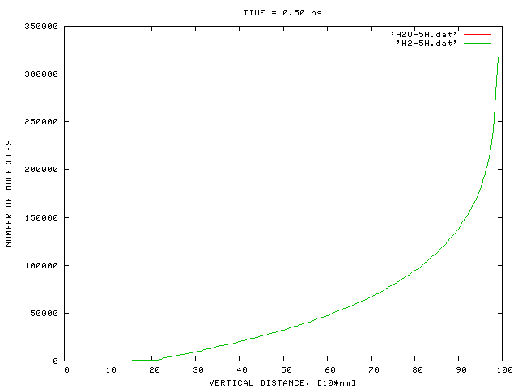
5 millions - molecules

Slide 26
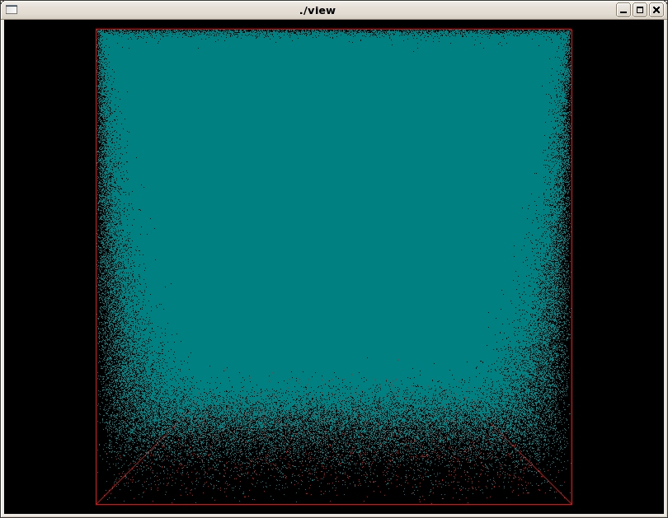
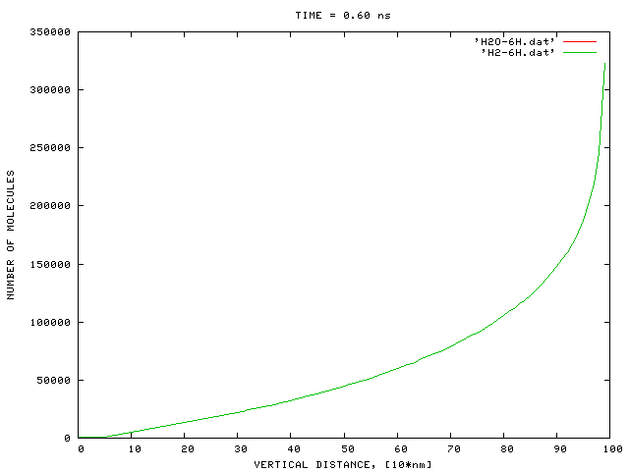
6 millions - molecules

Slide 27
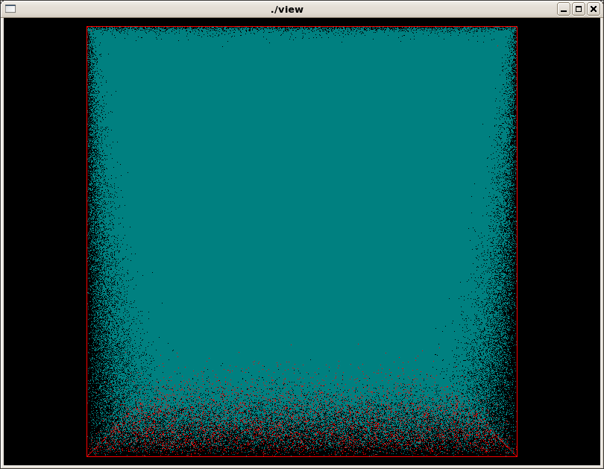
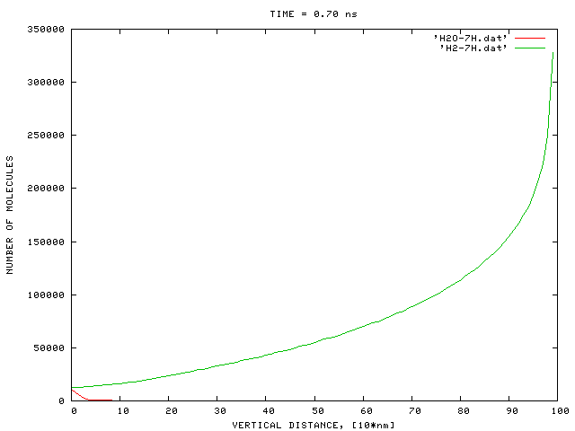
7 millions - molecules

Slide 28
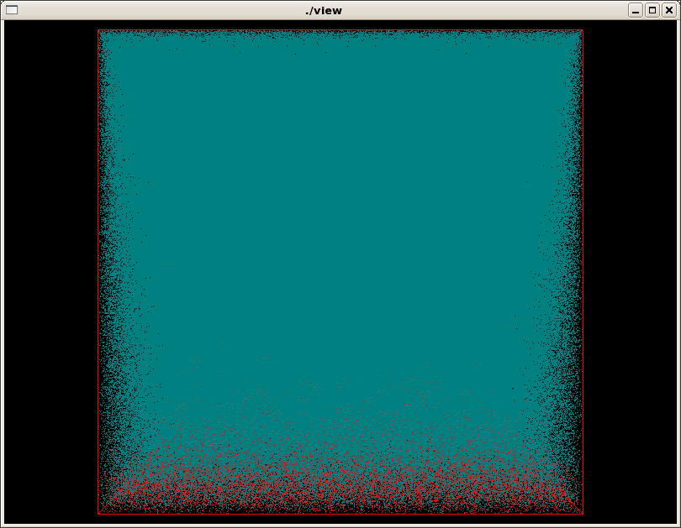
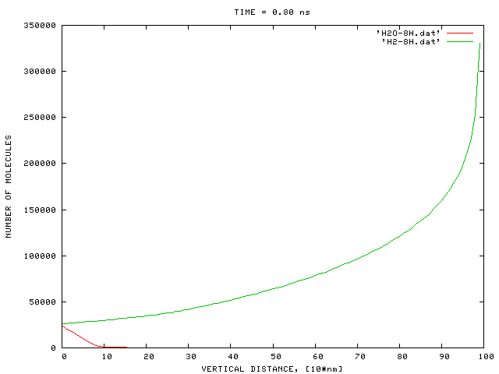
8 millions - molecules

Slide 29
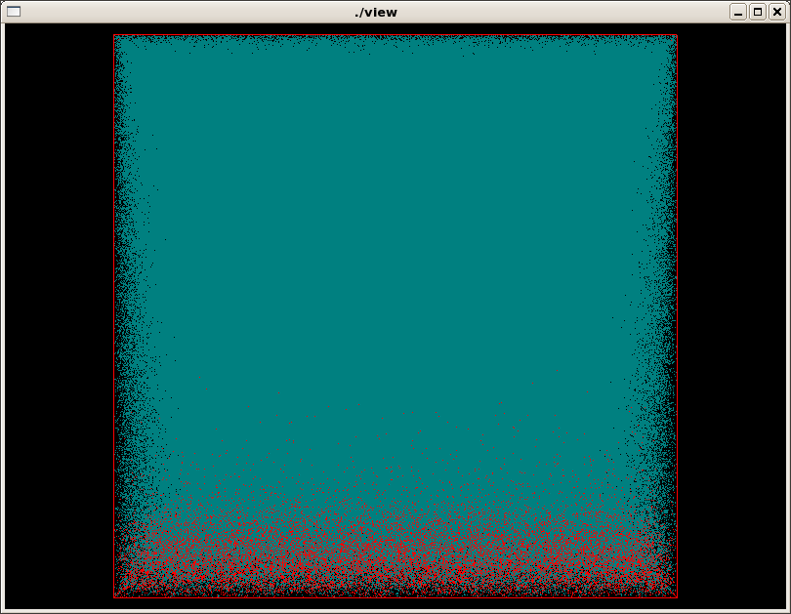

9 millions - molecules

Slide 30
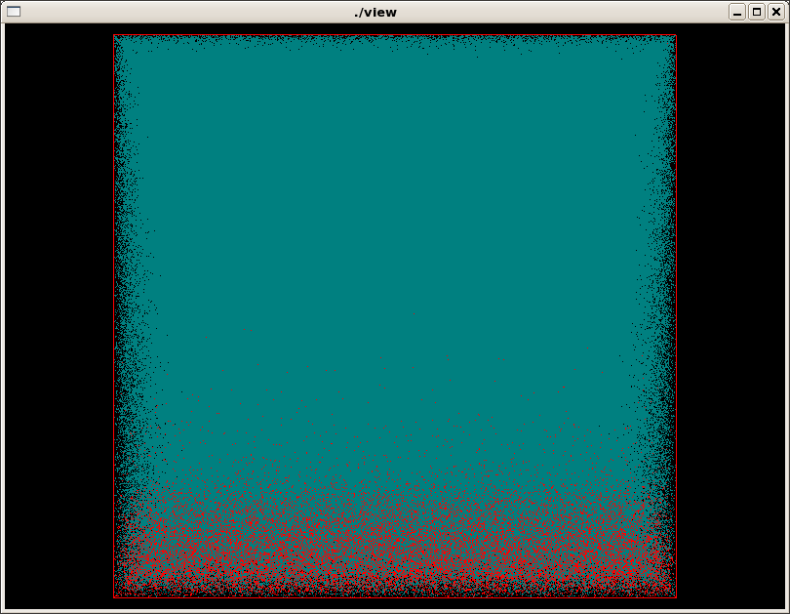
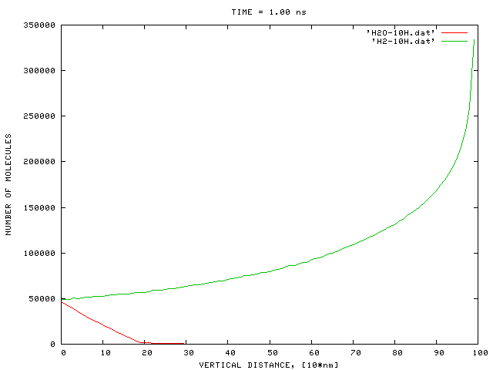
10 millions - molecules

Slide 31
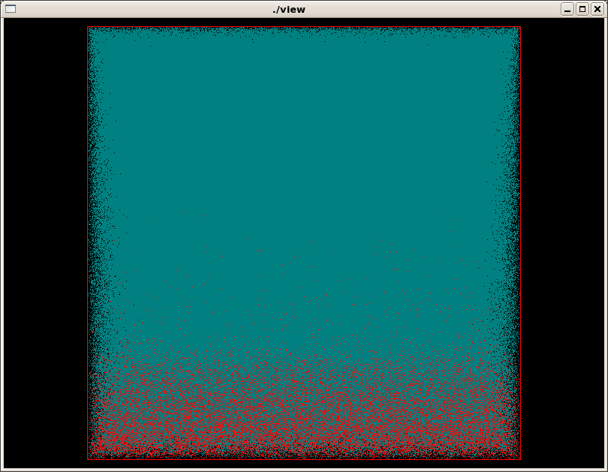
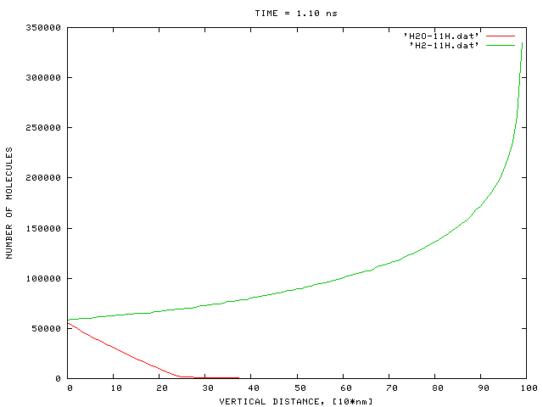
11 millions - molecules

Slide 32
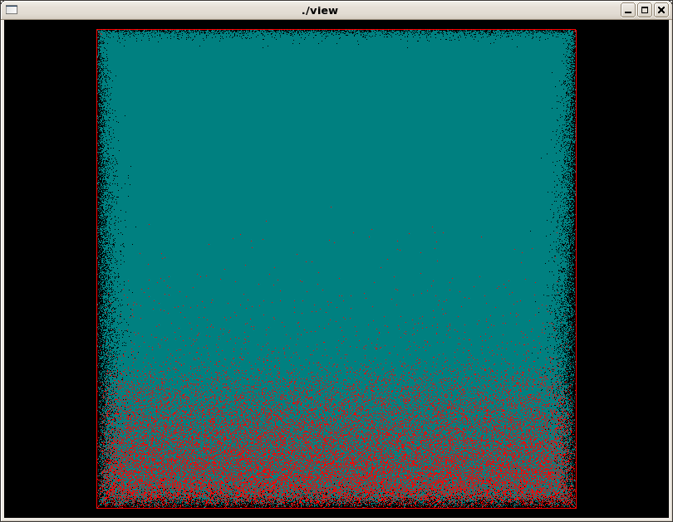
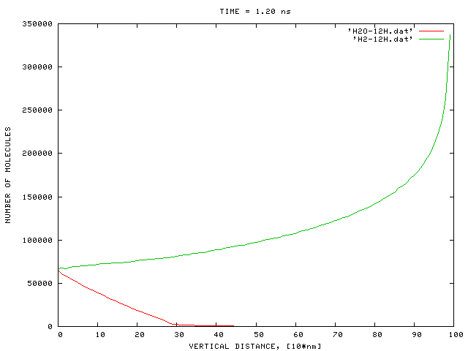
12 millions - molecules

Slide 33
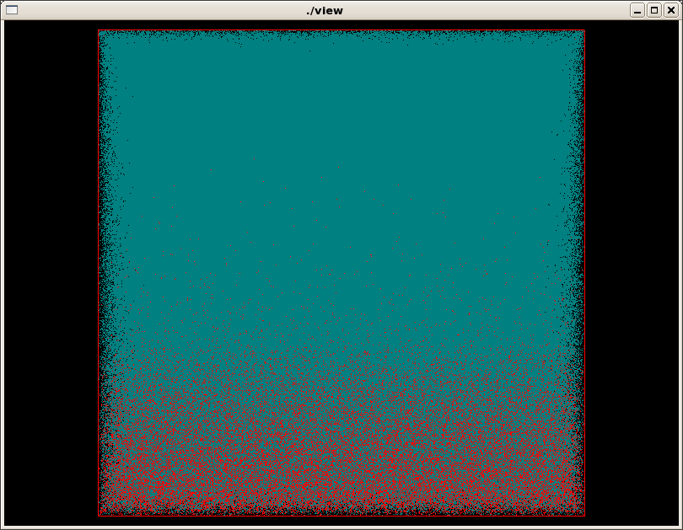
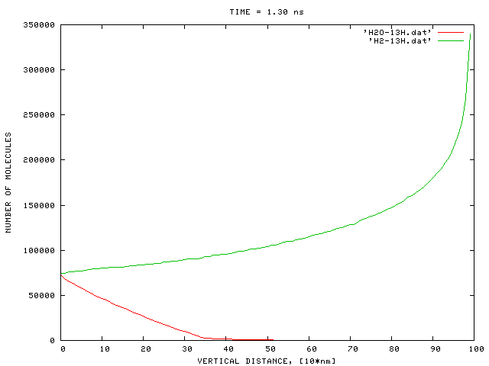
13 millions - molecules

Slide 34
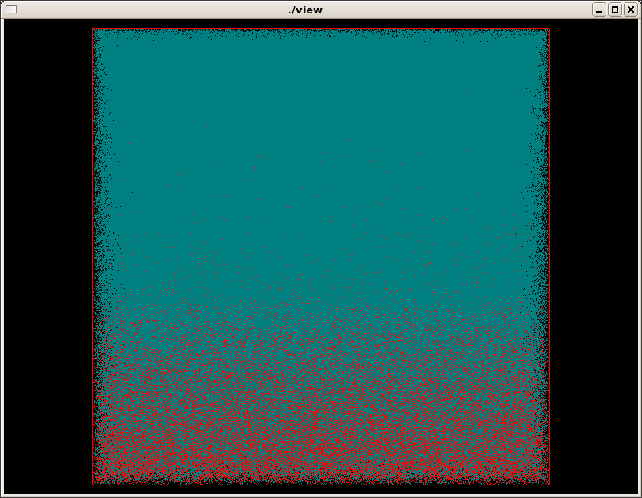

14 millions - molecules

Slide 35
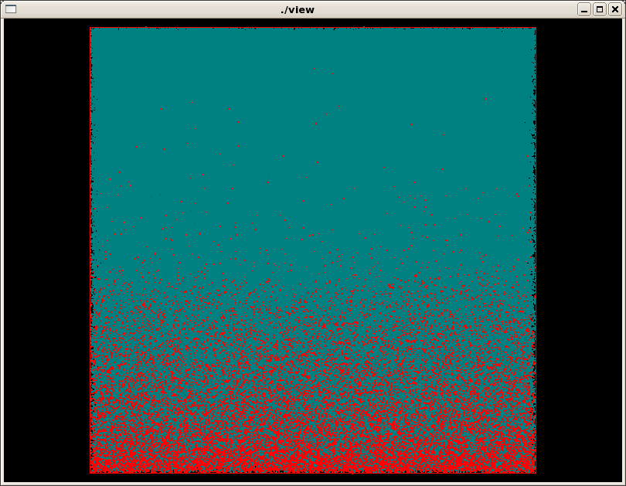
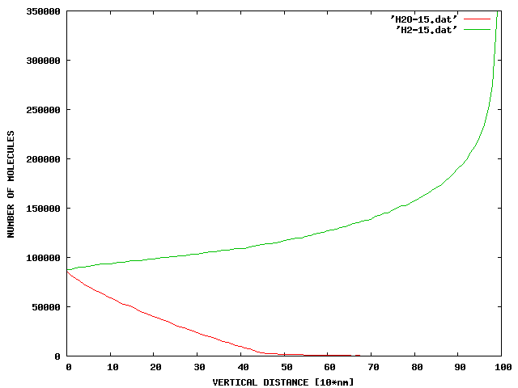
15 millions - molecules

Slide 36
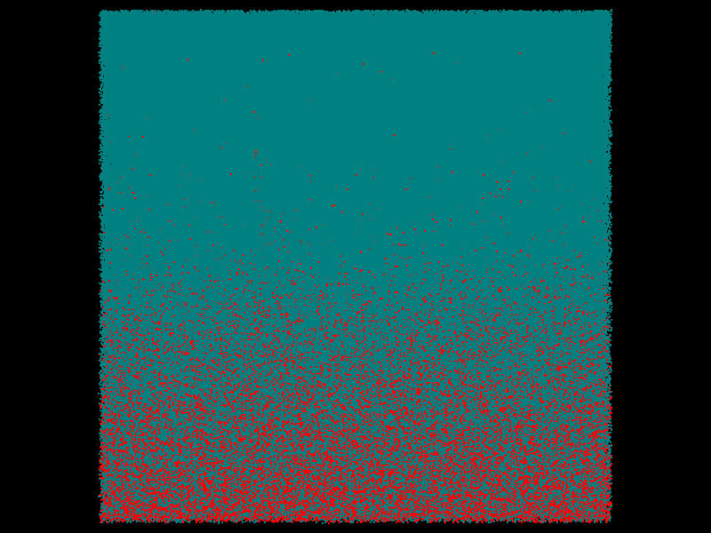
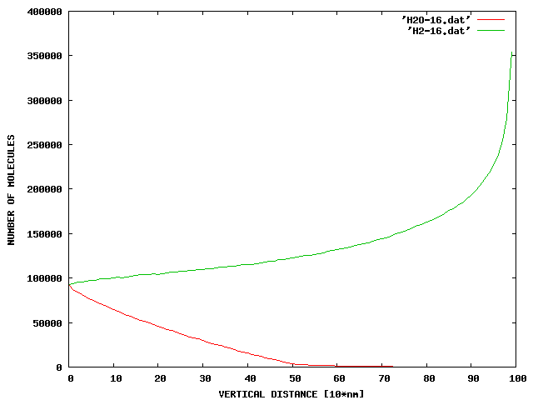
16 millions - molecules

Slide 37
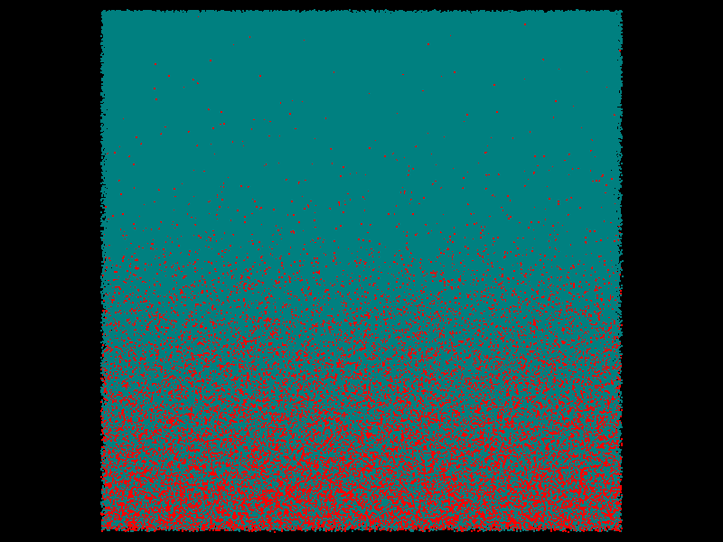
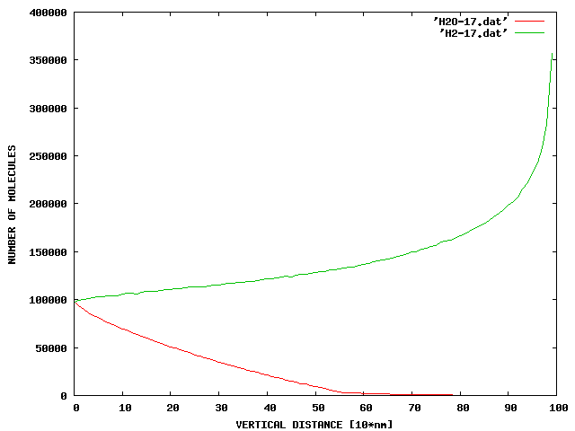
17 millions - molecules

Slide 38
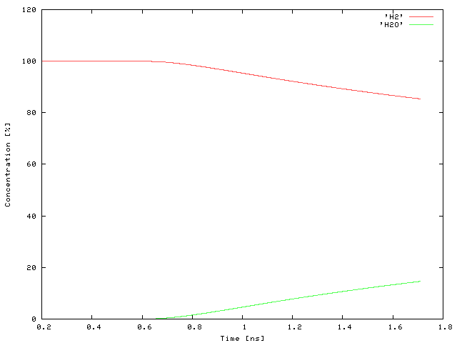
Concentrations

Slide 39
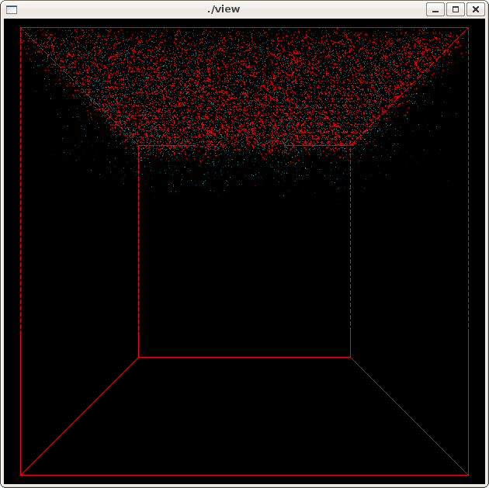
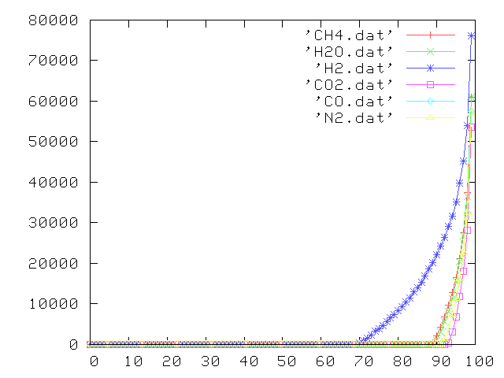
Syngas
1.5 million molecules in one cubic micron

Slide 40
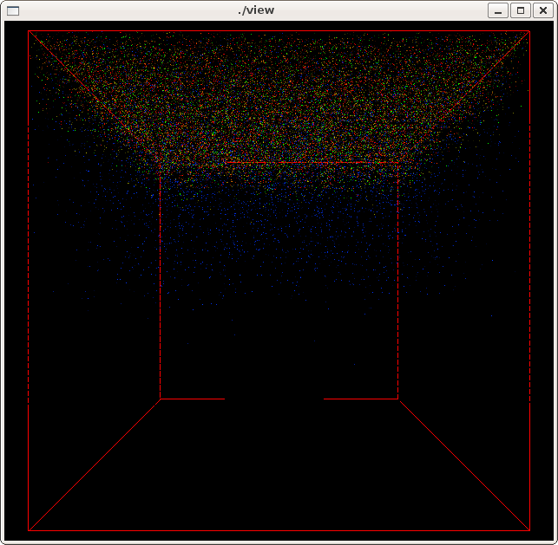
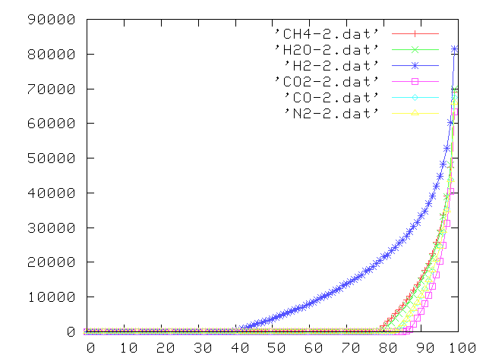
Syngas
3.0 million molecules in one cubic micron

Slide 41


Syngas
4.0 million molecules in one cubic micron

Slide 42


Syngas
5.0 million molecules in one cubic micron

Slide 43

Syngas
4.0 mil molecules

Slide 44

Syngas
5.0 mil molecules

Slide 45
Accomplishments
The capability was developed to simulate tens of millions of reacting molecules on a single workstation.
Developed techniques enable to conduct simulations in nanometer-to-micron range, bridging the gap between ab-initio QM and continuum mechanics paradigms.
Hundreds of bulk gas and surface reactions can be easily incorporated.
H2 + anode reactions inside one cubic micron pore were simulated.
Simulation of anode-Syngas reaction inside 1mc^3 pore, including 41 surface and 38 bulk reactions is continuing.

Slide 46
Future Work
Investigate transient effects in Syngas simulation in micron size pores.
Investigate transient effects of polarization.
Extend surface reaction model with surface species kinetics.
Extend simulations to larger size pores using a workstation cluster.
Investigate the effects of low ppm impurities on surface degradation.
Predict kinetic reaction rates.

