Slide 1
Evolutionary Optimization on the Grid
The Purpose of Research
To perform an evolutionary optimization of Micro-Areal Vehicles using genetic algorithms on grid computing systems.
Lay foundation for general EO of continuum mechanics systems, including shape optimizations, using Global Grid Exchange.
flybotics.com

Slide 2
EO for MAV with Grid Computing
Background
EO using Genetic Algorithms surpasses other methods for populations in excess of 100,000. Grid computing offers this opportunity.
MAV optimization is an important problem in aeronautical research, representative of a wide range of engineering optimization problems.
Nature already provided us with a solution - insects.
flybotics.org

Slide 3
Shape Optimization through CFD
Methodology
DNA prototypes: 2D and 3D shape parametrization using using Bezier curves and splines.
Fitness function: (1) unstructured meshing and (2) CFD solvers in Java.
Genetic Algorithm: Implementation/porting of genetic algorithms: mutation, selection, cross-breeding.
flybotics.org

Slide 4
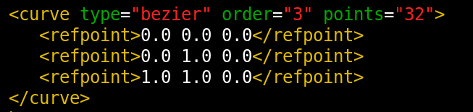
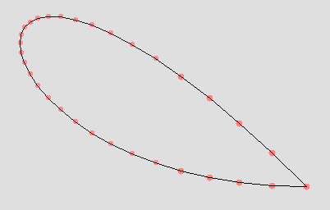
2D Shape Parametrization
Results
Bezier parameters:
Contour shape:
Implemented in Java:
flybotics.org/projects/aero/mavevo/prototypes/view
flybotics.com

Slide 5
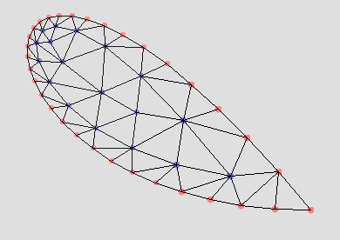
2D Shape Meshing
Results
General contour shape is meshed using a heuristic meshing algorithm developed in the course of this study, and based on a propagating front method. The algorithm is implemented in Java:
flybotics.com/projects/aero/mavevo/prototypes/mesh2d
flybotics.com

