Slide 1

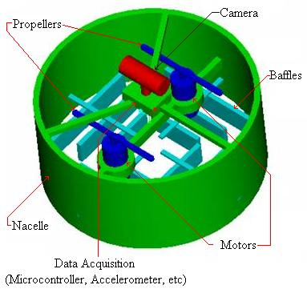
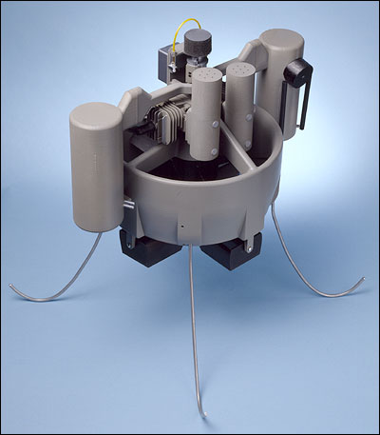
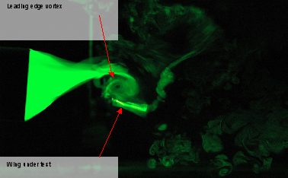
Micro-Aerial Vehicle Design
Purpose
The ability to control and design the next generation of miniature vehicles is of high importance to NASA and other government institutions
To perform an evolutionary optimization (EO) of Micro-Areal Vehicles using genetic algorithms on grid computing systems
Lay foundation for general EO of continuum mechanics systems, including shape optimizations, using Global Grid Exchange.
Various designs and experimental results for MAV design and testing

Slide 2

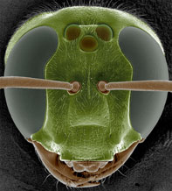
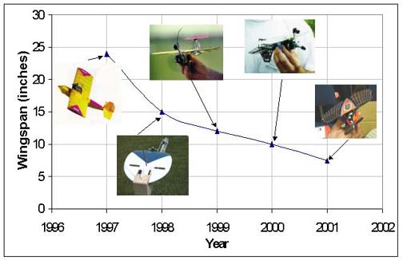
Micro-Aerial Vehicle Design
Background
EO using Genetic Algorithms surpasses other methods for populations in excess of 100,000. Grid computing offers this opportunity.
MAV optimization is an important problem in aeronautical research, representative of a wide range of engineering optimization problems.
Nature already provided us with a solution - insects.
Although CFD simulations of MAV are not ideally suited for grid computing, the design optimization is
As technology continues to advance, the size of the MAV’s decreases, however, their design times don’t decrease at the same rate

Slide 3
Micro-Aerial Vehicle Design
Methodology
How do we get there?
  DNA prototypes: 2D and 3D shape parametrization using using Bezier curves and splines.
  Fitness function: (1) unstructured meshing and (2) CFD solvers in Java.
  Genetic Algorithm: Implementation/porting of genetic algorithms: mutation, selection, cross-breeding.

Slide 4
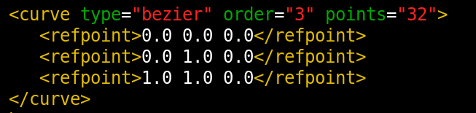
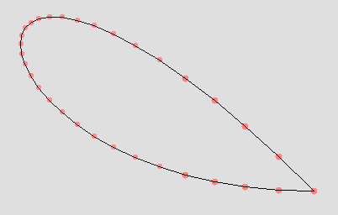
Micro-Aerial Vehicle Design
Results
Bezier parameters:
Contour shape:
Implemented in Java:
flybotics.org/projects/aero/mavevo/prototypes/view
The Bezier parameters are fully capable of capturing the curvature effects and additional points may be added as deemed necessary

Slide 5
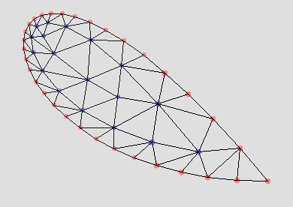
Micro-Aerial Vehicle Design
Results
General contour shape is meshed using a heuristic meshing algorithm developed in the course of this study, and based on a propagating front method.
The algorithm is implemented in Java

Slide 6
Micro-Aerial Vehicle Design
Summary
In summary, MAV design methodologies using Bezier functions highly suitable for design optimization; additional benchmarking pending with code optimization in JAVA
Native code run successfully on grid, and no changes required since written in JAVA
Grid computing strategy developed for design and test cases
Next 6 Months
  Continue evolutionary problem formulation
  Implement distributed simulation in a grid computing environment
  Continue optimization parameter space research for both wing shape optimization and flapping characteristics, which will be optimized with respect to wing lift to drag ratio

