Slide 1
Angular Features

Slide 2
What is Angular 7?
Angular 7 is an open source JavaScript framework for building web applications and apps in JavaScript, html, and Typescript which is a superset of JavaScript.
The code is written in Typescript, which compiles to JavaScript and displays the same in the browser.
Applications of Angular 7 are Google Supported Community ,POJO Based development,Typescript,Modular structure etc.
Features of Angular7 are Application Performance,CLI prompts,Drag and Drop,Virtual Scrolling.

Slide 3
Environment setup
To install angular, we require Nodejs, Npm, Angular CLI, IDE for writing your code.
To check if nodejs is installed on your system, type node -v in the terminal. This will help you see the version of nodejs currently installed on your system.
Type npm install –g @angular/cli in command prompt, to install angular cli on your system.

Slide 4
Components
Components are basically classes that interact with the .html file of the component, which gets displayed on the browser.
Now,angular-cli has a command to create your own component. However, the app component which is created by default will always remain the parent and the next components created will form the child components.
Several files that contain in the app component are .css files, .html files, .ts files, .spec.ts files.

Slide 5
Features of Angular7
CLI prompts
Application Performance
Virtual Scrolling
Drag and Drop
Bundle Budget

Slide 6
CLI Prompts:
It helps users to make a decision. It asks users about “want to add routing? Y/N” and about the type of styles user want to use.
Application Performance:
Earlier reflect-metadata is used in production but it is required at the time of development. Therefore, ployfill.ts is removed by default in angular 7.

Slide 7
Virtual Scrolling:
There are 4 steps to achieve virtual scrolling are as follows:
1.Add the dependancy
2.Add scrolling module
3.Add scrolling component
4.Replace *ngFor with *cdkVirtualFor

Slide 8
Drag and Drop:
It comes with the feature of automatic rendering.
Bundle Budget:
If the bundle size is more than 3MB, a warning message provided and for above 5MB, an error will be given.

Slide 9
Animation
Animations add a lot of interaction between the html elements. Animation was available with Angular 2, from Angular 4 onwards animation is no more a part of the @angular/core library.
To start with, we need to import the library with the below line of code
import { BrowserAnimationsModule } from '@angular/platform- browser/animations';

Slide 10
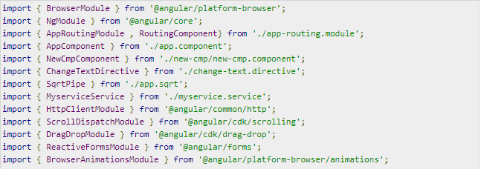
The BrowserAnimationsModule needs to be added to the import array in app.module.ts as follows:

Slide 11
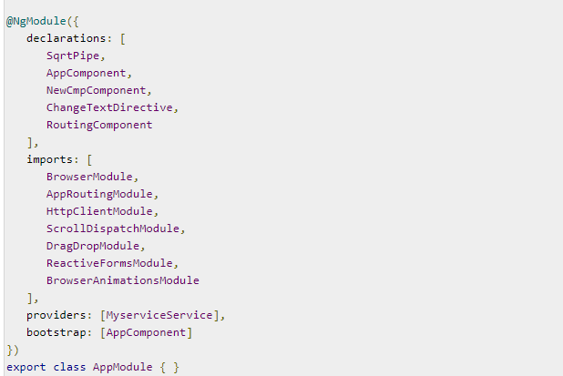
Declarations for animation sample program

Slide 12
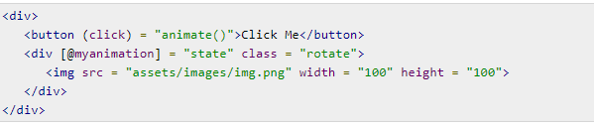
In app.component.html, we have added the html elements, which are to be animated.

Slide 13
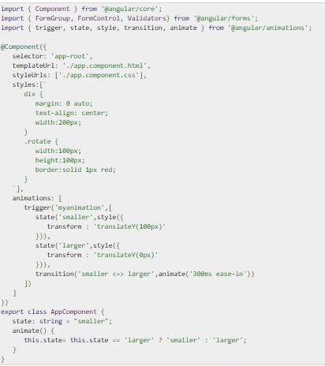
Let us now see the app.component.ts where the animation is defined

Slide 14
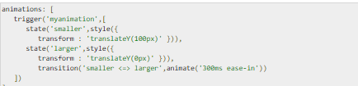
We have to import the animation function that is to be used in the .ts file
Now, we will add the animations property to the @Component () decorator −

Slide 15

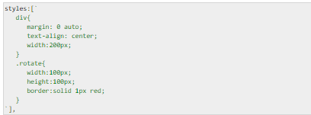
Let us now see the .html file to see how the transition function works −
There is a style property added in the @component directive, which centrally aligns the div. Let us consider the following example to understand the same −

Slide 16

Here, a special character [``] is used to add styles to the html element, if any. For the div, we have given the animation name defined in the app.component.ts file.
On the click of a button it calls the animate function, which is defined in the app.component.ts file as follows −

Slide 17
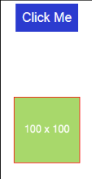
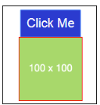
Output will be :

Slide 18

Materials
Materials offer a lot of built-in modules for your project. Features such as autocomplete, datepicker, slider, menus, grids, and toolbar are available for use with materials in Angular 7.
To use materials, we need to import the package. Angular 2 also has all the above features but they are available as part of the @angular/core module. From Angular 4, Materials module has been made available with a separate module @angular/materials.
Following is the command to add materials to your project −

Slide 19
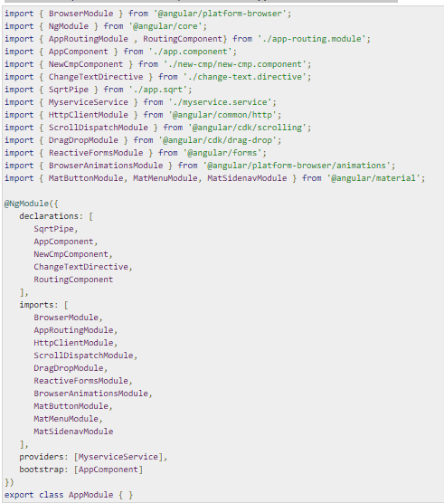
We will now import the modules in the parent module - app.module.ts as shown below.

Slide 20
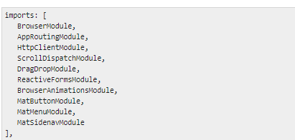
In the above file, we have imported the following modules from @angular/materials.
And the same is used in the imports array as shown below −

Slide 21
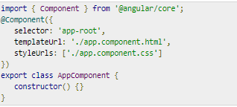
The app.component.ts is as shown below −
Let us now add the material-css support in styles.css

Slide 22
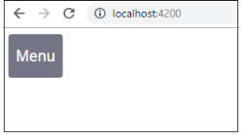
Menu
To add menu, <mat-menu></mat-menu> is used. The file and Save As items are added to the button under mat-menu. There is a main button added Menu. The reference of the same is given the <mat-menu> by using [matMenuTriggerFor]="menu" and using the menu with # in<mat-menu>.

Slide 23
