Slide 1
ROVER Relay
Replacement equipment
before the event starts
A checked plan. A remembered entrance. Your approval.
Working campus equipment rescue / Offline demo, simulated execution
01
Notes:
The campus coordinator needs compatible adapters before an event. All campus records are synthetic and dispatch is simulated. This deck accompanies a 3:30 recording storyboard. A final video is still pending.
Sources
https://github.com/multiagent111-collab/rover-relay/blob/codex/relay-hackathon-2026/docs/DEMO.md
https://github.com/multiagent111-collab/rover-relay/blob/codex/relay-hackathon-2026/README.md
Event branch links refer to the local candidate and require publication before external use.

Slide 2
A coordinator with a deadline
2 adapters
Auditorium delivery within 30 minutes
$35 total, including delivery
Stock and courier availability can change after planning.
The delivery entrance must match the coordinator’s preference.
ROVER Relay / Event candidate / October 22, 2026
02
Notes:
Canonical synthetic scenario. Relay checks compatibility, quantity, delivery cost, capacity and route time. This is a working demonstration, not a measured study of real event coordinators.
Sources
https://github.com/multiagent111-collab/rover-relay/blob/codex/relay-hackathon-2026/docs/JUDGE_QUICKSTART.md
Event branch links refer to the local candidate and require publication before external use.

Slide 3
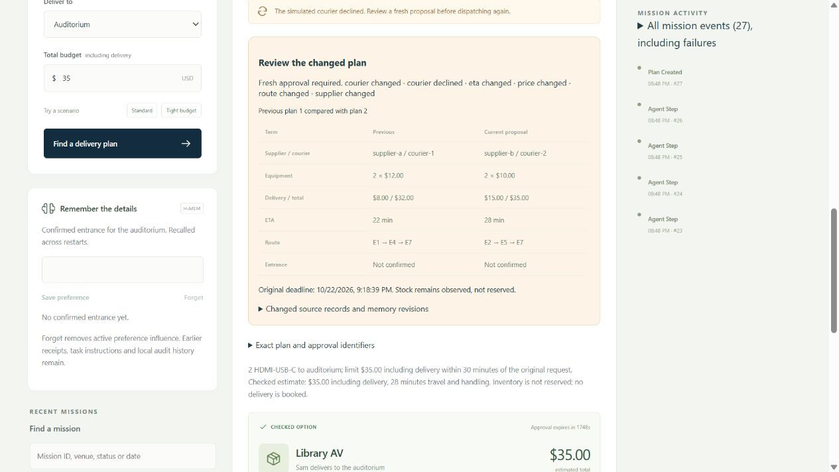
Changed facts require fresh approval
$32 / 22 min
Initial checked plan
$35 / 28 min
Replacement plan
New approval required
Actual RELAY-11 browser capture / Offline sample / Courier decline and replan
03
Notes:
This actual screenshot records courier decline and comparison. It is not the separate stock-loss HTTP run. Both flows produce a replacement requiring fresh approval. Observed stock is never a supplier reservation.
Sources
https://github.com/multiagent111-collab/rover-relay/blob/codex/relay-hackathon-2026/examples/recorded/relay-11-browser-2026-10-22.json
https://github.com/multiagent111-collab/rover-relay/blob/codex/relay-hackathon-2026/examples/recorded/relay-11-browser-comparison.jpg
Event branch links refer to the local candidate and require publication before external use.

Slide 4
Agent workflow and architecture
1
Confirmed request
Clarify missing budget or deadline
2
Planner and Critic
Bounded read tools, separate semantic review
3
Deterministic validation
Money, route, evidence and hard constraints
4
Explicit approval
Fresh sources and memory, version and digest
5
Durable simulator task
Atomic intent, idempotency and outbox
ROVER Relay / Event candidate / October 22, 2026
04
Notes:
Editable native workflow labels. React/Vite browser, TypeScript/Fastify API, Zod contracts, SQLite or PostgreSQL. Models cannot execute SQL or create jobs. Sample and live adapters are explicitly selected with no fallback.
Sources
https://github.com/multiagent111-collab/rover-relay/blob/codex/relay-hackathon-2026/docs/ARCHITECTURE.md
https://github.com/multiagent111-collab/rover-relay/blob/codex/relay-hackathon-2026/docs/INTAKE_AND_COORDINATION.md
https://github.com/multiagent111-collab/rover-relay/blob/codex/relay-hackathon-2026/docs/EXECUTION_CONTRACT.md
Event branch links refer to the local candidate and require publication before external use.

Slide 5
Meterless H-MEM in a working feature
“Use the North loading entrance”
Explicitly confirmed memory reaches both planning roles
and the approved simulated task.
Correction and forgetting invalidate stale terms.
Restart and scope tests pass with the actual engine.
ROVER Relay / Event candidate / October 22, 2026
05
Notes:
Official Meterless H-MEM at revision 1742dec56a66e58eef9dda2d2b865823758ca8cd, unmodified Apache-2.0 source included. Fifteen source hashes and thirteen upstream checks passed in RELAY-11. Initial integration is prior work. RELAY-06 adds confirmed preference influence, scope, multi-process persistence and stale approval proof. Upstream audit retention is distinct from active forgetting.
Sources
https://github.com/multiagent111-collab/rover-relay/blob/codex/relay-hackathon-2026/THIRD_PARTY_NOTICES.md
https://github.com/multiagent111-collab/rover-relay/blob/codex/relay-hackathon-2026/docs/MEMORY_SAFETY.md
https://github.com/multiagent111-collab/rover-relay/blob/codex/relay-hackathon-2026/examples/recorded/relay-11-offline-evaluation-2026-10-22.json
Event branch links refer to the local candidate and require publication before external use.

Slide 6
Actual sponsor mission evidence
Zetaris
Supplier SQLite HTTP and courier/route PostgreSQL
join inside Zetaris. Synthetic campus records.
Nightshift
Planner: NVIDIA Nemotron Super VL
Critic: NVIDIA Nemotron Ultra
39.917 seconds
One actual planning mission. No dispatch.
Exact Lightning pinning remains unverified.
ROVER Relay / Event candidate / October 22, 2026
06
Notes:
RELAY-11 captured 2026-10-23 UTC / October 22 PDT. Mission 5865aac1-dc3a-4ebb-bb3b-a51d70d65a66. Planner nvidia/nemotron-3.5-super-vl-120b-a12b, receipt rcpt_req_25sqnibj. Critic nvidia/nemotron-3-ultra-550b-a55b, receipt rcpt_req_ex5ig7x7. Both cache misses, Runtime receipt log matched. Six Relay HTTP attempts include discovery, two queries, two model requests and receipt read. Runtime internal fanout unmeasured. Receipt correlation is not independent NVIDIA attestation or signature verification. Actual H-MEM confirmed entrance in isolated state. The original report phase-label erratum is documented; no claim of exact requested Lightning model.
Sources
https://github.com/multiagent111-collab/rover-relay/blob/codex/relay-hackathon-2026/docs/EVALUATION.md
https://github.com/multiagent111-collab/rover-relay/blob/codex/relay-hackathon-2026/examples/recorded/relay-11-live-evaluation-2026-10-22.json
https://github.com/multiagent111-collab/rover-relay/blob/codex/relay-hackathon-2026/docs/SOURCE_EVIDENCE.md
Event branch links refer to the local candidate and require publication before external use.

Slide 7
Measured acceptance
21 public gates pass
114 application tests
14 actual PostgreSQL checks
13 upstream H-MEM checks
Three private ROVER gates remain deferred.
Controlled tests and actual sponsor runs retain separate labels.
ROVER Relay / Event candidate / October 22, 2026
07
Notes:
Dated RELAY-11 evaluation, commit 1fff46c. A01-A20 and A24 pass. A21-A23 deferred. These are functional checks, not statistical reliability estimates. Seven measured offline cases separately report generator and snapshot counts with zero external calls.
Sources
https://github.com/multiagent111-collab/rover-relay/blob/codex/relay-hackathon-2026/docs/EVALUATION.md
https://github.com/multiagent111-collab/rover-relay/blob/codex/relay-hackathon-2026/examples/recorded/relay-11-acceptance-2026-10-22.json
Event branch links refer to the local candidate and require publication before external use.

Slide 8
Prior work and event work
Declared prior work
Entire protected baseline, including H-MEM integration.
Inherited source integration retains its original provenance.
Codex event work
Clarification, bounded tools, semantic repair, Nightshift proof,
memory safety, atomic approval, browser workflow and evaluation.
ROVER Relay / Event candidate / October 22, 2026
08
Notes:
Protected baseline tag rover-relay-pre-event-2026-10-21 at 1b19c528d639134691289d9c0db38d82e9f277ff. RELAY-00 through RELAY-11 local commits are listed in docs/DEMO.md. RELAY-12 supplies reproducible current docs, HTTP setup proof and this deck/storyboard. All this session uses Codex, under user-supplied any-agent rule. No Cursor use/credits are claimed. A later commit cannot reclassify inherited code as new work.
Sources
https://github.com/multiagent111-collab/rover-relay/blob/codex/relay-hackathon-2026/docs/PRIOR_WORK.md
https://github.com/multiagent111-collab/rover-relay/blob/codex/relay-hackathon-2026/docs/EVENT_WORKFLOW.md
https://github.com/multiagent111-collab/rover-relay/blob/codex/relay-hackathon-2026/docs/DEMO.md
https://github.com/multiagent111-collab/rover-relay/blob/codex/relay-hackathon-2026/docs/DEVELOPMENT_LOG.md
Event branch links refer to the local candidate and require publication before external use.

Slide 9
Future ROVER integration
A public execution contract exists
Versioned approval intents and controlled HTTP gateway tests
prepare the boundary for an authoritative private service.
Real identity, provider acceptance, jobs and payments remain future work.
Current execution uses the local simulator.
ROVER Relay / Event candidate / October 22, 2026
09
Notes:
Execution-1.0 schemas and public gateway fixture conformance shipped in RELAY-10 d139f57. Normal server uses SimulatorExecutor. Gateway only constructor injection, no runtime activation flag. No private ROVER source, schema or real jobs ship in this candidate.
Sources
https://github.com/multiagent111-collab/rover-relay/blob/codex/relay-hackathon-2026/docs/EXECUTION_CONTRACT.md
Event branch links refer to the local candidate and require publication before external use.

Slide 10
Reproduce the sample
npm ci
npm run build
npm run local -- start --sample --service=relay --port=4183
npm run verify:setup
CPU sample. Real H-MEM. No sponsor calls at runtime.
Local deck and storyboard ready. Final recording and submission pending.
ROVER Relay / Event candidate / October 22, 2026
10
Notes:
Public scripts export current candidate source, perform a locked install/build and actual loopback HTTP scenarios plus measured memory cases. Node 22.13+, tested Node 26.2.0 Windows. No private helpers, Docker or keys needed. npm installation may need registry access. Event candidate local commits require publication before remote clone matches. Final 1-4 minute video is pending. Official event page accessed October 22 PDT confirms deadline October 27 2026 23:45 UTC and deck/video/source fields, but retains older Cursor wording that conflicts with participant-supplied update. Final account/team/track fields and upload remain participant actions.
Sources
https://github.com/multiagent111-collab/rover-relay/blob/codex/relay-hackathon-2026/docs/JUDGE_QUICKSTART.md
https://github.com/multiagent111-collab/rover-relay/blob/codex/relay-hackathon-2026/docs/DEMO.md
https://github.com/multiagent111-collab/rover-relay/blob/codex/relay-hackathon-2026/docs/HACKATHON_REQUIREMENTS.md
https://hackathon.genai.works/event/open-agent-hackathon-2026
Event branch links refer to the local candidate and require publication before external use.

