Slide 1



FIREWORKS: A Fast, Efficient, and Safe Serverless Framework using VM-level post-JIT Snapshot
Wonseok Shin¹, Wook-Hee Kim² ,Changwoo Min³
¹SK Telecom, ²Konkuk University, ³Virginia Tech
Notes:
Hello.
My name is Wonseok Shin. I am from SK Telecom in south Korea. I would like to introduce FIREWORKS we propose.
FIREWORKS is A Fast, Efficient, and Safe Serverless Framework, which utilizes VM-level post-JIT Snapshot.
This work was collaborated with my master's course advisor, Professor Min of Virginia Tech, and Professor. Kim. of Konkuk University.

Slide 2
Here is Serverless Computing!
Serverless computing is now mainstream in the cloud era
Amazon Lambda, Microsoft Azure, Google Cloud, IBM Cloud Functions
provide their serverless computing models
Developers do not need to effort into administration
It offers significant scalability for the resource provisioning
The serverless introduces pay-as-you-go
Notes:
Serverless computing is now becoming the mainstream beyond innovation in the cloud era.
Nowadays applications are often designed as a micro-services architecture.
These microservices usually can be deployed in a serverless computing method.
Many cloud providers, such as Amazon, Microsoft, Google, and IBM, have their serverless models and provide them to customers.
The reason for the popularity is..
Developers do not need to effort into administration because the cloud operators manage the serverless computing resources instead of them.
Moreover, the resources are dynamically provided as needed.
And you just pay what you use.
These advantages are making serverless the standard deployment in the cloud.
[next slide] So what is serverless computing?.

Slide 3
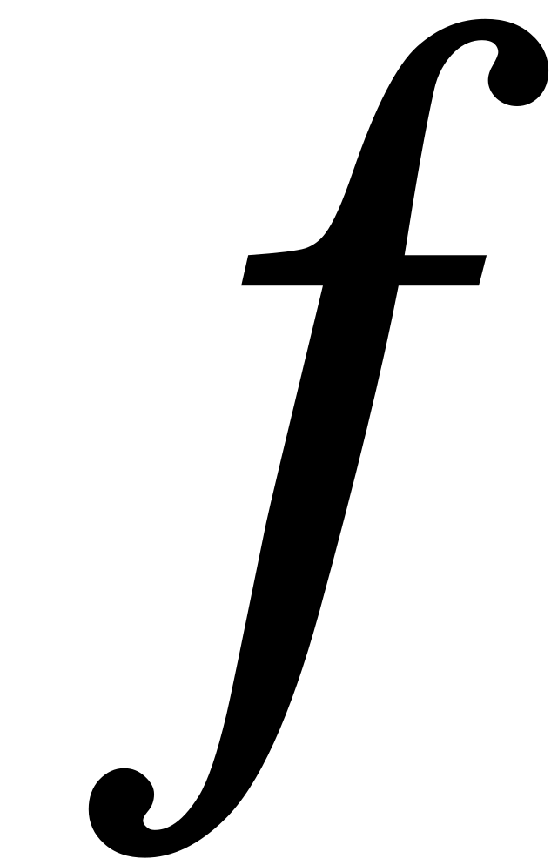
What is Serverless Computing?
Application can consist of small serverless functions
Serverless computing is Function-as-a-Service (FaaS)
Application
Micro service 1
Micro service 2
Micro service 3
Notes:
Serverless computing is different from normal server deployment.
Traditionally, an application was deployed on a long-running virtual machine or container,
But In serverless computing, applications are divided into microservices.
This small service can run as a function or several functions.
That's why serverless computing is also called function-as-a-service.
[next slide] If we look inside where these functions are operating, we can know how cloud operators manage serverless computing.

Slide 4
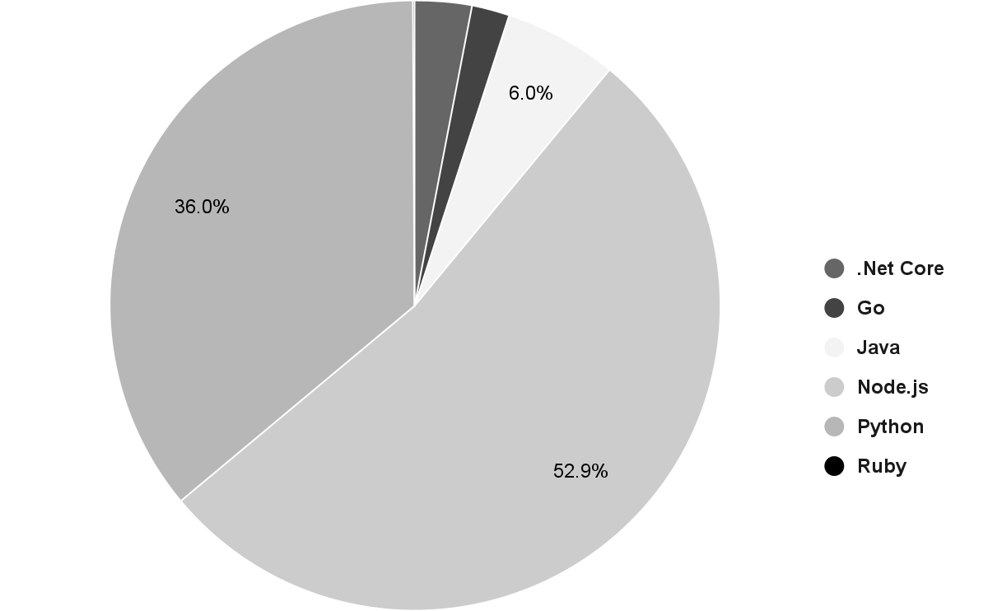
What is Serverless Computing?
Inside the serverless, each function runs in its own sandbox
Cloud operator manages functions flexibly for users
In function, most used languages and runtime(90%) is interpreter language
sandbox
sandbox
sandbox
sandbox
sandbox
sandbox
Hypervisor
Operating System
Server
* serverless benchmark report AWS lambda 2020
Notes:
Actually, a function is executed within a sandbox.
The sandbox is made by the hypervisor.
It allocates the server's resources to the sandbox in cooperation with the operating system.
Unlike in the past, functions are deployed and managed by the cloud operator on behalf of the user.
(next)Functions increase or decrease flexibly (next) according to the request.
(next)
One more thing to know is Most of the languages and runtimes used in functions are interpreter languages such as nodejs and python.

Slide 5
Characteristics of Serverless Computing
On-demand execution
The resources for functions are created on-demand when invoked
Shorter execution time
Functions on the serverless run in a short span
Cloud operators aim to consolidate a large number of serverless functions in a few machines to utilize server’s resources more efficiently
Notes:
Serverless with such a small function has “characteristics” that are different from the existing ones.
Basically, the necessary resources will be running in advance,
but in the case of a function, the resources are created on-demand when invoked
And Functions on serverless run in a short span because smaller services divided from one large application are executed in functions.
Here(....), the functions are deployed transparently by the cloud operator, so they aim to consolidate a large number of serverless functions in a few machines to use server resources efficiently
[next slide] Flexible deployment with such a small function seems suitable for modern applications and cloud environment, yes it is right, but there are some problems.

Slide 6
Problems
(1) Long startup time penalty
Long booting time of VM, OS, container and runtime
1st request = cold start, subsequent requests = warm start(can be expired)
In some cases, startup time > execution time of function
(2) Unpredictability in Just-In-Time(JIT) compilation of interpreter language
Short execution time of the function is not suitable for JIT compilation
(3) Memory is bottleneck in the consolidation
Cloud operators retain the functions in memory for a while waiting
(4) Security challenge
High consolidated serverless environment needs robust isolation
Notes:
(next)The first is long startup time penalty.
When there is a request, it is necessary to boot the resources such as VM, OS, container, runtime required for the function, after that the function is executed.
Time taken for the first request is called a cold start, and this time is booting time for the resources.
In the case of subsequent requests, it is called a warm start, and it does not take booting time because the resources already have been created.
In some cases, even the startup time is longer than the execution time.
(next)The second problem is that Just-In-Time compilation is difficult to utilize well in a serverless environment.
As I mentioned before, the most used languages in serverless are nodejs and python, which are interpreter languages.
For interpreter language, JIT compilation is very important to improve performance.
However, due to the short execution time of the function, the profile information for JIT is not maintained well.
(next) Third, Memory can be a bottleneck in the consolidation of functions.
Cloud operators try to keep functions in memory for a warm start.
It doesn't use the CPU, but it can use memory, so memory can become a bottleneck for multiple functions.
(next)Lastly, these high consolidated serverless environment needs robust isolation
[next slide] We thought about how to solve these problems ..

Slide 7
Our approach
Low-latency start up time
Snapshot
Fast execution time
Post-JIT
Snapshot
Memory efficiency
Sharing
Post-JIT
Snapshot
Robust isolation
Sharing
VM-level
Post-JIT
Snapshot
Notes:
First, (next) for low-latency startup, we utilize snapshot and it can solve the cold start problem.
(next)
And we force to perform Just In time compilation,
after that, through the snapshot, JIT compilation will be included in the snapshot file to ensure fast execution.
(next)
In the meantime, many small functions that are waiting or running in the memory by sharing this snapshot, can save memory
(next)
At this time, we adopt a VM-level snapshot to ensure robust isolation where functions are highly consolidated.

Slide 8

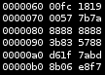
Our approach : VM-level post-JIT snapshot
Installation phase : create a memory snapshot with JIT compilation
Invocation phase : load the memory snapshot on a sandbox as a new function
Installation phase
Invocation phase
User code
sandbox
JIT Compilation
sandbox
Create
memory snapshot
Load
memory snapshot
JITed code
sandbox
Machine code
library
sandbox
runtime
sandbox
Notes:
The VM-level post-JIT snapshot operation method is divided into two phases.
These are the installation phase and the invocation phase.
(next) In the installation phase, we create a machine code by forcing JIT on the user code, and prepare it as a memory snapshot file.
(next) In the next invocation phase, sandboxes are prepared, and the memory snapshot file is loaded and executed on that as a new function.
[next slide] In practice, some challenges must be addressed at each step of implementation.

Slide 9
Challenges
Installation phase
How can we manipulate JIT compilation?
Do we know when creating a snapshot?
Invocation phase
How we can reduce a memory footprint?
How to solve the problem of duplicated IP and MAC using the same snapshot?
How can we pass multiple users’ arguments to the same running state of a memory snapshot?
Notes:
First, during the installation phase, the issue is how to make the snapshot.
How can we manipulate JIT compilation?
Afterward, we need to decide when to create a snapshot.
In the invocation phase, there is another problem because multiple functions need to be executed.
How can we reduce memory usage while executing multiple functions?
Is it possible to create multiple functions with one snapshot without duplicated IP or MAC?
How can we pass multiple users’ arguments to the same running state of the memory snapshot?
[next slide] There are some tasks that need to be solved

Slide 10
Our solution : FIREWORKS
We suggest FIREWORKS, a way to solve the challenges and realize a post-JIT snapshot
FIREWORKS
Sandbox
MicroVM Manager
@RequestJIT(function name)
Code annotator
JITed User code
</>
User code
</>
Snapshotter
Snapshot_request()
Invoker
Operating System
Parameter passer
Server
‹#›
Notes:
So, our solution FIREWORKS gives a way to solve the challenges and realize a post-jit snapshot
빨리
(next) in the installation phase, three components work together to create a post-JIT snapshot.
(next) To make the memory snapshot, the MicroVM manager launches a sandbox,
(next) and the code annotator puts the codes to request JIT compile and request a snapshot at an appropriate time.
(next) After that, the snapshotter saves the optimized sandbox memory state as a file.(next)
(next) Second, in the invocation phase, (next) the invoker and the parameter passer are responsible for executing the JITed code from the memory snapshot file when the function is requested.
[next slide] Let's look into more detail.

Slide 11
How can we manipulate JIT compilation?
Use source code annotation
Modern highly-optimized language runtimes already support annotation to trigger JIT at the program loading time.
We re-purpose this feature to create a post-JIT VM-level snapshot
function optfn() {
try {
%OptimizeFunctionOnNextCall(main);
}
catch (e) {
console.log(e);
}
}
@jit(cache=True)
def f(x, y):
return x + y
Node.js
Python
Notes:
In terms of creating the snapshot file, first of all, we use source code annotation for JIT compilation.
Modern language runtimes, especially interpreter languages, already support annotation to trigger JIT at the program loading time.
we selected most used language as the target language as below, and
we can force to generate the machine code by using these features.

Slide 12
Do we know when to create a snapshot?
Place a trigger of making a snapshot in user code
Only a function knows that the code is optimized and ready to run, rather than the environment that manages it
FIREWORKS
Annotated function
Python, Nodejs runtime
Import package
@jit(cache=True)
def main(params):
Request to make a snapshot
(HTTP request)
Snapshot_request()
Notes:
Another consideration is when to create the snapshot.
A way to achieve this is to place a trigger of making a snapshot in user code.
Only a function knows that the code is optimized and ready to run, rather than the environment that manages it like Fireworks
After executing the runtime, loading libraries, and forcing to JIT compile,
the function requests to make a snapshot to FIREWORKS.

Slide 13
How we can reduce memory footprint?
Redefine Running a function as loading a memory snapshot file
Sandbox #1 runs by loading the memory snapshot file
Sandbox #2 can share the memory in a copy-on-write manner
Load snapshot
Load snapshot
Sandbox #1
Sandbox #2
MicroVM
OS
Library
Runtime
JITed
code
State1
MicroVM
OS
Library
Runtime
JITed
code
State2
Copy-on-write
Physical
memory
Create snapshot
MicroVM
OS
Library
Runtime
JITed
code
Requests
Snapshot file
Notes:
Now, we need to run the ready snapshot file when invoked.
Since many functions can run on the same host simultaneously, resource efficiency, especially memory usage, is a concern.
so, In terms of memory usage,
we redefine Running a function as loading a memory snapshot file to share a snapshot file.
As shown in the figure below, sandbox1 can run immediately by loading the memory snapshot file.
If more requests come in, we can share the memory file in a copy-on-write manner.

Slide 14
How to solve the problem of duplication IP and
MAC using the same snapshot?
the same snapshot file
Take advantage of MMDS, iptables NAT and network namespace
MicroVM metadata service (MMDS) inserts unique information of the microVM
iptables NAT map the same ip to different exposed IP
conflict for the same device. ⇒ own network namespace.
Firecracker MMDS
iptables
Network namespace
hostname-A
hostname-B
A.A.A.A
B.B.B.B
net1:tap0
net2:tap0
Sandbox #1
Sandbox #2
Notes:
We mentioned earlier that we run multiple sandboxes with a single memory snapshot file.
Because of that, another consideration is how to deal with duplicated MAC or IP address using the same snapshot file.
For this, we used (next) firecracker's micro metadata service,(next) iptables NAT (next) and network namespace.

Slide 15

How can we pass multiple users’ arguments to
the same running state of a memory snapshot?
Create a repository that can be delivered between users and functions in the sandbox, and add logic to check it
Parameter passer
Sandbox #1 queue
Sandbox #3
Insert user’s arguments
Sandbox #2 queue
Sandbox #3 queue
...
Sandbox #N queue
Notes:
One more thing to consider with implementing multiple functions is..
How can we pass multiple users’ arguments to the same running state of a memory snapshot?
To do this, we create a component that interacts with a function and a users’ arguments.
It is the parameter passer that is a component of Fireworks.
After creating a single logical repository, we added a logic to see it on each other.

Slide 16
FIREWORKS
VM-level
Post-JIT
Snapshot
High isolation level
Low-latency start up
Fast execution
Memory efficiency
Code annotation
Argument passing
Request snapshot from a function
Multiple sandboxes from one memory snapshot
Notes:
In summary, Fireworks is VM-level Post-JIT Snapshot.
Fireworks handles all the existing serverless problems.
VM-level can achieve a high isolation level,
Post-JIT can achieve fast execution.
By sharing and utilizing snapshots, we can achieve low-latency start-up and even memory efficiency.

Slide 17
Implementation & Evaluation Methodology
Implementation
Firecracker v0.24.0
3,000 lines of Bash code for microVM manager, Invoker, Code annotator
500 lines of Node.js, Python for Snapshotter, Parameter passer
40 lines of C++ for Node.js V8 Source
17,480 lines of Node.js, Python borrowed code with modification from FaasDom and SeverlessBench Benchmark
Evaluation Methodology
FaaSdom Benchmark*1 represents basic performance in serverless
ServerlessBench*2 measures the real-world serverless application performance
*1 [DEBS20] Faasdom: a benchmark suite for serverless computing
*2 [SoCC20] Characterizing serverless platforms with serverlessbench.
Notes:
(next) Fireworks is implemented by the following elements:
As a hypervisor, we used AWS's firecracker which can deploy lightweight virtual machines called mircoVM
and
(next) We also used the faasdom benchmark and serverlessbench for evaluation.
They both provide various application performance measurement,
from CPU and disk intensive workloads to real world application.

Slide 18
Evaluation
How much can FIREWORKS reduce start-up time and function execution time of various serverless applications?
How effective are FIREWORKS’s design choices (VM-level snapshot, post-JIT snapshot) in improving performance and saving memory usage?
How much memory can Fireworks save by sharing memory snapshots across sandboxes?
Notes:
our evaluation tries to get the answer below questions.
How much can FIREWORKS reduce startup time and function execution time for various serverless applications?
And, How effective are FIREWORKS's design choices (which are VM level snapshot, post-JIT snapshot) in terms of performance or memory?
and , How much memory can Fireworks save by sharing memory snapshots across sandboxes?

Slide 19
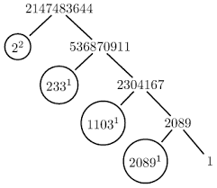
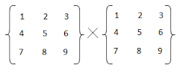


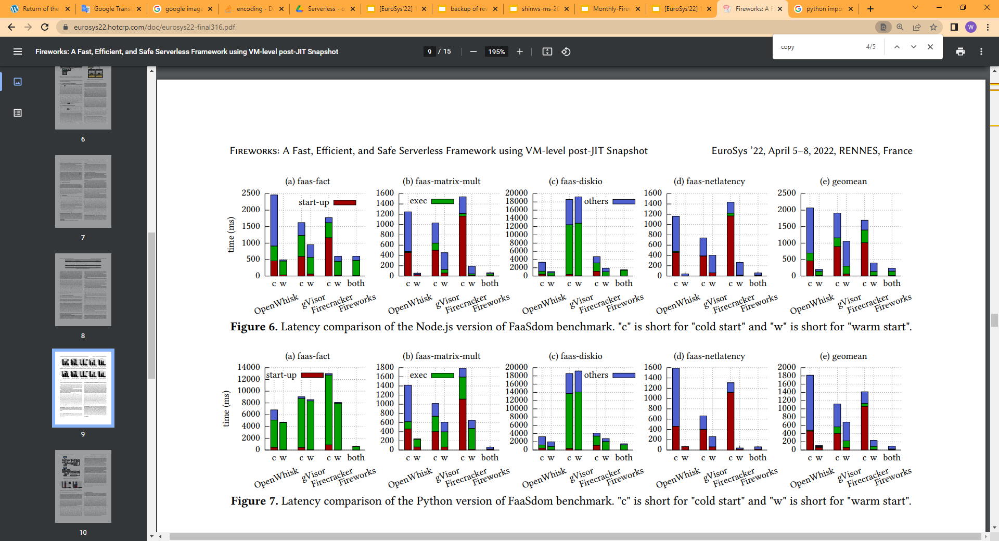
Microbenchmark : Python
write
read
faas-fact
faas-matrix-mult
faas-diskio
faas-netlatency
Notes:
Here is faasdom benchmark evaluation in Python.
Faasdom benchmark provides compute intensive and I/O intensive workloads
(next)
We can see that the start-up time shown in red and the execution time shown in green have been reduced as a result of the snapshot and JIT compilation of FIREWORKS.
====================================================================
The X-axis is for each serverless platform, and c stands for cold start and w stands for the warm start.
As we discuss before,
The cold start is a case in which the sandbox is not ready for the first incoming request.
And warm start is when the resources are reused.
The Y-axis means the time it takes, and it can be seen that the lower the value, the better the performance.
Red color indicates booting time, blue one indicates execution time, and green is other network delay or disk I/O time.
(next)
We can see that the start-up time shown in red and the execution time shown in green have been reduced as a result of the snapshot and JIT compilation of FIREWORKS.

Slide 20

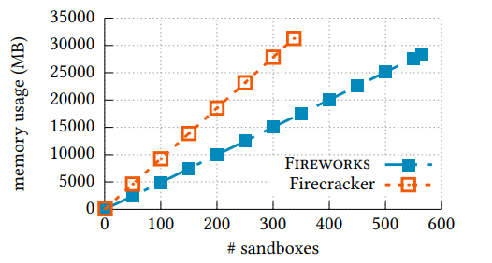

Memory Usage
FIREWORKS can make 565 sandboxes, and Firecracker can make 337 sandboxes without the swap memory
It allows FIREWORKS to consolidate 167% more sandbox than Firecracker
Notes:
We also measured how many sandboxes can run on just one server.
FIREWORKS can run 60% more sandboxes than Firecracker.

Slide 21
Conclusion
Seeking a safe, efficient, high performance serverless framework continues.
FIREWORKS can get all three:
We designed, implemented, and evaluated new serverless framework by using VM-level snapshots and JIT-based snapshots
20 time shorter (cold) startup time, 7 times lower memory footprint
The achievements give a guidance to utilize JIT and Snapshot in the serverless computing.
VM-level
Post-JIT
Snapshot
Safe
High performance
Efficiency
Notes:
In serverless, Efforts to achieve security, efficiency and high performance are continue.
Fireworks: VM-level post-JIT snapshots can achieve all three things.
by designing, implementing, and evaluating this new serverless framework, we hope to guide you through the use of Just-in-time compilation and snapshot.
thank you for your time.

