Slide 1


VIP: Safeguard Value Invariant Property for Thwarting Critical Memory Corruption Attacks
Mohannad Ismail (Virginia Tech), Jinwoo Yom (Virginia Tech), Christopher Jelesnianski (Virginia Tech), Yeongjin Jang (Oregon State University), Changwoo Min (Virginia Tech)
CCS '21: Proceedings of the 2021 ACM SIGSAC Conference on Computer and Communications Security

Slide 2
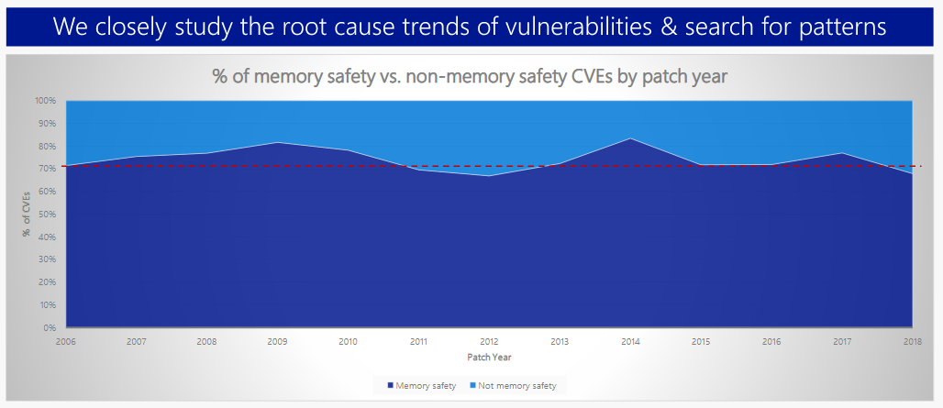
Memory corruption vulnerability is root of all EVIL
Microsoft reported that 70% of all security bugs are due to various memory safety issues.
Top three memory corruption attacks:
Heap out-of-bounds.
Use-after-free.
Type confusion.

Slide 3
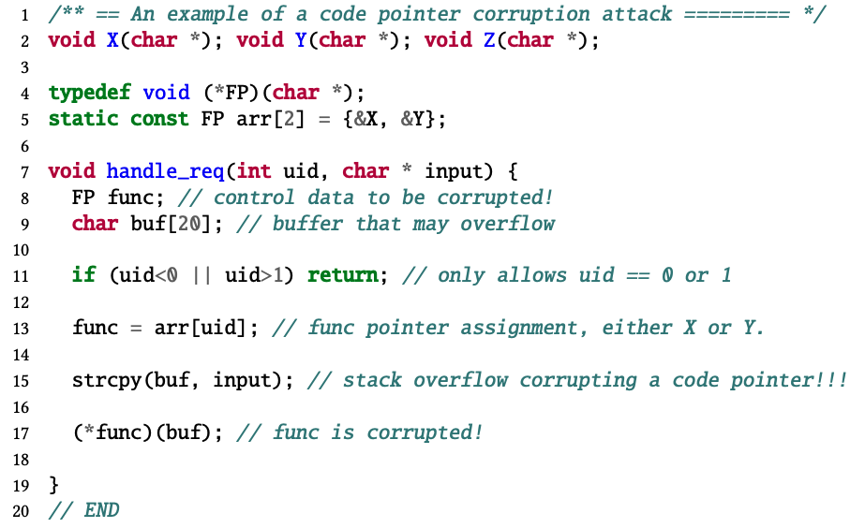

Vulnerable Control Data Example
stack
0x00
buf
Malicious ptr
func = &X
func
0xff
ret

Slide 4
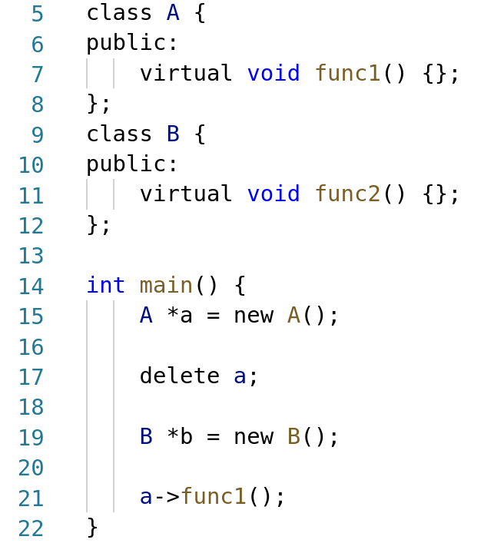
C++ VTable pointer Use-after-free example
Stack
Heap
A’s VTable
func1()
Class A
Class A
Class B
b
b
B’s VTable
a
a
func2()
ret

Slide 5
Problems with state-of-the-art techniques
Incur high overhead (e.g., DFI [OSDI06]):
Frequent metadata lookup.
Excessive instrumentation.
Require additional resources (e.g., uCFI [CCS18]):
Dedicated CPU cores for background analysis.
Are narrow-scoped defense (e.g., OTI [NDSS18]):
Needs to be used orthogonally with other defense techniques to provide stronger security.

Slide 6
Breaking an essential step in memory corruption attacks
Solution
STEP 1
STEP 2
STEP 3
STEP 4
STEP 4
Read program layout.
Use corrupted data
Locate sensitive data
(e.g., code pointers).
Corrupt sensitive data.
Use corrupted data
Do NOT allow attackers to use the corrupted data.

Slide 7
Outline
Introduction
Value Invariant Property (VIP)
HyperSpace
Implementation
Evaluation
Discussion
Conclusion

Slide 8
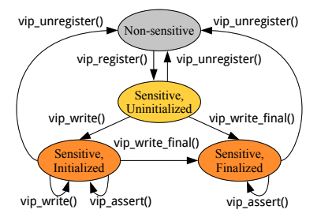
Overview of Value Invariant Property (VIP)
Our intuition behind VIP originates from a common pattern in programs:
Security-sensitive data should never be changed between two legitimate writes so there is a period such that security-sensitive data is immutable.
This period is represented by the state transition diagram, that relies on VIP primitives to enforce value integrity of security-sensitive data.

Slide 9
Overview of Value Invariant Property (VIP)
VIP maintains a shadow copy of sensitive data in an isolated “safe” region.
VIP checks and verifies value integrity instead of tracking control-flow.
To provide value integrity, VIP checks if the “value” of sensitive data is corrupted or not.
If corruption is detected, VIP will raise a security exception.
Compromised application is halted and prevented from executing further.

Slide 10
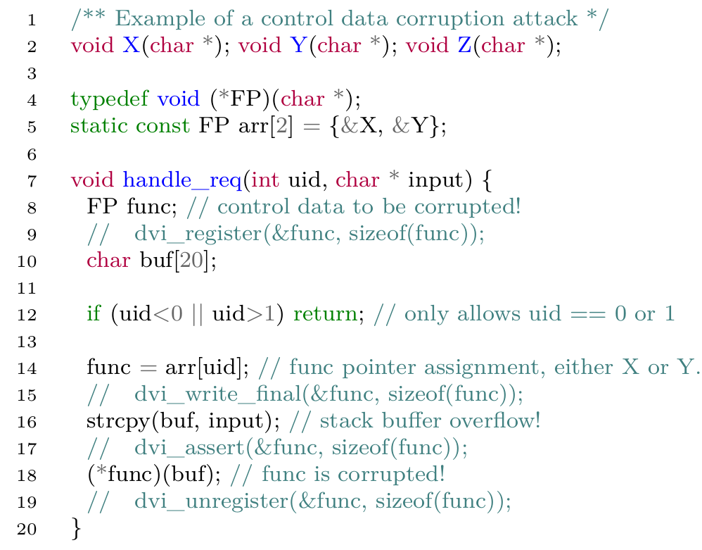

Main concept of VIP for Control data
Stack
Safe region
0x00
buf
Mismatched!
Malicious ptr
func = &X
func
func = &X
ret
0xff
// validation failed, program aborted!

Slide 11
Main concept of VIP for C++ VTable use-after-free
Stack
Heap
A’s VTable
func1()
b
b
Class A
Class A
Class B
a
B’s VTable
a
ret
func2()
Safe Region + data status
b
Registered,Initialized
Registered,Initialized
a
Registered,Initialized
Registered,Initialized
Registered,Initialized
Can’t use deregistered data!

Slide 12
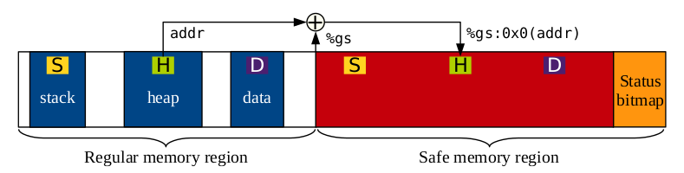
VIP safe memory region
The safe memory region is created by VIP’s modified Kernel.
Application’s memory space is bisected into regular and safe memory regions.
Status bitmap region holds the status bits for data that exists in the safe memory region.
8 byte in safe memory => 2 bits in status bitmap.
Maximum memory overhead is bounded to 103.1%.
%gs register holds the start address of safe region and used for fast safe region access.

Slide 13
Security of the safe memory region
The main issue with the use of the safe region is how to secure it from being maliciously corrupted.
Previous works, such as CPI [1], relied on information hiding.
The main challenge is ensuring that the only way to access the safe region is through the legitimate program logic.
In order to overcome this challenge, we rely on Intel’s Memory Protection Keys (MPK).
By leveraging MPK, we can unlock the safe region when access is needed by the program, and then lock it to prevent illegitimate access.
[1] Volodymyr Kuznetsov, László Szekeres, Mathias Payer, George Candea, R Sekar, and Dawn Song. 2014. Code-Pointer Integrity. In Proceedings of the 11th USENIX Symposium on Operating Systems Design and Implementation (OSDI). Broomfield, Colorado

Slide 14
Memory Protection Keys (MPK)
Intel’s new hardware primitive.
Utilizes previously unused 4 bits in each page table for upto 16 different fine-grained access control keys.
New user-accessible register (PKRU) with Access/Write disable bits for each key.
PKRU is a CPU register; thus, is thread-local.
Two new instructions:
rdpkru - for reading page permission.
wrpkru - for modifying page permission.
MPK protected!
Read-only access
Read/Write access

Slide 15
Outline
Introduction
Value Invariant Property (VIP)
HyperSpace
Implementation
Evaluation
Discussion
Conclusion

Slide 16
HyperSpace
HyperSpace manages the state of a memory location.
When a program starts, the entire memory space is in a non-sensitive state, meaning that no memory location stores security-sensitive data.
HyperSpace first requires the location to be registered upon its allocation. Then, the memory will be in a sensitive, uninitialized state.
Once the security-sensitive data is written to the memory location, the memory will be in a sensitive, initialized state.
If we know a write should be the final one until the deallocation of the memory, then we can put the memory into a sensitive, finalized state, and HyperSpace does not allow any further writes to that memory location.
These restrictions are enforced by HyperSpace with MPK.

Slide 17
HyperSpace
Fully implemented prototype that enforces VIP.
Four Defense Mechanisms:
Control flow integrity (VIP-CFI)
Protects all code pointers.
C++ VTable pointers protection (VIP-VTPtr)
Protects all virtual function table pointers (VTPtrs).
Code pointer integrity (VIP-CPI)
VIP-CFI and VIP-VTPtr protection + all sensitive object pointer protections.
HyperSpace heap metadata protection
Protect against inline heap metadata corruption attacks.

Slide 18





What is sensitive data?
Sensitive data varies for each security mechanism:
All function pointers.
<- VIP-CFI
& VIP-CPI
<- VIP-VTPtr
& VIP-CPI
VTPtrs in C++ objects.
Sensitive Object pointers.
<- VIP-CPI
How can we detect these sensitive data?
Recursive static analysis/Instrumentation.

Slide 19
Optimization
MPK is fast, but it’s not fast enough:
rdpkru ~0.5 CPU cycles
wrpkru ~23.3 CPU cycles
Frequent usage of wrpkru to modify safe region can incur significant overhead.
There is no single optimization that significantly improved performance across all components.
Six major optimizations:
Inlining DVI functions.
Not instrumenting objects in the SafeStack.
Runtime checks to reduce permission changes.
Coalescing permission changes within a Basic Block.
Coalescing permission changes within a safe function.
Huge Page enabled.
Reduces wrpkru usage!

Slide 20
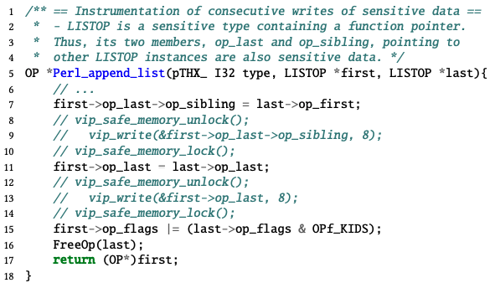
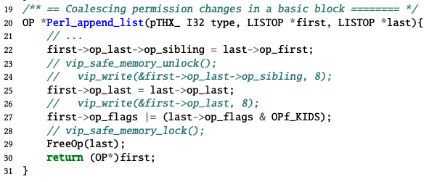
Optimization: Basic-block level coalescing
To reduce the unnecessary toggling of safe memory region permissions, we introduce an optimization technique to coalesce a series of HyperSpace protection instrumentation within a basic block.
All memory writes in a coalescing-safe basic block are guaranteed to not be capable of corrupting arbitrary memory locations.
Before
After

Slide 21
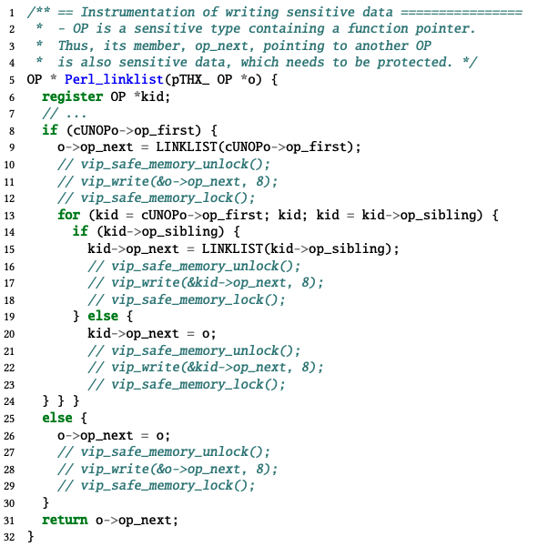
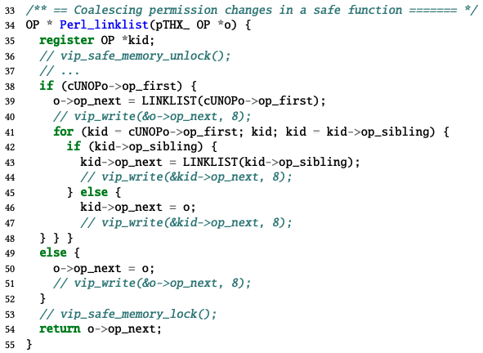
Optimization: Function-level coalescing
All basic blocks in the function are coalescing-safe.
It does not contain any indirect calls.
All direct call targets are coalescing-safe functions.
Before
After

Slide 22
Outline
Introduction
Value Invariant Property (VIP)
HyperSpace
Implementation
Evaluation
Discussion
Conclusion

Slide 23





HyperSpace Implementation
LLVM Compiler pass
Linux Kernel modification
Custom compiler pass for static analysis and instrumentation
(2516 LoC)
Bisect the memory layout of VIP enabled executables
(378 LoC)
VIP API library
Library for VIP primitives
(505 LoC)
+Additional support
ptmalloc inlining for heap metadata protection
(902 LoC)

Slide 24
Outline
Introduction
Value Invariant Property (VIP)
HyperSpace
Implementation
Evaluation
Discussion
Conclusion

Slide 25
Evaluation setup
2 x Intel Xeon Silver 4116 processor (2.10 GHz)
128GB DRAM
12 Cores
Fedora 28 Server Edition + Linux Kernel v5.0
Compiled using LLVM SafeStack
Linked with GNU gold v2.29.1-23.fc28
Security evaluation with:
3 real-world exploits (CVEs)
6 synthesized attacks
Performance/Memory evaluation with:
SPEC CPU 2006
NGINX (v1.14.2)
PostgreSQL

Slide 26
Security Evaluation
We evaluated HyperSpace with three real-world exploits and six synthesized attacks. These attacks demonstrate the effectiveness and versatility of HyperSpace.
Real-world exploits:
CVE-2016-10190 : Heap-based buffer overflow in ffmpeg.
CVE-2015-8668 : Heap-based buffer overflow in libtiff.
CVE-2014-1912 : Buffer overflow in Python2.7.
All prevented when using VIP-CFI/CPI, since exploit occurs on sensitive pointers.
C++ VTPtr synthesized attacks:
CFIXX C++ test suite released by Burow et al (VTPtr hijacking attacks).
COOP attack.
All prevented using VIP-CFI/CPI protection since we protect the VTPtrs
Synthesized heap attack:
Overwrite inline metadata of an allocated heap memory during “unlink”; while removing a memory chunk.
HyperSpace’s heap metadata protection can defend this, since we write/assert the metadata during all malloc/free functions.

Slide 27
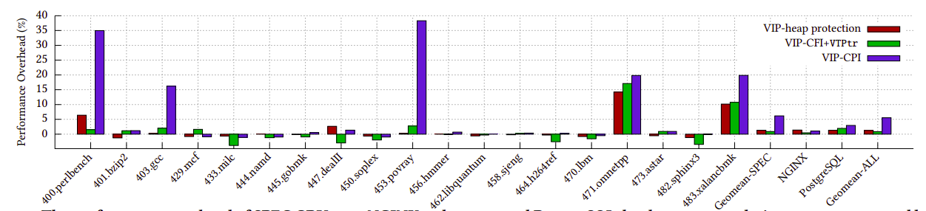
Runtime overhead of HyperSpace
Heap Metadata Protection
Average: 1.40%
Median: -0.23%
VIP-CFI + VTPtr
Average: 1.02%
Median: 0.23%
VIP-CPI
Average: 6.35%
Median: 0.67%
HyperSpace

Slide 28
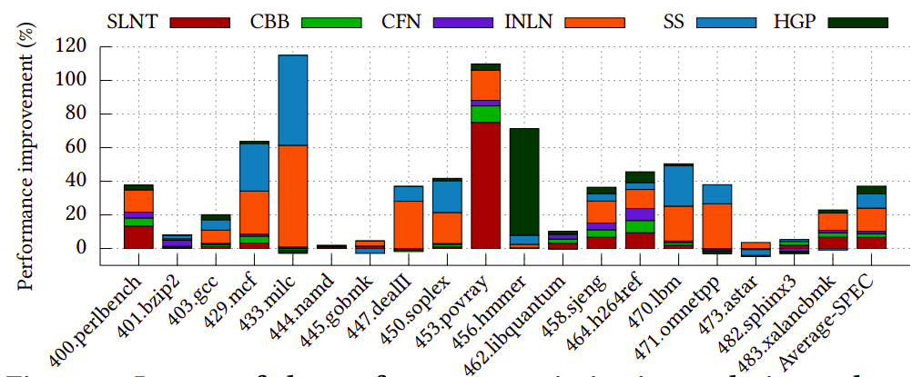
Impact of the optimization techniques
Optimizations
INLN = DVI API inlining
SS = SafeStack
RNT = Runtime permission check
CBB = Basic Block-level coalescing
CFN = Function-level coalescing
HGP = Huge Page

Slide 29
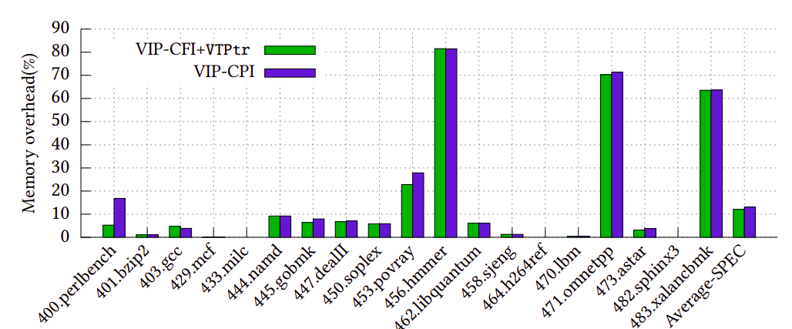
Memory overhead of HyperSpace
HyperSpace
VIP-CPI
Average: 15.47%
Median: 5.88%
VIP-CFI+VTPtr
Average: 14.42%
Median: 5.27%

Slide 30
Outline
Introduction
Value Invariant Property (VIP)
HyperSpace
Implementation
Evaluation
Discussion
Conclusion

Slide 31
Discussion
Could MPK be misused?
Because all MPK instructions, including wrpkru, are unprivileged instructions, if an attacker could subvert the control flow and change the MPK permission of the safe region to read-writable, then she is able to bypass HyperSpace defenses.
However, such an attack is unfeasible if the control flow is protected by HyperSpace’s control flow hijacking defenses (e.g., VIP-CFI/CPI).

Slide 32
Comparison with the state-of-the-art
Control Flow Integrity (CFI):
OS-CFI [1] incurs 7.1% and 𝜇CFI [2] incurs 9.9% performance overhead running SPEC CPU2006 Benchmark suite (while also requiring one dedicated CPU core for trace analysis).
VIP-CPI incurs less overhead (6.18%) while guaranteeing better security and does not require running additional threads for protection.
Code Pointer Integrity (CPI):
CPI [3] suffers from reliance on information hiding to protect its safe region.
VIP’s optimized use of MPK solves this. We have several optimizations that reduce the performance overhead, and guarantee better security.
VIP also goes a step further by protecting heap metadata which is not considered in CPI.
Object Type Integrity (OTI):
OTI [4] incurs 4.98% of performance overhead in the SPEC CPU2006 benchmark.
VIP offers better performance as well as greater protection coverage. Our evaluation of VIP-CFI+VTPtr incurs only 0.88% of performance overhead.
[1] Mustakimur Rahman Khandaker, Wenqing Liu, Abu Naser, Zhi Wang, and Jie Yang. 2019. Origin-sensitive Control Flow Integrity. In Proceedings of the 28th USENIX Security Symposium (Security).
[2] Hong Hu, Chenxiong Qian, Carter Yagemann, Simon Pak Ho Chung, William R. Harris, Taesoo Kim, and Wenke Lee. 2018. Enforcing Unique Code Target Property for Control-Flow Integrity. In Proceedings of the 25th ACM Conference on Computer and Communications Security (CCS).
[3] Volodymyr Kuznetsov, László Szekeres, Mathias Payer, George Candea, R Sekar, and Dawn Song. 2014. Code-Pointer Integrity. In Proceedings of the 11th USENIX Symposium on Operating Systems Design and Implementation (OSDI).
[4] Nathan Burow, Derrick McKee, Scott A. Carr, and Mathias Payer. 2018. CFIXX: Object Type Integrity for C++ Virtual Dispatch. In Proceedings of the 2018 Annual Network and Distributed System Security Symposium (NDSS).

Slide 33
Outline
Introduction
Value Invariant Property (VIP)
HyperSpace
Implementation
Evaluation
Discussion
Conclusion

Slide 34
Conclusion
Value Invariant Property (VIP) is a new defense policy that provides a versatile and elegant solution to thwarting memory corruption exploits.
Our prototype, HyperSpace, enforces VIP to provide various security mechanisms with the strongest guarantee (VIP-CPI) having 6.35% runtime overhead and 15.47% memory overhead.
Contributions:
VIP.
HyperSpace.
Optimization of HyperSpace.
Thorough evaluation of HyperSpace.
Thank You !

