Slide 1


Protect the System Call, Protect (most of) the World with BASTION
Christopher Jelesnianski, Mohannad Ismail, Yeongjin Jang*, Dan Williams, Changwoo Min
*
Notes:
Good morning My name is Christopher Jelesnianski
This work regarding system call protection is a joint effort between myself, Mohannad Ismail, Dr Jang, Dr. Williams and Dr. Min
So lets get into it!

Slide 2
Takeaway
System Calls are important
Core API interface between processes and the Operating System
Prevalent medium for code reuse to compromise entire system from a vulnerable application
Minimal guarding of System Calls
Linux seccomp
Eliminating surface area instead of eliminating abuse
Coarse-grained defenses
System Call Integrity: A targeted methodology to shore up system call defenses
Protection of the system, not protection of the application
Fine-grained & specialized protection that is efficient and strong
Notes:
The takeaway today is that system calls are important and should be respected as much, but thats not the case, They are a two-sided coin
There exist minimal protections, with Linux seccomp being the only deployed system call allowlist/denylist mechanism
Work has been proposed in this area, but it all focuses on eliminating surface area and usability of seccomp.
The goal of System Call Integrity is to ensure legitimate usage of system calls and even if an application has vulnerabilities, it can still be “contained” by SCI to not allow execution to go beyond the scope of that vulnerable application.
Linux introduces strong isolation boundaries and segregates the virtual memory into user space and kernel space to provide memory protection and hardware protection from malicious or errant software behavior [1]. All privileged functions, such as process scheduling, IPC (Inter-process communication), memory management, and network management et al., can only be executed in the kernel space. The only interface for switching from user space to kernel space is via the system call mechanism.
The latest stable Linux kernel (v5.18) provides about 350 system calls

Slide 3

Medium for Critical Attacks
Many code re-use attacks end-goal require leveraging a system call
Memory vulnerabilities continue to persist
Attacker intermediate steps may cause undefined behavior in application
But, cannot leave application process scope without system call
Majority system calls are non-security sensitive
Attack surface of Linux System Calls
OS Scope
chmod
exit
mprotect
mmap
Process 1
Process …
Process N
fstat
getfattr
getrlimit
uname
tee
epoll_wait
execve
fork
close_range
Notes:
System call are a controlled way to reach the OS, but jumping out can will break the system

Slide 4

Medium for Critical Attacks
Many code re-use attacks end-goal require leveraging a system call
Memory vulnerabilities continue to persist
Attacker intermediate steps may cause undefined behavior in application
But, cannot leave application process scope without system call
Majority system calls are non-security sensitive
Attack surface of Linux System Calls
OS Scope
chmod
exit
mprotect
mmap
Process 1
Process …
Process N
fstat
getfattr
getrlimit
uname
tee
epoll_wait
execve
fork
close_range
Notes:
Security sensitive system calls
system call are a controlled way to reach the OS, but jumping out can will break the system

Slide 5

Medium for Critical Attacks
Many code re-use attacks end-goal require leveraging a system call
Memory vulnerabilities continue to persist
Attacker intermediate steps may cause undefined behavior in application
But, cannot leave application process scope without system call
Majority system calls are non-security sensitive
Attack surface of Linux System Calls
OS Scope
chmod
exit
mprotect
mmap
Process 1
Process …
Process N
fstat
getfattr
getrlimit
uname
tee
epoll_wait
execve
fork
close_range
Notes:
Security sensitive system calls
system call are a controlled way to reach the OS, but jumping out can will break the system

Slide 6
System Call Defenses (and why they don’t do enough)
Defenses
Linux seccomp
Linux deployed coarse-grained allowlist/denylist
Automated System Call Filtering
sysfilter: Automated system call filtering for commodity software [RAID’20]
Refined Whitelisting
Temporal System Call Specialization [USENIX Sec’20]
Bottom Line
Coarse-grained filtering is not sufficient
System calls cannot be disabled because of core process necessity
Coincidently are targeted for attacker abuse
e.g., execve, mmap, mprotect
Instead of finding system call minimal set, find meaningful context surrounding system calls!
Notes:
Explain what seccomp is exactly
this is allow/deny list
Filtering = finding minimal set
(not sufficient)
there are some research efforts to improve seccomp such as automation and refinement
BUT
the core limitation is still coarse grained
and bottom line these defenses cannot handle core insight 1 (bullet 2)
System calls that cannot be disabled because of core process necessity coincidently are security-sensitive and are the ones abused by attackers!

Slide 7

Our Work: Introduction of System Call Integrity
execve( ctx->path, ctx->argv, ctx->envp );
‹#›
Notes:
The key idea behind our work is observing attacker abuse of system call invocation and shoring up defenses.
We introduce a new concept called System Call Integrity that is comprised of 3 primary contexts, all concerned with ensuring legitimate system call usage.
For example, for the system call below execve
System Call Integrity enforces that
it is reached legitimately with an expected control-flow
it is invoked correctly
and that none of it's arguments are corrupted

Slide 8

Our Work: Introduction of System Call Integrity
System Call Integrity
Comprised of three contexts
Based on attacker pattern insight
Attacker Pattern Insight:
How are system calls invoked?
How are system calls reached?
What is passed to system calls?
execve( ctx->path, ctx->argv, ctx->envp );
‹#›
Notes:
The key idea behind our work is observing attacker abuse of system call invocation and shoring up defenses.
We introduce a new concept called System Call Integrity that is comprised of 3 primary contexts, all concerned with ensuring legitimate system call usage.
For example, for the system call below execve
System Call Integrity enforces that
it is reached legitimately with an expected control-flow
it is invoked correctly
and that none of it's arguments are corrupted

Slide 9
Our Work: Introduction of System Call Integrity
System Call Integrity
Comprised of three contexts
Based on attacker pattern insight
Call-Type Context
Is this system call allowed to be called indirectly?
Attacker Pattern Insight:
How are system calls invoked?
How are system calls reached?
What is passed to system calls?
1
execve( ctx->path, ctx->argv, ctx->envp );
‹#›
Notes:
The key idea behind our work is observing attacker abuse of system call invocation and shoring up defenses.
We introduce a new concept called System Call Integrity that is comprised of 3 primary contexts, all concerned with ensuring legitimate system call usage.
For example, for the system call below execve
System Call Integrity enforces that
it is reached legitimately with an expected control-flow
it is invoked correctly
and that none of it's arguments are corrupted

Slide 10
Our Work: Introduction of System Call Integrity
System Call Integrity
Comprised of three contexts
Based on attacker pattern insight
Call-Type Context
Is this system call allowed to be called indirectly or at all?
Attacker Pattern Insight:
How are system calls invoked?
How are system calls reached?
What is passed to system calls?
Control-Flow Context
Does the live stack trace match expected program control-flow?
2
1
execve( ctx->path, ctx->argv, ctx->envp );
‹#›
Notes:
The key idea behind our work is observing attacker abuse of system call invocation and shoring up defenses.
We introduce a new concept called System Call Integrity that is comprised of 3 primary contexts, all concerned with ensuring legitimate system call usage.
For example, for the system call below execve
System Call Integrity enforces that
it is reached legitimately with an expected control-flow
it is invoked correctly
and that none of it's arguments are corrupted

Slide 11
Our Work: Introduction of System Call Integrity
System Call Integrity
Comprised of three contexts
Based on attacker pattern insight
Call-Type Context
Is this system call allowed to be called indirectly?
Attacker Pattern Insight:
How are system calls invoked?
How are system calls reached?
What is passed to system calls?
Control-Flow Context
Does the live stack trace match expected program control-flow?
Argument Integrity Context
Are any arguments corrupted?
2
1
3
execve( ctx->path, ctx->argv, ctx->envp );
‹#›
Notes:
The key idea behind our work is observing attacker abuse of system call invocation and shoring up defenses.
We introduce a new concept called System Call Integrity that is comprised of 3 primary contexts, all concerned with ensuring legitimate system call usage.
For example, for the system call below execve
System Call Integrity enforces that
it is reached legitimately with an expected control-flow
it is invoked correctly
and that none of it's arguments are corrupted

Slide 12
System Call Integrity - 1 - Call Type Context
Guarantee: Only permitted system calls are allowed to be called in their expected manner
Assigned Per-System-Call
3 Types
Example
1 void foo ( int f0 ){
2
3 int flags = MAP_ANON|MAP_SHARED;
4 bar( x1, flags );
5 ...
6 }
7 void bar ( char* b1, int b2 ){
8 int prots = PROT_READ|PROT_WRITE;
9 mmap( NULL, gshm->size, prots, b2,
-1, 0 );
10 ...
}
Notes:
Not Callable - are system calls never used by the application

Slide 13

System Call Integrity - 1 - Call Type Context
Guarantee: Only permitted system calls are allowed to be called in their expected manner
Assigned Per-System-Call
3 Types
Example
1 void foo ( int f0 ){
2
3 int flags = MAP_ANON|MAP_SHARED;
4 bar( x1, flags );
5 ...
6 }
7 void bar ( char* b1, int b2 ){
8 int prots = PROT_READ|PROT_WRITE;
9 mmap( NULL, gshm->size, prots, b2,
-1, 0 );
10 ...
}
Not-Callable
Notes:
Not Callable - are system calls never used by the application

Slide 14

System Call Integrity - 1 - Call Type Context
Guarantee: Only permitted system calls are allowed to be called in their expected manner
Assigned Per-System-Call
3 Types
Example
1 void foo ( int f0 ){
2
3 int flags = MAP_ANON|MAP_SHARED;
4 bar( x1, flags );
5 ...
6 }
7 void bar ( char* b1, int b2 ){
8 int prots = PROT_READ|PROT_WRITE;
9 mmap( NULL, gshm->size, prots, b2,
-1, 0 );
10 ...
}
Not-Callable
Directly
Callable
traditional
direct call
Notes:
Not Callable - are system calls never used by the application

Slide 15

System Call Integrity - 1 - Call Type Context
Guarantee: Only permitted system calls are allowed to be called in their expected manner
Assigned Per-System-Call
3 Types
Example
1 void foo ( int f0 ){
2
3 int flags = MAP_ANON|MAP_SHARED;
4 bar( x1, flags );
5 ...
6 }
7 void bar ( char* b1, int b2 ){
8 int prots = PROT_READ|PROT_WRITE;
9 mmap( NULL, gshm->size, prots, b2,
-1, 0 );
10 ...
}
Not-Callable
Directly
Callable
traditional
direct call
Indirectly-Callable
code pointers
Notes:
Not Callable - are system calls never used by the application

Slide 16
System Call Integrity - 1 - Call Type Context
Guarantee: Only permitted system calls are allowed to be called in their expected manner
Assigned Per-System-Call
3 Types
Example
1 void foo ( int f0 ){
2
3 int flags = MAP_ANON|MAP_SHARED;
4 bar( x1, flags );
5 ...
6 }
7 void bar ( char* b1, int b2 ){
8 int prots = PROT_READ|PROT_WRITE;
9 mmap( NULL, gshm->size, prots, b2,
-1, 0 );
10 ...
}
Applicable to
All System Calls
Not-Callable
Directly
Callable
traditional
direct call
Indirectly-Callable
code pointers
Notes:
Not Callable - are system calls never used by the application

Slide 17
System Call Integrity - 1 - Call Type Context
Guarantee: Only permitted system calls are allowed to be called in their expected manner
Assigned Per-System-Call
3 Types
Example
1 void foo ( int f0 ){
2
3 int flags = MAP_ANON|MAP_SHARED;
4 bar( x1, flags );
5 ...
6 }
7 void bar ( char* b1, int b2 ){
8 int prots = PROT_READ|PROT_WRITE;
9 mmap( NULL, gshm->size, prots, b2,
-1, 0 );
10 ...
}
Applicable to
All System Calls
Not-Callable
Sensitive System Calls Only
Directly
Callable
traditional
direct call
Indirectly-Callable
code pointers
Notes:
Not Callable - are system calls never used by the application

Slide 18
System Call Integrity - 1 - Call Type Context
Guarantee: Only permitted system calls are allowed to be called in their expected manner
Assigned Per-System-Call
3 Types
Example
1 void foo ( int f0 ){
2
3 int flags = MAP_ANON|MAP_SHARED;
4 bar( x1, flags );
5 ...
6 }
7 void bar ( char* b1, int b2 ){
8 int prots = PROT_READ|PROT_WRITE;
9 mmap( NULL, gshm->size, prots, b2,
-1, 0 );
10 ...
}
Applicable to
All System Calls
Not-Callable
Sensitive System Calls Only
Directly
Callable
traditional
direct call
Indirectly-Callable
code pointers
Notes:
Not Callable - are system calls never used by the application

Slide 19

System Call Integrity - 1 - Call Type Context
Guarantee: Only permitted system calls are allowed to be called in their expected manner
Assigned Per-System-Call
3 Types
Example
1 void foo ( int f0 ){
2
3 int flags = MAP_ANON|MAP_SHARED;
4 bar( x1, flags );
5 ...
6 }
7 void bar ( char* b1, int b2 ){
8 int prots = PROT_READ|PROT_WRITE;
9 mmap( NULL, gshm->size, prots, b2,
-1, 0 );
10 ...
}
Applicable to
All System Calls
Not-Callable
Sensitive System Calls Only
Directly
Callable
traditional
direct call
Indirectly-Callable
code pointers
System Call | Call Type
mmap | Directly-Callable
mprotect | Not-Callable
Sensitive system call use is sparse & rarely invoked indirectly.
Notes:
Not Callable - are system calls never used by the application

Slide 20
System Call Integrity - 2 - Control Flow Context
Guarantee: A sensitive system call is reached and invoked only through legitimate control-flow paths during runtime
Example
1 void foo ( int f0 ){
2
3 int flags = MAP_ANON|MAP_SHARED;
4 bar( x1, flags );
5 ...
6 }
7 void bar ( char* b1, int b2 ){
8 int prots = PROT_READ|PROT_WRITE;
9 mmap( NULL, gshm->size, prots, b2,
-1, 0 );
10 ...
}

Slide 21
System Call Integrity - 2 - Control Flow Context
Guarantee: A sensitive system call is reached and invoked only through legitimate control-flow paths during runtime
Example
1 void foo ( int f0 ){
2
3 int flags = MAP_ANON|MAP_SHARED;
4 bar( x1, flags );
5 ...
6 }
7 void bar ( char* b1, int b2 ){
8 int prots = PROT_READ|PROT_WRITE;
9 mmap( NULL, gshm->size, prots, b2,
-1, 0 );
10 ...
}
Call chains of sensitive system calls are usually short!
Valid Control Flow
bar < foo
mmap < bar
...

Slide 22
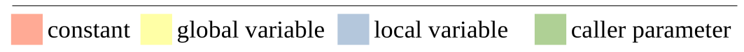
System Call Integrity - 3 - Argument Integrity Context
Guarantee: A sensitive system call can only use valid arguments when being invoked
Even if attackers have access to memory corruption vulnerabilities
Example
1 void foo ( int f0 ){
2
3 int flags = MAP_ANON|MAP_SHARED;
4 bar( x1, flags );
5 ...
6 }
7 void bar ( char* b1, int b2 ){
8 int prots = PROT_READ|PROT_WRITE;
9 mmap( NULL, gshm->size, prots, b2,
-1, 0 );
10 ...
}
Argument Type Coverage
Constants
Global Variables
Local Variables
Caller Parameters
Call depth to set system call arguments is fairly shallow – within the same function or only a few functions away.

Slide 23




BASTION Overview - System Call Integrity in Practice
BASTION Compiler
BASTION Runtime Monitor
Operating System
Every Sensitive System Call intercepted by BASTION
Static analysis
Record metadata
Sensitive variable instrumentation
Separate process
Leverage context metadata
Dynamic context checking
User Application
Notes:
Compiler Analysis is static and walks through entire LLVM IR

Slide 24
BASTION Compiler - Argument Integrity Context
1 void foo ( int f0 ){
2
3
4 int flags = MAP_ANON|MAP_SHARED;
5
6
7 bar( x1, flags );
8 ...
9 }
10 void bar ( char* b1, int b2 ){
11
12 int prots = PROT_READ|PROT_WRITE;
13
14
15
16
18
19
20
21
22 mmap( NULL, gshm->size, prots, b2, -1, 0 );
...
Procedure
Instrumented as inline assembly
Use variable use-def chains derived from LLVM IR
Static and dynamic variable support
Instrumentation
Notes:
can talk less here

Slide 25
BASTION Compiler - Argument Integrity Context
1 void foo ( int f0 ){
2
3
4 int flags = MAP_ANON|MAP_SHARED;
5
6
7 bar( x1, flags );
8 ...
9 }
10 void bar ( char* b1, int b2 ){
11
12 int prots = PROT_READ|PROT_WRITE;
13
14
15
16
18
19
20
21
22 mmap( NULL, gshm->size, prots, b2, -1, 0 );
...
Procedure
Instrumented as inline assembly
Use variable use-def chains derived from LLVM IR
Static and dynamic variable support
ctx_write_mem(&flags, sizeof(int));
Instrumentation
Instrumentation
ctx_write_mem(&b2, sizeof(int));
ctx_write_mem()
Added at each argument write operation
ctx_write_mem(&prots, sizeof(int));
Notes:
can talk less here

Slide 26
BASTION Compiler - Argument Integrity Context
1 void foo ( int f0 ){
2
3
4 int flags = MAP_ANON|MAP_SHARED;
5
6
7 bar( x1, flags );
8 ...
9 }
10 void bar ( char* b1, int b2 ){
11
12 int prots = PROT_READ|PROT_WRITE;
13
14
15
16
18
19
20
21
22 mmap( NULL, gshm->size, prots, b2, -1, 0 );
...
Procedure
Instrumented as inline assembly
Use variable use-def chains derived from LLVM IR
Static and dynamic variable support
ctx_write_mem(&flags, sizeof(int));
ctx_bind_mem_2(&flags);
Instrumentation
ctx_write_mem(&b2, sizeof(int));
ctx_write_mem()
Added at each argument write operation
ctx_write_mem(&prots, sizeof(int));
ctx_bind_const_1(NULL);
ctx_bind_mem_2(&gshm->size);
ctx_bind_mem_3(&prots);
ctx_bind_mem()/ctx_bind_const()
Stages expected values for performing runtime checking
ctx_bind_mem_4(&b2);
ctx_bind_const_5(-1);
ctx_bind_const_6(0);
Notes:
can talk less here

Slide 27





BASTION Design - Monitor Component
Monitor Goals:
Act as liaison between application and OS
Safeguard system calls from arbitrary use!
Separate process
Isolates BASTION from untrusted application!
Attacker cannot bypass/disable BASTION hooks
Only check contexts when system call invoked
Minimize interference for max performance!
Runtime Monitor Procedure
Monitor
User Application
mmap() invoked
BASTION Runtime Monitor
mmap() completed
Context Metadata
Process State Information
Operating System
Checking Mechanism
PC & code
Stack
Registers & Instrumentation
Notes:
How to check Call Type Context?
Use PC & callsite type (assembly)
How to check Control Flow Context?
Use process stack (& perform unwinding)
How to check Argument Context?
Use registers & Instrumentation

Slide 28


BASTION Prototype Implementation
BASTION Compiler
LLVM 10.0.0
~4K LoC
BASTION Library API
~700 LoC
BASTION Monitor
~8K LoC
seccomp-BPF
ptrace
System
X86-64
Linux 5.19.14
LLVM
Compiler Infrastructure
Security-Sensitive System Calls (20)
Arbitrary Code Execution
execve, execveat, fork, vfork, clone, ptrace
Memory Permission Changes
mprotect, mmap, mremap, remap_file_pages
Privilege Escalation
chmod, setuid, setgid, setreuid
Networking Reconfiguration
socket, bind, connect, listen, accept, accept4

Slide 29


BASTION Evaluation
Evaluation Summary
Performance: System-call & I/O Intensive Applications
NGINX - Most widely deployed web server
SQLite - Database Engine
vsFTPd - FTP server
Security: 32 Attack Study: ROP payloads, real-world CVEs, & synthesized attacks
Evaluation Questions
Performance
What is each context’s performance impact?
How much overall performance overhead does BASTION impose?
Security
How secure is BASTION?
How does BASTION defend against different attack strategies?
How does BASTION compare to other security archetypes?

Slide 30
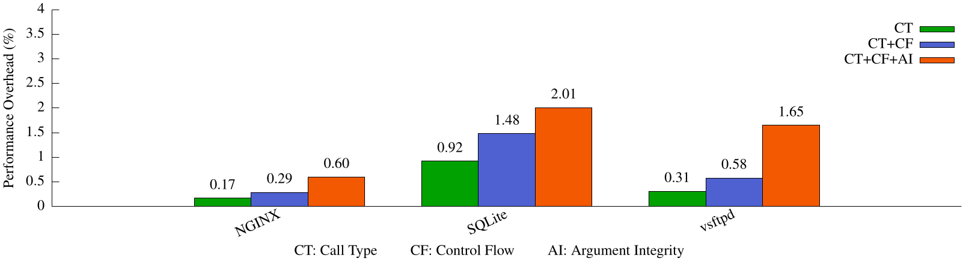
BASTION Performance
Argument Integrity Context is BASTION’s most expensive context to deploy
BASTION overall performance overhead is low (<2.01%)

Slide 31
BASTION Performance
Argument Integrity Context is BASTION’s most expensive context to deploy
BASTION overall performance overhead is low (<2.01%)

Slide 32
BASTION Performance
Argument Integrity Context is BASTION’s most expensive context to deploy
BASTION overall performance overhead is low (<2.01%)

Slide 33
BASTION Performance
Argument Integrity Context is BASTION’s most expensive context to deploy
BASTION overall performance overhead is low (<2.01%)

Slide 34

BASTION Security Analysis
Violated System Call Integrity Context
Attack Category | Call Type | Control Flow | Argument Integrity
Return-Oriented Programming (18) Stack pivot gives away ROP chain
Direct System Call Manipulation (9) Naive attacks corrupting function pointers
Indirect System Call Manipulation (5) Advanced attacks mimic valid program behavior All attacks attempt to corrupt arguments
NEWTON CPI Attack [SIGSAC’17]
AOCR Apache Attack [NDSS’17]
AOCR NGINX Attack 2 [NDSS’17]
COOP [S&P’15]
Control Jujutsu [CCS’15]

Slide 35
Conclusion
System Calls are an attacker gateway
Coarse-grained filtering is not enough
System call protection needs to be fine grained to be effective
System Call Integrity
System Call Integrity hardens system calls by applying three specialized contexts
Specialized coverage minimizes CPU interference while maximizing security around system calls
Looking Towards the Future
BASTION can be a stepping stone to enable configurable system call protection
BASTION can be expanded to add future contexts to protect against yet unknown system call threats
BASTION can be used as starting framework to protect against other system call threats
Notes:
maximizing security “specifically” around system calls

Slide 36
EXTRA SLIDES

Slide 37
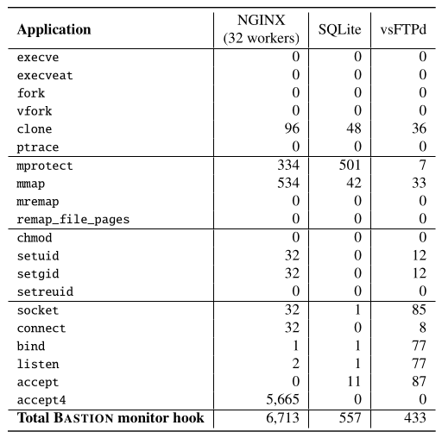
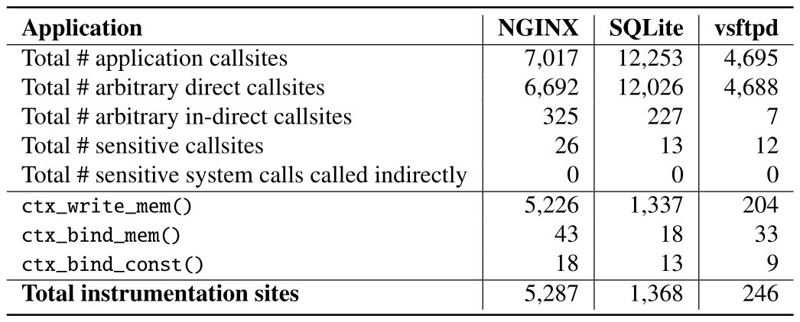
BASTION System Call Statistics
Some system calls are called more than others (e.g., accept4 vs connect)
System calls have sparse callsites
System calls very rarely invoked indirectly
Constant arguments are common

Slide 38
Other Considerations
Attacks able to bypass BASTION?
(subset of) Data-only attacks
In practice, will be difficult to overcome BASTION constraints
most information can be deduced from static analysis
Deploying BASTION to real-world (2 main challenges)
performance overhead - fine-grained defenses do constant checks to minimize deviation from correct control flow
Comparison to CFI
Call Type + Control Flow Context are NOT equivalent to CFI
Call Type is NOT per callsite
Control Flow is not application wide (only covers paths that eventually lead to system calls)
Effectiveness of BASTION under arbitrary memory corruption
info gained from static analysis significantly raises security
attacker would need to accurately recreate a fake version of all 3 contexts
In practice this would require MANY read/write operations to match constraints all the while STILL obeying all static constraints deduced from BASTION analysis

Slide 39
Other Considerations 2
Selection of “Sensitive System Calls”
Targets system calls enabling common attacker strategies aimed at escaping the scope of the victim application and reaching the underlying system
arbitrary code execution
memory permission changes
privilege escalation
network reconfiguration
We investigated open/write system call - this imposed significant performance overhead
We confirmed that overhead comes from fetching process state
Other competitors - Saffire (EuroS&P’20)
Explore fine-grained syscall filtering (of arguments)
BASTION is more secure as Saffire is a userspace solution (works inside scope of vulnerable application) and relies on fine-grained CFI to be in place to ensure their defense is not skipped
BASTION is faster than Saffire since the true performance cost for them is: CFI checking + Saffire checking
Selection of benchmarks
Did not look at compute bound benchmarks because these very rarely used security-sensitive system calls
Further, all compute benchmarks only used syscalls for initialization of datasets and importing libraries. very very rarely during computation phase

Slide 40
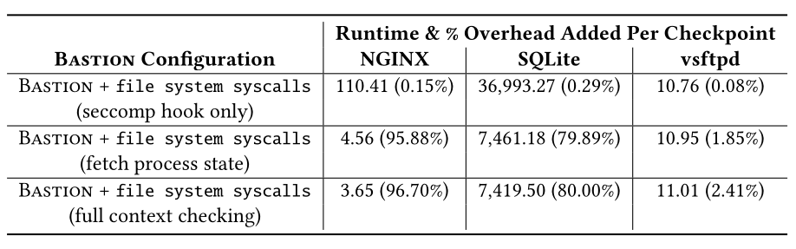
BASTION System Call Statistics 2
Even in the case of File system system calls, there was great contrast of call count (e.g., open (light use) vs write (heavy use) use in webserver)
Heavy system call invocation bottlenecked BASTION at context switching (userspace/kernelspace)
Would be resolved if BASTION was implemented directly in kernel (module)

