Slide 1

Practical Exploit Mitigation Design Against Code Re-Use and System Call Abuse Attacks
Christopher Jelesnianski
Ph.D. Dissertation Defense
December 2, 2022
Committee:
Changwoo Min (Chair)
Yeongjin Jang, Wenjie Xiong, Danfeng Yao, & Haibo Zeng
Notes:
Hello, my name is Christopher Jelesnianski. Today I will introduce my dissertation titled:
Practical Exploit Mitigation Against Code Re-Use Attacks & System Call Abuse

Slide 2

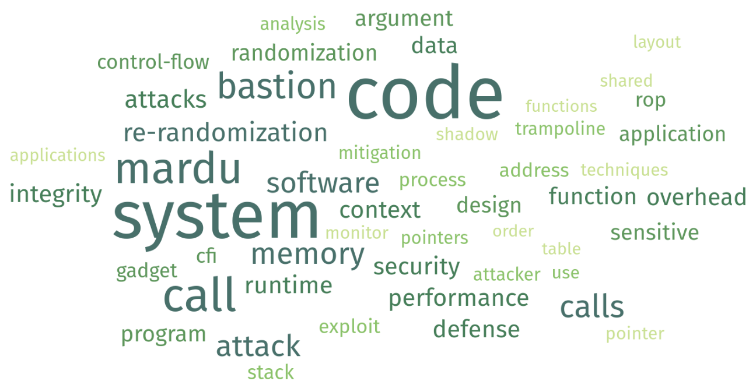
Executive Summary
Security Domain:
Why are software exploit mitigation designs not making it to market?
Core challenges to build practical exploit mitigations
How to make randomization effective against code re-use?
How to protect system calls?
System call usage is common theme among attacks
Gap exists in current security coverage of system calls
My Research:
Designing (& proof of concept of) practical exploit mitigations
Enabling randomization to be scalable and performant
Strengthening system call protection
Notes:
This dissertation dives into the security domain.
First, I explain why software exploit mitigation designs are not making it market and mainstream computing
Specifically, I expose what core challenges are being met to make practical defenses
With this knowledge
I chose to focus on code re-use attacks, as they are still a prominent attack type that have still not fully been addressed by the security community.
One way code re-use attacks are defended against is by using randomization, however traditional randomization is either weak security-wise or expensive performance-wise
This dissertation then moves on to work on a different part of the same problem, where we see that system calls are actually a common occurrence in code re-use attacks.
So to summarize this dissertation:
designs and implements two practical exploit mitigation designs
The first of which is a re-imagined version of continuous randomization
And the second is a fine-grained system call hardening scheme that can better protect system calls
Randomization is a technique with the most moving parts, so improving performance here can really give it a boost
does reactive randomization mechanism now make MARDU deterministic rather than probabilistic?? No because, in the end, still has randomization element
Empirical Survey of Security Defense Landscape
Observing missing qualities in current defenses
https://www.freewordcloudgenerator.com/generatewordcloud

Slide 3
Outline
Introduction
Background
MARDU: Practical Randomization
BASTION: Securing System Calls
Future Work & Conclusion
Notes:
So here is an Outline of what we will go over today
First, I will introduce the motivation for this work
Then I will explain the background regarding things like key terms and concepts related to this dissertation
Then I will briefly review MARDU, as it was previously presented in my Prelim
Then I will present BASTION.
And finally I will propose future work and conclude.
DO NOT SAY WHAT IS PRELIM AND WHAT IS NOW

Slide 4
Outline
Introduction
Motivation & Problem Statement
Background
MARDU: Practical Randomization
BASTION: Securing System Calls
Future Work & Conclusion
Notes:
So here is an Outline of what we will go over today
First, I will introduce the motivation for this work
Then I will explain the background regarding things like key terms and concepts
Then I will introduce and explain the contributions I have worked on for this thesis
Then I will propose the future work that still needs to be done
And finally summarize and conclude.

Slide 5
Mainstream Adoption of Software Mitigation Techniques
PaX Linux Address Space Layout Randomization (ASLR) (2001)
Linux Kernel Stack ASLR (2002)
No-Execute Bit (NX-bit)
Linux 2.6.8 (2004)
Windows XP SP2 (2004) -- Data Execution Prevention (DEP)
System Call Whitelisting (seccomp)
Linux 2.6.12 - (2005)
seccomp mode 2 - Linux 3.5 (2012)
seccomp eBPF - Linux 3.8 (2013)
GCC & Clang Control-Flow Integrity & SafeStack (USENIX Security 2014)
Adoption is limited & slow!
Notes:
This is NOT an EXHAUSTIVE LIST, rather these are examples of the most commonly deployed defenses in present day
One of the first things I noticed when I started my PhD was that even though there were a lot of papers in the security domain, barely any of them have been deployed and adopted by either Linux or Windows
To understand where this thesis statement came from, we need to look at mainstream security.
PaX Address Space Layout Randomization, also known as ASLR, was first introduced in 2001.
ASLR effectively tries to randomize the code layout when a program starts to make locating
sensitive attack components hard to locate for the attacker, so they cannot create the attack
KASLR, just ASLR for the Linux kernel soon after.
Then Data Execution Prevention, which specifically designates a memory region to non-executable was introduced in 2004.
This defense is what made code-injection attacks obsolete, and not longer possible.
Then seccomp was introduced, which is a system call whitelisting/blacklisting policy enforcement mechanism
to block attackers from using system calls in their attacks
seccomp has had many iterations since it's inception, but mostly to improve user experience
and to make it easy for developers to use.
MAKE SURE TO EXPLAIN WHY IT'S STILL NOT GOOD ENOUGH
Not until 2014 was control flow integrity and a safe stack mechanism were implemented into
the two most widely used compilers of GCC and Clang.
And that's about it, really.
Out of all the security papers published since ASLR not many have been integrated and deployed on production machines.
So that makes you wonder, …. why is that ??
========================================
https://en.wikipedia.org/wiki/NX_bit#x86
https://en.wikipedia.org/wiki/Address_space_layout_randomization
Enforcing Forward-Edge Control-Flow Integrity in GCC & LLVM - USENIX Sec 2014
https://web.archive.org/web/20140911011045/http://support.microsoft.com/kb/875352/en-us

Slide 6





Challenges in Exploit Mitigation Design
Why is Practical Exploit Mitigation Design Difficult to Achieve?
Non-Negligible Performance
Complex or frequent verification is hard to make fast
Attack Diversity & Complexity
Modern attacks require more code components to be guarded
Limited Scalability
Designing mechanisms with negligible system impact is hard
Fragility
Perfect analysis is challenging to achieve in practice
Notes:
Only talk about first 2 challenges. Performance and Attack diversity
And that is because there are real challenges in Modern Exploit Mitigation Design
These challenges are:
Performance
As in: Defense mechanisms that have complex or frequent checks are hard to make fast
Next, Attack Complexity
We see from the security community that attacks are becoming able to use more
and more various code components in their attacks
Therefore defenses need to protect more things to be secure
Next Limited Scalability
As in: Designing a defense that does not use any additional CPU cycles or memory is difficult to achieve
And finally Fragility
Since many defense techniques rely on some form of analysis whether it is static or dynamic,
the perfect analysis is hard to get right
And user-provided test cases are simply not generic enough for defenses to get a good idea
of what will really go on in a program during runtime.
========================
W. Landi et al. Undecidability of static analysis. ACM letters on programming languages and
systems, 1(4):323–337, 1992.
>> Performance Tradeoffs
Overhead of Enforcement versus Security Gains of the Enforcement
Intentional compromise in security for better performance
>> Fragility
Constructing a complete & precise Control Flow Graph (CFG) is undecidable
CFI will generally over-approximate in order to prevent false positive
CFG creation requires whole program analysis > difficult especially when Dynamically linked libraries are put into the mix
Either again perform over-approximation OR analysis at dynamic link time
for example, a JIT compiler
may change the control-flow graph of the program at runtime in order to optimize program execution.

Slide 7

Blueprint For Success in Practical Exploit Mitigation Design
Practical Design Properties
Low Performance Impact
Defenses should achieve low performance
Strong Security Guarantees
Defenses should provide strong security guarantees
Scalable Framework
Defenses should minimize use of additional CPU or memory resources
Reliable Defense
Defenses should not break the application runtime
Performance
Scalability
Security Guarantees
Reliability
Notes:
Now that we have laid down the foundation surrounding Code Re-use Attacks,
how the attack works and correspondingly how the defenses work…
We can draw up a blueprint for success and highlight what properties
a good practical defense design should have
So we have come up with 4 properties:
Low Performance Impact
Strong Security
Being Scalable
Being Reliable
More specifically, a practical defense should:
> have low performance impact on the application
> be strong security wise
> be designed in a scalable way to not hog CPU or memory
> be reliable means being a defense that still works under different use-cases, and being flexible to different configurations
and no false positives
==================================
4 Properties of Successful Practicality
> Reliable means:
Not fragile >> defense No false positives
Exploit Mitigation designs have drifted to becoming fine-grained (good!), but also attempting to protect absolutely everything (bad!)
Performance / Scalability / Reliability / etc >> all practical aspects killed in order to be “secure”

Slide 8
Problem Statement, Dissertation & Contributions
Problem Statement:
How can one create strong, yet practical exploit mitigation designs?
Dissertation Aims & Objectives:
Understand & identify critical attack/defense aspects to devise practical exploit mitigation designs
Show through prototyping that practical designs are achievable
Dissertation Contributions:
MARDU [ SYSTOR’20 / DTRAP’22 ]
On-demand, reactive re-randomization to minimize system performance impact
Ability of sharing randomized code system-wide
Re-randomizing without pausing execution
BASTION [ ASPLOS’23 - Major Revision ]
Fine-grained system call filtering
3 new contexts to enforce System Call Integrity
Call-Type Context
Execution Path Context
Argument Integrity Context
Block attack classes that rely on system calls
Notes:
What new insights could be leveraged to simultaneously advance the strength of security guarantees and enhance the understanding of practical exploit mitigation design, especially for code re-use and system call abuse?
Is it possible to resolve the performance, security, scalability, and robustness challenges in order to achieve practical exploit mitigation design?
If so, how? Particularly, what would a practical exploit mitigation design look like?
Compare to current state-of-the-art: they apply broad or complex coverage in order to be secure

Slide 9
Outline
Introduction
Motivation & Problem Statement
Background
Attacks: Code Re-use & System Call Use
Scope: Current Security Landscape
Defenses: Randomization & System Call Filtering
MARDU: Practical Randomization
BASTION: Securing System Calls
Conclusion & Future Work

Slide 10

How Code Re-Use Attacks Work
Assumptions / Threat Model
Memory Vulnerability Exists
Generalized Code Re-Use Attack Procedure
Stack-based - Buffer Overflow
Heap-based - Dangling Pointer (e.g., use-after-free, double-free)
1
2
3
4
5
Identify
Memory
Vulnerability
Perform
Memory
Disclosure
Identify
Code Components
Sensitive Data
and/or
Control-Flow
Hijacking
Illegitimate
System Call
Usage
Code Re-Use Variants
Return Oriented Programming (ROP) Shacham et al. (CCS 2007)
Just-In-Time ROP (JIT-ROP) Snow et al. (S&P 2013)
Blind ROP (BROP) Bittau et al. (S&P 2014)
Control Data & Non-Control Data Attacks van der Veen et al. (CCS 2017)
Notes:
Next let’s take a look at how code re-use attacks work.
This dissertation focuses on code re-use attacks since Code Injection was resolved with the introduction of DEP
So, Usually all threats start with the assumption that there are un-intended software bugs
or a memory vulnerability exists which can lead to things like buffer overflow
(Explain Attack Procedure)
Completing this procedure allows an attacker to take over the victim machine and perform arbitrary execution.
While this is the general premise of Code Re-use, there exist different variants of Code Re-use such as
the return oriented programming
JIT ROP and Blind ROP
They all focus on leveraging code gadgets.
Additionally, there exist more advanced attacks like non-control data attacks
which look to maliciously manipulate regular program variables to build and complete an attack.
Our first defense handles all variants except for non-control data attacks
Our second defense then looks to address this attack variant.
============================
The first 3 variants all are looking to leverage CODE GADGETS
Non-Control Data >> is complex that it is looking to reuse regular program variables like those that control array indices
ROP > The Geometry of Innocent Flesh on the Bone: Return‐Into‐Libc without Function Calls (on the x86)”,Hovav Shacham (ACM CCS 2007) // Solar Designer. Getting around non-executable stack (and fix), 1997.
JIT-ROP >K. Z. Snow, Just-in-time code reuse: On the effectiveness of fine-grained address space layout randomization. In IEEE Symposium on Security and Privacy, 2013.
BROP > Bittau, Andrea, et al. "Hacking blind." 2014 IEEE Symposium on Security and Privacy. IEEE, 2014.
Non-Control > van der Veen, Victor, et al. "The dynamics of innocent flesh on the bone: Code reuse ten years later." Proceedings of the 2017 ACM SIGSAC Conference on Computer and Communications Security. 2017.
Thing to say: we address the most important class/type of non-control data attack (argument integrity protects this non-control data)

Slide 11






Modern Defense Archetypes
Generalized Code Re-Use Attack Procedure
0
1
2
3
4
5
Presence of Sensitive Code Components
Identify
Memory
Vulnerability
Perform
Memory
Disclosure
Identify Viable
Code Components
Sensitive Data
and/or
Control-Flow
Hijacking
Illegitimate
System Call
Usage
Generalized Defense Archetype Created
Debloating
Memory Safety
Information Hiding
Re-Randomization
Data Integrity
& Control Flow
Integrity
System Call Filtering
Notes:
Now that we have gone over how code re-use works,
we can explain how the security community has specialized and proposed different approaches to try to
stop code re-use at each of the individual steps.
Debloating Cuts out as much unnecessary/unused code as possible to minimize the number of viable gadgets
MemSafety Comes in two major flavors, spatial safety in the form of bounds checking for allocated memory,
and temporal safety by preventing use-after-free vulnerabilities for allocated pointers
Info Hiding (Disclosure Resistant) Hide code/data layout completely during runtime either through randomization
or enforcing eXecute-only memory permissions
Re-Rand (Disclosure Resilient) Even if memory layout is disclosed, re-randomization introduces entropy
by constantly churning code at varying granularity from page size, to function, to basic-block
DI & CFI Data Integrity monitors memory writes and reads. And halts the program if there is inconsistency
or strictly uses the legitimate update value
CFI monitors program control flow, if there is incorrect control-flow transfer program is halted
SysCall Filter Derives and enforces a set white-list of permitted system calls to be used during runtime,
all other syscalls are disabled
This thesis focuses on Re-Randomization and System Call filtering

Slide 12


Why Re-Randomization & System Call Filtering?
Both great archetypes to refine design and make practical
Re-Randomization
Performance: Randomization imposes significant performance impact
Scalability: No code sharing support
System Call Specialization
Security: Coarse-grained, could be better
Scalability: Not able to support protecting dynamic arguments
3
5
Identify Viable
Code Components
Illegitimate
System Call
Usage
Re-Randomization
System Call Filtering

Slide 13
Outline
Introduction
Background
MARDU: Practical Randomization (Brief Review)
BASTION: Securing System Calls
Conclusion & Future Work
3
Identify Viable
Code Components
Re-Randomization

Slide 14


MARDU: Background
Attacks rely on known locations within the binary
Fundamental assumption to launch attacks is knowing process layout
Addresses of code gadgets & stack elements
Continuous randomization breaks attacker assumptions
Continuous churn makes code and data harder to find
Process layout is no longer deterministic
However, continuous randomization is not practical to be deployed
High performance impact & memory overhead
Code-sharing system-wide not possible
Notes:
Naive randomization prohibits code sharing system wide (esp. linked libraries)
Code Tracking incurs high performance overhead

Slide 15
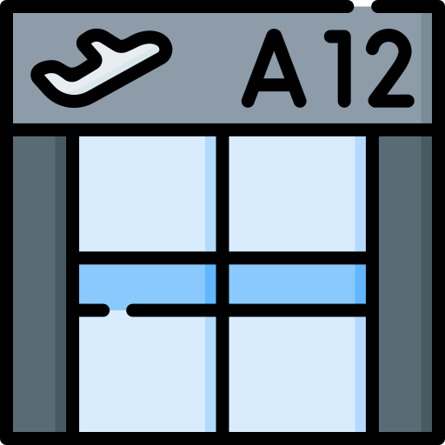


MARDU: Key Ideas
Stationary Trampolines
Simplify randomization tracking
Connect function entry to function body, but hide code gadgets
Memory Protection Keys (MPK) protect the code region by hiding it
What Trampolines Enable
MARDU shares randomized code in system-wide manner
Code sharing unlocks memory deduplication
Facilitate seamless migration to newly randomized code
Re-randomization without stopping-the-world
Process 1
Trampolines
Code
𝛼
Process 2
Process 3
Code
𝛽
Trampolines act as:
entry gateway to each function call exit gateway for each function return

Slide 16


MARDU: Summary
MARDU Contributions
Simple runtime tracking & reactive on-demand runtime re-randomization
Runtime re-randomization does not pause execution or stop-the-world
First randomization scheme capable of runtime re-randomization with code sharing
Trampolines separate and hide code gadgets from attackers
Advantages
Performance: 5.5% (AVG)
Significant Memory Savings (~7.5 GB)
Blocks all ROP attack variants
Limitations
Re-Randomization is probabilistic
Worst-case performance: 18.3%
Non-Control Data Attacks not covered
Notes:
Connect Contributions to Advantages!
Simple runtime tracking and reactive randomization makes MARDU have great performance
Trampolines allow seamless code-sharing across processes, system wide giving significant memory savings
Lastly, trampolines importantly hide function code bodies from the entry points so attackers cant reach the gadgets within
That being said, MARDU is not perfect,
Because MARDU uses randomization, it is still considered a probabilistic defense
And it has some outliers that could be further improved
Should i vocalize non-control data attacks? ( I think not )

Slide 17
Outline
Introduction
Background
MARDU: Practical Randomization
BASTION: Securing System Calls
Motivation
Design
Implementation
Evaluation
Conclusion & Future Work
5
Illegitimate
System Call
Usage
System Call Filtering
Notes:
So here is an Outline of what we will go over today
First, I will introduce the motivation for this work
Then I will explain the background regarding things like key terms and concepts
Then I will introduce and explain the contributions I have worked on for this thesis
Then I will propose the future work that still needs to be done
And finally summarize and conclude.

Slide 18
Outline
Introduction
Background
MARDU: Practical Randomization
BASTION: Securing System Calls
Motivation
Design
Implementation
Evaluation
Conclusion & Future Work
5
Illegitimate
System Call
Usage
System Call Filtering
Notes:
So here is an Outline of what we will go over today
First, I will introduce the motivation for this work
Then I will explain the background regarding things like key terms and concepts
Then I will introduce and explain the contributions I have worked on for this thesis
Then I will propose the future work that still needs to be done
And finally summarize and conclude.

Slide 19

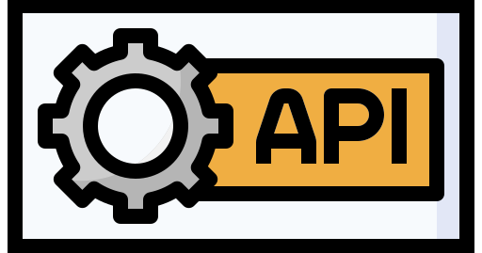



Why Do System Calls Matter?
System Call
Interface
Process Control
Arbitrary Code Execution
File Management
Device Management
Privilege Escalation
Network Reconfiguration
Information Maintenance
Communication
Memory Permission Changes
Core attack goals: Invoke one or more system calls
Out of control: Overcoming control-flow integrity [S&P’14]
< userspace >
< kernelspace >

Slide 20
System Calls: Use to Abuse
NGINX Web Server
Legitimate Use
execve() used to update server
in place during runtime
Example 1
// nginx/src/os/unix/ngx_process.c
static void ngx_execute_proc(ngx_cycle_t *cycle,void *data){
ngx_exec_ctx_t *ctx = data;
if( execve( ctx->path, ctx->argv, ctx->envp ) == -1){
ngx_log_error(NGX_LOG_ALERT, cycle->log, ngx_errno,
“execve() failed”);
Notes:
99.99% of system calls are safe
0.01% are dangerous
duality is incorrect terminology
So the Duality of system calls can be shown through this example
(Explain Code)
(Explain attack)
To highlight from this attack, we see that system calls can be abused in 2 ways
1st, the can be abused through illegitimate control-flow to reach them
and 2nd
the arguments need to be corrupted as well to be set to what the attacker wants
Sometimes syscalls are never used in an application.. figure out how to better show this

Slide 21
System Calls: Use to Abuse
NGINX Web Server
Attacker Abuse
execve() can launch an attacker binary or start shell (“/bin/sh”)
Example 1
// nginx/src/os/unix/ngx_process.c
static void ngx_execute_proc(ngx_cycle_t *cycle,void *data){
ngx_exec_ctx_t *ctx = data;
if( execve( ctx->path, ctx->argv, ctx->envp ) == -1){
ngx_log_error(NGX_LOG_ALERT, cycle->log, ngx_errno,
“execve() failed”);
ngx_execute_proc
ctx->path, ctx->argv, ctx->envp
Notes:
99.99% of system calls are safe
0.01% are dangerous
duality is incorrect terminology
Update “Attacker Patterns” wording, but how??
Normal System Calls can become dangerous. And they can become dangerous in different ways
(Explain Code)
(Explain attack)
To highlight from this attack, we see that system calls can be abused in 2 ways
1st, the can be abused through illegitimate control-flow to reach them
and 2nd
the arguments need to be corrupted as well to be set to what the attacker wants

Slide 22
System Calls: Use to Abuse
NGINX Web Server
Attacker Abuse
Sometimes, system calls are never needed/used in an application
mprotect() is never used in NGINX.
Reaching mprotect()can change attacker controlled memory region to have executable permissions
Example 2
// nginx/src/http/ngx_http_variables.c
ngx_http_variable_value_t *ngx_http_get_indexed_variable(
ngx_http_request_t *r, ngx_uint_t index){
...
if( v[index].get_handler(r, &r->variables[index],
v[index].data) == NGX_OK){
...
if( v[index].flags & NGX_HTTP_VAR_NOCACHEABLE){
r->variables[index].no_cacheable = 1;
}
return &r->variables[index];
}
...
return NULL;
index = 4321
&mprotect
r, &r->variables[index],
v[index].data
Attacker Pattern Insight:
How are system calls invoked?
How are system calls reached?
What is passed to system calls?
Notes:
99.99% of system calls are safe
0.01% are dangerous
duality is incorrect terminology
Update “Attacker Patterns” wording, but how??
Normal System Calls can become dangerous. And they can become dangerous in different ways
(Explain Code)
(Explain attack)
To highlight from this attack, we see that system calls can be abused in 2 ways
1st, the can be abused through illegitimate control-flow to reach them
and 2nd
the arguments need to be corrupted as well to be set to what the attacker wants

Slide 23





Related Work: System Call Protection
seccomp Introduced [2005]
Manual configuration required.
Configuration is challenging!
Coarse-grained call whitelisting
Does not strengthen
system call security!
Automation Added
sysfilter: Automated system call filtering for commodity software [RAID’20]
Automating Seccomp Filter Generation for Linux Applications [CCSW’21]
Refined Whitelisting
Temporal System Call Specialization [USENIX Sec’20]
Does not resolve attack angles in previous examples!
Core Research Question:
What information should be considered to check legitimacy of system call invocations?

Slide 24

Outline
Introduction
Background
MARDU: Practical Randomization
BASTION: Securing System Calls
Motivation
Design
Contexts
Overview
Compiler Component
Monitor Component
Implementation
Evaluation
Conclusion & Future Work
Call Type Context
Control Flow Context
Argument Integrity Context

Slide 25



BASTION Contexts - Call Type Context
Guarantee: Only permitted system calls are allowed to be called in their expected manner
Assigned Per-System-Call
Three (3) Types
Example 3
1 void foo ( int f0, char* f1 ){
2 f2 = getConfigString(f0, f1);
3 int flags = MAP_ANON|MAP_SHARED;
4 bar( x1, flags );
5 ...
6 }
7 void bar ( char* b1, int b2 ){
8 int prots = PROT_READ|PROT_WRITE;
9 mmap( NULL, gshm->size, prots, b2,
-1, 0 );
10 ...
}
Applicable to All System Calls
Not-Callable
(Never used by Application)
Sensitive System Calls Only
System Call | Call Type
mmap | Directly-Callable
mprotect | Not-Callable
Directly-Callable
(Traditional Direct Call)
Indirectly-Callable
(e.g., code pointers)
Notes:
NGINX only calls 12 out of 20 sensitive system calls

Slide 26
BASTION Contexts - Control Flow Context
Guarantee: A sensitive system call is reached and invoked only through legitimate control-flow paths during runtime
Example 3
1 void foo ( int f0, char* f1 ){
2 f2 = getConfigString(f0, f1);
3 int flags = MAP_ANON|MAP_SHARED;
4 bar( x1, flags );
5 ...
6 }
7 void bar ( char* b1, int b2 ){
8 int prots = PROT_READ|PROT_WRITE;
9 mmap( NULL, gshm->size, prots, b2,
-1, 0 );
10 ...
}
Valid Control Flow
bar < foo
mmap < bar
...

Slide 27
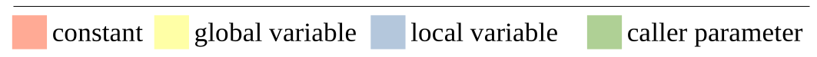
BASTION Contexts - Argument Integrity Context
Guarantee: A sensitive system call can only use valid arguments when being invoked
Even if attackers have access to memory corruption vulnerabilities
Argument Type Coverage
Constants
Global Variables
Local Variables
Caller Parameters
Example 3
1 void foo ( int f0, char* f1 ){
2 f2 = getConfigString(f0, f1);
3 int flags = MAP_ANON|MAP_SHARED;
4 bar( x1, flags );
5 ...
6 }
7 void bar ( char* b1, int b2 ){
8 int prots = PROT_READ|PROT_WRITE;
9 mmap( NULL, gshm->size, prots, b2,
-1, 0 );
10 ...
}

Slide 28

Outline
Introduction
Background
MARDU: Practical Randomization
BASTION: Securing System Calls
Motivation
Design
Contexts
Overview
Compiler Component
Monitor Component
Implementation
Evaluation
Conclusion & Future Work
Call Type Context
Control Flow Context
Argument Integrity Context

Slide 29

BASTION Criteria & Coverage
Defense Framework Criteria
Disable unnecessary system calls
Ensure system calls are reached legitimately
Ensure legitimate system call arguments
Easy deployment
Ensure practical performance
System Call Integrity
Attackers must use one of these sensitive system calls to achieve code re-use!
Security-Sensitive System Calls (20)
Arbitrary Code Execution
execve, execveat, fork, vfork, clone, ptrace
Memory Permission Changes
mprotect, mmap, mremap, remap_file_pages
Privilege Escalation
chmod, setuid, setgid, setreuid
Networking Reconfiguration
socket, bind, connect, listen, accept, accept4
Notes:
We chose these system calls because
these are the systems calls commonly used to achieve code re-use

Slide 30
BASTION THREAT MODEL
We make the following assumptions:
Assume powerful adversary with arbitrary read/write capabilities
Via exploiting present memory vulnerabilities in code base
Assume common security defenses are deployed:
ASLR
DEP
Shadow Stack
Assume the host operating system (OS) and hardware are trusted
Attacks targeting hardware and side-channels are out of scope:
Meltdown / Spectre
RowHammer

Slide 31





BASTION Design - Overview
BASTION Compiler
BASTION Runtime Monitor Process
Operating System
Every Sensitive System Call is intercepted by BASTION
Safe System Call Invocation
Call Type Analysis
Control Flow Analysis
Argument Integrity Analysis
Sensitive Variable Instrumentation
BASTION Context Metadata
Context Checking
Call Type
Control Flow
Argument Integrity
User Application
Process State Information
Notes:
Compiler Analysis is static and walks through entire LLVM IR

Slide 32

BASTION Compiler - Call Type Context
Goal: Provide more fine-grained calling constraints!
Enforce not only if system calls are allowed to be invoked, but how!
Analysis Procedure:
Initially assume all system calls: Not-Callable
Inspect all call instructions in LLVM IR
Non-sensitive system calls invoked: Whitelisted
Sensitive system calls invoked directly: Directly-Callable
Handling indirect call sites:
Record all code pointers
Scan for assignment of sensitive system calls: Indirectly-Callable
read
mmap
gettimeofday
nanosleep
accept4, 0x551234
mlock
munlock
socket
connect
Call Type Context Metadata
Sensitive system calls are sparsely used & rarely invoked indirectly.
Notes:
List of legitimate indirect callsites (via recorded binary file offset)

Slide 33
BASTION Compiler - Control Flow Context
foo
Goal: Prevent control-flow hijacking from reaching
sensitive system calls!
Analysis Procedure:
Derive application Control Flow Graph (CFG)
Start at each sensitive system call callsite
Recursively record each callee→caller association
Metadata contains all valid CFG paths for each sensitive system call
foo
bar
bar
buzz
mmap
buzz
mmap
qux
execve
execve
corg
Example CFG
Call chains of sensitive system calls are usually short!
Notes:
Committee Question: What about indirect calls
BASTION does not need to support indirect calls for several reasons:
Call chains are usually short
Other contexts can also step up to shore up the shortcomings of not covering indirect callsites

Slide 34
BASTION Compiler - Argument Integrity Context
Goal: Ensure variables passed as
arguments are never corrupted!
(Data value integrity)
Protection Scope:
Sensitive system call arguments can be two (2) types:
1) Direct Arguments (non-pointer variables)
Only need to check value
Example 3
1 void foo ( int f0, char* f1 ){
2 f2 = getConfigString(f0, f1);
3 int flags = MAP_ANON|MAP_SHARED;
4 bar( x1, flags );
5 ...
6 }
7 void bar ( char* b1, int b2 ){
8 int prots = PROT_READ|PROT_WRITE;
9 mmap( NULL, gshm->size, prots, b2,-1, 0 );
10 ...
}
Arg1 ?= NULL
Arg2 ?= 4096
Arg3 ?= PROT_READ | PROT_WRITE
Most arguments are constant!
Constant arguments cannot be altered.
Arg4 ?= MAP_ANON | MAP_SHARED
Arg5 ?= -1
Arg6 ?= 0
Notes:
if value is corrupted or not
more often than not checking value is good enough
but sometimes we need to check pointer also
execve path to file
Non-pointers are objects that, well, hold the actual type. int i; is a single integer. char name is a single character and so on.
this is a code snippet, and this is how we will protect it

Slide 35
BASTION Compiler - Argument Integrity Context
Goal: Ensure variables passed as
arguments are never corrupted!
(Data value integrity)
Protection Scope:
Sensitive system call arguments can be two (2) types:
2) Extended Arguments (pointers/pointer fields)
Need to check pointer address &
Need to check value
Example 1
1 // nginx/src/os/unix/ngx_process.c
2 ngx_execute_proc(ngx_cycle_t *cycle, void *data){
3
4 ngx_exec_ctx_t *ctx = data;
5 ...
6
7 if(execve(ctx->path,ctx->argv,ctx->envp)==-1)
8 ngx_log_error(NGX_LOG_ALERT, cycle->log,
ngx_errno, “execve() failed”);
Arg1 Adr ?= 0x5efe9000
Arg1 Val ?= “/usr/local/nginx”
Arg1 Adr ?= 0x5efe9004
Arg1 Val ?= “config=/usr/local/def.conf”
Arg3 Adr ?= 0x00000000
Arg3 Val ?= NULL
Notes:
if value is corrupted or not
more often than not checking value is good enough
but sometimes we need to check pointer also
execve path to file
Non-pointers are objects that, well, hold the actual type. int i; is a single integer. char name is a single character and so on.
Pointers are objects that contains addresses to other objects.
this is a code snippet, and this is how we will protect it
system call and argument specific
follow the pointer
and check the contents

Slide 36
BASTION Compiler - Argument Integrity Context
Example 3
1 void foo ( int f0, char* f1 ){
2 f2 = getConfigString(f0, f1);
3
4 int flags = MAP_ANON|MAP_SHARED;
5
6
7 bar( x1, flags );
8 ...
9 }
10 void bar ( char* b1, int b2 ){
11
12 int prots = PROT_READ|PROT_WRITE;
13
14
15
16
18
19
20
21
22 mmap( NULL, gshm->size, prots, b2, -1, 0 );
...
Instrumentation
ctx_write_mem()
Added at each write operation
Update sensitive variable values
ctx_write_mem(&flags, sizeof(int));
ctx_bind_mem_2(&flags);
ctx_bind_mem()/ctx_bind_const()
Added at each associated callsite
Provide staging for performing runtime checking
Procedure:
Work backwards from each callsite
Use-Def chains derived from LLVM IR
Internals automatically handle:
Direct vs Extended Arguments
ctx_write_mem(&b2, sizeof(int));
ctx_write_mem(&prots, sizeof(int));
ctx_bind_const_1(NULL);
ctx_bind_mem_2(&gshm->size);
ctx_bind_mem_3(&prots);
ctx_bind_mem_4(&b2);
ctx_bind_const_5(-1);
Call depth to set system call arguments is fairly shallow – within the same function or only a few functions away.
ctx_bind_const_6(0);

Slide 37
BASTION Compiler - Context Metadata Summary
Context MetaData
Each context extracts different metadata to enforce what is given to monitor
Call Type Context
Non-sensitive System Call List
Whitelisted syscall numbers
Sensitive System Call List
Directly-Callable syscall numbers
Indirectly-Callable syscall numbers
File offsets of all indirect callsites
Control Flow Context
Association list of valid
callee → caller
Argument Integrity Context
For sensitive system call call-sites:
Argument Type
Constant
Variables
Caller Parameters
For caller parameter call-sites:
Argument # that be must checked
Argument Type
Valid Control Flow Paths
mmap < bar
bar < foo
execve < buzz
buzz < bar
Whitelisted | read,gettimeofday,...
Directly-Callable | mmap,socket,connect,…
Indirectly-Callable | accept4
Indirect Callsite Binary Offsets | 343,9238,2341,1192, ...
Callsites (D = Direct Arg, Ext = Extended Arg)
396: bar(IGNORE, D)
441: mmap(D, D, D, D, D, D)
983: execve(Ext, Ext, Ext)

Slide 38


BASTION Design - Monitor Component
Monitor Goals:
Act as liaison between application and OS
Safeguard system calls from arbitrary use!
Separate process
Isolates BASTION from untrusted application!
Attacker cannot bypass/disable BASTION hooks
Only check contexts when system call invoked
Minimize interference for max performance!
Runtime Monitor Process
Monitor
User Application
mmap() invoked
BASTION Runtime Monitor
mmap() completed
Context Metadata
Process State Information
Operating System
Checking Mechanism
PC & code
Stack
Registers & Instrumentation
Notes:
How to check Call Type Context?
Use PC & callsite type (assembly)
How to check Control Flow Context?
Use process stack (& perform unwinding)
How to check Argument Context?
Use registers & Instrumentation

Slide 39

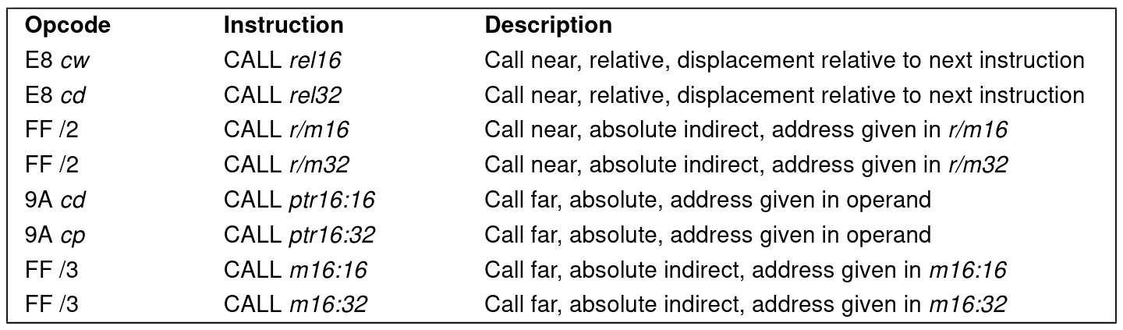
BASTION Design - Checking Call Type Context
Every callsite occurs at specific address
Use Program Counter (PC) to get current binary offset
Inspect OPCODE for call type (Directly Callable vs Indirectly-Callable)

Slide 40
BASTION Design - Checking Control Flow Context
Leverage current process stack against
callee → caller Association List
Current Process Stack
Frame 3: foo
Valid Control Flow Paths
mmap < bar
bar < foo
execve < buzz
buzz < bar
Frame 3: foo
Frame 2: bar
Frame 2: bar
bar < foo
Frame 1: buzz
Frame 1: buzz
execve < buzz
Frame 0: execve
buzz < bar
Frame 0: execve

Slide 41
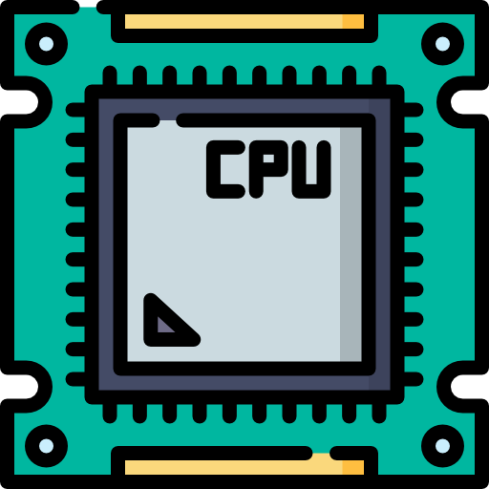

BASTION Design - Checking Argument Integrity
Fetch register values
Fetch Context Metadata
Callsite Information
Expected Values
Perform check for each callsite
Unpause application
Context Metadata
Callsite 983: execve(Ext, Ext, Ext)
$rdi
$rsi
$rdx
Arg #1
Arg #2
Arg #3
Arg #4
Arg #5
Arg #6
$rcx
$r8
$r9

Slide 42


BASTION Runtime Checking
BASTION Protected NGINX
Application HALTED
How System Call Checking Works:
Example 1
1. seccomp catches each sensitive system call for BASTION
// nginx/src/os/unix/ngx_process.c
static void ngx_execute_proc(ngx_cycle_t *cycle,void *data){
ngx_exec_ctx_t *ctx = data;
if( execve( ctx->path, ctx->argv, ctx->envp ) == -1){
ngx_log_error(NGX_LOG_ALERT, cycle->log, ngx_errno,
“execve() failed”);
2. ptrace fetches application process state for BASTION
“/bin/bash”,
3. Checking Procedure
Confirm valid Call Type
Confirm valid Control Flow
Confirm Argument Integrity (for all parameters)
Fetch expected values from hashtable
Any inconsistency triggers program HALT
Call
Type
Control
Flow
Argument
Integrity

Slide 43
Outline
Introduction
Background
MARDU: Practical Randomization
BASTION: Securing System Calls
Motivation
Design
Implementation
Evaluation
Future Work & Conclusion
5
Illegitimate
System Call
Usage
System Call Filtering
Notes:
So here is an Outline of what we will go over today
First, I will introduce the motivation for this work
Then I will explain the background regarding things like key terms and concepts
Then I will introduce and explain the contributions I have worked on for this thesis
Then I will propose the future work that still needs to be done
And finally summarize and conclude.

Slide 44


Implementation
Working Prototype
BASTION Compiler
LLVM 10.0.0
~4K LoC
BASTION Library API
~700 LoC
BASTION Monitor
~8K LoC
seccomp-BPF
ptrace
Kernel
X86-64 Linux 5.19.14
LLVM
Compiler Infrastructure

Slide 45
Outline
Introduction
Background
MARDU: Practical Randomization
BASTION: Securing System Calls
Motivation
Design
Implementation
Evaluation
Future Work & Conclusion
5
Illegitimate
System Call
Usage
System Call Filtering
Notes:
So here is an Outline of what we will go over today
First, I will introduce the motivation for this work
Then I will explain the background regarding things like key terms and concepts
Then I will introduce and explain the contributions I have worked on for this thesis
Then I will propose the future work that still needs to be done
And finally summarize and conclude.

Slide 46
BASTION Evaluation
Evaluation Summary
Performance: System-call & I/O Intensive Applications
Security: 32 ROP payloads, real-world CVEs, & synthesized attacks
Evaluation Questions
Security
How secure is BASTION?
How does BASTION defend against different attack strategies?
How does BASTION compare to other security archetypes?
Performance
What is each context’s performance impact?
How much overall performance overhead does BASTION impose?

Slide 47
BASTION Evaluation
Experimental Setup
All programs compiled via BASTION LLVM compiler (-fPIC optimization flags)
Platform:
8-core (16-hardware thread) machine featuring AMD Ryzen 7 PRO 5850U CPU
16 GB DRAM
Applications
NGINX Most widely deployed web server
SQLite Database Engine
vsftpd FTP Server
Notes:
NGINX the is most widely deployed web server application in production

Slide 48


How BASTION Defends
32-Attack Case Study
ROP Payloads (18)
Stack pivot gives away ROP chain
Direct System Call Manipulation (9)
Naive attacks corrupting function pointers
Indirect System Call Manipulation (5)
Advanced attacks mimic valid program behavior to varying degrees
All attacks attempt to corrupt arguments
Core Summary
BASTION foremost protects the system
to not be compromised
BASTION protects against attacks other fine-grained defenses cannot
 | Violated Context
Attack Category | Call Type | Control Flow | Argument Integrity
Return-Oriented Programming (18)
Direct System Call Manipulation (9)
Indirect System Call Manipulation (5)
NEWTON CPI Attack [SIGSAC’17]
AOCR Apache Attack [NDSS’17]
AOCR NGINX Attack 2 [NDSS’17]
COOP [S&P’15]
Control Jujutsu [CCS’15]
Advanced defenses:
Code Pointer Integrity [OSDI’14]
Context Sensitive CFI e.g., GRIFFIN [ASPLOS’17] cannot defend against these advanced attacks!
Notes:
Indirect System Call Manipulation: When talking about these, YOU NEED TO EXPLAIN WHY those attacks were chosen. (e.g., advanced attacks, which cannot be easily defended.)
NEWTON SIGSAC’17
AOCR NDSS’17
COOP
Control Jujutsu CCS’15
need to explain why
BASTION so much better than CFI, CPI
>>>advanced attacks by pass even fine-grained CFI!

Slide 49

Defending Indirect System Call Manipulation
Example: AOCR NGINX Attack 2
Main Loop
void ngx_master_process_cycle(){
...
if (ngx_change_binary) {
...
ngx_new_binary = ngx_exec_new_binary(cycle, ngx_argv);
}
Leverage memory corruption vulnerability to:
1. Change parameters (ngx_cycle_t cycle, char **ngx_argv) to attacker-controlled values
2. Trigger ngx_change_binary signal to fall into nginx_exec_new_binary()
3. Execute execve() with attacker-controlled ngx_argv to initiate new /bin/bash shell
BASTION Argument Integrity Context detects argument corruption in ngx_argv and halts execution!
Notes:
Will abide by legal program control-flow transfers
Will call system call in expected manner
Will only corrupt system call parameter variables

Slide 50
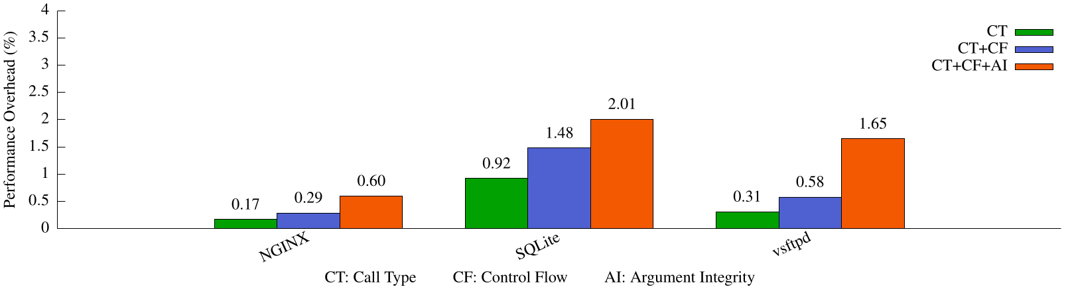
How BASTION Performs
Argument Integrity Context is BASTION’s most expensive context to deploy
BASTION overall performance overhead is low (<2.01%)

Slide 51
BASTION Summary
BASTION is practical
System-call-specialized coverage minimizes defense interference
Security blocks all ROP & attack classes that rely on leveraging system calls
BASTION hardens system calls using three new contexts to accomplish System Call Integrity
2.01% worst-case performance overhead
BASTION can be used as starting framework to protect against other system call threats

Slide 52
Outline
Introduction
Background
MARDU: Practical Randomization
BASTION: Securing System Calls
Future Work & Conclusion
Notes:
So First, Motivation

Slide 53
Future Work
BASTION
Extend BASTION to be a generic defense framework
Implementing as Kernel Module would ensure maintained fast performance as more features added:
More system call classes support
More fine-grained contexts
Protect beyond ROP-originating attacks
Augment BASTION protection to cover Information Disclosure
read, write, open, sendfile64, sendto, sendmsg, sendmmsg
Perform systematic research to classify and quantify the security threat each available system call imposes on the host OS
Opportunity to:
Better map system call abilities to attacker intentions
Uncover new system call attack classes
Operating System Enhancements to Prevent the Misuse of System Calls [CCS’00]
Notes:
mapping system call abilities is like mapping the functionality of gadgets. certain gadgets can accomplish certain operations necessary to complete a ROP chain

Slide 54
Conclusion
Problem Statement:
How can one create strong, yet practical exploit mitigation designs?
Dissertation Aims & Objectives:
Understand & identify critical attack/defense aspects to devise practical exploit mitigation designs
Show through prototyping that practical designs are achievable
Dissertation Contributions:
MARDU [ SYSTOR’20 / DTRAP’22 ]
On-demand, reactive re-randomization
Capable of code sharing randomized code system-wide
Capable of randomizing without pausing execution
BASTION [ ASPLOS’23 - Major Revision ]
Fine-grained system call filtering
3 contexts to enforce System Call Integrity
Can block all attack classes that rely on system calls to carry out attack
Notification - Jan. 19, 2023
Notes:
What new insights could be leveraged to simultaneously advance the strength of security guarantees and enhance the understanding of practical exploit mitigation design, especially for code re-use and system call abuse?
Is it possible to resolve the performance, security, scalability, and robustness challenges in order to achieve practical exploit mitigation design?
If so, how? Particularly, what would a practical exploit mitigation design look like?

Slide 55
Publications
BASTION
Protect the System Call, Protect (most of) the World with BASTION ( ASPLOS ’23 - Major Revision - Notification Jan 19, 2023 )
Christopher Jelesnianski, Mohannad Ismail, Yeongjin Jang, Dan Williams, Changwoo Min
MARDU
Securely Sharing Randomized Code that Flies
Christopher Jelesnianski, Jinwoo Yom, Changwoo Min, and Yeongjin Jang ( DTRAP ’22 )
MARDU: Efficient and Scalable Code Re-randomization
Christopher Jelesnianski, Jinwoo Yom, Changwoo Min, and Yeongjin Jang ( SYSTOR ’20 )
Other Security
Tightly Seal Your Sensitive Pointers with PACTight
Mohannad Ismail, Andrew Quach, Christopher Jelesnianski, Yeongjin Jang and Changwoo Min ( USENIX Security ’22 )
Data protection utilizing ARM Pointer Authentication (PA) security primitive
VIP: Safeguard Value Invariant Property for Thwarting Critical Memory Corruption Attacks
Mohannad Ismail, Jinwoo Yom, Christopher Jelesnianski, Yeongjin Jang and Changwoo Min ( CCS ’21 )
Value Integrity for security-relevant data types
Notes:
In terms of publications:
SYSTOR which is
The International Systems and Storage Conference
and DTRAP which a recently created journal by ACM
Digital Threats: Research and Practice

Slide 56
Publications
Compilers & System Software
Breaking the Boundaries in Heterogeneous-ISA Datacenters
Antonio Barbalace, Robert Lyerly, Christopher Jelesnianski, Anthony Carno, Ho-Ren Chuang, Vincent Legout, and Binoy Ravindran (ASPLOS’17)
Operating system process and thread migration in heterogeneous platforms
Robert Lyerly, Antonio Barbalace, Christopher Jelesnianski, Vincent Legout, Anthony Carno, and Binoy Ravindran (MaRS’16)
Popcorn: Bridging the programmability gap in heterogeneous-isa platforms
Antonio Barbalace, Marina Sadini, Saif Ansary, Christopher Jelesnianski, Akshay Ravichandran, Cagil Kendir, Alastair Murray, and Binoy Ravindran (Eurosys’15)

Slide 57
Acknowledgements
Ph.D. Committee:
Dr. Changwoo Min
Dr. Yeongjin Jang
Dr. Wenjie Xiong
Dr. Danfeng Yao
Dr. Haibo Zeng

Slide 58
Achieving Harmony in Practical Exploit Mitigation Design Against Code Re-Use Attacks and System Call Abuse
Thank you!
Christopher Jelesnianski
Questions?
Notes:
Thank you for your attention.
This brings the presentation to a close and I am now ready for questions.

Slide 59



I’m Headed to Apogee Research
https://apogee-research.com/
Arlington, Virginia

Slide 60
Timing
12 min (6 + 4 + 4)
Introduction = Done (6 Min)
Background = Done (4 Min)
MARDU = Done (4 Min)
BASTION = (25 Min)
Motivation = 10 Min >> 6
Design = 10 Min >> 14
Implementation = Done (0 Min)
Evaluation = (5 Min)
Future Work + Conclusion = Done (5 Min)
Target = 43 minutes (13+25+5)

Slide 61
Back-up Slides
Notes:
Hello, my name is Christopher Jelesnianski. Today I will introduce my preliminary thesis:
Practical Exploit Mitigation Against Code Re-Use Attacks & System Call Abuse

Slide 62
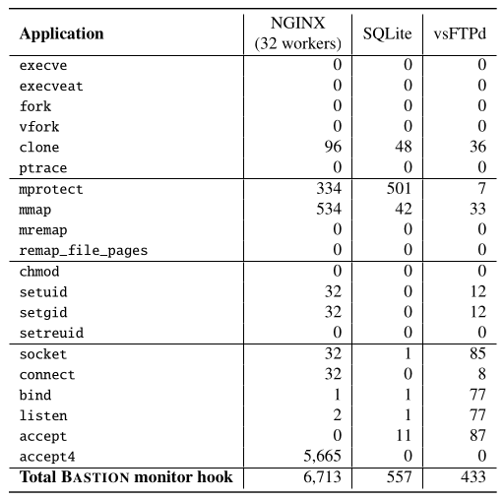
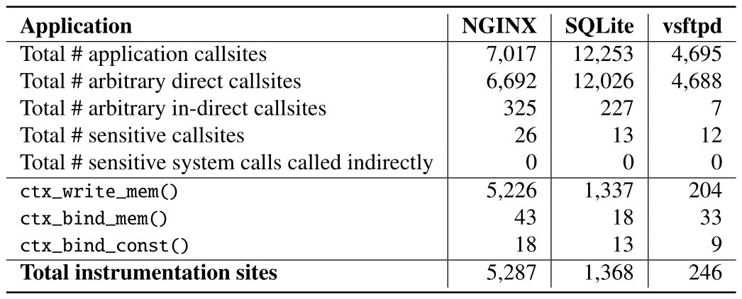
BASTION Insights
Some system calls are called more than others (e.g., accept4 vs connect)
System calls are sparsely used
System calls are called indirectly very rarely
Constant arguments are common

Slide 63
BASTION Contexts - Call Type Context (Indirect Call)
Indirectly Callable Type
BASTION checks all right hand assignments for sensitive system calls
Running Example 2
int(*cmd_fp)(char*, char*, char*);
void foo ( int f0, char* f1 ){
if(SETUP)
cmd_fp = &execve;
else
cmd_fp = &custom_exec;
}
void custom_exec ( char* e1, char* e2, char* e3 ){
...
execve( ... );
}
System Call | Call Type
execve | Directly-Callable, Indirectly-Callable

