Slide 1
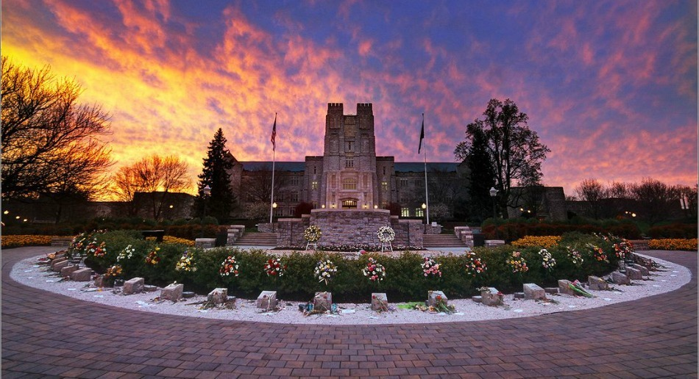
Retina: Cross-Layered Key-Value Store for Computational Storage
Naga Sanjana B
Dept. of ECE, Virginia Tech
February 18, 2022
COSMOSS Lab @ VT
Notes:
Intro
Today I’m going to be talking about my Masters thesis fDSM

Slide 2
Executive Summary
Today Key-Value stores are dominating the database world!
Disk is no longer the bottleneck
Conventional key-value stores are lagging due to CPU-bottleneck
Research contributions:
Achieve performance by offloading compute onto computational storage
Design a Key-Value storage framework to leverage Samsung SmartSSD(Computational storage)
Two international patents with Samsung to license our IP

Slide 3
Outline
Background
Retina Key-value Store Design
Implementation
Evaluation
Future Work
Conclusion

Slide 4
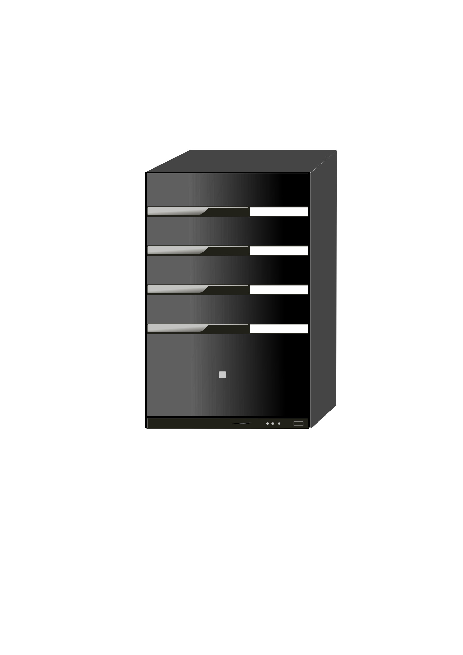
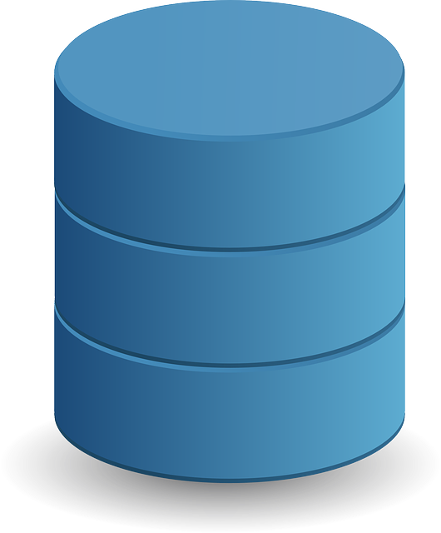
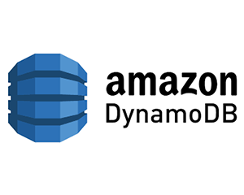



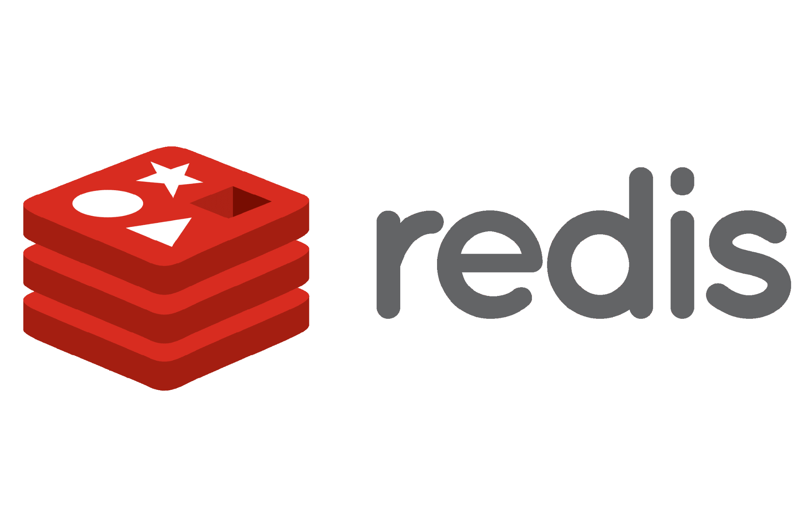







Key-value stores are Everywhere !
Key | Value
12 | {“Id”:12 “name:sam}
A key-value store is a distributed dictionary of records that are identified with a unique key/hash.
Today key-value stores are used from cloud to embedded applications, to being an algorithmic block for bigger applications
KV Store
Hash(Key) % Machines

Slide 5
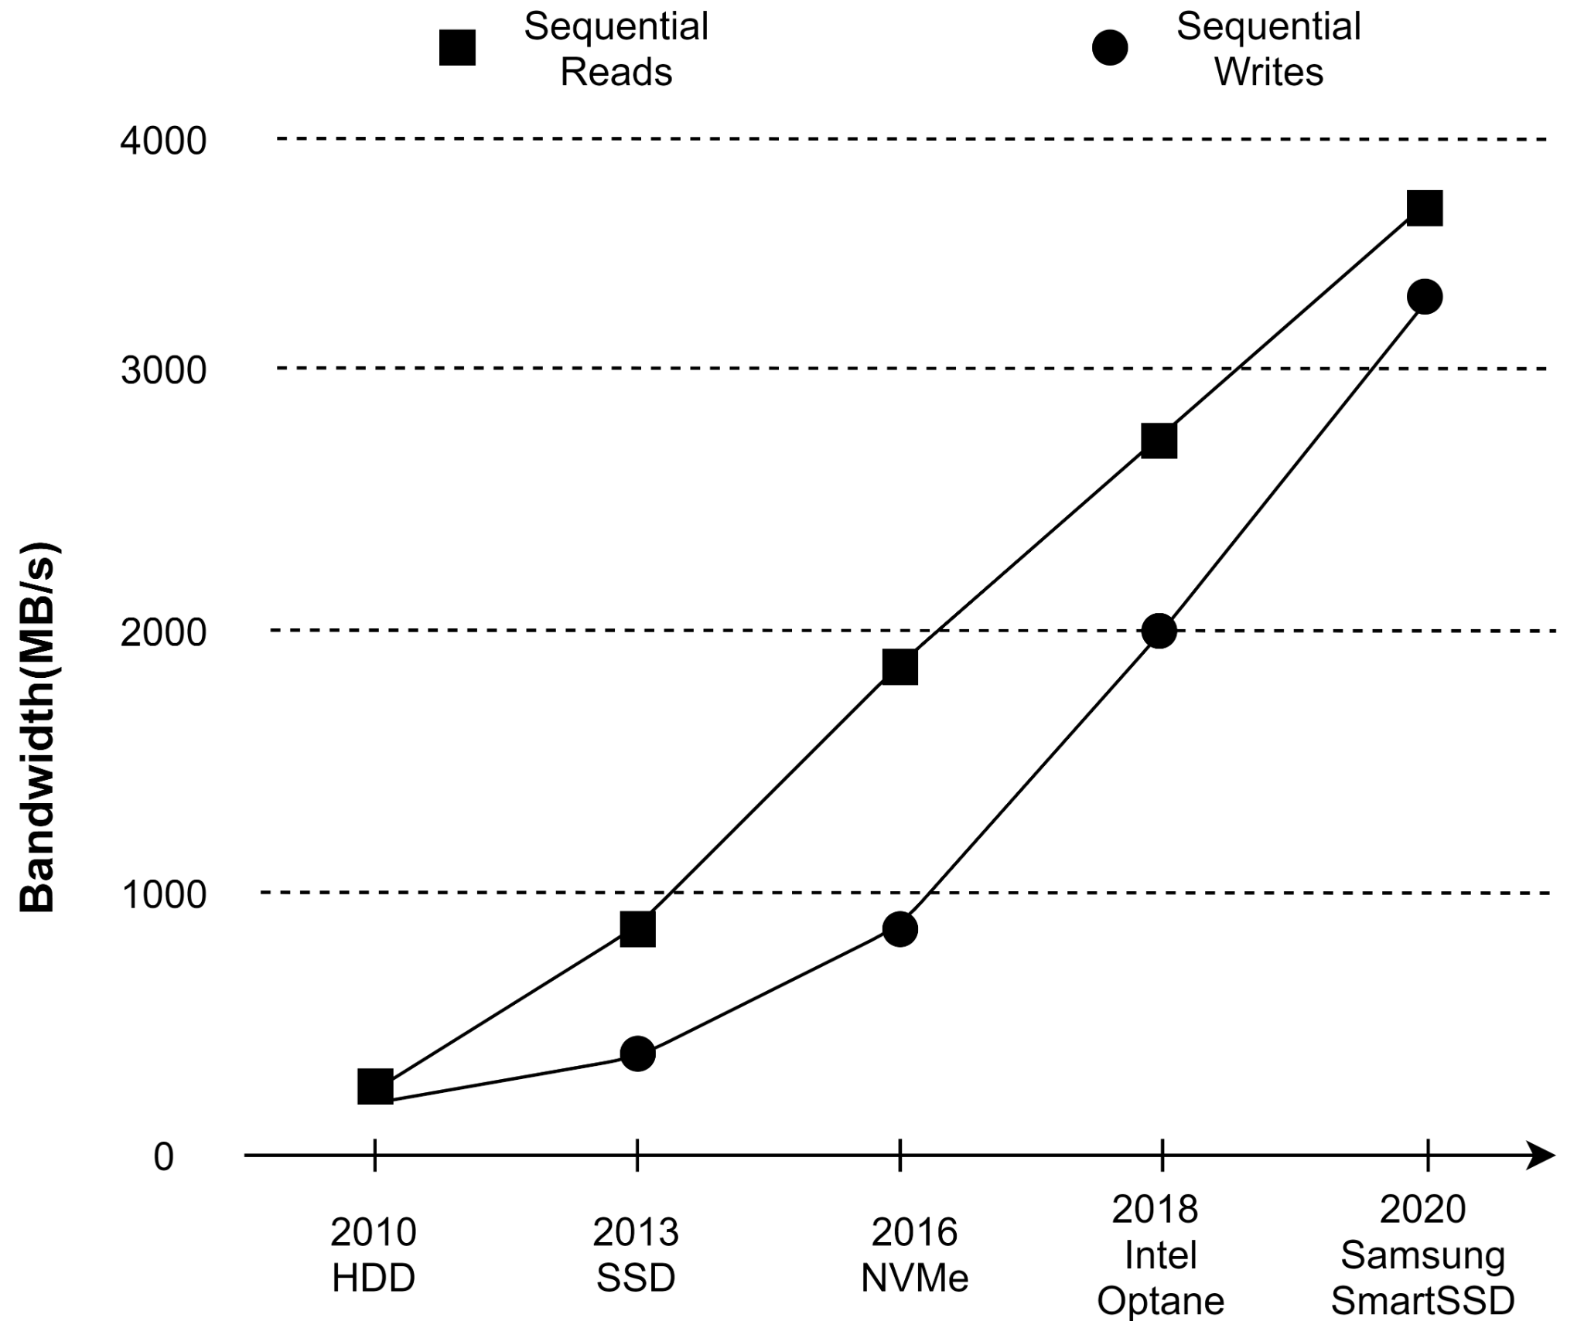


Secondary Storage Trends
SmartSSD I/O Read/Write speeds are 20x of HDD
SmartSSD also realizes near data processing.
Secondary Storage is no longer the bottleneck!
Secondary Storage is getting FASTER
SMARTER with Near Data processing
Notes:
Many of these key-value store are designed for slow disks, however if you look at the evolution of disk speed as shown in the graph, you can see that the disk speeds have increased dramatically in the past few year. From disks that can read and write a few hundred of gigabyte per sec we now have disks that can read and write at over 3 giga bytes per second.

Slide 6
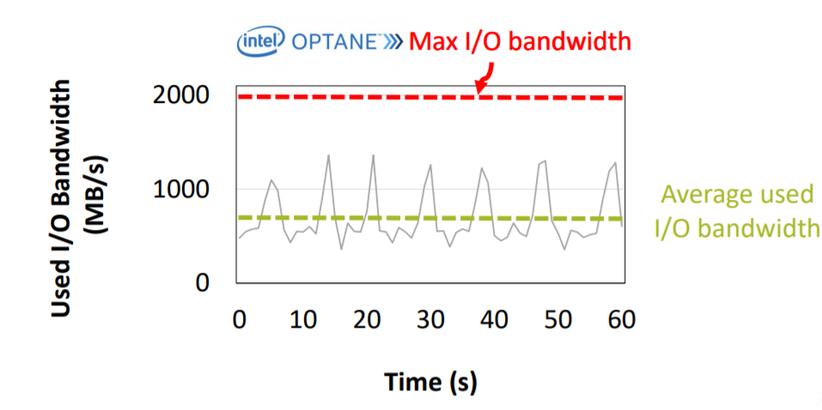
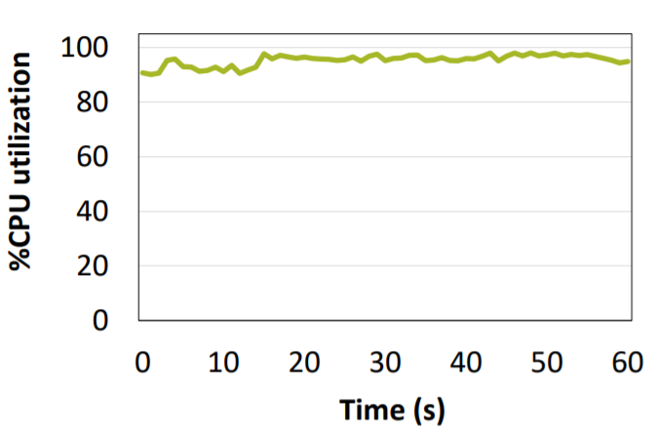
Problems of Conventional Key-Value Stores
Most prevalent key-value store
Log-Structured Merge(LSM) Tree
Experiment on LSM Tree:
Only 50% of the maximum I/O bandwidth used
while saturating the CPU utilization to almost 100%.
CPU becomes the bottleneck before the IO bandwidth is fully saturated.
Source: https://dl.acm.org/doi/10.1145/3341301.3359628

Slide 7
LSM Tree : Most Prevalent Key-Value Design
Insert(key, value)
Has a host DRAM component and disk component
If DRAM full, push to disk
Data is ordered by key on both host DRAM and disk
Host DRAM
Disk
Insert are made to host DRAM component
When its is full, key-value are pushed to disk
But cannot keep pushing data to disk
Need to do merge data on DRAM and disk
This garbage collection task -> “Compaction”

Slide 8
Shortfalls of LSM-based design
60% of CPU is utilized for ‘Compaction’ and ‘Garbage Collection’
Traditionally LSM was designed for HDD
Today disks are much more faster than HDD
Why is this a problem now?
CPU is becoming a bottleneck in Key-Value Stores

Slide 9
How to Improve Performance?
CPU
DRAM
Move compute to data - Near Data Processing
Attach compute source inside the storage
Data is internally transferred in the storage - high speed
Reduces the number of network hops
Computational Storage
Storage design that enables Near-data processing
Network(PCIe)
SSD
Accel-
erator
DRAM
Computational Storage designs use near-data processing!
Computational Storage Design
Notes:
Change CPU to accel

Slide 10
What is Near-Data Processing?
DRAM
CPU
DRAM
CPU
3. Compute on CPU
1.Request data
1.Request data
Network(PCIe)
Network(PCIe)
2. Move data over the network
1.Return the result
2. Compute on Storage
4. Write data to Storage
SSD
SSD
Accel-
erator
DRAM
Conventional Storage Model
Computational Storage Model

Slide 11
Benefits of Computational Storage
Helps reduce the ‘Network bottleneck’
Compared to the conventional model, reduces network hops by 2x
Improves overall throughput
Takes advantage of high internal bandwidth inside the storage
Manipulates the data and only sends the aggregate results - lesser load on network
On-storage compute to compress/decompress - further lesser load on network
Improves scalability
As computational storage provides isolation and requires very little coordination from the host.
Notes:
Thus to quickly summarize, computational storage

Slide 12
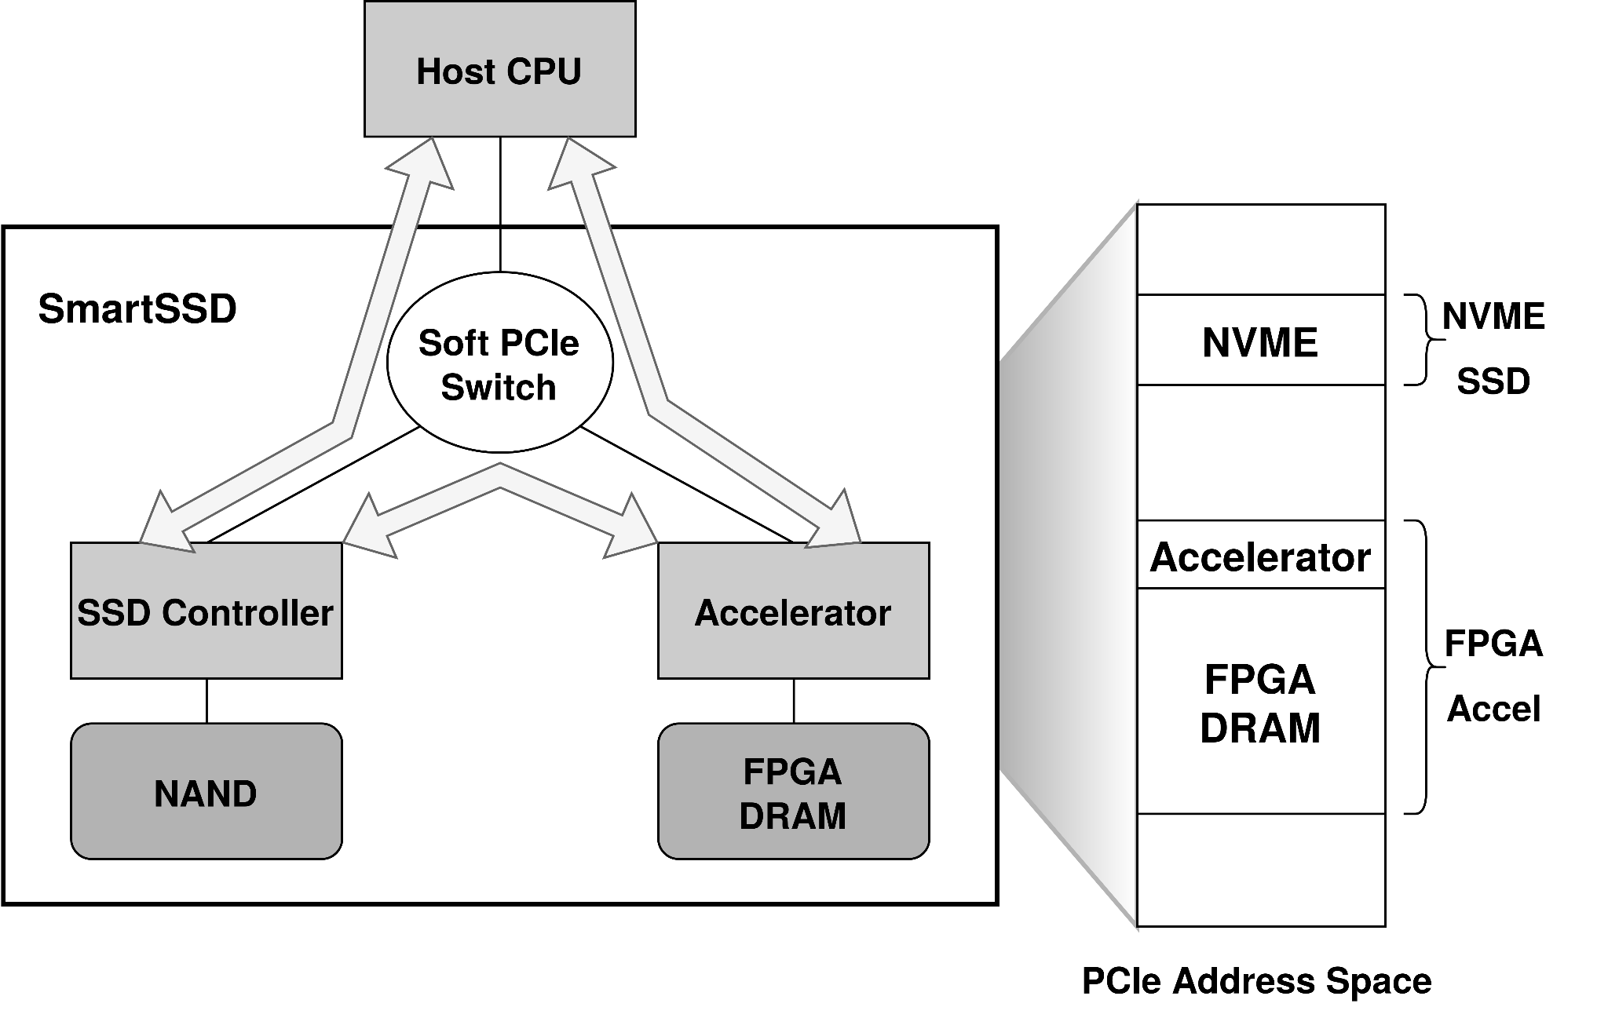
Computational Storage: Samsung SmartSSD
Performant on-storage compute
Xilinx FPGA - embarrassingly parallel accelerator
High internal bandwidth
Data transfer across the internal data path called ‘Peer-to-Peer Memory’
Notes:
Samsung CSD (Computational Storage Drive) is launched with a Xilinx Kintex FPGA to
bring computational storage capabilities in a standard form factor
Internally, the computational storage uses the on-platform PCIe switch and FPGA memory to route data transfers between the NVMe SSD and FPGA.
The data movement across the internal data path is termed peer-to-peer (P2P) memory.

Slide 13
Summary
Secondary storage is getting FASTER and SMARTER
Traditional key-value stores under-utilize the I/O bandwidth
Due to design choices, the CPU bottlenecks even before the I/O bandwidth is saturated
Change design paradigm - ‘Move compute to data’
Computational storage avoid network bottlenecks by integrating compute near storage
Key-Value store can thus benefit from computational storage.

Slide 14
Outline
Background
Retina Key-value Store Design
Implementation
Evaluation
Future Work
Conclusion

Slide 15
Design goals
“Provide a storage framework that leverages Computational storage”
Results in by-products
Maximizes IO utilization and throughput
Provides High-performance and scalability
Notes:
Maximize IO utilization and throughput
Provide High-performance and scalability
Provide a storage framework that leverages Computational storage

Slide 16
How do we build the Framework?
Three key components:
Cross-layered design- architecture to maximize resource utilization
Mirror cache- caching mechanism to maximize data locality
Version-based crash consistency- Optimize critical path performance

Slide 17
Cross-Layered Design

Slide 18
Why do we need a new design?
Goal : Maximize Computational Storage utilization to achieve high performance
Challenges & solutions:
I/O is under-utilized because of CPU contention
Relieve load off of CPU by offloading compute to SmartSSD
Network bottleneck degrades overall performance
Reduce data transfer over the network
Achieve scalability without losing performance
Decouple the key-value store to act independently on the host and the SmartSSD

Slide 19
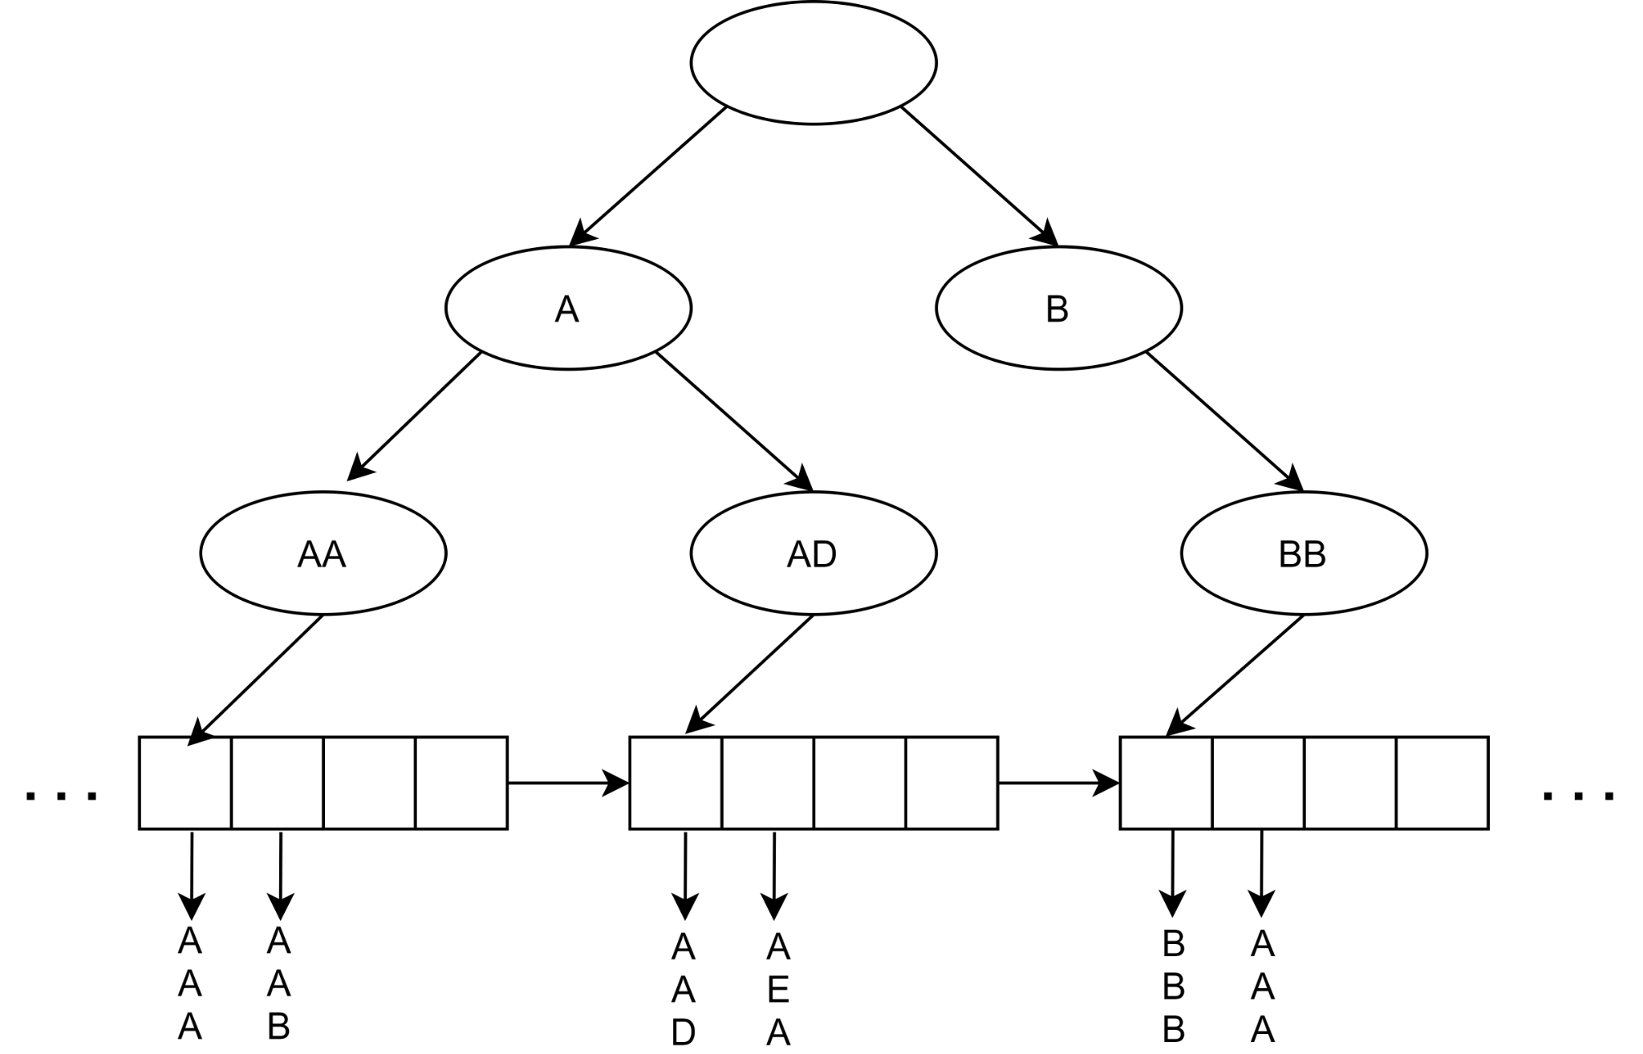
Relieve load of CPU by offloading compute to SmartSSD
Key Idea - Design a KV store to allow compute-offload between Host and SmartSSD
Search for the partial keys in this tree structure. Thus it is called ‘Search Layer’
We choose the kv-store,
Host - tree structure - Search layer
SmartSSD - doubly linked list - Data layer
Host CPU only handles ‘Search Layer’
SmartSSD handles ‘Data Layer’
Host
SmartSSD
Once we narrow down the partial key we fetch the actual data from leaf node. Thus the chained leaf nodes is called ‘Data Layer’
Notes:
Need

Slide 20
Reduce data transfer over the network
Key Idea- Find the right location to store Search and Data layer - avoid network hops
Host DRAM
Store ‘Search Layer’ on the host DRAM
As host CPU manipulate ‘Search Layer’
Host CPU
Search
Layer
Store ‘Data Layer’ on the SmartSSD
As FPGA manipulate ‘Data Layer’
PCIe
Data Layer
FPGA
Thus reducing network latencies
By fully leveraging near-storage compute
SSD
SmartSSD

Slide 21
Decouple the design to act independently on host & SmartSSD
Key Idea- Distribute responsibilities host and SmartSSD to best suit their compute capabilities
Host CPU is best used in the control plane
Issues IO requests
Handles concurrency control & manages caching
Handles Crash consistency & garbage collection
FPGA on SmartSSD leverages near-dataness in the data plane
Maximizes the advantage of high-internal bandwidth inside SmartSSD
Caters to host's requests in the data plane
Reduces network latencies by only returning the result of an operation

Slide 22
Working of Cross-Layered design
1. Operation issued to Host
2. Host looks up the Search Layer
Host DRAM
Host CPU
Search
Layer
6. FPGA returns control to the host
3. Finds the location of data in SSD
PCIe
Data Layer
FPGA
4. Triggers FPGA to execute on data
SSD
SmartSSD
5. FPGA reads data from Data Layer and executes

Slide 23
Benefits of Cross-Layered Design
Decouples Key-Value store logic
Reduce compute contention
Decouple the physical placement of Key-Value store
Reduce network contention
Take advantage of high-speed internal bandwidth in SmartSSD
Distributes responsibilities between host and SmartSSD to best suit their capabilities
Host to handle control logic
FPGA to handle the data operation
Provides the foundation for a robust computational storage framework

Slide 24
Mirror Cache

Slide 25
Why do we need a new cache?
Host DRAM based Cache
Goal : Maximize I/O Performance
DRAM
CPU
Challenges & Solutions:
Host based Cache(not OS cache but the cache for disk data)
Increase network Latency
Under-utilizes SmartSSD
Leverage memory on SmartSSD to avoid network bottlenecks
1.Cache
Invalidate
2. Read over the network
1.Cachereadmiss
Network(PCIe)
2. Write over the network
Network latency !
SSD
Accel-erator
DRAM
SmartSSD under-
utilized
SmartSSD
Notes:
Computational Storage is under-
utilized
Leverage Memory on SmartSSD to avoid data movement
Leverage Memory on SmartSSD to avoid data movement

Slide 26
Leverage memory on SmartSSD to avoid network bottlenecks
Key Idea - Design a new cache to improve I/O performance
CPU Register
Host
Common Memory Area(CMA) is the shared memory area between SSD and FPGA
Logically, CMA can be placed between the host DRAM and the rest of SmartSSD
Leverage this memory Hierarchy to implement Mirror Cache
Mirror Cache
cache metadata on host DRAM
cache data page on CMA
HOST DRAM
Mirror Cache
Common Memory Area
FPGA DRAM
SSD
SmartSSD
Notes:
With Cross-layered design, data is transferred directly between the SSD and the P2P memory without the involvement of the host DRAM.
Using a host-based cache thus results in increased data hops over the network.
Mirror cache is a layered cache design that leverages ‘Host Memory’ and ‘Common Memory Area’.

Slide 27
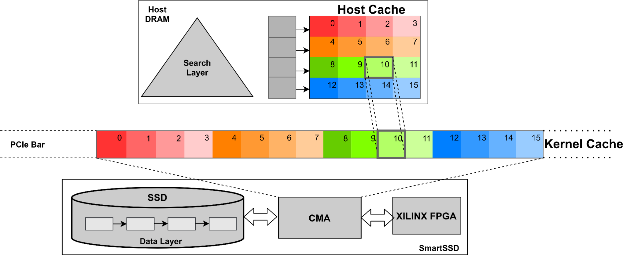
Mirror Cache design
Host cache is a hash table in Host DRAM that stores metadata of data nodes.
Kernel Cache is a flattened 1D array (large P2P buffer) in CMA that stores the actual data nodes.
Each entry store the metadata such as LBA, timestamp, flag to check occupancy, and, locks.
Each entry in Kernel cache stores the actual data node at the same offset as the host cache.

Slide 28
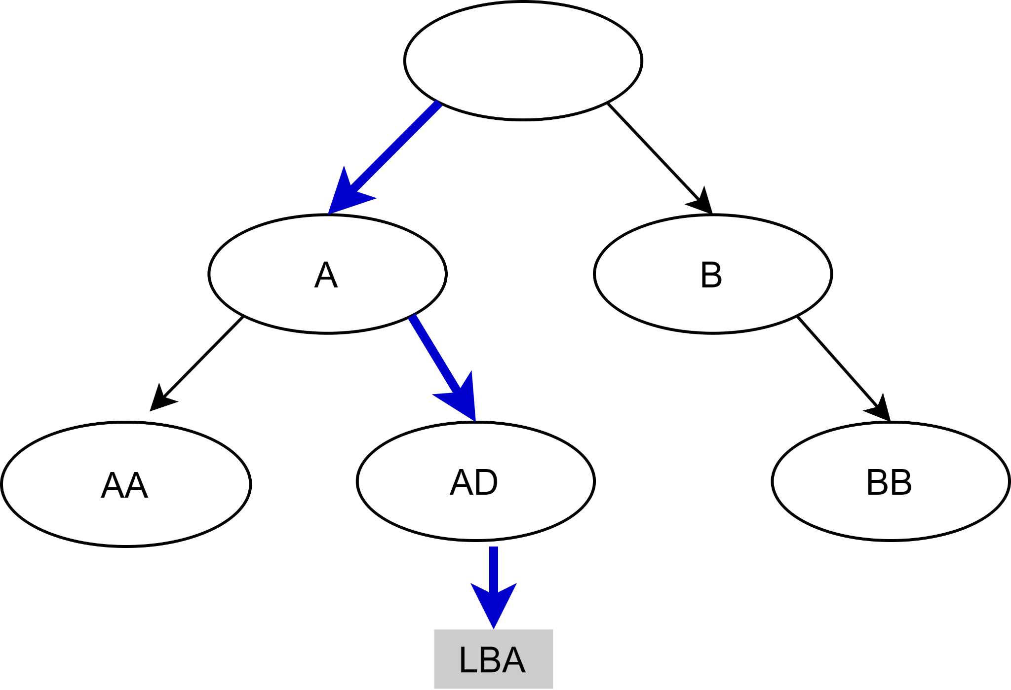
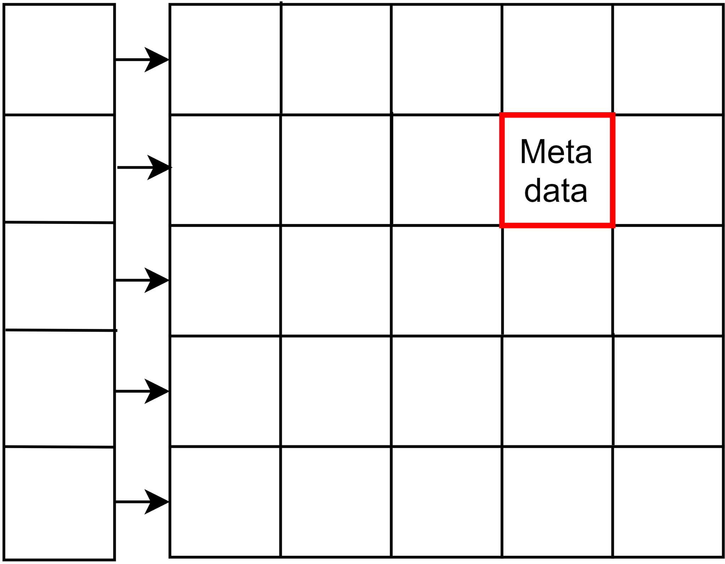
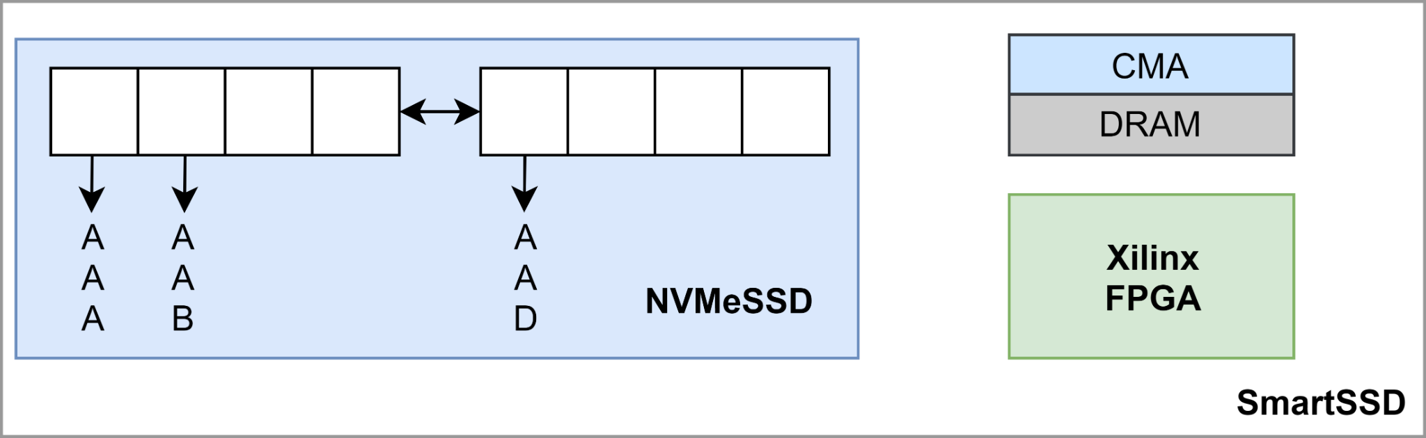
Working of Mirror Cache
Host DRAM
Host Cache
2. Use LBA to lookup metadata on host cache
1. CPU lookup Partial Key
3. If cache hit issue kernel call
5. Write the data page back to SSD
4. kernel execution
‹#›

Slide 29
Version-based Crash Consistency

Slide 30
Crash consistency : Variable Key-value support
Retina internally handles crash consistency - small fixed sized key-value
Takes advantage of atomic 4K read/write to SSD
Organizes key-value in 4K sized data pages
Retina on-long run caters AI/ML applications - Large variable sized key-value
Cannot promise crash consistency with the current design

Slide 31
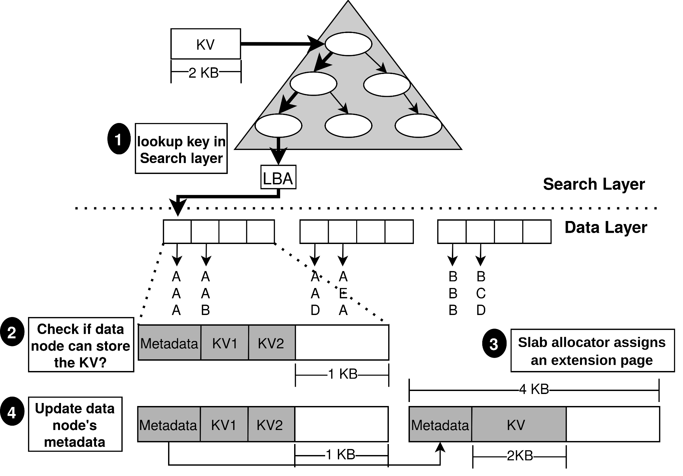
Variable Key-value: workflow
Cannot guarantee crash consistency for two node in one atomic write

Slide 32
Verison-based Crash Consistency: Motivation
Traditional key-value stores use logging based crash consistency
Issues with Logging based crash consistency
Degrades critical path performance - using multiple sequential writes
Increases write amplification - by logging at every operation
Version-based crash consistency
Lightweight crash consistency using version number to track live pages
Reduces the number of writes to the disk
No extra logs are maintained

Slide 33
Working of VCC
Scheme:
Assign same version number to data and extension page
Increase the version number at every update
Persist
Data pages in-place
Extension pages out-of-place

Slide 34
Verison-based Crash Consistency
SSD
CMA
3. FPGA reads the data & ext nodes from CMA
1. Update to the ext. node of Data Node
Data Node 3
Ext.
Node 3
Data Node 3
Ext.
Node 3
0
0
2. Create copies of Data node and its extension to the CMA
0
0
FPGA
Version number
Data Node 3
Ext.
Node 3
Data Node 3
Ext.
Node 3
0
4. FPGA writes the updated(version:0 to 1) nodes back to CMA
0
1
1
Ext.
Node 3
1
5. Write updated extension node to SSD out-of-place
Data Node 3
Ext.
Node 3
6. Write updated data node to SSD in-place
0
0
1
Ext.
Node 3
1
‹#›

Slide 35
Supported API Calls

Slide 36
Retina’s API Calls
Insert(k,v)
update(k,v)
remove(k)
lookup(k)
scan(k, range)

Slide 37
Insert API Call
insert(k,v)
Host
CPU
Issue
Insert Kernel call
exit
Lookup key in Search layer
Lookup LBA in the host cache
Yes
Cache hit?
No
Issue P2P write from CMA to SSD
Issue P2P read from SSD to CMA
LBA
PCIe Bar
Data Node
CMA
SSD
Get key finger
print
Insert fp & (k,v) in data node
FPGA DRAM
SmartSSD
Xilinx FPGA

Slide 38
Outline
Background
Retina Key-value Store Design
Implementation
Evaluation
Future Work
Conclusion

Slide 39
Implementation
Retina uses Vitis Accel toolchain to configure and trigger FPGA kernels
Based on OpenCL execution model, we implement
C/C++ host code to execute on the host processor and
OpenCL/C/C++ hardware kernel code on Xilinx FPGA
Finally, use OpenCL API to manage communication between host and Xilinx FPGA
Retina Host-side: implements the search layer, Mirror cache (host-
side), metadata for the data layer
Retina Kernel-side: implements kernel logic for each API Call
Retina consists of 4000 lines of C++ code and 1200 lines of HLS kernel code.

Slide 40
Outline
Background
Retina Key-value Store Design
Implementation
Evaluation
Future Work
Conclusion

Slide 41
Evaluation Setup
We use Yahoo Cloud Serving Benchmark(YCSB) -
Widely used to evaluate storage system performance
Production-like workloads with varying % of storage reads and write
Host system being used is,
Intel Xeon Gold 6152 CPU with eight-core (256KB L1, 4MB L2, 60MB L3 cache)
263GB DRAM memory
SmartSSD integrates,
Samsung V-NAND SSD of 3.84TB capacity with
Xilinx Kintex Ultrascale (KU15P) FPGA.
RocksDB is used as the State-of-the-art key-value store.

Slide 42
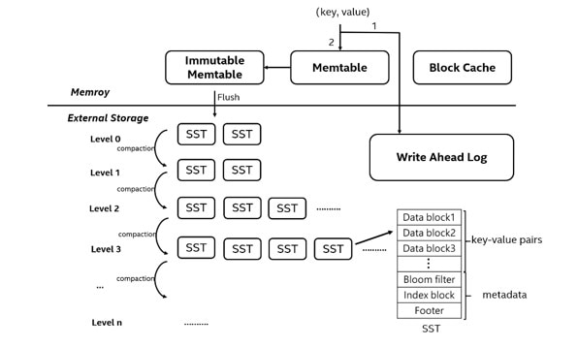
RocksDB system configuration
Goal : Fair performance comparison of RocksDB and Retina
For Fair comparison
Need to use Direct I/O
To switch RocksDB to Direct I/O
Disable OS page cache & block cache
Also, disable bloom filters

Slide 43
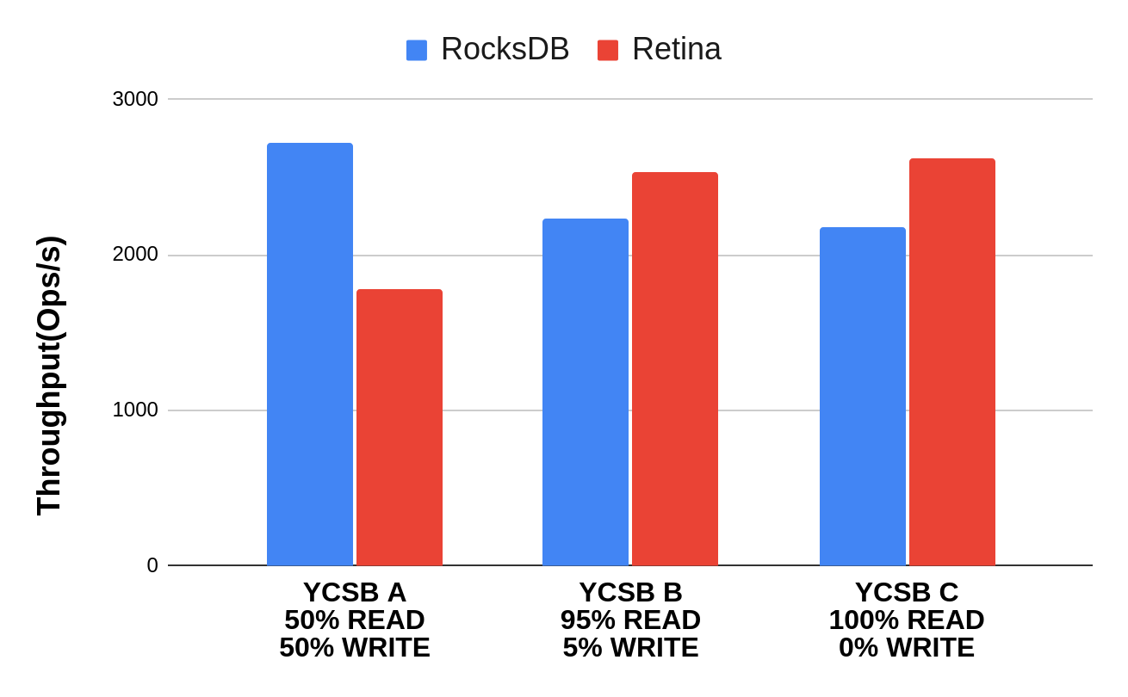
Overall Performance
Throughput increase by 20.5%
Ran YCSB A workload with 16 threads, key-value size of 1024 bytes for 5 Millions dataset size.
Retina’s throughput improves by 20.5% compared to RocksDB for read-intensive workload (YCSB C)
As ‘Mirror Cache’ exploties data locality to improve performance.
This effect is more pronounced due to Zipfian access pattern

Slide 44
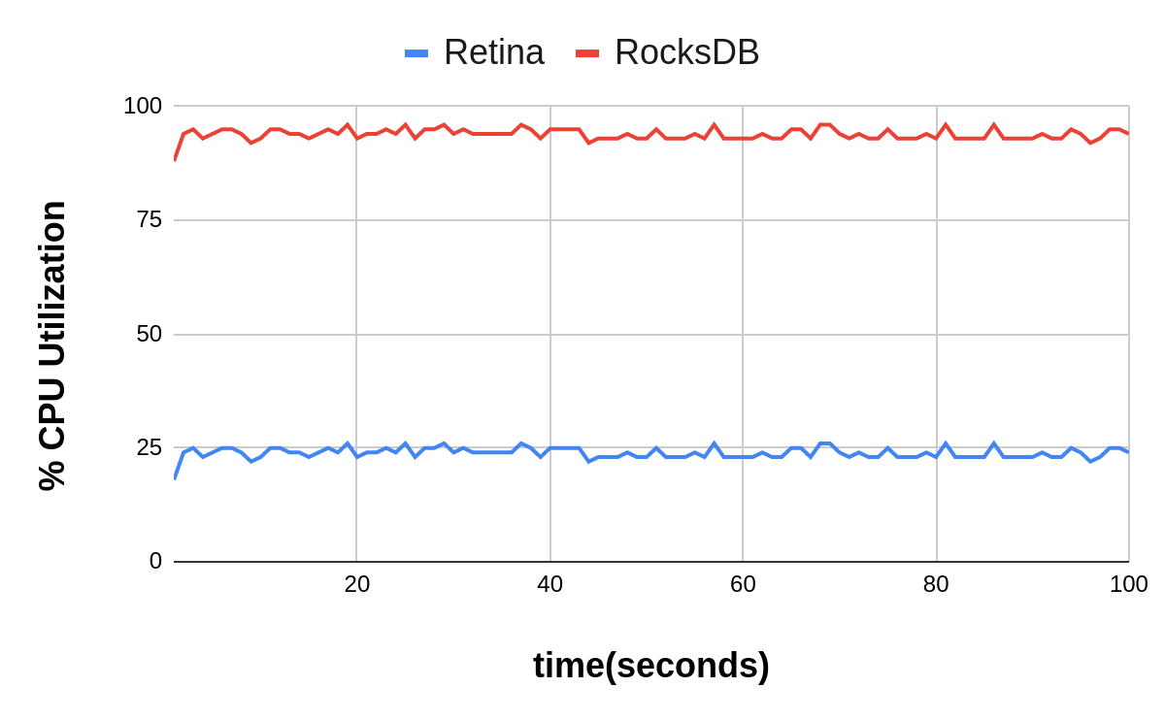
Overall Performance
Ran YCSB A workload with 16 threads, key-value size of 1024 bytes for 5 Millions dataset size.
In the same experiment, Retina’s reduces CPU by about 4x in comparison to RocksDB
Retina’s cross-layer design reduces CPU contention by offloading to SmartSSD
While also achieving high throughput performance

Slide 45
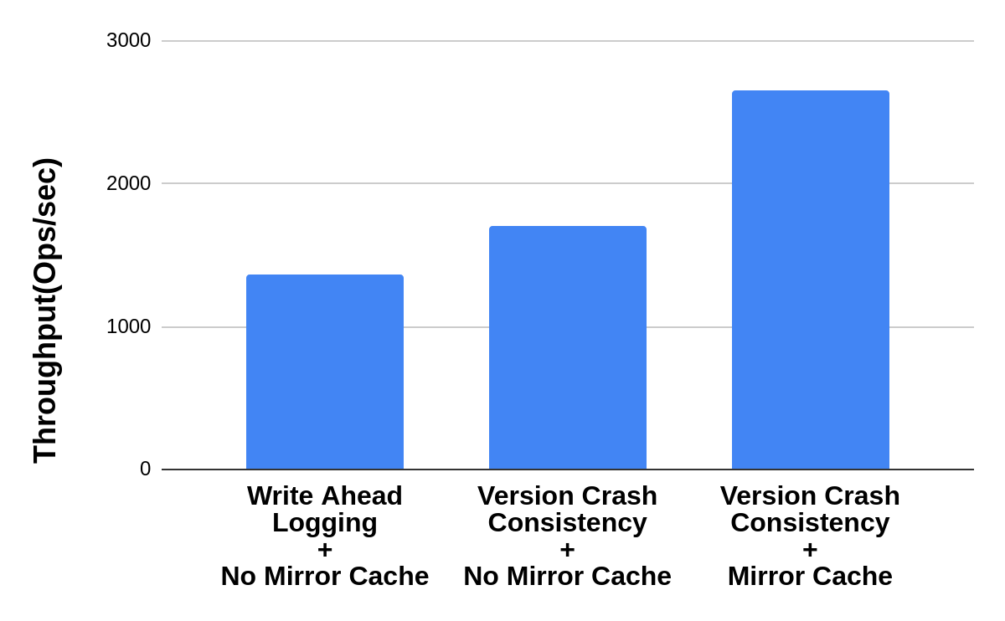
Profiling Mirror Cache and Version-based Crash Consistency
Ran YCSB A benchmark with single thread 5 Millions dataset size.
Second config achieve 25.4% throughput increase
VCC reduces the number of SSD writes by 2x in comparison to WAL
Third config achieve 56.1% throughput increase
Mirror cache results in reduced SSD access by taking advantage of data locality and access patterns.
56.1% impr.
25.4% impr.
VCC - Version based Crash Consistency
WAL - Write-Ahead-Logging

Slide 46
Outline
Background
Retina Key-value Store Design
Implementation
Evaluation
Future Work
Conclusion

Slide 47
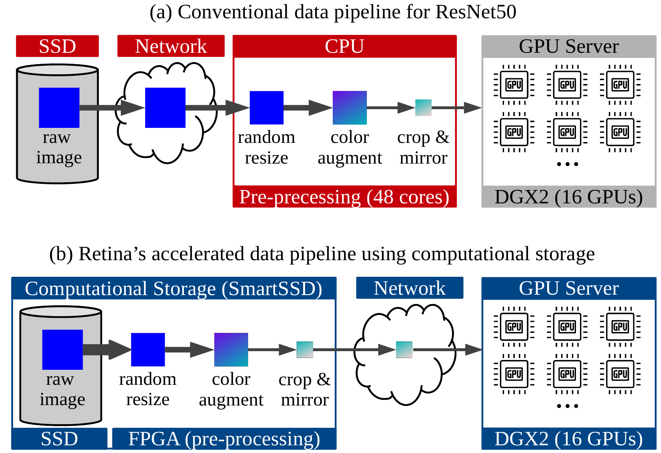
Retina: Computational Preprocessing Pipeline
Our computational storage based data pipeline uses FPGA to perform preprocessing (that scales and provides higher throughput).
Retina eliminates data fetch stalls as it transfers data directly from the SSD to FPGA DDR with our new KV store implementation.

Slide 48
Outline
Background
Retina Key-value Store Design
Implementation
Evaluation
Future Work
Conclusion

Slide 49
Conclusion
We present a Cross-layered Key-Value Store for Computational Storage that
Maximizes IO utilization and throughput
Provide High-performance and scalability
Provides the storage framework for our bigger project:
“Retina: Computational Preprocessing Pipeline for AI/ML applications”
Thesis Contributions:
IP 1: Architecture of Cross-Layered Key-Value Store with Computational Storage
IP 2: Cross-Layered Key-Value Store with Computational Storage
Notes:
Patent 1: Architecture of Cross-Layered Key-Value Store with Computational Storage
Patent 2: Cross-Layered Key-Value Store with Computational Storage

Slide 50
Thank you ! Questions?

Slide 51


Bare-Bones Key-Value Store
Insert(K’,V’)
Lookup(K1)
Key-value store based on a file
Two key operations
Insert (key, value)
Lookup (key)
Disk
< K1, V1 >
< K2, V2 >
Return V3
< K1, V3 >
Write performance - O(1)
Read performance - O(n) n - number of total key-value pairs
< K4, V4 >
Lookup the most recent value of K1
< K’, V’ >
Append at end of file
Log File
Notes:
Consider our key-value store is based on a text file, where each key-value pairs is stored by appending at the end of the file.
Suppose this key-value store supports the following operations,
Insert(key, value) - that appends the key and value at the end of the text file
Lookup(key) - will search the entire text file to find the most recent value associated with that particular key.
Though our write performance is very efficient O(1), our read performance is very bad O(n) where n is the number of records in the file.

Slide 52
Hash based Key-Value Stores
Hash Index
Key | Offset
K1 | 0X00
K2 | 0X08
Lookup(K2)
Improve read performance ❓
✅ Store key-offset mapping in a hash table.
Hash table that aids the lookup in key-value stores is called an ‘Index Structure’.
Insert(K’,V’)
K’ 0X16
Host DRAM
Disk
0X00
< K1, V1 >
0X08
< K2, V2 >
0X16
Return V2
< K’, V’ >
Now, the read performance is O(1)
Append at end of file
Log File
Notes:
To improve read performance, we try to store the locations of each key-value pair in a hash table as an offset in the append-only log file.
Thus at Lookup, we just lookup the hash table to find the file offset of the key.
This structure is called the ‘Index structure’ that sits in the host DRAM

Slide 53
Issues with Hash based Key-Value Stores
Too many duplicates, wasting disk space
✅ Need a ‘Garbage collection’ scheme
Hash Index can run out of the Host DRAM space
✅ Store offsets of the start of a collection of key-value pairs
How to still achieve good read performance?
✅ Store sorted key-value pairs on disk
Notes:
Stale key-value pair taking up all the disk space
Solution: split the files into segments and compact them on a timely basis
Issue: Key-offset mapping cannot fit in-memory anymore
Solution: Store only start of segments
Issue: How do we know which key-value pair is in which segment?
Sort keys in each segment files

Slide 54
Issues with Hash based Key-Value Stores
Too many duplicates wasting disk space
✅ Need a ‘Garbage collection’ scheme
Hash table can run out of the Host DRAM space
✅ Store offsets of the start of a collection of key-value pairs
How to still achieve good read performance?
✅ Store sorted key-value pairs on disk
Notes:
Stale key-value pair taking up all the disk space
Solution: split the files into segments and compact them on a timely basis
Issue: Key-offset mapping cannot fit in-memory anymore
Solution: Store only start of segments
Issue: How do we know which key-value pair is in which segment?
Sort keys in each segment files

Slide 55
Store Segment Offsets in the Hash Index
✔ Store < Key, Offset > for each segment start.
✔ Fetch the entire segment of key-value pairs to the host DRAM and then lookup.
Host DRAM
Disk
Hash Index
Log File
Key | Offset
K’ | 0X0000
K’’ | 0X0800
… | …
Segment 1
Segment 2
. . .
Notes:
Instead of maintaining mapping for every key and offset just maintain mapping for each segment.
Once the segment is fetched from the storage, just find the required key-value pair inside the segment.

Slide 56
Issues with Hash based Key-Value Stores
Too many duplicates wasting disk space
✅ Need a ‘Garbage collection’ scheme
Hash table can run out of the Host DRAM space
✅ Store offsets of the start of a collection of key-value pairs
How to still achieve good read performance?
✅ Store sorted key-value pairs on disk
Notes:
Stale key-value pair taking up all the disk space
Solution: split the files into segments and compact them on a timely basis
Issue: Key-offset mapping cannot fit in-memory anymore
Solution: Store only start of segments
Issue: How do we know which key-value pair is in which segment?
Sort keys in each segment files

Slide 57
Store Sorted keys to Improve Reads
Hash index only stores offsets of segments. No key-value ordering
How to improve reads without searching all the segment ❓
✔ Store sorted keys in each segment. Thus every segment holds a range of <K, V>
Host DRAM
Disk
Hash Index
Log File
Key | Offset
K1 | 0X0000
K4 | 0X0800
… | …
<K1,V1>
<K2,V2>
<K3,V3>
Segment 1 range: [K1, K3]
<K4,V4>
<K5,V5>
<K6,V6>
Segment 2 range: [K4, K6]
. . .
Notes:
Instead of maintaining mapping for every key and offset just maintain mapping for each segment.
Once the segment is fetched from the storage, just find the required key-value pair inside the segment.

Slide 58
LSM Tree - Most prevalent key-value store design
Insert(K2, V2)
<K1,V1>
<K3,V3>
Stores sorted keys using In-memory self balancing tree, called ‘Memtable’
Key Offset
MemTable
K’ Seg1
<K1,V1>
<K2,V2>
<K3,V3>
Hash Index
Host DRAM
Disk
Inserts can cause cascading compactions
Hash Index to store <key, Segment Offset>
Segment0
LSM is made of Sorted Segments of key-value pairs
Segment1
Segment2
Organizes segments into layers to maintain fast access for frequently accessed <K,V>
Segment3
Segment4
Segment5
Notes:
LSM adopts all the above mentioned solutions to internally stores all its key-value pairs in sorted segments on disk
It maintains an in-memory hash table that maintains the key-segment offset mapping
But to enable storing sorted data they also use a in-memory tree structure that stores the updates in a sorted manner.
To further improve data locality they maintain segments on levels. Moving from top to bottom, we encounter most recently accessed key-value pairs to least recently accessed.
Thus an insert adds the key-value pair to the in-memory tree, if its full we move L0 level and can cascade until the end.

Slide 59
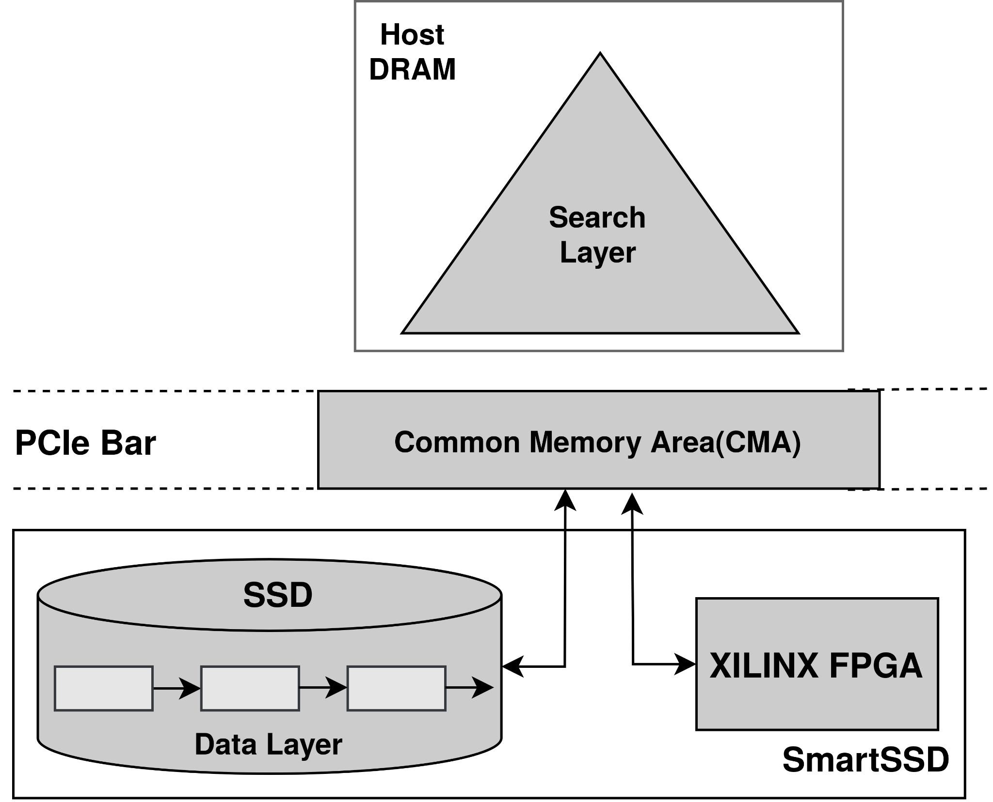
Retina’s Cross-Layered design
Maximize computational storage’s bandwidth utilization:
Remove CPU botlleneck by offloading compute to Smart SSD's accelerator.
Reduce data hops over the PCIE bus.
Split the underlying KV store design between Host DRAM and SmartSSD to fully leverage the near-data accelerator and reduce network overhead.
Maximally utilize host CPU to act as the control plane:
Issues IO requests
Handles concurrency control
Manages caching
Handles Crash consistency & garbage collection
Maximally utilize FPGA on SmartSSD in the data plane
Caters to host's requests in the data plane
Reduces network latencies by handling IO requests and increases overall throughput by compressing keys

Slide 60
Cross-layered Vs Traditional Key-value store
 | Cross-layer KV store | Traditional KV store(ex:RocksDB)
CPU utilization | Avoids bottleneck by splitting the KV store logically into Search and Data layer to use CPU only as the control plane and offload data plane task to FPGA. | Overwhelms the CPU with compute intensive garbage collection, expensive logic to store sorted keys on disk, and complex synchronization mechanisms.
I/O bandwidth utilization | Maximizes I/O bandwidth utilization by transferring data to FPGA through P2P thus reducing the network hops and increasing the overall throughput | Sub-optimally utilizes I/O bandwidth due to CPU bottleneck
Crash Consistency | Version-based Crash-consistency that uses a simple versioning system and 4K atomic updates to avoid journaling | Uses expensive logging-based recovery
Scalability | As the Search layer and the Data layer are logically and physically split between the Host CPU and SmartSSD FPGA, the key value store can be scaled without any synchronization issues | Scaling is non-trivial

