Slide 1

Practical Exploit Mitigation Against Code Re-Use Attacks and System Call Abuse
Christopher Jelesnianski
April 13, 2022
Committee:
Changwoo Min (Chair)
Yeongjin Jang, Danfeng Yao, Wenjie Xiong, & Haibo Zeng
Notes:
Hello, my name is Christopher Jelesnianski. Today I will introduce my preliminary thesis:
Practical Exploit Mitigation Against Code Re-Use Attacks & System Call Abuse

Slide 2
Outline
Motivation
Background
Contributions
Future Work
Summary
Notes:
So here is an Outline of what we will go over today
First, I will introduce the motivation for this work
Then I will explain the background regarding things like key terms and concepts
Then I will introduce and explain the contributions I have worked on for this thesis
Then I will propose the future work that still needs to be done
And finally summarize and conclude.

Slide 3
Outline
Motivation
Background
Contributions
Future Work
Summary
Notes:
So First, Motivation

Slide 4
Thesis Statement
Exploit mitigation techniques need to shift focus to not only provide an effective solution to the latest threat, but also to be a practical defense that can be readily deployed
Notes:
So the thesis statement for this work is the following:
Code Is everywhere
from your car to your washing machine
more things need to be protected!!

Slide 5
Mainstream Adoption of Mitigation Techniques
PaX Linux Address Space Layout Randomization (ASLR) (2001)
Linux Kernel Stack ASLR (2002)
No-Execute Bit (NX-bit)
Linux 2.6.8 (2004)
Windows XP SP2 (2004) -- Data Execution Prevention (DEP)
System Call Whitelisting (seccomp)
Linux 2.6.12 - (2005)
Linux 2.6.23 - (2007)
seccomp mode 2 - Linux 3.5 (2012)
seccomp eBPF - Linux 3.8 (2013)
GCC & Clang Control-Flow Integrity & SafeStack (USENIX Security 2014)
That’s about it…
Notes:
To understand where this thesis statement came from, we need to look at mainstream security.
PaX Address Space Layout Randomization, also known as ASLR, was first introduced in 2001.
ASLR effectively tries to randomize the code layout when a program starts to make locating
sensitive attack components hard to locate for the attacker, so they cannot create the attack
KASLR, just ASLR for the Linux kernel soon after.
Then Data Execution Prevention, which specifically designates a memory region to non-executable was introduced in 2004.
This defense is what made code-injection attacks obsolete, and not longer possible.
Then seccomp was introduced, which is a system call whitelisting/blacklisting policy enforcement mechanism
to block attackers from using system calls in their attacks
seccomp has had many iterations since it's inception, but mostly to improve user experience
and to make it easy for developers to use.
Not until 2014 was control flow integrity and a safe stack mechanism were implemented into
the two most widely used compilers of GCC and Clang.
And that's about it, really.
Out of all the security papers published since ASLR not many have been integrated and deployed on production machines.
So that makes you wonder, …. why is that ??
========================================
https://en.wikipedia.org/wiki/NX_bit#x86
https://en.wikipedia.org/wiki/Address_space_layout_randomization
Enforcing Forward-Edge Control-Flow Integrity in GCC & LLVM - USENIX Sec 2014
https://web.archive.org/web/20140911011045/http://support.microsoft.com/kb/875352/en-us

Slide 6






Challenges in Exploit Mitigation Design
Why is Practical Exploit Mitigation Design Difficult to Achieve?
Non-Negligible Performance
Complex or frequent verification is hard to make fast
Attack Complexity
Modern attacks require more code components to be guarded
Limited Scalability
Designing mechanisms with negligible system impact is hard
Fragility
Perfect analysis is challenging to achieve in practice
Notes:
And that is because there are real challenges in Modern Exploit Mitigation Design
These challenges are:
Performance
As in: Defense mechanisms that have complex or frequent checks are hard to make fast
Next, Attack Complexity
We see from the security community that attacks are becoming able to use more
and more various code components in their attacks
Therefore defenses need to protect more things to be secure
Next Limited Scalability
As in: Designing a defense that does not use any additional CPU cycles or memory is difficult to achieve
And finally Fragility
Since many defense techniques rely on some form of analysis whether it is static or dynamic,
the perfect analysis is hard to get right
And user-provided test cases are simply not generic enough for defenses to get a good idea
of what will really go on in a program during runtime.
========================
W. Landi et al. Undecidability of static analysis. ACM letters on programming languages and
systems, 1(4):323–337, 1992.
>> Performance Tradeoffs
Overhead of Enforcement versus Security Gains of the Enforcement
Intentional compromise in security for better performance
>> Fragility
Constructing a complete & precise Control Flow Graph (CFG) is undecidable
CFI will generally over-approximate in order to prevent false positive
CFG creation requires whole program analysis > difficult especially when Dynamically linked libraries are put into the mix
Either again perform over-approximation OR analysis at dynamic link time
for example, a JIT compiler
may change the control-flow graph of the program at runtime in order to optimize program execution.

Slide 7
Outline
Motivation
Background
Attack-Sensitive Code Components
How Code Re-Use Attacks Work
Modern Defense Archetypes
Contributions
Future Work
Summary
Notes:
Now that we have explained the motivation
we can take a step back and go over the background for this thesis
Including Sensitive code components
How code re-use attacks work,
and the modern defense archetypes currently used in practice

Slide 8



Attack-Sensitive Code Components
You’re Compromised!
Code Gadgets
Pointers (Code & Data)
System Calls
Non-Control Data
Application Code
Process Stack
Code Gadget
2
Code Gadget N
1
Code Gadget …
Code Gadget 3
Code Ptr
Code Gadget 2
3
Code Gadget 1
System Call
4
Notes:
TALK SLOW+ Explain what each component IS
So we will build up the knowledge for practical design starting with
the common attack sensitive code components used to create an attack.
As we introduced ASLR, we said that it works by trying to randomize the code layout so attackers can’t figure out where the pieces they need are.
If attackers do get the code layout, they can stitch them together to reach a system call and complete the attack.
These pieces that attackers are looking for are things like
code gadgets
pointers that can be both code and data pointers
system calls
and non-control data
So, just to describe a little more,
code gadgets are >> small snippets of assembly that can perform various operations.
Chained together they form the basis for a code-reuse attack
!!!! Code gadgets are really cool because they can be found all throughout the application code, and can be pieced together like a puzzle
x86 is arbitrary length so any different offset can be reinterpreted as a gadget
Pointers >> Code pointers dictate what target function will be invoked when a code pointer is called
System Calls >> are the API used to interact with the OS, some system calls are security critical tasks like:
execve: which can execute new programs
or mprotect which can change memory permissions
And Non-Control Data >> which Include arbitrary program variables that are used as function arguments, flags, array/vector indexes.
This data can also be corrupted through a memory vulnerability
====================
explain meaning of ASLR here for committee >> explain WHY THEY MATTER
code layout shows where components are.> can stitch them together > then reach the system call

Slide 9

How Code Re-Use Attacks Work
Assumptions / Threat Model
Memory Vulnerability Exists
Generalized Code Re-Use Attack Procedure
Buffer Overflow
Dangling Pointer
1
2
3
4
5
Identify
Memory
Vulnerability
Perform
Memory
Disclosure
Identify
Code Components
Sensitive Data
and/or
Control-Flow
Hijacking
Illegitimate
System Call
Usage
Code Re-Use Variants
Return Oriented Programming (ROP) Shacham et al. (CCS 2007)
Just-In-Time ROP (JIT-ROP) Snow et al. (S&P 2013)
Blind ROP (BROP) Bittau et al. (S&P 2014)
Control Data & Non-Control Data Attacks van der Veen et al. (CCS 2017)
Notes:
Next let’s take a look at how code re-use attacks work.
This thesis focuses on code re-use attacks since Code Injection was resolved with the introduction of DEP
So, Usually all threats start with the assumption that there are un-intended software bugs
or a memory vulnerability exists which can lead to things like buffer overflow
(Explain Attack Procedure)
Completing this procedure allows an attacker to take over the victim machine and perform arbitrary execution.
While this is the general premise of Code Re-use, there exist different variants of Code Re-use such as
the return oriented programming
JIT ROP and Blind ROP
They all focus on leveraging code gadgets.
Additionally, there exist more advanced attacks like non-control data attacks
which look to maliciously manipulate regular program variables to build and complete an attack.
Our first defense handles all variants except for non-control data attacks
Our second defense then looks to address this attack variant.
============================
The first 3 variants all are looking to leverage CODE GADGETS
Non-Control Data >> is complex that it is looking to reuse regular program variables like those that control array indices
ROP > The Geometry of Innocent Flesh on the Bone: Return‐Into‐Libc without Function Calls (on the x86)”,Hovav Shacham (ACM CCS 2007) // Solar Designer. Getting around non-executable stack (and fix), 1997.
JIT-ROP >K. Z. Snow, Just-in-time code reuse: On the effectiveness of fine-grained address space layout randomization. In IEEE Symposium on Security and Privacy, 2013.
BROP > Bittau, Andrea, et al. "Hacking blind." 2014 IEEE Symposium on Security and Privacy. IEEE, 2014.
Non-Control > van der Veen, Victor, et al. "The dynamics of innocent flesh on the bone: Code reuse ten years later." Proceedings of the 2017 ACM SIGSAC Conference on Computer and Communications Security. 2017.

Slide 10






Modern Defense Archetypes
Generalized Code Re-Use Attack Procedure
0
1
2
3
4
5
Presence of Sensitive Code Components
Identify
Memory
Vulnerability
Perform
Memory
Disclosure
Identify Viable
Code Components
Sensitive Data
and/or
Control-Flow
Hijacking
Illegitimate
System Call
Usage
Generalized Defense Archetype Created
Debloating
Memory Safety
Information Hiding
Re-Randomization
Data Integrity
& Control Flow
Integrity
System Call Filtering
Notes:
Now that we have gone over how code re-use works,
we can explain how the security community has specialized and proposed different approaches to try to
stop code re-use at each of the individual steps.
Debloating Cuts out as much unnecessary/unused code as possible to minimize the number of viable gadgets
MemSafety Comes in two major flavors, spatial safety in the form of bounds checking for allocated memory,
and temporal safety by preventing use-after-free vulnerabilities for allocated pointers
Info Hiding (Disclosure Resistant) Hide code/data layout completely during runtime either through randomization
or enforcing eXecute-only memory permissions
Re-Rand (Disclosure Resilient) Even if memory layout is disclosed, re-randomization introduces entropy
by constantly churning code at varying granularity from page size, to function, to basic-block
DI & CFI Data Integrity monitors memory writes and reads. And halts the program if there is inconsistency
or strictly uses the legitimate update value
CFI monitors program control flow, if there is incorrect control-flow transfer program is halted
SysCall Filter Derives and enforces a set white-list of permitted system calls to be used during runtime,
all other syscalls are disabled
This thesis focuses on Re-Randomization and System Call filtering

Slide 11
Blueprint For Success in Practical Exploit Mitigation Design
Practical Design Properties
Low Performance Impact
Defenses should achieve low performance
Strong Security Guarantees
Defenses should provide strong security guarantees
Scalable Framework
Defenses should minimize use of additional CPU or memory resources
Reliable Defense
Defenses should not break the application runtime
Performance
Scalability
Security Guarantees
Reliability
Notes:
Now that we have laid down the foundation surrounding Code Re-use Attacks,
how the attack works and correspondingly how the defenses work…
We can draw up a blueprint for success and highlight what properties
a good practical defense design should have
So we have come up with 4 properties:
Low Performance Impact
Strong Security
Being Scalable
Being Reliable
More specifically, a practical defense should:
> have low performance impact on the application
> be strong security wise
> be designed in a scalable way to not hog CPU or memory
> be reliable means being a defense that still works under different use-cases, and being flexible to different configurations
and no false positives
==================================
4 Properties of Successful Practicality
> Reliable means:
Not fragile >> defense No false positives

Slide 12
Blueprint For Success in Practical Exploit Mitigation Design
Necessary Considerations
Being Aware of Trade-offs
Deriving the Essentials
What code pieces really needs to be protected?
What is the least amount of security coverage needed to still be strong and block attacks?
Performance
Scalability
Security Guarantees
Reliability
Notes:
In addition to the 4 practical properties that a defense should strive to achieve,
they should also have the following considerations in the back of their head during their design creation
Specifically,
to be aware of the trade-offs they may need to make
between performance, security, scalability, and reliability
and also to aim to figure out what are really the bare essentials to effectively protect modern code bases
like what code components are the most important to protect, and how to not have redundant protection

Slide 13
Outline
Motivation
Background
Contributions
MARDU
BASTION
Future Work
Summary
Notes:
So now we have gone over the motivation and background for this work,
Next we will dive into the contributions of this thesis

Slide 14
Thesis Contributions
This thesis proposal presents two Practical Exploit Mitigation Designs:
MARDU: Efficient and Scalable Code Re-Randomization
Motivation
Design
Implementation
Evaluation
BASTION: Context Sensitive System Call Protection
Motivation
Preliminary Design
SYSTOR ‘20
DTRAP ‘22
To Be Submitted ASPLOS ‘23
Notes:
Specifically this thesis presents two practical exploit mitigation designs
MARDU and BASTION
MARDU is ….
Efficient and Scalable Re-Randomization Technique
BASTION is ….
A Specialized System Filtering mechanism
I will first go over MARDU in it's entirety and then present BASTION
Note that BASTION is not yet complete so we only present:
BASTION’s motivation,
some preliminary design and a preliminary evaluation we did

Slide 15
Outline
Motivation
Background
Contributions
MARDU
BASTION
Future Work
Summary
3
Identify Viable
Code Components
Re-Randomization

Slide 16


Current randomization techniques are good ...
Code Randomization
Address Space Layout Randomization (ASLR)
Light-weight
Static code layout
One memory disclosure can compromise entire
code layout
Re-Randomization Techniques
Continuous churn makes gadgets hard to find
High overhead
Rely on predictable thresholds such as
Time interval
Syscall invocation
Call history
Oxymoron
Coarse-Grained ASLR
(Memory Page)
USENIX Security 2014
Shuffler
Fine-Grained Runtime Re-Randomization
(Function Granularity)
USENIX OSDI 2016
Notes:
As we discussed the key idea of ASLR is to randomize base address to hide code layout
This means a long standing application only has 1 randomization applied to it
This is can lead to a memory disclosure breaking the security guarantees
so then this evolved into defenses that re-randomize code throught runtime
Re-randomization makes any leaked data stale and unusable for an attacker
BUT comes at the cost of high overhead and applications being slowed down
These two state-of-the-art works have each of the respective problems as we have discussed

Slide 17
But They Are Not Practical. Why?
Performance
Users desire acceptable performance (<10% avg & worst-case)
Users desire strong defenses
Users desire scalability as more computation is moved to the cloud
Have system-wide security coverage including shared libraries
Users desire reliable defense that can be generically deployed
Achieving all together is hard
Scalability
Security Guarantees
Reliability
Notes:
This motivation shows that randomization techniques are still not practical
Instead for a defense to be practical it should….

Slide 18
Challenges For Practical Re-randomization
Performance Challenges
Avoiding Useless Overwork: Active randomization wastes CPU cycles in case of “what-if”
Security Challenges
Code Disclosure: a single leaked pointer allows attacker to obtain code layout of a victim process
Scalability Challenges
Code Tracking: to support runtime re-randomization tracking and updating of pc-relative code is a necessary and expensive evil
Stop-the-World: Updating shared code on-the-fly is challenging especially in concurrent access
Reliability Challenges
Being Generic: Ability for incremental deployment is preferred to completely overhauling a system for isolated protection
Notes:
MARDU seeks to address all 4 key challenges
For Performance, most randomization techniques are active and continuously re-randomize code, regardless if there is an attack happening or not
this takes up valuable system resources to provide a defense
Instead MARDU only performs randomization re-actively only when needed.
For Security, if the memory layout is disclosed it breaks the defense.
MARDU uses execute-only memory to protect all sensitive code regions the attacker needs to create a ROP attack
For scalability, most randomization techniques require costly code-tracking and patching to maintain program semantics and are also not capable of sharing randomized code
MARDU leverages trampolines to minimize patching overheads as well as to have a way to securely share code
For reliability, some defenses cannot be incrementally deployed, or work system-wide
Because MARDU is capable of code sharing (meaning it can protect libraries shared by multiple applications)
it can both be incrementally deployed and is a defense that secures the platform system-wide
=======================
Code disclosure = code probing attempts (entire code layout)
Code tracking = expensive for both host and overall system
Avoid stop the world = patching is hard
Useless overwork = constant interval and syscall trigger is bypassable

Slide 19
MARDU
MARDU Goal Summary
Goal 1: Performance Low performance impact, but still high entropy
Goal 2: Security Code is secure in runtime
Goal 3: Scalability Code-sharing is possible in MARDU
Goal 4: Reliability MARDU supports mixed (un)instrumented libraries
MARDU Key Points
Performance
MARDU performs reactive on-demand runtime re-randomization
No previous randomization scheme is capable of runtime re-randomization AND code sharing
Security / Scalability / Reliability
MARDU uses code trampolines with PC-relative addressing
MARDU can share it's randomized code in a system-wide manner
Notes:
Now we will go over the goals of MARDU from a high level view and then go into more detail thereafter
We design MARDU to achieve all 4 practical design properties
It will have low performance impact but still high entropy
MARDU’s code will be secure throughout runtime
MARDU will be scalable by enabling sharing of randomized code
and MARDU will be deployable incrementally
The key takeaways I want you to remember about MARDU is that
It's performance is is achieved by implementing a randomization that is performed
on-demand only when necessary
And that
Code trampolines are really the key design feature that really unlock MARDU’s
security, scalability, and reliability aspects
===============================
trampolines are gateway so attackers are unable to jump into the middle of a function code to reach a gadget

Slide 20

MARDU
MARDU Design
MARDU: Design Overview
Key Concept: How Code Trampolines Work
Scalability: How MARDU Shares Code
Performance: Re-randomization Without Stopping the World
Implementation
Evaluation
Notes:
To explain the Performance and Scalability of MARDU
I’ll first go over the Design overview
Then since trampolines really are a key part of MARDU, I’ll explain how they work
Then with that knowledge,
I can show you how we enable code sharing in MARDU
and
we show how we re-randomize code during runtime without stopping the world

Slide 21



MARDU Design Overview
Compiler Component
Code Analysis
Create & Insert MARDU Trampolines
Generate Fixup Information for Patching
MARDU Process
Kernel Component
Memory layout & Execute-only Overlay
On-Demand Re-Randomization & Patching
Data
Trampolines
Code
Heap
Stack
Read Write
Execute-Only
Trampolines act as:
entry gateway to each function call exit gateway for each function return
Notes:
MARDU has 2 main parts, a compiler and a kernel component
The Compiler is responsible for
code analysis and instrumentation
as well as generating the needed fixup information
for patching during runtime
The Kernel is responsible for the actual process memory layout
and performing the actual on-demand runtime re-randomization and patching
These two components therefore allow us to make a MARDU process look something like the following
where the trampolines are the glue that holds MARDU together as well as what makes it secure.
So now I need to explain what trampolines are in detail and how they work
=========
what is trampoline
what is fixup
compiler is responsible for setting up trampolines

Slide 22

How Code Trampolines Work
Traditional Control-Flow
MARDU Control-Flow
Code Region
Trampoline Region
void foo() {
/* … */
bar();
/* … */
}
void foo() {
/* … */
bar();
/* … */
}
Entry Gateways
1
foo_entry
1
bar_entry
2
Exit Gateways
void bar(){
/* … */
}
void bar(){
/* … */
}
foo_exit
3
bar_exit
2
4
Notes:
The Gold sparkles here are the fixup information which allow for patching to occur
Patching is necessary because of the randomized layout of function bodies
==============
each function is always called throught the entry gateway and exit gateway
i will explain how the function call works
MARDU always goes through the trampoline region
need to introduce compiler component better
how is this related to fixups and patching

Slide 23


How Code Trampolines Work
MARDU runtime always transfers using
the trampoline region
Trampolines leverage immutable code
MARDU has a ground truth that will always
maintain program semantics
Simplified Runtime Tracking
& Re-Randomization

Slide 24
Example: How MARDU Programs Work
MARDU Patch Info Section
.text Section
Code
Region (C)
Trampoline
Region (T)
Fixups
MARDU-compiled Binary/Library
Place Trampoline & Code Region
Perform patching
2
3
C
T
In-Kernel Randomized code cache
1
Map Kernel Memory
Notes:
So to explain what the MARDU runtime looks like
Suppose we have a MARDU instrumented Binary with instrumented Code and Trampoline Regions
In addition the compiler creates a new section that contains fixup information for updating code
to remain semantically correct during runtime
When the MARDU runtime starts, it first maps a code cache in kernel-space
Then the Trampoline and Code Regions are randomized and mapped in
Finally all necessary fixups are patched to maintain semantics
After this the program proceeds and executes as normal
=============================
1) suppose that websrv is launched and try to load libc.so
2) here is the binary
3) code cache
4) mapped to websrv
5) okay, what happens dbsrv is launched.
Fixups are info on =
Fix Offsets such that control transfers and data is semantically consistent

Slide 25
Example: How MARDU Shares Code
web server
libc.so
dbserver
libc.so
MARDU
Process 1 Userspace
C
T
C
T
MARDU
Process 2 Userspace
C
T
C
T
5
6
libc.so
C
T
In-Kernel Randomized code cache
Notes:
So now assuming we have a MARDU-enabled LIBC
If we have a new MARDU enabled program startup like a web server,
it will first perform it's own MARDU randomization
and then simply map a virtual copy of the MARDU randomized libc
into it's userspace memory and use it like normal
the same process occurs for any other MARDU enabled program
-----------
One reason why prior randomization techniques cannot share code is because
they perform the randomization during compilation
and make a staticly linked binary (all needed library code is included
A staticly linked binary has all the external libraries it needs combined into a single binary
One more reason re-randomization techniques cannot share code is because they are designed using
virtualization and only work within the address space of the target process
For Example,
Shuffler operates within the same address space as the programs it defends.
========================
Why prior re-randomization techniques cannot share code
Prior re-randomization techniques either randomize the code as it being created into a binary
(making a staticly-linked binary with all libraries randomized and compiled in together)
Or design their defense such that the entire code base is encapsulated for given program

Slide 26


Re-Randomization Without Stopping the World
web server
libc.so
dbserver
libc.so
MARDU
Process 1 Userspace
C
T
C
T
MARDU
Process 2 Userspace
C
T
C
T
Re-active re-randomization
Only when attack detected (on-demand)
Responsibility of exiting (crashed) process/thread
In-Kernel Randomized code cache
C v1
T v1
0xffffffff81171000
Notes:
Lets assume we have the same 2 MARDU enabled programs
as before currently running and sharing LIBC
In the case that the database server is attacked
this usually means that the database server memory layout
and all associated shared library code is now exposed to the attacker
meaning without any defenses, the attacker can now leverage
this information and perform an attack on the web server process
---
NOTE: The Database Server crashing can be perceived as an attack attempt.
For example Probe attack will crash a connected process
or an expendable worker thread to learn it's memory layout
and then use this layout information to carry out it's attack on another still live thread or process

Slide 27
Re-Randomization Without Stopping the World
web server
libc.so
Gadgets previously deduced are now stale
Randomization is replicated for ALL ASSOCIATED shared code of a victim process
MARDU
Process 1 Userspace
C
T
C v1
C v2
T v1
T v2
2
3
Map Code v2 to userspace
Map Trampoline v2 to userspace
In-Kernel Randomized code cache
C v1
T v1
C v2
T v2
4
Unmap old region
0xffffffff81171000
1
0xffffffff2245d000
Map new region
Notes:
However, with MARDU, the attack on the database server will trigger re-randomization
on LIBC
when the attack was detected, let’s assume the web server and data-base server
were using version 1 of LIBC
when re-randomization begins, we setup a new mapped area for LIBC to be re-randomized, denoted as V2
We re-randomize and patch as done before
What happens next is how we achieve not-stopping-the-world for a MARDU process
For a brief time we actually allow both versions to exist in userspace
such that the webserver does not need to stop in case it was executing LIBC code when re-randomization was triggered
This is possible because MARDU trampolines are immutable
allowing the return address of the trampoline to always be correct
once the reference count for the first version reached 0,
we can safely unmap the old version of libc,
and unmap it's kernel memory as well
this process makes any information gathered, if any
stale and useless to the attacker
to further clarify, this re-randomization scheme is repeated on-demand
whenever an attack is detected for any number of associated code
that might have been compromised
==========
think about how to make it easuier to present
both layout and what you are saying
you did not explain what these arrows are Tv2 to Cv1/Cv2

Slide 28



MARDU Implementation
Working Framework
Compiler
LLVM/Clang 6.0.0
3.5K LOC
Kernel
X86-64 linux 4.17.0
4K LOC
musl LibC
General C library
LLVM
Compiler Infrastructure
Notes:
in addition,
we made a few linux kernel modifications to support our runtime

Slide 29
MARDU Evaluation
Evaluation
Security: Popular ROP attacks -> MARDU Wins
Performance: Compute Bound -> Minimal Runtime Overhead
Scalability: Concurrent WebServer-> Negligible Runtime Overhead and Scalability
How much performance overhead does MARDU impose?
How scalable is MARDU in terms of memory savings?

Slide 30
Experimental Setup and Applications
Experimental Setup
All programs compiled with MARDU LLVM compiler and -O2 -fPIC optimization flags
Platform:
24-core (48-Hardware thread) machine with two Intel Xeon Silver 4116 CPUs (2.10 GHz)
128 GB DRAM
Applications
SPEC CPU 2006 (All C applications)
NGINX web server

Slide 31
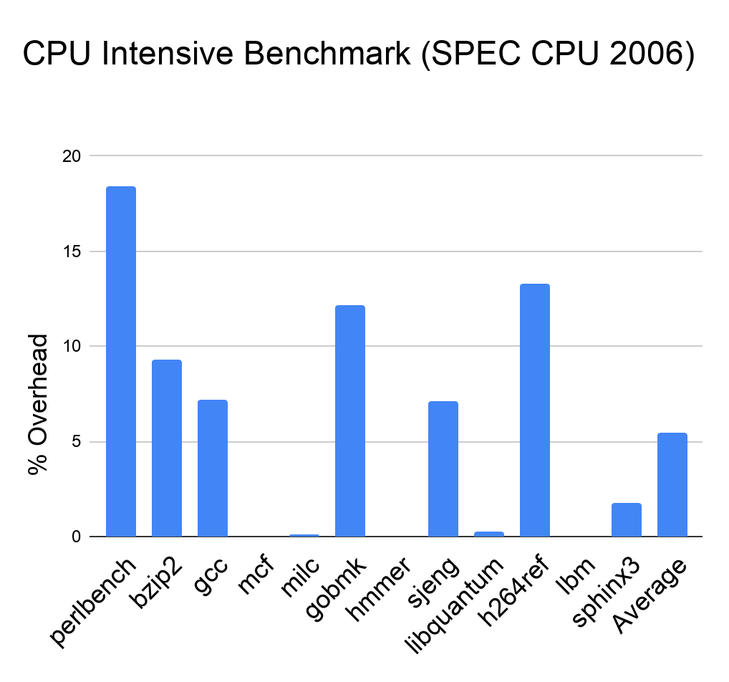
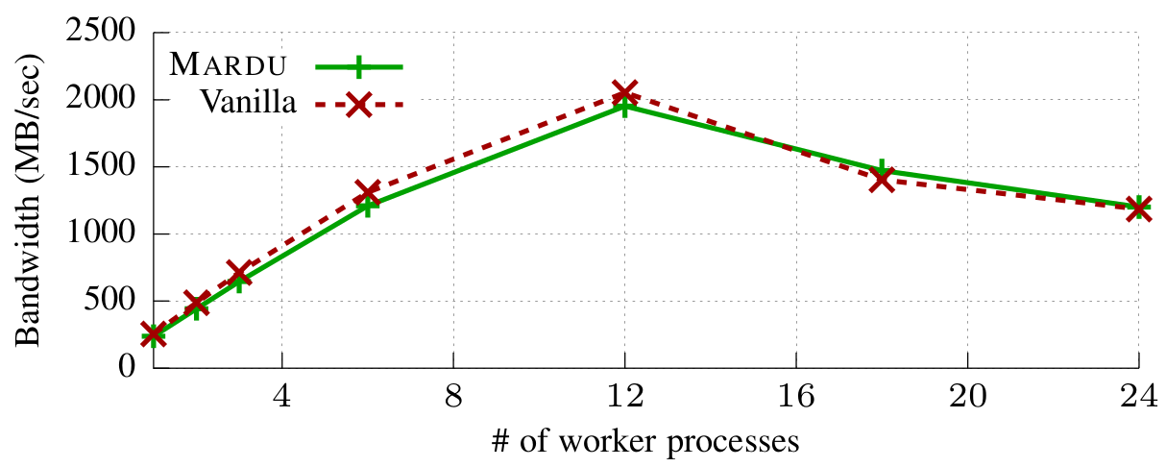
How MARDU Performs
CPU Intensive Benchmark
SPEC CPU 2006
Concurrent Web Server
NGINX
5.5%
NGINX Average Degradation: 4.4%
Notes:
To evaluate our work, we compiled the SPEC CPU2006 benchmark suite
and the latest NGINX web server using the Mardu compiler and ran the applications on a Mardu enabled kernel
For SPEC, we achieved an average runtime overhead of 5.5%
while in the best case, MARDU had a negligible overhead
We also evaluated MARDU in a concurrent setting using NGINX and measured throughput
Across various worker counts, we observed a 4.4% average degradation in throughput
==========================
Bottleneck: high frequency of short function calls
low priority >> change these graphs to be manually redrawn instead of screen shot

Slide 32
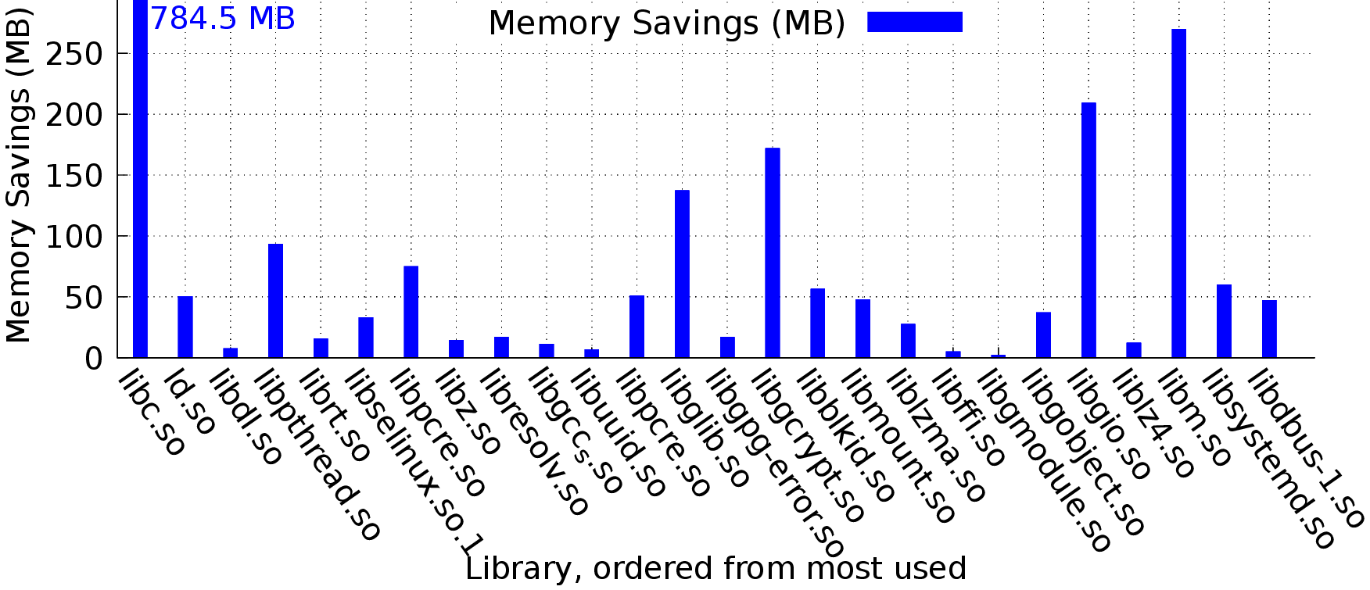
How MARDU Scales
One-time upfront cost to instrument
Native shared library total size: 787 MB
Traditional non-sharing would incur
8.8 GB overhead
Library replicated & allocated new memory per process
MARDU incurs 1.3 GB memory usage (over 7.5 GB memory savings)
Biggest memory savings come from
libc.so saves 0.78 GB memory
libm.so, saves 0.26 GB memory
Notes:
simple experiment to collect and count top 25 most used libraries
on a idle linux system
then calculate how much memory
a non-sharing defense would need to use to secure each library instance
Compared to MARDU, mardu with it's code sharing would save over 7.5 GB of memory
if it was applied for all these libraries
==================
dont explain in detail, just 30 second blurb explanation quick and move on

Slide 33
MARDU Summary & Limitations
Summary
MARDU is Practical
5.5% average performance overhead
Security blocks all ROP attack variants
First randomization scheme capable of runtime re-randomization with code sharing
Does not Stop-the-World for
runtime re-randomization
Limitations
Re-Randomization is a probabilistic defense
Performance could be improved,
worst case performance is 18.3%
Non-Control Data Attacks are
not covered by MARDU
Notes:
To summarize, MARDU is practical, but still has inherent limitations
After all, Re-randomization is a probabilistic defense compared to other defense types that are deterministic
The performance overhead of MARDU is 5.5% on average but it's worst case can be up to 18.3%
Finally, MARDU is inable to address non-control data attacks,
because it is focused on protection of the code region as a whole from the granularity of functions,
and is not detailed enough to able to protect regular program variables that can be used as non-control data in code re-use attacks

Slide 34


Modern Security
Generalized Code Re-Use Attack Procedure
1
1
2
2
3
3
4
4
5
Identify
Memory
Vulnerability
Identify
Memory
Vulnerability
Perform
Memory
Disclosure
Perform
Memory
Disclosure
Identify Viable
Code Components
Identify Viable
Code Components
Sensitive Data
and/or
Control-Flow
Hijacking
Sensitive Data
and/or
Control-Flow
Hijacking
Illegitimate
System Call
Usage
System Call Filtering
Notes:
Lets take a step back and look at the Code re-use attack chain
Objectively looking at the early attack steps
defenses trying to address these attack steps need to have a very large code coverage
to protect the entire memory layout
to protect every single code component
to protect every control-flow transfer!
Why not simplify defenses to block at the last (but necessary) attack step code re-use
where it needs to use a system call
since it appears that code re-use attacks can be funneled down into their system call usage
system calls are therefore another great potential defense target
Even in the case of non-control data attacks, they still also need to use system calls to complete their attack
For example, non-control data attacks that try to leak sensitive information (like passwords)
back to an attacker across the network still needs to use the send syscall to send that information back.

Slide 35

Outline
Motivation
Background
Contributions
MARDU
BASTION
Future Work
Summary
5
Illegitimate
System Call
Usage
System Call Filtering
Notes:
Therefore we introduce BASTION

Slide 36
Outline
Motivation
Background
Contributions
MARDU
BASTION
Insights & Motivation
Design
Preliminary Evaluation
Future Work
Summary
5
Illegitimate
System Call
Usage
System Call Filtering

Slide 37


Insights of System Call Usage in Code Re-Use
For Applications (Legitimate Usage)
Provide an API interface between applications and host OS kernel
Provide numerous services
359 system calls currently implemented (Linux v5.17.1)
Many system calls are non-sensitive
System Calls are scarcely used in practice
For Attacks (Malicious Usage)
Provide an API interface to further gain a foothold on victim host
Some system calls are security-critical especially:
execve
mmap
mprotect
Notes:
System calls are a very important part of the code ecosystem as they provide an API interface to communicate with the OS kernel
They provide numerous services like
process control
file manipulation
and communication
However they can also be leveraged for malicious use.
especially since a small number of system calls are actually security-critical like
execve,
mmap,
and mprotect
At the same time we see that many system calls are actually non-security critical, and actually there
are over 359 system calls currently implemented in linux
of which we see that many are scarcely used.
==================
How did I calculate number of system calls
OPEN linux/arch/x86/entry/syscalls/syscall_64.tbl in v5.17.1 src code
Count 0-334 + 424+450 did not count x32 specific system calls

Slide 38
Example 1: Duality of System Call Usage
NGINX Web Server
Legitimate Uses
execve() used to update
server in place during runtime
Attacker Uses
execve() can launch an attacker binary by reaching system call and corrupting ctx->path, ctx->argv
// nginx/src/os/unix/ngx_process.c
static void ngx_execute_proc(ngx_cycle_t *cycle,void *data){
ngx_exec_ctx_t *ctx = data;
if( execve( ctx->path, ctx->argv, ctx->envp ) == -1){
ngx_log_error(NGX_LOG_ALERT, cycle->log,
ngx_errno, “execve() failed”);
}
exit(1);
}
ngx_execute_proc
ctx->path, ctx->argv, ctx->envp
Notes:
So the Duality of system calls can be shown through this example
(Explain Code)
(Explain attack)
To highlight from this attack, we see that system calls can be abused in 2 ways
1st, the can be abused through illegitimate control-flow to reach them
and 2nd
the arguments need to be corrupted as well to be set to what the attacker wants

Slide 39
Summary of System Call Usage
Code Re-Use Attacks
Attacks greatly vary in approach, complexity, and end goals
Attacks desire to reach and use system calls in needed way
Consequences:
System calls could be considered a critical lynchpin in attack completion
Protecting system calls can block many system-call based attacks
Strong contexts are needed to adequately protect system calls
Bottom Line:
System calls deserve more attention!
Notes:
So to summarize present day system call usage and their part in code re-use attacks

Slide 40
Current Practices in System Call Filtering
What is Current System Call Filtering Doing?
Analysis to derive Allow/Block list of system calls
Static Argument Constraints
seccomp: System Call Whitelisting
Defacto manual system call policy mechanism implemented in Linux
Needs new separate policy for every application, & every configuration
sysfilter: Automated Policy Generation
Introduction of automation from analysis framework to generate appropriate
seccomp filter for a target application
reduces burden on administrator, not stronger security
1
2
1 The kernel development community. Seccomp BPF (SECure COMPuting with filters), 2015
2 Nicholas DeMarinis et al. sysfilter: Automated system call filtering for commodity software. (RAID 2020)
Notes:
So system calls have been getting more attention lately, but not in the way I wanted.
Iff we look at the current practices in system call filtering
we see that most are only trying to make seccomp easier to use
rather than specialize and actually harden system call protection.

Slide 41
BASTION: Our Solution
Surround system calls with three tight, specialized contexts
BASTION System Call Contexts
Call-Type Context
Is this system call used in the program?
How is this system call invoked by the program? (directly, indirectly, or both)
Control-Flow Context
What are the valid Control Flow Graph (CFG) paths that reach this system call callsite?
Argument Integrity Context
What are the sensitive variables used as system call arguments and dependent variables for each system call callsite?
Notes:
So our solution to the gap in security regarding system calls is to
introduce new contexts that do surround system calls and provide them with added security
BASTION proposes 3 new system call contexts
The first is Call-Type, which works by…
The next one is Control-flow Context, which asks:
what are the valid control-flow paths that can reach this system call callsite legitimately
and finally Argument integrity context which ensures that all the variables that are used as system call arguments
as well as those variables that directly update these variables are genuine and uncorrupted with a system call is invoked
So
We use Call-Type and Control-flow contexts to address control flow hijacking targeting system calls
and we use argument integrity to address argument coruption.
And what super special about BASTION
is that we specialize each of the contexts to be narrow for only system call usage
What I mean by this is
For example Data Flow integrity is applied arbitrarily system-wide for all program variables to ensure their integrity,
but this leads to very very costly overheads.
For BASTION, we specialize the argument integrity context to only apply data integrity for those variables that will be used as system call arguments, all the other variables dont matter
For example, CFI is traditionally over approximated and expensive, because it's applied arbitrarily system-wide
BASTION enforces CFI only for those stack traces that lead to a system call
============================
also pairing with call-type makes it even stronger

Slide 42
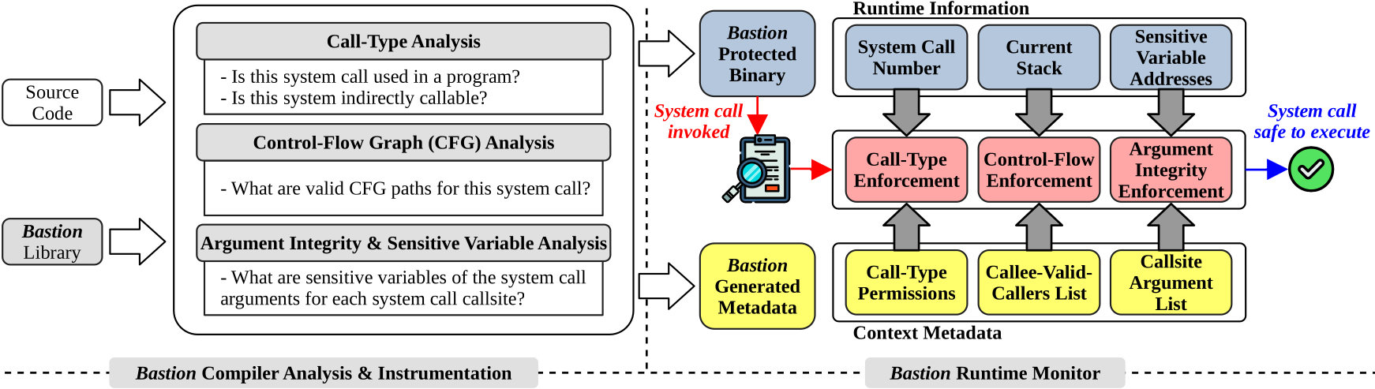
BASTION: Our Solution
BASTION Framework Overview
how to protect the runtime monitor?
Notes:
Here we show you the framework overview for BASTION
Note that this is still a work in progress
BASTION’s design is similar to MARDU
Where it has a compiler and runtime component
The Compiler…
Does the analysis
generates as much metadata as it can derive offline
and does a little bit of instrumentation to resolve the dynamic portions of the code during runtime
The Runtime Monitor
Uses the generated metadata as well as runtime information to enforce all three contexts successfully
NOTE: We minimize runtime checking by only performing it when a system call is attempted to be invoked
Because system calls are generally scarcely used this brief pause does not incur much overhead
For example in most compute bound applications, all of the system calls are used
during the program start-up phase to allocate memory for all the data to be processed

Slide 43
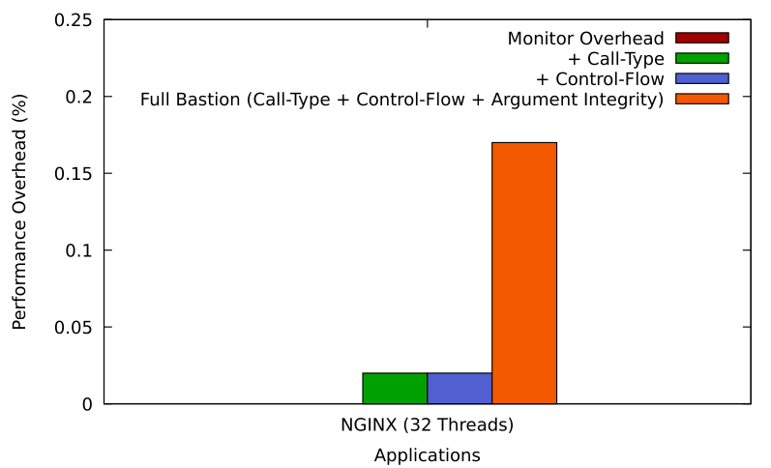
BASTION: Preliminary Evaluation
Evaluation
Application: NGINX Web Server
Results
Negligible Overhead
BASTION Argument Integrity is significantly cheaper than DFI by being specialized
Notes:
Currently we do have a bare-bones version of BASTION, and were able to perform the following experiment
Here we ran NGINX compiled and run with BASTION monitor
These preliminary results show that BASTION overall has a negligible overhead
and even our argument integrity context is significantly cheaper than DFI for example
because it is specialized to only cover system-call related variables.

Slide 44
Outline
Motivation
Background
Contributions
Future Work
Summary
Notes:
That wraps up our discussion of the contributions for this preliminary thesis
I will now propose the future work I wish to complete for this thesis

Slide 45
BASTION Future Work
Current Status:
Bare-Bones Prototype of BASTION in place
Ongoing Research
Complete BASTION System Call Defense Framework
Comprehensive Security Study of BASTION
Comprehensive Performance Study of BASTION
Questions To Answer:
Can BASTION adequately protect against prominent Code Re-Use Attack Vectors?
Is BASTION just as performant for a diverse set of real-world applications as shown in our preliminary evaluation?
Notes:
As I said before MARDU has already by published and is completed.
So the focus of the future work will be on BASTION
So we currently only have a bare-bones prototype of BASTION
To complete BASTION
We need to finish the implementation to support more complex code patterns in applications
Once the implementation is done we need to perform a comprehensive study for it's performance and security
In the studies we want to do, we want to answer the following questions
First
Is BASTION an effective defense against prominent code re-use attacks
and second
Is the full implementation of BASTION just as performant in real-world applications
as we saw in the preliminary evaluation.

Slide 46
BASTION Future Work
Proposed Security Study:
Real-world CVEs
Address Oblivious Code Re-Use (AOCR) NDSS ’17
NEWTON: Dynamic Gadget Discovery Framework CCS ’17
Proposed Performance Study:
NGINX Web Server
SQLite SQL Database Engine
Other real-world application candidates
vsftpd FTP server
Notes:
To further clarify
for the security study, we want to test BASTION against
real-world CVEs to show BASTION can defense against real vulnerabilities
Address oblivious code re-use (AOCR)
and NEWTON, a dynamic code gadget discover framework
for the performance study, we want to expand BASTION to be able to support real-world applications
such as SQLite, a MySQL database engine
and vsftpd a FTP server

Slide 47
Outline
Motivation
Background
Contributions
Future Work
Summary
Notes:
That concludes the future work, and now I’ll summarize

Slide 48
Summary of Research
Defense techniques to fight code re-use
Exploit Mitigation Mechanisms that are practical
MARDU Key Contributions
Enabled capability of code sharing for randomized code
Efficient, system-wide (re-)randomization that is
on-demand
BASTION Key Contributions
Stop code re-use attack chain at system call usage step
Three new contexts to protect system calls
Narrow design only enforcing integrity on system call relevant components
Notes:
This thesis develops defense techniques that fight code re-use and are practical
Specifically in this presentation we covered practical designs:
MARDU and BASTION
MARDUs key contributions are
the enabling of code sharing especially for re-randomization techniques
and being an efficient re-randomization technique by only randomizing on demand
For BASTION, remember that we only shown it's preliminary design
Nonetheless, it's key contributions are that
BASTION can stop code re-use attacks at the system call usage step
BASTION introduces 3 new contexts to strengthen the protection around system calls
call-type
control-flow
and argument integrity
And most importantly, these contexts are specialized to only focus on system call relevant
code components to minimize performance impact of BASTION,
without sacrificing it's security guarantees

Slide 49
Summary of Research
Publications:
BASTION
BASTION: Protect the System Call, Protect (most of) the World
To be completed and submitted ASPLOS ’23
MARDU
MARDU: Efficient and Scalable Code Re-randomization
Christopher Jelesnianski, Jinwoo Yom, Changwoo Min, and Yeongjin Jang (SYSTOR’20)
Securely Sharing Randomized Code that Flies
Christopher Jelesnianski, Jinwoo Yom, Changwoo Min, and Yeongjin Jang (DTRAP’22)
Notes:
In terms of publications:
SYSTOR which is
The International Systems and Storage Conference
and DTRAP which a recently created journal by ACM
Digital Threats: Research and Practice

Slide 50
Summary of Research
Other Publications:
Security
Tightly Seal Your Sensitive Pointers with PACTight
Mohannad Ismail, Andrew Quach, Christopher Jelesnianski, Yeongjin Jang and Changwoo Min (To appear USENIX Security’22)
Data protection utilizing ARM Pointer Authentication (PA) security primitive
VIP: Safeguard Value Invariant Property for Thwarting Critical Memory Corruption Attacks
Mohannad Ismail, Jinwoo Yom, Christopher Jelesnianski, Yeongjin Jang and Changwoo Min (CCS’21)
Value Integrity for security-relevant data types
Compilers & System Software
Breaking the Boundaries in Heterogeneous-ISA Datacenters
Antonio Barbalace, Robert Lyerly, Christopher Jelesnianski, Anthony Carno, Ho-Ren Chuang, Vincent Legout, and Binoy Ravindran (ASPLOS’17)
Operating system process and thread migration in heterogeneous platforms
Robert Lyerly, Antonio Barbalace, Christopher Jelesnianski, Vincent Legout, Anthony Carno, and Binoy Ravindran (MaRS’16)
Popcorn: Bridging the programmability gap in heterogeneous-isa platforms
Antonio Barbalace, Marina Sadini, Saif Ansary, Christopher Jelesnianski, Akshay Ravichandran, Cagil Kendir, Alastair Murray, and Binoy Ravindran (Eurosys’15)

Slide 51
Practical Exploit Mitigation Against Code Re-Use Attacks and System Call Abuse
Thank you!
Christopher Jelesnianski
Questions?
Notes:
Thank you for your attention.
This brings the presentation to a close and I am now ready for questions.

Slide 52
Backup Slides

Slide 53
Recent Re-Randomization Works
1
2
Oxymoron
Coarse-Grained ASLR
Good Performance
Low Overhead: 2.7%
Code Sharing
No Additional Background Process
Vulnerable to Attack via Memory Disclosure
Shuffler
Fine-Grained Runtime Re-Randomization
High Overhead
Avg Perf: 14%
Worst Case Perf: 55%
Code Sharing Unavailable
Requires Background Process
Attack Resilient
1 Backes, Michael, and Stefan Nürnberger. "Oxymoron: Making Fine-Grained Memory Randomization Practical by Allowing Code Sharing." (USENIX Security 2014).
2 Williams-King, David, et al. "Shuffler: Fast and Deployable Continuous Code Re-Randomization." (USENIX OSDI 2016).
Notes:
=========
re-iterate slide 17
oxymoron is a state of the art ASLR
shuffler is state of the art Re-rand

Slide 54
Practicality Challenges in Detail
Common culprits hurting Performance
Tracking
Verification
Runtime Churn
Common culprits hurting Security
New ROP attack variants have been found (JIT-ROP, BROP, Low Profile)
This makes current state-of-the-art stale and broken again…
Common culprits hurting Scalability
Runtime monitor needs to worker-per-targetapp-thread
Mechanism needs virtualization (hypervisor/EPT) to work
Code share is made unavailable by defense design (randomization per application = cannot mix)
Common culprits hurting Reliability
Aggressive defenses that physically disable or remove code (debloating, destructive code read)
Static Analysis is used
Use-cases are used
Insight: Many challenges overlap in different ways
Example: Employing Tracking means:
Expensive runtime
Invasive Instrumentation
Performance Incurred vs Security Gained from this tracking
Notes:
How to make this slide fit?
Without adding million citations

Slide 55
Modern Defense Archetypes
Pros / Cons of Each Respective Archetype
Debloating
Memory Safety
Information Hiding
Re-Randomization
Data Integrity
& Control Flow
Integrity
System Call Filtering
Pros
>No overhead
>Simple
Cons
>Fragile
>Can accidentally cut needed code
>Needs new policy per-configuration
Pros
>No overhead
Cons
>“Setup” syscalls cannot be disabled
>Coarse-grained
>Static Argument support only
>Need new policy per-configuration
Pros
>Simple
Cons
>Perf Expensive
>Uses memory (FAT pointers)
Pros
Cons
>Single Randomization is not sufficient
Toggling
>Destructive (destructive code read)
Pros
>Fine-granularity
>Disclosure Resilient
Cons
>Probabilistic Def
>Predictable (interval, etc)
>Major Overhead from patching
Pros
>Precise (Deterministic)
>Fine-Granularity
>Strongest Defense
Cons
>Major Overhead
>CFI - Equivalence Classes
>Over Approximation
Notes:
BACKUP SLIDE
Memory Safety
> Nagarakatte, Santosh, et al. "SoftBound: Highly compatible and complete spatial memory safety for C." Proceedings of the 30th ACM SIGPLAN Conference on Programming Language Design and Implementation. 2009.
> BOGO
> Other spatial / temporal memory safety mechanisms

Slide 56
Modern Defense Archetypes
Generalized Defense Archetype Created
Debloating
Memory Safety
Information Hiding
Re-Randomization
Data Integrity
& Control Flow
Integrity
System Call Filtering
Piece-Wise
RAZOR
Nibbler
CHISEL
PacJam
TRIMMER
SoftBound
BOGO
HardBound
CHERI (RISC)
DangSan
DangNULL
Oxymoron
Readactor
HideM
kR^X
HeisenByte
NEAR
MARDU
--------------
CodeArmor
Shuffler
ReRanz
TASR
Isomeron
RuntimeASLR
CPI
DFI
VIP
---
CFI
uCFI
OS-CFI
PT-CFI
BASTION
------------
Saffire
sysfilter
Temporal
ABHAYA
Notes:
BACKUP SLIDE
Memory Safety
> Nagarakatte, Santosh, et al. "SoftBound: Highly compatible and complete spatial memory safety for C." Proceedings of the 30th ACM SIGPLAN Conference on Programming Language Design and Implementation. 2009.
> BOGO
> Other spatial / temporal memory safety mechanisms

Slide 57
Why were re-randomization and syscall filtering chosen?
Both archetypes are great targets to refine and hone in design to be practical
Re-Randomization
Performance: active approaches are equivalent to CFI/DFI (in terms of performance)
Security: passive approaches are equivalent to ASLR (in terms of security)
Scalability: is non-existent because of no support for code sharing
Reliability: Does not really apply to this category of defense. But, could be argued that since randomization is a probablistic approach (rather than deterministic like CFI, DFI) “reliability” metric of re-randomization is hard to determine.
System Call Specialization
Performance: Does not apply to this category as all current defenses are offline and cost of applying syscall-policy at start of program is negligible
Security: No current works strive to raise security bar for system calls
Security: More and more evidence shows that system calls are security-critical code components (as much attention should be given to them as code/data pointers so far by the security community!)
Scalability: Debloating is especially non-scalable as a debloated shared library for one application may not work for another!
But otherwise scalability is non-issue for this archetype
Reliability: Debloating/seccomp is fragile potentially even in the same application. If a different usage configuration is used by a user, application has a chance to accidentally be broken by unconsidered use-case

Slide 58
MARDU Backup Slides

Slide 59
MARDU Outline
MARDU Design
Security: Leveraging code trampolines
Scalability: Enabling code sharing
Performance: Re-randomization without stopping the world
Implementation
Evaluation

Slide 60
Example: Code Control Flow
Source Code
Traditional Control Flow
void foo(){
/* … */
bar();
/* … */
}
/* … */
call foo()
1
foo:
/* … */
call bar()
/* … */
ret
void bar(){
/* … */
}
2
4
bar:
/* … */
ret
3

Slide 61
MARDU is Secure
Code and Trampoline regions protect forward edge
Trampolines are immutable code targets
Protects against code disclosure
Shadow stack protects backward edge
Randomization occurs at:
Process startup AND
Whenever an attack is detected (on-demand)
Process crash
Execute-only memory violation
Code
Trampoline
Stack
Stack
+ Shadow Stack
...
...
...
local
local
ret_addr5
local
local
ret_addr6
ret_addr
Notes:
Mardu separates code into secure code and trampoline regions in order to protect forward edge code transitions
Mardu takes advantage of a shadow stack to secure backward edges

Slide 62
Example: Securing MARDU Code
Source Code
Using Code Trampolines Control Flow
Intel MPK
void foo(){
/* … */
bar();
/* … */
}
XoM Coverage
Code Region
Trampoline Region
Shadow Stack
foo_body:
/* … */
jmp bar_trampoline()
foo_ret0:
/* … */
jmp ShadowStack_top
bar_trampoline:
jmp bar_body
...
3
2
foo_ret0_tr
foo_trampoline:
jmp foo_body
void bar(){
/* … */
}
1
foo_ret0_trampoline:
jmp foo_ret0
5
bar_body:
/* … */
jmp ShadowStack_top
4
Notes:
>>>>>This present too much information at once. You should use animation here. For example,
1) present source code, explaining foo() and bar()
2) then show the code, explaining we want to hide it completely for XXX
3) then ask how to access the code? explain trampoline
4) code rerand of code
5) mpk...

Slide 63
MARDU Aims to Use Minimal System Resources
MARDU is capable of code sharing (e.g., shared libraries)
No previous randomization scheme is capable of runtime re-randomization AND code sharing
MARDU leverages position independent code (-fPIC) for easy fixups of PC-relative code.
MARDU supports mixed instrumented and non-instrumented libraries
Notes:
since position-dependent memory references can't be shared by different processes and thus are copied.
Slightly mention oxymoron, but say that their system required use of a hypervisor!!
NOTE: reference counter used guarantee safe transition of randomized library code

Slide 64

How MARDU Defends Against Prominent ROP
Blind ROP (BROP) & Code Inference Attacks
MARDU: XoM protected code triggers a permission violation and re-randomization of code
MARDU: Re-randomization makes all previous collected layout information stale
MARDU: Usage of trampolines & function granularity randomization makes correlation prediction challenging for attackers
JIT-ROP Attacks
Low Profile Attacks
Code Pointer Offsetting Attacks

Slide 65
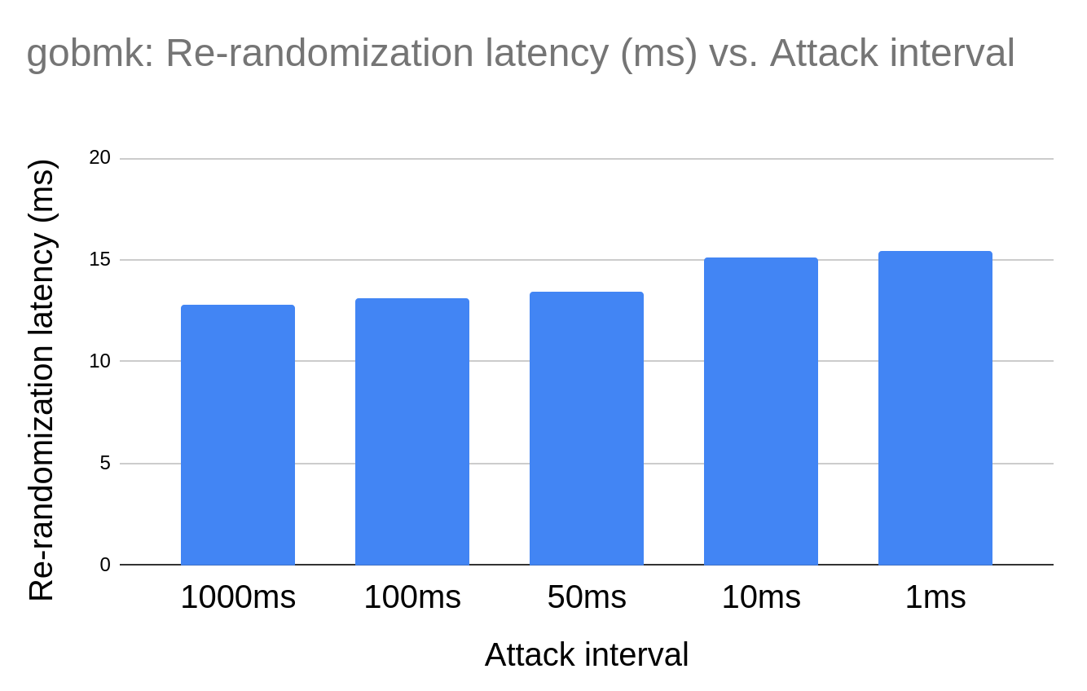
MARDU Randomization with Scalability
Re-randomization latency scales approximately linearly with number of fixups required
Cold start randomization latency for any number of workers for NGINX is 61ms
Re-randomization latency plateau’s even when under attack

Slide 66
Re-Randomization without Stopping-the-World
Why can MARDU perform Re-Rand without stopping the World, but other re-randomization techniques can’t?
MARDU has the unique concept of return trampolines and information hiding.
By leveraging the static nature of the Trampoline Region and the Huge Virtually allocated space that MARDU does for each MARDU process
we can support 2 randomizations at once with maintaining semantics
Having the old one also cannot hurt because there is no way to reference it once the trampoline region is updated to v2
Compare this other re-randomization works, which also use forward trampolines but then rely on:
pausing the process,
tearing down the current randomization variant
re-randomizing and replacing the code base with new randomization variant
updating their own data regions with the updated mappings
resuming process

Slide 67
How is MARDU able to support both MARDU and uninstrumented Shared Libs?
So first I have to note that the security implications are different for a full MARDU system and a system that will have applications that are MARDU enabled and not.
In this case, mixed code will come down to the weakest link and still potentially allow an attack to happen via the un-instrumented shared lib
That being said. MARDU is able to support both, because the Linux kernel can support both stack semantics simultaneously.
In both MARDU and uninstrumented cases a function call will go to the symbol label for a given function.
If it's MARDU then symbol label == trampoline entry
If it's vanilla then symbol label == unrandomized function body entry
The same can be assumed for the return value just in reverse.

Slide 68
BASTION Backup Slides

Slide 69
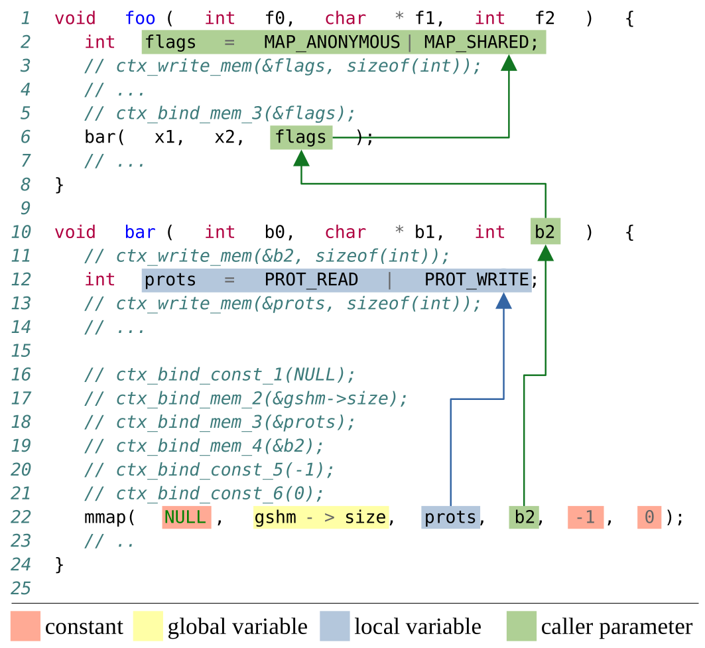
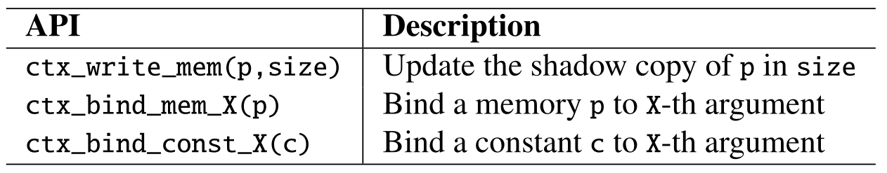
BASTION: Our Solution
BASTION Implementation & Instrumentation
Three Inlined API Functions
cfa_write_mem() - performs data integrity tracking
cfa_bind() - performs data prepping for runtime monitor verification

Slide 70
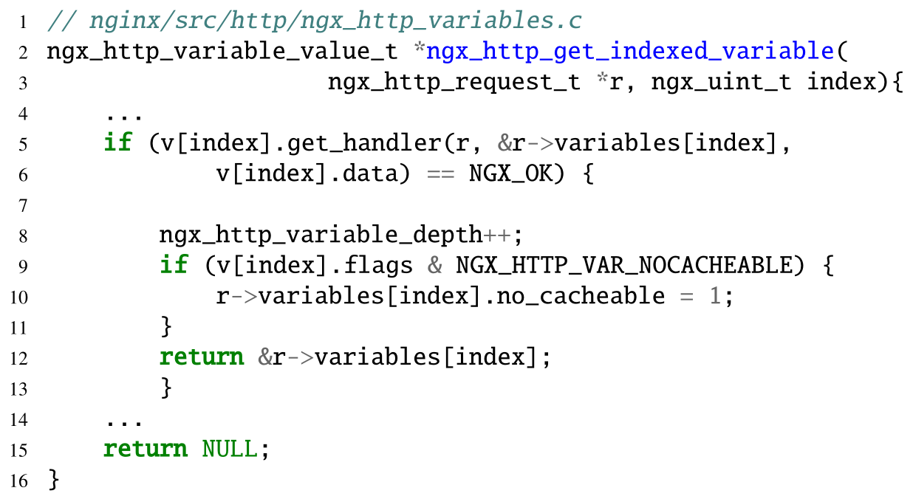
Example 2: System Call Usage (and Attacks)
NGINX Web Server
Legitimate Uses
mprotect() is used during process startup to set memory region permissions
Attacker Uses
mprotect() can be used to maliciously mark a attacker controlled memory region to executable using a code pointer
Notes:
mprotect has it's address taken since it is used in start up to mark memory region permissions

Slide 71
BASTION: Three Contexts Visualized
unsigned long r_size;
main(int argc, char** argv){
r_size = argv[2];
foo(...);
bar( int bar1, ... );
buzz(..., int buzz_arg2 );
int prots = PROT_READ | PROT_WRITE;
mmap( NULL, r_size, prots, buzz_arg2, -1, 0 );
Call-Type Context
Control-Flow Context
Argument Integrity Context

Slide 72
Committee Question Backup Slides

Slide 73
Question Types
10-15 questions From Out-of-Area, non-expert
10 questions Security community member, but no idea about randomization or system call filtering
5 questions Non-security, Systems person would ask
5 questions Subject Matter Expert would ask
Then add backup slides to address these questions!!
HZ
Embedded Systems
Cyber-Physical systems
Real-Time Systems
WX
Computer Architecture == HW Bugs
Cryptography
Formal Methods
Machine Learning
DY
Scanning for Vulnerability CryptoGuard

Slide 74
Questions
How does MARDU/BASTION address: Ransomware/ CPS attacks/ 0-day supply chain vulnerabilities
Further Motivation for MARDU:
more and more things are becoming digital, even you refrigerator and
So actually, more and more points of access, things need to protected, pronto!
False alarms are really a pain
Practical defenses to really be able to protect the entire chain of the whole ecosystem from the front-end to the backend like PCI

Slide 75
Questions
What are the current best competitors for BASTION?
Saffire & Temporal System Call Filtering
These are the only 2 papers that actually try to improve security surrounding system calls. Rest of current works only focus on “user experience”
Are there any Attack variant papers that are more recent?

