Slide 1


Tightly Seal your Sensitive Pointers with PACTight
Mohannad Ismail (Virginia Tech), Andrew Quach (Oregon State University), Christopher Jelesnianski (Virginia Tech), Yeongjin Jang (Oregon State University), Changwoo Min (Virginia Tech)
Notes:
Hello everyone. Thank you for attending my talk. My name is Mohannad Ismail and this is the presentation for our work titled “Tightly Seal your Sensitive Pointers with PACTight”. This is joint work with Andrew Quach, Christopher Jelesnianski, Yeongjin Jang, and Changwoo Min.

Slide 2


ARM is becoming popular!
More and more servers, data centers and high-performance computers are using ARM.
Greater importance to have effective and efficient defenses for ARM in these environments.
Notes:
ARM processors have been increasing in popularity in recent years due to expansions into the desktop and data center market. This expansion exposes ARM more than ever to security attacks. Thus, it is becoming increasingly important to have effective and efficient defenses for ARM in these new environments.

Slide 3
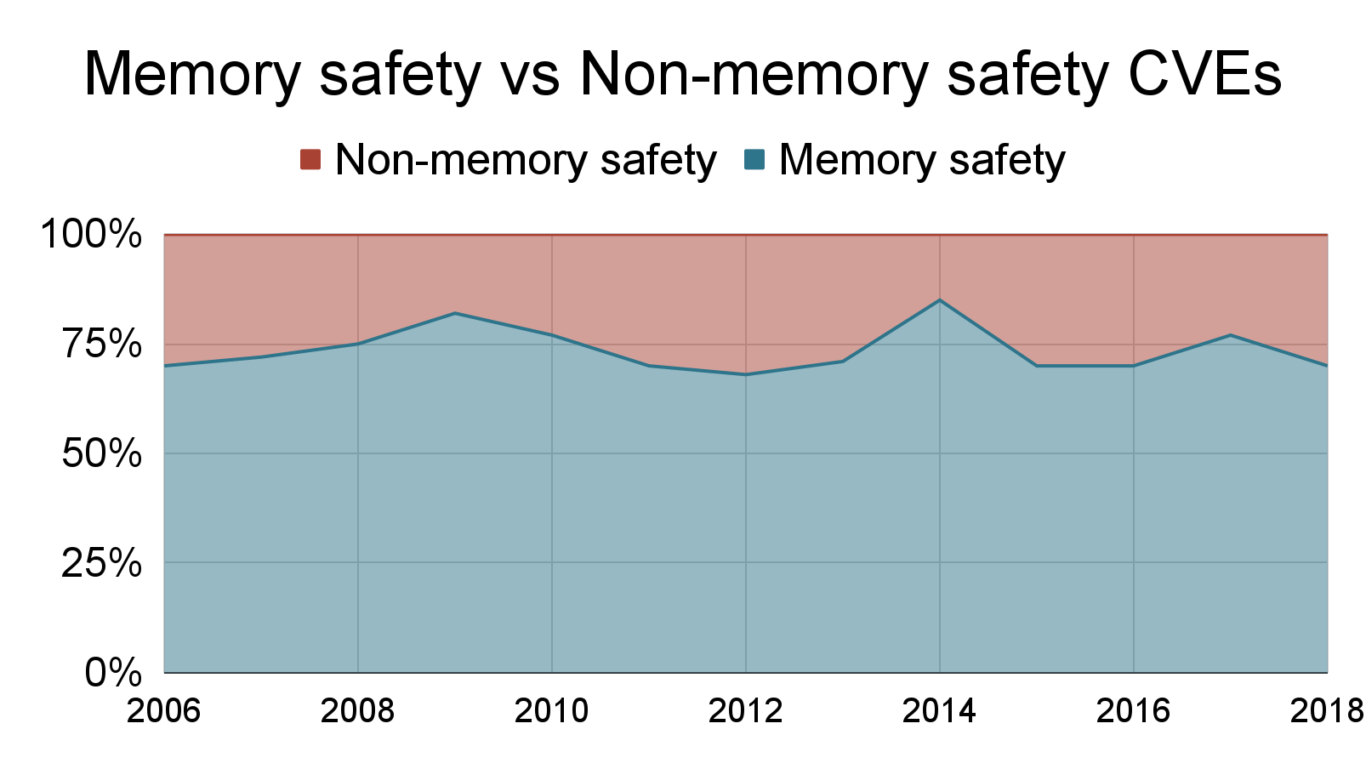
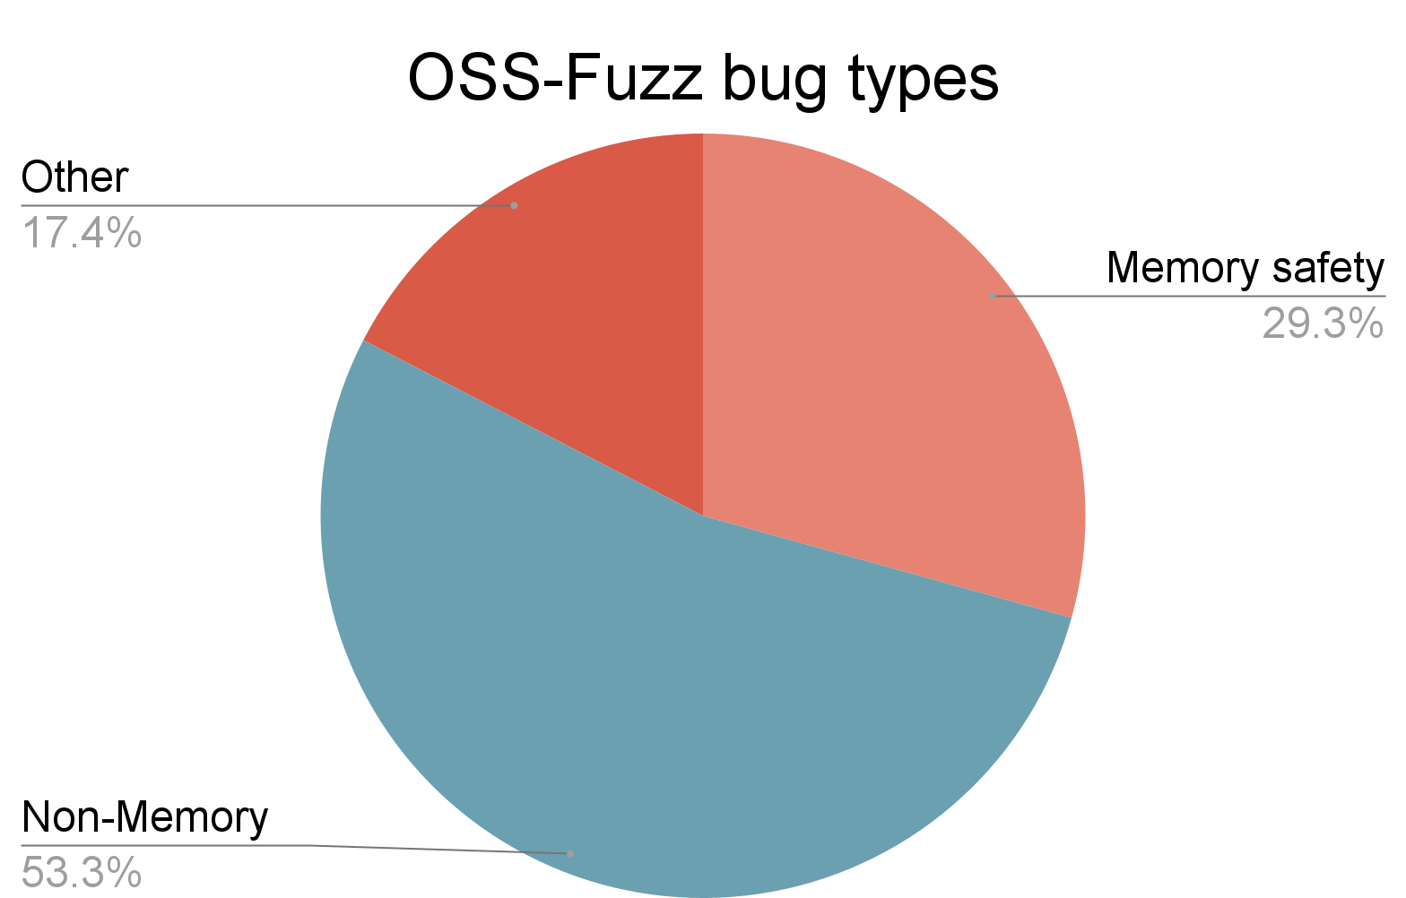
Memory safety is a serious problem!
Microsoft Product CVEs
Google OSS (Open Source Software) Fuzz bugs
https://www.zdnet.com/article/microsoft-70-percent-of-all-security-bugs-are-memory-safety-issues/
https://security.googleblog.com/2018/11/a-new-chapter-for-oss-fuzz.html
Notes:
Many of these security attacks are due to memory corruption vulnerabilities. In a study done by Microsoft on its products, they reported that 70% of all security bugs found were due to memory safety issues, and 30% of bugs in Google Open Source are memory safety bugs.

Slide 4
Outline
Introduction
Background and related work
Introducing PACTight
PACTight design
PACTight defense mechanisms
Evaluation
Conclusion
Notes:
Let’s take a look at some background and related work, starting with some attacks.

Slide 5


Control-flow hijacking and use-after free attacks are critical!
Control-flow hijacking and use-after-free attacks are dangerous memory corruption attacks
First Basic Block
Memory object
Allocate
Free
Control-flow transfer
Illegal control flow transfer
e.g., SYSTEM()!
DANGLING!
Adversary!
Control-flow hijacking
Use-after free
Notes:
Here I will introduce two attacks based on violating memory safety: Control flow hijacking and use-after-free attacks. Control-flow hijacking attacks aim to maliciously change the legitimate control-flow of a program. This can be done by corrupting indirect calls or jumps, or return addresses. This allows the adversary to execute an illegitimate control-flow transfer, that can reach, for example, a system call. Use-after-free attacks are temporal attacks aimed to exploit the incorrect use of dynamic memory. A pointer is allocated on the heap and can be used by the program. When the memory is freed, the pointer becomes dangling and can be exploited by an attacker.

Slide 6
ARM Pointer Authentication
Pointer Authentication Code (PAC) is generated by a cryptographic hash function.
The PAC is then placed on the unused bits of the 64-bit pointer.
Plaintext (Address)
Key
Hash
Salt
Hashed Text (PAC)
40-bits
Address
PAC
64-bits
Notes:
To help combat abusing pointers, ARM released Pointer Authentication. Pointer Authentication relies on utilizing the unused bits of a 64-bit pointer to store a Pointer Authentication Code or PAC that is generated by a cryptographic hash function. This PAC cannot be calculated without a secret key. This allows the pointer to be signed by this PAC, and thus the PAC needs to be properly removed, or authenticated, before the pointer can be used.

Slide 7


ARM Pointer Authentication
PAC signing: The algorithm takes the pointer and modifier, as well as a key, and generates a PAC.
PAC authentication: The algorithm takes the pointer with the PAC and the modifier. The PAC is then regenerated and compared with the one on the passed pointer.
Address
Address
PAC
Secret Key
Cryptographic algorithm
Modifier
Secret Key
Cryptographic algorithm
Modifier
Key
Hash
Salt
Key
Hash
Salt
Address
PAC
Address
Notes:
So how does this mechanism work? There are two main primitives. The first is the signing of the pointer. A cryptographic hash algorithm takes a secret key, a pointer and the modifier, which is provided by the program. The secret key is initialized by the kernel and stored in a register. The algorithm then computes the PAC, and places it on the top of the pointer. Then when a pointer needs to be authenticated, the algorithm takes the same inputs again and regenerates the PAC. If the PAC matches, then the PAC is removed from the pointer and the pointer can be used.

Slide 8

ARM Pointer Authentication
PAC signing: The algorithm takes the pointer and modifier, as well as a key, and generates a PAC.
PAC authentication: The algorithm takes the pointer with the PAC and the modifier. The PAC is then regenerated and compared with the one on the passed pointer.
Address
Address
PAC
Secret Key
Cryptographic algorithm
Modifier
Secret Key
Cryptographic algorithm
Modifier
Key
Hash
Salt
Key
Hash
Salt
Address
PAC
Address
0x2
Notes:
However, if the authentication fails, the top two bits of the pointer are flipped, thus rendering the pointer to be unusable. Any change in any of the components passed to the cryptographic algorithm will result in a different PAC and thus a failed authentication.

Slide 9
Current state-of-the-art PAC techniques
Protection scope | PAC modifier
Return addresses and indirect code pointers | SP (Stack Pointer) + function id for return addresses and type id for indirect code pointers.
Return addresses | Previous chained return address on the stack
Heap allocated objects | A generated object-id
PARTS-CFI
Lilijestrand et. al
(USENIX SEC’19)
PACStack
Lilijestrand et. al
(USENIX SEC’21)
PTAuth
Farkhani et. al
(USENIX SEC’21)
Notes:
There have been several defenses proposed very recently that utilize pointer authentication. I will quickly go over their main points of interest. This is pretty simplified, so please read the respective papers for the full technical details.

Slide 10
Current state-of-the-art PAC techniques
Protection scope | PAC modifier
Return addresses and indirect code pointers | SP (Stack Pointer) + function id for return addresses and type id for indirect code pointers.
Return addresses | Previous chained return address on the stack
Heap allocated objects | A generated object-id
PARTS-CFI
Lilijestrand et. al
(USENIX SEC’19)
PACStack
Lilijestrand et. al
(USENIX SEC’21)
PTAuth
Farkhani et. al
(USENIX SEC’21)
Notes:
The first is PARTS-CFI, which offers forward and backward edge control flow protection. Its modifier is the stack pointer combined with a function id for return addresses and a type-id for indirect code pointers.

Slide 11
Current state-of-the-art PAC techniques
Protection scope | PAC modifier
Return addresses and indirect code pointers | SP (Stack Pointer) + function id for return addresses and type id for indirect code pointers.
Return addresses | Previous chained return address on the stack
Heap allocated objects | A generated object-id
PARTS-CFI
Lilijestrand et. al
(USENIX SEC’19)
PACStack
Lilijestrand et. al
(USENIX SEC’21)
PTAuth
Farkhani et. al
(USENIX SEC’21)
Notes:
Next we have PACStack, a defense mechanism that protects the backward edge. Its modifier is the previous chained return address on the stack.

Slide 12
Current state-of-the-art PAC techniques
Protection scope | PAC modifier
Return addresses and indirect code pointers | SP (Stack Pointer) + function id for return addresses and type id for indirect code pointers.
Return addresses | Previous chained return address on the stack
Heap allocated objects | A generated object-id
PARTS-CFI
Lilijestrand et. al
(USENIX SEC’19)
PACStack
Lilijestrand et. al
(USENIX SEC’21)
PTAuth
Farkhani et. al
(USENIX SEC’21)
Notes:
Last we have PTAuth, which is a temporal defense mechanism protecting against dynamic memory attacks. Its modifier is a generated object-id for each heap object allocated. One quick observation; these defenses put a lot of emphasis on the modifier, thus showcasing its importance.

Slide 13



Limitations of state-of-the-art PAC techniques
Reliance on a modifier that can be repeated, thus attackers can reuse the PAC generated for one in the context of using the other. [PARTS-CFI SEC’19]
Reliance on the presence of a forward-edge CFI technique with the PAC defense mechanism. [PACStack SEC’21]
Constrained threat model, defending only against attackers with just arbitrary write. The defense is not effective if the attacker has arbitrary read.
[PTAuth SEC’21]
Notes:
There are limitations present in the current state-of-the-art. One limitation is reliance on a modifier that can be repeated. This means attackers can reuse the PACs that are generated. Another limitation is needing a forward edge CFI technique to be present, so that the attacker cannot skip the instrumentation. Another limitation of some techniques is the reliance on a weaker threat model with only arbitrary write. The attacker must not have arbitrary read for the defense to be viable. There are many limitations in the current state-of-the-art with plenty of room for improvement.

Slide 14
Outline
Introduction
Background and related work
Introducing PACTight
PACTight design
PACTight defense mechanisms
Evaluation
Conclusion
Notes:
Next I will introduce our solution PACTight.

Slide 15


PACTight Overview
We define three security properties of a pointer such that, if achieved, prevent pointers from being tampered with.
Unforgeability: A pointer should always point to its legitimate object.
Non-copyability: A pointer can only be used when it is at its specific legitimate location.
Non-dangling: A pointer cannot be used after its object has been freed.
Notes:
Based on the limitations I mentioned, we identified three security properties in pointers that, if enforced, completely protect pointers from being abused.

Slide 16
PACTight Overview
We define three security properties of a pointer such that, if achieved, prevent pointers from being tampered with.
Unforgeability: A pointer should always point to its legitimate object.
Non-copyability: A pointer can only be used when it is at its specific legitimate location.
Non-dangling: A pointer cannot be used after its object has been freed.
Notes:
They are unforgeability, in which a pointer must always point to its legitimate object,

Slide 17
PACTight Overview
We define three security properties of a pointer such that, if achieved, prevent pointers from being tampered with.
Unforgeability: A pointer should always point to its legitimate object.
Non-copyability: A pointer can only be used when it is at its specific legitimate location.
Non-dangling: A pointer cannot be used after its object has been freed.
Notes:
non-copyability, meaning a pointer can’t be used at a location other than its legitimate one,

Slide 18
PACTight Overview
We define three security properties of a pointer such that, if achieved, prevent pointers from being tampered with.
Unforgeability: A pointer should always point to its legitimate object.
Non-copyability: A pointer can only be used when it is at its specific legitimate location.
Non-dangling: A pointer cannot be used after its object has been freed.
Notes:
and finally non-dangling, meaning a pointer cannot be used after its object has been freed. Enforcing these three properties tightly seals the pointers from illegal use.

Slide 19
Introducing PACTight
The three properties:
Notes:
Let’s take a closer look at the three properties to better define them.

Slide 20
Introducing PACTight
The three properties:
Pointer
Object
Forged Pointer
Object
Another object
Pointer is corrupted
Forgeability
Notes:
Foregability means that a pointer that points to a specific object becomes corrupted with a forged pointer to point to another object.

Slide 21
Introducing PACTight
The three properties:
Pointer
Object
Pointer
Object
Forged Pointer
Object
Pointer
Object
Another object
Copied Pointer
Pointer is harvested and copied
Pointer is corrupted
Forgeability
Copyability
Notes:
Copyability means that a maliciously copied pointer can still be legitimately used to point to an object.

Slide 22
Introducing PACTight
The three properties:
Pointer
Object
Pointer
Object
Pointer
Object
Pointer use after free
Forged Pointer
Object
Pointer
Object
Pointer
Freed object
Another object
Copied Pointer
or
Pointer is harvested and copied
Pointer
Realloc’d object
Pointer is corrupted
Forgeability
Copyability
Dangling
Notes:
Dangling means that the pointer of a freed or realloc’d object still points to that object and can be abused by an attacker.

Slide 23
Introducing PACTight
The three properties:
Pointer
Object
Pointer
Object
Pointer
Object
Pointer use after free
Forged Pointer
Object
Pointer
Object
Pointer
Freed object
Another object
Copied Pointer
or
Pointer is harvested and copied
Pointer
Realloc’d object
Pointer is corrupted
Forgeability -> Generating valid PAC
Copyability -> Reuse valid pointer
Dangling -> Reuse invalid pointer
Notes:
Powerful memory corruption attacks are a direct implication of violating these three properties. An attacker can generate valid PACs with forgeability, reuse valid pointers with copyability, and reuse invalid pointers with dangling.

Slide 24

Introducing PACTight: Goal
The importance of these properties stems from the fact that to hijack control-flow, at least one of these properties must be violated.
PACTight tightly seals pointers and guarantees that a sealed pointer cannot be forged, copied, and is not dangling.
PACTight overcomes the limitations of previous approaches:
The non-copyability property prevents any PAC reuse.
PACTight protects all globals, stack variables and heap variables.
PACTight assumes a strong threat model that has both arbitrary read and write capabilities.
Notes:
The importance of these properties stems from the fact that, in order to hijack control-flow, at least one of these properties must be violated, based on our analysis. And so, PACTight seals pointers and guarantees that they cannot be misused. PACTight also overcomes the limitations of previous approaches. The non-copyability property prevents any PAC reuse. PACTight protects all globals, stack variables and heap variables. PACTight assumes a strong threat model with arbitrary read and write capabilities

Slide 25
Outline
Introduction
Background and related work
Introducing PACTight
PACTight design
PACTight defense mechanisms
Evaluation
Conclusion
Notes:
Next let’s take a closer look into the design

Slide 26


PACTight Design: Enforcing the properties
In order to enforce the three properties, PACTight relies on the PAC modifier.
Any changes in either the modifier or the address result in a different PAC, detecting the violation.
Notes:
So how will PACTight enforce the three properties? PACTight relies on the pointer authentication modifier. This modifier is used by the cryptographic hash algorithm to generate the PAC. The reason we rely on it is that it is user-controlled and can be made complex enough to generate a unique PAC. Any modification to it or the pointer would result in a violation

Slide 27
PACTight Design: Enforcing the properties
We propose to blend the address of a pointer (&p) and a random tag associated with a memory object (tag(p)) to efficiently enforce the PACTight pointer integrity property
Notes:
PACTight blends the address of the pointer (ampersand p) and a unique random tag, generated by the PACTight compiler and associated with the memory object, to enforce the three properties.

Slide 28
PACTight Design: Enforcing the properties
We propose to blend the address of a pointer (&p) and a random tag associated with a memory object (tag(p)) to efficiently enforce the PACTight pointer integrity property
Address
Secret Key
Cryptographic algorithm
Modifier
&p ⨁ tag(p)
Address
PAC
Signing
Notes:
For signing, we incorporate these elements into the modifier, so the cryptographic algorithm modifier is the location of the pointer and the tag,

Slide 29
PACTight Design: Enforcing the properties
We propose to blend the address of a pointer (&p) and a random tag associated with a memory object (tag(p)) to efficiently enforce the PACTight pointer integrity property
Address
Address
PAC
Secret Key
Cryptographic algorithm
Modifier
&p ⨁ tag(p)
Secret Key
Cryptographic algorithm
Modifier
&p ⨁ tag(p)
Address
PAC
Address
Signing
Authentication
Notes:
and the same way for authentication, as can be seen, to regenerate the PAC successfully. I’ll explain now how this choice enforces the three properties.

Slide 30


PACTight Design: Enforcing the properties
Unforgeability: The PAC mechanism includes the pointer as one of the inputs to generate the PAC. If the pointer is forged, it will be detected at authentication.
Pointer
Object
Forged Pointer
Object
Another object
Pointer (p)
Forged Pointer (q = corrupted p = execve)
Authenticate
Authenticate
Address
PAC
Address
execve
PAC
execve
0x2
Modifier
&p ⨁ tag(p)
Modifier
&q ⨁ tag(q)
Object
Another object
Notes:
Starting with unforgeability, the PAC mechanism on itself includes the pointer as one of the inputs to generate the PAC. Thus a forged pointer would trigger a fault on authentication, due to the pointer having a different value from the one that was used for that PAC.

Slide 31
PACTight Design: Enforcing the properties
Non-copyability: PACTight adds the location of the pointer (&p) as part of the modifier. Any change in the location by copying the pointer triggers an authentication fault.
Pointer
Object
Forged Pointer
Object
Copied Pointer
Pointer (p)
Copied Pointer (q = p)
Authenticate
Authenticate
Address
PAC
Address
Address
PAC
Address
0x2
Modifier
&p ⨁ tag(p)
Modifier
&q ⨁ tag(q)
Object
Object
&q != &p
Notes:
For non-copyability, the location of the pointer being included as a part of the modifier means that any copied pointer will generate a different PAC on authentication, due to a different ampersand p, thus resulting in mismatch on authentication. This means that a pointer can only be used in its legitimate location, enforcing the second property.

Slide 32
PACTight Design: Enforcing the properties
Non-dangling: PACTight uses a random tag to track the lifecycle of a memory object. The lifecycle of a PACTight-sealed pointer is bonded to that of the object.
Pointer
Freed object
Pointer
Object
or
Pointer
Realloc’d object
Pointer (p)
Dangling Pointer (freed p)
Authenticate
Authenticate
Address
PAC
Address
Address
PAC
Address
0x2
Modifier
&p ⨁ tag(p)
Modifier
&p ⨁ tag(p)
INVALID TAG!
Object
Freed object
Notes:
To enforce the non-dangling property, PACTight assigns a random tag to the pointer. This random tag is generated upon allocation and changes when an object is freed or reallocated, thus allowing the lifecycle of the object to be tracked. A dangling pointer being used will not have a tag, and thus the PAC generated on authentication will not match, resulting in a violation, and thus preventing any misuse of dangling pointers.

Slide 33
PACTight structure and overall design
PACTight instruments programs to guarantee the three properties.
PACTight automates its instrumentation in four different levels: forward-edge, backward-edge, C++ VTable, and sensitive pointers
Source code
FP_t *p = malloc(8);
p = &func;
(*p)("Hello, PACTight");
Instrumented Program
FP_t *p = malloc(8);
p = &func;
pct_sign(&p);
pct_auth(&p, p);
(*p)("Hello, PACTight!");
Clang
IR
PACTight Instrumentation
PACTight library (compiler-rt)
Protected Binary
Notes:
Taking a look at the structure and overall design, PACTight’s security properties are used as a framework to instrument programs, and instrumentations depends on how broadly the properties will be applied. PACTight is composed of the PACTight LLVM pass, that does static analysis on the LLVM IR, and instruments the program with PACTight’s functions. The result is an instrumented and protected program. This is a simplified example for the sake of the presentation but more details in the paper.

Slide 34
Outline
Introduction
Background and related work
Introducing PACTight
PACTight design
PACTight defense mechanisms
Evaluation
Conclusion
Notes:
Next we’ll talk about the PACTight defense mechanisms.

Slide 35
PACTight Defense Mechanisms
The PACTight compiler automatically instruments all globals, stack variables and heap variables in a program, inserting the necessary PACTight APIs.
We implement four defense mechanisms:
Control-Flow Integrity (forward edge protection)
C++ VTable pointers protection
Code Pointer Integrity (all sensitive pointer protection) [Kuznetsov et. al, OSDI 2014]
Return address protection (backward edge protection)
Notes:
PACTight can be easily applied to protect a variety of pointer types. The PACTight compiler automatically instruments all globals, stack and heap variables. We chose to implement four PACTight defense mechanisms to demonstrate PACTight’s versatility and coverage.

Slide 36
PACTight Defense Mechanisms
The PACTight compiler automatically instruments all globals, stack variables and heap variables in a program, inserting the necessary PACTight APIs.
We implement four defense mechanisms:
Control-Flow Integrity (forward edge protection)
C++ VTable pointers protection
Code Pointer Integrity (all sensitive pointer protection) [Kuznetsov et. al, OSDI 2014]
Return address protection (backward edge protection)
Notes:
I will only be explaining PACTight code pointer integrity or PACTight-CPI but PACTight is versatile and can also be applied to achieve control flow integrity, protecting C++ VTable pointers, and enforcing return address protection. Details are in our paper.

Slide 37
PACTight Defense Mechanisms: PACTight-CPI
PACTight-CPI guarantees the PACTight pointer integrity properties for all sensitive pointers.
Sensitive pointers are all code pointers and all data pointers that point to code pointers recursively.
It authenticates the PAC on a sensitive pointer at legitimate sensitive sites. At all other sites, the pointer is sealed so it cannot be abused.
PACTight-CPI identifies all sensitive pointers using LLVM type information. It recursively looks through all elements inside a composite type.
Notes:
PACTight CPI guarantees the three properties for all sensitive pointers. Sensitive pointers are all code pointers and all data pointers that point to code pointers. The sensitive pointers are authenticated only at legitimate sensitive sites. Otherwise, the pointer has a PAC on it and cannot be used. PACTight-CPI relies on LLVM static analysis for instrumentation, and it recursively looks inside all elements of a composite type to guarantee coverage.

Slide 38
Outline
Introduction
Background and related work
Introducing PACTight
PACTight design
PACTight defense mechanisms
Evaluation
Conclusion
Notes:
Next we take a look at the evaluation of PACTight

Slide 39
Evaluation Questions
How effectively can PACTight prevent not only synthetic attacks but also real-world attacks by enforcing PACTight pointer integrity properties?
How much performance and memory overhead does PACTight impose?
Notes:
We evaluate PACTight by answering the following questions. How effectively can PACTight prevent not only synthetic attacks but also real-world attacks by enforcing PACTight pointer integrity properties? How much performance and memory overhead does PACTight impose?

Slide 40
Evaluation Questions
How effectively can PACTight prevent not only synthetic attacks but also real-world attacks by enforcing PACTight pointer integrity properties?
How much performance and memory overhead does PACTight impose?
Notes:
For the sake of time, I will go through the performance evaluation, but the full security evaluation is in the paper.

Slide 41
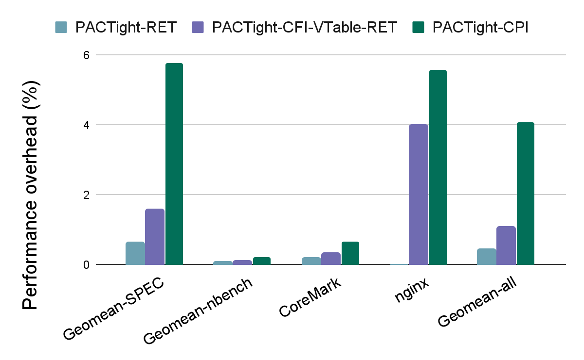
Evaluation: Performance overhead
Geometric mean:
0.43% for PACTight-RET
1.09% for PACTight-CFI+VTable+RET
4.07% for PACTight-CPI
Notes:
We ran PACTight with three sets of benchmarks, the SPEC CPU2006 set, the nbench set and CoreMark. We also ran one real-world application, nginx, which is a web server. The following graph shows our numbers for the different PACTight defense mechanisms. As can be seen, PACTight has low average overhead.

Slide 42
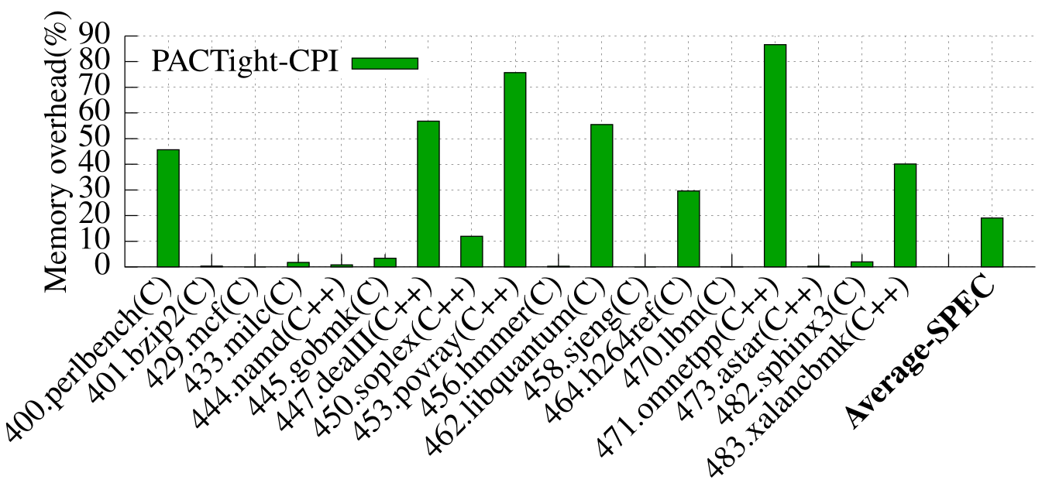
Evaluation: Memory overhead
We ran the SPEC benchmarks with the PACTight-CPI protection:
19% memory overhead on average.
Notes:
We also evaluated the memory overhead of PACTight-CPI on the SPEC benchmarks and got a 19% memory overhead on average.

Slide 43
Outline
Introduction
Background and related work
Introducing PACTight
PACTight design
PACTight defense mechanisms
Evaluation
Conclusion
Notes:
And finally I will conclude

Slide 44
Conclusion
PACTight is an efficient and robust mechanism utilizing ARM’s PA mechanism.
Three security properties that PACTight enforces to ensure pointer integrity.
We implemented PACTight with four defense mechanisms, protecting forward-edge, backward-edge, virtual function pointers, and sensitive pointers.
PACTight is secure against real and synthesized attacks (more details in the paper) and has low performance and memory overhead
Notes:
I have introduced PACTight, which is an efficient and robust mechanism that utilizes ARM’s pointer authentication primitives to guarantee pointer integrity. We identified three security properties that PACTight enforces. We showcased PACTight with four defense mechanisms that protect a wide variety of security-sensitive pointers. We evaluated PACTight against real-world and synthesized attacks, more details on those in the paper, and showcased its low overhead on a variety of benchmarks and using real PAC instructions.

Slide 45

Thank you!
Questions?
Mohannad Ismail
imohannad@vt.edu
https://github.com/cosmoss-jigu/pactight
Notes:
Also, I have spent my PhD during Covid and this is the first in-person conference I attend since starting, so please feel free to reach out to me and connect. Thank you very much for listening to my presentation and I will gladly take any questions.

Slide 46
Conclusion
PACTight is an efficient and robust mechanism utilizing ARM’s PA mechanism.
Three security properties that PACTight enforces to ensure pointer integrity.
We implemented PACTight with four defense mechanisms, protecting forward-edge, backward-edge, virtual function pointers, and sensitive pointers.
PACTight is secure against real and synthesized attacks (more details in the paper) and has low performance and memory overhead
Mohannad Ismail
imohannad@vt.edu
https://github.com/cosmoss-jigu/pactight
Notes:
Thank you very much for listening to my presentation and I will gladly take any questions.

Slide 47
Extra slides

Slide 48
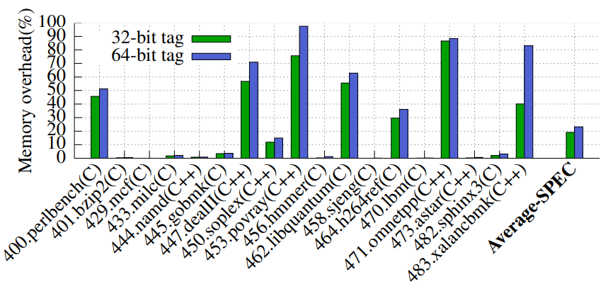
Evaluation: Memory overhead
We ran the SPEC benchmarks with the PACTight-CPI protection, since it requires the largest number of entries in the metadata store.
23% on average for 64-bit tags
19% on average for 32-bit tags.
Notes:
We also evaluated the memory overhead of PACTight-CPI on the SPEC benchmarks. We used both 32-bit and 64-bit tags in our evaluation. We used PACTight-CPI since it would have the most instrumentations. In spite of that, the average memory overhead is around 23% on average for 64-bit tags and 19% on average for 32-bit tags.

Slide 49
PACTight Design: Enforcing the properties
Non-copyability: PACTight adds the location of the pointer (&p) as part of the modifier. Any change in the location by copying the pointer triggers an authentication fault.
Pointer (p)
Pointer
Object
Authenticate
Object
Address
PAC
Address
Modifier
&p ⨁ tag(p)
tag(p)
Tag Metadata store
Copied Pointer (p)
Pointer
Object
Authenticate
Object
Address
PAC
Address
0x2
Copied Pointer
Modifier
&p’ ⨁ tag(p)
tag(p)
Tag Metadata store
Notes:
For non-copyability, the location of the pointer being included as a part of the modifier means that any copied pointer will generate a different PAC on authentication, due to a different ampersand p, thus resulting in mismatch on authentication. This means that a pointer can only be used in its legitimate location, enforcing the second property.

Slide 50

PACTight Design: Enforcing the properties
Non-dangling: PACTight uses a random tag to track the lifecycle of a memory object. The lifecycle of a PACTight-sealed pointer is bonded to that of the object.
Pointer (p)
Pointer
Object
Authenticate
Object
Address
PAC
Address
Modifier
&p ⨁ tag(p)
tag(p)
Tag Metadata store
Dangling Pointer (p)
Pointer
Freed object
Authenticate
Freed object
Address
PAC
Address
0x2
or
Pointer
Realloc’d object
Modifier
&p
tag(p)
Notes:
To enforce the non-dangling property, PACTight assigns a random tag to the pointer, stored in a separate metadata. This random tag is generated upon allocation and removed upon deallocation, thus allowing the lifecycle of the object to be tracked. A dangling pointer being used will not have a tag, and thus the PAC generated on authentication will not match, resulting in a violation, and thus preventing any misuse of dangling pointers.

Slide 51
PACTight structure and overall design
PACTight instruments programs to guarantee the three properties.
PACTight automates its instrumentation in four different levels: forward edge, backward edge, C++ VTable, and sensitive pointers
Source code
Clang
IR
PACTight Instrumentation
Instrumented Program
Metadata Store
PACTight library (compiler-rt)
Protected Binary
Compile time
Runtime
Notes:
At compile time, the PACTight LLVM pass does static analysis on the LLVM IR, and instruments them with PACTight’s functions.

Slide 52
PACTight structure and overall design
PACTight instruments programs to guarantee the three properties.
PACTight automates its instrumentation in four different levels: forward edge, backward edge, C++ VTable, and sensitive pointers
Source code
Clang
IR
PACTight Instrumentation
Instrumented Program
Metadata Store
PACTight library (compiler-rt)
Protected Binary
Compile time
Runtime
Notes:
Then in runtime, the instrumented program is protected with a metadata store being accessed by the runtime library functions.

