Slide 1


Birds of a Feather Flock Together: Scaling RDMA RPCs with Flock
Sumit Kumar Monga, Sanidhya Kashyap, Changwoo Min
Notes:
Hello everyone, welcome to my talk. I am Sumit and I will present our work on scaling RDMA RPCs with FLOCK.
This is done in collaboration with Professor Sanidhya Kashyap from EPFL and my advisor Professor Changwoo Min from Virginia Tech

Slide 2
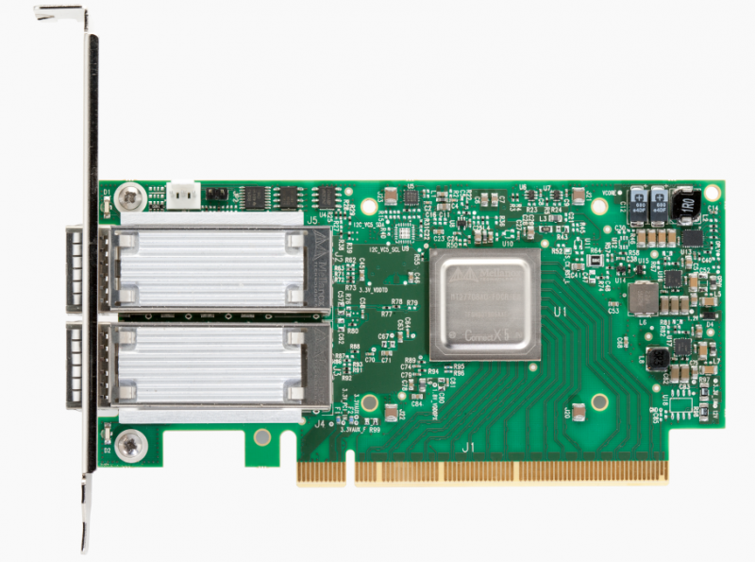
Datacenters adopting RDMA
To achieve good performance, datacenter applications require the network to deliver
high throughput
low latency
[1] https://www.datacenterknowledge.com/archives/2015/06/17/rdma-replaces-tcpip-in-linbits-data-replication-tool
[2] https://www.nextplatform.com/2018/03/27/in-modern-datacenters-the-latency-tail-wags-the-network-dog/
Within datacenters RDMA deployment
high throughput and low latency
drop in RDMA hardware prices
Notes:
RDMA has been gaining traction within datacenters as it can deliver high throughput and low latency. Also, the price of RDMA hardware have been going down in recent years facilitating its adoption.

Slide 3
Remote direct memory access (RDMA)
enables direct access to memory of a remote machine
low latency (1 µs)
kernel bypass + CPU bypass
Notes:
Some of the key features of RDMA are the ability to directly access memory of a remote machine, its ultra-low latency (single digit microsecond) and kernel bypass which enables zero-copy transfers and CPU bypass.

Slide 4
RDMA background
Transport Types
Reliable Connection (RC)
Unreliable Connection (UC)
Unreliable Datagram (UD)
Queue Pair : hosts establish queue pairs (QP) to communicate with each other
Server
Client 1
Server
Client 1
RDMA primitives
memory (one-sided) ops (read, write, atomics)
messaging ops (send/recv)
QP
QP
RDMA NIC caches QP state in its memory, so |connected transport| > |datagram transport|
NIC faces cache thrashing as state increases
QP-1
QP-2
QP
Client 2
QP
QP
Client 2
QP-3
QP
Client 3
QP
Client 3
RC supports all RDMA primitives
UD supports only send/recv
Connected transport (RC, UC)
Datagram transport (UD)
Notes:
The most common RDMA transports are RC, UC and UD. RDMA hosts establish communication by creating queue pairs of one of these transports.
Next, we look at the differences between connected and datagram transports using an example where a server communicates with three clients C1,C2 and C3.
The left figure shows the connected transport where the server creates a dedicated QP for each client. On the right is the datagram transport showing the server communicating with the clients using a single QP.
One thing to note is that these QPs are cached by the RDMA NIC, so the connected transport requires more state than datagram for a similar communication pattern. As the NIC’s memory is very limited, it faces cache thrashing as the state increases.

Slide 5
Large cluster RDMA scalability challenges
Non-scalable RC
+ Provides one-sided ops
- Limited on-chip memory on the RDMA NIC
Limited UD functionality:
+ Enables one-to-many communication
- Lacks CPU-efficient one-sided ops
Which RDMA transport to use for scalable communication ?
Only RC | Only UD | Hybrid
FaRM [NSDI 14, SOSP 15] Storm [SYSTOR 19] ScaleRPC [EuroSys 19] | FaSST [OSDI 16] eRPC [NSDI 19] | HERD [SIGCOMM 14] (UC + UD) DrTM+H [OSDI 18] (RC + UD)
Notes:
RDMA is good however, achieving scalability in large RDMA clusters is a challenging problem.
This is because RC is non-scalable as its point-to-point communication model requires more state on the NIC.
In contrast, UD is inherently scalable due to its one-to-many communication model but lacks CPU-efficient one-sided operations, all of which are supported by RC
There has been a long debate over which RDMA transport should be used for scalable communication
Some works have gone on with using only RC
while others have chosen to use only UD
A few research efforts have explored a hybrid of connected and datagram transport

Slide 6
Connection scalability with RDMA full flexibility?
Goals:
Maintain connection scalability
Expose all RDMA features, i.e., versatility
Minimal software-induced overheads
Notes:
This brings us to our problem statement :
Can an RDMA communication framework

Slide 7
Connection scalability with RDMA full flexibility?
Goals:
Maintain connection scalability
Expose all RDMA features, i.e., versatility
Minimal software-induced overheads
FLOCK: An RDMA communication library
Notes:
This brings us to our problem statement :
Can an RDMA communication library maintain connection scalability,
FLOCK is such an RDMA communication library to achieve the above goals

Slide 8
FLOCK
Uses RC
+ Exposes all RDMA capabilities
Uses QP sharing among threads^{[1,2]}
+ Uses FLOCK synchronization for connection scalability
Introduces symbiotic send-recv scheduling
+ A cooperative scheduling policy between sender and receiver
+ Enables efficient network resource allocation and utilization at the end-hosts
[1] FaRM : Fast remote memory, NSDI 2014
[2] No compromises : distributed transactions with consistency, availability, and performance, SOSP 2015
Notes:
I will now present the key design aspects of FLOCK are :
FLOCK is based on RC to provide all RDMA primitives
We use QP sharing among threads like prior works to achieve connection scalability and propose a new QP sharing mechanism called FLOCK synchronization
FLOCK introduces a cooperative scheduling policy between the sender and receiver named symbiotic send-recv scheduling enabling efficient network resource allocation & utilization at the end-hosts

Slide 9
FLOCK Architecture
(6) Thread scheduler migrates threads from a deactivated QP to another active QP
(1) client asks for credit while sending request to server
Sender (Client)
Receiver (Server)
(1) submit request
(3) QP scheduler decides whether to keep this QP active
Thread
Scheduler
(6)
RPC Region
RPC Region
(3)
QP
Scheduler
Connection Handle
(6)
(5)
(4) return response
(2)
App
Threads
RPC Workers
(2) all requests are processed
(5) app threads receive response
(4) server provides credits or deactivates the QP along with the response to client
Active QP
Inactive QP
Receiver-side QP Scheduler dynamically activates/deactivates QPs on a per-sender basis to avoid NIC cache pressure
Sender-side Thread scheduler multiplexes active QPs among application threads
Notes:
We now look at the FLOCK architecture by considering a client and server example to see how request processing is handled in FLOCK. Client and server start communication by creating a connection handle which is our abstraction on top of the QPs. The figure shows a connection handle with three QPs shown as green bars, all of which are active QPs.
Each of client and server have an RPC memory region where they prepare RPC requests and responses respectively. Also, both client and server run a scheduler component which I will explain in a bit.
Let’s look at the working of RPC in FLOCK.
The client initiates the RPC by sending a request to the server.
As part of this, client asks the server for credits for future requests.
This is because FLOCK is like receiver-driven transports in the sense that it requires a sender to have a credit before it can submit a request.

Slide 10
But isn’t QP sharing bad for performance
QP sharing among threads is detrimental to performance^{[1,2]}
Low parallelism
High synchronization overheads
FLOCK synchronization overcomes these challenges
Threads sharing a QP progress concurrently with minimal synchronization
Coalesces smaller messages utilizing network bandwidth + CPU efficiently
[1] FaRM : Fast remote memory, NSDI 2014
[2] FaSST : Fast, Scalable and Simple Distributed Transactions with Two-Sided RDMA Datagram RPCs, OSDI 2016
Notes:
FLOCK uses a new QP sharing mechanism called FLOCK synchronization wherein

Slide 11
FLOCK Synchronization
QP sharing using leader-follower coordination
leader coalesces requests from followers
Sender (Client)
Thread Combining Queue (TCQ)
Enqueue into the TCQ via atomic swap on Flock Tail, head of TCQ becomes the leader which manages the request buffer
Flock Tail = null
Flock Tail = null
Flock Tail
Follower requests memory buffers from leader
A coalesced message
Thread 1
Thread 2
Leader provides memory buffers to threads in the TCQ, reserving memory for the coalesced message
Leader
Follower
All threads copy their payload within the provided buffer
Leader sets up header & canary to get the coalesced message ready
Request Buffer
FLOCK synchronization enables
low synchronization overheads for QP sharing
concurrent progress of threads and fairness in terms of their arrival order
efficient network utilization reducing small messages sent due to coalescing
fewer CPU cycles for MMIO operations due to reduction in messages exchanged
Header
Meta₁
Data₁
…
Meta_{N}
Data_{N}
Canary
Header
Meta₁
Data₁
Meta₂
Data₂
Canary
RDMA Write
Leader issues RDMA write
Receiver (Server)
Header
Meta₁
Data₁
…
Meta_{N}
Data_{N}
Canary
Notes:
Let’s reconsider the client-server example to understand the working of FLOCK synchronization.
The green region within the request buffer shows how a coalesced message looks like in FLOCK. It consists of a header, N pairs of data & metadata and a canary. The header contains information such as the total message length, number of requests within the message which in this case is N. Each pair of data and metadata is one request with the data containing the actual payload while the metadata contains the payload length and rpc to execute at the server.
FLOCK synchronization is a QP sharing mechanism using a form of leader-follower coordination
Associated with each QP at the client is a Thread Combining Queue (TCQ) as shown in the top right side in the figure.
Once the message is prepared, it can be sent to the server by the leader using an RDMA write.
Please refer to our paper to see how FLOCK resolves the performance-scalability tradeoff in RDMA networks using symbiotic send-recv scheduling.

Slide 12
Evaluation Questions
FLOCK vs state-of-the-art RDMA RPC systems
Impact on a real-world application
Notes:
As part of our evaluation, we want to answer the following questions
How FLOCK performs in comparison with state-of-the-art RDMA RPC systems like eRPC ?
Can symbiotic scheduling enable FLOCK to maintain scalability as the number of senders increase ?
How performance of a real-world application impacted by integrating it with FLOCK ?

Slide 13
Evaluation Environment
24 machines from CloudLab d6515 cluster
32-core AMD 7452 2.5 GHz CPU
Mellanox ConnectX-5 100 Gbps NIC
100 Gbps switch connecting the machines
Maximum active QP count at the server is 256

Slide 14
FLOCK vs eRPC
Configuration : 1 server, 23 clients
Workload : 64B request and 64B response
3.4X
FLOCK throughput up to 3.4X against eRPC
Tail latency lower by up to a factor of 2
-----------------------------------------------------------------
+ Coalescing enables more concurrency at the clients & scheduling limits active QP count
- UD-based RPCs have higher CPU overheads
2.1X
Notes:
Here are the results. The upper figure shows the throughput in operations per us and the bottom figure shows the 99th percentile latency in us.
FLOCK consistently outperforms eRPC and delivers throughput up to 3.4 times that of eRPC. In addition, tail latency is lower in FLOCK by up to a factor of 2 compared to eRPC.
This is primarily due to coalescing in FLOCK which enables more concurrency at the clients while QP scheduling at the server limits the active QP count. Hence, server NIC doesn’t face cache thrashing.
In contrast, eRPC like other UD-based RPCs suffers from high CPU overheads.

Slide 15
Distributed Transaction Processing
Configuration
comparison against FaSST, an RDMA-based transaction processing system
Transaction protocol like FaSST : OCC^{[1]} and 2-phase commit to provide serializable transactions
3 servers and 20 clients
Workloads
TATP (read-intensive)
Smallbank (write-intensive)
[1] Optimistic Concurrency Control
Notes:
To evaluate the performance impact of FLOCK on distributed transaction processing, we compare it against FaSST which is an RDMA-based transaction processing system.
For a fair comparison, we use a similar transaction protocol as FaSST : OCC and 2-phase commit for serializable transactions
3 machines are used as servers and 20 machines as clients in this evaluation.

Slide 16
FLOCK vs FaSST for TATP
2.4X
FaSST performs better up to 2 threads, but its performance saturates at 4 threads
Throughput in FLOCK up to 2.4X FaSST with lower median and tail latency
FLOCK’s performance improves with higher thread counts due to better coalescing and efficient network utilization
3.4X
* FaSST suffers packet loss at 32 threads
Notes:
Here are the result for TATP. Upper figure shows the throughput and bottom one shows the 99% latency.
FaSST outperforms FLOCK up to 2 threads, but its performance saturates at 4 threads
In contrast, FLOCK’s throughput improves as the number of threads per client increases. Overall FLOCK delivers throughput up to 2.4 times that of FaSST with lower median and tail latency
These gains are again down to coalescing and efficient network utilization.
Similar results for Smallbank, see our paper for more evaluations.

Slide 17
Conclusion
FLOCK
targets balancing the performance-scalability tradeoff in vanilla RDMA hardware
offers low overhead QP sharing using leader-follower synchronization
a cooperative scheduling mechanism between client and server to limit the maximum load at the server
superior performance with efficient network utilization and reduced CPU usage
Thank you!

