Slide 1

Scaling RDMA RPCs with Flock
Sumit Kumar Monga

Slide 2
Outline
Background
Motivation
Design of FLOCK
Evaluation
Future work
Conclusion

Slide 3
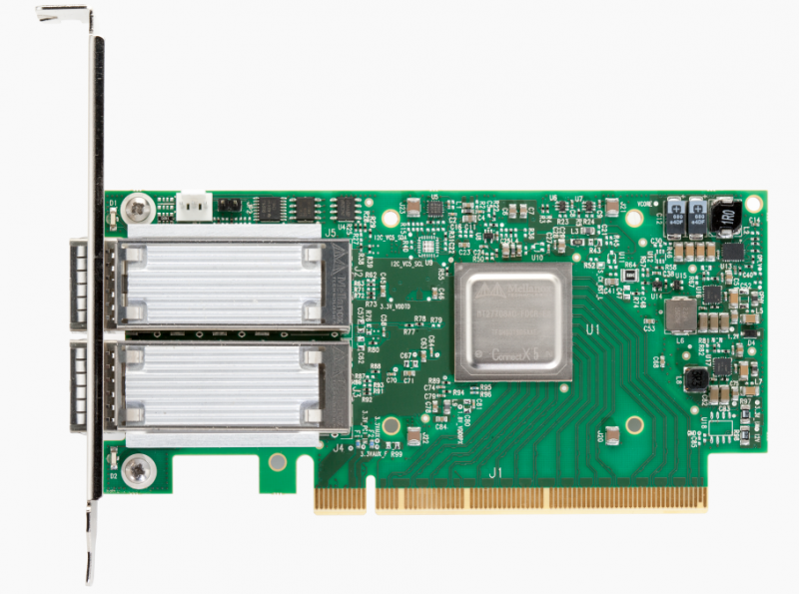
Datacenters adopting RDMA
To achieve good performance, datacenter applications require the network to deliver
high throughput
low latency
[1] https://www.datacenterknowledge.com/archives/2015/06/17/rdma-replaces-tcpip-in-linbits-data-replication-tool
[2] https://www.nextplatform.com/2018/03/27/in-modern-datacenters-the-latency-tail-wags-the-network-dog/
Within datacenters RDMA deployment
high throughput and low latency
drop in RDMA hardware prices

Slide 4
Remote direct memory access (RDMA)
enables direct access to memory of a remote machine
low latency (~ 2 µs per hop)
kernel bypass + CPU bypass
Node 1
Node 2
user buffer
DMA
NIC
NIC
DMA
user buffer
(1)
(2)
(3)
Memory buffers registered with the RDMA NIC

Slide 5
RDMA background
Transport Types
Reliable Connection (RC)
Unreliable Connection (UC)
Unreliable Datagram (UD)
Queue Pair : connection abstraction to establish communication between the hosts
Reliable transport implements packet loss and congestion control in hardware
Server
QP
Client 1
Server
QP
Client 1
RDMA NIC uses its limited SRAM to cache
QP state
virtual-to-physical address translation & permissions for registered memory
|connected transport| > |datagram transport|
NIC faces cache thrashing as the state increases
QP-1
QP-2
QP
Client 2
QP
QP
Client 2
QP-3
QP
Client 3
QP
Client 3
Connected transport (RC, UC)
Datagram transport (UD)

Slide 6
RDMA primitives
Messaging (two-sided) -> send/recv
Memory (one-sided) -> read, write, atomics
Transport | Read / Atomic | Write | Send/Recv
RC | ✓ | ✓ | ✓
UC | ✗ | ✓ | ✓
UD | ✗ | ✗ | ✓

Slide 7
Outline
Background
Problem Statement
Design of FLOCK
Evaluation
Future work
Conclusion

Slide 8
Large cluster RDMA scalability challenges
Non-scalable RC
+ Provides one-sided ops
- Limited on-chip memory on the RDMA NIC
Limited UD functionality:
+ Enables one-to-many communication
- Lacks CPU-efficient one-sided ops
Which RDMA transport to use for scalable communication ?
Only RC | Only UD | Hybrid
FaRM [NSDI 14, SOSP 15] Storm [SYSTOR 19] ScaleRPC [EuroSys 19] | FaSST [OSDI 16] eRPC [NSDI 19] | HERD [SIGCOMM 14] (UC + UD) DrTM+H [OSDI 18] (RC + UD)

Slide 9
Scalability comparison of RC vs UD
Benchmark setup: 1 server with increasing clients
Each client issues
a 16B one-sided read from server memory (RC)
a 16B RPC with server (UD)
* each machine has a Mellanox ConnectX-5 100 Gbps NIC
NIC's cache thrashing after 700 clients
UD:
Lower throughput and saturates earlier than RC
Server CPU cycles are used

Slide 10
Connection scalability with RDMA full flexibility?
Goals:
Maintain connection scalability
Expose all RDMA features, i.e., versatility
Minimal software-induced overheads

Slide 11
Connection scalability with RDMA full flexibility?
Goals:
Maintain connection scalability
Expose all RDMA features, i.e., versatility
Minimal software-induced overheads
FLOCK: An RDMA communication library

Slide 12
Outline
Background
Problem Statement
Design of FLOCK
Evaluation
Future work
Conclusion

Slide 13
FLOCK Overview
Uses RC
+ Exposes all RDMA capabilities
Uses QP sharing among threads^{[1,2]}
+ Uses FLOCK synchronization for connection scalability
Introduces symbiotic send-recv scheduling
+ A cooperative scheduling policy between the sender and receiver
+ Enables efficient network resource allocation and utilization at the end-hosts
[1] FaRM : Fast remote memory, NSDI 2014
[2] No compromises : distributed transactions with consistency, availability, and performance, SOSP 2015

Slide 14
FLOCK Architecture
(6) Thread scheduler migrates threads from a deactivated QP to another active QP
(1) client asks for credit while sending request to server
Sender (Client)
Receiver (Server)
(1) submit request
(3) QP scheduler decides whether to keep this QP active
Thread
Scheduler
(6)
RPC Region
RPC Region
(3)
QP
Scheduler
Connection Handle
(6)
(5)
(4) return response
(2)
App
Threads
RPC Workers
(2) all requests are processed
(5) app threads receive response
(4) server provides credits or deactivates the QP along with the response to client
Active QP
Inactive QP
Receiver-side QP Scheduler dynamically activates/deactivates QPs on a per-sender basis to avoid NIC cache pressure
Sender-side Thread scheduler multiplexes active QPs among application threads

Slide 15
But isn’t QP sharing bad for performance
QP sharing among threads is detrimental to performance^{[1,2]}
Low parallelism
High synchronization overheads
FLOCK synchronization overcomes these challenges
Threads sharing a QP progress concurrently with minimal synchronization
Coalesces smaller messages utilizing network bandwidth + CPU efficiently
[1] FaRM : Fast remote memory, NSDI 2014
[2] FaSST : Fast, Scalable and Simple Distributed Transactions with Two-Sided RDMA Datagram RPCs, OSDI 2016

Slide 16
FLOCK Synchronization
QP sharing using leader-follower coordination
leader coalesces requests from followers
Sender (Client)
Thread Combining Queue (TCQ)
Enqueue into the TCQ via atomic swap on Flock Tail, head of TCQ becomes the leader which manages the request buffer
Flock Tail = null
Flock Tail = null
Flock Tail
Follower requests memory buffers from leader
A coalesced message
Thread 1
Thread 2
Leader provides memory buffers to threads in the TCQ, reserving memory for the coalesced message
Leader
Follower
All threads copy their payload within the provided buffer
Leader sets up header & canary to get the coalesced message ready
Request Buffer
FLOCK synchronization enables
low synchronization overheads for QP sharing
concurrent progress of threads and fairness in terms of their arrival order
efficient network utilization reducing small messages sent due to coalescing
fewer CPU cycles for MMIO operations due to reduction in messages exchanged
Header
Meta₁
Data₁
…
Meta_{N}
Data_{N}
Canary
Header
Meta₁
Data₁
Meta₂
Data₂
Canary
RDMA Write
Leader issues RDMA write
Receiver (Server)
Header
Meta₁
Data₁
…
Meta_{N}
Data_{N}
Canary

Slide 17
Performance-Scalability Tradeoff
RDMA networks face a tradeoff between performance and scalability
FLOCK aims to resolve this tradeoff using symbiotic send-recv scheduling
Configuration | Performance | Scalability
Threads using dedicated QPs | ✓ More parallelism within RDMA NIC | ✗ Limited NIC cache
Threads sharing QP | ✗ Hampers performance due to synchronization overheads | ✓ Fewer NIC cache misses

Slide 18
Receiver-side QP Scheduling
Limit active QP count to bound NIC state and prevent CPU overload
Allocate fewer QPs to dormant clients and more to active clients
QP scheduler distributes active QPs to clients based on their utilization metrics
Credit renewal: client demands credits from server for future requests
Coalescing degree: indicates number of requests coalesced within a message. Client piggybacks coalescing degree when requesting credits from the server. Higher values imply QP contention

Slide 19
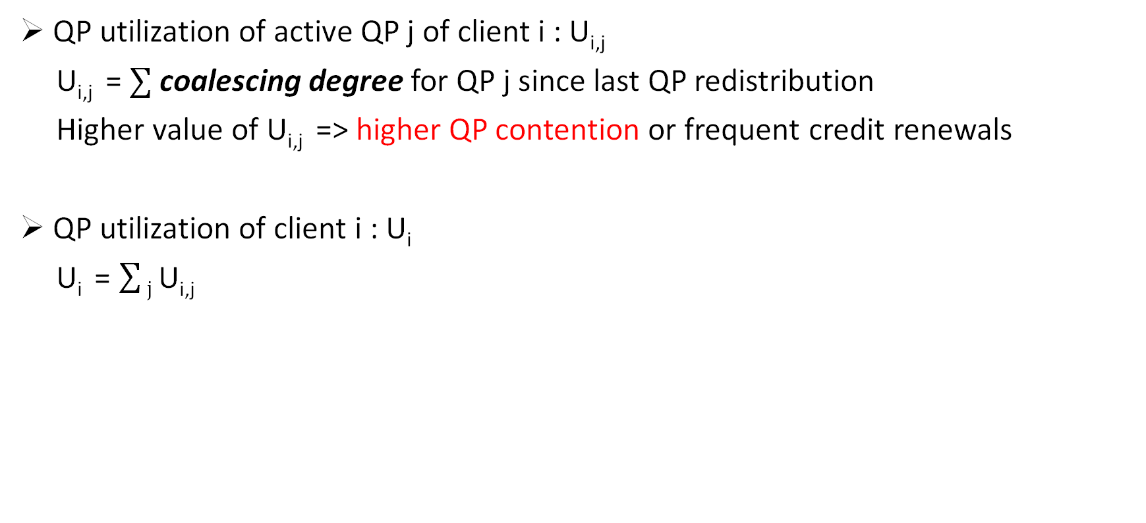
Receiver-side QP Scheduling (Contd.)
QP utilization of active QP j of client i : U_{i,j}
U_{i,j} = $∑$ coalescing degree for QP j since last QP redistribution
Higher value of U_{i,j} => higher QP contention or frequent credit renewals
QP utilization of client i : U_{i}
U_{i} = $\sum{j}$ $\text{U}\text{i}\text{,}\text{j}$
Clients receive active QPs in proportion to their utilization

Slide 20
Sender-side Thread Scheduling
Receiver can dynamically activate/deactivate QPs
Inactive QP cannot be used for request processing
Thread scheduler decides assignment of application threads to active QPs
minimize head-of-line blocking : threads with larger payload should not be placed with another sending small payload. Also, co-locating threads with smaller payloads increases coalescing opportunities.
fair utilization of QPs : each active QP processes approximately an equal amount of data

Slide 21
Implementation-level optimizations
Selective Signaling
Reduction in the completion entries DMA-ed by the RDMA NIC
saves PCIe bandwidth
extra processing by NIC
MMIO = Memory Mapped IO
CQE = Completion Queue Entry
CPU
NIC
CPU
NIC
signaled
MMIO
MMIO
R1
R1
signaled
CQE
signaled
R2
R2
signaled
R3
CQE
R3
signaled
R4
signaled
R4
1 CQE for every request
1 CQE for every 2 requests

Slide 22
Implementation-level optimizations (Contd.)
Use of RDMA Operations to avoid synchronization
RDMA Writes to submit requests to server RPC dispatcher thread receive requests by polling memory buffer
RDMA Write-with-Immediate to acquire credits from server QP scheduler receives credit demand by polling completion queue
Synchronization avoided between RPC dispatcher and QP scheduler

Slide 23
Outline
Background
Problem Statement
Design of FLOCK
Evaluation
Future work
Conclusion

Slide 24
Evaluation Questions
FLOCK vs state-of-the-art RDMA RPC systems
Scalability with symbiotic scheduling
Effect of coalescing on performance & CPU utilization
Impact on a real-world application

Slide 25
Evaluation Environment
24 machines from CloudLab d6515 cluster
32-core AMD 7452 2.5 GHz CPU
Mellanox ConnectX-5 100 Gbps NIC
100 Gbps switch connecting the machines
Maximum active QP count at the server is 256

Slide 26
FLOCK vs eRPC
Configuration : 1 server, 23 clients
Workload : 64B request and 64B response
3.4X
FLOCK throughput up to 3.4X against eRPC
Tail latency lower by up to a factor of 2
-----------------------------------------------------------------
+ Coalescing enables more concurrency at clients & scheduling limits active QP count at server
- UD-based RPCs have higher CPU overheads
2.1X

Slide 27
Scalability with Symbiotic Scheduling
Similar performance up to 16 threads
FLOCK outperforms others by up to 133% at higher thread counts
Sharing using spinlock serializes threads working on the same QP
Coalescing in FLOCK enables concurrent request submission by threads sharing a QP, reducing messages transferred by client as well as server
2.3X

Slide 28
Impact of Coalescing
Configuration : 1 server, 23 clients each running 32 threads with or without coalescing
Workload : 64B request and 64B response
1.7X
Coalescing enables better network utilization by reducing number of small packets exchanged in both directions
For 1 outstanding request per thread, server receives 1.56 requests per coalesced message. The CPU cycles on MMIO operations reduced by 36%, similarly polling overhead is reduced
3.8X

Slide 29
Distributed Transaction Processing
Configuration
comparison against FaSST^{[1]}, an RDMA-based transaction processing system
Transaction protocol like FaSST : OCC^{[2]} and 2-phase commit to provide serializable transactions
3 servers hosting a partitioned and 3-way replicated key-value store
20 clients
Workloads
TATP (read-intensive)
Smallbank (write-intensive)
[1] FaSST : Fast, Scalable and Simple Distributed Transactions with Two-Sided RDMA Datagram RPCs, OSDI 2016
[2] Optimistic Concurrency Control

Slide 30
FLOCK vs FaSST for TATP
2.4X
FaSST performs better up to 2 threads, but its performance saturates at 4 threads
Throughput in FLOCK up to 2.4X FaSST with lower median and tail latency
FLOCK’s performance improves with higher thread counts due to better coalescing and efficient network utilization
3.4X
* FaSST suffers packet loss at 32 threads

Slide 31
Other evaluations
Performance under increasing node counts
Head-of-line blocking mitigation using symbiotic scheduling
Comparison with eRPC using in-memory index structure (HydraList)

Slide 32
Outline
Background
Problem Statement
Design of FLOCK
Evaluation
Future work
Conclusion

Slide 33
Future Work
Extending FLOCK to support multiple applications and multi-tenancy
Current Focus & Avenues for multi-tenancy
current work is more focused towards multi-threaded applications via FLOCK synchronization and symbiotic send-recv scheduling
multiple applications can be supported via a central scheduler process managing network resources and allocating them to the application processes, a similar approach as Snap^{[1]}
Support advanced RDMA functionality (cross-channel communication, extended atomics)
currently support the most common RDMA primitives including RPC, one-sided and two-sided verbs
can be extended to support advanced functionality such as cross-channel communication (e.g., trigger an operation when an operation on a different communication channel completes as in Hyperloop^{[2]} ) and extended atomic operations
[1] Snap: A microkernel approach to host networking, SOSP 2019
[2] Hyperloop: group-based NIC-offloading to accelerate replicated transactions in multi-tenant storage systems, SIGCOMM 2018

Slide 34
Conclusion
FLOCK
targets balancing the performance-scalability tradeoff in vanilla RDMA hardware
offers low overhead QP sharing using leader-follower synchronization
a cooperative scheduling mechanism between client and server to limit the maximum load at the server
superior performance with efficient network utilization and reduced CPU usage

Slide 35
Publications thus far
Birds of a Feather Flock Together : Scaling RDMA RPCs with FLOCK Sumit Kumar Monga, Sanidhya Kashyap, and Changwoo Min In Proceedings of ACM Symposium on Operating Systems Principles (SOSP 2021)
TIPS: Making Volatile Index Structures Persistent with DRAM-NVMM Tiering R. Madhava Krishnan, Wook-Hee Kim, Xinwei Fu, Sumit Kumar Monga, Hee Won Lee, Minsung Jang, Ajit Mathew, and Changwoo Min In Proceedings of USENIX Annual Technical Conference (ATC 2021)
Making Volatile Index Structures Persistent using TIPS R. Madhava Krishnan, Wook-Hee Kim, Hee Won Lee, Minsung Jang, Sumit Kumar Monga, Ajit Mathew, and Changwoo Min In Proceedings of the 12th annual non-volatile memories workshop (NVMW 2021)

Slide 36
Questions

