Slide 1





TENET: Memory Safe and Fault Tolerant Persistent Transactional Memory
R. Madhava Krishnan, Diyu Zhou, Wook-Hee Kim, Sudarsun Kannan,
Sanidhya Kashyap, Changwoo Min

Slide 2
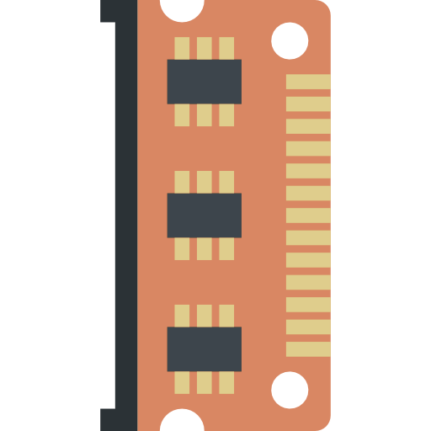
Boon and bane of Non-volatile Memory (NVM)
Byte-addressability enables application to directly access NVM using load/store instructions
NVM is directly mapped to the application’s address space
Load/store access
Application
NVM mapped directly to the user space
mmap region
NVM Hardware

Slide 3



Boon and bane of Non-volatile Memory (NVM)
Byte-addressability makes NVM data vulnerable to memory safety bugs in the application
Load/store access
Memory safety bug
e.g., buffer overflow
Application
mmap region
NVM mapped directly to the user space
NVM Hardware

Slide 4

Hardware (Media) errors are a threat too!
NVM data is vulnerable to Media Errors
Device wear-out, power spikes, soft media faults etc
Load/store access
Application
NVM mapped directly to the user space
Media errors corrupts the NVM data and the entire NVM page (data) is lost
mmap region
NVM Hardware

Slide 5
Research problem that we tackle..
How to detect memory safety bugs in the application and prevent it from corrupting the NVM data?
How to prevent data loss due to the NVM media errors?
TENET

Slide 6
Talk Outline
Background NVM memory safety errors
TENET Overview
TENET Design
Evaluation
Conclusion

Slide 7
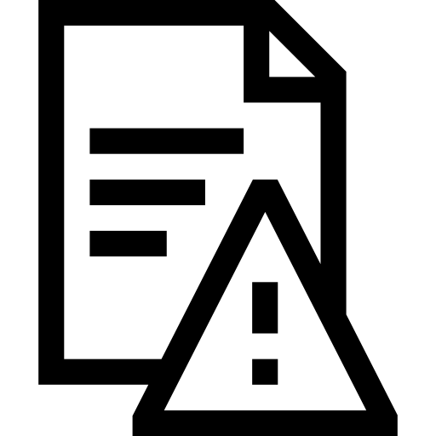
Background on types of memory safety violations
01
Memory Safety Violations
Spatial Safety Violations
Temporal Safety Violations
Spatial Safety Violations
Temporal Safety Violations
(1) Alloc
(2) Free
(3) Realloc
memcpy(buff, src, 64)
buff
buff
buff
buff (32 bytes)
use-after-free
use-after-realloc
buffer overflow
Ptr = buff
Spatial safety violations happens when applications access the memory beyond the allocated range
Temporal safety violations happens when applications access the memory using dangling pointers

Slide 8
Background on types of Media Errors
02
NVM Media Errors
Correctable Media Errors
Uncorrectable Media Errors
NVM has high Random Bit Error Rate (RBER) ~= NAND flash
Uncorrectable media errors (UME) are detected by the hardware ECC but can not be corrected
UME can happen at random offset and the OS kernel offlines the corrupted NVM page
Application is responsible for fixing the corrupted NVM page
Applications are required to maintain a backup of NVM data to rollback the affected NVM page to prevent data loss

Slide 9


Summary of prior Persistent Transactional Memory (PTM) works
PTM | Baseline PTM* | Spatial Safety | Temporal Safety | Fault Tolerance | Performance Overhead | NVM Cost Overhead
Libpmemobj-R | libpmemobj |  |  |  | 100% | High
SafePM [Eurosys-22] | libpmemobj |  |  |  | 55%
Pangolin [ATC-19] | libpmemobj |  |  |  | 67% | Moderate
Guaranteeing memory safety and fault tolerance at a lower performance overhead and cost is a very challenging problem
*Performance overhead reported for hash table
*Pangolin’s overhead is directly referenced from the paper

Slide 10
Talk Outline
Background NVM memory safety errors
TENET Overview
TENET Design
Evaluation
Conclusion

Slide 11

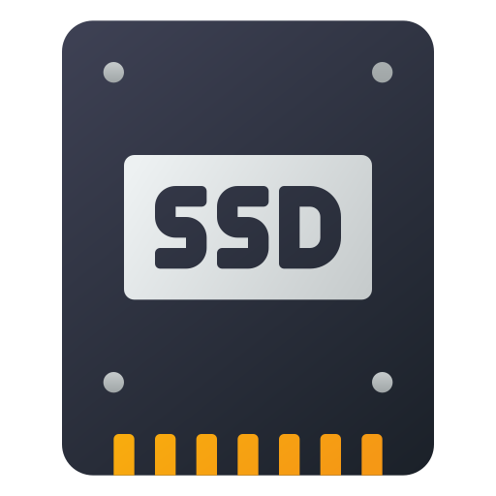
TENET overview: Goals and Assumptions
TENET is a NVM programming framework to develop memory safe and fault tolerant NVM data structures and applications
Protect NVM data from a buggy application code
Guarantee spatial safety and temporal safety
Protect NVM data against Uncorrectable Media Errors (UME)
Guarantee a performance and cost efficient fault tolerance
Adversarial attacks are out-of-scope
TENET library code and OS kernel are trusted (TCB)

Slide 12
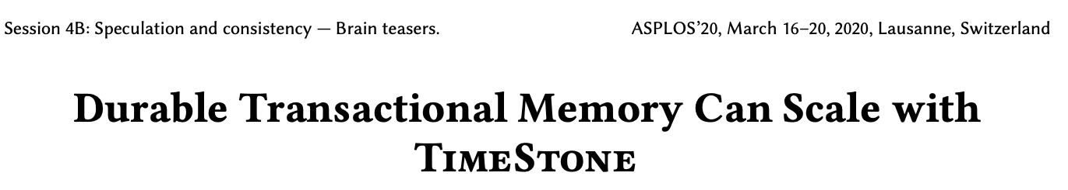
TENET overview: Programming Model
TENET provides persistent transaction programming model
TENET uses TimeStone persistent transactional memory (PTM)
TimeStone is the state-of-the-art high-performing, highly scalable PTM
TimeStone does not provide memory safety or fault tolerance

Slide 13
Talk Outline
Background NVM memory safety errors
TENET Overview
TENET Design
Evaluation
Conclusion

Slide 14
Spatial safety design in TENET
Application code or any code outside the TENET library is not allowed to perform direct NVM writes
Only the TENET library code is allowed to perform writes to the NVM data

Slide 15
Direct NVM writes in the application code is dangerous
A buggy application write on the NVM can cause spatial safety violation
Application code:
memcpy(buffer, src, 128)
Readers access the
corrupted data
NVM Pool
Buffer (64 bytes)
Node A
Node B
Node C
NVM objects (application data structure)
NVM is read-only for the application code to prevent buggy writes from corrupting the NVM data

Slide 16


Prevent direct NVM writes using Memory Protection Keys (MPK)
TENET uses MPK to enforce read-only access to the NVM object pool for all the code outside of the TENET library
Application code:
write(Node B)
Readers do not need to validate NVM objects
MPK domain
SIGSEGV Exception
…
Node A
Node B
Node C
…
NVM objects
NVM Object Pool (read-only access)
How does application writes to the NVM objects?

Slide 17
Prevent direct NVM writes using Memory Protection Keys (MPK)
Application writes only on the DRAM region and TENET writes back the DRAM object to the NVM after validating it for spatial safety
DRAM Objects
Application code:
Update (B,B²)
Validate DRAM Object for spatial safety violation
Updates to NVM object pool
through the TENET library
Node B
Node B²
How does TENET validate the DRAM objects?
…
Node B²
Node A
Node B
Node C
…
NVM objects
NVM Object Pool (read-only access)

Slide 18

Protecting DRAM objects using canary bits
TENET assigns 8 byte canaries at the boundary of a DRAM object at the time of its creation
Canary bits are inspected when the application commits its transaction
Corrupted canary bits indicates a spatial safety violation
Buggy Application
write
DRAM Objects
MPK and Canary bits validation together guarantees spatial safety for the NVM data
…
Canary(C0)
Node A²
Canary(C1)
Canary(C0)
Node B²
Canary(C1)
…
Spatial safety violation bug
Commit time canary bits validation
Abort and terminate the program

Slide 19
Read-only NVM access can cause temporal safety violations
Application can dereference a dangling pointer to an NVM object as TENET grants read access to the NVM objects
Does making NVM read-only solve all the problems and prevent NVM data corruption?
Application code:
deref(NodeB)
NVM object dereference succeeds
Temporal safety violation
use-after-free bug
NVM Object Pool (read-only access)
…
Node A
Node B
Node C
…
Node B is already freed
NVM objects
How does TENET enforce temporal memory safety for the NVM objects?

Slide 20
Enforcing temporal safety for NVM objects using pointer tags
NVM address is tagged at the time of creation; the tag is stored in the allocated NVM object and a copy of the tag is encoded in the upper 16 bits of the NVM pointer
The encoded pointer to Node B is stored in Node A
Node A
tag = 0xFACE
Encoded pointer
Node B
tag = 0xCAFE
tag is stored in the NVM object at the time of creation
Upper 16 bits are unused
Node B’s address → 0x00001265FFCAB734; Tag → 0xCAFE
Encoded pointer → Node B || Tag << 48 → 0xCAFE1265FFCAB734
tag bits
NVM address
Encoded pointer layout
63 48 0
A copy of the tag is encoded to the upper 16 bits of Node B’s address
tag 0xCAFE
Address

Slide 21

Enforcing temporal safety for NVM objects using pointer tags
Application accesses the NVM objects using the encoded pointer -- the encoded tag in the pointer is compared with the tag stored in the corresponding NVM object
Application code:
deref(NodeA-->next)
Node A
tag = 0xFACE
Encoded pointer
Node B
tag = 0xCAFE
Application dereferences
the encoded pointer
Encoded Node B pointer [NodeA→next]
tag 0xCAFE
Address
Compare tags ==
Valid NVM pointer dereference

Slide 22
Enforcing temporal safety for NVM objects using pointer tags
Dangling pointer is detected by comparing the tag stored in the NVM object with the tag encoded in the pointer to the NVM object
Application code:
deref(NodeB)
Node A
tag = 0xFACE
Encoded pointer
Node B
tag = NULL
Node B is freed
Node B’s address
tag 0xCAFE
Address
Compare tags ==
Dangling pointer dereference
use-after-free bug

Slide 23
Replicating NVM data for fault tolerance against UME
NVM data corruption due to software errors
Spatial memory safety → MPK + canary bits validation
Temporal memory safety → Pointer tags validation
How does TENET make the NVM data fault tolerance against the UME?
TENET replicates the NVM data to the local SSD to maintain backup copy
Restore the corrupted NVM page from the SSD replica
TENET’s replication provides many desirable properties
Cost efficiency → replicating to the local SSD
Performance efficiency → replicating the data out-of-the critical path
Consistent loss-less recovery
Refer to the paper for more details

Slide 24
Talk Outline
Background NVM memory safety errors
TENET and TimeStone Overview
TENET Design
Evaluation
Conclusion

Slide 25
Evaluation of TENET
Evaluation Questions
How does TENET compare against the prior PTM works in terms of features and performance overhead?
How much overhead does TENET incurs over its baseline PTM system TimeStone?
Evaluation Settings
We use a 2 socket server with 64 core Intel Xeon Gold CPU
64GB DRAM, 512GB NVM, 1TB SSD
We evaluate two different versions of TENET
TENET-MS → supports only memory safety
TENET → supports memory safety and fault tolerance
We evaluate TENET with different data structures for different read/write ratios
YCSB workloads and microbenchmarks

Slide 26
Comparison of TENET with the other PTMs
PTM | Baseline PTM* | Spatial safety | Temporal Safety | Fault tolerance
Libpmemobj-R | libpmemobj
SafePM [Eurosys-22] | libpmemobj
Pangolin [ATC-19] | libpmemobj
TENET | TimeStone
Replicates NVM data to a local NVM pool
Adds address sanitizer (Asan) to the libpmemobj
Supports parity based replication and object checksums
TENET is the only PTM to provide spatial memory safety, temporal memory safety, and fault tolerance for the NVM data
*PTM - persistent transactional memory
*Libpmemobj is a transactional library in the PMDK

Slide 27
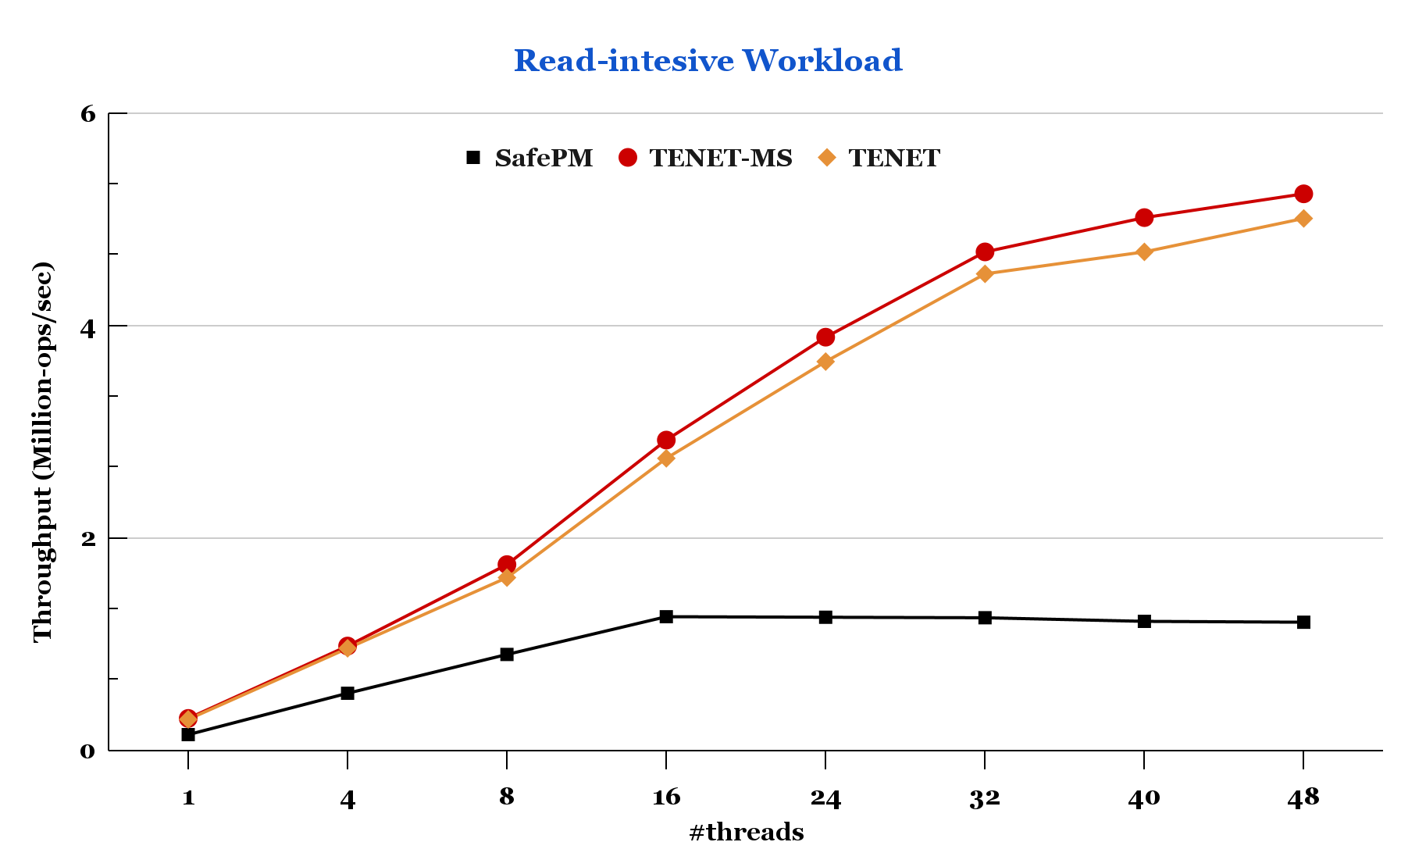
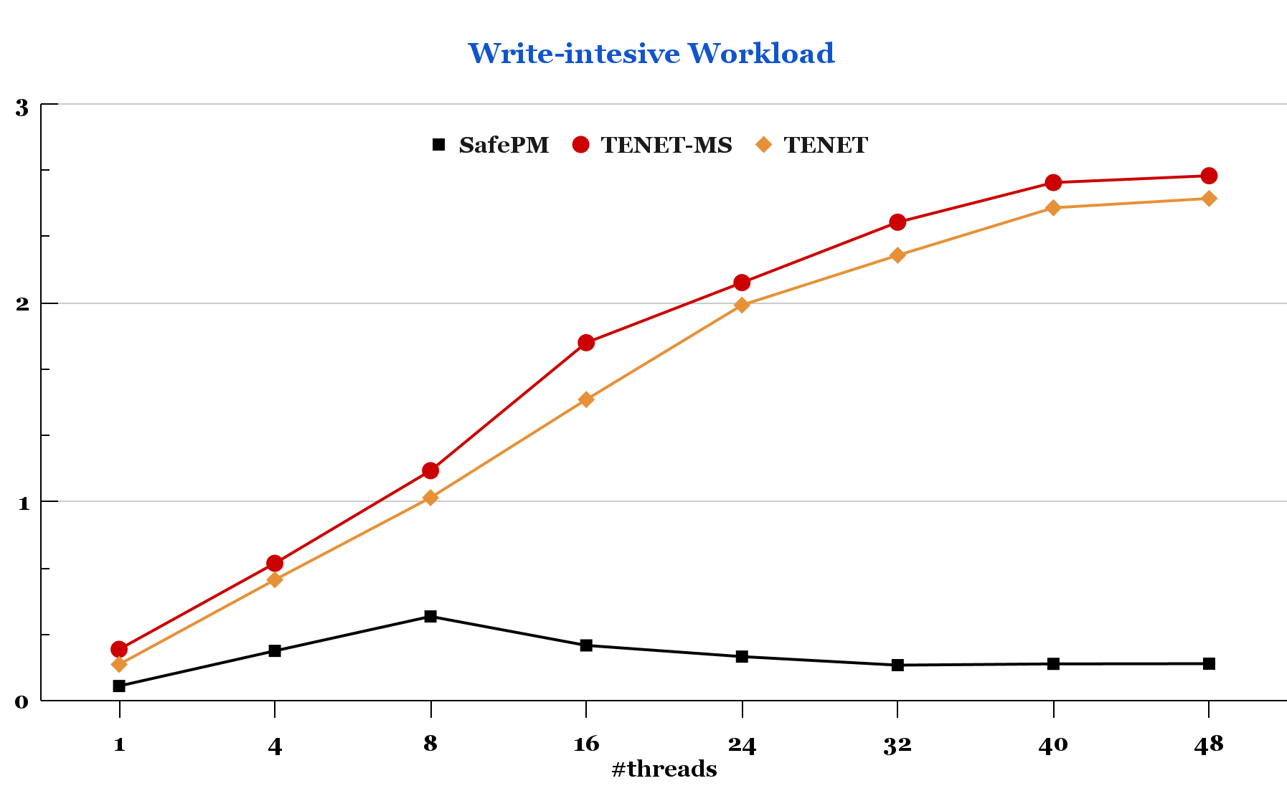
Performance of TENET and SafePM for a concurrent hash table
Memory safety only
Memory safety only
~8%
~3.5X
~13X
Memory safety +
fault tolerance
Memory safety + fault tolerance
TENET is up to 13x faster than SafePM
Adding replication (TENET) incurs only a 8% overhead
For a fair comparison lets compare the relative performance slowdown against their respective baseline PTM

Slide 28
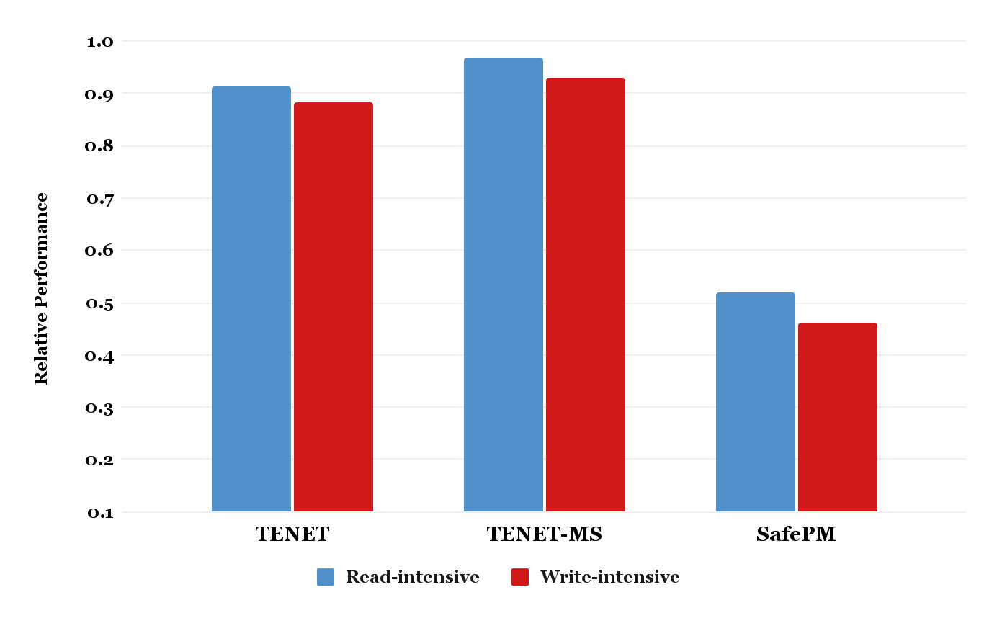
Performance of TENET and SafePM for a concurrent hash table
~12% slower
than TimeStone
~4% slower
than TimeStone
~55% slower
than libpmemobj
1.0 → is the maximum possible performance
SafePM incurs ~55% performance overhead for only memory safety guarantee
Higher the better
TENET adds ~12% performance overhead for memory safety and fault tolerance
Performance is normalized to their respective baseline PTMs
SafePM normalized to the libpmemobj → throughput (safePM)/throughput (libpmemobj)
TENET normalized to the TimeStone → throughput (TENET)/throughput (TimeStone)

Slide 29
Performance of TENET and SafePM for a concurrent hash table
~11% slower
than TimeStone
~4% slower
than TimeStone
~55% slower
than libpmemobj
TENET does not require additional crash consistency operations for its memory safety metadata
MPK → hardware primitive
Pointer tags → embedded directly into the object
Higher the better
TENET does not perform memory safety validation for every NVM access
Spatial safety checks performed only at the commit time
Temporal safety checks performed only at the first-dereference of an NVM object
Performance is normalized to their respective baseline PTMs
SafePM normalized to the libpmemobj
TENET normalized to the TimeStone
Refer to the paper for more details on these optimizations

Slide 30
Other interesting insights in the paper
How the spatial, temporal safety, and fault tolerance techniques works in tandem?
How TENET leverages concurrency properties of PTM (ACID properties) for performance efficiency?
How TENET leverages RCU style grace period to guarantee a consistent recovery?
Array interface design for guaranteeing spatial and temporal safety
How can the TENET’s techniques be applied to the other PTM systems?
More evaluations and in-depth analysis on TENET’s design

Slide 31
Conclusion
NVM is vulnerable to data corruption due to software bugs and media errors
NVM is exposed to the user space thus it is vulnerable to spatial and temporal memory safety violations
TENET a NVM programming framework to design memory safe and fault tolerant NVM data structures and applications
Spatial memory safety → Memory protection keys (MPK) + Canary bits validation
Temporal memory safety → Encoded pointer tag validation during dereference
TENET guarantees fault tolerance for NVM data against uncorrectable media errors (UME)
Replicates the NVM objects to the local SSD
TENET guarantees a robust memory protection and fault tolerance at a modest performance overhead
Thank You!

