Slide 1
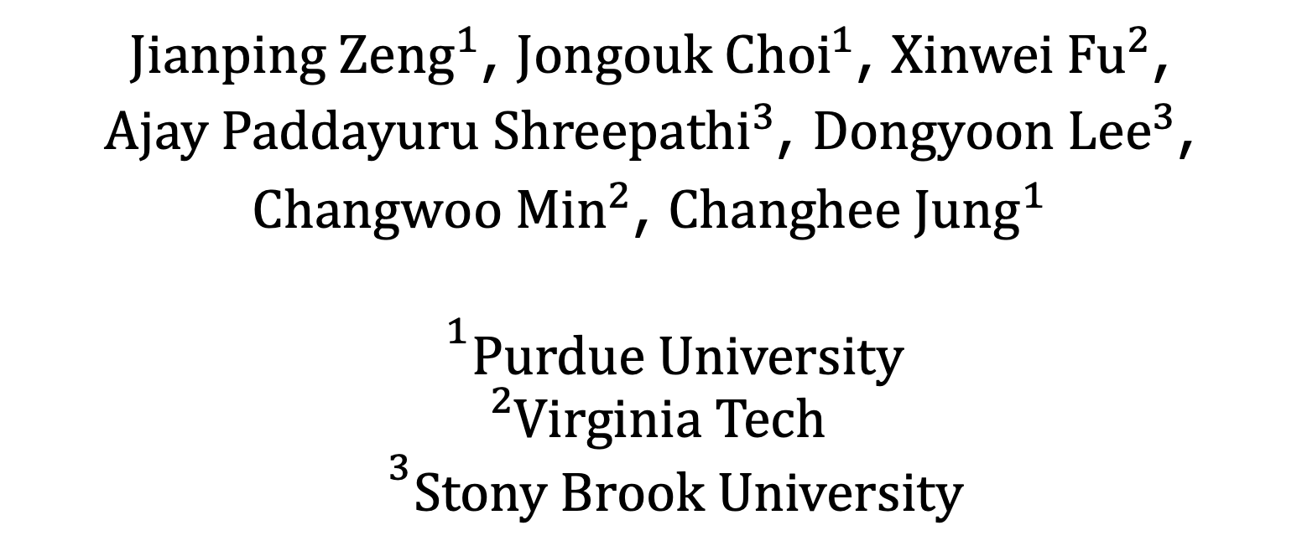
ReplayCache: Enabling Caches for Energy
Harvesting Systems
$Jianping Zeng^{1}$, $Jongouk Choi^{1}$, ${\text{Xinwei} \text{Fu}}^{2}$,
$Ajay Paddayuru Shreepathi^{3}$, $Dongyoon Lee^{3}$,
$Changwoo Min^{2}$, $Changhee Jung^{1}$
$${}^{1}Purdue University$$
$${}_{}^{2}{Virginia Tech}$$
$${}^{3}Stony Brook University$$
Notes:
Hello, this is Jianping Zeng from Purdue. Today, I am going to present the paper--ReplayCache: Enabling Caches for Energy Harvesting Systems. [click]

Slide 2

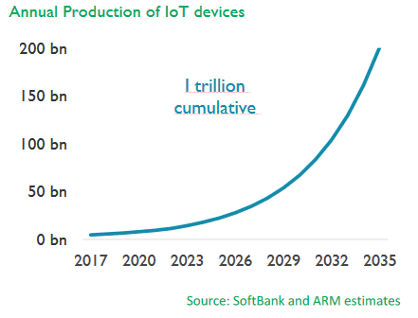
Battery is Not the Way to Go!
Batteries are bulky
They must be replaced
Notes:
almost every IoT device has a battery. However, because of increasing number of IoT devices, there is a high demand on replacing battery of those systems and thus incurring high cost.
Due to batteryless nature, energy harvesting system is becoming more popular and attracting more attention from research and industry community. Also energy harvesting can downsize wearables thanks to the lack of battery [click]

Slide 3

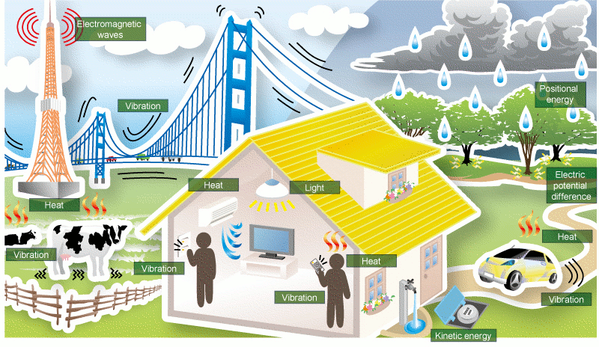
Energy Harvesting Systems (EHS)
WiFi
RF
Solar
Notes:
Energy harvesting system can collect energy from various sources without battery, such as WIFI, radio frequency, and solar. However, those energy sources are not stable!

Slide 4
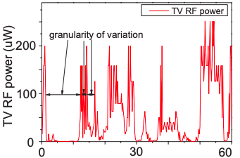
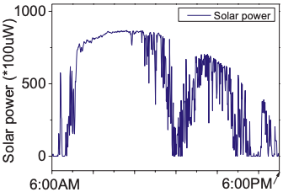
Unreliability of Ambient Energy Sources
(a). Time (s) (Sample time: 0.33us)
(b). Time (s) (Sample time: 0.33us)
[Ma,HPCA’2015]
Notes:
Because of the instability, no matter which energy source is used, input energy fluctuate a lot. [click]

Slide 5

Problem of Frequently Data Loss
Stagnation
∞
Timeline of program execution
: Power failure on which all volatile registers lose their data
54th IEEE/ACM International Symposium on Microarchitecture
Notes:
Frequent energy fluctuation leads to frequent power failure.
[click]
This is a timeline of program execution.
[click]
When a power failure happens in the middle of program execution, [click] processor loses all register content and needs to go back to program beginning to restart program execution for recovery.
[click]
If the power failure happens again and again before reaching the end of program [click], program never finishes causing a so-called stagnation problem. [click]

Slide 6

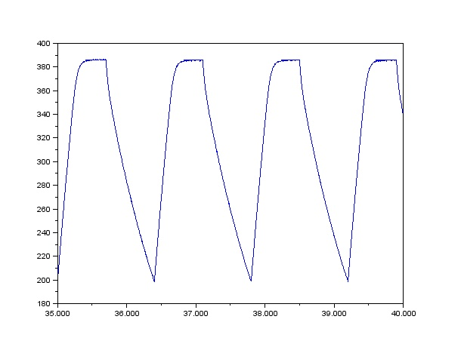
NVP: Just-in-time Register Checkpointing
Register access is not delayed because of no NVFF access during program execution
No-rollback: program resumes at the exactly failure point
Vdd
NVP
Harvested
energy
Capacitor charge
Vbk
Voltage monitor
Vdd
Backup/recovery controller
Voff
Pipeline
NVM
Volatile register
NVFF
Time
[Ma,HPCA’2015]
Notes:
To solve this stagnation problem, people come up with nonvolatile processor (NVP) which JIT checkpoints entire RF when power failure is impending.
[click] To achieve this goal, it uses a voltage monitor to checkpoint and restore RF.
[click, click]
When input voltage drops below backup threshold, [click] voltage monitor signals backup controller to [click] checkpoint entire RF to (nonvolatile flip-flop) NVFF which is slower than RF because of non-volatile technology used.
[click]
When the power is off, [click] volatile register content are lost.
[click] Once power comes back, [click] NVP reversely restores [click] register content from NVFF to the register file as we can see from the figure.
[click]
Because of not accessing NVFF during regular program execution, NVP never delay the register access. In the wake of power failure, NVP can resume the program execution exactly from the failure point without rollback.

Slide 7
NVP Has No Cache Due to Its Crash Consistency Issue
* We can’t restart program from the exactly failure point as NVP does
Pipeline
Cache
NVM
Volatile
Registers
NVFF
Notes:
[click] NVP usually doesn‘t have a cache even though NVM access latency is so long. The reason is volatile cache puts more pressure on crash consistency.
As shown in the figure, [click] when power failure happens, all RF content are checkpointed to NVFF. But cache content are lost.

Slide 8
NVSRAM: The State-of-the-Art and its Limitations
[Chui, VLSI’2010]
Vbk’
Secured energy is used only for backup; less progress
Slow booting for securing the higher voltage
High manufacturing complexity
Voltage Monitor
Secured higher voltage
Capacitor Charge
NVSRAM
Core
Backup/recovery Controller
Vbk
SRAM
Cache
Voff
NVM
NVM
backup
Volatile register
NVFF
Time
Notes:
To deal with this issue, prior solution NVSRAM was proposed to [click] JIT checkpoint entire SRAM Cache to a NVM backup when power is about to be cut off.
[click] After that, all SRAM cache content are lost when power is off.
[click] when power comes back, [click] it restores cache content from NVM backup reversely.
[click] The biggest problem is we must increase [click] backup voltage to secure this amount [click] of energy only for entire SRAM cache backup, and this secured energy can not be used for other purpose.
[click]
If there is no NVSRAM cache, this energy otherwise can be used for making program progress. Except that, It takes more time to secure high energy, leading to slow booting time. Moreover, laying out nonvolatile technology over SRAM with 3D die stacking causes a big cost.

Slide 9


ReplayCache: A Pure Software Solution to Enabling Performant Volatile Cache for EHS
Slow
WB-NVCache
Performance Overhead
WT-VCache
Traditional
HW/SW Co-Design
NVSRAM Cache
ReplayCache
Ideal
Hardware Cost
Expensive
* Software undo/redo logging slow down 1.6-5x
Notes:
To avoid expensive hardware cost, we propose RepalyCache --- a pure software solution to enabling volatile cache for EHS.
[click] As we have seen before, NVSRAM cache is super expensive [click]
[click]
People might want to use nonvolatile memory as a whole cache so that it can survive power outages, but it is pretty slow.
[click]
Another design is using WT policy for volatile cache which is still slower than WB-volatile cache.
[click]
If we go with traditional HW/SW co-design, it is typically sitting there.
[click]
but our goal is more challenging than that, even though replay cache is a pure software design, we perform aggressive optimizations to make the performance of replay ache as close to the NVSRAM cache as possible.
to make the performance on par with NVSRAM, we are only left with one option volatile cache but it causes crash consistency issue as we've seen before. let’s see what is the fundamental reason for the inconsistency issue.[click]

Slide 10

Reason for Crash Inconsistency of Volatile Cache
* r2, r3 are restored from NVFF
Store r2, [r3]
…
r4 = Load [r3]
…
Pipeline
Cache
New
data
Crash inconsistency caused by stores left behind power failure
r2
r3
New
data
RF
NVM
Old
data
r3
JIT Backup
Recovery
Power
interrupted
NVFF
Notes:
[click]
We assume the store and load access the same memory location as left figure shows.
[click]
When power is on, processor is executing the store instruction and writes its data to the cache (we assume a cache hit here).
[click]
Then processor continues executing following load.
[click]
When a power failure happens at that load, RF content is JIT checkpointed into NVFF. [click] then all data in RF and Cache are lost when power is off.
[click]
When power comes back, [click] RF content is restored from NVFF, [click] here, register r2 and r3 are restored, [click] Then NVP resumes at the power failure point for executing that load. But, this time, [click] processor gets an old data instead of the new data just written by store.
[click]
Thus, causing crash consistency issue.
[click]
We clearly see the crash consistency issue is caused by that unpersisted store left behind the power failure.
[click]

Slide 11

ReplayCache Solution: Replaying Unpersisted Stores
* Recovery status after power failure happens
Store r2, [r3]
…
r4 = Load [r3]
…
Pipeline
Cache
r2
r3
New
data
RF
NVM
Old
data
New
data
r3
Recovery
Power
interrupted
NVFF
Notes:
To deal with unpersisted stores, we propose to replay those stores before resuming the power-interrupted program from the failure point. Let’s see how it works!
[click]
In the slide, figures show the recovery status after power failure happens.
[click] When power comes back, [click] RF data is restored from NVFF.
[click] Then all registers are restored with checkpointed values, here register r2 and r3 are restored.
[click] Then processor replays that problematic store instruction again with recovered register r2 and r3 and [click] writes its data directly to NVM this time. Here, store data is persisted in NVM.
[click] processor then resumes at the power failure point to execute that load instruction [click] by loading the new data.
[click] As a result, we correctly recover the program status.
in this way, replaying unpersisted stores can achieve crash consistency for volatile cache, but it is not always possible; let's see the reason [click]

Slide 12
Store Integrity: A Property to Ensure Correct Replaying
Store integrity: register operands of stores must be
not overwritten by following definitions
…
Store r0, [r1]
…
= Load [r2]
…
…
Store r0, [r1]
…
= Load [r2]
…
Write-after-read
(WAR) dep
r1
r3
Register Renaming
(a). Code of no store integrity
(b). Store integrity code by renaming
Notes:
Since compiler never expects replaying stores, its operand is likely to be reused as with register r1 in this example.
[click]
Because of the Write-after-read (WAR)-dependence on register r1, [click] when a power failure happens, [click] replaying store will write the value to a wrong memory location.
To guarantee correctly program recovery, we propose a program property---store integrity that register operands of stores must be ensured to be not overwritten by following definitions. In other words, there should not be WAR dependence on store registers.
[click]
To eliminate WAR-dependence on store registers, we can leverage register renaming to [click] replace the r1 by r3 for the load. In this way, we can recover program status by re-executing stores.

Slide 13
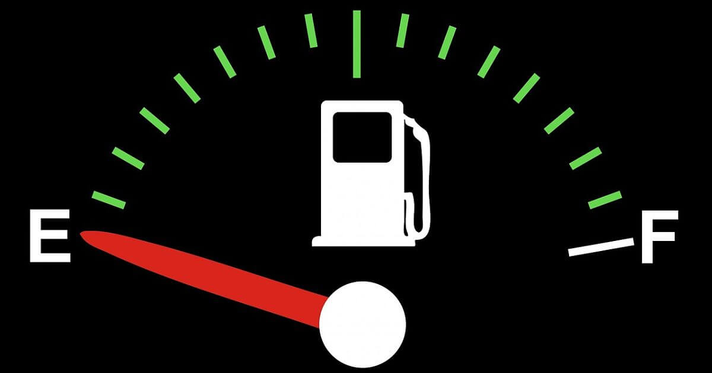
Challenge of Guaranteeing Store Integrity
Limited number of registers prevents store integrity
…
Store r0, [r1]
…
r3 = Load [r2]
…
Assume only 4 registers
Store r2, [r3]
r3
Write-after-read
(WAR) dep
rename?
r4
Notes:
however it is challenging to achieve store integrity for every single store of program due to limited number of registers in the architecture.
[click]
We assume only 4 registers in the architecture, what if we have the second store using register r3.
[click]
Therefore, we have a WAR-dependence again on register r3, which prevents correct replay of the second store.
[click]
We might want to rename r3 defined by load to another register, e.g., r4. However, [click] it is impossible to perform register renaming because we are out of registers.
With that in mind, we propose region level store integrity [click]

Slide 14
Region-Level Store Integrity and Implications
…
Store r0, [r1]
…
…
= Load [r2]
…
Region level register reuse
Region level store persistence
Store r2, [r3]
Safe to overwrite store register across regions
r3
r0
Notes:
Where compiler partitions the program into a series of special regions. [click] The beauty of this approach is each region has freedom to reuse all registers.
Therefore, [click] we can use r0 to breakdown the WAR dependence on register r3 for second region.
But [click] the WAR-dependence on register r0 still happens for the first region, which will corrupt the replay of store. [click] Therefore we need to provide region level store persistence, meaning that all stores must be persisted in the NVM by the end of each region. In doing so, it is safe to overwrite the register r0 across the regions.

Slide 15

Region-Level Store Persistence
Store r0, [r1]
CLWB
…
Store r2, [r3]
CLWB
…
r0 = Load [r2]
…
* CLWB: asynchronously write back store to memory.
PC
ST1
PC
Pipeline
Cache
ST1
ST2
PC
ST2
ST2
NVM
PC
Notes:
we realize region-level store persistence, by inserting CLWB instruction after each store so that its writeback can be done asynchronously.
[click] Processor starts to write first store to cache and [click] writes it back asynchronously while [click] executing following instructions of first region.
[click] Similarly, processor overlaps the persistence of second store ST2 with execution of following instructions. [click] while the ST2's writeback is on the way, program control already reaches the end of the second region; here the processor should wait [click] until the writeback is completed. In this way, each region has freedom to reuse all registers without compromising store replaying. [click]

Slide 16
Recovery Protocol
Stores left behind failure are the root of cause
Replaying them in the wake of failure with store integrity
Due to limited registers, region-level store integrity is
introduced, which in turn requires region-level store
persistence to allow each region to use all registers.
Recovery protocol
Notes:
So far, we talk about region level integrity which requires store persistence. Let’s see how to recover the program status [click]

Slide 17
Just Restart a Power-interrupted Region?
Re-executing the region from its beginning fails to recover program status
…
Store r0, [r1]
…
Store r2, [r3]
…
r0 = Load [r2]
…
r3 = r0 << 2
r0
r0
Power
interrupted
Notes:
Once a power failure happened, we might want to restart the interrupted region from its beginning. However, this naive solution doesn't work.
[click] What if we have a shifting operation in the code? that shifting operation [click] introduces a WAR dependence on register r0 which is overwritten by last load.
[click] Assume a power failure happens in the bottom of second region.
[click] When power comes back,
[click] re-execution of second region from its beginning [click] will write the value to a wrong memory location.
To deal with this issue, we let compiler to generate per-region recovery code which contains only stores of the region.
Let’s see how we recover the program status by leveraging recovery code
[click]

Slide 18
Region-Level Recovery Protocol
* Program Status and NVM status during recovery
…
Store r0, [r1]
…
r2 = r0 << 2
Store r2, [r3]
Store r2, [r3+4]
…
r0 = Load [r2]
…
ST1
Recovery Code
Store r2, [r3]
Store r2, [r3+4]
ST2
NVM
ST1
ST3
access NVFF registers
r2 and r3 in recovery code
Power
interrupted
Notes:
Here, This figure shows the status in the wake of power failure [click]. Here, the first store ST1 is already persisted in NVM.
[click] When power comes back, the registers are first restored, processor then goes to the beginning of recovery code and writes second store ST2 and third store ST3 directly to NVM this time without going through cache [click] [click].
After that, it goes to the failure point to continue program execution. In this way, all status of the program is correctly recovered.
Let’s see how we leverage compiler to implement this idea [click]

Slide 19


Challenge to Generate Store-Integrity Regions
Original
program
Region partitioning
ReplayCache Compiler
Register preservation
(register renaming)
Region
partitioned
program
Notes:
At first glance, region formation appears to be as simple as counting number of stores in program.
However, this is a challenging problem because of circular dependence. As we talked before, when register renaming fails, we have to place a region boundary. Therefore, region partitioning depends on register preservation. On the other hand, register preservation also depends on partitioning. That is because the way register renaming works is affected by where region gets started, which determines the number of stores in the region.
let's see how to break the circular dependence.
[click]

Slide 20
No Store Integrity with Existing Register
Allocation
Pre-RA
Post-RA
Assume only 3 registers
Disjoint live ranges can share the same physical register (x,z)
Live ranges
call, …
x = …
y = …
st y,…
st x,…
…
z = …
p = …
…
q = z<<2
x
call, …
r0 = …
r1 = …
st r1,…
st r0,…
…
r0 = …
r1 = …
…
r1 = r0<<2
y
Register Assignment
x ----> r0
y ----> r1
z ----> r0
p ----> r1
q ----> r1
z
p
q
Notes:
Our compiler [click] treats callsites as initial boundaries to break out circular dependence. Unfortunately, existing register allocation has no way to guarantee store integrity for those initial regions.
Just a little bit background, register allocation uses live ranges of program variables as a basis for allocating them to physical registers.
[click] here, we have 5 live ranges and 3 physical registers. To fully take advantage of high-speed registers, register allocation always shares the same physical register for disjoint live ranges, e.g., x and z can share the same physical register.
After the register allocation [click], we can see the resulting code in the right side. Here, [click] the store operand r0 is overwritten by the following assignment of variable z, because it is assigned to the same register r0, which fails to replay the store due to the WAR dependence leading to incorrect recovery.
Let’s see how our renaming-aware region partitioning solves this problem. [click]

Slide 21
Register-Renaming-Aware Region Partitioning
Store operands must not share same registers with following definitions
Assume 3 registers
Pre-RA
Post-RA
call, …
x = …
y = …
st y,…
st x,…
…
z = …
p = …
…
q = z<<2
call, …
r0 = …
r1 = …
st r1,…
st r0,…
…
r2 = …
r1 = …
…
r1 = r2<<2
x
Register
Assignment
y
x ----> r0
y ----> r1
z ----> r2
p ----> r1
q ----> r1
Extended
live ranges
z
p
4 overlaps
q
Notes:
The crux of store register overwriting problem is store variable shares the same physical register with following definitions.
The most important thing for store integrity is to prevent store operands from being shared with following definitions. [click] To do that, we extend the live ranges of store variables from their last use points.
While extending the live ranges of store operands, we keep checking the number of overlapping live ranges to see if it is greater than the number of available registers. If so, [click] as shown in this example, 4 overlapping but we only have 3 registers, that indicates we might fail to perform register renaming as we’ve seen before. [click] thus, we need to place a region boundary at this point.
Our compiler makes sure register allocation comply with those extended live ranges. [click], here in the the resulting code, we don't have WAR-dependence anymore, [click]. As you can see, currently variable z gets assigned to register r2, which solves the previous problem of incorrect recovery.
We are pretty much done. The only thing left is handling spill code. Let’s see how to solve it. [click]

Slide 22
Spilling-Store-Registers Preservation
call, …
r0 = …
r1 = …
st r1,…
st r0,…
…
r2 = …
r1 = …
…
r1 = r2<<2
Register Assignment
x ----> r0
y ----> r1
z ----> r2
p ----> r1
q ----> r1
st r1,…
stack spill
Notes:
When compiler fails to assign every variable to a register for the third region, [click] it generates a spill store which saves register r1 to a stack slot of current function. Here, we can see [click] This spill store has a WAR-dependence on register r1 which is overwritten by the following shifting operation. To deal with this issue, [click] we just simply place a region boundary right before that shifting operation, thus guaranteeing the store integrity of spilling store as well.

Slide 23
Methodology and Evaluation
Gem5-based NVPSim modeling a single core in-order ARMv7 processor with 8kB 2-way set-associative L1 I/D cache, and 16MB ReRAM as main memory.
LLVM-based region formation.
Mediabench + Mibench.
Notes:
We use a gem5-based nvpsim to model a single core in-order ARMv7 processor with 8KB 2-way set-associative L1 instruction and data cache, and 16MB ReRAM as a main memory. We use mediabench and mibench to evaluate our performance and implement out region formation algorithm on top of LLVM compiler. All applications are compiled by LLVM compiler with –O3 flag.

Slide 24
Speedup over No-cache Baseline with Real Power Trace
11.3
Speedup
8.9
3.3
4.2
NVCache
NVSRAM
WT-VCache
ReplayCache
Notes:
This figure shows the speedup over non-cache baseline with the power trace collected from real energy harvesting system. ReplayCache achieves almost 9x speedup and achieves 76% performance of the ideal design—NVSRAM cache. What interesting is WT-volatile cache is still faster than write back nonvolatile cache even though it uses a WT policy, which again confirms our motivation to enable a volatile cache for achieving high performance.

Slide 25
ILP Efficiency (no power failure)
71%
63%
60%
ILP Eff. (%)
Mediabench
Mibench
Geomean
Notes:
This figure shows our ILP execution efficiency. Average 63% of store persistence latency can be hidden by asynchronously store writeback.

Slide 26
Sensitivity to Cache Size
NVCache
NVSRAM
WT-VCache
Speedup
ReplayCache
10.6
9.1
8.5
7.3
7.6
5.7
6.5
4.6
5.1
4.3
4.3
4.4
3.2
3.5
4.0
3.0
3.2
2.5
2.7
2.9
512B
1KB
2KB
4KB
8KB
* Office power trace
Notes:
This figure shows the sensitivity of ReplayCache performance to cache size. It shows no matter what cache size is, the performance of ReplayCache is closed to that of NVSRAM cache. what's interesting here is NVSRAM achieves higher speedup with large cache compared to ReplayCache. The reason is because NVSRAM cache can benefit from warm cache effect across power failure.

Slide 27

Conclusion
A pure software design for enabling WB volatile cache
with crash consistency
guarantee.
Never amplify writes.
Comparable performance to an ideal NVSRAM cache for realistic power traces.
Unpersisted stores in a
power-interrupted region
Slow
WB-NVCache
Performance Overhead
WT-VCache
NVSRAM
Cache
ReplayCache
Ideal
Expensive
Notes:
In conclusion, replay-cache is the first software-based crash consistency solution to enabling high-performance write back volatile cache for energy harvesting system. Unlike prior logging approaches, it never amplify write operations by replaying potentially un-persisted stores. More importantly, even though replaycache is pure SW-based approach, its performance is on par with ideal NVSRAM hardware design.

Slide 28
Thank You
Q&A
Notes:
Please refer to our paper for more details. Thank you!

Slide 29
Jianping Zeng @Purdue University
(zeng207@purdue.edu)
This presentation and recording belong to the authors. No distribution is allowed without the authors' permission.

Slide 30
Normalized Energy Consumption Breakdown
Cache
Main Memory
Compute
Breakdown[%]
30
20
10
NVCache
NVSRAM
WT-VCache
ReplayCache
* Office power trace
Notes:
This figure shows the resulting energy consumption breakdown, normalized to the same no-cache baseline, using the office power trace. Overall, ReplayCache turns out to be very effective, allowing NVP to spend more energy for computation rather than memory access compared to other schemes. Also, ReplayCache’s energy consumption is on par with the ideal NVSRAM. As a result, ReplayCache enables NVP to make a further forward progress than the no-cache baseline.

Slide 31
Architecture of WT-VCache and WB NVCache
Processor
Processor
Volatile Registers
NVFF
Volatile Registers
NVFF
NVCache
SRAM Cache
write-through
Write-back
NVM
NVM
(a). Write-through (WT)
volatile cache
(b). Write-back (WB) Nonvolatile cache
Notes:
To fairly compare the performance of ReplayCache, we evaluate two other cache designs, WT volatile cache [click, click] which directly write data back to NVM without being cached in cache, and WB nonvolatile [click, click] which uses a nonvolatile memory as a whole cache.

Slide 32
Speedup over Non-cache Baseline
Home trace
Office trace
11.3
11
8.9
8.5
Speedup
3.3
4.2
4.4
3.2
NVCache
NVSRAM
WT-VCache
ReplayCache
Notes:
With power failure, ReplayCache achieves slightly lower speedup, 8.5x, compared that of non-cache baseline
ReplayCache still achieves 76% performance of optimal design.

