Slide 1



Memtis: Efficient Memory Tiering with Dynamic Page Classification and Page Size Determination
SOSP 2023, Koblenz, Germany, October 24, 2023
Taehyung Lee, Sumit Kumar Monga,
Changwoo Min, and Young Ik Eom

Slide 2



Tiered main memory in OS
Physical memory space
Fast tier (Tier 1)
Capacity tier (Tier 2)
DRAM
CXL memory expander / Intel Optane DC PMM
High $/GB
High load/store latency
Low capacity
Low $/GB
Low load/store latency
High capacity
Notes:
In recent years, pros and cons of dram and cxl/optane ~.
Thus, Tiering both types of memory devices is one of the promising solutions ~.
In tiered memory systems, DRAM is usually used as the fast tier ~.
These memory devices are mapped onto the same physical address space and can access memory at a cache line granularity.

Slide 3
Tiered main memory in OS
Physical memory space
Fast tier (Tier 1)
Capacity tier (Tier 2)
Monitor memory accesses
Decide which pages are hot
Migrate hot pages to the fast tier
Goal: maximize the utilization of fast tier memory with hot pages
Notes:
To extract full potential benefit of the fast tier, it is important to ~(goal).
One of the most important things is how hot pages are determined based on what criteria.
Now let’s look at how previous systems do this.

Slide 4
Which pages are hot?
Static access counts as a threshold for hot pages
AutoNUMA:
CPU
DRAM
❶ NUMA hint page fault
CXL/PMEM
Notes:
In most prior approaches, a hotness threshold is deeply entangled in their design.
For example, automatic numa balancing in stock linux scans page table entries and sets a protection bit to make any further accesses to those pages trigger page faults.
Once CPU accesses a page, a numa hint page fault is generated.

Slide 5
Which pages are hot?
Static access counts as a threshold for hot pages
AutoNUMA:
CPU
DRAM
❷ Page promotion
❶ NUMA hint page fault
CXL/PMEM
Notes:
and it tries to migrate faulted page to DRAM if there are free space.

Slide 6
Which pages are hot?
Static access counts as a threshold for hot pages
AutoNUMA: 1 access (considering only access recency)
CPU
DRAM
❷ Page promotion
❶ NUMA hint page fault
CXL/PMEM
Notes:
In other words, autonuma only considers page recency and then the hot threshold is just one in this case.

Slide 7
Which pages are hot?
Static access counts as a threshold for hot pages
AutoNUMA: 1 access (considering only access recency)
TPP [ASPLOS 2023]:
CPU
DRAM
❶ NUMA hint page fault
Active
LRU list
Inactive
LRU list
CXL/PMEM
Notes:
Recently proposed TPP enhances the Autonuma functionalities by decoupling allocation and demotion procedures and by employing more apt hot page detection method which harnesses page’s position in existing LRU lists.
If a page in the inactive list are accessed after scanned, the numa hint page fault occurs

Slide 8
Which pages are hot?
Static access counts as a threshold for hot pages
AutoNUMA: 1 access (considering only access recency)
TPP [ASPLOS 2023]:
CPU
DRAM
❶ NUMA hint page fault
Active
LRU list
Inactive
LRU list
CXL/PMEM
❷ Move to the active LRU list
Notes:
And TPP moves this page to the active list instead of directly promoting it to the fast tier.

Slide 9
Which pages are hot?
Static access counts as a threshold for hot pages
AutoNUMA: 1 access (considering only access recency)
TPP [ASPLOS 2023]:
CPU
DRAM
❶ NUMA hint page fault
❸ NUMA hint page fault after consecutive scanning
Active
LRU list
Inactive
LRU list
CXL/PMEM
❷ Move to the active LRU list
Notes:
If the subsequent numa hint page fault occurs at the same page and this page is still in the active list,

Slide 10
Which pages are hot?
Static access counts as a threshold for hot pages
AutoNUMA: 1 access (considering only access recency)
TPP [ASPLOS 2023]: 2 accesses
CPU
DRAM
❶ NUMA hint page fault
❹ Page promotion
❸ NUMA hint page fault after consecutive scanning
Active
LRU list
Inactive
LRU list
CXL/PMEM
❷ Move to the active LRU list
Notes:
TPP promotes it to the fast tier. So we can say that the hot threshold of TPP is two.

Slide 11
Which pages are hot?
Static access counts as a threshold for hot pages
AutoNUMA: 1 access (considering only access recency)
TPP [ASPLOS 2023]: 2 accesses
HeMem [SOSP 2021]: hot threshold → 8 load accesses or 4 store accesses cooling threshold → 18 accesses (monitored through PEBS)
Notes:
Next example is HeMem,~
Pages with access counts beyond the hot threshold are promoted to the fast tier. And whenever the access count of any page reach the static cooling threshold, HeMem halves the access counts of all pages to ensure the freshness of the hot set.

Slide 12

Which pages are hot?
Static access counts as a threshold for hot pages
AutoNUMA: 1 access (considering only access recency)
TPP [ASPLOS 2023]: 2 accesses
HeMem [SOSP 2021]: hot threshold → 8 load accesses or 4 store accesses cooling threshold → 18 accesses (monitored through PEBS)
Are such static approaches sufficient for
transparent management of tiered memory?
Notes:
As you may know, the quality of hot and cold detection critically affects the effectiveness of tiered memory systems, but many recent systems still adopt static criteria for hotness detection. In this step, our question is

Slide 13

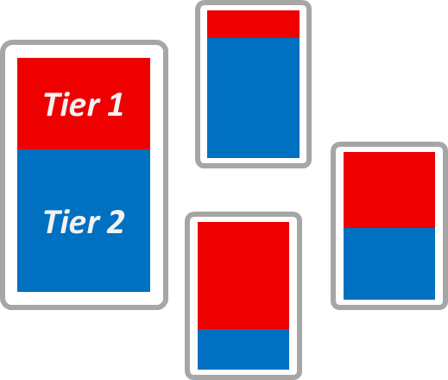
Criticality of hotness detection
Diverse set of applications
Various memory configurations
Notes:
There is a diverse set of applications in modern cloud and datacenter environments and the emerging memory functionality like CXL memory pooling allows for even more flexibilities in memory setups. So, to make the system efficient and transparent, tiered memory management method should perform well across a diverse range of applications and memory configurations.

Slide 14
Criticality of hotness detection
Case 1: hot set size > fast tier size
Diverse set of applications
Various memory configurations
Fast tier
Capacity tier
Notes:
There are two typical cases which hamper the effective utilization of the fast tier memory. The first case happens when the identified hot set size exceeds the fast tier memory. In this case, some subset of hot pages will be placed in the capacity tier. The problem is that such subset of hot pages has arbitrary hotness. It means hot pages accessed very frequently also could be placed in the capacity tier.
Thus, it is important to maintain hot set size below the fast tier size.

Slide 15
Criticality of hotness detection
Case 1: hot set size > fast tier size
Case 2: hot set size < fast tier size
Diverse set of applications
Various memory configurations
Fast tier
Capacity tier
Notes:
The second case happens when the hot set size is much lower than the fast tier size. In this case, we can ensure that very hot pages are placed in the fast tier. However, the remainder capacity of the precious fast tier may be wasted with arbitrary cold pages. Thus, it seems good to maintain the hot set size as close as possible to the fast tier size.
Unfortunately, it is impossible with static hotness detection.

Slide 16
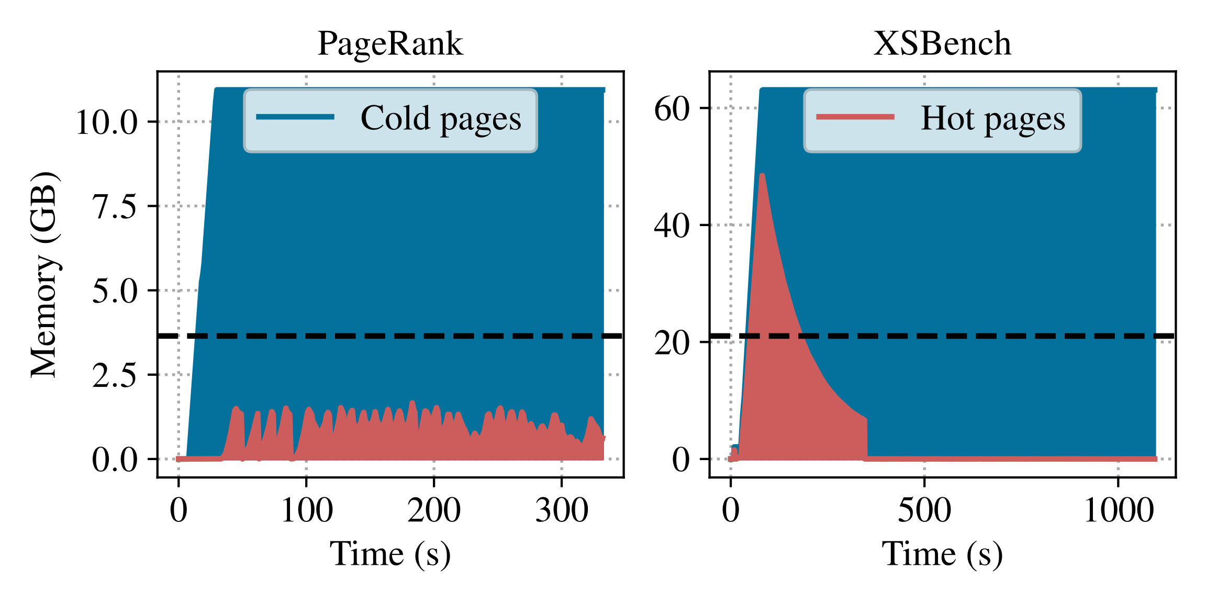
Criticality of hotness detection
HeMem: Hot/cold memory footprint
DRAM + NVM tiered memory system
Notes:
We examined actual hot/cold memory footprint by using HeMem and two applications

Slide 17
Criticality of hotness detection
HeMem: Hot/cold memory footprint
DRAM + NVM tiered memory system
DRAM size
Notes:
The black dashed line denotes the dram size allocated to each application.

Slide 18
Criticality of hotness detection
HeMem: Hot/cold memory footprint
DRAM + NVM tiered memory system
DRAM size
Notes:
In case of PageRank, HeMem consistently classifies 1.5GB of memory as hot so nearly a half of the fast tier is underutilized with arbitrary cold pages during entire duration.

Slide 19
Criticality of hotness detection
HeMem: Hot/cold memory footprint
DRAM + NVM tiered memory system
DRAM size
Notes:
In XSBench, the hot set size initially exceeds the fast tier size roughly for 130s and then decreases rapidly. Such a significant drop of the hot set is caused by a few number of pages which are excessively accessed and then incurs frequent cooling operations.
These results clearly show that the static criteria for hotness detection is not optimal. One can try different threshold values to get the best result for applications, however, it is unlikely that a single threshold will work well across different workloads.

Slide 20
Our solution: Memtis
Goals
Maximize the fast tier utilization with truly hot pages
Work well for diverse set of applications and memory configurations
Notes:
Our solution is MEMTIS.. MEMTIS enables to make the best use of the fast tier with truly hot pages in more transparent and efficient ways. There are three main design components in MEMTIS.

Slide 21
Our solution: Memtis
Goals
Maximize the fast tier utilization with truly hot pages
Work well for diverse set of applications and memory configurations
Fine-grained, lightweight access tracking
Notes:
Firstly, MEMTIS tracks memory accesses by using hardware event-based sampling techniques for scalable and fine-grained access tracking. And it maintains its CPU overhead for access tracking below a predefined threshold.

Slide 22
Our solution: Memtis
Goals
Maximize the fast tier utilization with truly hot pages
Work well for diverse set of applications and memory configurations
Fine-grained, lightweight access tracking
Histogram-based hot set classification
Notes:
Secondly, MEMTIS harnesses the overall access frequency distribution of pages in determining page hotness. It collects distribution by using page access histogram and properly fills the fast tier with very hot pages.

Slide 23
Our solution: Memtis
Goals
Maximize the fast tier utilization with truly hot pages
Work well for diverse set of applications and memory configurations
Fine-grained, lightweight access tracking
Histogram-based hot set classification
Skewness-aware page size determination
Notes:
Lastly, Using a huge page is not always good to performance because not all subpages in a huge page are evenly accessed. Thus, MEMTIS automatically balances the address translation cost and memory access cost by dynamically deciding the page size.

Slide 24
Our solution: Memtis
Goals
Maximize the fast tier utilization with truly hot pages
Work well for diverse set of applications and memory configurations
Fine-grained, lightweight access tracking
Histogram-based hot set classification
Skewness-aware page size determination
Notes:
In this talk, I will introduce how MEMTIS tracks memory accesses and determines hot pages.

Slide 25

Fine-grained, Lightweight memory access sampling
Using processor event-based sampling (PEBS): LLC load miss and store inst.
Sampling thread of Memtis: ksampled
PEBS ring buffer
CPU core
Huge
Page
i+1
head
Physical memory
Huge
Page i
PMU
tail
Notes:
MEMTIS uses PEBS and samples two types of events: llc load miss and store instruction. We initially set the sampling interval to once every 200 for llc load misss and once every 100,000 for store instructions.

Slide 26
Fine-grained, Lightweight memory access sampling
Using processor event-based sampling (PEBS): LLC load miss and store inst.
Sampling thread of Memtis: ksampled
PEBS ring buffer
CPU core
head
Huge
Page
i+1
Sample
Physical memory
Huge
Page i
PMU
Event sampling
tail
Notes:
The sampled events are recorded in a PEBS ring buffer

Slide 27
Fine-grained, Lightweight memory access sampling
Using processor event-based sampling (PEBS): LLC load miss and store inst.
Sampling thread of Memtis: ksampled
PEBS ring buffer
CPU core
head
Huge
Page
i+1
Sample
Physical memory
Huge
Page i
PMU
Address,
Process ID,
…
Event sampling
tail
Notes:
and each sample contains exact memory address that a corresponding event happens.
Our sampling thread called ksampled reads this buffer and handles a sample.

Slide 28


Fine-grained, Lightweight memory access sampling
Using processor event-based sampling (PEBS): LLC load miss and store inst.
Fine-grained access tracking for huge pages
Sampling thread of Memtis: ksampled
PEBS ring buffer
CPU core
head
Huge
Page
i+1
Sample
$$P_{i}++$$
Physical memory
Huge
Page i
PMU
Address,
Process ID,
…
Event sampling
tail
$${Subpage}_{ij}++$$
Notes:
It first finds a sampled physical page and updates the access count. If this page is huge page, MEMTIS updates both the access count of the huge page and the access count of a subpage inside the huge page. Note that The access information for subpages is only used by our page size determination procedure.

Slide 29
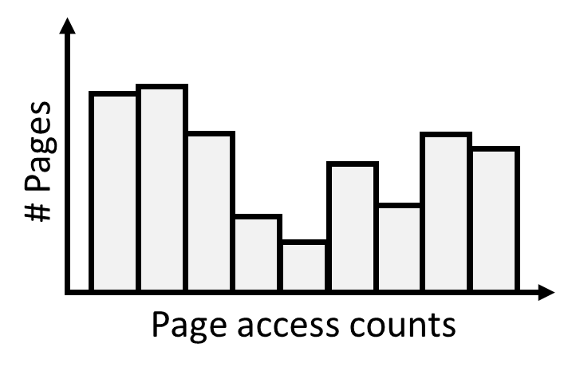
Fine-grained, Lightweight memory access sampling
Using processor event-based sampling (PEBS): LLC load miss and store inst.
Fine-grained access tracking for huge pages
Building page access histogram
Sampling thread of Memtis: ksampled
PEBS ring buffer
CPU core
head
Huge
Page
i+1
Sample
$$P_{i}++$$
Physical memory
Huge
Page i
PMU
Address,
Process ID,
…
Event sampling
tail
$${Subpage}_{ij}++$$
Notes:
Then, to obtain the memory access distribution of pages, we update the page access histogram whenever we handle samples.

Slide 30
Fine-grained, Lightweight memory access sampling
Using processor event-based sampling (PEBS): LLC load miss and store inst.
Fine-grained access tracking for huge pages
Building page access histogram
Sampling thread of Memtis: ksampled
PEBS ring buffer
CPU core
head
Huge
Page
i+1
Sample
Each bin → a specific range of page access counts (exponential scale)
E.g., bin-N → [2^{n}, 2^{n+1})
$$P_{i}++$$
Physical memory
Huge
Page i
PMU
Address,
Process ID,
…
Event sampling
tail
$${Subpage}_{ij}++$$
Notes:
Each bin in the histogram represents a specific range of access counts which follows an exponential scale; 𝑛-th bin has the range of access counts from two to the power of n to two to the power of n+1, and the last bin has no upper bound on it.

Slide 31
Fine-grained, Lightweight memory access sampling
Using processor event-based sampling (PEBS): LLC load miss and store inst.
Fine-grained access tracking for huge pages
Building page access histogram
The value (y-axis) of each bin →
the number of distinct pages (counting at 4KB granularity) in the access count range
Sampling thread of Memtis: ksampled
PEBS ring buffer
CPU core
head
Huge
Page
i+1
Sample
$$P_{i}++$$
Physical memory
Huge
Page i
PMU
Address,
Process ID,
…
Event sampling
tail
$${Subpage}_{ij}++$$
Notes:
The value (y-axis) of each bin denotes the number of distinct pages (counting at 4KB granularity) in the access count range.
Thus, we can know the total number of pages which has the specific range of access count through this histogram.

Slide 32
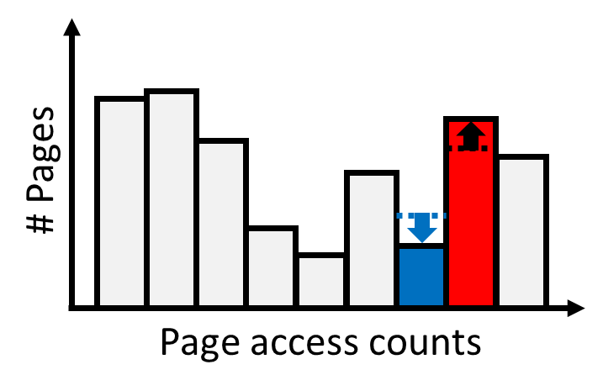
Fine-grained, Lightweight memory access sampling
Using processor event-based sampling (PEBS): LLC load miss and store inst.
Fine-grained access tracking for huge pages
Building page access histogram
Sampling thread of Memtis: ksampled
PEBS ring buffer
CPU core
head
Huge
Page
i+1
Sample
$$P_{i}++$$
Physical memory
Huge
Page i
PMU
Address,
Process ID,
…
Event sampling
tail
$${Subpage}_{ij}++$$
Notes:
Updating the page access histogram is very efficient. Whenever ksampled updates the access count of a page, it checks whether the new access count falls into a different bucket and updated histogram if needed.

Slide 33
Fine-grained, Lightweight memory access sampling
Using processor event-based sampling (PEBS): LLC load miss and store inst.
Fine-grained access tracking for huge pages
Building page access histogram
Dynamically adjusts the sampling period → keep the CPU usage < 3%
Sampling thread of Memtis: ksampled
PEBS ring buffer
CPU core
head
Huge
Page
i+1
Sample
$$P_{i}++$$
Physical memory
Huge
Page i
PMU
Address,
Process ID,
…
Event sampling
tail
$${Subpage}_{ij}++$$
Notes:
ksampled periodically calculates the exponential moving average of its CPU usage and adjusts the sampling period to meet the upper limit of its CPU usage. By default, this limit is set to 3% of a single core.
We observed that, across all our evaluated benchmarks, ksampled only consumes roughly 2% of a single CPU time with 0.9% of performance overheads on average

Slide 34
Histogram-based hot set classification
Determining hot/warm/cold thresholds
# Pages
Page access counts
Fast tier (Tier 1)
Capacity tier (Tier 2)
Notes:
MEMTIS established hot, warm, and cold thresholds by using the generated histogram.
And we used the bin indexes as thresholds in our system.
Its goal is to maintain the hot set size as close as possible to the fast tier size

Slide 35
Histogram-based hot set classification
Determining hot/warm/cold thresholds
# Pages
H
Page access counts
Fast tier (Tier 1)
Capacity tier (Tier 2)
Notes:
To determine the hot threshold, MEMTIS sums the total size of pages fallen into each bin in the histogram from highest to lowest indexes.

Slide 36
Histogram-based hot set classification
Determining hot/warm/cold thresholds
# Pages
H
H
Page access counts
Fast tier (Tier 1)
Capacity tier (Tier 2)

Slide 37
Histogram-based hot set classification
Determining hot/warm/cold thresholds
# Pages
H
H
H
Page access counts
Fast tier (Tier 1)
Capacity tier (Tier 2)

Slide 38
Histogram-based hot set classification
Determining hot/warm/cold thresholds
Arbitrary set of hot pages (including very hot pages) can be placed in the capacity tier memory
# Pages
H
H
H
H
Page access counts
Fast tier (Tier 1)
Capacity tier (Tier 2)
Notes:
If the cumulative size of the hot set exceeds the fast tier size, an arbitrary subset of hot pages can be placed in the capacity tier. To avoid such an undesirable state, we set the hot threshold as the bin index preceding this point

Slide 39
Histogram-based hot set classification
Determining hot/warm/cold thresholds
Hot pages are always placed in fast tier memory
# Pages
H
H
W
H
Page access counts
Fast tier (Tier 1)
Capacity tier (Tier 2)
Notes:
such that the fast tier can accommodate all hot pages.

Slide 40
Histogram-based hot set classification
Determining hot/warm/cold thresholds
# Pages
H
H
W
H
Page access counts
Fast tier (Tier 1)
Capacity tier (Tier 2)
Notes:
The number of pages fallen into this bucket is spanning both memory tiers.
We classify them as warm.

Slide 41
Histogram-based hot set classification
Determining hot/warm/cold thresholds
No promotion for warm pages
No demotion unless there are cold pages in fast tier and Memtis needs to secure some free space
# Pages
H
H
W
H
Page access counts
Fast tier (Tier 1)
Capacity tier (Tier 2)
Notes:
The warm pages quickly transition to either hot or cold states, so we don’t allow them to be promoted or demoted unless they should inevitably be demoted for securing free space. It helps to prevent the ping-pong migration behavior like demotion right after promotion.

Slide 42
Histogram-based hot set classification
Determining hot/warm/cold thresholds
C
C
# Pages
C
H
H
W
C
H
C
Page access counts
Fast tier (Tier 1)
Capacity tier (Tier 2)
Notes:
Finally, The remaining buckets are classified as cold and all pages belonging to those classes are placed in the capacity tier.

Slide 43
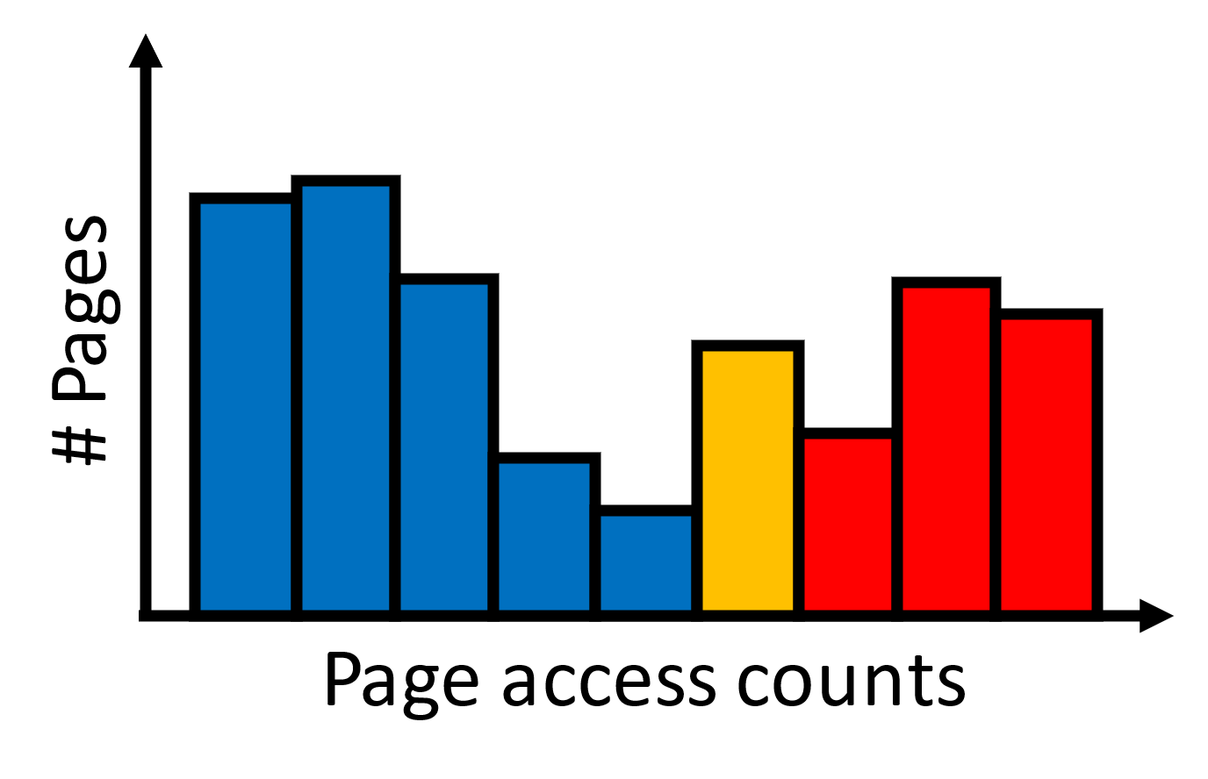
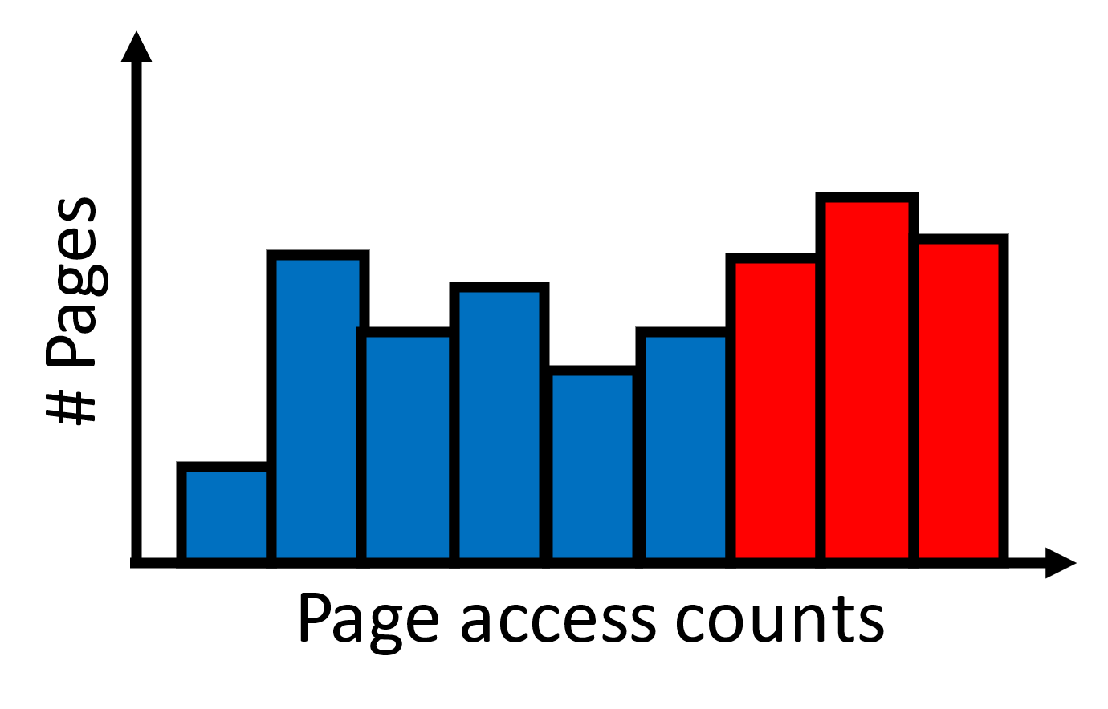
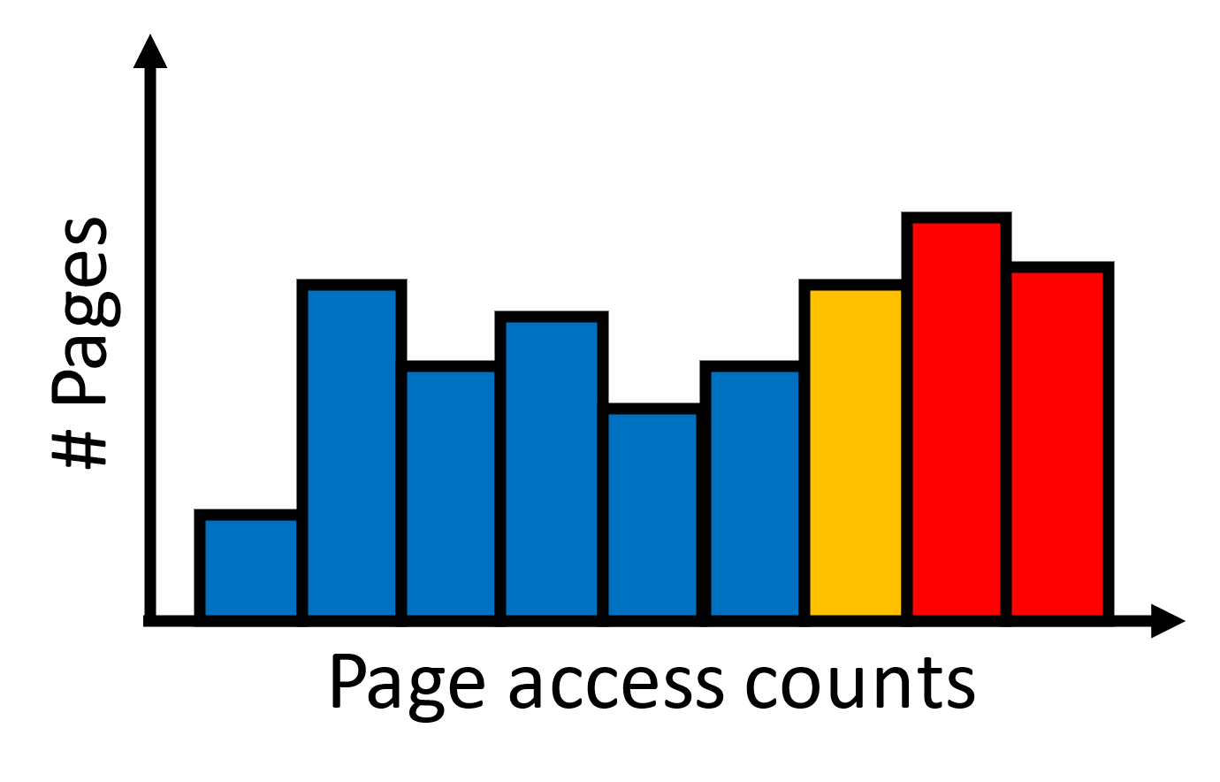
Histogram-based hot set classification
Threshold adaptation
Maintain the hot set size not to exceed the size of fast tier memory
Notes:
If we don’t adjust the hot threshold, the hot set size will exceed the fast tier size as pages are accessed and the histogram is accordingly updated.
Thus, we periodically adjust the hot threshold to maintain the hot set size below the size of the fast tier.

Slide 44
Histogram-based hot set classification
Threshold adaptation
Maintain the hot set size not to exceed the size of fast tier memory
Periodic cooling
Decay the impact of old accesses and give more weight to recent accesses
Exponential moving average of page access counts with a decay factor of 0.5 (halves every page’s access count)
Notes:
In addition, MEMTIS performs cooling for pages and histograms to ensure the freshness of memory accesses.
Our cooling process halves the access counts of all pages, ~

Slide 45
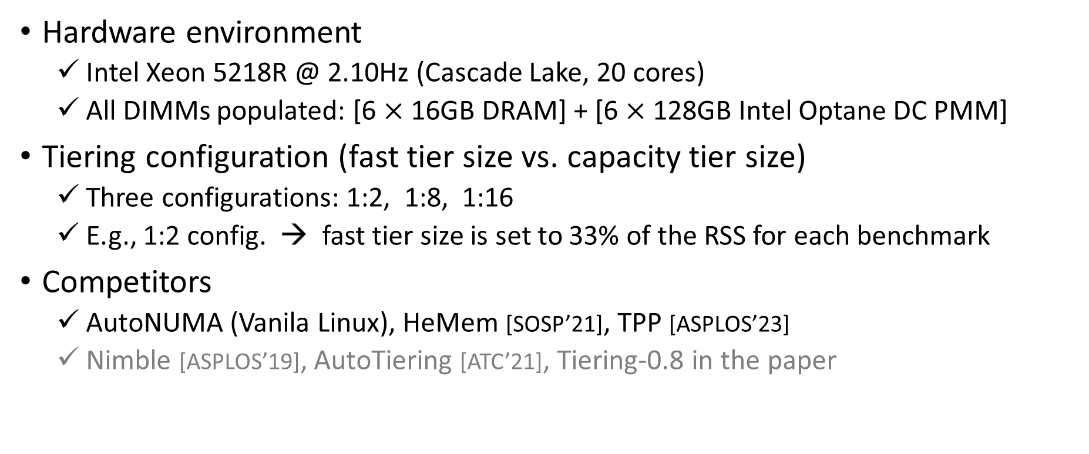
Evaluation setup
Hardware environment
Intel Xeon 5218R @ 2.10Hz (Cascade Lake, 20 cores)
All DIMMs populated: [6 $×$ 16GB DRAM] + [6 $×$ 128GB Intel Optane DC PMM]
Tiering configuration (fast tier size vs. capacity tier size)
Three configurations: 1:2, 1:8, 1:16
E.g., 1:2 config. → fast tier size is set to 33% of the RSS for each benchmark
Competitors
AutoNUMA (Vanila Linux), HeMem [SOSP’21], TPP [ASPLOS’23]
Nimble [ASPLOS’19], AutoTiering [ATC’21], Tiering-0.8 in the paper
Notes:
To evaluate MEMTIS, we constructed a tiered memory system by using DRAM and Intel Optane DC persistent memory modules on our cascade lake server.
To demonstrate the effectiveness of MEMTIS, we conducted experiments with three distinct tiering configurations, each defined by the ratio of fast tier to capacity tier sizes. These configurations included 1:2, 1:8, and 1:16 settings, allowing us to explore a range of memory setup scenarios and their impact on system performance.

Slide 46
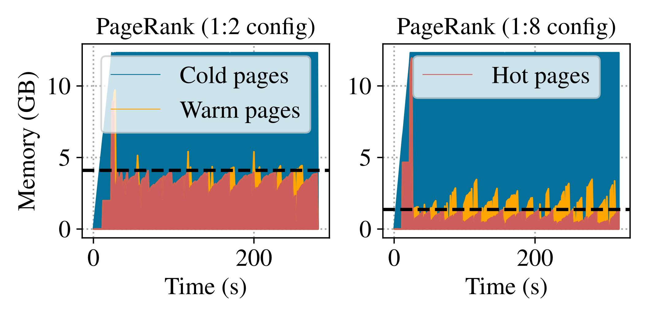
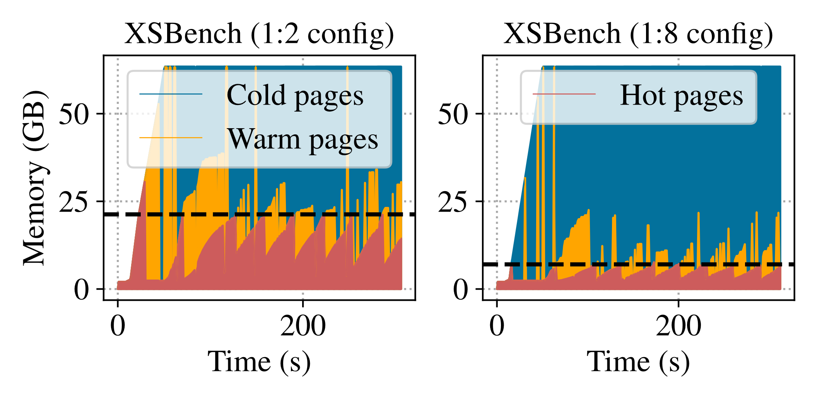
Page hotness identification
HeMem
Memtis
Notes:
We examined the amount of hot, warm, and cold memory identified by MEMTIS, especially focusing on two different applications and two distinct tiering configurations. Unlike HeMem, MEMTIS adjusts the hot set size to align with changes in fast tier sizes. This adaptability proves to be effective across both applications.

Slide 47
Performance comparison
Normalized to all-NVM performance
Normalized performance
Normalized performance
Normalized performance
Notes:
Now we show the performance comparison to existing tiering systems.
각각 설명~
One interesting point is that even under 1:16 setting, memtis shows similar performance to or outperforms other systems like this (click)
The performance of AutoNUMA in XSBench at 1:2 setting is slightly better than that of memtis. ~

Slide 48
Scalability to memory sizes
Increasing the RSS of Graph500 from 128GB to 690GB (Fast tier size: 64GB)
PEBS-based systems become more effective as the RSS increases
Normalized performance
Resident set size
Notes:
We evaluate Memtis by increasing the RSS of Graph500 from 128GB to 690GB. The fast tier size is 64GB in all experiments.
Autonuma has no performance improvements in all cases.
TPP works well when the RSS is 128GB, but its effectiveness decrease as the RSS increases. (~due to pt scanning)
HeMem uses PEBS, thereby ~~
MEMTIS uses PEBS and optimally classifies page hotness. Thus, it always shows superior performance in all cases.
These results clearly demonstrate the effectiveness of PEBS and the importance of precise hotness classification.

Slide 49
Conclusion
Efficient and transparent management of tiered memory should
Track memory access in a scalable way
Consider both diverse memory access patterns and memory configurations
Maintain the hot set size as close as possible to the fast tier size
Memtis
Performs memory access tracking in a lightweight, fine-grained manner
Adjusts hotness thresholds based on the page access distribution
(Dynamically decides page size for better utilization of fast tier memory)
Thank you!
Notes:
To summarize, ~
MEMTIS does all these things and thereby enables efficient and transparent management of tiered memory.
Thank you!.

