Slide 1




Retina: Cross-layered Key-Value Store for Computational Storage
R. Madhava Krishnan¹, Naga Sanjana Bikonda^{1,2}, Shashwat Jain¹, Wook-Hee Kim³
Hamid Hadian¹, Vishwanath Maram², Changwoo Min^{1,4}
1
2
3
4
Notes:
Thank you for your introduction. Today I will be presenting Retina which is a collaborative work between Virginia tech and Samsung’s memory solutions lab.

Slide 2
Agenda
Motivation
System Overview
Retina: Cross Layered Key-Value Store
Retina: Dynamically compostable computational pipeline
Evaluation
Notes:
Here is the agenda for the rest of the talk. I will first present the motivation, system overview, our contributions with Retina and finally the evaluations

Slide 3


Motivation
Data has been growing exponentially in the recent years.
Massive data generation increased data movement.
Data movement in system design is not inherently bad but excessive or in-efficient data movement can lead to problems
Performance impacts
Cost
impacts
Increased latency
Resource bottlenecks
Scalability Challenges
Power
Infrastructure
Maintenance
Notes:
We have been experiencing an exponential data growth in the past decade. And this massive data generation results in increased data movement. Although data movement is not inherently a bad thing, excessive or in-efficient movement can cause problems. We can categorize the challenges into two broad sections, performance impacts and cost impacts.
Although we have seen storage media and network growing rapidly, similar is the trend in data generation with bigger AI models, big data applications and so on.
With all the increased data movement, we see increased latencies, network bottlenecks, cpu bottlenecks and issue with scalability. Thus affecting performance
On the cost impacts, inefficient data handling can result in increased power consumption, increased need for infrastructure and maintenance

Slide 4
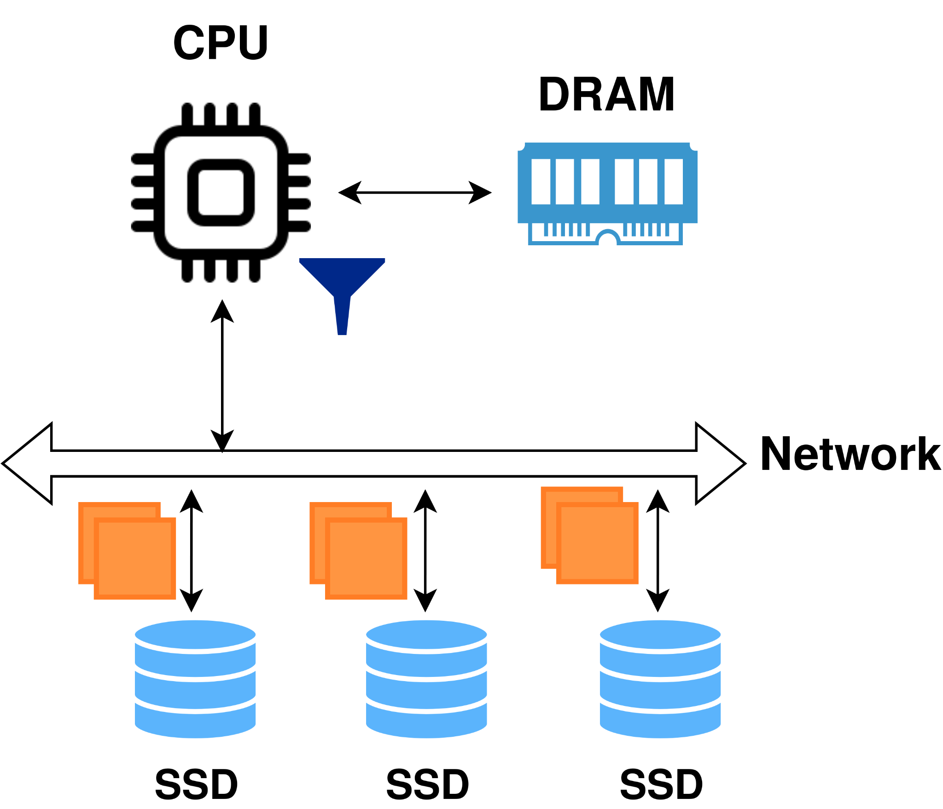
Challenges of Data Movement
Conventional Data flow
Data filtering on CPU
Input data is in the order of terabytes
DRAM is not big enough to store it all
Only small fraction of data is relevant
Results:
Wasting CPU cycles
Ineffective use of DRAM
Causes network bottlenecks
increases power utilization
Performance degradation
Large unfiltered data
Notes:
To better understand the challenges of data movement, let's consider a simple example of data filtering on CPU, for example a database scan operation with low selectivity and huge input dataset,
The general protocol is that the CPU reads terabytes of raw input data from multiple storage devices to run filtering
DRAM is not big enough to store all the data at once thus data is fetched in batches
But only a small fraction of data is actually relevant to the request
Thus resulting in wasting CPU cycles, ineffective using DRAM, network bottlenecks and most importantly increasing power utilization by increasing data movement.

Slide 5
How to address challenges of Data Movement?
Move compute to data - Near Data Processing
Computational Storage - Storage design that enables Near-data processing
Attach compute source inside the storage
Data is internally transferred inside the storage - high internal speed
Reduces the number of network hops
Computational Storage at rescue!
Notes:
So how do we address the challenges of data movement?
If data movement is the culprit here, why don’t we change the design paradigm and move the compute to the data with Near Data processing.
One way to realize this could be with computational storage,
Where a compute source is attached inside the storage
With this the data is internally transferred inside the storage using high internal bandwith
Thus reducing overall network hops

Slide 6
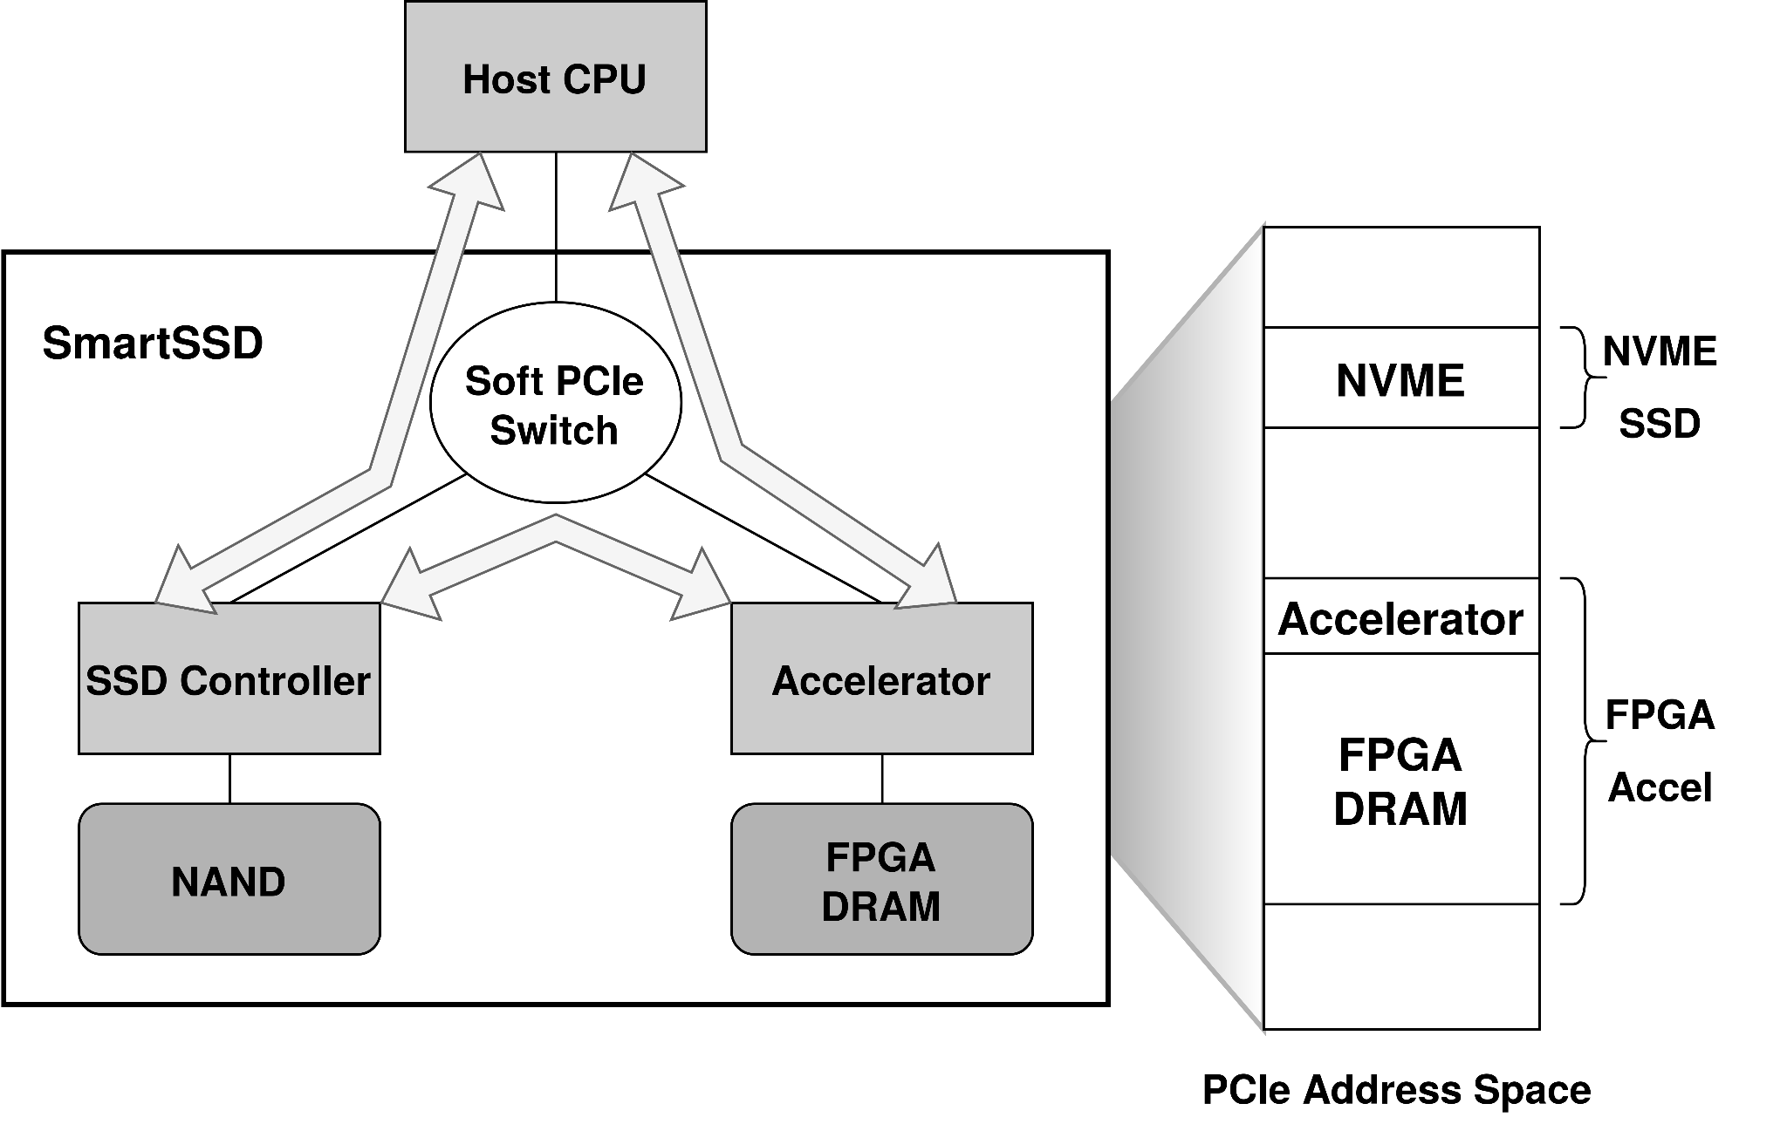
Computational Storage Drive(CSD): Samsung SmartSSD
Performant on-storage compute
Xilinx FPGA - embarrassingly parallel accelerator
High internal bandwidth
Data transfer across the internal data path called ‘Peer-to-Peer’ transfer.
Internal bandwidth is 2.5x the host to device bandwidth
Source: https://ieeexplore.ieee.org/document/6558444
Notes:
In our work, we used Samsung SmartSSD 1.0 as our choice of computational storage and here is a brief introduction.
SmartSSD 1.0 is launched with a Xilinx Kintex FPGA to bring computational storage capabilities in a standard form factor
Internally, the computational storage uses the on-platform PCIe switch and FPGA memory to route data transfers between the NVMe SSD and FPGA.
The data movement across the internal data path is termed peer-to-peer (P2P) transfer.
With the help of peer to peer transfer, SmartSSD provides an higher internal bandwidth faster than the network bandwidth

Slide 7
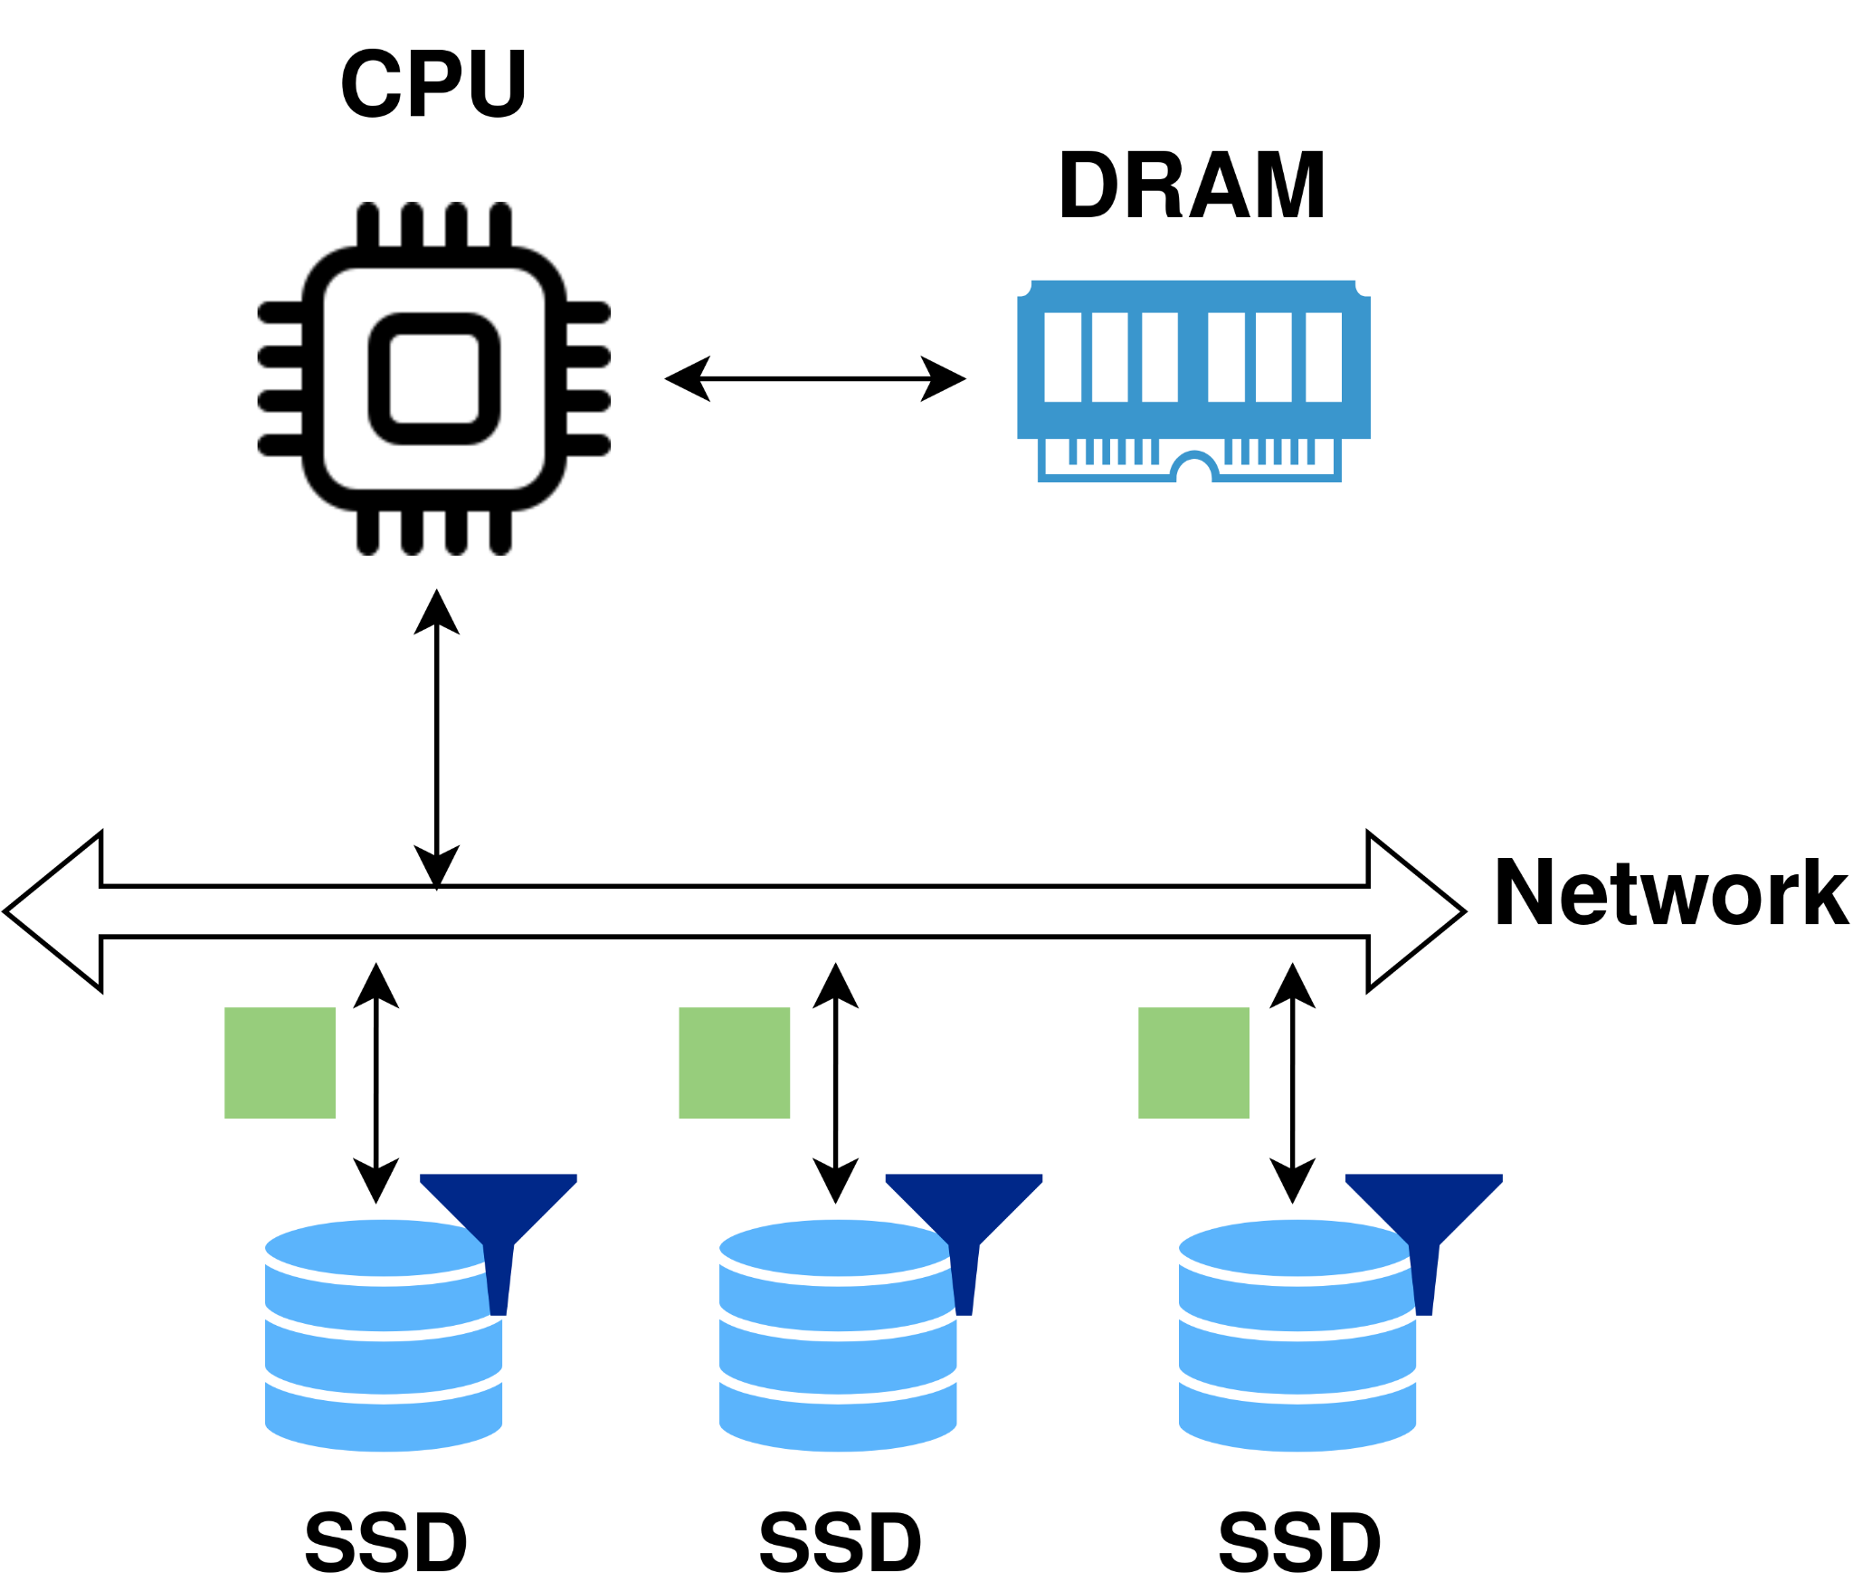
Redesign with Computational Storage Drive(CSD)
Computation Storage flow
Data filtering offloaded to Computational storage(CSD)
Large input data is filtered inside CSD
Small output data sent to CPU
Results:
Improved performance
Reduces resource bottlenecks
Minimized data transfer costs & power consumption
Better scalability with increasing data
Small filtered
data
CSD
CSD
CSD
Notes:
Now let’s see how we can redesign our filtering example with computation storage,
As you can see in the system diagram here, we have replaces all the secondary storage with computational storage drives(CSD for short) and we have offloaded the filtering function onto each of the computational storage.
To handle the filtering, the raw input data is moved from the storage media to the accelerator inside the CSD
The accelerator performs the filtering and only return a small fraction of filtered data back to the CPU
Thus resulting in,
Improved latency,
Reduces resource bottlenecks
Minimized power consumption
Better scalability

Slide 8
Is CSD ready to use?
Can applications plug-in CSD to benefit from Near Data Computation?
No, applications need to use low-level HDL to offload compute onto accelerators inside CSD
End users don’t have access to a framework to handle the entire data path seamlessly
Notes:
It all sounds wonderful. But It's worth mentioning that, near data computation is not a new concept. And it has been around for more than two decades. But the important question is why isn’t is it widely used? Let’s consider Computational Storage, a simple question would be, Is easy for the end-user to use computational storage?
The answer is no,
Application need to deal with low level hardware description languages to offload compute
And there is no high level programming stack or framework available to the user to handle the entire data path seamlessly

Slide 9
What do we need?
Framework that enables users to exploit the benefits of CSD,
Improved performance - latency, throughput
Reduction of resource bottlenecks - CPU utilization
Improve the programmability of CSDs,
Provide application the flexibility to seamlessly compose and offload compute in run time
Retina: End-to-End (Storage+Compute) Framework
Notes:
So what do we need to bridge this gap,
We need a framework that allows users to exploit the benefits of computational storage
And that improves programmability
Thus we propose Retina an end-to-end storage and compute Framework

Slide 10
Agenda
Motivation
System Overview
Retina: Cross Layered Key-Value Store
Retina: Dynamically compostable computational pipeline
Evaluation
Notes:
Up next I will discuss the system overview

Slide 11
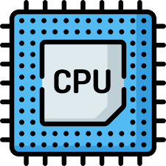
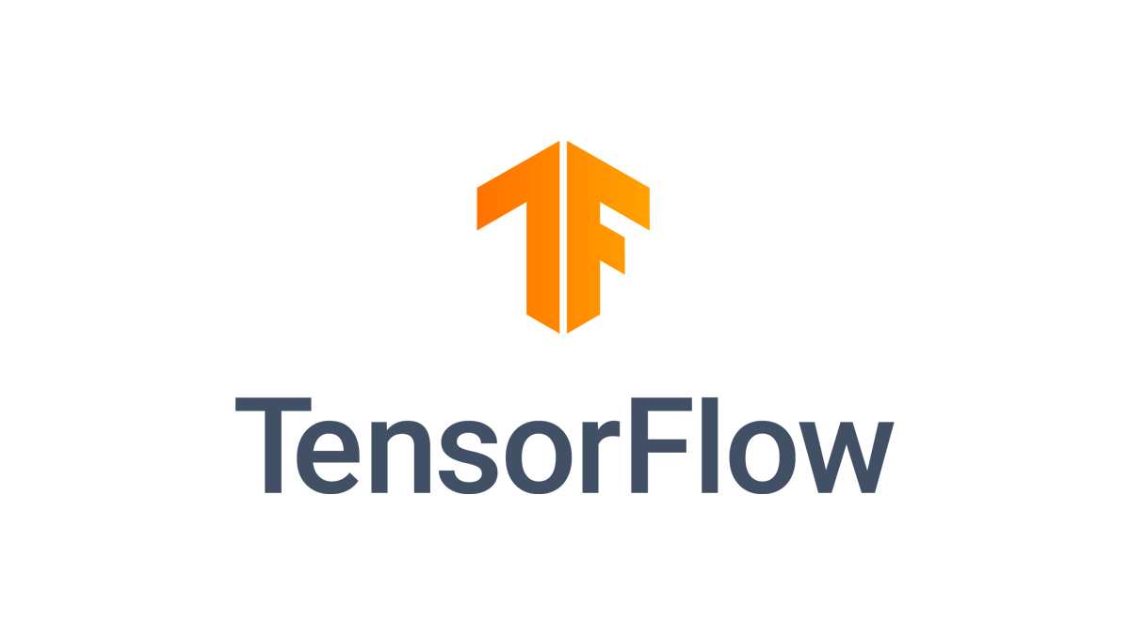

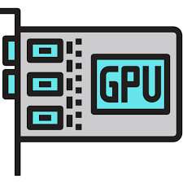
Data Pipeline Today
Storage stack
(e.g., File System, Key-Value Store)
Application
(e.g., TensorFlow)
1. Indexing
Find out where the
data is located
2. Retrieval
Fetch the data
from the storage
3. Compute
Process the data
open( “cat02.jpg” )
read( “cat02.jpg” )
Pre-processing
jpg_decode(...)
resize(...)
crop(...)
mirror(...)
DNN model training
model_training(...)
DNN Model Training
Database scan, filtering, and
aggregation
How should the data pipeline be re-designed for Computational Storage?
Notes:
Before diving in the details of the retina, let's think about how we use the data,
Locate the data
Fetch the data from secondary storage like an SSD
Finally process the data
Typically the indexing and retrieving is handled by the storage stack such as fs or storage engine. Once the data is ready, it is fed into an application such tensorflow to say run a classification model
Given we have all the basic building blocks of a data pipeline, now the question is how do we redesign with CSD.

Slide 12
RETINA: End-to-End (Storage+Compute) Framework
RETINA = Key-Value Store + Computational Pipeline on CS
Application
1. Indexing
Find out where the
data is located
2. Retrieval
Fetch the data
from the storage
3. Compute on CS
App-provided
compute functions
4. Compute on xPU
Process the data
We propose RETINA, an end-to-end framework for Computational Storage
Data management: Cross-Layered RETINA Key-Value Store
Indexing, crash consistency, concurrency, etc.
At-Rest data processing: Dynamically Composable Computational Pipeline
Offload computation to Computational Storage
Chain compute functions as requested
Notes:
Our answer is Retina,
With Retina the data pipeline mostly remains the same with slight changes,
Like earlier, we first do the indexing then retrieve the data and before returning the data to the host we perform some compute on the CSD. Finally the partially processed data is sent to the host to finish computing
Retina cover the first three stages of the pipeline with its end-end framework for computational storage
Essentially with Retina we propose two things,
The first is a Data management engine : which is a cross layered key-value store that supports all feature of a datastore such as indexing, crash consistency etc
The seconds is a data processing engine: which allows the user to compose compute pipelines on the fly

Slide 13
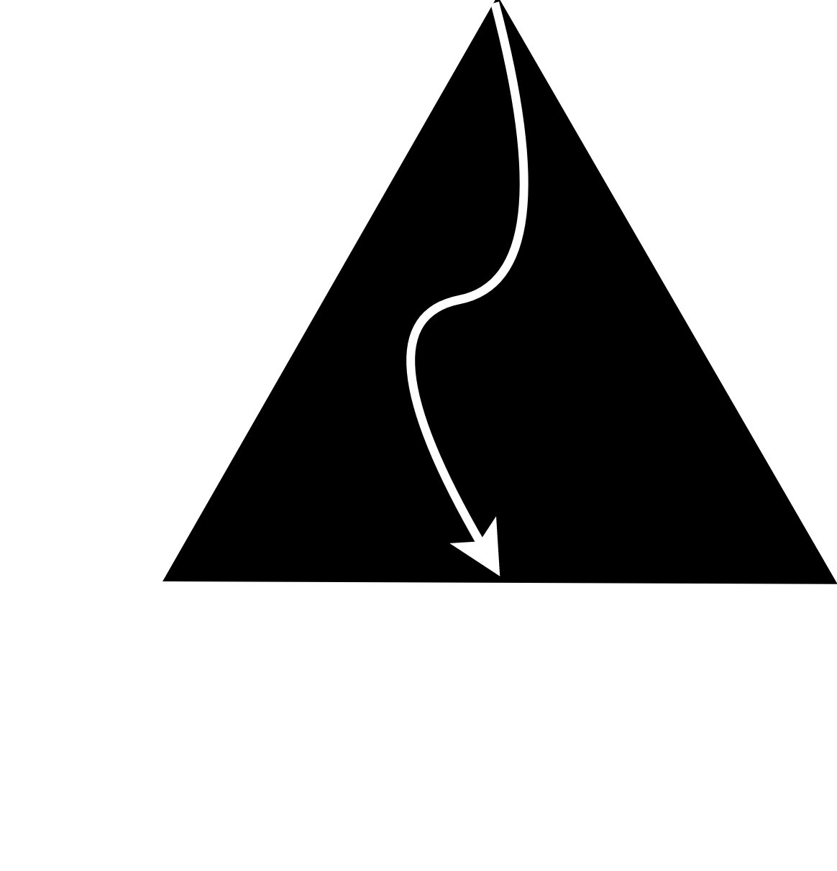
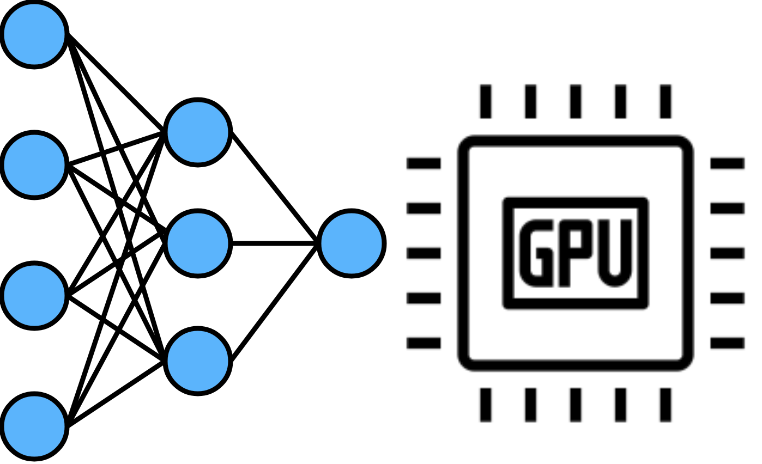
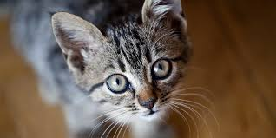
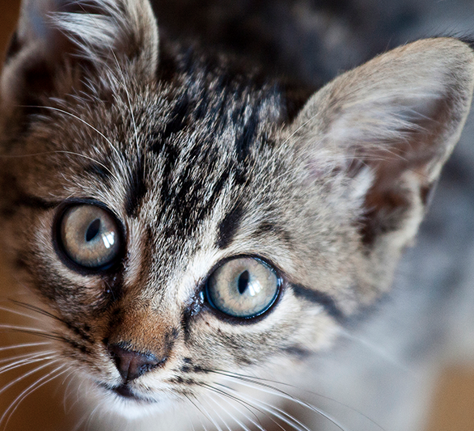
RETINA: End-to-End (Storage+Compute) Framework
Lookup(“cat02.jpg”, [jpg_decode,resize,crop,mirror])
RETINA = Key-Value Store + Computational Pipeline on CS
Application
1. Indexing
Find out where the
data is located
2. Retrieval
Fetch the data
from the storage
3. Compute on CS
App-provided
compute functions
4. Compute on xPU
Process the data
jpg_decode(...)
resize(...)
crop(...)
mirror(...)
Advantages of RETINA approach
Exploit the fast internal (peer-to-peer) bandwidth inside CSD (SmartSSD ® )
Reduce data movement especially when the computed data is smaller
Allow sharing a CSD with multiple applications and tenants having different computations
Notes:
Putting it all together, here is Retina’s flow for an end user application.
For example, instead of simply issuing lookup cat02.jpg, we also pass a list of operations like decode, resize, crop, mirror
Here Retina will lookup the index, fetch the image, and performs the series of functions on the image before feeding the processed image to GPU
This architecture has many advantages such as ,
Data is fetched using high internal bandwidth inside the CSD which is faster than network bw
Overall data movement is reduced with transferring processed data which in most applications is orders of magnitude smaller than raw data
Dynamic compute composability enables sharing the CSD between applications

Slide 14
Agenda
Motivation
System Overview
Retina: Cross Layered Key-Value Store
Retina: Dynamically compostable computational pipeline
Evaluation
Notes:
Now let's zoom in to Retina’s key value store engine

Slide 15
RETINA Cross-Layered Key-Value Store
Let’s exploit what host and CS can do best for each.
Relieve CPU from data movement → reduce power and bandwidth consumption
Abstain CS accelerator (FPGA) from control plane operations (e.g., concurrency, OS interaction) → reduces the complexity
Use CPU as a control plane
Communicate with FPGA and OS
Manage concurrency, caching, etc.
Use FPGA to perform compute at-rest
Use high speed interconnect between FPGA and SSD
Offload CPU-intensive compute operations (data decoding, compression)
Reduces data movement by bringing only the end-user data
Notes:
One of the key ideas of Retina’s key-value store is the cross layered approach. Cross layered in this context means that we split the key-value store between CPU and CSD. But why take this approach?
The main reason is that there some tasks that CPU does best and some tasks that FPGA does the best. So why not use both
With Cross layered approach,
we can relieve CPU from data movement and use it for control plan ops such as
Issuing commands to FPGA, OS interactions, cachin, concurrency, etc
we reduce complexity on FPGA abstaining from control ops and performing pure compute and reduce data movement by taking advantage of the high internal bw inside the CSD

Slide 16
Why Cross-Layered Approach?
Lookup(“cat02.jpg”)
Search Layer
Locate the requested data’s address using the key
Traversing an index is branch-divergent so CPU can do well
Data Layer
Store actual data in leaf nodes, which is an array of key-value pairs
Requiring a large data movement so CS can do well.
“b”
“c”
“d”
“at”
“at”
“og”
bat00.jpg
bat01.jpg
bat02.jpg
cat00.jpg
cat01.jpg
cat02.jpg
dog00.jpg
dog01.jpg
dog02.jpg
Notes:
To solidify the idea, here is a conceptual diagram of our sorted index similar to a b-tree with its leaf nodes consisting of key-value pairs. So here we divide the key-value store into search layer and data layer.
Search layer consists of internal node of an index that help locate the key and Data layer consists of the leaf nodes where the actual data is stored
Suppose we are looking for cat02.jpg, we first traverse the search layer to find the leaf node. As traversing an index is a branch-divergent task, we allocate it to the CPU
Once we narrowed down the leaf node we need to retrieve the key-value pair. As this requires large data movement we use the FPGA to handle the transfer inside the CSD

Slide 17
RETINA: Cross-Layered Key-Value Store Architecture
Search layer is stored on the host DRAM
and is manipulated by the host CPU.
“b”
“c”
“d”
Data layer is stored on the SmartSSD and
is processed by the SmartSSD®’s FPGA.
“at”
“at”
“og”
cat00.jpg
cat01.jpg
cat02.jpg
dog00.jpg
dog01.jpg
dog02.jpg
CMA
Common Memory Area
bat00.jpg
bat01.jpg
bat02.jpg
P2P
FPGA
SSD
Accelerator
Host CPU as control plane: triggering FPGA kernel call & SSD IO, concurrency, etc.
FPGA as at-rest data processing plane: manipulating and handling data on SSD
Notes:
Thus the search layer is stored in the host DRAM and is manipulated by the host CPU
And the data layer is stored on the SmartSSD and is processed by the FPGA using peer to peer transfers onto the common memory area
Thus reaping all the benefits of CPU in control plane and FPGA on data plane

Slide 18
RETINA Key-Value Store In Action: lookup(cat02.jpg)
(1) Host looks up the index with a key, “cat02.jpg” and locates a leaf node.
“b”
“c”
“d”
(2) Host triggers the SSD IO to move the leaf node to the CMA
“at”
“at”
“og”
cat00.jpg
cat01.jpg
cat02.jpg
dog00.jpg
dog01.jpg
dog02.jpg
CMA
Common Memory Area
bat00.jpg
bat01.jpg
bat02.jpg
P2P
FPGA
SSD
Accelerator
Notes:
Lets take the example of a lookup operation, such as lookup(cat02.jpg).
As the first step,

Slide 19
RETINA Key-Value Store In Action: lookup(cat02.jpg)
(4) Host calls the FPGA
lookup kernel to search the leaf node on CMA
(3) SSD copies the leaf node to the FPGA memory (CMA) using peer-to-peer transfer.
“b”
“c”
“d”
“at”
“at”
“og”
bat00.jpg
bat01.jpg
bat02.jpg
cat00.jpg
cat01.jpg
cat02.jpg
dog00.jpg
dog01.jpg
dog02.jpg
CMA(Common Memory Area)
FPGA
Insert
Lookup
P2P
cat00.jpg
cat01.jpg
cat02.jpg
SSD
Accelerator

Slide 20
RETINA Key-Value Store In Action: lookup(cat02.jpg)
++ Cross-layered cache design
++ Crash consistency guarantee
++ Concurrency control
“b”
“c”
“d”
(5) The FPGA lookup kernel
finds “cat02.jpg” and copies
the value to CMA for host.
“at”
“at”
“og”
bat00.jpg
bat01.jpg
bat02.jpg
cat00.jpg
cat01.jpg
cat02.jpg
dog00.jpg
dog01.jpg
dog02.jpg
CMA(Common Memory Area)
FPGA
Insert
Lookup
P2P
cat00.jpg
cat01.jpg
cat02.jpg
SSD
Accelerator
Notes:
In the interest of time I couldn’t cover all the design details of Retina’s key-value store but please refer to the paper for more information

Slide 21
Agenda
Motivation
System Overview
Retina: Cross Layered Key-Value Store
Retina: Dynamically compostable computational pipeline
Evaluation
Notes:
Moving on next we discuss about Retina’s data processing engine

Slide 22
RETINA: Dynamically Composable Computational Pipeline
What is Computational pipeline?
jpg_decode
resize
crop
mirror
Why Computational Pipeline?
Simple and well-defined interface only interact with input and output streams
Easy to integrate different types of kernels as long as following the input/output streams
Naturally exploit the pipeline parallelism for accelerator
Why Dynamically Composing Kernels is important?
Hardwired pipelines are not generic enough
Applications may require different compute kernels or different orders of compute kernels
A compute kernel can be re-used in multiple applications
Notes:
Computational Pipeline is one of the parallel computation models where we create a ever-running chain of compute functions connected using streams. Here the data is fed into the pipeline in-batches, processed and result is returned.
Why use this model is because it is very simple and performat. we can easily add different types of kernel to the pipeline just with the help of a pair of streams.
Also this model allows us to dynamically compose a chain of kernels based on the applications need.

Slide 23
How to Achieve Dynamic Composability?
Goal: dynamically compose compute kernels as per user request on the fly
Central pipeline manager (arbiter) based approach
Compute kernels
Already installed on FPGA
Communicate via streams
Don’t communicate with each other directly like in the hardwired pipeline architecture
Central pipeline manager (arbiter)
Instead, kernels communicate from/to arbiter using streams which manages the IO forwarding order
Arbiter performs scheduling of compute kernels and manages FPGA memory
Notes:
But how do we realize the dynamic composability?
The end goal is to dynamically compose compute kernels as per user request on the fly
And we achieve that by using a central pipeline manager
To use this design we establish that, the kernels are already downloaded to the FPGA, all the communication among the kernels happends through streams . Finally to avoid hardwiring the communications between the kernels, we use a centralized pipeline manager called the arbiter.

Slide 24
RETINA Computational Pipeline Architecture
Arbiter receives a sequence of compute kernels: lookup jpg_decode resize crop mirror
Input/output stream: Each
kernel talks only with the arbiter.
Arbiter
lookup
insert
png_decode
jpg_decode
resize
crop
mirror
Kernels for RETINA key-value
store are also pipelined equally.
Notes:
Let looks at a concrete example describing our pipeline architecture
In this example these are the computational pipeline we have, lookup etc
All the kernels are connected to the arbiter using input and output streams.
If the user sends a lookup request then the arbiter performs the series of operations.

Slide 25
RETINA in Action: lookup_ops(“cat02.jpg”,[jpg_decode,resize,crop,mirror])
Host CPU looks up the search layer and performs SSD IO for the lead node.
Host CPU sends a request to arbiter with lookup→jpg_decoder→resize→crop→mirror.
Arbiter forwards input & output as per the requested kernel order.
Request
++ Scheduling
++ CMA memory management
++ Pipeline parallelism
Request
Arbiter
lookup
insert
png_decode
jpg_decode
resize
crop
mirror
CMA(Common Memory Area)
cat00.jpg
cat01.jpg
cat02.jpg

Slide 26

Retina : Other Interesting Features
Cross-layered caching
Version-based crash consistency
Retina Arbiter’s memory model
Retina Arbiter’s task scheduling model
Retina’s Implementation

Slide 27
Agenda
Motivation
System Overview
Retina: Cross Layered Key-Value Store
Retina: Dynamically compostable computational pipeline
Evaluation

Slide 28

Evaluation Questions
Performance benefits of offloading compute from CPU to the storage?
Effects of offloading compute on CPU utilization?
Impacts of RETINA on real-world application?

Slide 29
Evaluation Configuration
Server equipped with Samsung SmartSSD
Intel Xeon Gold 6152 CPU with eight cores(256KB L1, 4MB L2, 60MB L3) & two NUMA nodes
263 GB DRAM
Samsung SmartSSD v1.0: NVMe SSD (PCIe Gen3) of 3.84TB & KU15P FPGA
NVIDIA Tesla V100 GPU
Vitis Accel toolchain to configure, compile FPGA kernels and OpenCL APIs to communicate with the FPGA
5 Compute kernels(eg: crop, flip, etc) & 6 KVS kernels(eg: lookup, insert, etc)
RETINA maintains only one instance of each FPGA kernels
Host-side concurrency limited to 1 thread

Slide 30
Near-storage vs. CPU Compute
Snappy compression and JPEG decoding
Offloaded on FPGA: Snappy compression and JPEG decoder from open-sourced VITIS library
Run on CPU: Google’s Snappy implementation & JPEG decoder in the OpenCV
Benchmark: YCSB 2M operations on the 1M preloaded key-value pairs
RETINA-FPGA and RETINA-CPU uses RETINA KVS framework to insert/lookup the data in the SSD.

Slide 31
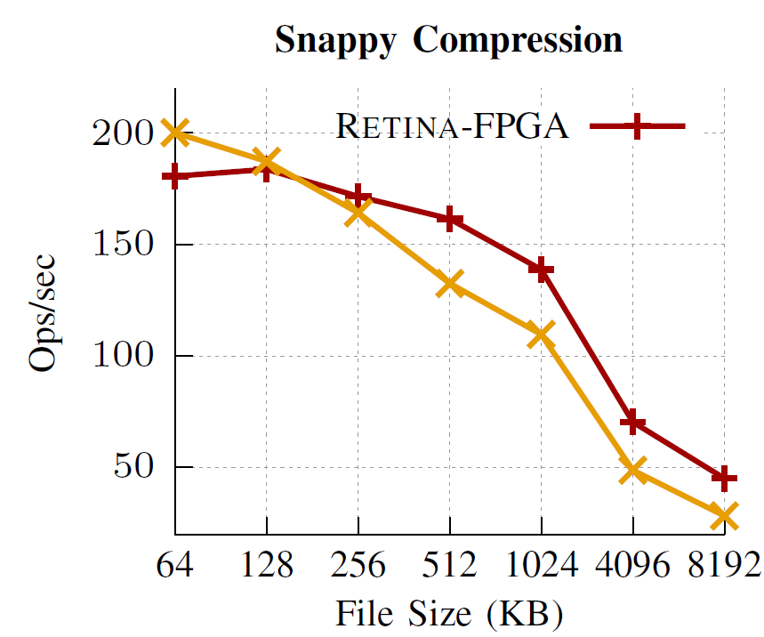
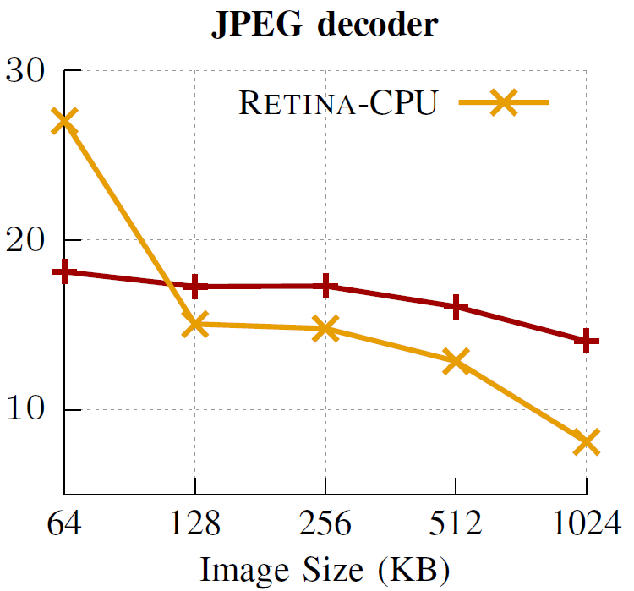
Performance of Near-storage vs. CPU Compute
Increased benefits of offloading compute to the storage for larger file sizes.
Retina-FPGA takes advantage of SmartSSD’s high internal Bandwidth to perform better than Retina-CPU

Slide 32
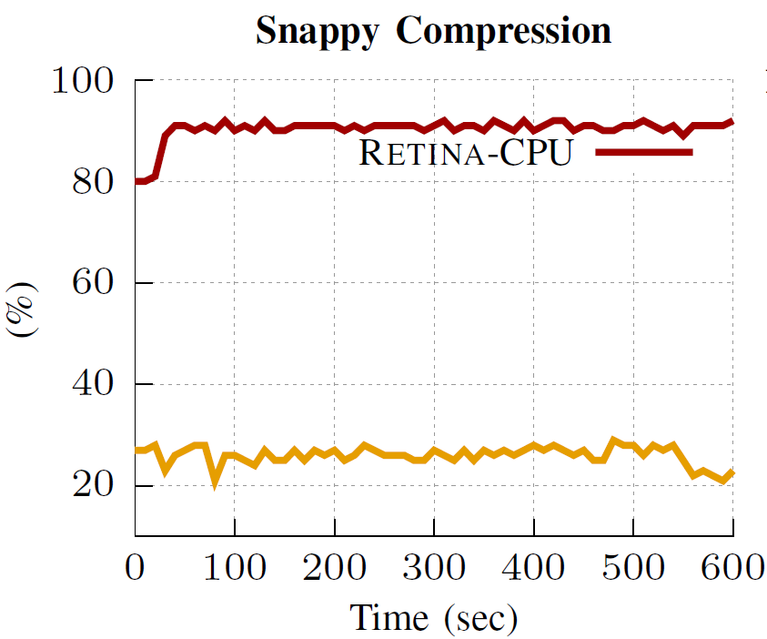
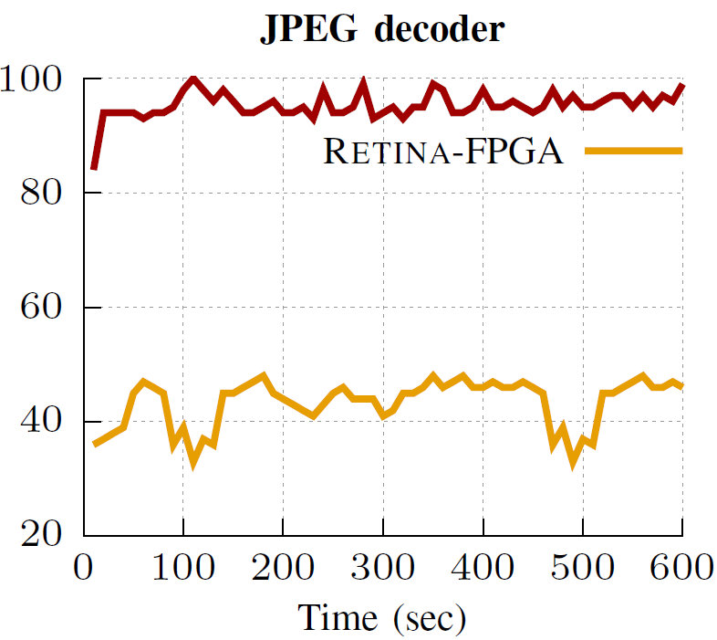
CPU Utilization of Near-storage vs. CPU Compute
RETINA-FPGA consumes ∼65% less CPU time than RETINA-CPU
Retina-FPGA saves CPU cycles by only using it to orchestrate commands

Slide 33
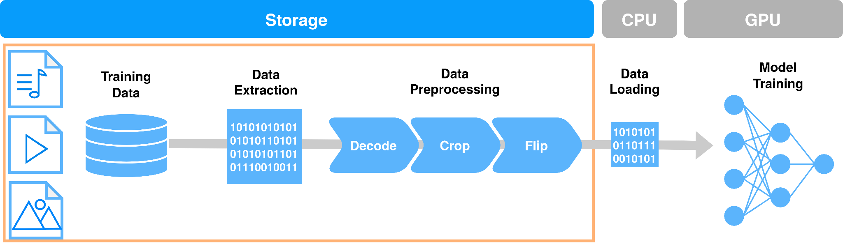
RETINA with real-world application
Offload image preprocessing steps in the ResNet50 DL model training to the CSD
Tensorflow framework issues commands to Retina KVS through its custom file system support alone with preprocessing functions
CPU reads the output from Retina’s pipeline and loads it to GPU for training

Slide 34
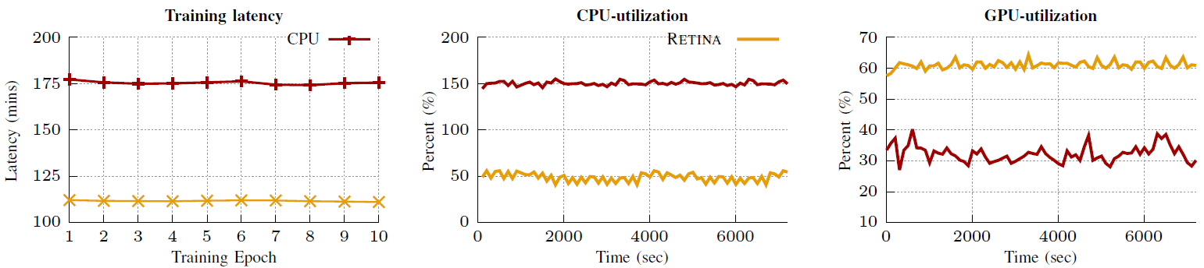
Resnet50 with CPU vs Retina
Preprocessing steps are faster on Retina than CPU on large image sizes(100KB)
Data movement is reduced in RETINA as it sends small preprocessed images and not raw images to CPU
Retina consumes 100% less CPU thus reducing GPU idle time by up to ∼25% during the training
RETINA reduces the overall preprocessing latency and GPU idle times by removing CPU bottlenecks

Slide 35
Conclusion
Traditional data pipelines
CPU lead data extraction underutilized IO bandwidth and increases data movement
CPU lead data preprocessing causes GPU to be idle
Retina’s End-to-End (Storage+Compute) Framework
Offloads data extraction to Retina KVS on CSD
Offloads data preprocessing to Retina Computational pipeline on CSD
RETINA performs up to 75% faster against CPU-only systems
Saves up to 65% CPU time and reduces GPU idle time by up to ∼25% for real world application like Resnet50.
Retina enables Sustainable computation!

Slide 36
Thank You!

Slide 37
Questions?
nagasanjana@vt.edu

