Slide 1
Comparison of software and hardware accelerated video codecs from perspective of power consumption
Jaroslav Svoboda
Michele Maffei

Slide 2
VMAF
Video Multi-method Assessment Fusion
Developed by Netflix
Based on machine learning
Not really battle-tested

Slide 3
PSNRHVSM
Peak Signal to Noise Ratio taking into account Contrast Sensitivity Function (CSF) and between-coefficient contrast masking of DCT basis functions
“... the proposed PSNR-HVS-M outperforms all other considered metrics and demonstrates an appropriate correspondence to human perception.” Nikolay Ponomarenko; Flavia Silvestri; Karen Egiazarian; Marco Carli; Jaakko Astola; Vladimir Lukin, "On between-coefficient contrast masking of DCT basis functions" (in German), CD-ROM Proceedings of the Third International Workshop on Video Processing and Quality Metrics for Consumer Electronics VPQM-07, 25.–26. Januar 2007 (Scottsdale AZ)
Calculated by VQMT

Slide 4
What we tested
Intel iCore i5 4570
Theora – old, buggy, single threaded, just for interesting comparison
x264 – best SW H.264 implementation
h264_nvenc – Nvidia 960GTX
Both last gen of 22nm HW
3 4k 8-bit yuv420p raw videos, each 500 frames

Slide 5
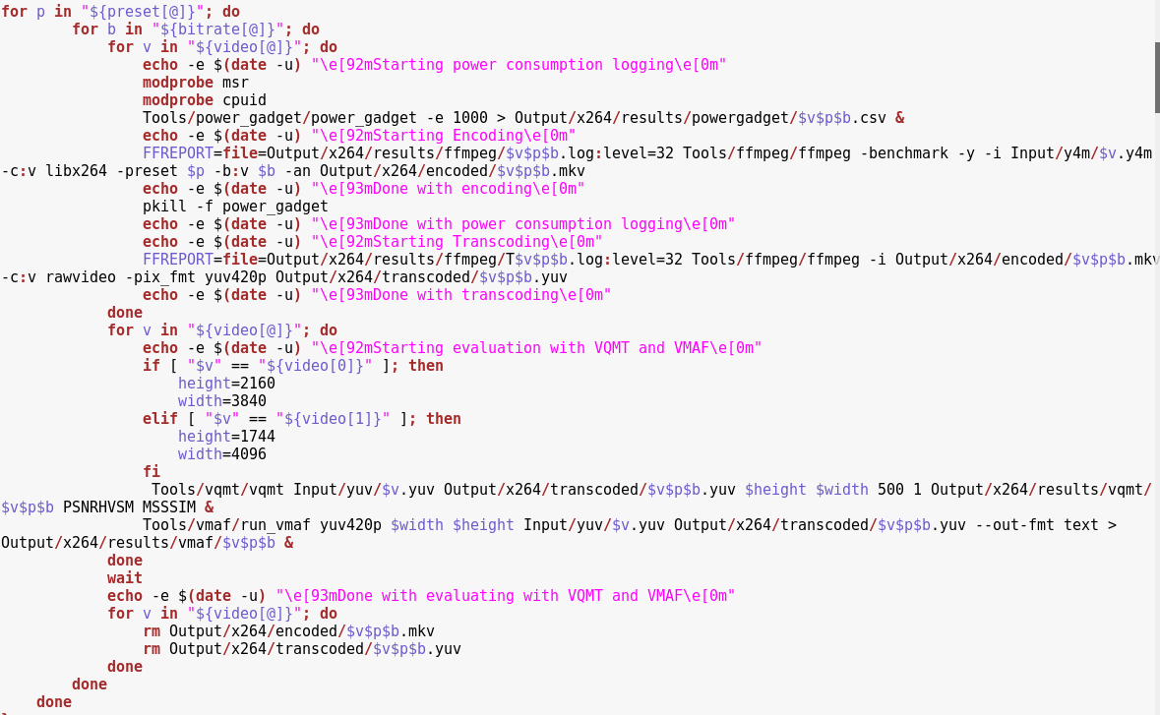
How we tested

Slide 6
Statistics
Runtime for 1 codec 8-10 presets – cca week
1140 encodes
More than 6 TB of data processed
Evaluation takes longer than actual encode
Luckily we don't pay for electricity

Slide 7
(almost) All data in one graph

Slide 8
Zoom a little

Slide 9
crowd_run

Slide 10
crowd_run

Slide 11
old_town_cross

Slide 12
old_town_cross

Slide 13
sintel

Slide 14
sintel

Slide 15
Conclusions so far
Do not use theora, placebo, (very)slow(er)
X264 - ultrafast, medium, faster
CGI differs – lower bitrates are OK
h264_nvenc presets do not have great effect
h264_nvenc PWR cons. changes basically only on basis of video
Do not use ll presets
Good presets medium and hq
So far h264_nvenc best quality/PWR
Even with CPU – at least 2-4x more efficient

Slide 16
Future
hevc_nvenc and x265 (VPx if time allows)
Somebody else could:
  nvidia-smi with cumulative PWR
  Kaby Lake vs. Pascal (14nm resp. 16nm)
https://github.com/multiflexi/II2202-report

