Slide 1

Quantum Theory of the Atom

Slide 2

The Wave Nature of Light
A wave is a continuously repeating change or oscillation in matter or in a physical field. Light is also a wave.
  It consists of oscillations in electric and magnetic fields that travel through space.
  Visible light, X rays, and radio waves are all forms of electromagnetic radiation. (See Animation: Electromagnetic Wave)
Notes:
2

Slide 3
The Wave Nature of Light
A wave can be characterized by its wavelength and frequency.
  The wavelength, λ (lambda), is the distance between any two adjacent identical points of a wave. (See Figure 7.3)
  The frequency, ν (nu), of a wave is the number of wavelengths that pass a fixed point in one second.
Notes:
2

Slide 4

The Wave Nature of Light
The product of the frequency, ν (waves/sec) and the wavelength, λ (m/wave) would give the speed of the wave in m/s.
  In a vacuum, the speed of light, c, is 3.00 x 10⁸ m/s. Therefore,
  So, given the frequency of light, its wavelength can be calculated, or vice versa.
Notes:
2

Slide 5
The Wave Nature of Light
What is the wavelength of yellow light with a frequency of 5.09 x 10¹⁴ s⁻¹? (Note: s⁻¹, commonly referred to as Hertz (Hz) is defined as “cycles or waves per second”.)
  If c = νλ, then rearranging, we obtain λ = c/ν
Notes:
2

Slide 6
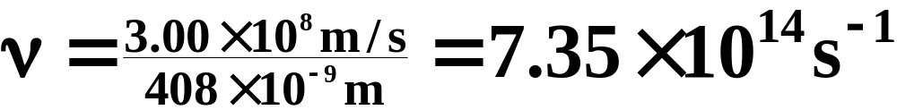
The Wave Nature of Light
What is the frequency of violet light with a wavelength of 408 nm? (See Figure 7.5)
  If c = νλ, then rearranging, we obtain ν = c/λ.
Notes:
2

Slide 7
The Wave Nature of Light
The range of frequencies or wavelengths of electromagnetic radiation is called the electromagnetic spectrum. (See Figure 7.5)
  Visible light extends from the violet end of the spectrum at about 400 nm to the red end with wavelengths about 800 nm.
  Beyond these extremes, electromagnetic radiation is not visible to the human eye.
Notes:
2

Slide 8

Quantum Effects and Photons
Photoelectric Effect
  The energy of the photons proposed by Einstein would be proportional to the observed frequency, and the proportionality constant would be Planck’s constant.
  h = planck’s constant 6.626 x 10⁻³⁴ j·s (energy of one photon.
  In 1905, Einstein used this concept to explain the “photoelectric effect.”
Notes:
2

Slide 9
Quantum Effects and Photons
Photoelectric Effect
  The photoelectric effect is the ejection of electrons from the surface of a metal when light shines on it. (See Figure 7.6)
  Electrons are ejected only if the light exceeds a certain “threshold” frequency.
  Violet light, for example, will cause potassium to eject electrons, but no amount of red light (which has a lower frequency) has any effect.
Notes:
2

Slide 10
Quantum Effects and Photons
Photoelectric Effect
  Einstein’s assumption that an electron is ejected when struck by a single photon implies that it behaves like a particle.
  When the photon hits the metal, its energy, hν is taken up by the electron.
  The photon ceases to exist as a particle; it is said to be “absorbed.”
Notes:
2

Slide 11
Radio Wave Energy
What is the energy of a photon corresponding to radio waves of frequency 1.255 x 10 ⁶ s⁻¹?
Solve for E, using E = hν, and four
significant figures for h.
Notes:
12

Slide 12
Radio Wave Energy
What is the energy of a photon corresponding to radio waves of frequency 1.255 x 10 ⁶ s⁻¹?
Solve for E, using E = hν, and four
significant figures for h.
(6.626 x 10⁻³⁴ J.s) x (1.255 x 10⁶ s⁻¹) =
8.3156 x 10⁻²⁸ = 8.316 x 10⁻²⁸ J
Notes:
13

Slide 13
The Bohr Theory of the Hydrogen Atom
Atomic Line Spectra
  When a heated metal filament emits light, we can use a prism to spread out the light to give a continuous spectrum-that is, a spectrum containing light of all wavelengths.
  The light emitted by a heated gas, such as hydrogen, results in a line spectrum-a spectrum showing only specific wavelengths of light. (See Figure 7.2 and Animation: H₂ Line Spectrum)
Notes:
2

Slide 14
The Bohr Theory of the Hydrogen Atom
Bohr’s Postulates
  Bohr set down postulates to account for (1) the stability of the hydrogen atom and (2) the line spectrum of the atom.
  1. Energy level postulate An electron can have only specific energy levels in an atom.
  2. Transitions between energy levels An electron in an atom can change energy levels by undergoing a “transition” from one energy level to another. (See Figures 7.10 and 7.11)
Notes:
2

Slide 15
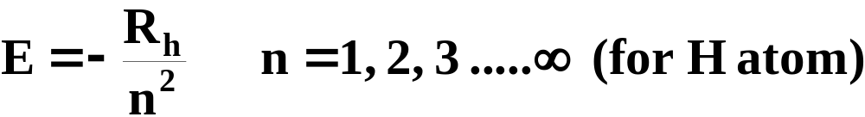
The Bohr Theory of the Hydrogen Atom
Bohr’s Postulates
  Bohr derived the following formula for the energy levels of the electron in the hydrogen atom.
  R_{h} is a constant (expressed in energy units) with a value of 2.18 x 10⁻¹⁸ J.
Notes:
2

Slide 16
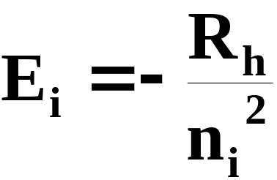
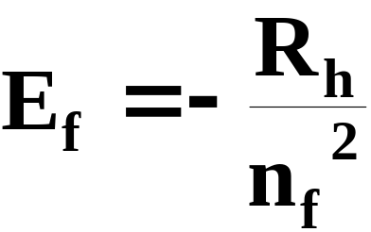
The Bohr Theory of the Hydrogen Atom
Bohr’s Postulates
  When an electron undergoes a transition from a higher energy level to a lower one, the energy is emitted as a photon.
  From Postulate 1,
Notes:
2

Slide 17
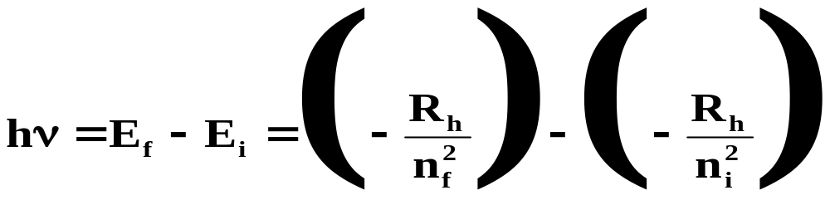
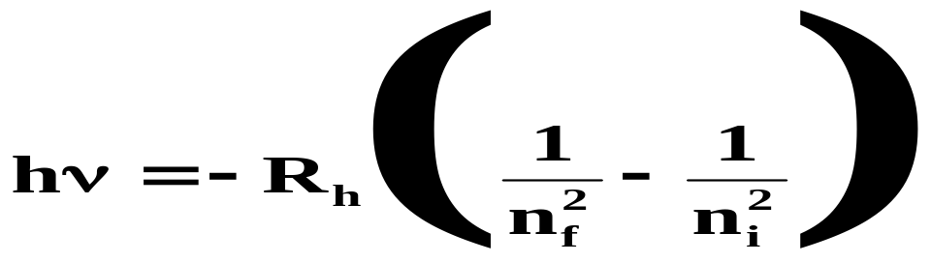
The Bohr Theory of the Hydrogen Atom
Bohr’s Postulates
  If we make a substitution into the previous equation that states the energy of the emitted photon, hν, equals E_{i} - E_{f},
  Rearranging, we obtain
Notes:
2

Slide 18
The Bohr Theory of the Hydrogen Atom
Bohr’s Postulates
  Bohr’s theory explains not only the emission of light, but also the absorbtion of light.
  When an electron falls from n = 3 to n = 2 energy level, a photon of red light (wavelength, 685 nm) is emitted.
  When red light of this same wavelength shines on a hydrogen atom in the n = 2 level, the energy is gained by the electron that undergoes a transition to n = 3.
Notes:
2

Slide 19
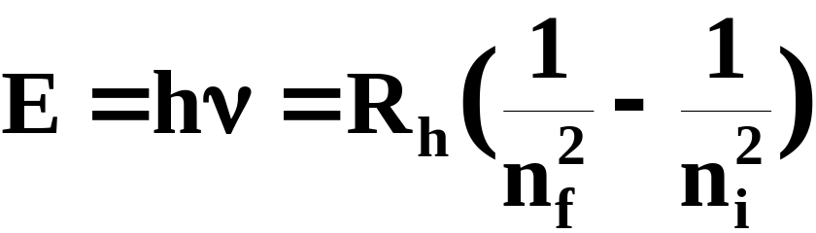
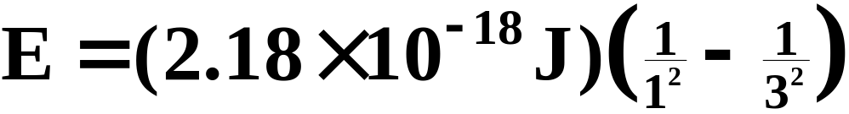
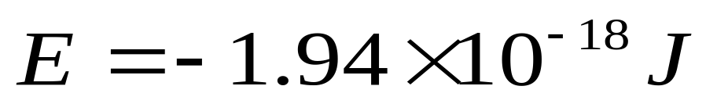
A Problem to Consider
Calculate the energy of a photon of light emitted from a hydrogen atom when an electron falls from level n = 3 to level n = 1.
Note that the sign of E is negative because energy is emitted when an electron falls from a higher to a lower level.
Notes:
2

Slide 20
Quantum Mechanics
Bohr’s theory established the concept of atomic energy levels but did not thoroughly explain the “wave-like” behavior of the electron.
  Current ideas about atomic structure depend on the principles of quantum mechanics, a theory that applies to subatomic particles such as electrons.
Notes:
2

Slide 21
Quantum Mechanics
The first clue in the development of quantum theory came with the discovery of the de Broglie relation.
  In 1923, Louis de Broglie reasoned that if light exhibits particle aspects, perhaps particles of matter show characteristics of waves.
  He postulated that a particle with mass m and a velocity v has an associated wavelength.
  The equation λ = h/mv is called the de Broglie relation.
Notes:
2

Slide 22
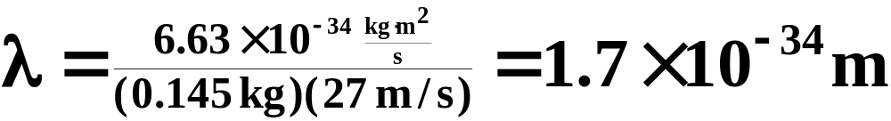
Quantum Mechanics
If matter has wave properties, why are they not commonly observed?
  The de Broglie relation shows that a baseball (0.145 kg) moving at about 60 mph (27 m/s) has a wavelength of about 1.7 x 10⁻³⁴ m.
  This value is so incredibly small that such waves cannot be detected.
Notes:
2

Slide 23
Quantum Mechanics
If matter has wave properties, why are they not commonly observed?
  Electrons have wavelengths on the order of a few picometers (1 pm = 10⁻¹² m).
  Under the proper circumstances, the wave character of electrons should be observable.
Notes:
2

Slide 24
Quantum Mechanics
If matter has wave properties, why are they not commonly observed?
  In 1927, it was demonstrated that a beam of electrons, just like X rays, could be diffracted by a crystal.
  The German physicist, Ernst Ruska, used this wave property to construct the first “electron microscope” in 1933. (See Figure 7.16)
Notes:
2

Slide 25
Quantum Mechanics
Quantum mechanics is the branch of physics that mathematically describes the wave properties of submicroscopic particles.
  We can no longer think of an electron as having a precise orbit in an atom.
  To describe such an orbit would require knowing its exact position and velocity.
  In 1927, Werner Heisenberg showed (from quantum mechanics) that it is impossible to know both simultaneously.
Notes:
2

Slide 26
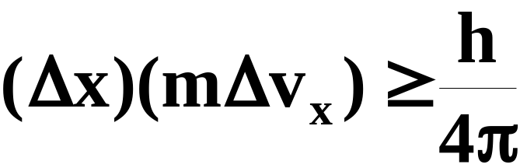
Quantum Mechanics
Heisenberg’s uncertainty principle is a relation that states that the product of the uncertainty in position (Δx) and the uncertainty in momentum (mΔv_{x}) of a particle can be no larger than h/4π.
  When m is large (for example, a baseball) the uncertainties are small, but for electrons, high uncertainties disallow defining an exact orbit.
Notes:
2

Slide 27
Quantum Mechanics
Although we cannot precisely define an electron’s orbit, we can obtain the probability of finding an electron at a given point around the nucleus.
  Erwin Schrodinger defined this probability in a mathematical expression called a wave function, denoted ψ (psi).
  The probability of finding a particle in a region of space is defined by ψ². (See Figures 7.18 and 7.19)
Notes:
2

Slide 28
Quantum Numbers and Atomic Orbitals
According to quantum mechanics, each electron is described by four quantum numbers.
  Principal quantum number (n)
  Angular momentum quantum number (l)
  Magnetic quantum number (m_{l})
  Spin quantum number (m_{s})
  The first three define the wave function for a particular electron. The fourth quantum number refers to the magnetic property of electrons.
Notes:
2

Slide 29
Quantum Numbers and Atomic Orbitals
The principal quantum number(n) represents the “shell number” in which an electron “resides.”
  The smaller n is, the smaller the orbital.
  The smaller n is, the lower the energy of the electron.
Notes:
2

Slide 30
Quantum Numbers and Atomic Orbitals
The angular momentum quantum number (l) distinguishes “sub shells” within a given shell that have different shapes.
  Each main “shell” is subdivided into “sub shells.” Within each shell of quantum number n, there are n sub shells, each with a distinctive shape.
  l can have any integer value from 0 to (n - 1)
  The different subshells are denoted by letters.
  Letter s p d f g …
  l 0 1 2 3 4 ….
Notes:
2

Slide 31
Quantum Numbers and Atomic Orbitals
The magnetic quantum number (m_{l}) distinguishes orbitals within a given sub-shell that have different shapes and orientations in space.
  Each sub shell is subdivided into “orbitals,” each capable of holding a pair of electrons.
  m_{l} can have any integer value from -l to +l.
  Each orbital within a given sub shell has the same energy.
Notes:
2

Slide 32
Quantum Numbers and Atomic Orbitals
The spin quantum number (m_{s}) refers to the two possible spin orientations of the electrons residing within a given orbital.
  Each orbital can hold only two electrons whose spins must oppose one another.
  The possible values of m_{s} are +1/2 and –1/2. (See Table 7.1 and Figure 7.23 and Animation: Orbital Energies)
Notes:
2

Slide 33
Quantum Numbers and Atomic Orbitals
Using calculated probabilities of electron “position,” the shapes of the orbitals can be described.
  The s sub shell orbital (there is only one) is spherical. (See Figures 7.24 and 7.25 and Animation: 1s Orbital)
  The p sub shell orbitals (there are three) are dumbbell shape. (See Figure 7.26 and Animation: 2p_{x} Orbital)
  The d sub shell orbitals (there are five ) are a mix of cloverleaf and dumbbell shapes. (See Figure 7.27 and Animations: 3d_{xy} Orbital and 3d_{z}² Orbital)
Notes:
2

Slide 34
Operational Skills
Relating wavelength and frequency of light.
Calculating the energy of a photon.
Determining the wavelength or frequency of a hydrogen atom transition.
Applying the de Broglie relation.
Using the rules for quantum numbers.
Notes:
2

Slide 35
Animation: Electromagnetic Wave
(Click here to open QuickTime animation)
Return to Slide 2

Slide 36
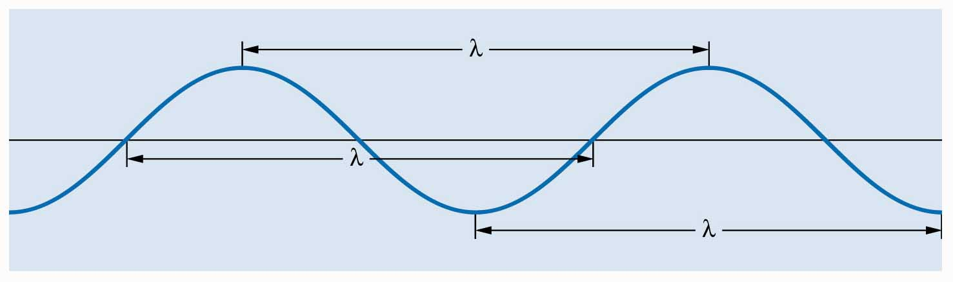
Figure 7.3: Water wave (ripple).
Return to Slide 3

Slide 37
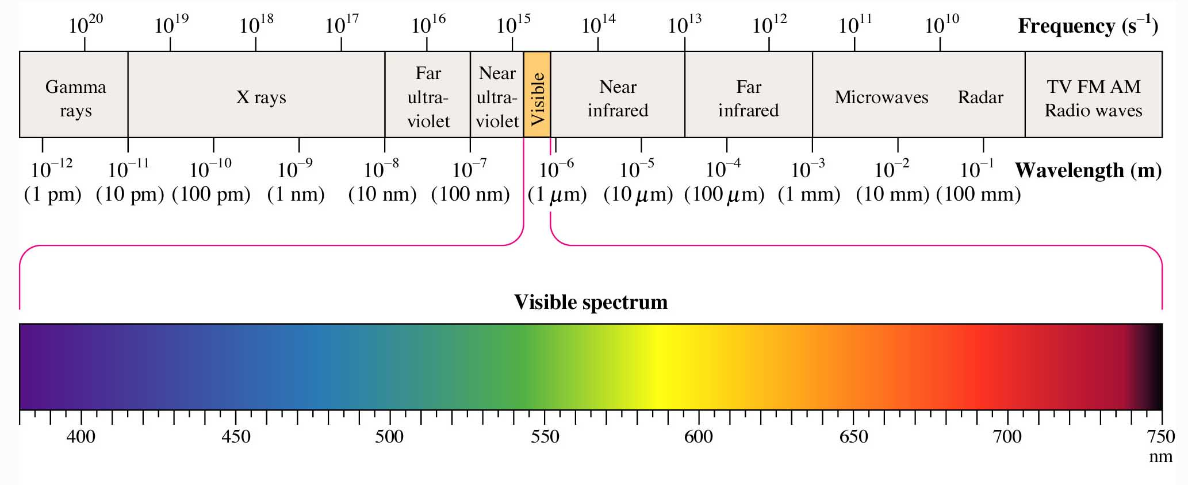
Figure 7.5: The electromagnetic spectrum.
Return to Slide 6

Slide 38
Figure 7.5: The electromagnetic spectrum.
Return to Slide 7

Slide 39

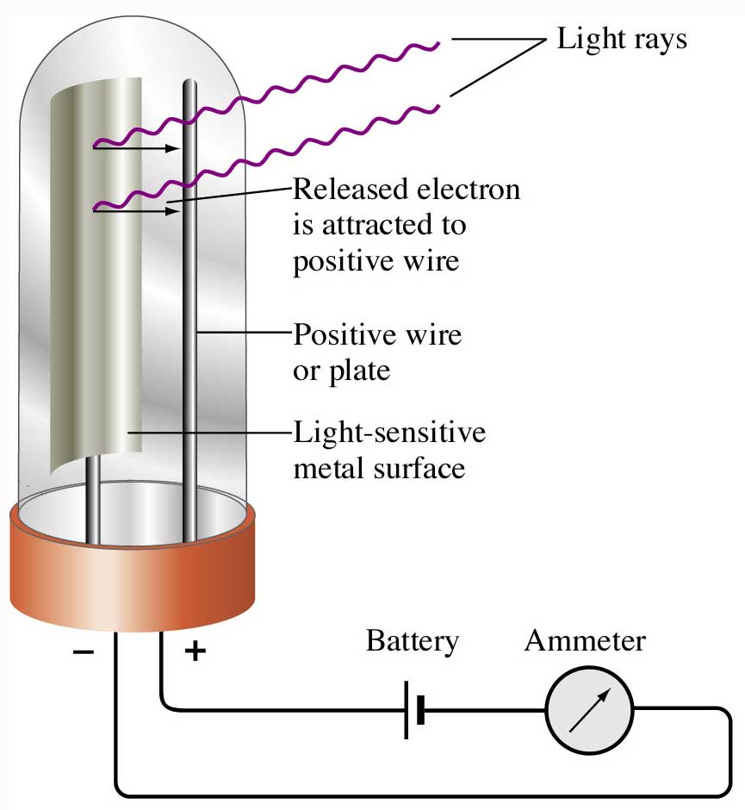
Figure 7.6: The photoelectric effect.
Return to Slide 8

Slide 40
Animation: Photoelectric Effect
(Click here to open QuickTime animation)
Return to Slide 8

Slide 41
Figure 7.6: The photoelectric effect.
Return to Slide 13

Slide 42
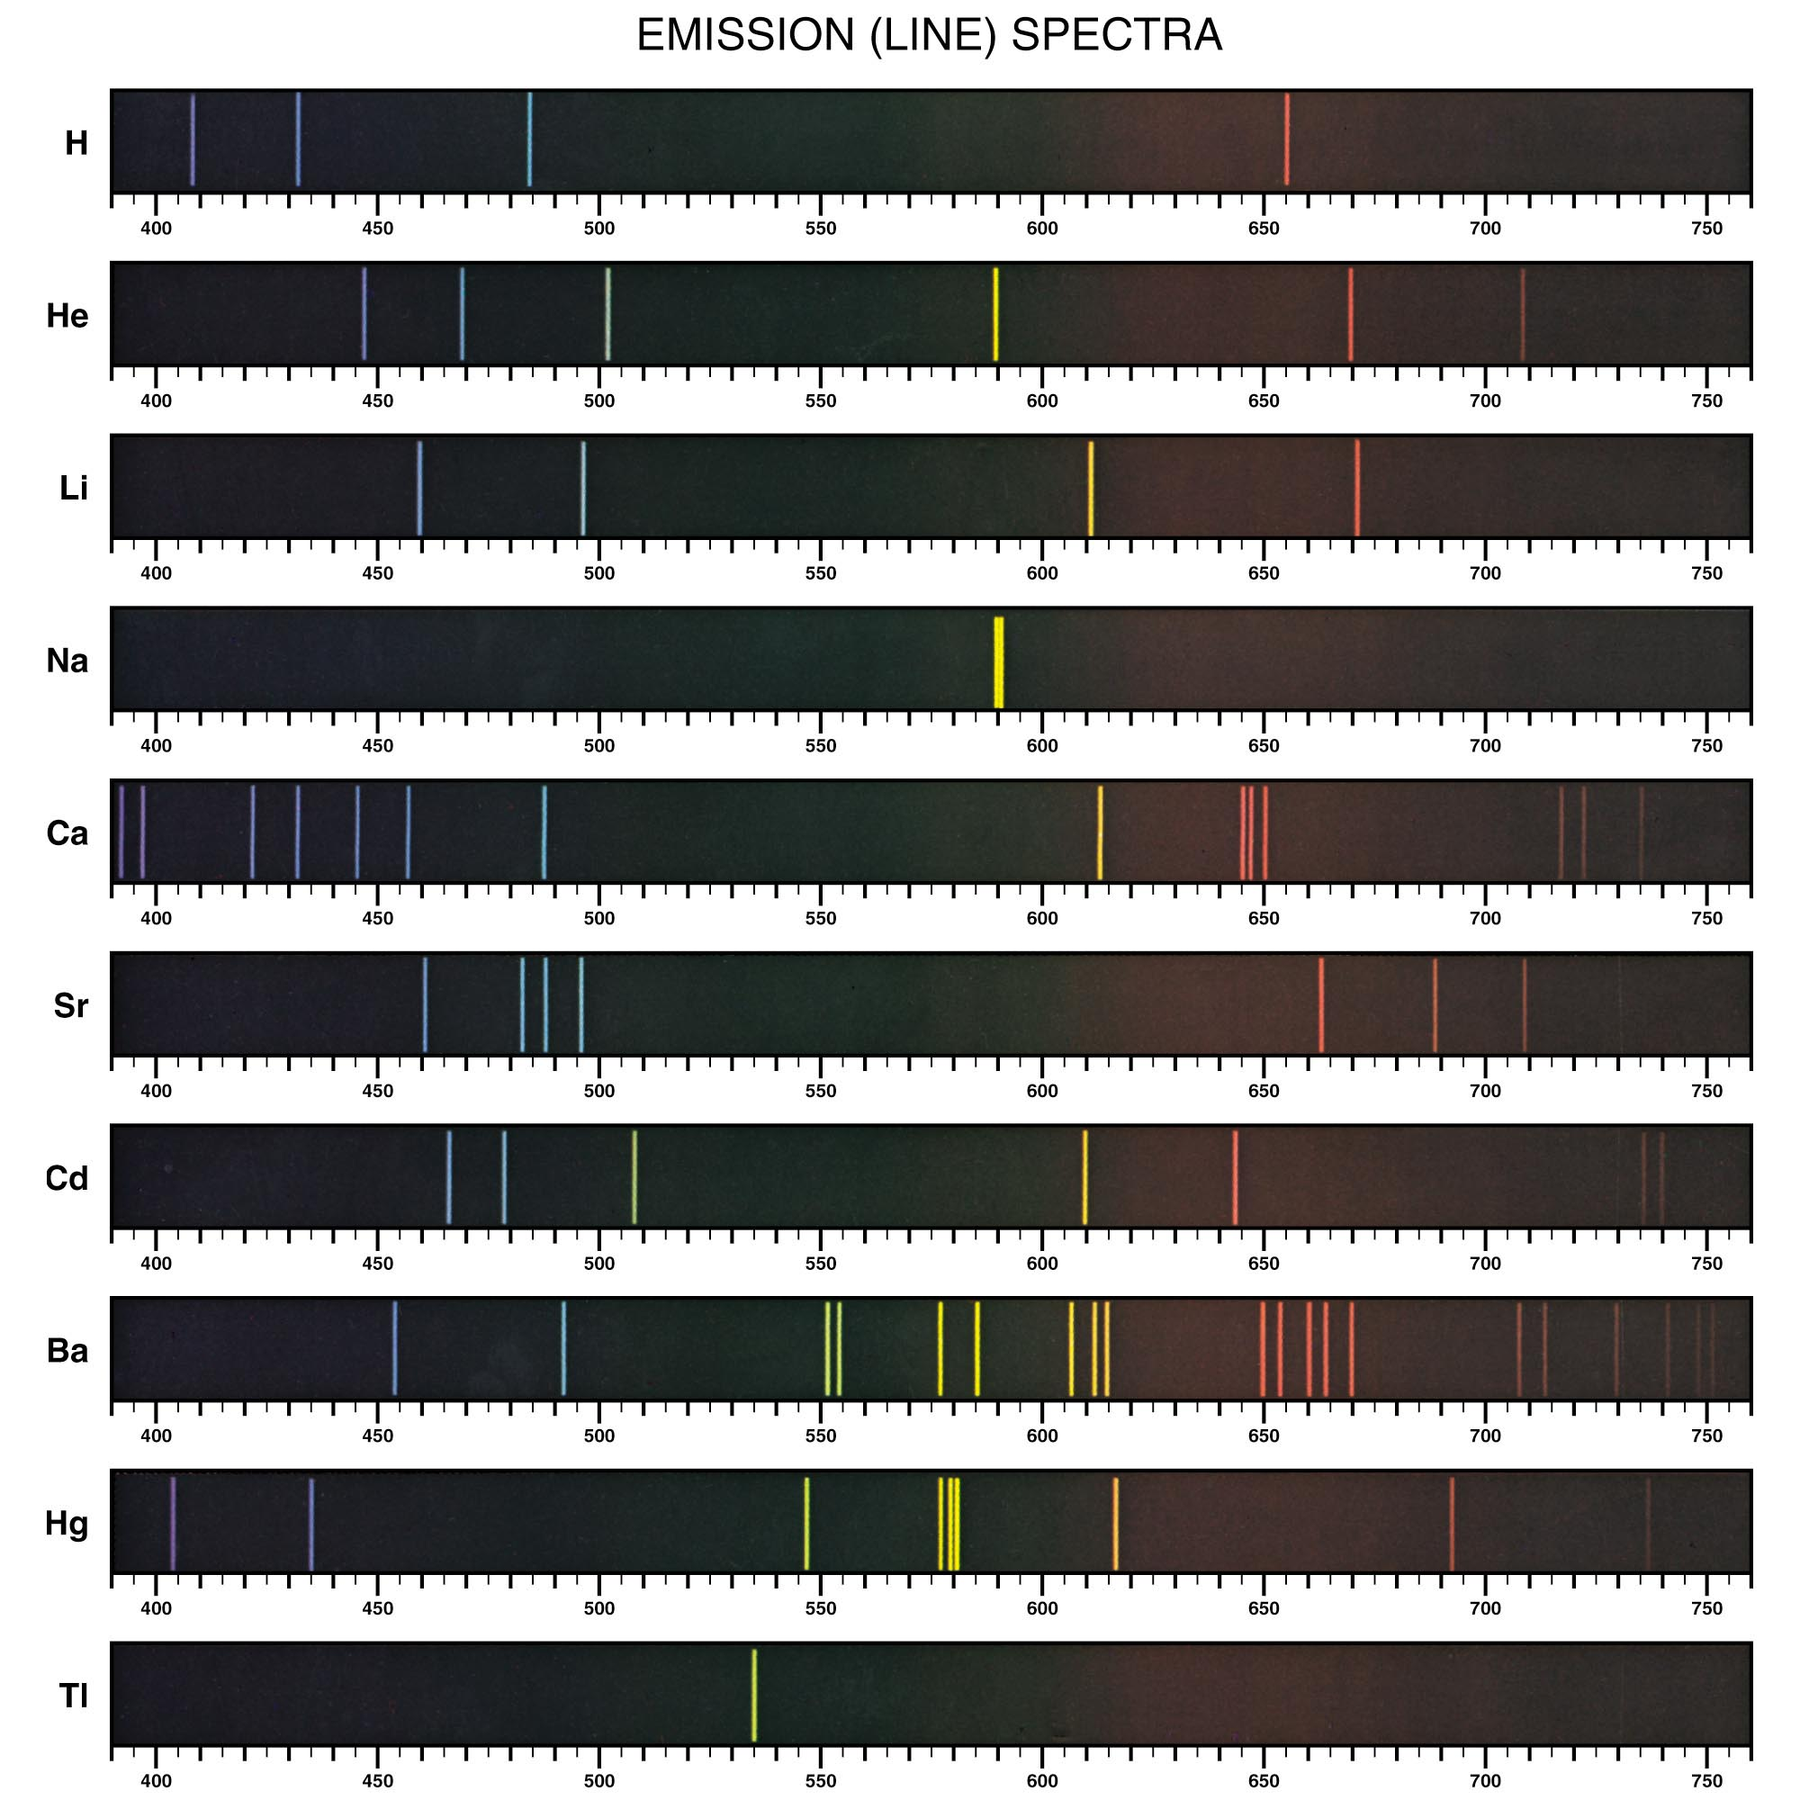
Figure 7.2: Emission (line) spectra of some elements.
Return to Slide 19

Slide 43
Animation: H₂ Line Spectrum
(Click here to open QuickTime animation)
Return to Slide 19

Slide 44
Figure 7.2: Emission (line) spectra of some elements.
Return to Slide 20

Slide 45
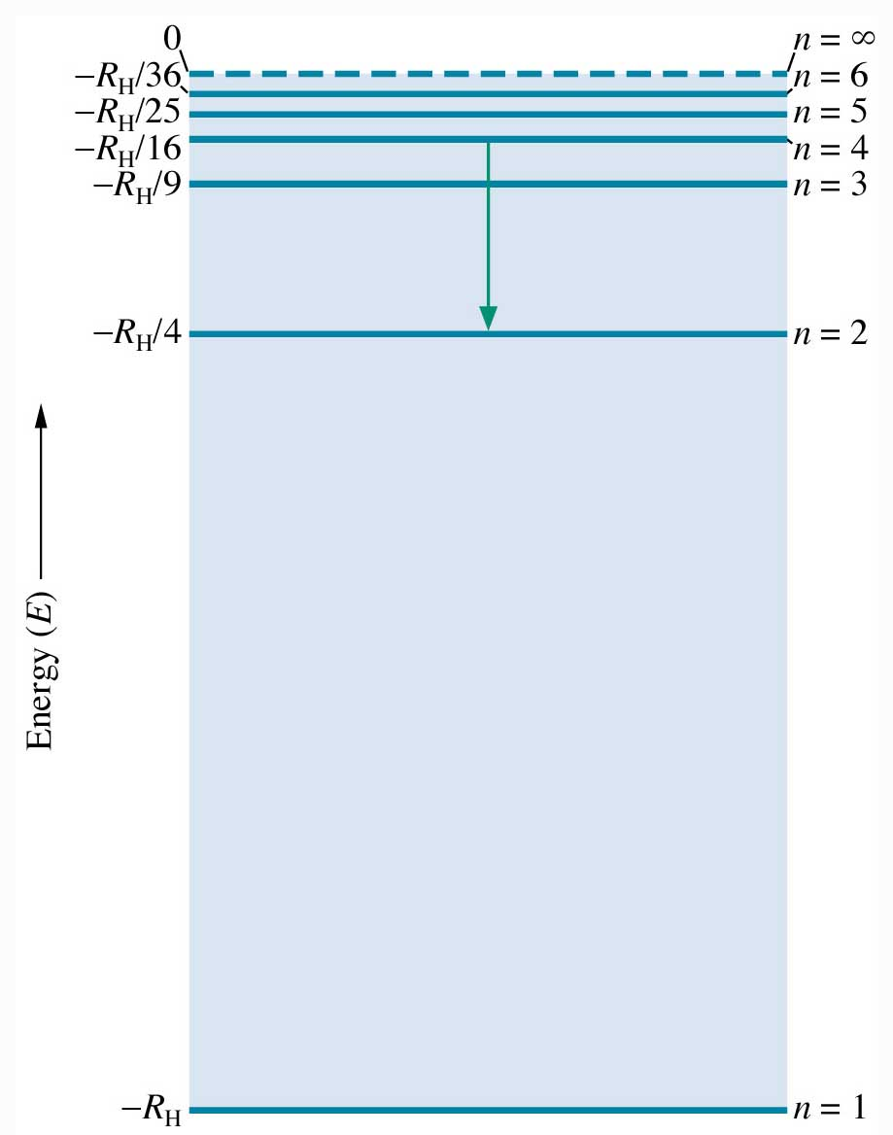
Figure 7.10: Energy-level diagram for the electron in the hydrogen atom.
Return to Slide 21

Slide 46
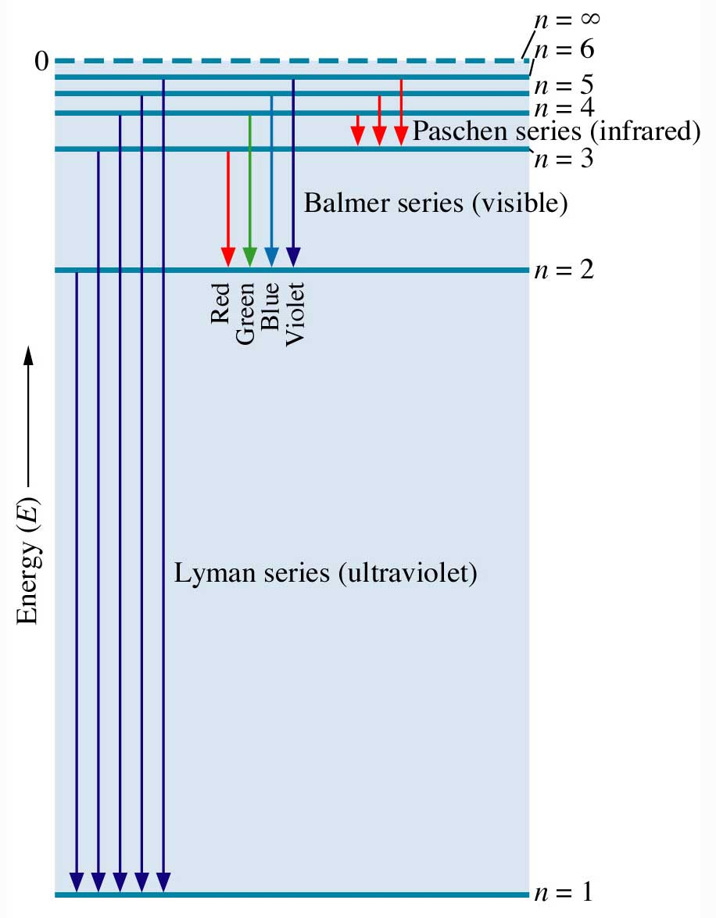
Figure 7.11: Transitions of the electron in the hydrogen atom.
Return to Slide 21

Slide 47
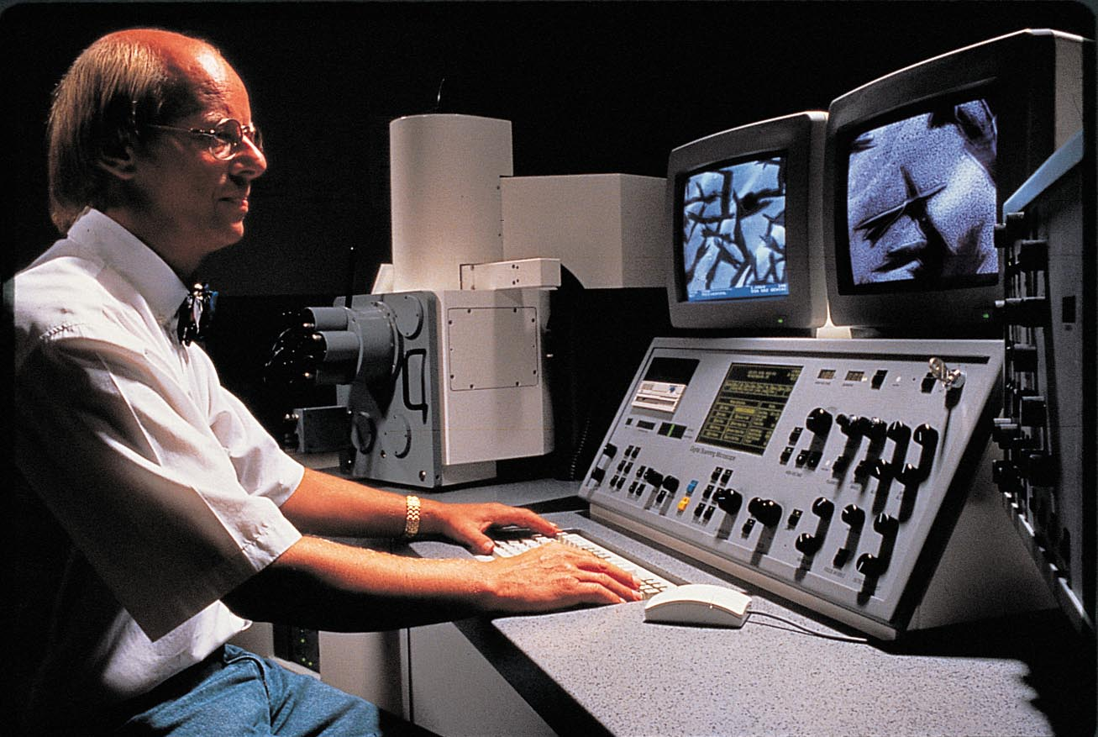
Figure 7.16: Scanning electron microscope. Photo courtesy of Carl Zeiss, Inc., Thornwood, NY.
Return to Slide 31

Slide 48
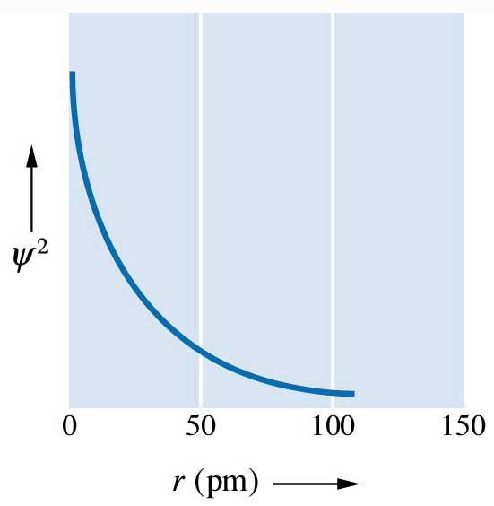
Figure 7.18: Plot of ψ² for the lowest energy level of the hydrogen atom.
Return to Slide 34

Slide 49
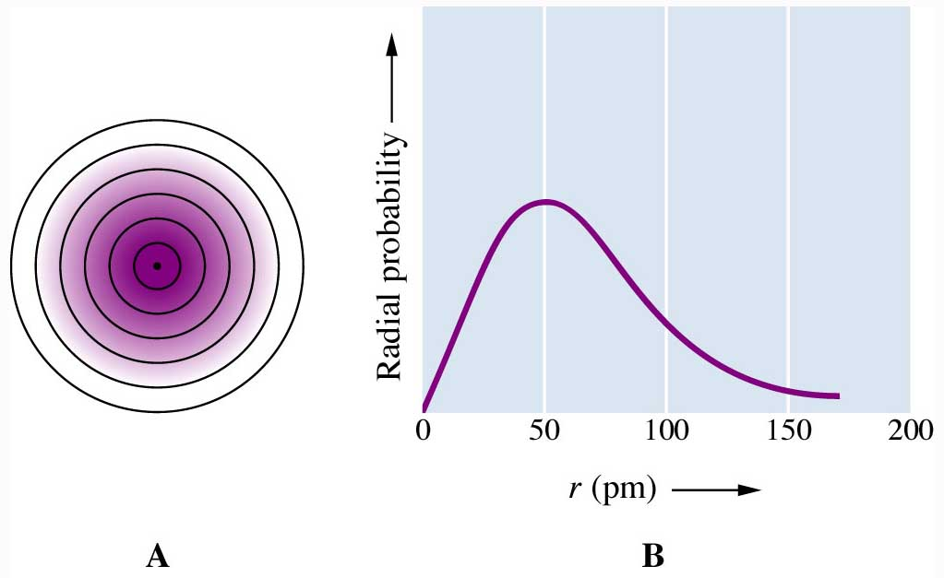
Figure 7.19: Probability of finding an electron in a spherical shell about the nucleus.
Return to Slide 34

Slide 50
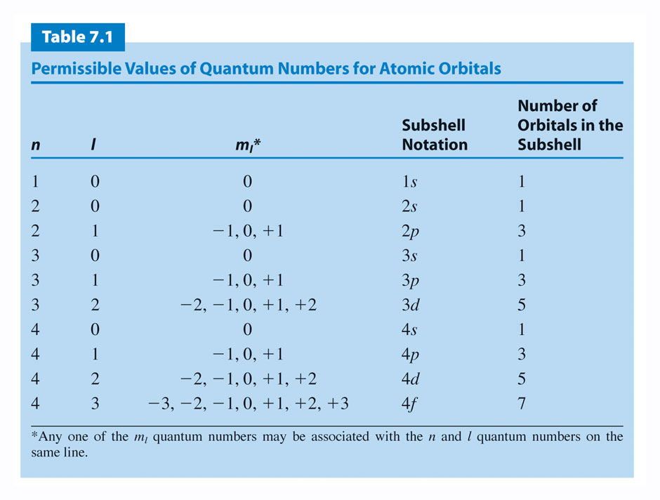
Return to Slide 39

Slide 51
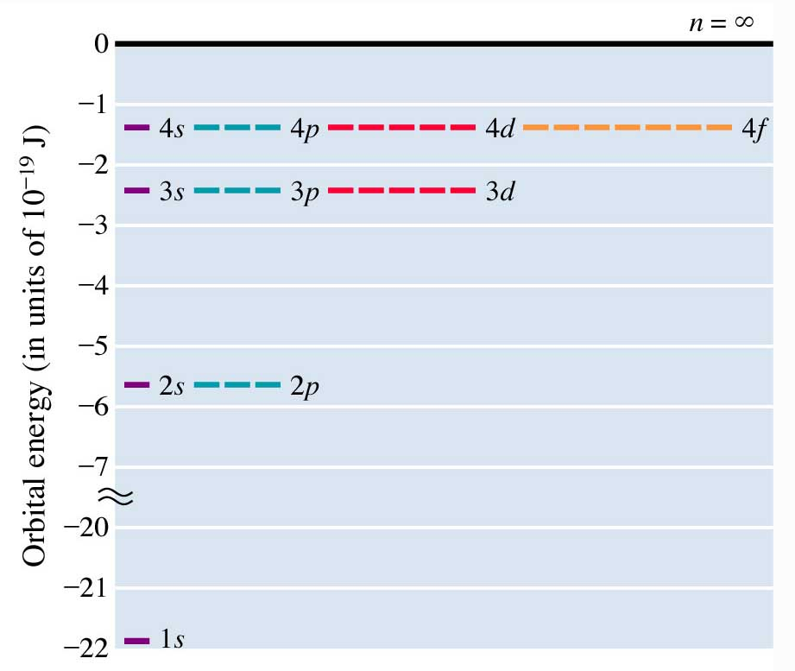
Figure 7.23: Orbital energies of the hydrogen atom.
Return to Slide 39

Slide 52
Animation: Orbital Energies
(Click here to open QuickTime animation)
Return to Slide 39

Slide 53
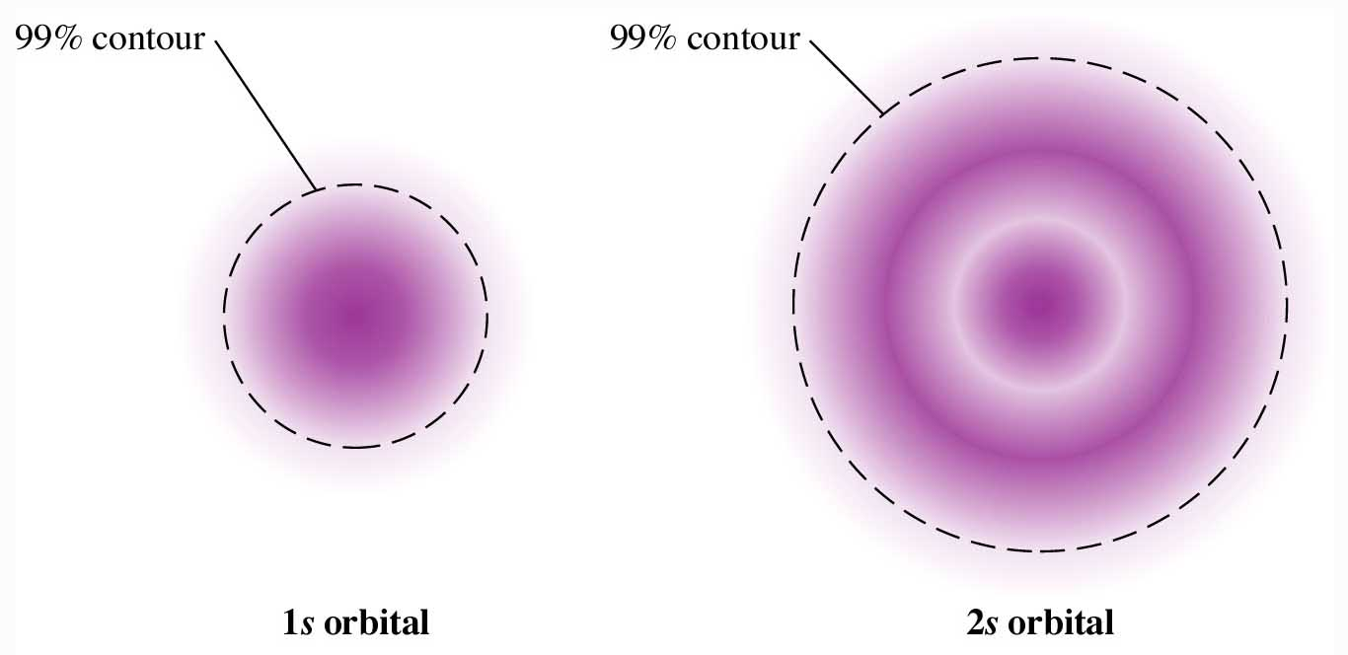
Figure 7.24: Cross-sectional representations of the probability distributions of S orbitals.
Return to slide 40

Slide 54
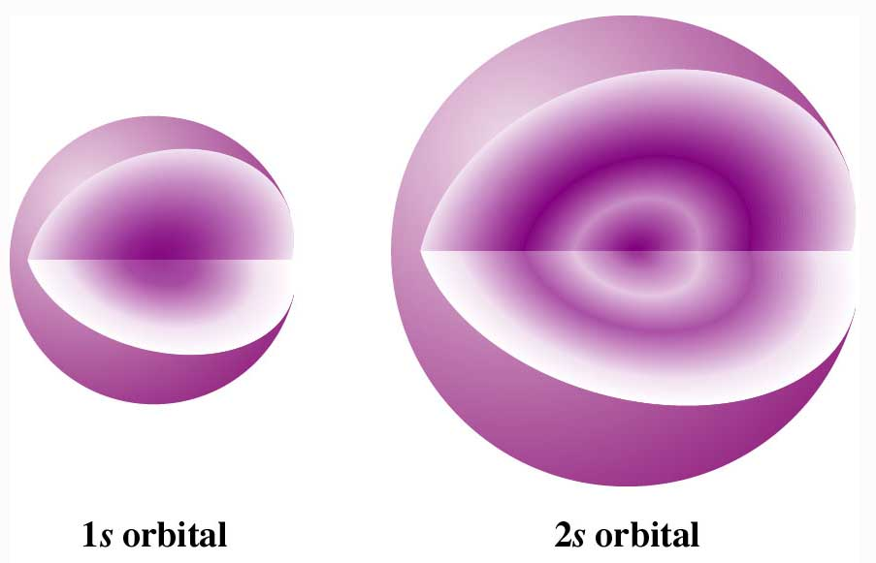
Figure 7.25: Cutaway diagrams showing the spherical shape of S orbitals.
Return to slide 41

Slide 55
Animation: 1s Orbital
(Click here to open QuickTime animation)
Return to slide 40

Slide 56
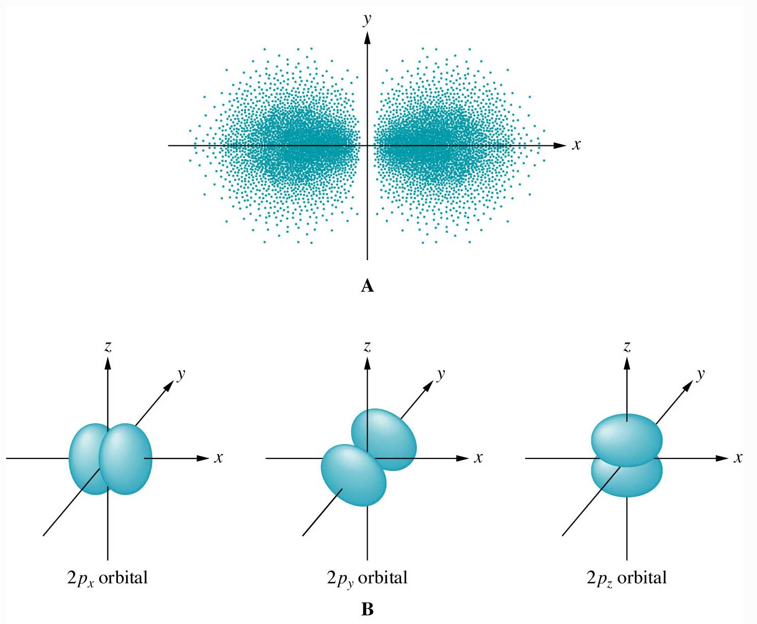
Figure 7.26: The 2p orbitals.
Return to slide 40

Slide 57
Animation: 2p_{x} Orbital
(Click here to open QuickTime animation)
Return to slide 40

Slide 58
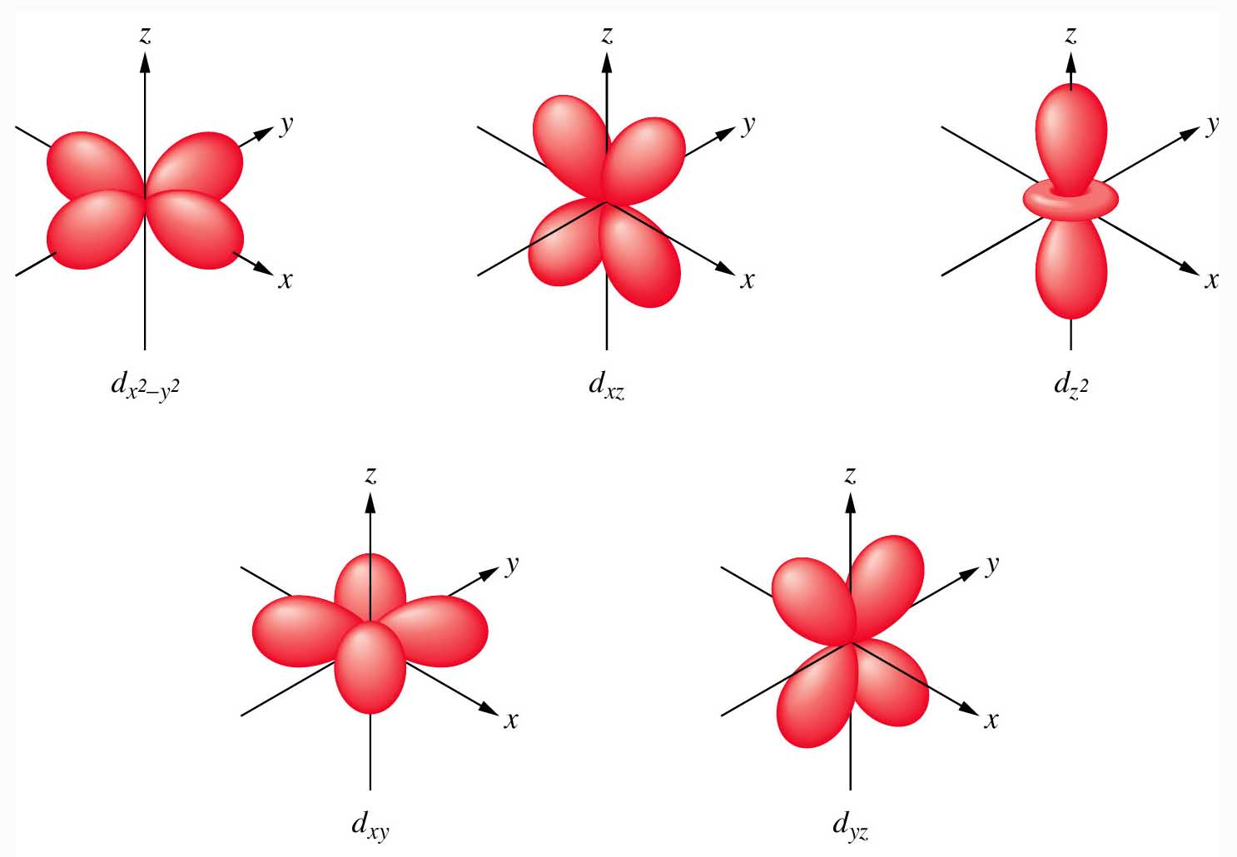
Figure 7.27: The five 3d orbitals.
Return to slide 40

Slide 59
Animation: 3d_{xy} Orbital
(Click here to open QuickTime animation)
Return to slide 40

Slide 60
Animation: 3d_{z}² Orbital
(Click here to open QuickTime animation)
Return to slide 40

