Slide 1
Operational Skills
Writing nuclide symbols.
Determining atomic weight from isotopic masses and fractional abundances.
Writing an ionic formula, given the ions.
Writing the name of a compound from its formula, or vice versa.
Writing the name and formula of an anion from an acid.
Balancing simple equations.
Copyright © Houghton Mifflin Company.All rights reserved.
Presentation of Lecture Outlines, 1–<number>
Notes:
2

Slide 2
Operational Skills
Using the law of conservation of mass.
Using significant figures in calculations.
Converting from one temperature scale to another.
Calculating the density of a substance.
Converting units.
Calculating percentage of water in hydrate formulas.
Copyright © Houghton Mifflin Company.All rights reserved.
Presentation of Lecture Outlines, 1–<number>

Slide 3
Operational Skills
Calculating the formula weight from a formula.
Calculating the mass of an atom or molecule.
Converting moles of substance to grams and vice versa.
Calculating the number of molecules in a given mass.
Calculating the percentage composition from the formula.
Calculating the mass of an element in a given mass of compound.
Calculating the percentages C and H by combustion.
Determining the empirical formula from percentage composition.
Determining the true molecular formula.
Relating quantities in a chemical equation.
Calculating with a limiting reagent.
Copyright © Houghton Mifflin Company.All rights reserved.
Presentation of Lecture Outlines, 1–<number>
Notes:
2

Slide 4
Operational Skills
Using solubility rules.
Calculating molarity from mass and volume.
Using molarity as a conversion factor.
Diluting a solution.
Determining the amount of a substance by gravimetric analysis.
Calculating the volume of reactant solution needed.
Calculating the quantity of a substance by titration.
Know the first ten hydrocarbon names and formulas.
Know basic organic terms alkanes, alkenes, alkynes, isomers, alcohol, amines, ketone, benzene, etc.
Copyright © Houghton Mifflin Company.All rights reserved.
Presentation of Lecture Outlines, 1–<number>

Slide 5

Measurement and Significant Figures (cont’d)
To indicate the precision of a measured number (or result of calculations on measured numbers), we often use the concept of significant figures.
  Significant figures are those digits in a measured number (or result of the calculation with a measured number) that include all certain digits plus a final one having some uncertainty.
Copyright © Houghton Mifflin Company.All rights reserved.
Presentation of Lecture Outlines, 1–<number>
Notes:
2

Slide 6
Measurement and Significant Figures (cont’d)
To count the number of significant figures in a measurement, observe the following rules:
  All nonzero digits are significant.
  Zeros between significant figures are significant.
  Zeros preceding the first nonzero digit are not significant.
  Zeros to the right of the decimal after a nonzero digit are significant.
  Zeros at the end of a nondecimal number may or may not be significant. (Use scientific notation.)
Copyright © Houghton Mifflin Company.All rights reserved.
Presentation of Lecture Outlines, 1–<number>
Notes:
2

Slide 7
Measurement and Significant Figures (cont’d)
Number of significant figures refers to the number of digits reported for the value of a measured or calculated quantity, indicating the precision of the value.
  When multiplying and dividing measured quantities, give as many significant figures as the least found in the measurements used.
  When adding or subtracting measured quantities, give the same number of decimals as the least found in the measurements used.
Copyright © Houghton Mifflin Company.All rights reserved.
Presentation of Lecture Outlines, 1–<number>
Notes:
2

Slide 8
Measurement and Significant Figures (cont’d)
14.0 g /102.4 mL = 0.137 g/mL
only three significant figures
Copyright © Houghton Mifflin Company.All rights reserved.
Presentation of Lecture Outlines, 1–<number>

Slide 9
Measurement and Significant Figures (cont’d)
An exact number is a number that arises when you count items or when you define a unit.
  For example, when you say you have nine coins in a bottle, you mean exactly nine.
  When you say there are twelve inches in a foot, you mean exactly twelve.
  Note that exact numbers have no effect on significant figures in a calculation.
Copyright © Houghton Mifflin Company.All rights reserved.
Presentation of Lecture Outlines, 1–<number>
Notes:
2

Slide 10
Table 1.2 SI Base Units
Quantity | Unit | Symbol
Length | Meter | m
Mass | Kilogram | Kg
Time | Second | S
Temperature | Kelvin | K
Amount of substance | Mole | mol
Electric current | Ampere | A
Luminous intensity | Candela | cd
Copyright © Houghton Mifflin Company.All rights reserved.
Presentation of Lecture Outlines, 1–<number>
Notes:
2

Slide 11
Table 1.3 SI Prefixes
Multiple | Prefix | Symbol
10⁶ | mega | M
10³ | kilo | k
10⁻¹ | deci | D
10⁻² | centi | C
10⁻³ | milli | m
10⁻⁶ | micro | μ
10⁻⁹ | nano | n
10⁻¹² | pico | p
Copyright © Houghton Mifflin Company.All rights reserved.
Presentation of Lecture Outlines, 1–<number>
Notes:
2

Slide 12

Temperature
The Celsius scale (formerly the Centigrade scale) is the temperature scale in general scientific use.
  However, the SI base unit of temperature is the kelvin (K), a unit based on the absolute temperature scale.
  The conversion from Celsius to Kelvin is simple since the two scales are simply offset by 273.15o.
Copyright © Houghton Mifflin Company.All rights reserved.
Presentation of Lecture Outlines, 1–<number>
Notes:
2

Slide 13
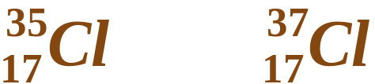
Atomic Theory of Matter
Nuclear structure; Isotopes
  Isotopes are atoms whose nuclei have the same atomic number but different mass numbers; that is, the nuclei have the same number of protons but different numbers of neutrons.
  Chlorine, for example, exists as two isotopes: chlorine-35 and chlorine-37.
  The fractional abundance is the fraction of a sample of atoms that is composed of a particular isotope. (See Figure 2.13)
Copyright © Houghton Mifflin Company.All rights reserved.
Presentation of Lecture Outlines, 1–<number>
Notes:
2

Slide 14
Atomic Weights
Calculate the atomic weight of boron, B, from the following data:
ISOTOPE ISOTOPIC MASS (amu) FRACTIONAL ABUNDANCE
B-10 10.013 0.1978
B-11 11.009 0.8022
Copyright © Houghton Mifflin Company.All rights reserved.
Presentation of Lecture Outlines, 1–<number>

Slide 15
Atomic Weights
Calculate the atomic weight of boron, B, from the following data:
ISOTOPE ISOTOPIC MASS (amu) FRACTIONAL ABUNDANCE
B-10 10.013 0.1978
B-11 11.009 0.8022
B-10: 10.013 x 0.1978 = 1.9805
B-11: 11.009 x 0.8022 = 8.8314
10.8119 = 10.812 amu
( = atomic wt.)
Copyright © Houghton Mifflin Company.All rights reserved.
Presentation of Lecture Outlines, 1–<number>

Slide 16
Chemical Formulas; Molecular and Ionic Substances
Organic compounds
  An important class of molecular substances that contain carbon is the organic compounds.
  Organic compounds make up the majority of all known compounds.
  The simplest organic compounds are hydrocarbons, or compounds containing only hydrogen and carbon.
  Common examples include methane, CH₄, ethane, C₂H₆, and propane, C₃H₈.
Copyright © Houghton Mifflin Company.All rights reserved.
Presentation of Lecture Outlines, 1–<number>
Notes:
2

Slide 17
Chemical Substances; Formulas and Names
Binary molecular compounds
  Here are some examples of prefix names for binary molecular compounds.
  SF₄ sulfur tetrafluoride
  ClO₂ chlorine dioxide
  SF₆ sulfur hexafluoride
  Cl₂O₇ dichlorine heptoxide
Copyright © Houghton Mifflin Company.All rights reserved.
Presentation of Lecture Outlines, 1–<number>
Notes:
2

Slide 18
Chemical Substances; Formulas and Names
Hydrates
  A hydrate is a compound that contains water molecules weakly bound in its crystals.
  Hydrates are named from the anhydrous (dry) compound, followed by the word “hydrate” with a prefix to indicate the number of water molecules per formula unit of the compound.
  For example, CuSO₄. 5H₂O is known as copper(II)sulfate pentahydrate. (See Figure 2.27)
Copyright © Houghton Mifflin Company.All rights reserved.
Presentation of Lecture Outlines, 1–<number>
Notes:
2

Slide 19
Working with Solutions
Molar Concentration
When we dissolve a substance in a liquid, we call the substance the solute and the liquid the solvent.
  The general term concentration refers to the quantity of solute in a standard quantity of solution.
Copyright © Houghton Mifflin Company.All rights reserved.
Presentation of Lecture Outlines, 1–<number>

Slide 20
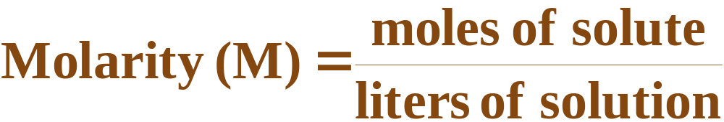
Working with Solutions
Molar Concentration
Molar concentration, or molarity (M), is defined as the moles of solute dissolved in one liter (cubic decimeter) of solution.
Copyright © Houghton Mifflin Company.All rights reserved.
Presentation of Lecture Outlines, 1–<number>

Slide 21

Working with Solutions
Molar Concentration
The molarity of a solution and its volume are inversely proportional. Therefore, adding water makes the solution less concentrated.
  This inverse relationship takes the form of:
  So, as water is added, increasing the final volume, V_{f}, the final molarity, M_{f}, decreases.
Copyright © Houghton Mifflin Company.All rights reserved.
Presentation of Lecture Outlines, 1–<number>

Slide 22
Quantitative Analysis
Gravimetric Analysis
Gravimetric analysis is a type of quantitative analysis in which the amount of a species in a material is determined by converting the species into a product that can be isolated and weighed.
  Precipitation reactions are often used in gravimetric analysis.
  The precipitate from these reactions is then filtered, dried, and weighed.
Copyright © Houghton Mifflin Company.All rights reserved.
Presentation of Lecture Outlines, 1–<number>

Slide 23
Quantitative Analysis
Gravimetric Analysis
Suppose a 1.00 L sample of polluted water was analyzed for lead(II) ion, Pb2+, by adding an excess of sodium sulfate to it. The mass of lead(II) sulfate that precipitated was 229.8 mg. What is the mass of lead in a liter of the water? Express the answer as mg of lead per liter of solution.
Copyright © Houghton Mifflin Company.All rights reserved.
Presentation of Lecture Outlines, 1–<number>

Slide 24
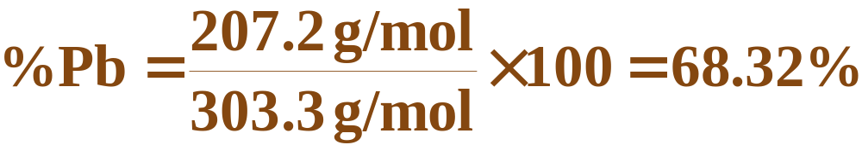
Quantitative Analysis
Gravimetric Analysis
First we must obtain the mass percentage of lead in lead(II) sulfate, by dividing the molar mass of lead by the molar mass of PbSO₄, then multiplying by 100.
  Then, calculate the amount of lead in the PbSO₄ precipitated.
Copyright © Houghton Mifflin Company.All rights reserved.
Presentation of Lecture Outlines, 1–<number>

Slide 25
Quantitative Analysis
Volumetric Analysis
Consider the reaction of sulfuric acid, H₂SO₄, with sodium hydroxide, NaOH:
  Suppose a beaker contains 35.0 mL of 0.175 M H₂SO₄. How many milliliters of 0.250 M NaOH must be added to completely react with the sulfuric acid?
Copyright © Houghton Mifflin Company.All rights reserved.
Presentation of Lecture Outlines, 1–<number>

Slide 26
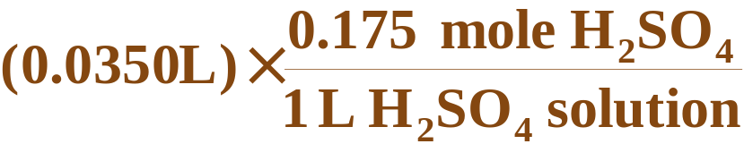
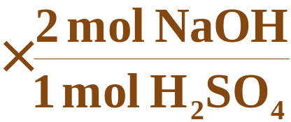
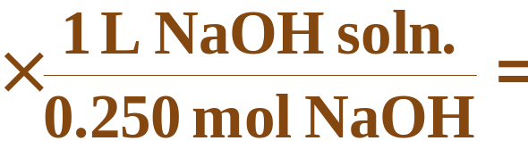
Quantitative Analysis
Volumetric Analysis
  First we must convert the 0.0350 L (35.0 mL) to moles of H₂SO₄ (using the molarity of the H₂SO₄).
  Then, convert to moles of NaOH (from the balanced chemical equation).
  Finally, convert to volume of NaOH solution (using the molarity of NaOH).
Copyright © Houghton Mifflin Company.All rights reserved.
Presentation of Lecture Outlines, 1–<number>

