Slide 1
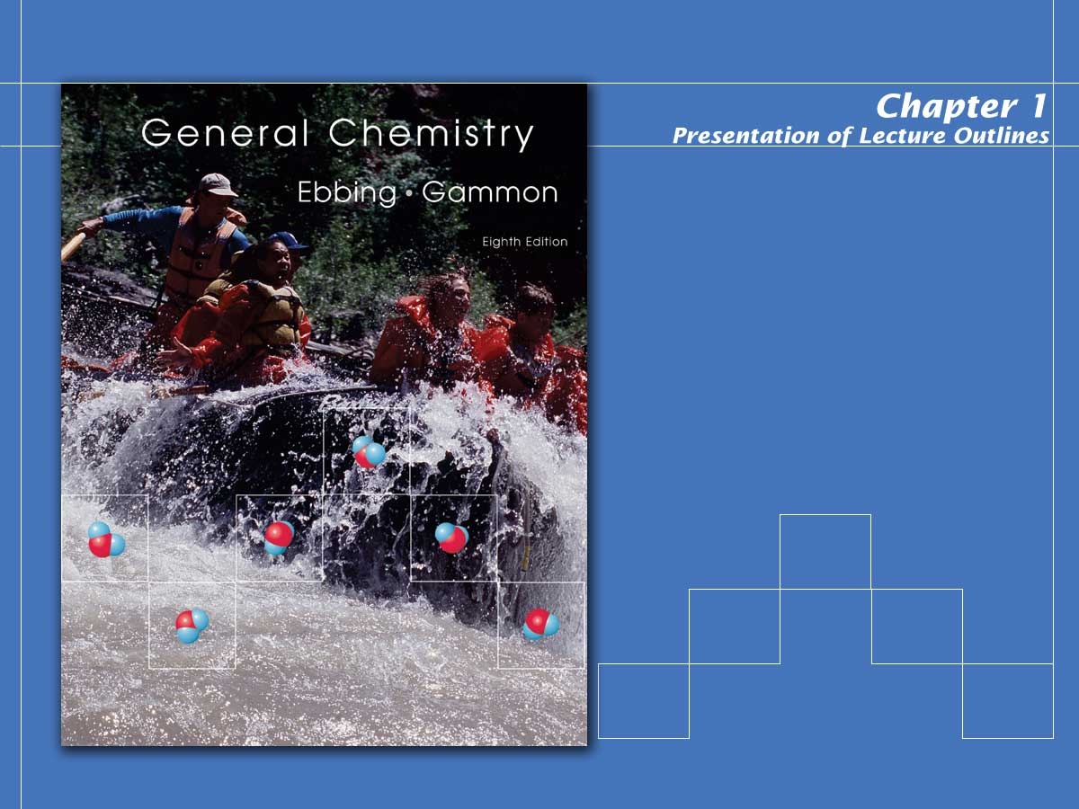
Chemistry and Measurement

Slide 2

What Is Chemistry?
Chemistry is the study of the composition, structure, and properties of matter and energy and changes that matter undergoes.
  Matter is anything that occupies space and has mass.
  Energy is the “ability to do work.”
Notes:
2

Slide 3
Experiment and Explanation
The general process of advancing scientific knowledge through observation, laws, hypotheses, or theories is called the scientific method. (See Figure 1.7)
<footer>Copyright © Houghton Mifflin Company.All rights reserved.
Presentation of Lecture Outlines, 1–<number>
Notes:
2

Slide 4
Matter: Physical State and
Chemical Constitution
There are two principal ways of classifying matter:
  By its physical state as a solid, liquid, or gas.
  By its chemical constitution as an element, compound, or mixture.
Notes:
2

Slide 5
Solids, Liquids, and Gases
Solid: the form of matter characterized by rigidity; a solid is relatively incompressible and has a fixed shape and volume. (See Figure 1.11a)
Liquid: the form of matter that is a relatively incompressible fluid; liquid has a fixed volume but no fixed shape. (See Figure 1.11b)
Gas: the form of matter that is an easily compressible fluid; a given quantity of gas will fit into a container of almost any size in shape. (See Figure 1.11c)
Notes:
2

Slide 6
Elements, Compounds, and Mixtures
To understand how matter is classified by its chemical constitution we must first look at physical and chemical changes.
  A physical change is a change in the form of matter but not in its chemical identity.
  Physical changes are usually reversible.
  No new compounds are formed during a physical change.
  Melting ice is an example of a physical change.
Notes:
2

Slide 7
Elements, Compounds, and Mixtures (cont’d)
A chemical change, or chemical reaction, is a change in which one or more kinds of matter are transformed into a new kind of matter or several new kinds of matter.
  Chemical changes are usually irreversible.
  New compounds are formed during a chemical change.
  The rusting of iron is an example of a chemical change.
Notes:
2

Slide 8
Elements, Compounds, and Mixtures (cont’d)
A physical property is a characteristic that can be observed for material without changing its chemical identity.
Examples are physical state (solid, liquid,or gas), melting point, and color.
A chemical property is a characteristic of a material involving its chemical change.
  A chemical property of iron is its ability to react with oxygen to produce rust.
Notes:
2

Slide 9
Elements, Compounds, and Mixtures (cont’d)
Millions of substances have been characterized by chemists. Of these, a very small number are known as elements, from which all other substances are made.
  An element is a substance that cannot be decomposed by any chemical reaction into simpler substances. (See Figure 1.14)
  The smallest unit of an element is the atom.
Notes:
2

Slide 10
Elements, Compounds, and Mixtures (cont’d)
Most substances are compounds.
  A compound is a substance composed of two or more elements chemically combined.
  The smallest unit of a compound is the molecule.
  The law of definite proportions states that a pure compound, whatever its source, always contains definite or constant proportions of the elements by mass.
Notes:
2

Slide 11
Elements, Compounds, and Mixtures (cont’d)
Most of the materials we See around us are mixtures.
  A mixture is a material that can be separated by physical means into two or more substances. (See Figure 1.12 and Figure 1.19)
  Unlike a pure compound, a mixture has variable composition.
  Mixtures are classified as heterogeneous if they consist of physically distinct parts or homogeneous when the properties are uniform throughout. (See Figure 1.15a , Figure 1.15b)
Notes:
2

Slide 12
Measurement and Significant Figures
Measurement is the comparison of a physical quantity to be measured with a unit of measurement -- that is, with a fixed standard of measurement.
  The term precision refers to the closeness of the set of values obtained from identical measurements of a quantity.
  Accuracy is a related term; it refers to the closeness of a single measurements to its true value.
Notes:
2

Slide 13
Measurement and Significant Figures (cont’d)
To indicate the precision of a measured number (or result of calculations on measured numbers), we often use the concept of significant figures.
  Significant figures are those digits in a measured number (or result of the calculation with a measured number) that include all certain digits plus a final one having some uncertainty.
Notes:
2

Slide 14
Measurement and Significant Figures (cont’d)
To count the number of significant figures in a measurement, observe the following rules:
  All nonzero digits are significant.
  Zeros between significant figures are significant.
  Zeros preceding the first nonzero digit are not significant.
  Zeros to the right of the decimal after a nonzero digit are significant.
  Zeros at the end of a nondecimal number may or may not be significant. (Use scientific notation.)
Notes:
2

Slide 15
Measurement and Significant Figures (cont’d)
Number of significant figures refers to the number of digits reported for the value of a measured or calculated quantity, indicating the precision of the value.
  When multiplying and dividing measured quantities, give as many significant figures as the least found in the measurements used.
  When adding or subtracting measured quantities, give the same number of decimals as the least found in the measurements used.
Notes:
2

Slide 16
Measurement and Significant Figures (cont’d)
14.0 g /102.4 mL = 0.137 g/mL
only three significant figures

Slide 17
Measurement and Significant Figures (cont’d)
An exact number is a number that arises when you count items or when you define a unit.
  For example, when you say you have nine coins in a bottle, you mean exactly nine.
  When you say there are twelve inches in a foot, you mean exactly twelve.
  Note that exact numbers have no effect on significant figures in a calculation.
Notes:
2

Slide 18
SI Units and SI Prefixes
In 1960, the General Conference of Weights and Measures adopted the International System of units (or SI), which is a particular choice of metric units.
  This system has seven SI base units, the SI units from which all others can be derived.
Notes:
2

Slide 19
Table 1.2 SI Base Units
Quantity | Unit | Symbol
Length | Meter | m
Mass | Kilogram | Kg
Time | Second | S
Temperature | Kelvin | K
Amount of substance | Mole | mol
Electric current | Ampere | A
Luminous intensity | Candela | cd
Notes:
2

Slide 20
SI Units and SI Prefixes
The advantage of the metric system is that it is a decimal system.
  A larger or smaller unit is indicated by a SI prefix -- that is, a prefix used in the International System to indicate a power of 10.
  Table 1.3 lists the SI prefixes. The next slide shows those most commonly used.
Notes:
2

Slide 21
Table 1.3 SI Prefixes
Multiple | Prefix | Symbol
10⁶ | mega | M
10³ | kilo | k
10⁻¹ | deci | D
10⁻² | centi | C
10⁻³ | milli | m
10⁻⁶ | micro | μ
10⁻⁹ | nano | n
10⁻¹² | pico | p
Notes:
2

Slide 22
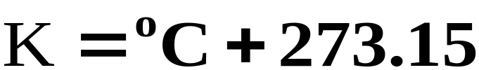
Temperature
The Celsius scale (formerly the Centigrade scale) is the temperature scale in general scientific use.
  However, the SI base unit of temperature is the kelvin (K), a unit based on the absolute temperature scale.
  The conversion from Celsius to Kelvin is simple since the two scales are simply offset by 273.15o.
Notes:
2

Slide 23
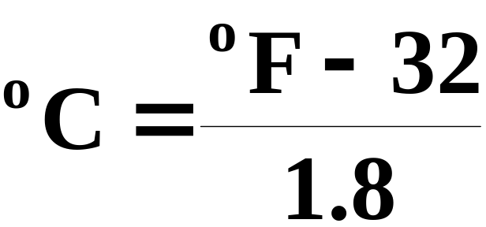
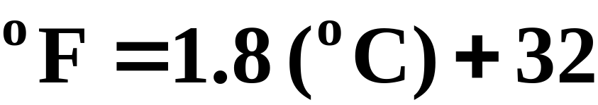
Temperature
The Fahrenheit scale is at present the common temperature scale in the United States.
  The conversion of Fahrenheit to Celsius, and vice versa, can be accomplished with the following formulas (See Figure 1.23).
Notes:
2

Slide 24
Derived Units
  Volume is defined as length cubed and has an SI unit of cubic meters (m3).
  Traditionally, chemists have used the liter (L), which is a unit of volume equal to one cubic decimeter.
Notes:
2

Slide 25
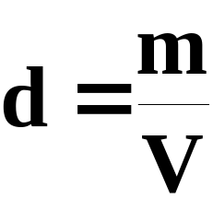
Derived Units
The density of an object is its mass per unit volume,
where d is the density, m is the mass, and V is the volume. (See Figure 1.25)
  Generally the unit of mass is the gram.
  The unit of volume is the mL for liquids; cm³ for solids; and L for gases.
Notes:
2

Slide 26
A Density Example
A sample of the mineral galena (lead sulfide) weighs 12.4 g and has a volume of 1.64 cm3. What is the density of galena?
mass
12.4 g
Density =
=
volume
1.64 cm³

Slide 27
A Density Example
A sample of the mineral galena (lead sulfide) weighs 12.4 g and has a volume of 1.64 cm3. What is the density of galena?
mass
12.4 g
Density =
=
= 7.5609 = 7.56 g/cm³
volume
1.64 cm³

Slide 28
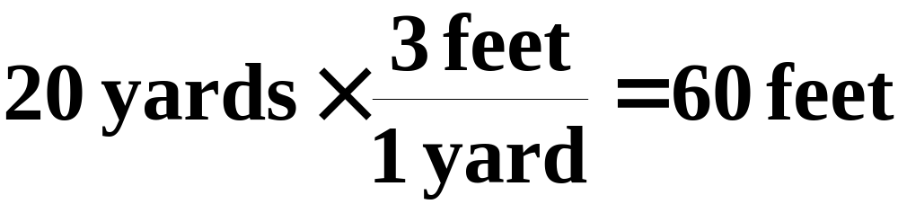
Units: Dimensional Analysis
Dimensional analysis (or the factor-label method) is the method of calculation in which one carries along the units for quantities.
  Suppose you simply wish to convert 20 yards to feet.
  Note that the units have cancelled properly to give the final unit of feet.
Notes:
2

Slide 29
Table 1.5 Relationships of Some U.S. and Metric Units
Length | Mass | Volume
1 in = 2.54 cm | 1 lb = 0.4536 kg | 1 qt = 0.9464 L
1 yd = 0.9144 m | 1 lb = 16 oz | 4 qt = 1 gal
1 mi = 1.609 km | 1 oz = 28.35 g
1 mi = 5280 ft
Notes:
2

Slide 30
Unit Conversion
Sodium hydrogen carbonate (baking soda) reacts with acidic materials such as vinegar to release carbon dioxide gas. Given an experiment calling for 0.348 kg of sodium hydrogen carbonate, express this mass in milligrams.
10³ g
10³ mg
0.348 kg x
x
= 3.48 x 10⁵ mg
1 kg
1 g

Slide 31
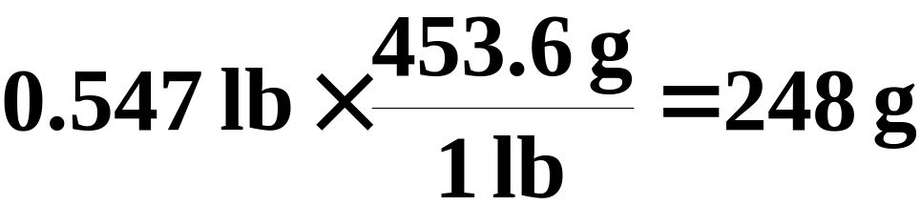
Unit Conversion
Suppose you wish to convert 0.547 lb to grams.
  From Table 1.5, note that 1 lb = 453.6 g, so the conversion factor from pounds to grams is 453.6 g/1 lb. Therefore,

Slide 32
Operational Skills
Using the law of conservation of mass.
Using significant figures in calculations.
Converting from one temperature scale to another.
Calculating the density of a substance.
Converting units.

Slide 33

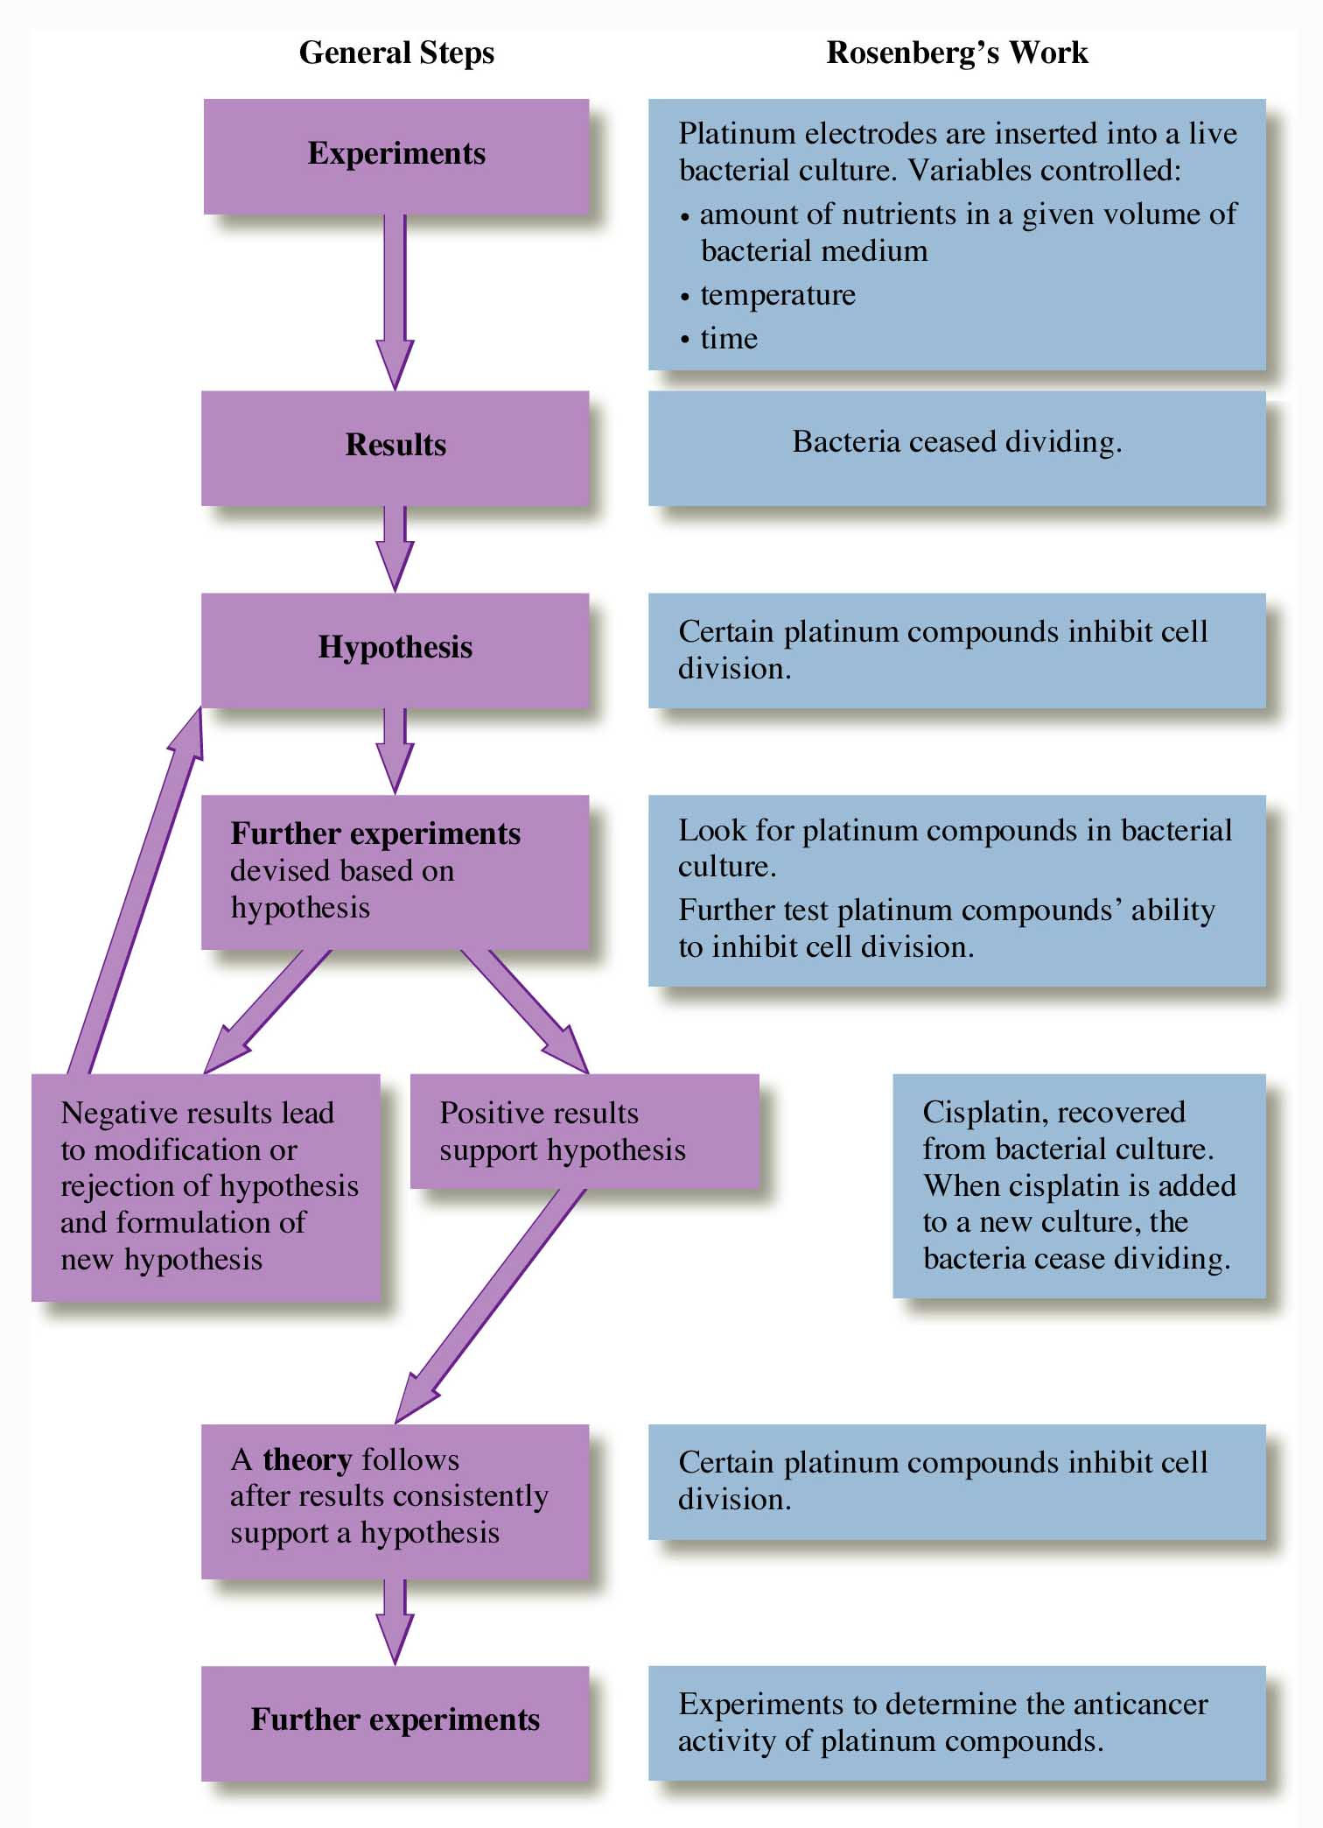
Figure 1.7:
A representation of the scientific method.
Return to slide 6.

Slide 34
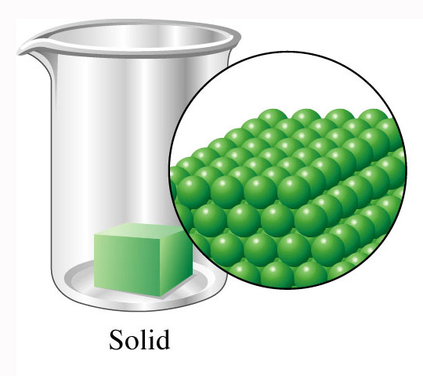
Figure 1.11a: Molecular representation of a solid.
Return to slide 8.

Slide 35
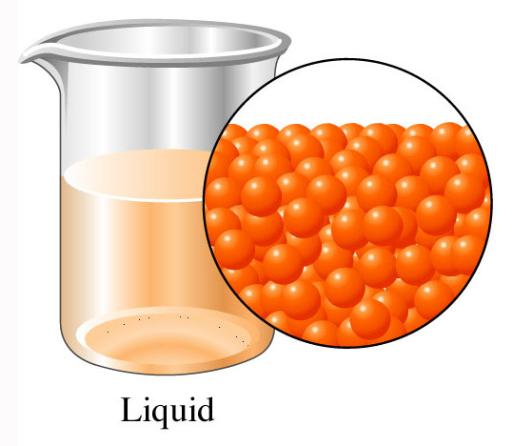
Figure 1.11b: Molecular representation of a solid.
Return to slide 8.

Slide 36
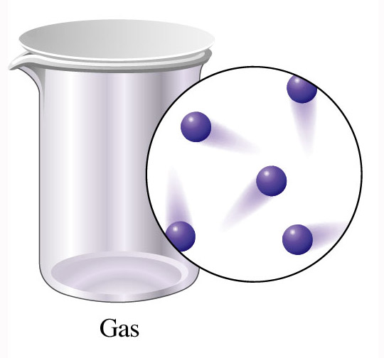
Figure 1.11c: Molecular representation of a solid.
Return to slide 8.

Slide 37
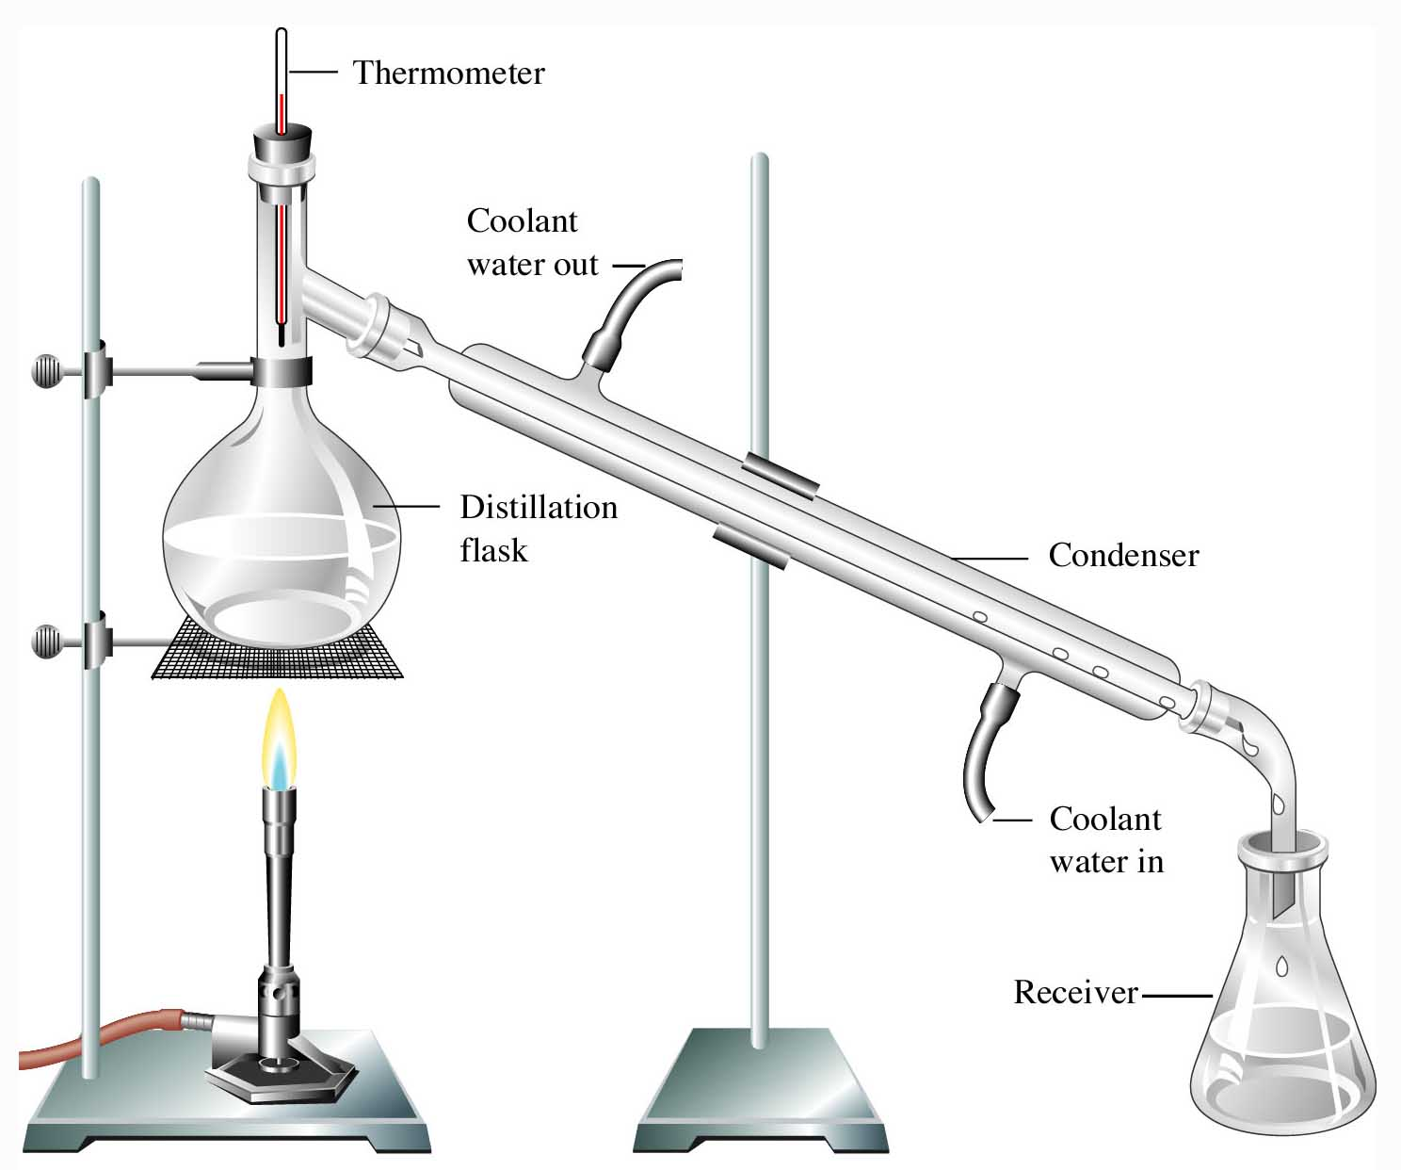
Figure 1.12: Separation by distillation.
Return to slide 14.

Slide 38
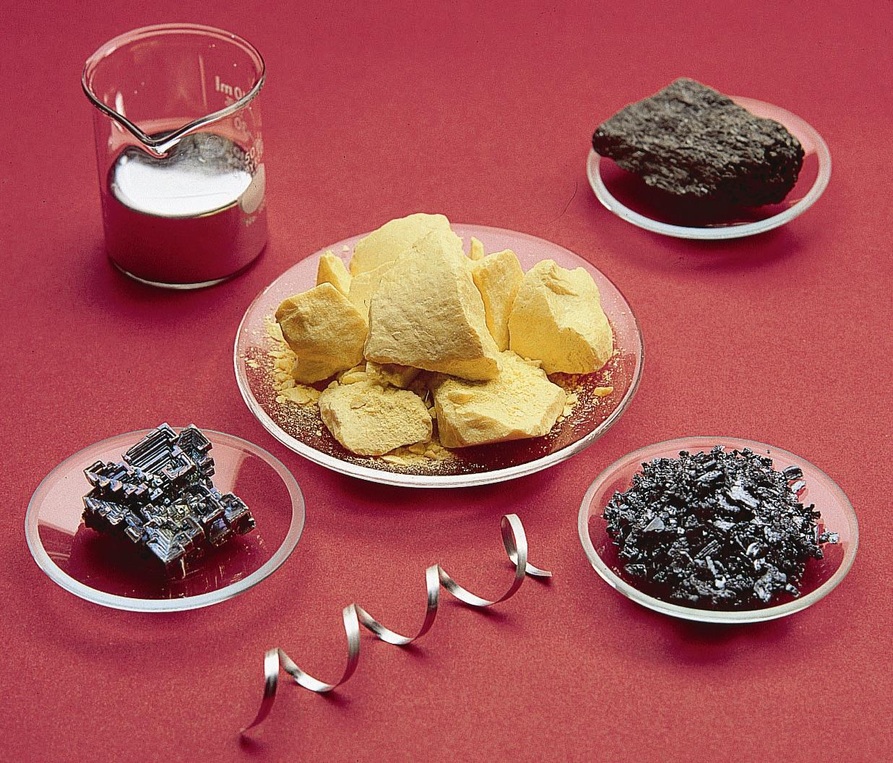
Figure 1.14: Elements: sulfur, arsenic, iodine, magnesium, bismuth, mercury. Photo courtesy of American Color.
Return to slide 12.

Slide 39
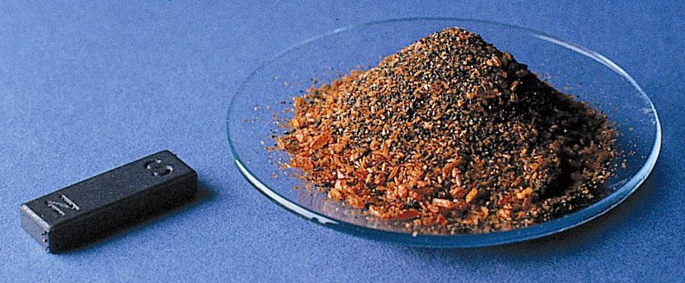
Figure 1.15: A mixture of potassium dichromate and iron fillings. Photo courtesy of James Scherer.
Return to slide 15.

Slide 40
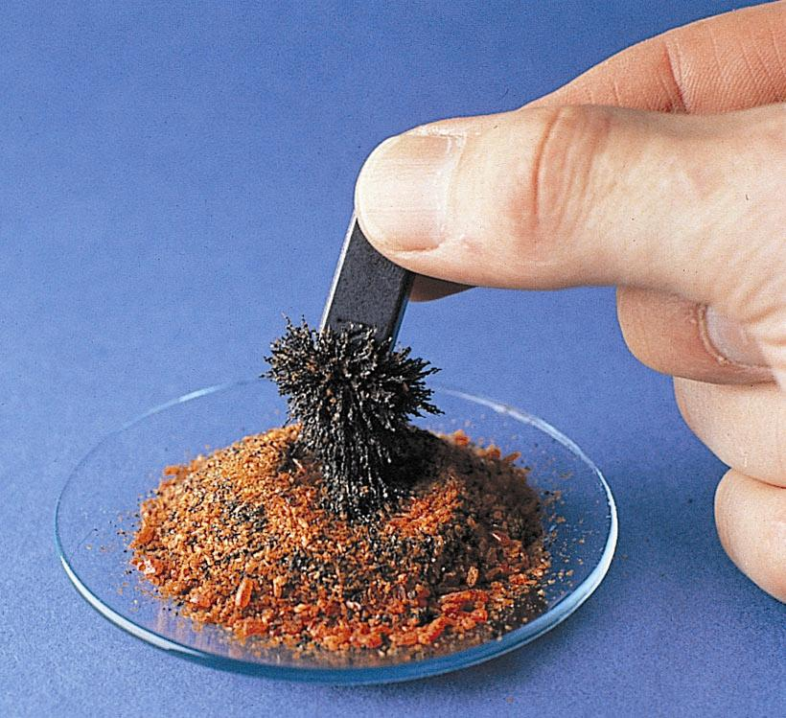
Figure 1.15: A magnet separates the iron filling from the mixture. Photo courtesy of James Scherer.
Return to slide 15.

Slide 41
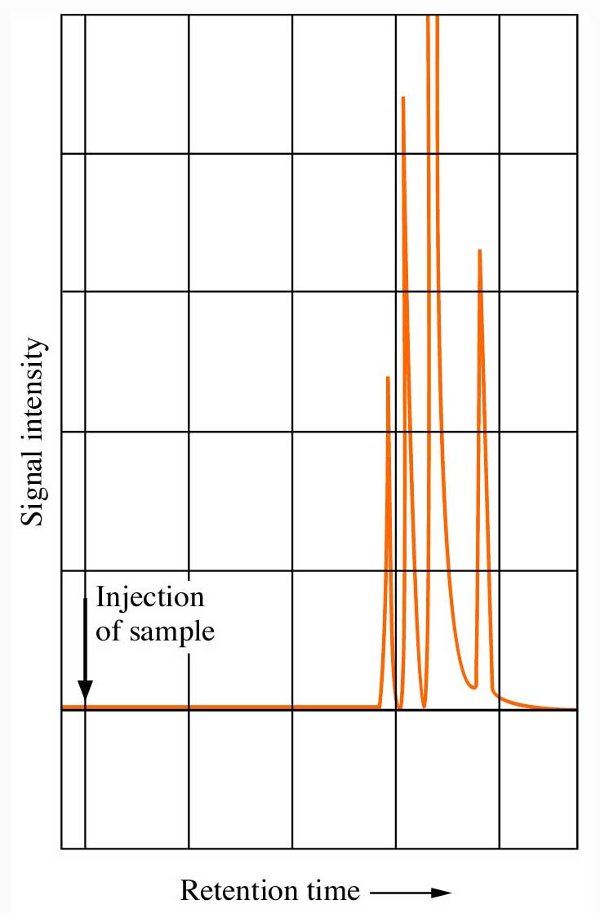
Figure 1.19:
Gas chromatography
Return to slide 14.

Slide 42
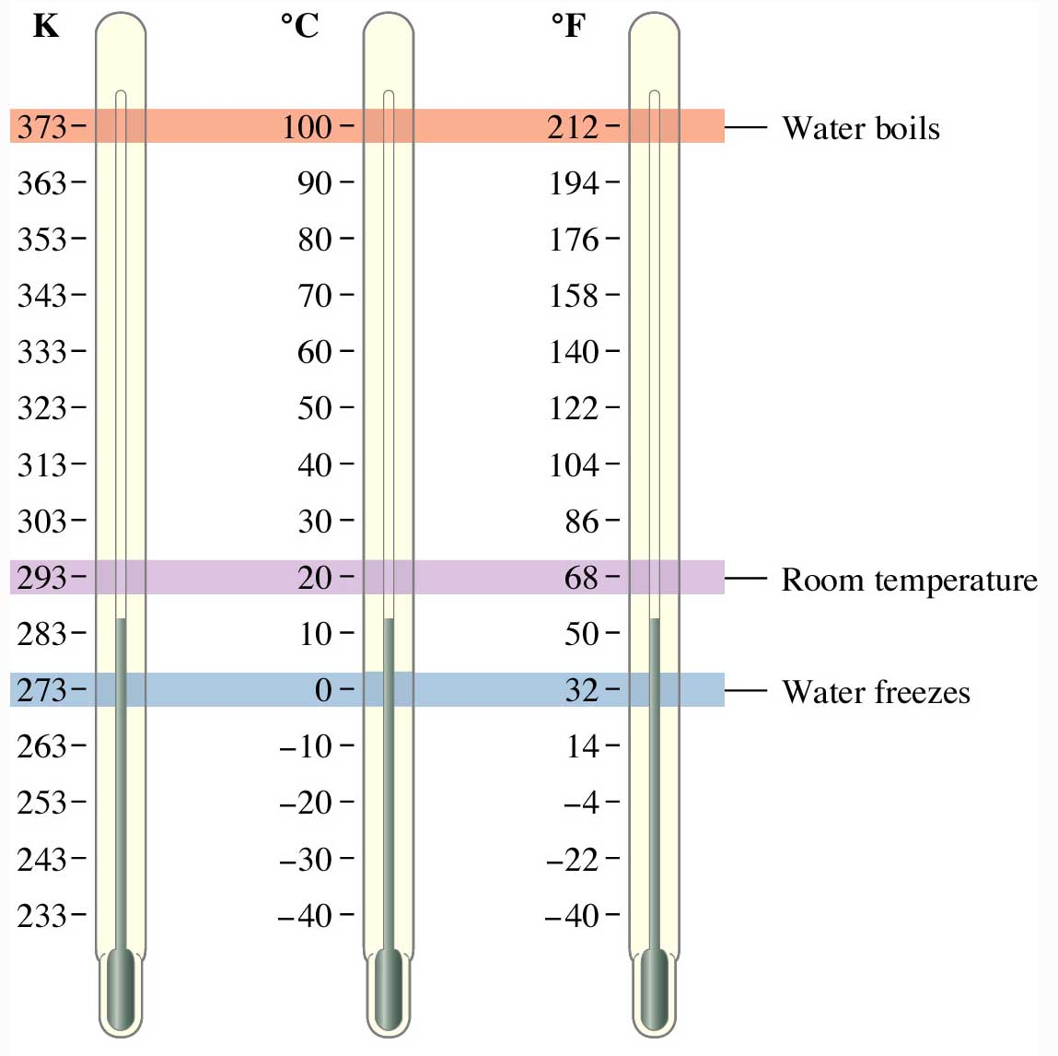
Figure 1.23: Comparison of temperature scales.
Return to slide 29.

Slide 43
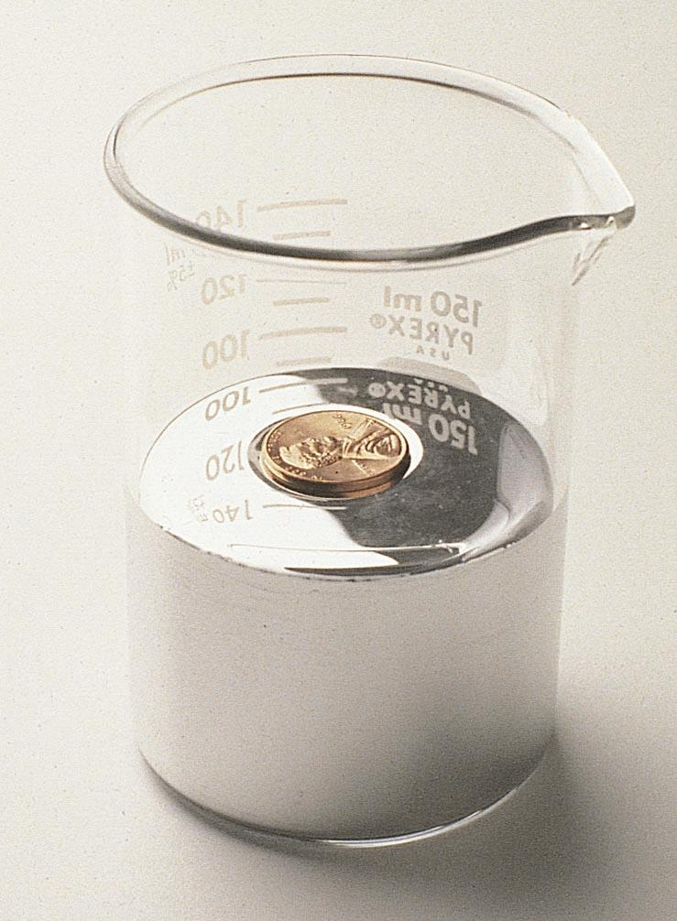
Figure 1.25: The relative densities of copper and mercury.
Photo courtesy of James Scherer.
Return to slide 31.

