Slide 1
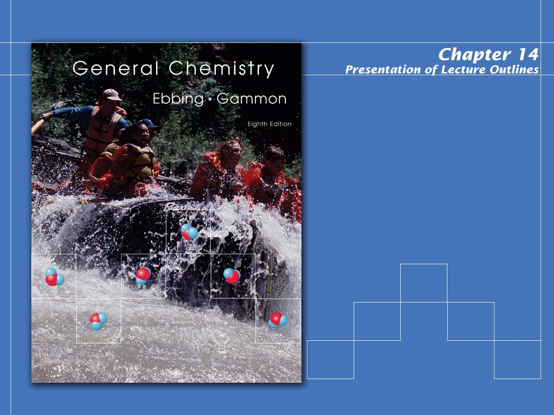
Rates of Reaction

Slide 2

Reaction Rates
Chemical reactions require varying lengths of time for completion.
  This reaction rate depends on the characteristics of the reactants and products and the conditions under which the reaction is run. (see Figure 14.1)

Slide 3
Reaction Rates
The questions posed in this chapter will be:
  How is the rate of a reaction measured?
  What conditions will affect the rate of a reaction?
  How do you express the relationship of rate to the variables affecting the rate?
  What happens on a molecular level during a chemical reaction?

Slide 4
Reaction Rates
Chemical kinetics is the study of reaction rates, how reaction rates change under varying conditions, and what molecular events occur during the overall reaction.
  What variables affect reaction rate?
Concentration of reactants.
Concentration of a catalyst
Temperature at which the reaction occurs.
Surface area of a solid reactant or catalyst.

Slide 5
Factors Affecting Reaction Rates
Concentration of reactants.
  More often than not, the rate of a reaction increases when the concentration of a reactant is increased.
  Increasing the population of reactants increases the likelihood of a successful collision.
  In some reactions, however, the rate is unaffected by the concentration of a particular reactant, as long as it is present at some concentration.

Slide 6
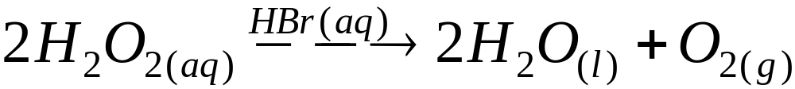
Factors Affecting Reaction Rates
Concentration of a catalyst.
  A catalyst is a substance that increases the rate of a reaction without being consumed in the overall reaction.
  The catalyst generally does not appear in the overall balanced chemical equation (although its presence may be indicated by writing its formula over the arrow).

Slide 7
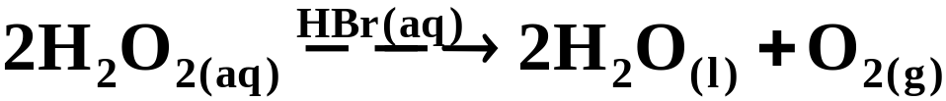
Factors Affecting Reaction Rates
Concentration of a catalyst.
  Figure 14.2 shows the HBr catalyzed decomposition of H₂O₂ to H₂O and O₂.
  A catalyst speeds up reactions by reducing the “activation energy” needed for successful reaction.
  A catalyst may also provide an alternative mechanism, or pathway, that results in a faster rate.

Slide 8
Factors Affecting Reaction Rates
Temperature at which a reaction occurs.
  Usually reactions speed up when the temperature increases.

Slide 9
Factors Affecting Reaction Rates
Surface area of a solid reactant or catalyst.
  Because the reaction occurs at the surface of the solid, the rate increases with increasing surface area.

Slide 10
Definition of Reaction Rate
The reaction rate is the increase in molar concentration of a product of a reaction per unit time.
  It can also be expressed as the decrease in molar concentration of a reactant per unit time.

Slide 11
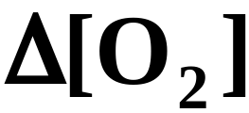
Definition of Reaction Rates
Consider the gas-phase decomposition of dintrogen pentoxide.
  If we denote molar concentrations using brackets, then the change in the molarity of O₂ would be represented as
  where the symbol, Δ (capital Greek delta), means
  “the change in.”

Slide 12
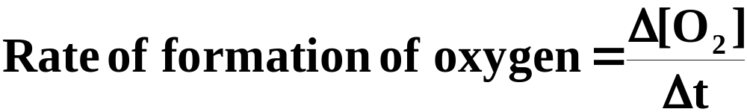
Definition of Reaction Rates
Then, in a given time interval, Δt , the molar concentration of O₂ would increase by Δ[O₂].
  The rate of the reaction is given by:
  This equation gives the average rate over the time interval, Δt.
  If Δt is short, you obtain an instantaneous rate, that is, the rate at a particular instant. (Figure 14.4)

Slide 13

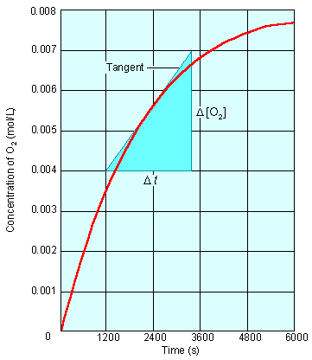

Figure 14.4 The instantaneous rate of reaction
In the reaction
The concentration of O₂ increases over time. You obtain the instantaneous rate from the slope of the tangent at the point of the curve corresponding to that time.

Slide 14
Definition of Reaction Rates
Figure 14.5 shows the increase in concentration of O₂ during the decomposition of N₂O₅.
  Note that the rate decreases as the reaction proceeds.

Slide 15
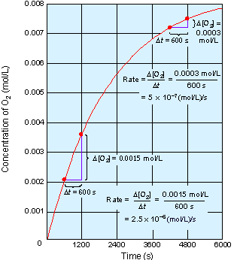
Figure 14.5 Calculation of the average rate.
When the time changes from 600 s to 1200 s, the average rate is
2.5 x 10⁻⁶ mol/(L.s). Later when the time changes from 4200 s to 4800 s, the average rate has slowed to
5 x 10⁻⁷ mol/(L.s). Thus, the rate of a reaction decreases as the reaction proceeds.

Slide 16
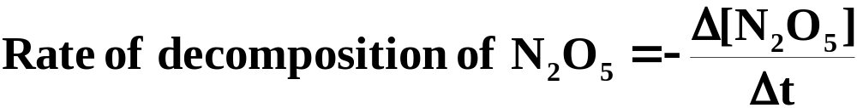
Definition of Reaction Rates
Because the amounts of products and reactants are related by stoichiometry, any substance in the reaction can be used to express the rate.
Note the negative sign. This results in a positive rate as reactant concentrations decrease.

Slide 17
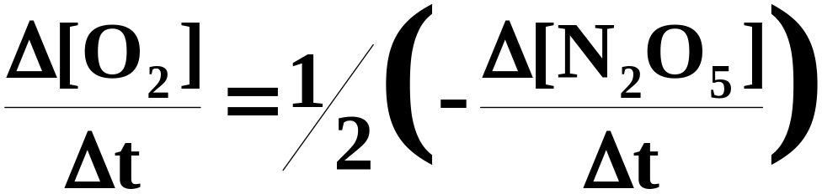
Definition of Reaction Rates
The rate of decomposition of N₂O₅ and the formation of O₂ are easily related.
Since two moles of N₂O₅ decompose for each mole of O₂ formed, the rate of the decomposition of N₂O₅ is twice the rate of the formation of O₂.

Slide 18
Dependence of Rate on Concentration
Experimentally, it has been found that the rate of a reaction depends on the concentration of certain reactants as well as catalysts.
  Let’s look at the reaction of nitrogen dioxide with fluorine to give nitryl fluoride.
  The rate of this reaction has been observed to be proportional to the concentration of nitrogen dioxide.

Slide 19
Dependence of Rate on Concentration
  When the concentration of nitrogen dioxide is doubled, the reaction rate doubles.
  The rate is also proportional to the concentration of fluorine; doubling the concentration of fluorine also doubles the rate.
  We need a mathematical expression to relate the rate of the reaction to the concentrations of the reactants.

Slide 20
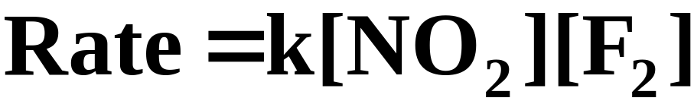
Dependence of Rate on Concentration
A rate law is an equation that relates the rate of a reaction to the concentration of reactants (and catalyst) raised to various powers.
  The rate constant, k, is a proportionality constant in the relationship between rate and concentrations.

Slide 21
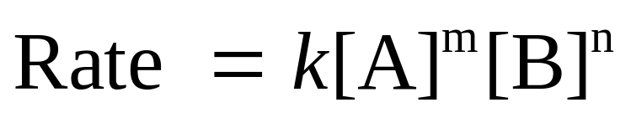
Dependence of Rate on Concentration
As a more general example, consider the reaction of substances A and B to give D and E.
  You could write the rate law in the form
  The exponents m, n are frequently, but not always, integers. They must be determined experimentally and cannot be obtained by simply looking at the balanced equation.

Slide 22
Dependence of Rate on Concentration
Reaction Order
  The reaction order with respect to a given reactant species equals the exponent of the concentration of that species in the rate law, as determined experimentally.
  The overall order of the reaction equals the sum of the orders of the reacting species in the rate law.

Slide 23
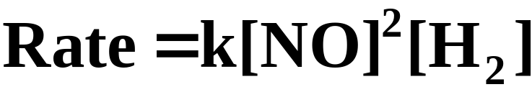
Dependence of Rate on Concentration
Reaction Order
  Consider the reaction of nitric oxide with hydrogen according to the following equation.
  The experimentally determined rate law is
  Thus, the reaction is second order in NO, first order in H₂, and third order overall.

Slide 24
Dependence of Rate on Concentration
Reaction Order
  Zero and negative orders are also possible.
  The concentration of a reactant with a zero-order dependence has no effect on the rate of the reaction.
  Although reaction orders frequently have whole number values (particularly 1 and 2), they can be fractional.

Slide 25
Dependence of Rate on Concentration
Determining the Rate Law.
  One method for determining the order of a reaction with respect to each reactant is the method of initial rates.
  It involves running the experiment multiple times, each time varying the concentration of only one reactant and measuring its initial rate.
  The resulting change in rate indicates the order with respect to that reactant.

Slide 26
Dependence of Rate on Concentration
Determining the Rate Law.
  If doubling the concentration of a reactant has a doubling effect on the rate, then one would deduce it was a first-order dependence.
  If doubling the concentration had a quadrupling effect on the rate, one would deduce it was a second-order dependence.
  A doubling of concentration that results in an eight-fold increase in the rate would be a third-order dependence.

Slide 27
A Problem to Consider
Iodide ion is oxidized in acidic solution to triiodide ion, I3- , by hydrogen peroxide.
A series of four experiments was run at different concentrations, and the initial rates of I₃⁻ formation were determined.
From the following data, obtain the reaction orders with respect to H₂O₂, I⁻, and H⁺.
Calculate the numerical value of the rate constant.

Slide 28
A Problem to Consider
 | Initial Concentrations (mol/L)
 | H₂O₂ | I⁻ | H⁺ | Initial Rate [mol/(L.s)]
Exp. 1 | 0.010 | 0.010 | 0.00050 | 1.15 x 10⁻⁶
Exp. 2 | 0.020 | 0.010 | 0.00050 | 2.30 x 10⁻⁶
Exp. 3 | 0.010 | 0.020 | 0.00050 | 2.30 x 10⁻⁶
Exp. 4 | 0.010 | 0.010 | 0.00100 | 1.15 x 10⁻⁶
Comparing Experiment 1 and Experiment 2, you see that when the H₂O₂ concentration doubles (with other concentrations constant), the rate doubles.
This implies a first-order dependence with respect to H₂O₂.

Slide 29
A Problem to Consider
 | Initial Concentrations (mol/L)
 | H₂O₂ | I⁻ | H⁺ | Initial Rate [mol/(L.s)]
Exp. 1 | 0.010 | 0.010 | 0.00050 | 1.15 x 10⁻⁶
Exp. 2 | 0.020 | 0.010 | 0.00050 | 2.30 x 10⁻⁶
Exp. 3 | 0.010 | 0.020 | 0.00050 | 2.30 x 10⁻⁶
Exp. 4 | 0.010 | 0.010 | 0.00100 | 1.15 x 10⁻⁶
Comparing Experiment 1 and Experiment 3, you see that when the I⁻ concentration doubles (with other concentrations constant), the rate doubles.
This implies a first-order dependence with respect to I⁻.

Slide 30
A Problem to Consider
 | Initial Concentrations (mol/L)
 | H₂O₂ | I⁻ | H⁺ | Initial Rate [mol/(L.s)]
Exp. 1 | 0.010 | 0.010 | 0.00050 | 1.15 x 10⁻⁶
Exp. 2 | 0.020 | 0.010 | 0.00050 | 2.30 x 10⁻⁶
Exp. 3 | 0.010 | 0.020 | 0.00050 | 2.30 x 10⁻⁶
Exp. 4 | 0.010 | 0.010 | 0.00100 | 1.15 x 10⁻⁶
Comparing Experiment 1 and Experiment 4, you see that when the H⁺ concentration doubles (with other concentrations constant), the rate is unchanged.
This implies a zero-order dependence with respect to H⁺.

Slide 31
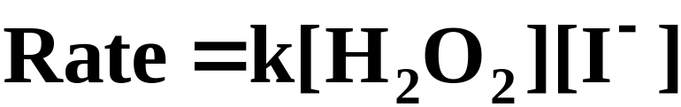
A Problem to Consider
 | Initial Concentrations (mol/L)
 | H₂O₂ | I⁻ | H⁺ | Initial Rate [mol/(L.s)]
Exp. 1 | 0.010 | 0.010 | 0.00050 | 1.15 x 10⁻⁶
Exp. 2 | 0.020 | 0.010 | 0.00050 | 2.30 x 10⁻⁶
Exp. 3 | 0.010 | 0.020 | 0.00050 | 2.30 x 10⁻⁶
Exp. 4 | 0.010 | 0.010 | 0.00100 | 1.15 x 10⁻⁶
Because [H⁺]⁰ = 1, the rate law is:
The reaction orders with respect to H₂O₂, I⁻, and H⁺, are 1, 1, and 0, respectively.

Slide 32
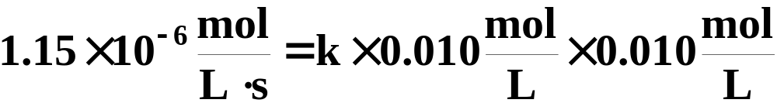
A Problem to Consider
 | Initial Concentrations (mol/L)
 | H₂O₂ | I⁻ | H⁺ | Initial Rate [mol/(L.s)]
Exp. 1 | 0.010 | 0.010 | 0.00050 | 1.15 x 10⁻⁶
Exp. 2 | 0.020 | 0.010 | 0.00050 | 2.30 x 10⁻⁶
Exp. 3 | 0.010 | 0.020 | 0.00050 | 2.30 x 10⁻⁶
Exp. 4 | 0.010 | 0.010 | 0.00100 | 1.15 x 10⁻⁶
You can now calculate the rate constant by substituting values from any of the experiments. Using Experiment 1 you obtain:

Slide 33
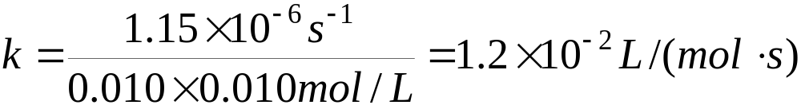
A Problem to Consider
 | Initial Concentrations (mol/L)
 | H₂O₂ | I⁻ | H⁺ | Initial Rate [mol/(L.s)]
Exp. 1 | 0.010 | 0.010 | 0.00050 | 1.15 x 10⁻⁶
Exp. 2 | 0.020 | 0.010 | 0.00050 | 2.30 x 10⁻⁶
Exp. 3 | 0.010 | 0.020 | 0.00050 | 2.30 x 10⁻⁶
Exp. 4 | 0.010 | 0.010 | 0.00100 | 1.15 x 10⁻⁶
You can now calculate the rate constant by substituting values from any of the experiments. Using Experiment 1 you obtain:

Slide 34
Change of Concentration with Time
A rate law simply tells you how the rate of reaction changes as reactant concentrations change.
  A more useful mathematical relationship would show how a reactant concentration changes over a period of time.

Slide 35
Change of Concentration with Time
A rate law simply tells you how the rate of reaction changes as reactant concentrations change.
  Using calculus we can transform a rate law into a mathematical relationship between concentration and time.
  This provides a graphical method for determining rate laws.

Slide 36
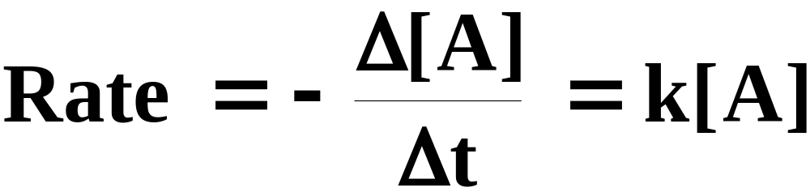
Concentration-Time Equations
First-Order Integrated Rate Law
  You could write the rate law in the form

Slide 37
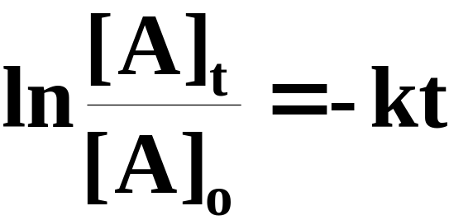
Concentration-Time Equations
First-Order Integrated Rate Law
  Using calculus, you get the following equation.
  Here [A]_{t} is the concentration of reactant A at time t, and [A]_{o} is the initial concentration.
  The ratio [A]_{t}/[A]_{o} is the fraction of A remaining at time t.

Slide 38
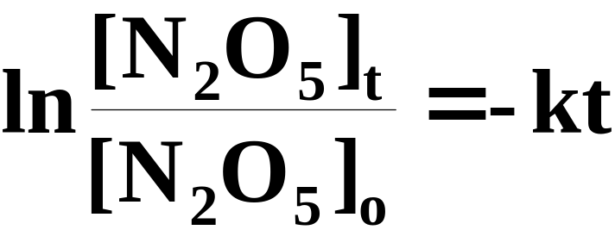
A Problem to Consider
The decomposition of N₂O₅ to NO₂ and O₂ is first order with a rate constant of 4.8 x 10⁻⁴ s⁻¹. If the initial concentration of N₂O₅ is 1.65 x 10⁻² mol/L, what is the concentration of N₂O₅ after 825 seconds?
  The first-order time-concentration equation for this reaction would be:

Slide 39
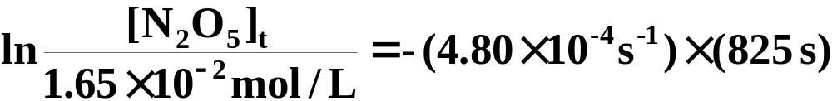
A Problem to Consider
The decomposition of N₂O₅ to NO₂ and O₂ is first order with a rate constant of 4.8 x 10⁻⁴ s⁻¹. If the initial concentration of N₂O₅ is 1.65 x 10⁻² mol/L, what is the concentration of N₂O₅ after 825 seconds?
  Substituting the given information we obtain:

Slide 40
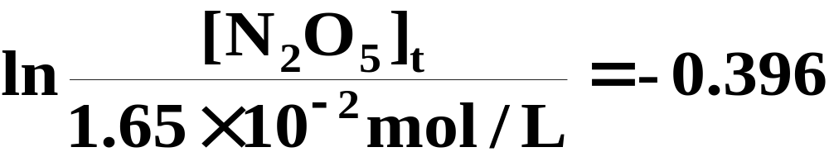
A Problem to Consider
The decomposition of N₂O₅ to NO₂ and O₂ is first order with a rate constant of 4.8 x 10⁻⁴ s⁻¹. If the initial concentration of N₂O₅ is 1.65 x 10⁻² mol/L, what is the concentration of N₂O₅ after 825 seconds?
  Substituting the given information we obtain:

Slide 41
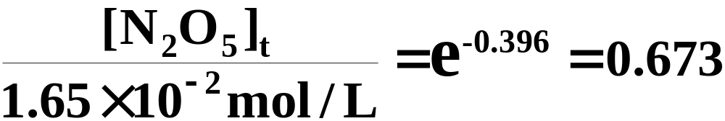
A Problem to Consider
The decomposition of N₂O₅ to NO₂ and O₂ is first order with a rate constant of 4.8 x 10⁻⁴ s⁻¹. If the initial concentration of N₂O₅ is 1.65 x 10⁻² mol/L, what is the concentration of N₂O₅ after 825 seconds?
  Taking the inverse natural log of both sides we obtain:

Slide 42
A Problem to Consider
The decomposition of N₂O₅ to NO₂ and O₂ is first order with a rate constant of 4.8 x 10⁻⁴ s⁻¹. If the initial concentration of N₂O₅ is 1.65 x 10⁻² mol/L, what is the concentration of N₂O₅ after 825 seconds?
  Solving for [N₂O₅] at 825 s we obtain:

Slide 43
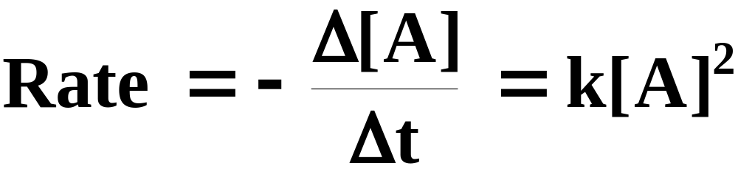
Concentration-Time Equations
Second-Order Integrated Rate Law
  You could write the rate law in the form

Slide 44
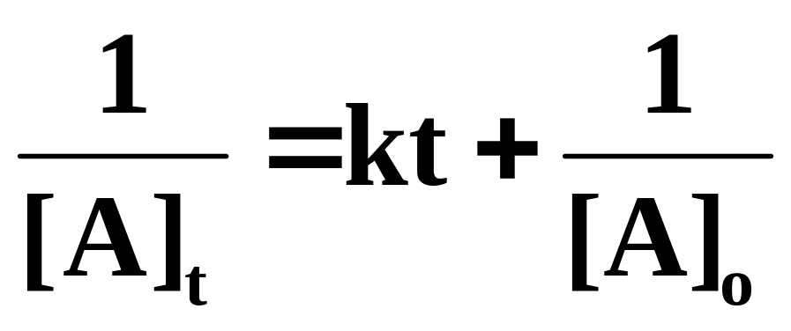
Concentration-Time Equations
Second-Order Integrated Rate Law
  Using calculus, you get the following equation.
  Here [A]_{t} is the concentration of reactant A at time t, and [A]_{o} is the initial concentration.

Slide 45
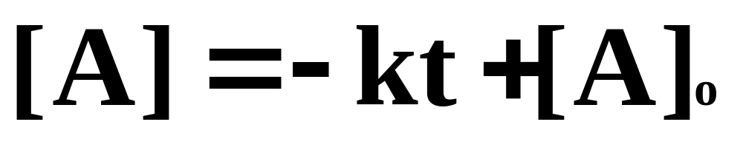
Concentration-Time Equations
Zero-Order Integrated Rate Law
  The Zero-Order Integrated Rate Law equation is:.

Slide 46
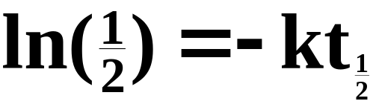
Half-life
The half-life of a reaction is the time required for the reactant concentration to decrease to one-half of its initial value.
  For a first-order reaction, the half-life is independent of the initial concentration of reactant.
  In one half-life the amount of reactant decreases by one-half. Substituting into the first-order concentration-time equation, we get:

Slide 47
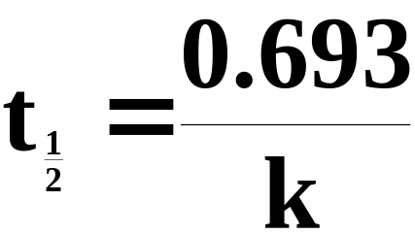
Half-life
The half-life of a reaction is the time required for the reactant concentration to decrease to one-half of its initial value.
  Solving for t_{1/2} we obtain:
  Figure 14.8 illustrates the half-life of a first-order reaction.

Slide 48
Half-life
Sulfuryl chloride, SO₂Cl₂, decomposes in a first-order reaction to SO₂ and Cl₂.
At 320 ºC, the rate constant is 2.2 x 10⁻⁵ s⁻¹. What is the half-life of SO₂Cl₂ vapor at this temperature?
Substitute the value of k into the relationship between k and t_{1/2.}

Slide 49
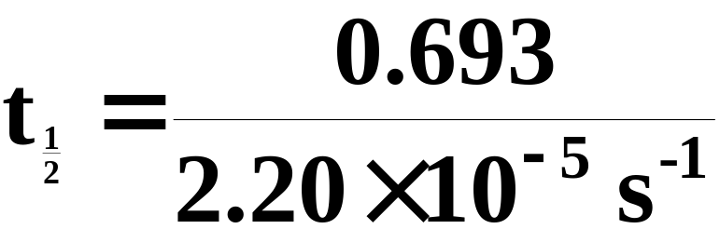
Half-life
Sulfuryl chloride, SO₂Cl₂, decomposes in a first-order reaction to SO₂ and Cl₂.
At 320 ºC, the rate constant is 2.20 x 10⁻⁵ s⁻¹. What is the half-life of SO₂Cl₂ vapor at this temperature?
Substitute the value of k into the relationship between k and t_{1/2.}

Slide 50
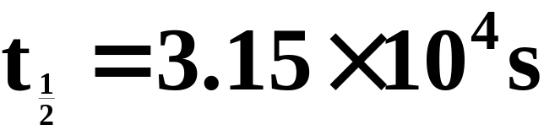
Half-life
Sulfuryl chloride, SO₂Cl₂, decomposes in a first-order reaction to SO₂ and Cl₂.
At 320 ºC, the rate constant is 2.20 x 10⁻⁵ s⁻¹. What is the half-life of SO₂Cl₂ vapor at this temperature?
Substitute the value of k into the relationship between k and t_{1/2.}

Slide 51
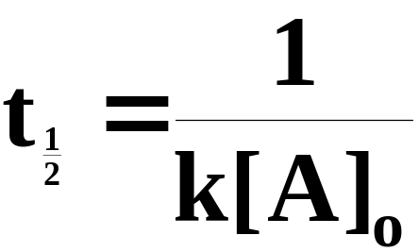
Half-life
For a second-order reaction, half-life depends on the initial concentration and becomes larger as time goes on.
  Again, assuming that [A]_{t} = ½[A]_{o} after one half-life, it can be shown that:
  Each succeeding half-life is twice the length of its predecessor.

Slide 52
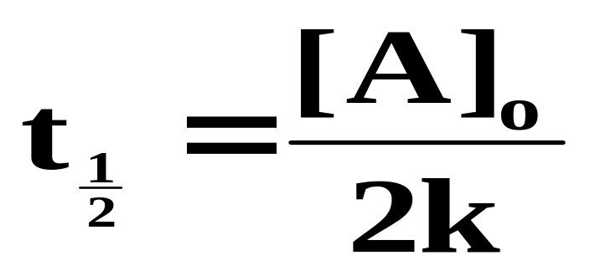
Half-life
For Zero-Order reactions, the half-lite is dependent upon the initial concentration of the reactant and becomes shorter as the reaction proceeds.

Slide 53
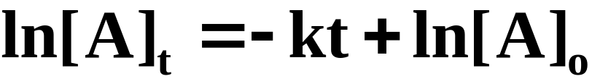
Graphing Kinetic Data
In addition to the method of initial rates, rate laws can be deduced by graphical methods.
  If we rewrite the first-order concentration-time equation in a slightly different form, it can be identified as the equation of a straight line.
y = mx + b

Slide 54
Graphing Kinetic Data
In addition to the method of initial rates, rate laws can be deduced by graphical methods.
  If we rewrite the first-order concentration-time equation in a slightly different form, it can be identified as the equation of a straight line.
  This means if you plot ln[A] versus time, you will get a straight line for a first-order reaction. (see Figure 14.9)

Slide 55
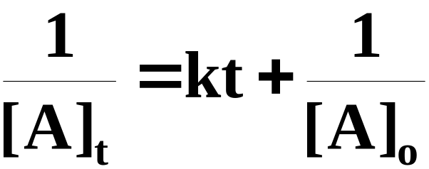
Graphing Kinetic Data
In addition to the method of initial rates, rate laws can be deduced by graphical methods.
  If we rewrite the second-order concentration-time equation in a slightly different form, it can be identified as the equation of a straight line.
y = mx + b

Slide 56
Graphing Kinetic Data
In addition to the method of initial rates, rate laws can be deduced by graphical methods.
  If we rewrite the second-order concentration-time equation in a slightly different form, it can be identified as the equation of a straight line.
  This means if you plot 1/[A] versus time, you will get a straight line for a second-order reaction.
  Figure 14.10 illustrates the graphical method of deducing the order of a reaction.

Slide 57
Collision Theory
Rate constants vary with temperature. Consequently, the actual rate of a reaction is very temperature dependent.
Why the rate depends on temperature can by explained by collision theory.

Slide 58
Collision Theory
Collision theory assumes that for a reaction to occur, reactant molecules must collide with sufficient energy and the proper orientation.
The minimum energy of collision required for two molecules to react is called the activation energy, E_{a}.

Slide 59
Transition-State Theory
Transition-state theory explains the reaction resulting from the collision of two molecules in terms of an activated complex.
  An activated complex (transition state) is an unstable grouping of atoms that can break up to form products.
  A simple analogy would be the collision of three billiard balls on a billiard table.

Slide 60
Transition-State Theory
Transition-state theory explains the reaction resulting from the collision of two molecules in terms of an activated complex.
  Suppose two balls are coated with a slightly stick adhesive.
  We’ll take a third ball covered with an extremely sticky adhesive and collide it with our joined pair.

Slide 61
Transition-State Theory
Transition-state theory explains the reaction resulting from the collision of two molecules in terms of an activated complex.
  At the instant of impact, when all three spheres are joined, we have an unstable transition-state complex.
  The “incoming” billiard ball would likely stick to one of the joined spheres and provide sufficient energy to dislodge the other, resulting in a new “pairing.”

Slide 62
Transition-State Theory
Transition-state theory explains the reaction resulting from the collision of two molecules in terms of an activated complex.
  If we repeated this scenario several times, some collisions would be successful and others (because of either insufficient energy or improper orientation) would not be successful.
  We could compare the energy we provided to the billiard balls to the activation energy, E_{a}.

Slide 63
Potential-Energy Diagrams for Reactions
To illustrate graphically the formation of a transition state, we can plot the potential energy of a reaction versus time.
  Figure 14.13 illustrates the endothermic reaction of nitric oxide and chlorine gas.
  Note that the forward activation energy is the energy necessary to form the activated complex.
  The ΔH of the reaction is the net change in energy between reactants and products.

Slide 64
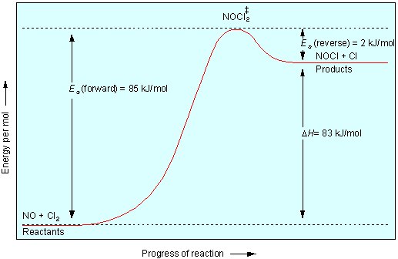
Figure 14.13 Potential-energy curve for the endothermic reaction of nitric oxide and chlorine.

Slide 65
Potential-Energy Diagrams for Reactions
The potential-energy diagram for an exothermic reaction shows that the products are more stable than the reactants.
  Figure 14.14 illustrates the potential-energy diagram for an exothermic reaction.
  We see again that the forward activation energy is required to form the transition-state complex.
  In both of these graphs, the reverse reaction must still supply enough activation energy to form the activated complex.

Slide 66
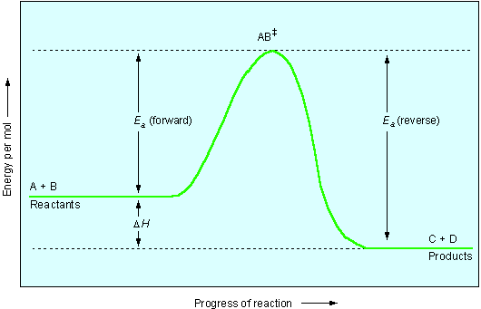
Figure 14.14 Potential-energy curve for an exothermic reaction.

Slide 67
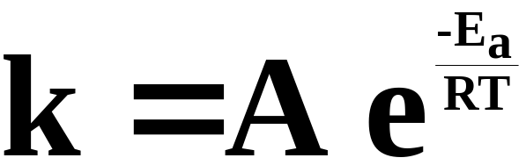
The Arrhenius Equation
If we were to combine the relatively constant terms, Z and p, into one constant, let’s call it A. We obtain the Arrhenius equation:
  The Arrhenius equation expresses the dependence of the rate constant on absolute temperature and activation energy.

Slide 68
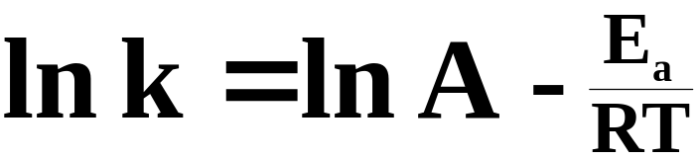
The Arrhenius Equation
It is useful to recast the Arrhenius equation in logarithmic form.
  Taking the natural logarithm of both sides of the equation, we get:

Slide 69
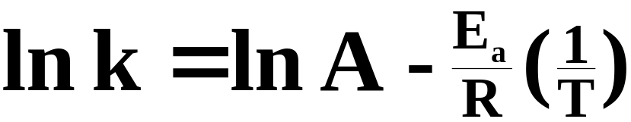
The Arrhenius Equation
It is useful to recast the Arrhenius equation in logarithmic form.
  We can relate this equation to the (somewhat rearranged) general formula for a straight line.
y = b + m x
  A plot of ln k versus (1/T) should yield a straight line with a slope of (-E_{a}/R) and an intercept of ln A. (see Figure 14.15)

Slide 70
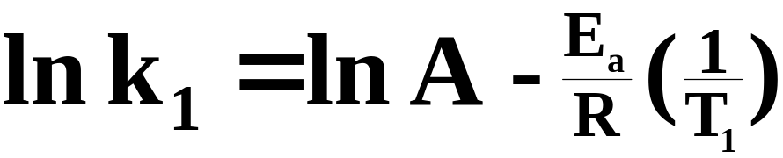
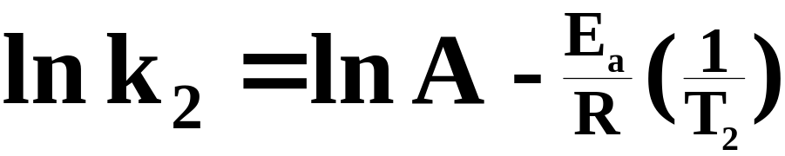
The Arrhenius Equation
A more useful form of the equation emerges if we look at two points on the line this equation describes that is, (k₁, (1/T₁)) and (k₂, (1/T₂)).
  The two equations describing the relationship at each coordinate would be
and

Slide 71
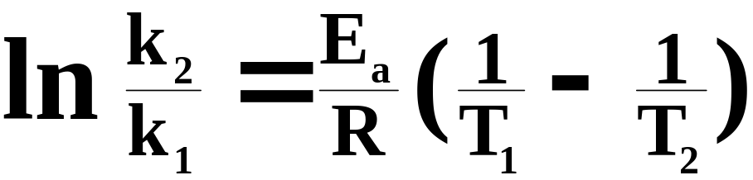
The Arrhenius Equation
A more useful form of the equation emerges if we look at two points on the line this equation describes that is, (k₁, (1/T₁)) and (k₂, (1/T₂)).
  We can eliminate ln A by subtracting the two equations to obtain

Slide 72
The Arrhenius Equation
A more useful form of the equation emerges if we look at two points on the line this equation describes that is, (k₁, (1/T₁)) and (k₂, (1/T₂)).
  With this form of the equation, given the activation energy and the rate constant k₁ at a given temperature T₁, we can find the rate constant k₂ at any other temperature, T₂.

Slide 73
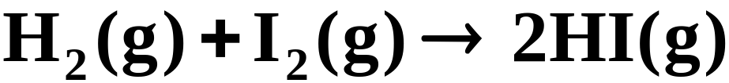
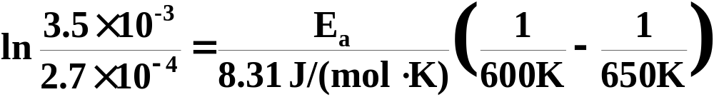
A Problem to Consider
The rate constant for the formation of hydrogen iodide from its elements
  is 2.7 x 10⁻⁴ L/(mol.s) at 600 K and 3.5 x 10⁻³ L/(mol.s) at 650 K. Find the activation energy, E_{a}.
  Substitute the given data into the Arrhenius equation.

Slide 74
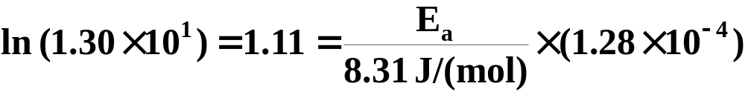
A Problem to Consider
The rate constant for the formation of hydrogen iodide from its elements
  is 2.7 x 10⁻⁴ L/(mol.s) at 600 K and 3.5 x 10⁻³ L/(mol.s) at 650 K. Find the activation energy, E_{a}.
  Simplifying, we get:

Slide 75
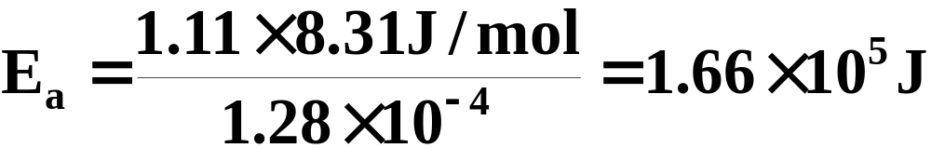
A Problem to Consider
The rate constant for the formation of hydrogen iodide from its elements
  is 2.7 x 10⁻⁴ L/(mol.s) at 600 K and 3.5 x 10⁻³ L/(mol.s) at 650 K. Find the activation energy, E_{a}.
Solving for E_{a}:

Slide 76
Reaction Mechanisms
Even though a balanced chemical equation may give the ultimate result of a reaction, what actually happens in the reaction may take place in several steps.
  This “pathway” the reaction takes is referred to as the reaction mechanism.
  The individual steps in the larger overall reaction are referred to as elementary reactions. (See animation: Decomposition of N₂O₅ Step 1)

Slide 77
Elementary Reactions
Consider the reaction of nitrogen dioxide with carbon monoxide.
  This reaction is believed to take place in two steps.
(elementary reaction)
(elementary reaction)

Slide 78
Elementary Reactions
Each step is a singular molecular event resulting in the formation of products.
  Note that NO₃ does not appear in the overall equation, but is formed as a temporary reaction intermediate.

Slide 79
Elementary Reactions
Each step is a singular molecular event resulting in the formation of products.
  The overall chemical equation is obtained by adding the two steps together and canceling any species common to both sides.

Slide 80
Molecularity
We can classify reactions according to their molecularity, that is, the number of molecules that must collide for the elementary reaction to occur.
  A unimolecular reaction involves only one reactant molecule.
  A bimolecular reaction involves the collision of two reactant molecules.
  A termolecular reaction requires the collision of three reactant molecules.

Slide 81
Molecularity
We can classify reactions according to their molecularity, that is, the number of molecules that must collide for the elementary reaction to occur.
  Higher molecularities are rare because of the small statistical probability that four or more molecules would all collide at the same instant.

Slide 82
Rate Equations for Elementary Reactions
Since a chemical reaction may occur in several steps, there is no easily stated relationship between its overall reaction and its rate law.
For elementary reactions, the rate is proportional to the concentrations of all reactant molecules involved.

Slide 83


Rate Equations for Elementary Reactions
For example, consider the generic equation below.
  The rate is dependent only on the concentration of A; that is,

Slide 84


Rate Equations for Elementary Reactions
However, for the reaction
  the rate is dependent on the concentrations of both A and B.

Slide 85


Rate Equations for Elementary Reactions
For a termolecular reaction
  the rate is dependent on the populations of all three participants.

Slide 86



Rate Equations for Elementary Reactions
Note that if two molecules of a given reactant are required, it appears twice in the rate law. For example, the reaction
  would have the rate law:
or

Slide 87
Rate Equations for Elementary Reactions
So, in essence, for an elementary reaction, the coefficient of each reactant becomes the power to which it is raised in the rate law for that reaction.
  Note that many chemical reactions occur in multiple steps and it is, therefore, impossible to predict the rate law based solely on the overall reaction.

Slide 88
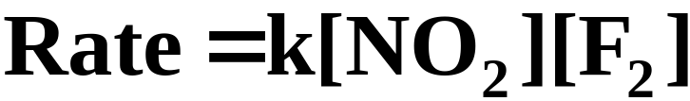
Rate Laws and Mechanisms
Consider the reaction below.
  Experiments performed with this reaction show that the rate law is
  The reaction is first order with respect to each reactant, even though the coefficient for NO₂ in the overall reaction is.

Slide 89
Rate Laws and Mechanisms
Consider the reaction below.
  Experiments performed with this reaction show that the rate law is
  This implies that the reaction above is not an elementary reaction but rather the result of multiple steps.

Slide 90
Rate-Determining Step
In multiple-step reactions, one of the elementary reactions in the sequence is often slower than the rest.
  The overall reaction cannot proceed any faster than this slowest rate-determining step.

Slide 91
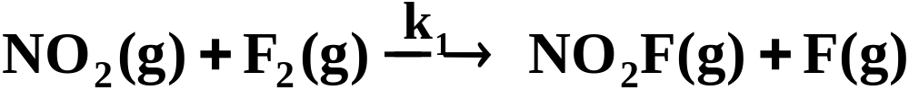
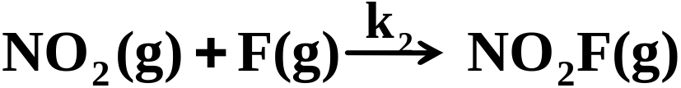
Rate-Determining Step
In multiple-step reactions, one of the elementary reactions in the sequence is often slower than the rest.
  Our previous example occurs in two elementary steps where the first step is much slower.
(slow)
(fast)

Slide 92
Rate-Determining Step
In multiple-step reactions, one of the elementary reactions in the sequence is often slower than the rest.
  Since the overall rate of this reaction is determined by the slow step, it seems logical that the observed rate law is Rate = k₁[NO₂][F₂].
(slow)

Slide 93
Rate-Determining Step
In a mechanism where the first elementary step is the rate-determining step, the overall rate law is simply expressed as the elementary rate law for that slow step.
  A more complicated scenario occurs when the rate-determining step contains a reaction intermediate, as you’ll see in the next section.

Slide 94
Rate-Determining Step
Mechanisms with an Initial Fast Step
  There are cases where the rate-determining step of a mechanism contains a reaction intermediate that does not appear in the overall reaction.
  The experimental rate law, however, can be expressed only in terms of substances that appear in the overall reaction.

Slide 95

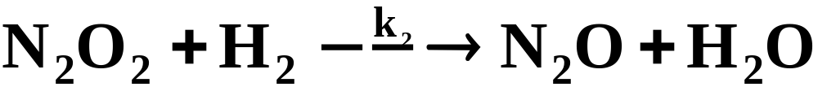
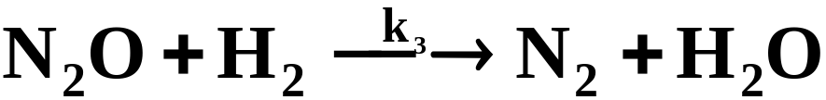
Rate-Determining Step
Consider the reduction of nitric oxide with H₂.
  A proposed mechanism is:
k₁
(fast, equilibrium)
k₋₁
(slow)
(fast)
  It has been experimentally determined that the rate law is Rate = k [NO]²[H₂]

Slide 96

Rate-Determining Step
The rate-determining step (step 2 in this case) generally outlines the rate law for the overall reaction.
(Rate law for the rate-determining step)
  As mentioned earlier, the overall rate law can be expressed only in terms of substances represented in the overall reaction and cannot contain reaction intermediates.

Slide 97
Rate-Determining Step
The rate-determining step (step 2 in this case) generally outlines the rate law for the overall reaction.
(Rate law for the rate-determining step)
  It is necessary to reexpress this proposed rate law after eliminating [N₂O₂].

Slide 98
Rate-Determining Step
The rate-determining step (step 2 in this case) generally outlines the rate law for the overall reaction.
(Rate law for the rate-determining step)
  We can do this by looking at the first step, which is fast and establishes equilibrium.

Slide 99
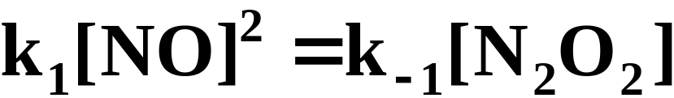
Rate-Determining Step
The rate-determining step (step 2 in this case) generally outlines the rate law for the overall reaction.
(Rate law for the rate-determining step)
  At equilibrium, the forward rate and the reverse rate are equal.

Slide 100

Rate-Determining Step
The rate-determining step (step 2 in this case) generally outlines the rate law for the overall reaction.
(Rate law for the rate-determining step)
  Therefore,
  If we substitute this into our proposed rate law we obtain:

Slide 101

Rate-Determining Step
The rate-determining step (step 2 in this case) generally outlines the rate law for the overall reaction.
(Rate law for the rate-determining step)
  If we replace the constants (k₂k₁/k₋₁) with k, we obtain the observed rate law: Rate = k[NO]²[H₂].

Slide 102
Catalysts
A catalyst is a substance that provides a good “environment” for a reaction to occur, thereby increasing the reaction rate without being consumed by the reaction.
  To avoid being consumed, the catalyst must participate in at least one step of the reaction and then be regenerated in a later step.

Slide 103
Catalysts
A catalyst is a substance that provides a good “environment” for a reaction to occur, thereby increasing the reaction rate without being consumed by the reaction.
  Its presence increases the rate of reaction by either increasing the frequency factor, A (from the Arrhenius equation) or lowering the activation energy, E_{a}.

Slide 104
Catalysts
Homogeneous catalysis is the use of a catalyst in the same phase as the reacting species.
  The oxidation of sulfur dioxide using nitric oxide as a catalyst is an example where all species are in the gas phase.

Slide 105
Catalysts
Heterogeneous catalysis is the use of a catalyst that exists in a different phase from the reacting species, usually a solid catalyst in contact with a liquid or gaseous solution of reactants.
  Such surface catalysis is thought to occur by chemical adsorbtion of the reactants onto the surface of the catalyst.
  Adsorbtion is the attraction of molecules to a surface.

Slide 106
Enzyme Catalysis
Enzymes have enormous catalytic activity.
  The substance whose reaction the enzyme catalyzes is called the substrate. (see Figure 14.20)
  Figure 14.21 illustrates the reduction in acivation energy resulting from the formation of an enzyme-substrate complex.

Slide 107
Operational Skills
Relating the different ways of expressing reaction rates
Calculating the average reaction rate
Determining the order of reaction from the rate law
Determining the rate law from initial rates
Using the concentration-time equation for first-order reactions
Relating the half-life of a reaction to the rate constant

Slide 108
Operational Skills
Using the Arrhenius equation
Writing the overall chemical equation from a mechanism
Determining the molecularity of an elementary reaction
Writing the rate equation for an elementary reaction
Determining the rate law from a mechanism

Slide 109


Figure 14.1:
Combining product of formaldehyde with hydrogen sulfite ion.
Photo courtesy of James Scherer.
Return to Slide 2

Slide 110

Figure 14.9: A plot of ln [N₂O₅] versus time.
Return to Slide 58

Slide 111

Figure 14.15: Plot of ln k versus 1/T.
Return to Slide 80

Slide 112
Animation: Decomposition of N₂O₅
(Click here to open QuickTime animation)
Return to Slide 87

Slide 113

Figure 14.20: Enzyme action (lock-and-key model).
Return to Slide 117

Slide 114

Figure 14.21 Potential-energy curves for the reaction of substrate, S, to products, P.
Return to Slide 117

