Slide 1
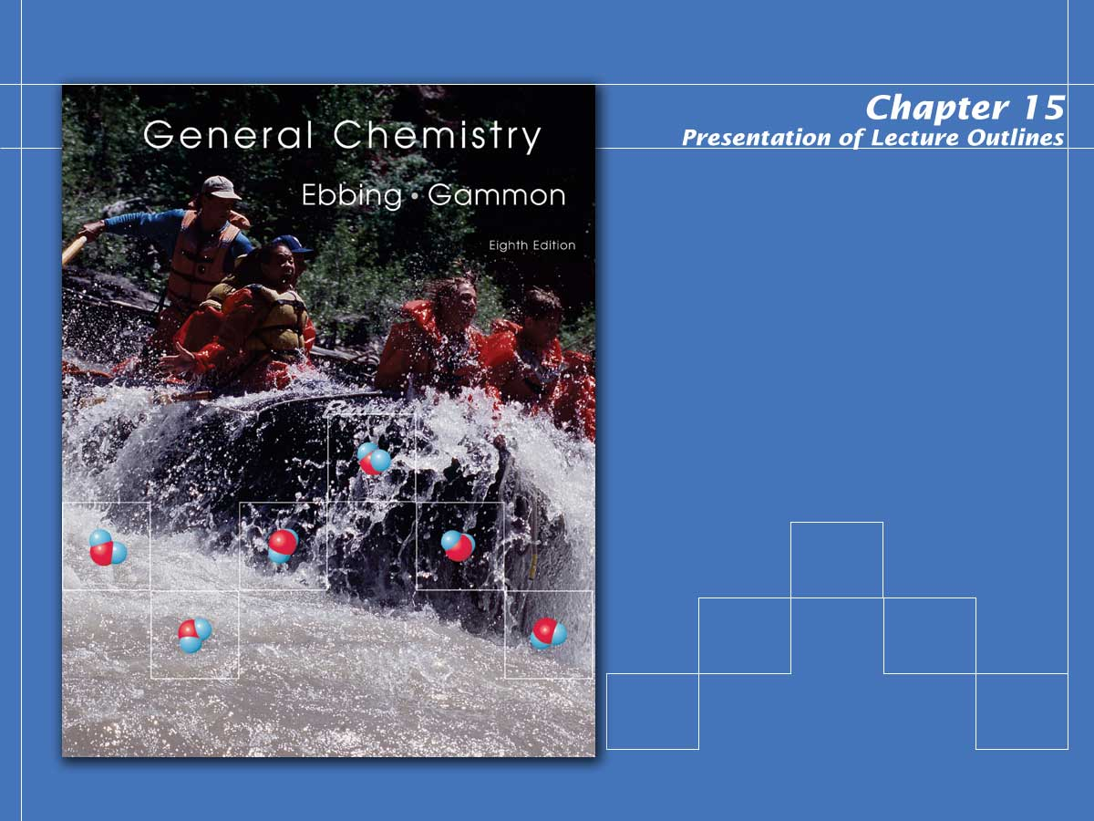
Chemical Equilibrium

Slide 2

Chemical Equilibrium
When compounds react, they eventually form a mixture of products and unreacted reactants, in a dynamic equilibrium.
  A dynamic equilibrium consists of a forward reaction, in which substances react to give products, and a reverse reaction, in which products react to give the original reactants.
  Chemical equilibrium is the state reached by a reaction mixture when the rates of the forward and reverse reactions have become equal.
Notes:
2

Slide 3
Chemical Equilibrium
For example, the Haber process for producing ammonia from N2 and H2 does not go to completion.
  It establishes an equilibrium state where all three species are present.
Notes:
2

Slide 4
A Problem to Consider
Applying Stoichiometry to an Equilibrium Mixture.
  Suppose we place 1.000 mol N₂ and 3.000 mol H₂ in a reaction vessel at 450 ºC and 10.0 atmospheres of pressure. The reaction is
  What is the composition of the equilibrium mixture if it contains 0.080 mol NH₃?
Notes:
2

Slide 5
The Equilibrium Constant
Every reversible system has its own “position of equilibrium” under any given set of conditions.
  The ratio of products produced to unreacted reactants for any given reversible reaction remains constant under constant conditions of pressure and temperature.
  The numerical value of this ratio is called the equilibrium constant for the given reaction.
Notes:
2

Slide 6
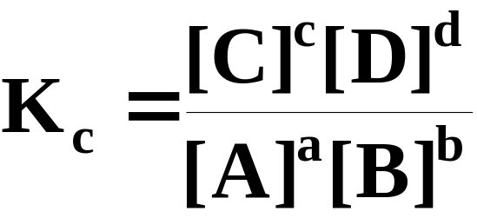
The Equilibrium Constant
The equilibrium-constant expression for a reaction is obtained by multiplying the concentrations of products, dividing by the concentrations of reactants, and raising each concentration to a power equal to its coefficient in the balanced chemical equation.
  For the general equation above, the equilibrium-constant expression would be:
Notes:
2

Slide 7
The Equilibrium Constant
The equilibrium constant, K_{c}, is the value obtained for the equilibrium-constant expression when equilibrium concentrations are substituted.
  A large K_{c} indicates large concentrations of products at equilibrium.
  A small K_{c} indicates large concentrations of unreacted reactants at equilibrium.
Notes:
2

Slide 8
The Equilibrium Constant
The law of mass action states that the value of the equilibrium constant expression K_{c} is constant for a particular reaction at a given temperature, whatever equilibrium concentrations are substituted.
  Consider the equilibrium established in the Haber process.
Notes:
2

Slide 9
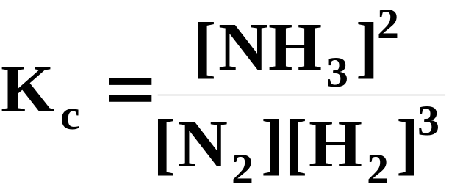
The Equilibrium Constant
The equilibrium-constant expression would be
  Note that the stoichiometric coefficients in the balanced equation have become the powers to which the concentrations are raised.
Notes:
2

Slide 10
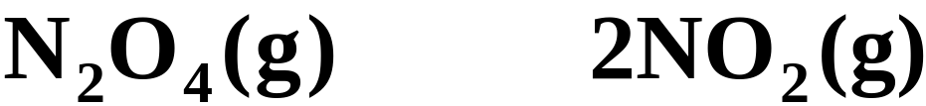
Equilibrium: A Kinetics Argument
If the forward and reverse reaction rates in a system at equilibrium are equal, then it follows that their rate laws would be equal.
  Consider the decomposition of N₂O₄, dinitrogen tetroxide.
  If we start with some dinitrogen tetroxide and heat it, it begins to decompose to produce NO₂.
Notes:
2

Slide 11
Equilibrium: A Kinetics Argument
If the forward and reverse reaction rates in a system at equilibrium are equal, then it follows that their rate laws would be equal.
  Consider the decomposition of N₂O₄, dinitrogen tetroxide.
  However, once some NO₂ is produced it can recombine to form N₂O₄.
Notes:
2

Slide 12
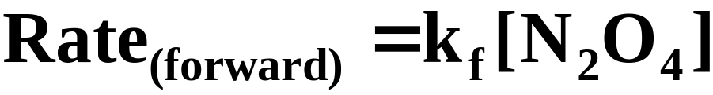
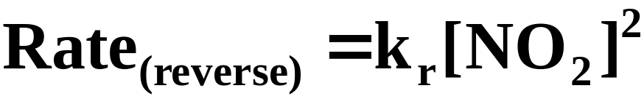
Equilibrium: A Kinetics Argument
k_{f}
k_{r}
  Call the decomposition of N₂O₄ the forward reaction and the formation of N₂O₄ the reverse reaction.
  These are elementary reactions, and you can immediately write the rate law for each.
Here k_{f} and k_{r} represent the forward and reverse rate constants.
Notes:
2

Slide 13
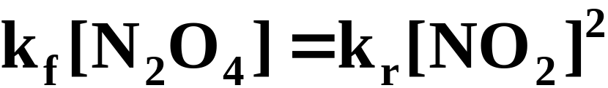
Equilibrium: A Kinetics Argument
k_{f}
k_{r}
  Ultimately, this reaction reaches an equilibrium state where the rates of the forward and reverse reactions are equal. Therefore,
Notes:
2

Slide 14
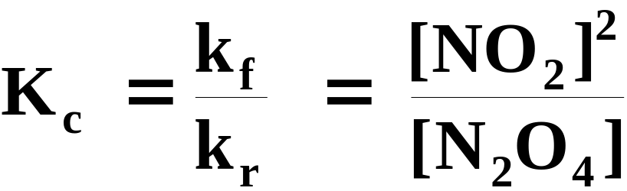
Equilibrium: A Kinetics Argument
k_{f}
k_{r}
  Combining the constants you can identify the equilibrium constant, Kc, as the ratio of the forward and reverse rate constants.
Notes:
2

Slide 15
Obtaining Equilibrium Constants for Reactions
Equilibrium concentrations for a reaction must be obtained experimentally and then substituted into the equilibrium-constant expression in order to calculate K_{c}.
Notes:
2

Slide 16
Obtaining Equilibrium Constants for Reactions
Consider the reaction below (see Figure 15.5).
  Suppose we started with initial concentrations of CO and H₂ of 0.100 M and 0.300 M, respectively.
Notes:
2

Slide 17
Obtaining Equilibrium Constants for Reactions
Consider the reaction below (see Figure 15.5).
  When the system finally settled into equilibrium we determined the equilibrium concentrations to be as follows.
Reactants
Products
[CO] = 0.0613 M
[CH₄] = 0.0387 M
[H₂] = 0.1893 M
[H₂O] = 0.0387 M
Notes:
2

Slide 18
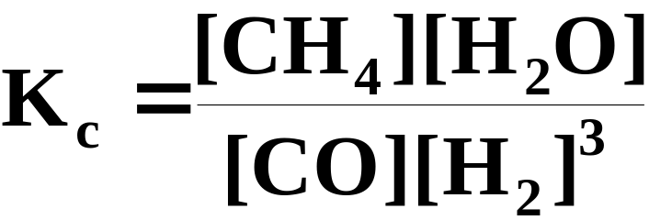
Obtaining Equilibrium Constants for Reactions
Consider the reaction below (see Figure 15.5).
  The equilibrium-constant expression for this reaction is:
Notes:
2

Slide 19
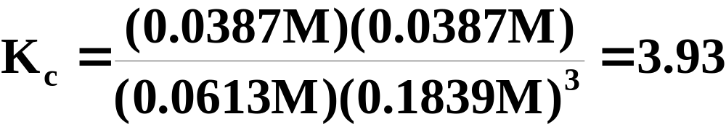
Obtaining Equilibrium Constants for Reactions
Consider the reaction below (see Figure 15.5).
  If we substitute the equilibrium concentrations, we obtain:
Notes:
2

Slide 20
Obtaining Equilibrium Constants for Reactions
Consider the reaction below (see Figure 15.5).
  Regardless of the initial concentrations (whether they be reactants or products), the law of mass action dictates that the reaction will always settle into an equilibrium where the equilibrium-constant expression equals K_{c}.
Notes:
2

Slide 21
Obtaining Equilibrium Constants for Reactions
Consider the reaction below (see Figure 15.5).
  As an example, let’s repeat the previous experiment, only this time starting with initial concentrations of products:
[CH₄]_{initial} = 0.1000 M and [H₂O]_{initial} = 0.1000 M
Notes:
2

Slide 22
Obtaining Equilibrium Constants for Reactions
Consider the reaction below (see Figure 15.5).
  We find that these initial concentrations result in the following equilibrium concentrations.
Reactants
Products
[CO] = 0.0613 M
[CH₄] = 0.0387 M
[H₂] = 0.1893 M
[H₂O] = 0.0387 M
Notes:
2

Slide 23
Obtaining Equilibrium Constants for Reactions
Consider the reaction below (see Figure 15.5).
  Substituting these values into the equilibrium-constant expression, we obtain the same result.
  Whether we start with reactants or products, the system establishes the same ratio.
Notes:
2

Slide 24
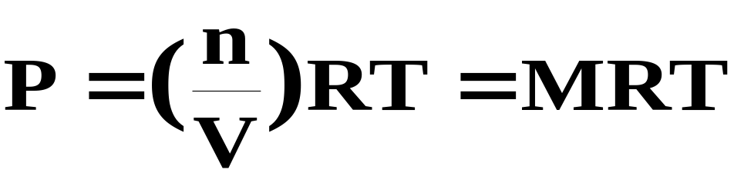
The Equilibrium Constant, K_{p}
In discussing gas-phase equilibria, it is often more convenient to express concentrations in terms of partial pressures rather than molarities (see Figure 15.6).
  It can be seen from the ideal gas equation that the partial pressure of a gas is proportional to its molarity.
Notes:
2

Slide 25
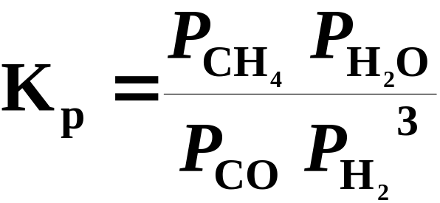
The Equilibrium Constant, K_{p}
If we express a gas-phase equilibria in terms of partial pressures, we obtain K_{p}.
  Consider the reaction below.
  The equilibrium-constant expression in terms of partial pressures becomes:
Notes:
2

Slide 26
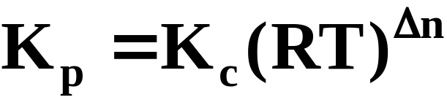
The Equilibrium Constant, K_{p}
In general, the numerical value of K_{p} differs from that of K_{c}.
  From the relationship n/V=P/RT, we can show that
  where Δn is the sum of the moles of gaseous products in a reaction minus the sum of the moles of gaseous reactants.
Notes:
2

Slide 27
A Problem to Consider
Consider the reaction
  K_{c} for the reaction is 2.8 x 10² at 1000 ºC. Calculate K_{p} for the reaction at this temperature.
Notes:
2

Slide 28
A Problem to Consider
Consider the reaction
  We know that
  From the equation we see that Dn = -1. We can simply substitute the given reaction temperature and the value of R (0.08206 L.atm/mol.K) to obtain K_{p}.
Notes:
2

Slide 29
A Problem to Consider
Consider the reaction
  Since
Notes:
2

Slide 30
Equilibrium Constant for the Sum of Reactions
Similar to the method of combining reactions that we saw using Hess’s law in Chapter 6, we can combine equilibrium reactions whose K_{c} values are known to obtain K_{c} for the overall reaction.
  With Hess’s law, when we reversed reactions or multiplied them prior to adding them together, we had to manipulate the ΔH’s values to reflect what we had done.
  The rules are a bit different for manipulating K_{c}.
Notes:
2

Slide 31
Equilibrium Constant for the Sum of Reactions
If you reverse a reaction, invert the value of K_{c}.
If you multiply each of the coefficients in an equation by the same factor (2, 3, …), raise K_{c} to the same power (2, 3, …).
If you divide each coefficient in an equation by the same factor (2, 3, …), take the corresponding root of K_{c} (i.e., square root, cube root, …).
When you finally combine (that is, add) the individual equations together, take the product of the equilibrium constants to obtain the overall K_{c}.
Notes:
2

Slide 32
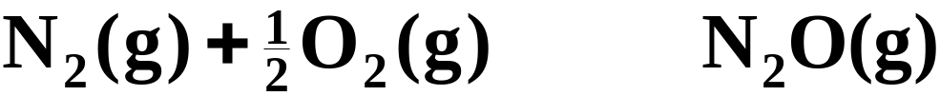
Equilibrium Constant for the Sum of Reactions
For example, nitrogen and oxygen can combine to form either NO(g) or N₂O (g) according to the following equilibria.
(1)
K_{c} = 4.1 x 10⁻³¹
(2)
K_{c} = 2.4 x 10⁻¹⁸
  Using these two equations, we can obtain K_{c} for the formation of NO(g) from N₂O(g):
(3)
K_{c} = ?
Notes:
2

Slide 33
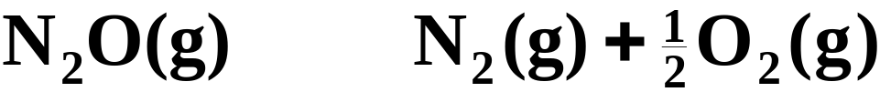
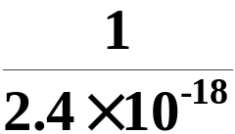
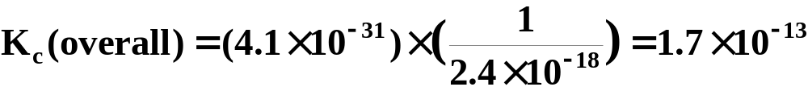
Equilibrium Constant for the Sum of Reactions
To combine equations (1) and (2) to obtain equation (3), we must first reverse equation (2). When we do we must also take the reciprocal of its K_{c} value.
(1)
K_{c} = 4.1 x 10⁻³¹
(2)
K_{c} =
(3)
Notes:
2

Slide 34
Heterogeneous Equilibria
A heterogeneous equilibrium is an equilibrium that involves reactants and products in more than one phase.
  The equilibrium of a heterogeneous system is unaffected by the amounts of pure solids or liquids present, as long as some of each is present.
  The concentrations of pure solids and liquids are always considered to be “1” and therefore, do not appear in the equilibrium expression.
Notes:
2

Slide 35
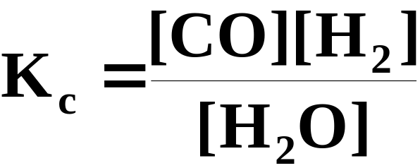
Heterogeneous Equilibria
Consider the reaction below.
  The equilibrium-constant expression contains terms for only those species in the homogeneous gas phase…H₂O, CO, and H₂.
Notes:
2

Slide 36
Predicting the Direction of Reaction
How could we predict the direction in which a reaction at non-equilibrium conditions will shift to reestablish equilibrium?
  To answer this question, substitute the current concentrations into the reaction quotient expression and compare it to K_{c}.
  The reaction quotient, Q_{c}, is an expression that has the same form as the equilibrium-constant expression but whose concentrations are not necessarily at equilibrium.
Notes:
2

Slide 37
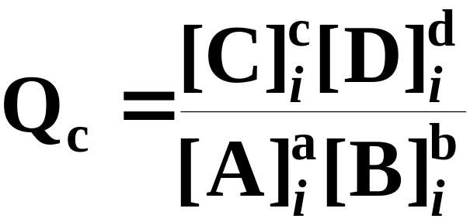
Predicting the Direction of Reaction
For the general reaction
  the Q_{c} expresssion would be:
Notes:
2

Slide 38
Predicting the Direction of Reaction
For the general reaction
  If Q_{c} > K_{c}, the reaction will shift left…toward reactants.
  If Q_{c} < K_{c}, the reaction will shift right… toward products.
  If Q_{c} = K_{c}, then the reaction is at equilibrium.
Notes:
2

Slide 39
A Problem to Consider
  Consider the following equilibrium.
  A 50.0 L vessel contains 1.00 mol N₂, 3.00 mol H₂, and 0.500 mol NH₃. In which direction (toward reactants or toward products) will the system shift to reestablish equilibrium at 400 ºC?
  K_{c} for the reaction at 400 ºC is 0.500.
Notes:
2

Slide 40
A Problem to Consider
  First, calculate concentrations from moles of substances.
1.00 mol
3.00 mol
0.500 mol
50.0 L
50.0 L
50.0 L
Notes:
2

Slide 41
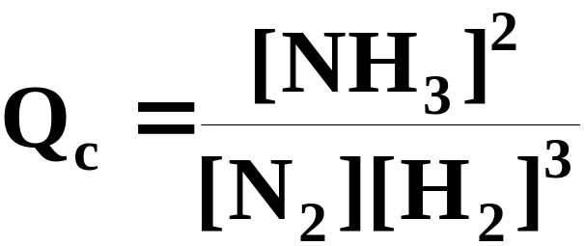
A Problem to Consider
  First, calculate concentrations from moles of substances.
0.0200 M
0.0600 M
0.0100 M
  The Q_{c} expression for the system would be:
Notes:
2

Slide 42
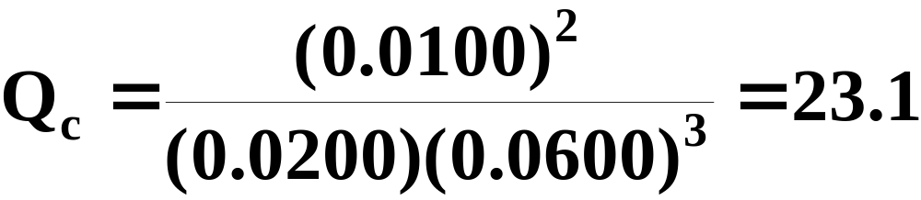
A Problem to Consider
  First, calculate concentrations from moles of substances.
0.0200 M
0.0600 M
0.0100 M
  Substituting these concentrations into the reaction quotient gives:
Notes:
2

Slide 43
A Problem to Consider
  First, calculate concentrations from moles of substances.
0.0200 M
0.0600 M
0.0100 M
  Because Q_{c} = 23.1 is greater than K_{c} = 0.500, the reaction will go to the left (toward reactants) as it approaches equilibrium.
Notes:
2

Slide 44
Calculating Equilibrium Concentrations
Once you have determined the equilibrium constant for a reaction, you can use it to calculate the concentrations of substances in the equilibrium mixture.
Notes:
2

Slide 45
Calculating Equilibrium Concentrations
For example, consider the following equilibrium.
Suppose a gaseous mixture contained 0.30 mol CO, 0.10 mol H₂, 0.020 mol H₂O, and an unknown amount of CH₄ per liter.
What is the concentration of CH₄ in this mixture? The equilibrium constant K_{c} equals 3.92.
Notes:
2

Slide 46
Calculating Equilibrium Concentrations
  First, calculate concentrations from moles of substances.
0.30 mol
0.10 mol
0.020 mol
??
1.0 L
1.0 L
1.0 L
Notes:
2

Slide 47
Calculating Equilibrium Concentrations
  First, calculate concentrations from moles of substances.
0.30 M
0.10 M
??
0.020 M
  The equilibrium-constant expression is:
Notes:
2

Slide 48
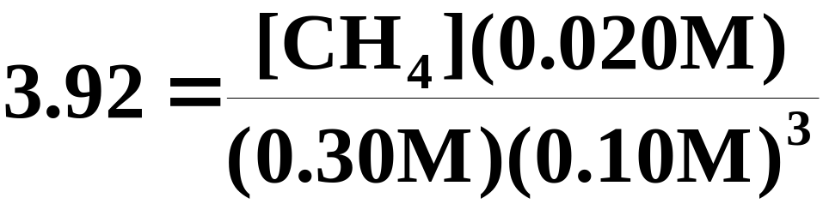
Calculating Equilibrium Concentrations
  First, calculate concentrations from moles of substances.
0.30 M
0.10 M
??
0.020 M
Substituting the known concentrations and the value of K_{c} gives:
Notes:
2

Slide 49
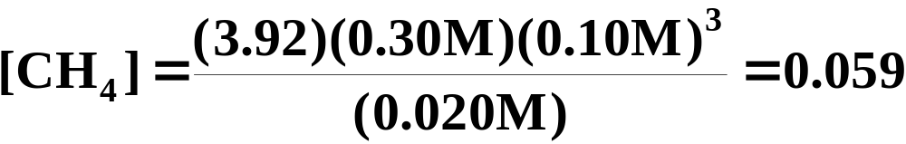
Calculating Equilibrium Concentrations
  First, calculate concentrations from moles of substances.
0.30 M
0.10 M
??
0.020 M
You can now solve for [CH₄].
The concentration of CH₄ in the mixture is 0.059 mol/L.
Notes:
2

Slide 50
Calculating Equilibrium Concentrations
Suppose we begin a reaction with known amounts of starting materials and want to calculate the quantities at equilibrium.
Notes:
2

Slide 51
Calculating Equilibrium Concentrations
  Consider the following equilibrium.
    Suppose you start with 1.000 mol each of carbon monoxide and water in a 50.0 L container. Calculate the molarity of each substance in the equilibrium mixture at 1000 ºC.
    K_{c} for the reaction is 0.58 at 1000 ºC.
Notes:
2

Slide 52
Calculating Equilibrium Concentrations
First, calculate the initial molarities of CO and H₂O.
1.000 mol
1.000 mol
50.0 L
50.0 L
Notes:
2

Slide 53
Calculating Equilibrium Concentrations
First, calculate the initial molarities of CO and H₂O.
0.0200 M
0.0200 M
0 M
0 M
    The starting concentrations of the products are 0.
    We must now set up a table of concentrations (starting, change, and equilibrium expressions in x).
Notes:
2

Slide 54
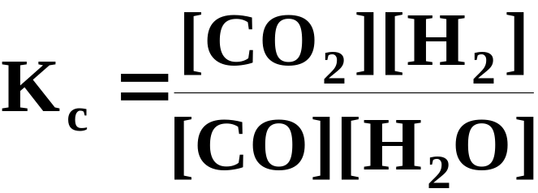
Calculating Equilibrium Concentrations
Let x be the moles per liter of product formed.
Starting | 0.0200 | 0.0200 |  | 0 | 0
Change | -x | -x |  | +x | +x
Equilibrium | 0.0200-x | 0.0200-x |  | x | x
The equilibrium-constant expression is:
Notes:
2

Slide 55
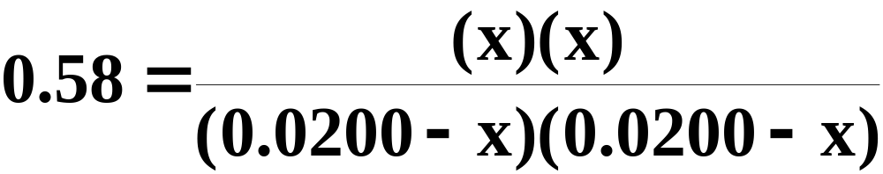
Calculating Equilibrium Concentrations
Solving for x.
Starting | 0.0200 | 0.0200 |  | 0 | 0
Change | -x | -x |  | +x | +x
Equilibrium | 0.0200-x | 0.0200-x |  | x | x
Substituting the values for equilibrium concentrations, we get:
Notes:
2

Slide 56
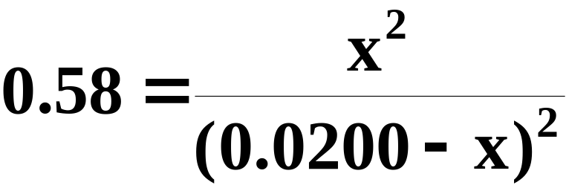
Calculating Equilibrium Concentrations
Solving for x.
Starting | 0.0200 | 0.0200 |  | 0 | 0
Change | -x | -x |  | +x | +x
Equilibrium | 0.0200-x | 0.0200-x |  | x | x
Or:
Notes:
2

Slide 57
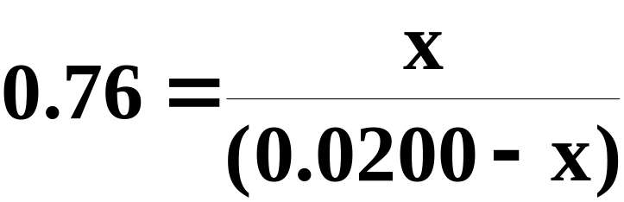
Calculating Equilibrium Concentrations
Solving for x.
Starting | 0.0200 | 0.0200 |  | 0 | 0
Change | -x | -x |  | +x | +x
Equilibrium | 0.0200-x | 0.0200-x |  | x | x
Taking the square root of both sides we get:
Notes:
2

Slide 58
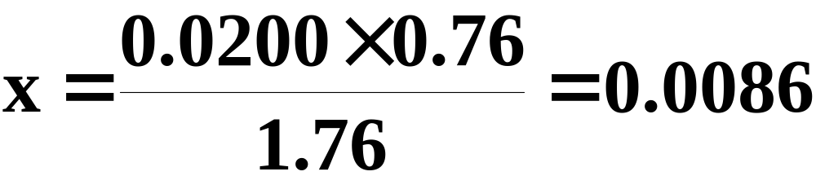
Calculating Equilibrium Concentrations
Solving for x.
Starting | 0.0200 | 0.0200 |  | 0 | 0
Change | -x | -x |  | +x | +x
Equilibrium | 0.0200-x | 0.0200-x |  | x | x
Rearranging to solve for x gives:
Notes:
2

Slide 59
Calculating Equilibrium Concentrations
Solving for equilibrium concentrations.
Starting | 0.0200 | 0.0200 |  | 0 | 0
Change | -x | -x |  | +x | +x
Equilibrium | 0.0200-x | 0.0200-x |  | x | x
If you substitute for x in the last line of the table you obtain the following equilibrium concentrations.
0.0114 M CO
0.0086 M CO₂
0.0114 M H₂O
0.0086 M H₂
Notes:
2

Slide 60
Calculating Equilibrium Concentrations
The preceding example illustrates the three steps in solving for equilibrium concentrations.
  Set up a table of concentrations (starting, change, and equilibrium expressions in x).
  Substitute the expressions in x for the equilibrium concentrations into the equilibrium-constant equation.
  Solve the equilibrium-constant equation for the values of the equilibrium concentrations.
Notes:
2

Slide 61
Calculating Equilibrium Concentrations
In some cases it is necessary to solve a quadratic equation to obtain equilibrium concentrations.
The next example illustrates how to solve such an equation.
Notes:
2

Slide 62
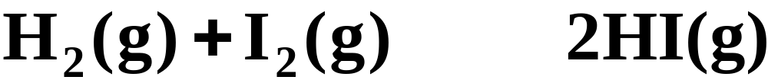
Calculating Equilibrium Concentrations
Consider the following equilibrium.
    Suppose 1.00 mol H₂ and 2.00 mol I₂ are placed in a 1.00-L vessel. How many moles per liter of each substance are in the gaseous mixture when it comes to equilibrium at 458 ºC?
    K_{c} at this temperature is 49.7.
Notes:
2

Slide 63
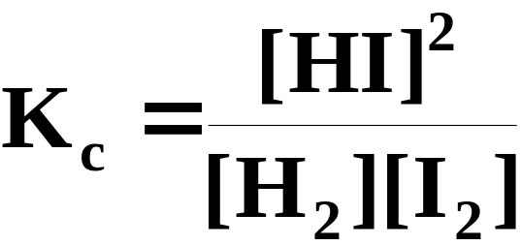
Calculating Equilibrium Concentrations
  The concentrations of substances are as follows.
Starting | 1.00 | 2.00 |  | 0
Change | -x | -x |  | +2x
Equilibrium | 1.00-x | 2.00-x |  | 2x
The equilibrium-constant expression is:
Notes:
2

Slide 64
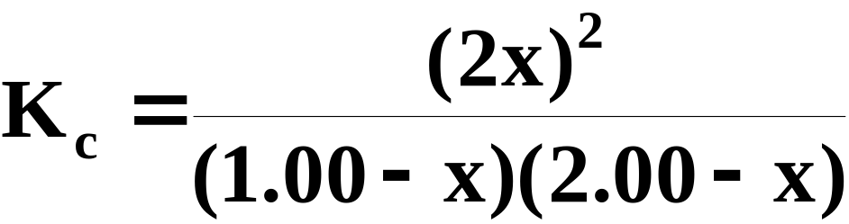
Calculating Equilibrium Concentrations
  The concentrations of substances are as follows.
Starting | 1.00 | 2.00 |  | 0
Change | -x | -x |  | +2x
Equilibrium | 1.00-x | 2.00-x |  | 2x
Substituting our equilibrium concentration expressions gives:
Notes:
2

Slide 65
Calculating Equilibrium Concentrations
Solving for x.
Starting | 1.00 | 2.00 |  | 0
Change | -x | -x |  | +2x
Equilibrium | 1.00-x | 2.00-x |  | 2x
Because the right side of this equation is not a perfect square, you must solve the quadratic equation.
Notes:
2

Slide 66
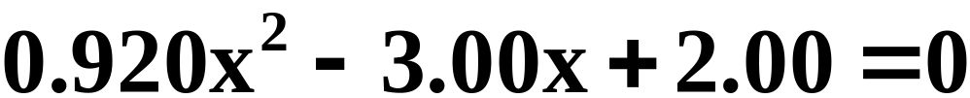
Calculating Equilibrium Concentrations
Solving for x.
Starting | 1.00 | 2.00 |  | 0
Change | -x | -x |  | +2x
Equilibrium | 1.00-x | 2.00-x |  | 2x
The equation rearranges to give:
Notes:
2

Slide 67
Calculating Equilibrium Concentrations
Solving for x.
Starting | 1.00 | 2.00 |  | 0
Change | -x | -x |  | +2x
Equilibrium | 1.00-x | 2.00-x |  | 2x
The two possible solutions to the quadratic equation are:
Notes:
2

Slide 68

Calculating Equilibrium Concentrations
Solving for x.
Starting | 1.00 | 2.00 |  | 0
Change | -x | -x |  | +2x
Equilibrium | 1.00-x | 2.00-x |  | 2x
However, x = 2.33 gives a negative value to 1.00 - x (the equilibrium concentration of H₂), which is not possible.
Notes:
2

Slide 69
Calculating Equilibrium Concentrations
Solving for equilibrium concentrations.
Starting | 1.00 | 2.00 |  | 0
Change | -x | -x |  | +2x
Equilibrium | 1.00-x | 2.00-x |  | 2x
If you substitute 0.93 for x in the last line of the table you obtain the following equilibrium concentrations.
0.07 M H₂ 1.07 M I₂ 1.86 M HI
Notes:
2

Slide 70
Le Chatelier’s Principle
Obtaining the maximum amount of product from a reaction depends on the proper set of reaction conditions.
  Le Chatelier’s principle states that when a system in a chemical equilibrium is disturbed by a change of temperature, pressure, or concentration, the equilibrium will shift in a way that tends to counteract this change.
Notes:
2

Slide 71
Removing Products or Adding Reactants
Let’s refer back to the illustration of the U-tube in the first section of this chapter.
“reactants”
“products”
It’s a simple concept to see that if we were to remove products (analogous to dipping water out of the right side of the tube) the reaction would shift to the right until equilibrium was reestablished.
Notes:
2

Slide 72
Removing Products or Adding Reactants
Let’s refer back to the illustration of the U-tube in the first section of this chapter.
“reactants”
“products”
Likewise, if more reactant is added (analogous to pouring more water in the left side of the tube) the reaction would again shift to the right until equilibrium is reestablished.
Notes:
2

Slide 73
Effects of Pressure Change
A pressure change caused by changing the volume of the reaction vessel can affect the yield of products in a gaseous reaction only if the reaction involves a change in the total moles of gas present (see Figure 15.12).
Notes:
2

Slide 74
Effects of Pressure Change
If the products in a gaseous reaction contain fewer moles of gas than the reactants, it is logical that they would require less space.
So, reducing the volume of the reaction vessel would, therefore, favor the products.
Conversely, if the reactants require less volume (that is, fewer moles of gaseous reactant), then decreasing the volume of the reaction vessel would shift the equilibrium to the left (toward reactants).
Notes:
2

Slide 75
Effects of Pressure Change
Literally “squeezing” the reaction will cause a shift in the equilibrium toward the fewer moles of gas.
It’s a simple step to see that reducing the pressure in the reaction vessel by increasing its volume would have the opposite effect.
In the event that the number of moles of gaseous product equals the number of moles of gaseous reactant, vessel volume will have no effect on the position of the equilibrium.
Notes:
2

Slide 76
Effect of Temperature Change
Temperature has a significant effect on most reactions (see Figure 15.13).
  Reaction rates generally increase with an increase in temperature. Consequently, equilibrium is established sooner.
  In addition, the numerical value of the equilibrium constant K_{c} varies with temperature.
Notes:
2

Slide 77
Effect of Temperature Change
Let’s look at “heat” as if it were a product in exothermic reactions and a reactant in endothermic reactions.
We see that increasing the temperature is analogous to adding more product (in the case of exothermic reactions) or adding more reactant (in the case of endothermic reactions).
This ultimately has the same effect as if heat were a physical entity.
Notes:
2

Slide 78
Effect of Temperature Change
For example, consider the following generic exothermic reaction.
Increasing temperature would be analogous to adding more product, causing the equilibrium to shift left.
Since “heat” does not appear in the equilibrium-constant expression, this change would result in a smaller numerical value for K_{c}.
Notes:
2

Slide 79
Effect of Temperature Change
For an endothermic reaction, the opposite is true.
Increasing temperature would be analogous to adding more reactant, causing the equilibrium to shift right.
This change results in more product at equilibrium, amd a larger numerical value for K_{c}.
Notes:
2

Slide 80
Effect of Temperature Change
In summary:
  For an endothermic reaction (ΔH positive) the amounts of products are increased at equilibrium by an increase in temperature (K_{c} is larger at higher temperatures).
  For an exothermic reaction (ΔH is negative) the amounts of reactants are increased at equilibrium by an increase in temperature (K_{c} is smaller at higher temperatures).
Notes:
2

Slide 81
Effect of a Catalyst
A catalyst is a substance that increases the rate of a reaction but is not consumed by it.
  It is important to understand that a catalyst has no effect on the equilibrium composition of a reaction mixture (see Figure 15.15).
  A catalyst merely speeds up the attainment of equilibrium.
Notes:
2

Slide 82
Operational Skills
Applying stoichiometry to an equilibrium mixture
Writing equilibrium-constant expressions
Obtaining the equilibrium constant from reaction composition
Using the reaction quotient
Obtaining one equilibrium concentration given the others
Notes:
2

Slide 83
Operational Skills
Solving equilibrium problems
Applying Le Chatelier’s principle
Notes:
2

Slide 84
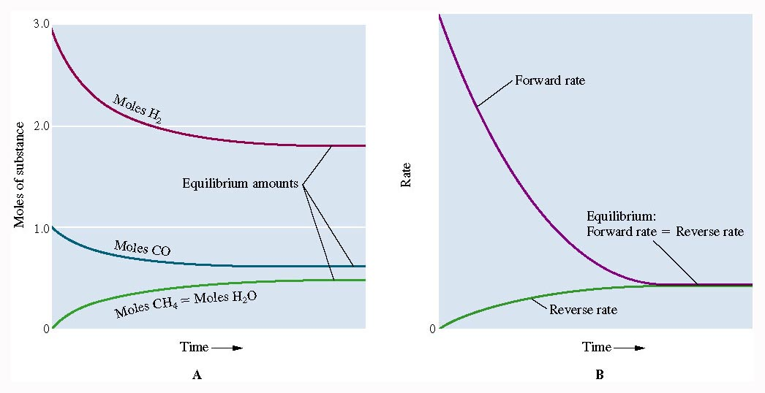
Figure 15.3: Catalytic methanation reaction approaches equilibrium.
Return to Slide 3

Slide 85
Animation: Equilibrium Decomposition of N₂O₄
(Click here to open QuickTime animation)
Return to Slide 15

Slide 86
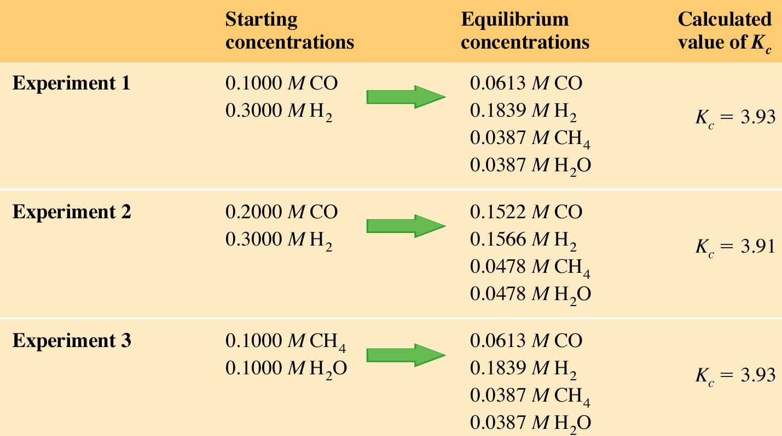
Figure 15.5: Some equilibrium compositions for the methanation reaction.
Return to Slide 20

Slide 87
Figure 15.5: Some equilibrium compositions for the methanation reaction.
Return to Slide 21

Slide 88
Figure 15.5: Some equilibrium compositions for the methanation reaction.
Return to Slide 22

Slide 89
Figure 15.5: Some equilibrium compositions for the methanation reaction.
Return to Slide 23

Slide 90
Figure 15.5: Some equilibrium compositions for the methanation reaction.
Return to Slide 24

Slide 91
Figure 15.5: Some equilibrium compositions for the methanation reaction.
Return to Slide 25

Slide 92
Figure 15.5: Some equilibrium compositions for the methanation reaction.
Return to Slide 26

Slide 93
Figure 15.5: Some equilibrium compositions for the methanation reaction.
Return to Slide 27

Slide 94
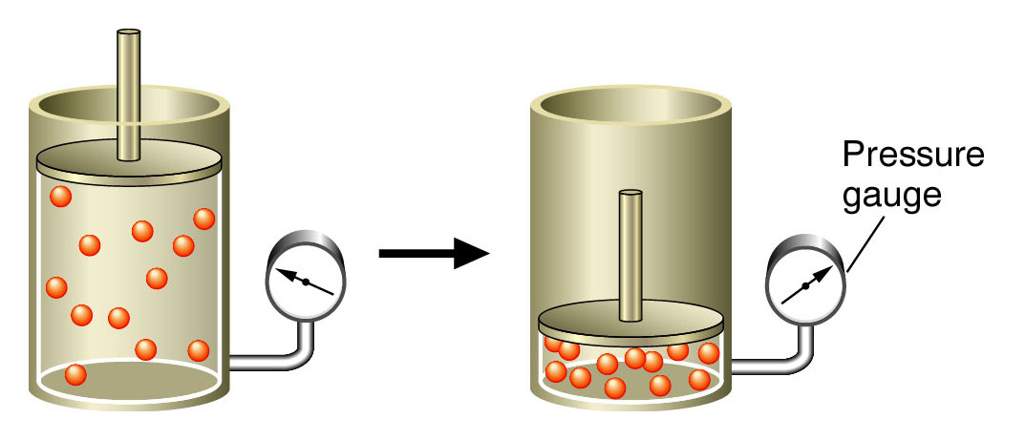
Figure 15.6: The concentration of a gas at a given temperature is proportional to the pressure.
Return to Slide 28

Slide 95
Animation: Pressure and Concentration of a Gas
(Click here to open QuickTime animation)
Return to Slide 28

Slide 96

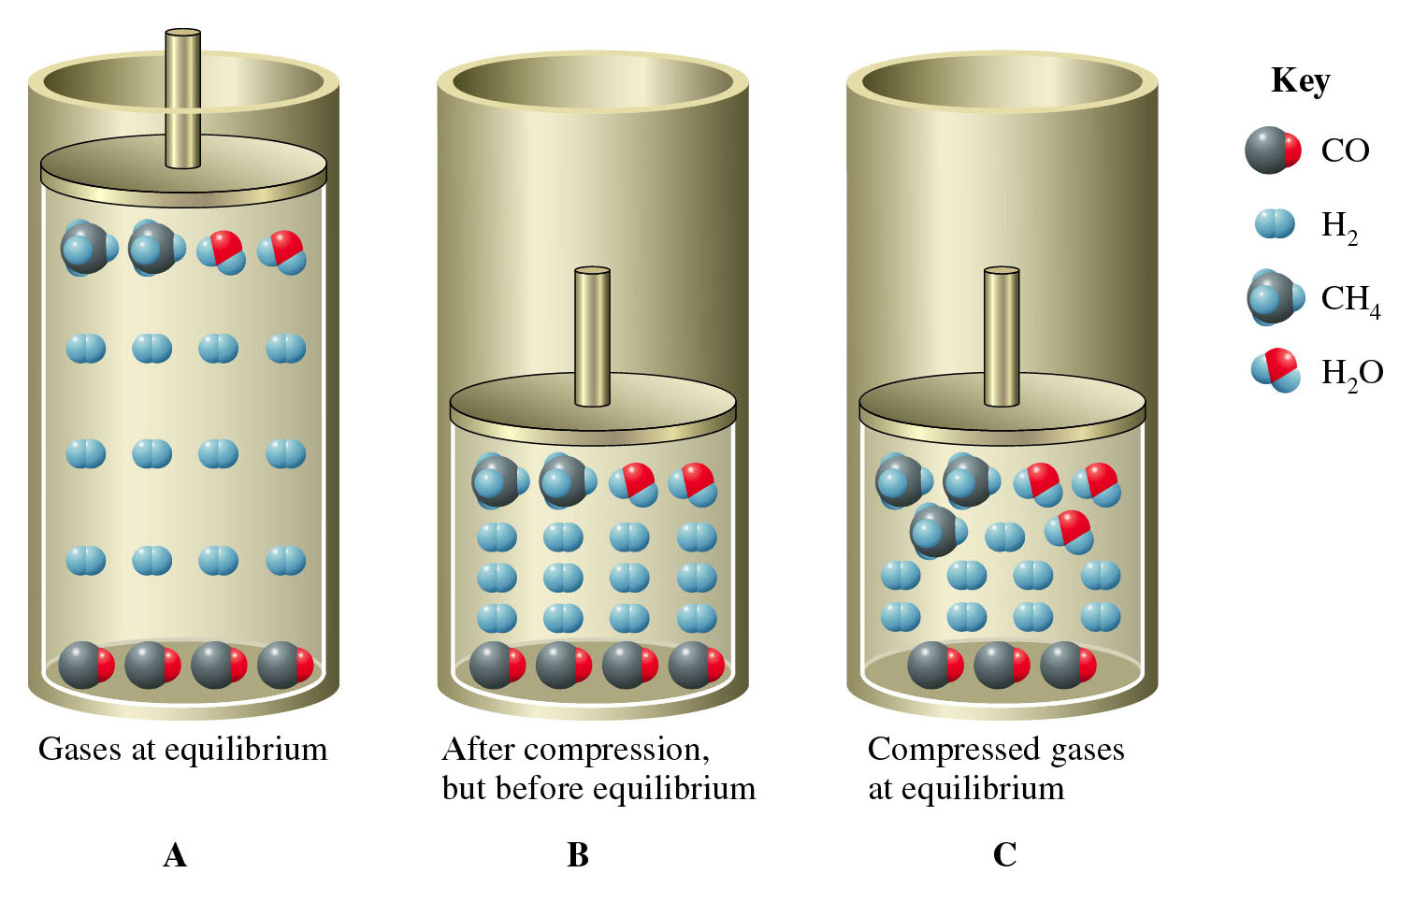
Figure 15.12 A-C
Return to Slide 77

Slide 97
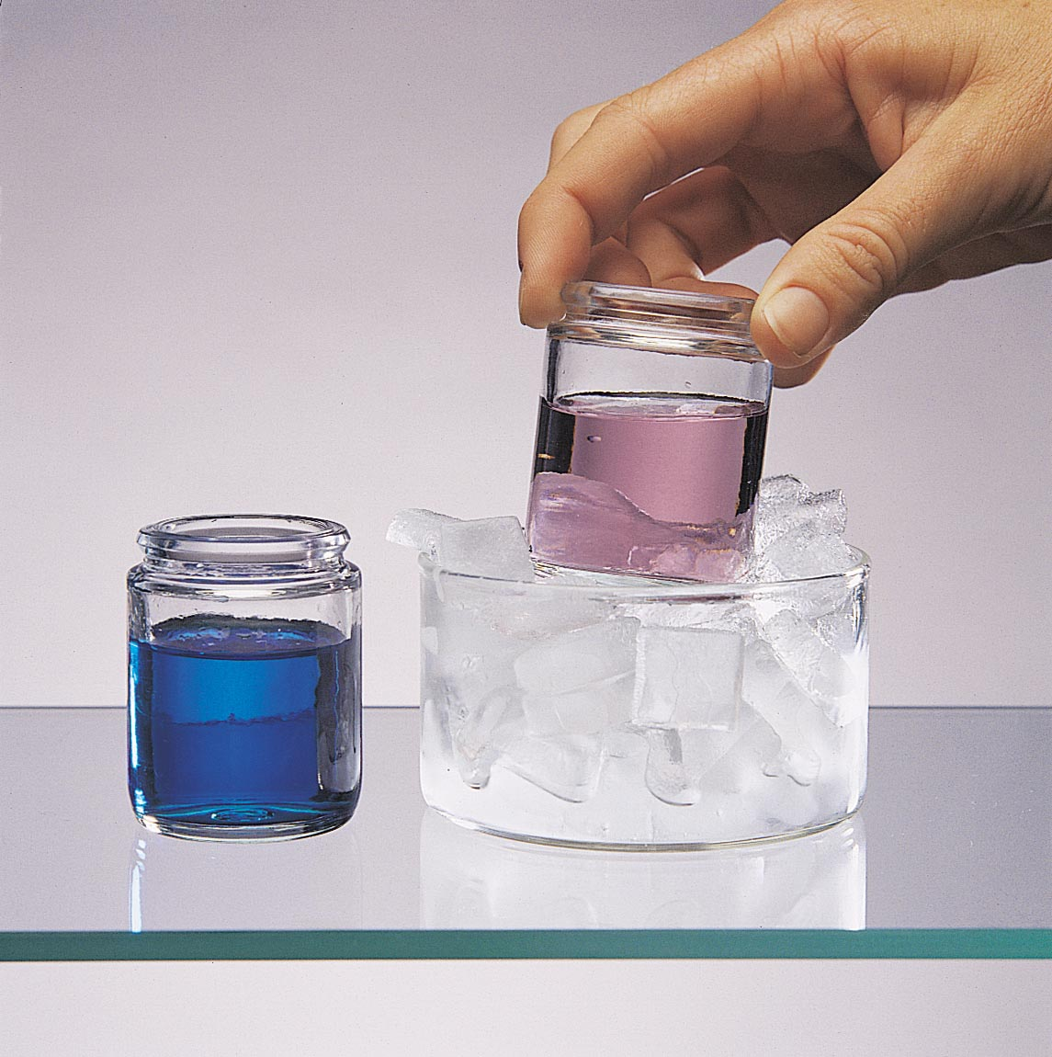
Figure 15.13:
The effect of changing the temperature on chemical equilibrium. Photo courtesy of American Color.
Return to Slide 80

Slide 98
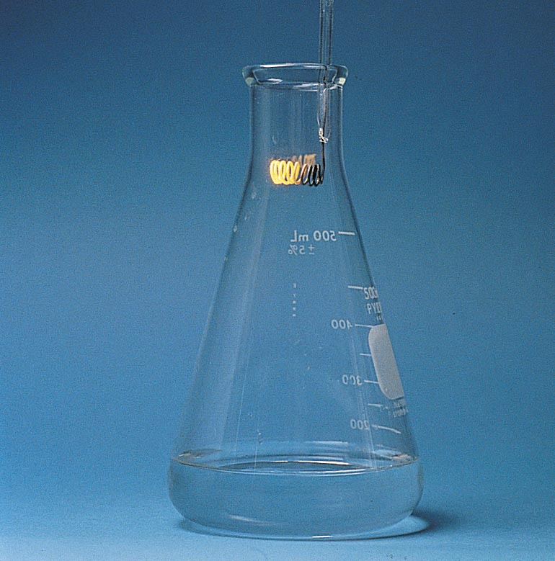
Figure 15.15: Oxidation of ammonia using a copper catalyst.
Photo courtesy of James Scherer.
Return to Slide 85

