Slide 1
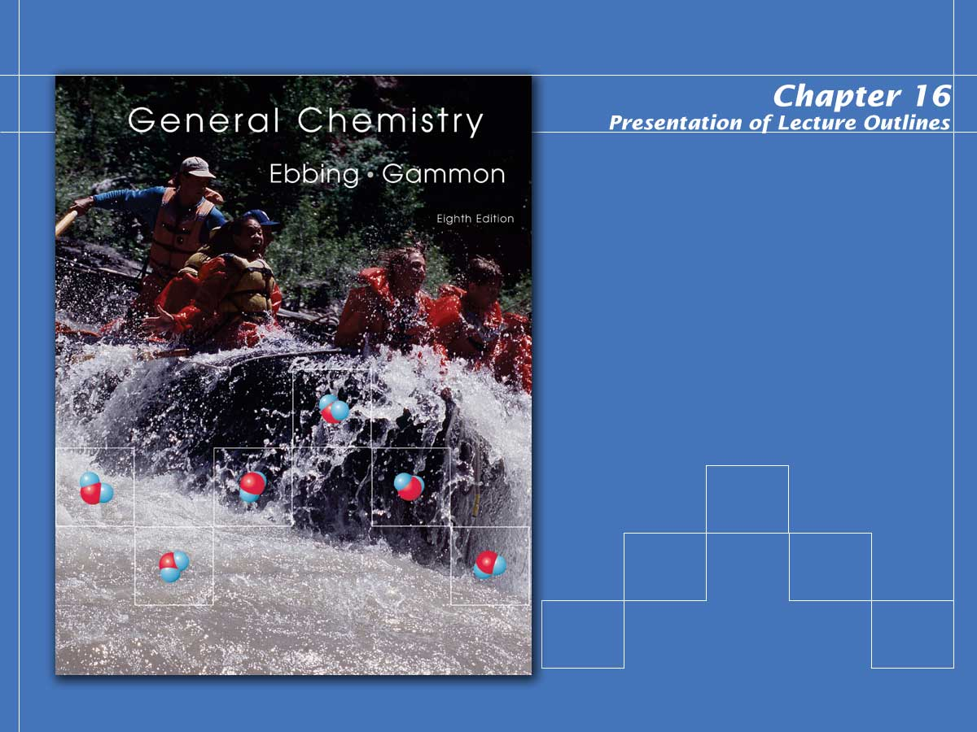
Acids and Bases

Slide 2

Acid-Base Concepts
Antoine Lavoisier was one of the first chemists to try to explain what makes a substance acidic.
  In 1777, he proposed that oxygen was an essential element in acids.
  The actual cause of acidity and basicity was ultimately explained in terms of the effect these compounds have on water by Svante Arrhenius in 1884.
Notes:
2

Slide 3
Acid-Base Concepts
In the first part of this chapter we will look at several concepts of acid-base theory including:
  The Arrhenius concept
  The Bronsted Lowry concept
  The Lewis concept
  This chapter expands on what you learned in Chapter 3 about acids and bases.
Notes:
2

Slide 4
Arrhenius Concept of Acids and Bases
According to the Arrhenius concept of acids and bases, an acid is a substance that, when dissolved in water, increases the concentration of hydronium ion (H₃O⁺).
  Chemists often use the notation H⁺(aq) for the H₃O⁺(aq) ion, and call it the hydrogen ion.
  Remember, however, that the aqueous hydrogen ion is actually chemically bonded to water, that is, H₃O⁺.
Notes:
2

Slide 5
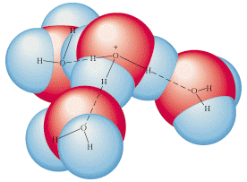
Arrhenius Concept of Acids and Bases
According to the Arrhenius concept of acids and bases, an acid is a substance that, when dissolved in water, increases the concentration of hydronium ion (H₃O⁺).
The H₃O⁺ is shown here hydrogen bonded to three water molecules.
Notes:
2

Slide 6
Arrhenius Concept of Acids and Bases
A base, in the Arrhenius concept, is a substance that, when dissolved in water, increases the concentration of hydroxide ion, OH⁻(aq).
Notes:
2

Slide 7
Arrhenius Concept of Acids and Bases
In the Arrhenius concept, a strong acid is a substance that ionizes completely in aqueous solution to give H₃O⁺(aq) and an anion.
  An example is perchloric acid, HClO₄.
  Other strong acids include HCl, HBr, HI, HNO₃ , and H₂SO₄.
Notes:
2

Slide 8
Arrhenius Concept of Acids and Bases
In the Arrhenius concept, a strong base is a substance that ionizes completely in aqueous solution to give OH⁻(aq) and a cation.
  An example is sodium hydroxide, NaOH.
  Other strong bases include LiOH, KOH, Ca(OH)₂, Sr(OH)₂, and Ba(OH)₂.
Notes:
2

Slide 9
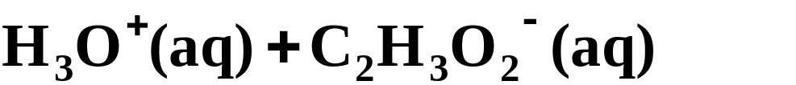
Arrhenius Concept of Acids and Bases
Most other acids and bases that you encounter are weak. They are not completely ionized and exist in reversible reaction with the corresponding ions.
  An example is acetic acid, HC₂H₃O₂.
  Ammonium hydroxide, NH₄OH, is a weak base.
Notes:
2

Slide 10
Arrhenius Concept of Acids and Bases
The Arrhenius concept is limited in that it looks at acids and bases in aqueous solutions only.
  In addition, it singles out the OH⁻ ion as the source of base character, when other species can play a similar role
  Broader definitions of acids and bases are discussed in the next sections.
Notes:
2

Slide 11
Brønsted-Lowry Concept of Acids and Bases
According to the Brønsted-Lowry concept, an acid is the species donating the proton in a proton-transfer reaction.
A base is the species accepting the proton in a proton-transfer reaction.
  In any reversible acid-base reaction, both forward and reverse reactions involve proton transfer.
Notes:
2

Slide 12
Brønsted-Lowry Concept of Acids and Bases
Consider the reaction of NH₃ and H₂0.
Notes:
2

Slide 13
Brønsted-Lowry Concept of Acids and Bases
Consider the reaction of NH₃ and H₂O.
base
acid
H⁺
  In the forward reaction, NH₃ accepts a proton from H₂O. Thus, NH₃ is a base and H₂O is an acid.
Notes:
2

Slide 14
Brønsted-Lowry Concept of Acids and Bases
Consider the reaction of NH₃ and H₂O.
acid
base
H⁺
  In the reverse reaction, NH₄⁺ donates a proton to OH⁻. The NH₄⁺ ion is the acid and OH⁻ is the base.
Notes:
2

Slide 15
Brønsted-Lowry Concept of Acids and Bases
Consider the reaction of NH₃ and H₂O.
base
acid
  The species NH₄⁺ and NH₃ are a conjugate acid-base pair.
  A conjugate acid-base pair consists of two species in an acid-base reaction, one acid and one base, that differ by the loss or gain of a proton.
Notes:
2

Slide 16
Brønsted-Lowry Concept of Acids and Bases
Consider the reaction of NH₃ and H₂O.
base
acid
  Here NH₄⁺ is the conjugate acid of NH₃ and NH₃ is the conjugate base of NH₄⁺.
  The Brønsted-Lowry concept defines a species as an acid or a base according to its function in the proton-transfer reaction.
Notes:
2

Slide 17
Brønsted-Lowry Concept of Acids and Bases
Some species can act as an acid or a base.
  An amphoteric species is a species that can act either as an acid or a base (it can gain or lose a proton).
  For example, HCO₃⁻ acts as a proton donor (an acid) in the presence of OH⁻
H⁺
Notes:
2

Slide 18
Brønsted-Lowry Concept of Acids and Bases
Some species can act as an acid or a base.
  An amphoteric species is a species that can act either as an acid or a base (it can gain or lose a proton).
  Alternatively, HCO₃ can act as a proton acceptor (a base) in the presence of HF.
H⁺
Notes:
2

Slide 19
Brønsted-Lowry Concept of Acids and Bases
The amphoteric characteristic of water is important in the acid-base properties of aqueous solutions.
  Water reacts as an acid with the base NH₃.
H⁺
Notes:
2

Slide 20
Brønsted-Lowry Concept of Acids and Bases
The amphoteric characteristic of water is important in the acid-base properties of aqueous solutions.
  Water can also react as a base with the acid HF.
H⁺
Notes:
2

Slide 21
Brønsted-Lowry Concept of Acids and Bases
In the Brønsted-Lowry concept:
  A base is a species that accepts protons; OH⁻ is only one example of a base.
  Acids and bases can be ions as well as molecular substances.
  Acid-base reactions are not restricted to aqueous solution.
  Some species can act as either acids or bases depending on what the other reactant is.
Notes:
2

Slide 22
Lewis Concept of Acids and Bases
The Lewis concept defines an acid as an electron pair acceptor and a base as an electron pair donor.
Notes:
2

Slide 23
Lewis Concept of Acids and Bases
The reaction of boron trifluoride with ammonia is an example.
:
:
:
:
:
:
F
H
F
H
:
:
:
+
:
:
F
B
N
H
F
B
N
H
:
:
:
:
:
:
F
H
F
H
:
:
  Boron trifluoride accepts the electron pair, so it is a Lewis acid. Ammonia donates the electron pair, so it is the Lewis base.
Notes:
2

Slide 24
Relative Strength of Acids and Bases
The Brønsted-Lowry concept introduced the idea of conjugate acid-base pairs and proton-transfer reactions.
  We consider such acid-base reactions to be a competition between species for hydrogen ions.
  From this point of view, we can order acids by their relative strength as hydrogen ion donors.
Notes:
2

Slide 25
Relative Strength of Acids and Bases
The Brønsted-Lowry concept introduced the idea of conjugate acid-base pairs and proton-transfer reactions.
  The stronger acids are those that lose their hydrogen ions more easily than other acids.
  Similarly, the stronger bases are those that hold onto hydrogen ions more strongly than other bases.
Notes:
2

Slide 26
Relative Strength of Acids and Bases
The Brønsted-Lowry concept introduced the idea of conjugate acid-base pairs and proton-transfer reactions.
  If an acid loses its H⁺, the resulting anion is now in a position to reaccept a proton, making it a Brønsted-Lowry base.
  It is logical to assume that if an acid is considered strong, its conjugate base (that is, its anion) would be weak, since it is unlikely to accept a hydrogen ion.
Notes:
2

Slide 27
Relative Strength of Acids and Bases
Consider the equilibrium below.
acid
base
acid
base
conjugate acid-base pairs
In this system we have two opposing Brønsted-Lowry acid-base reactions.
In this example, H₃O⁺ is the stronger of the two acids. Consequently, the equilibrium is skewed toward reactants.
Notes:
2

Slide 28

Molecular Structure and Acid Strength
Two factors are important in determining the relative acid strengths.
  One is the polarity of the bond to which the hydrogen atom is attached.
  The H atom should have a partial positive charge:
δ+
δ-
  The more polarized the bond, the more easily the proton is removed and the greater the acid strength.
Notes:
2

Slide 29
Molecular Structure and Acid Strength
Two factors are important in determining the relative acid strengths.
  The second factor is the strength of the bond. Or, in other words, how tightly the proton is held.
  This depends on the size of atom X.
d+
d-
  The larger atom X, the weaker the bond and the greater the acid strength.
Notes:
2

Slide 30
Molecular Structure and Acid Strength
Consider a series of binary acids from a given column of elements.
  As you go down the column of elements, the radius increases markedly and the H-X bond strength decreases.
  You can predict the following order of acidic strength.
Notes:
2

Slide 31
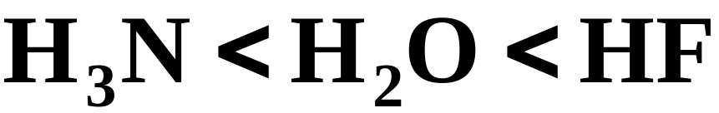
Molecular Structure and Acid Strength
As you go across a row of elements, the polarity of the H-X bond becomes the dominant factor.
  As electronegativity increases going to the right, the polarity of the H-X bond increases and the acid strength increases.
  You can predict the following order of acidic strength.
Notes:
2

Slide 32

Molecular Structure and Acid Strength
Consider the oxoacids. An oxoacid has the structure:
  The acidic H atom is always attached to an O atom, which in turn is attached to another atom Y.
  Bond polarity is the dominant factor in the relative strength of oxoacids.
  This, in turn, depends on the electronegativity of the atom Y.
Notes:
2

Slide 33
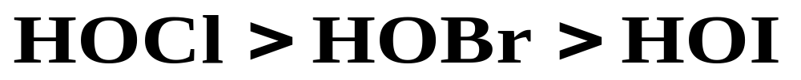
Molecular Structure and Acid Strength
Consider the oxoacids. An oxoacid has the structure:
  If the electronegativity of Y is large, then the O-H bond is relatively polar and the acid strength is greater.
  You can predict the following order of acidic strength.
Notes:
2

Slide 34
Molecular Structure and Acid Strength
Consider the oxoacids. An oxoacid has the structure:
  Other groups, such as O atoms or O-H groups, may be attached to Y.
  With each additional O atom, Y becomes effectively more electronegative.
Notes:
2

Slide 35
Molecular Structure and Acid Strength
Consider the oxoacids. An oxoacid has the structure:
  As a result, the H atom becomes more acidic.
  The acid strengths of the oxoacids of chlorine increase in the following order.
Notes:
2

Slide 36
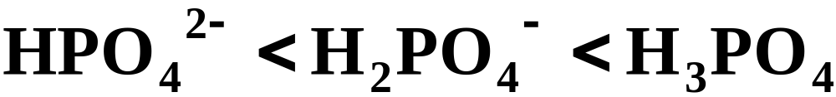
Molecular Structure and Acid Strength
Consider polyprotic acids and their corresponding anions.
  Each successive H atom becomes more difficult to remove.
  Therefore the acid strength of a polyprotic acid and its anions decreases with increasing negative charge.
Notes:
2

Slide 37
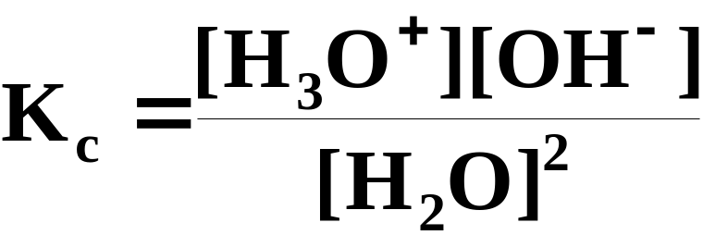
Self-ionization of Water
Self-ionization is a reaction in which two like molecules react to give ions.
  In the case of water, the following equilibrium is established.
  The equilibrium-constant expression for this system is:
Notes:
2

Slide 38
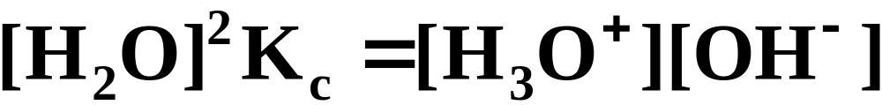
Self-ionization of Water
Self-ionization is a reaction in which two like molecules react to give ions.
  The concentration of ions is extremely small, so the concentration of H₂O remains essentially constant. This gives:
constant
Notes:
2

Slide 39
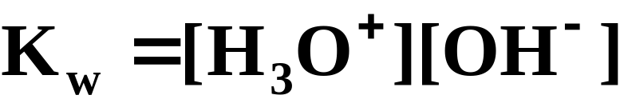
Self-ionization of Water
Self-ionization is a reaction in which two like molecules react to give ions.
  We call the equilibrium value for the ion product [H₃O⁺][OH⁻] the ion-product constant for water, which is written K_{w}.
  At 25 ºC, the value of K_{w} is 1.0 x 10⁻¹⁴.
  Like any equilibrium constant, K_{w} varies with temperature.
Notes:
2

Slide 40
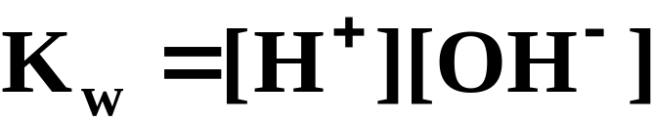
Self-ionization of Water
Self-ionization is a reaction in which two like molecules react to give ions.
  Because we often write H₃O⁺ as H⁺, the ion-product constant expression for water can be written:
  Using K_{w} you can calculate the concentrations of H⁺ and OH⁻ ions in pure water.
Notes:
2

Slide 41
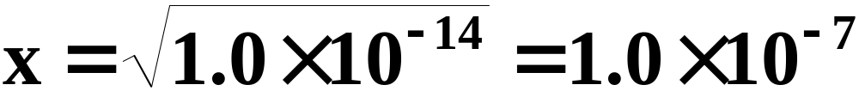
Self-ionization of Water
These ions are produced in equal numbers in pure water, so if we let x = [H⁺] = [OH⁻]
  Thus, the concentrations of H⁺ and OH⁻ in pure water are both 1.0 x 10⁻⁷ M.
  If you add acid or base to water they are no longer equal but the K_{w} expression still holds.
Notes:
2

Slide 42
Solutions of Strong Acid or Base
In a solution of a strong acid you can normally ignore the self-ionization of water as a source of H⁺(aq).
  The H⁺(aq) concentration is usually determined by the strong acid concentration.
  However, the self-ionization still exists and is responsible for a small concentration of OH⁻ ion.
Notes:
2

Slide 43
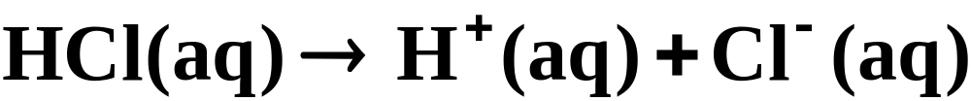
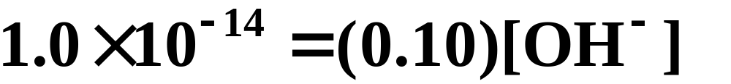
Solutions of Strong Acid or Base
As an example, calculate the concentration of OH⁻ ion in 0.10 M HCl.
  Because you started with 0.10 M HCl (a strong acid) the reaction will produce 0.10 M H⁺(aq).
  Substituting [H⁺]=0.10 into the ion-product expression, we get:
Notes:
2

Slide 44
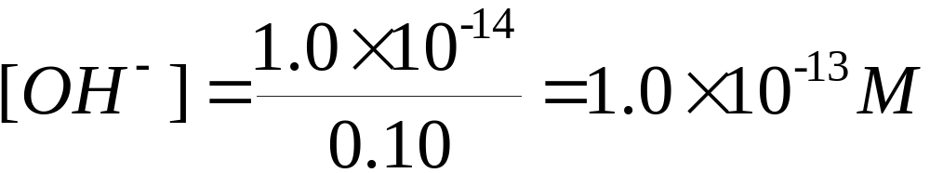
Solutions of Strong Acid or Base
As an example, calculate the concentration of OH⁻ ion in 0.10 M HCl.
  Because you started with 0.10 M HCl (a strong acid) the reaction will produce 0.10 M H⁺(aq).
  Substituting [H⁺]=0.10 into the ion-product expression, we get:
Notes:
2

Slide 45
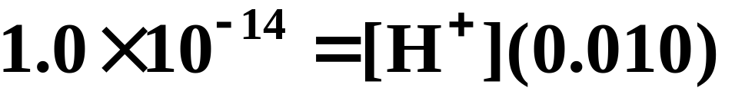
Solutions of Strong Acid or Base
As an example, calculate the concentration of H⁺ ion in 0.010 M NaOH.
  Because you started with 0.010 M NaOH (a strong base) the reaction will produce 0.010 M OH⁻(aq).
  Substituting [OH⁻]=0.010 into the ion-product expression, we get:
Notes:
2

Slide 46
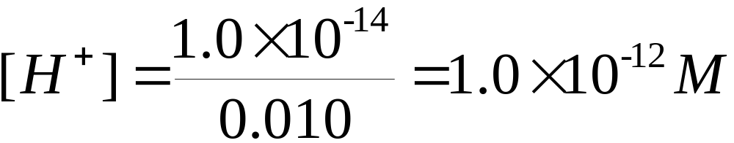
Solutions of Strong Acid or Base
As an example, calculate the concentration of H⁺ ion in 0.010 M NaOH.
  Because you started with 0.010 M NaOH (a strong base) the reaction will produce 0.010 M OH⁻(aq).
  Substituting [OH⁻]=0.010 into the ion-product expression, we get:
Notes:
2

Slide 47
Solutions of Strong Acid or Base
By dissolving substances in water, you can alter the concentrations of H⁺(aq) and OH⁻(aq).
  In a neutral solution, the concentrations of H⁺(aq) and OH⁻(aq) are equal, as they are in pure water.
  In an acidic solution, the concentration of H⁺(aq) is greater than that of OH⁻(aq).
  In a basic solution, the concentration of OH⁻(aq) is greater than that of H⁺(aq).
Notes:
2

Slide 48
Solutions of Strong Acid or Base
At 25°C, you observe the following conditions.
  In an acidic solution, [H⁺] > 1.0 x 10⁻⁷ M.
  In a neutral solution, [H⁺] = 1.0 x 10⁻⁷ M.
  In a basic solution, [H⁺] < 1.0 x 10⁻⁷ M.
Notes:
2

Slide 49
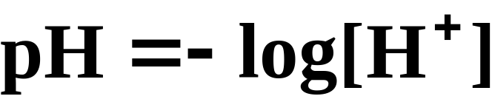
The pH of a Solution
Although you can quantitatively describe the acidity of a solution by its [H⁺], it is often more convenient to give acidity in terms of pH.
  The pH of a solution is defined as the negative logarithm of the molar hydrogen-ion concentration.
Notes:
2

Slide 50
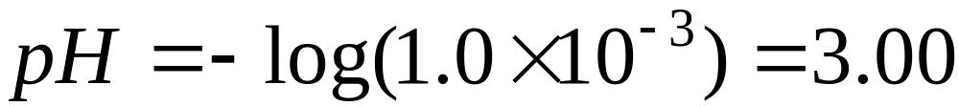
The pH of a Solution
For a solution in which the hydrogen-ion concentration is 1.0 x 10⁻³, the pH is:
  Note that the number of decimal places in the pH equals the number of significant figures in the hydrogen-ion concentration.
Notes:
2

Slide 51
The pH of a Solution
In a neutral solution, whose hydrogen-ion concentration is 1.0 x 10⁻⁷, the pH = 7.00.
For acidic solutions, the hydrogen-ion concentration is greater than 1.0 x 10⁻⁷, so the pH is less than 7.00.
Similarly, a basic solution has a pH greater than 7.00.
Figure 16.6 shows a diagram of the pH scale and the pH values of some common solutions.
Notes:
2

Slide 52
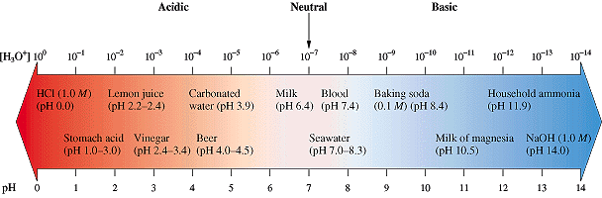
Figure 16.8: The pH Scale
Notes:
2

Slide 53
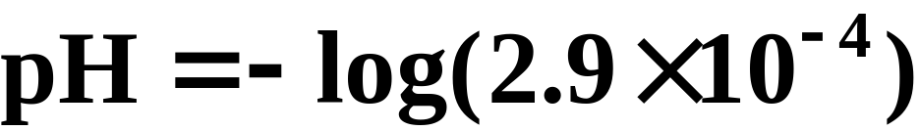
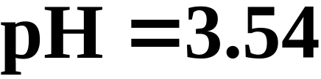
A Problem to Consider
A sample of orange juice has a hydrogen-ion concentration of 2.9 x 10⁻⁴ M. What is the pH?
Notes:
2

Slide 54
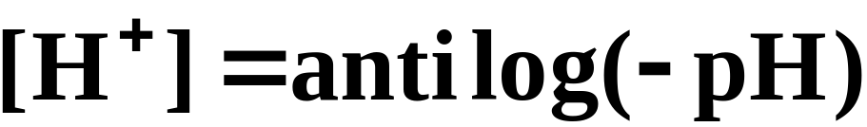
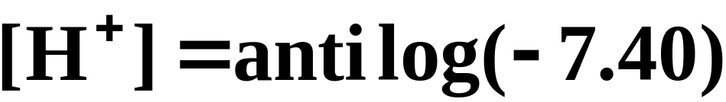
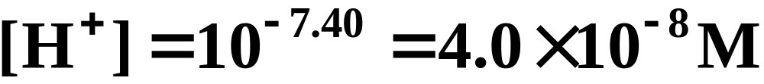
A Problem to Consider
The pH of human arterial blood is 7.40. What is the hydrogen-ion concentration?
Notes:
2

Slide 55
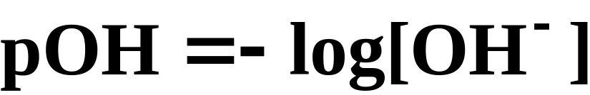
The pH of a Solution
A measurement of the hydroxide ion concentration, similar to pH, is the pOH.
  The pOH of a solution is defined as the negative logarithm of the molar hydroxide-ion concentration.
Notes:
2

Slide 56
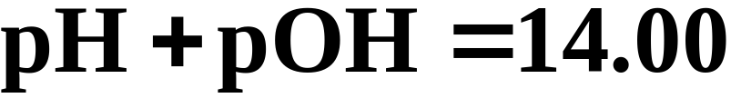
The pH of a Solution
A measurement of the hydroxide ion concentration, similar to pH, is the pOH.
  Then because K_{w} = [H⁺][OH⁻] = 1.0 x 10⁻¹⁴ at 25 ºC, you can show that
Notes:
2

Slide 57
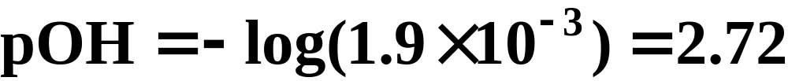
A Problem to Consider
An ammonia solution has a hydroxide-ion concentration of 1.9 x 10⁻³ M. What is the pH of the solution?
  You first calculate the pOH:
  Then the pH is:
Notes:
2

Slide 58
The pH of a Solution
The pH of a solution can accurately be measured using a pH meter (see Figure 16.9).
  Although less precise, acid-base indicators are often used to measure pH because they usually change color within a narrow pH range.
  Figure 16.8 shows the color changes of various acid-base indicators.
Notes:
2

Slide 59
Operational Skills
Identifying acid and base species
Identifying Lewis acid and base species
Deciding whether reactants or products are favored in an acid-base reaction
Calculating the concentration of H⁺ and OH⁻ in solutions of strong acid or base
Calculating the pH from the hydrogen-ion concentration, and vice versa
Notes:
2

Slide 60
Animation: Acid Ionization Equilibrium
(Click here to open QuickTime animation)
Return to Slide 7
Notes:
2

Slide 61
Animation: Self-Ionization of Water to Form H⁺ and OH⁻ in Equilibrium
(Click here to open QuickTime animation)
Return to Slide 38
Notes:
2

Slide 62

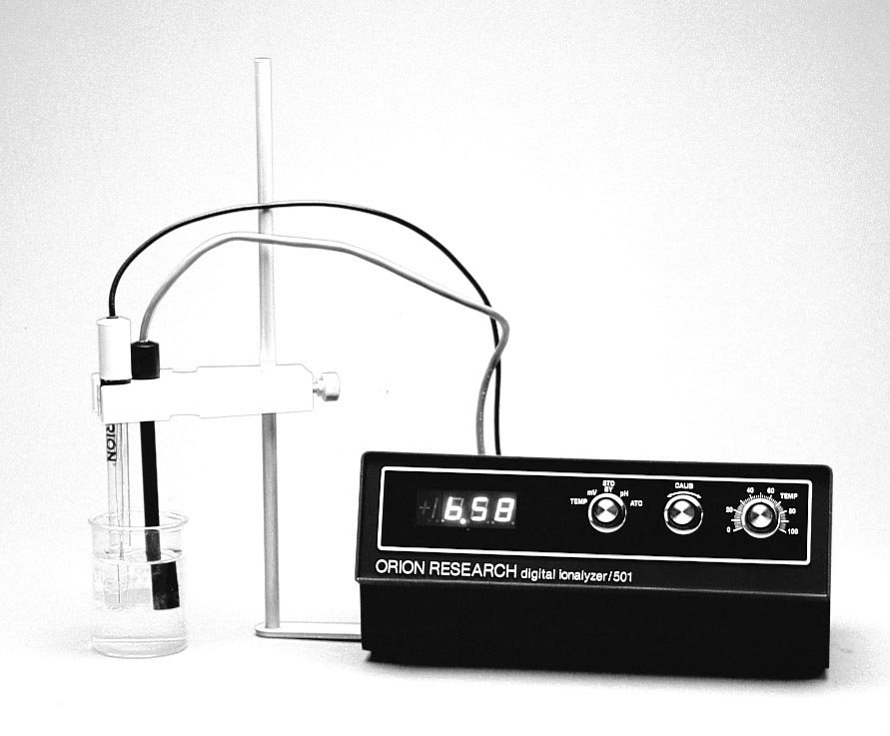
Figure 16.9:
A digital pH meter.
Photo courtesy of American Color.
Return to Slide 60

