Slide 1
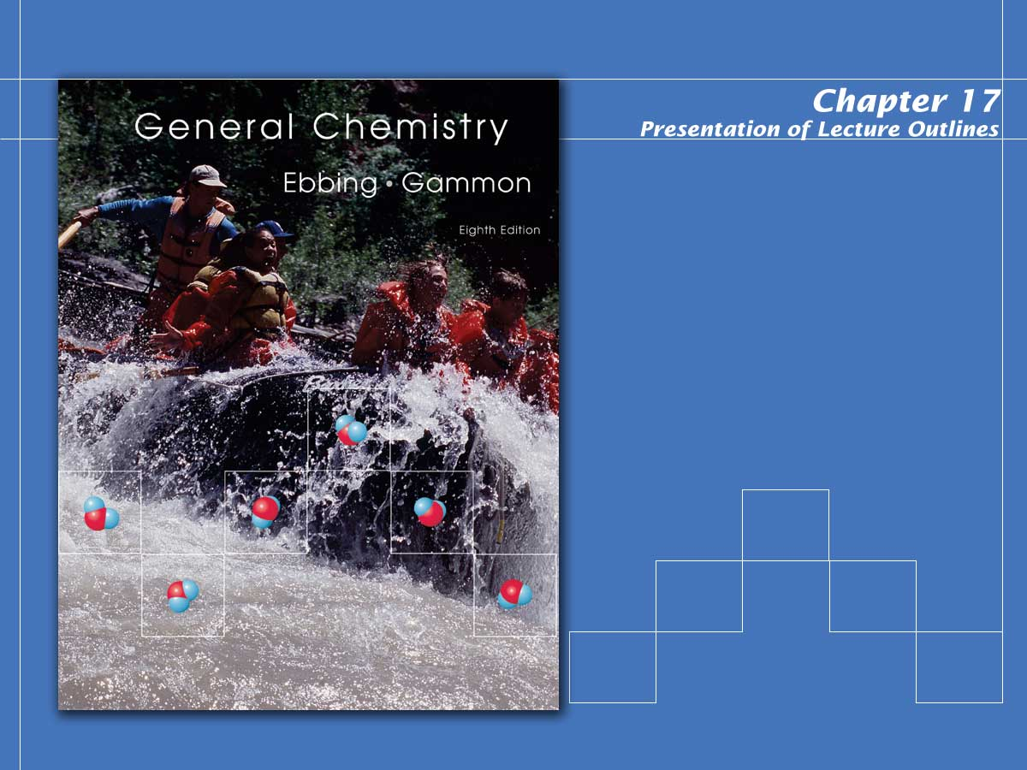
Acid-Base Equilibria

Slide 2
Solutions of a Weak Acid or Base
The simplest acid-base equilibria are those in which a single acid or base solute reacts with water.
  In this chapter, we will first look at solutions of weak acids and bases.
  We must also consider solutions of salts, which can have acidic or basic properties as a result of the reactions of their ions with water.
Copyright © Houghton Mifflin Company.All rights reserved.
Presentation of Lecture Outlines, 17–<number>
Notes:
2

Slide 3
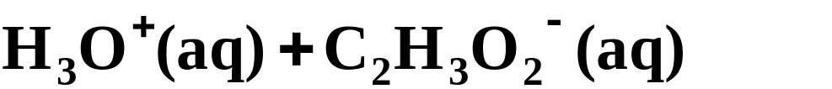
Acid-Ionization Equilibria
Acid ionization (or acid dissociation) is the reaction of an acid with water to produce hydronium ion (hydrogen ion) and the conjugate base anion.
  When acetic acid is added to water it reacts as follows.
  Because acetic acid is a weak electrolyte, it ionizes to a small extent in water.
Copyright © Houghton Mifflin Company.All rights reserved.
Presentation of Lecture Outlines, 17–<number>
Notes:
2

Slide 4
Acid-Ionization Equilibria
For a weak acid, the equilibrium concentrations of ions in solution are determined by the acid-ionization constant (also called the acid-dissociation constant).
  Consider the generic monoprotic acid, HA.
Copyright © Houghton Mifflin Company.All rights reserved.
Presentation of Lecture Outlines, 17–<number>
Notes:
2

Slide 5
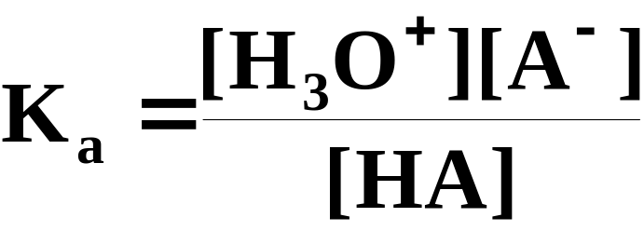
Acid-Ionization Equilibria
For a weak acid, the equilibrium concentrations of ions in solution are determined by the acid-ionization constant (also called the acid-dissociation constant).
  Thus, K_{a} , the acid-ionization constant, equals the constant [H₂O]K_{c}.
Copyright © Houghton Mifflin Company.All rights reserved.
Presentation of Lecture Outlines, 17–<number>
Notes:
2

Slide 6
A Problem To Consider
Nicotinic acid is a weak monoprotic acid with the formula HC₆H₄NO₂. A 0.012 M solution of nicotinic acid has a pH of 3.39 at 25°C. Calculate the acid-ionization constant for this acid at 25°C.
  It is important to realize that the solution was made 0.012 M in nicotinic acid, however, some molecules ionize making the equilibrium concentration of nicotinic acid less than 0.012 M.
  We will abbreviate the formula for nicotinic acid as HNic.
Copyright © Houghton Mifflin Company.All rights reserved.
Presentation of Lecture Outlines, 17–<number>
Notes:
2

Slide 7
A Problem To Consider
Nicotinic acid is a weak monoprotic acid with the formula HC₆H₄NO₂. A 0.012 M solution of nicotinic acid has a pH of 3.39 at 25°C. Calculate the acid-ionization constant for this acid at 25°C.
  Let x be the moles per liter of product formed.
Starting | 0.012 |  |  | 0 | 0
Change | -x |  |  | +x | +x
Equilibrium | 0.012-x |  |  | x | x
Copyright © Houghton Mifflin Company.All rights reserved.
Presentation of Lecture Outlines, 17–<number>
Notes:
2

Slide 8
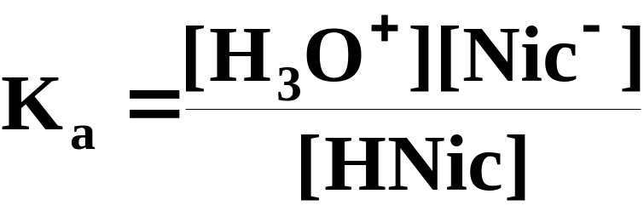
A Problem To Consider
Nicotinic acid is a weak monoprotic acid with the formula HC₆H₄NO₂. A 0.012 M solution of nicotinic acid has a pH of 3.39 at 25°C. Calculate the acid-ionization constant for this acid at 25°C.
  The equilibrium-constant expression is:
Copyright © Houghton Mifflin Company.All rights reserved.
Presentation of Lecture Outlines, 17–<number>
Notes:
2

Slide 9
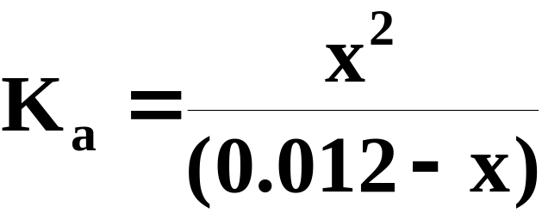
A Problem To Consider
Nicotinic acid is a weak monoprotic acid with the formula HC₆H₄NO₂. A 0.012 M solution of nicotinic acid has a pH of 3.39 at 25°C. Calculate the acid-ionization constant for this acid at 25°C.
  Substituting the expressions for the equilibrium concentrations, we get
Copyright © Houghton Mifflin Company.All rights reserved.
Presentation of Lecture Outlines, 17–<number>
Notes:
2

Slide 10
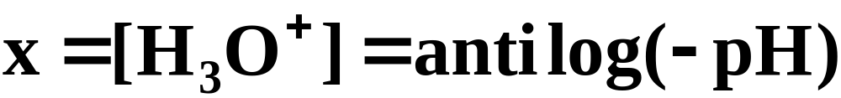

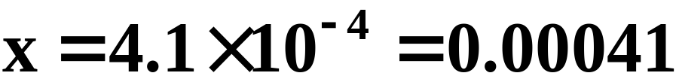
A Problem To Consider
Nicotinic acid is a weak monoprotic acid with the formula HC₆H₄NO₂. A 0.012 M solution of nicotinic acid has a pH of 3.39 at 25°C. Calculate the acid-ionization constant for this acid at 25°C.
  We can obtain the value of x from the given pH.
Copyright © Houghton Mifflin Company.All rights reserved.
Presentation of Lecture Outlines, 17–<number>
Notes:
2

Slide 11
A Problem To Consider
Nicotinic acid is a weak monoprotic acid with the formula HC₆H₄NO₂. A 0.012 M solution of nicotinic acid has a pH of 3.39 at 25°C. Calculate the acid-ionization constant for this acid at 25°C.
  Substitute this value of x in our equilibrium expression.
  Note first, however, that
      the concentration of unionized acid remains virtually unchanged.
Copyright © Houghton Mifflin Company.All rights reserved.
Presentation of Lecture Outlines, 17–<number>
Notes:
2

Slide 12
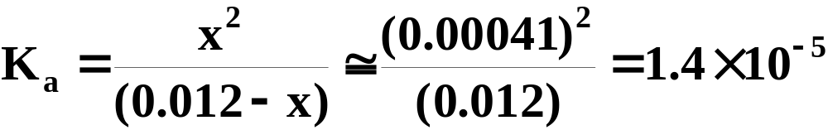
A Problem To Consider
Nicotinic acid is a weak monoprotic acid with the formula HC₆H₄NO₂. A 0.012 M solution of nicotinic acid has a pH of 3.39 at 25°C. Calculate the acid-ionization constant for this acid at 25°C.
  Substitute this value of x in our equilibrium expression.
Copyright © Houghton Mifflin Company.All rights reserved.
Presentation of Lecture Outlines, 17–<number>
Notes:
2

Slide 13
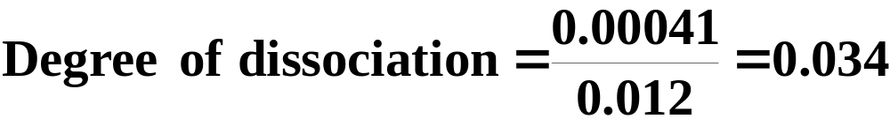
A Problem To Consider
Nicotinic acid is a weak monoprotic acid with the formula HC₆H₄NO₂. A 0.012 M solution of nicotinic acid has a pH of 3.39 at 25°C. Calculate the acid-ionization constant for this acid at 25°C.
  To obtain the degree of dissociation:
  The percent ionization is obtained by multiplying by 100, which gives 3.4%.
Copyright © Houghton Mifflin Company.All rights reserved.
Presentation of Lecture Outlines, 17–<number>
Notes:
2

Slide 14
Calculations With K_{a}
Once you know the value of K_{a}, you can calculate the equilibrium concentrations of species HA, A-, and H₃O⁺ for solutions of different molarities.
  The general method for doing this was discussed in Chapter 15.
Copyright © Houghton Mifflin Company.All rights reserved.
Presentation of Lecture Outlines, 17–<number>
Notes:
2

Slide 15
Calculations With K_{a}
Note that in our previous example, the degree of dissociation was so small that “x” was negligible compared to the concentration of nicotinic acid.
It is the small value of the degree of ionization that allowed us to ignore the subtracted x in the denominator of our equilibrium expression.
The degree of ionization of a weak acid depends on both the K_{a} and the concentration of the acid solution (see Figure 17.3).
Copyright © Houghton Mifflin Company.All rights reserved.
Presentation of Lecture Outlines, 17–<number>
Notes:
2

Slide 16

Calculations With K_{a}
How do you know when you can use this simplifying assumption?
  It can be shown that if the acid concentration, C_{a}, divided by the K_{a} exceeds 100, that is,
  then this simplifying assumption of ignoring the subtracted x gives an acceptable error of less than 5%.
Copyright © Houghton Mifflin Company.All rights reserved.
Presentation of Lecture Outlines, 17–<number>
Notes:
2

Slide 17
Calculations With K_{a}
How do you know when you can use this simplifying assumption?
  If the simplifying assumption is not valid, you can solve the equilibrium equation exactly by using the quadratic equation.
  The next example illustrates this with a solution of aspirin (acetylsalicylic acid), HC₉H₇O₄, a common headache remedy.
Copyright © Houghton Mifflin Company.All rights reserved.
Presentation of Lecture Outlines, 17–<number>
Notes:
2

Slide 18
A Problem To Consider
What is the pH at 25°C of a solution obtained by dissolving 0.325 g of acetylsalicylic acid (aspirin), HC₉H₇O₄, in 0.500 L of water? The acid is monoprotic and K_{a}=3.3 x 10⁻⁴ at 25°C.
  The molar mass of HC₉H₇O₄ is 180.2 g.
    From this we find that the sample contained 0.00180 mol of the acid.
Copyright © Houghton Mifflin Company.All rights reserved.
Presentation of Lecture Outlines, 17–<number>
Notes:
2

Slide 19
A Problem To Consider
What is the pH at 25°C of a solution obtained by dissolving 0.325 g of acetylsalicylic acid (aspirin), HC₉H₇O₄, in 0.500 L of water? The acid is monoprotic and K_{a}=3.3 x 10⁻⁴ at 25°C.
  The molar mass of HC₉H₇O₄ is 180.2 g.
    Hence, the concentration of the acetylsalicylic acid is 0.00180 mol/0.500 L = 0.0036 M (Retain two significant figures, the same number of significant figures in K_{a}).
Copyright © Houghton Mifflin Company.All rights reserved.
Presentation of Lecture Outlines, 17–<number>
Notes:
2

Slide 20
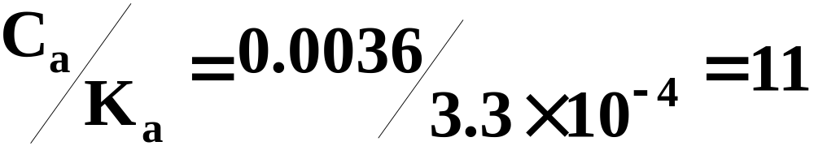
A Problem To Consider
What is the pH at 25°C of a solution obtained by dissolving 0.325 g of acetylsalicylic acid (aspirin), HC₉H₇O₄, in 0.500 L of water? The acid is monoprotic and K_{a}=3.3 x 10⁻⁴ at 25°C.
  Note that
    which is less than 100, so we must solve the equilibrium equation exactly.
Copyright © Houghton Mifflin Company.All rights reserved.
Presentation of Lecture Outlines, 17–<number>
Notes:
2

Slide 21
A Problem To Consider
What is the pH at 25°C of a solution obtained by dissolving 0.325 g of acetylsalicylic acid (aspirin), HC₉H₇O₄, in 0.500 L of water? The acid is monoprotic and K_{a}=3.3 x 10⁻⁴ at 25°C.
  We will abbreviate the formula for acetylsalicylic acid as HAcs and let x be the amount of H₃O⁺ formed per liter.
  The amount of acetylsalicylate ion is also x mol; the amount of nonionized acetylsalicylic acid is (0.0036-x) mol.
Copyright © Houghton Mifflin Company.All rights reserved.
Presentation of Lecture Outlines, 17–<number>
Notes:
2

Slide 22
A Problem To Consider
What is the pH at 25°C of a solution obtained by dissolving 0.325 g of acetylsalicylic acid (aspirin), HC₉H₇O₄, in 0.500 L of water? The acid is monoprotic and K_{a}=3.3 x 10⁻⁴ at 25°C.
  These data are summarized below.
Starting | 0.0036 |  |  | 0 | 0
Change | -x |  |  | +x | +x
Equilibrium | 0.0036-x |  |  | x | x
Copyright © Houghton Mifflin Company.All rights reserved.
Presentation of Lecture Outlines, 17–<number>
Notes:
2

Slide 23
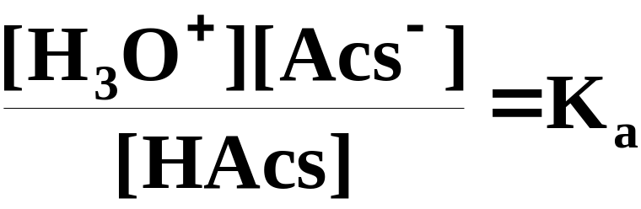
A Problem To Consider
What is the pH at 25°C of a solution obtained by dissolving 0.325 g of acetylsalicylic acid (aspirin), HC₉H₇O₄, in 0.500 L of water? The acid is monoprotic and K_{a}=3.3 x 10⁻⁴ at 25°C.
  The equilibrium constant expression is
Copyright © Houghton Mifflin Company.All rights reserved.
Presentation of Lecture Outlines, 17–<number>
Notes:
2

Slide 24
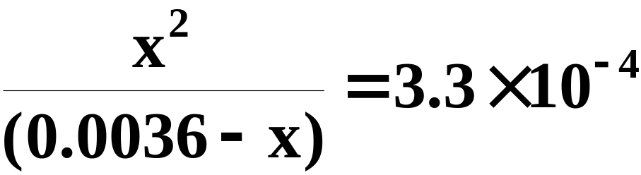
A Problem To Consider
What is the pH at 25°C of a solution obtained by dissolving 0.325 g of acetylsalicylic acid (aspirin), HC₉H₇O₄, in 0.500 L of water? The acid is monoprotic and K_{a}=3.3 x 10⁻⁴ at 25°C.
  If we substitute the equilibrium concentrations and the K_{a} into the equilibrium constant expression, we get
Copyright © Houghton Mifflin Company.All rights reserved.
Presentation of Lecture Outlines, 17–<number>
Notes:
2

Slide 25
A Problem To Consider
What is the pH at 25°C of a solution obtained by dissolving 0.325 g of acetylsalicylic acid (aspirin), HC₉H₇O₄, in 0.500 L of water? The acid is monoprotic and K_{a}=3.3 x 10⁻⁴ at 25°C.
  You can solve this equation exactly by using the quadratic formula.
  Rearranging the preceding equation to put it in the form ax² + bx + c = 0, we get
Copyright © Houghton Mifflin Company.All rights reserved.
Presentation of Lecture Outlines, 17–<number>
Notes:
2

Slide 26
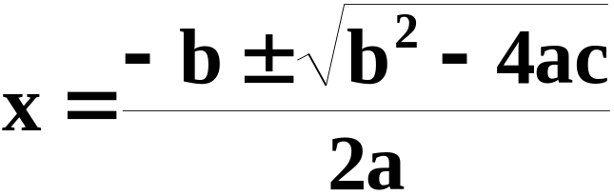
A Problem To Consider
What is the pH at 25°C of a solution obtained by dissolving 0.325 g of acetylsalicylic acid (aspirin), HC₉H₇O₄, in 0.500 L of water? The acid is monoprotic and K_{a}=3.3 x 10⁻⁴ at 25°C.
  Now substitute into the quadratic formula.
Copyright © Houghton Mifflin Company.All rights reserved.
Presentation of Lecture Outlines, 17–<number>
Notes:
2

Slide 27
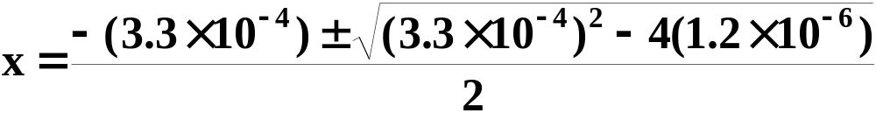
A Problem To Consider
What is the pH at 25°C of a solution obtained by dissolving 0.325 g of acetylsalicylic acid (aspirin), HC₉H₇O₄, in 0.500 L of water? The acid is monoprotic and K_{a}=3.3 x 10⁻⁴ at 25°C.
  Now substitute into the quadratic formula.
  The lower sign in ± gives a negative root which we can ignore
Copyright © Houghton Mifflin Company.All rights reserved.
Presentation of Lecture Outlines, 17–<number>
Notes:
2

Slide 28
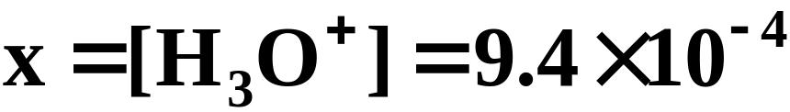
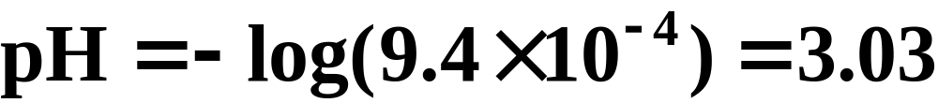
A Problem To Consider
What is the pH at 25°C of a solution obtained by dissolving 0.325 g of acetylsalicylic acid (aspirin), HC₉H₇O₄, in 0.500 L of water? The acid is monoprotic and K_{a}=3.3 x 10⁻⁴ at 25°C.
  Taking the upper sign, we get
  Now we can calculate the pH.
Copyright © Houghton Mifflin Company.All rights reserved.
Presentation of Lecture Outlines, 17–<number>
Notes:
2

Slide 29
Polyprotic Acids
Some acids have two or more protons (hydrogen ions) to donate in aqueous solution. These are referred to as polyprotic acids.
  Sulfuric acid, for example, can lose two protons in aqueous solution.
  The first proton is lost completely followed by a weak ionization of the hydrogen sulfate ion, HSO₄⁻.
Copyright © Houghton Mifflin Company.All rights reserved.
Presentation of Lecture Outlines, 17–<number>
Notes:
2

Slide 30
Polyprotic Acids
Some acids have two or more protons (hydrogen ions) to donate in aqueous solution. These are referred to as polyprotic acids.
  For a weak diprotic acid like carbonic acid, H₂CO₃, two simultaneous equilibria must be considered.
Copyright © Houghton Mifflin Company.All rights reserved.
Presentation of Lecture Outlines, 17–<number>
Notes:
2

Slide 31
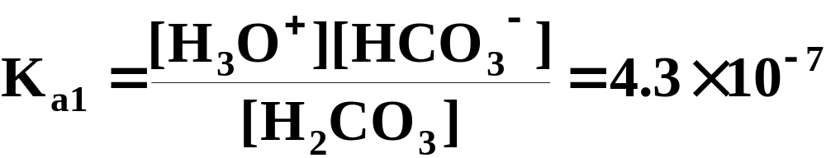
Polyprotic Acids
Some acids have two or more protons (hydrogen ions) to donate in aqueous solution. These are referred to as polyprotic acids.
  Each equilibrium has an associated acid-ionization constant.
      For the loss of the first proton
Copyright © Houghton Mifflin Company.All rights reserved.
Presentation of Lecture Outlines, 17–<number>
Notes:
2

Slide 32
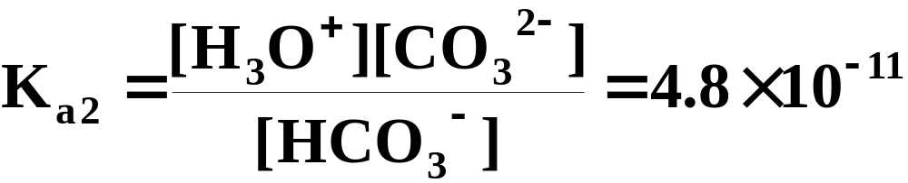
Polyprotic Acids
Some acids have two or more protons (hydrogen ions) to donate in aqueous solution. These are referred to as polyprotic acids.
  Each equilibrium has an associated acid-ionization constant.
      For the loss of the second proton
Copyright © Houghton Mifflin Company.All rights reserved.
Presentation of Lecture Outlines, 17–<number>
Notes:
2

Slide 33
Polyprotic Acids
Some acids have two or more protons (hydrogen ions) to donate in aqueous solution. These are referred to as polyprotic acids.
  In general, the second ionization constant, K_{a2}, for a polyprotic acid is smaller than the first ionization constant, K_{a1}.
  In the case of a triprotic acid, such as H₃PO₄, the third ionization constant, K_{a3}, is smaller than the second one, K_{a2}.
Copyright © Houghton Mifflin Company.All rights reserved.
Presentation of Lecture Outlines, 17–<number>
Notes:
2

Slide 34
Polyprotic Acids
  When several equilibria occur at once, it might appear complicated to calculate equilibrium compositions.
  However, reasonable assumptions can be made that simplify these calculations as we show in the next example.
Copyright © Houghton Mifflin Company.All rights reserved.
Presentation of Lecture Outlines, 17–<number>
Notes:
2

Slide 35
A Problem To Consider
Ascorbic acid (vitamin C) is a diprotic acid, H₂C₆H₆O₆. What is the pH of a 0.10 M solution? What is the concentration of the ascorbate ion, C₆H₆O₆²⁻ ?
The acid ionization constants are K_{a1} = 7.9 x 10⁻⁵ and K_{a2} = 1.6 x 10⁻¹².
  For diprotic acids, K_{a2} is so much smaller than K_{a1} that the smaller amount of hydronium ion produced in the second reaction can be neglected.
Copyright © Houghton Mifflin Company.All rights reserved.
Presentation of Lecture Outlines, 17–<number>
Notes:
2

Slide 36
A Problem To Consider
Ascorbic acid (vitamin C) is a diprotic acid, H₂C₆H₆O₆. What is the pH of a 0.10 M solution? What is the concentration of the ascorbate ion, C₆H₆O₆²⁻ ?
The acid ionization constants are K_{a1} = 7.9 x 10⁻⁵ and K_{a2} = 1.6 x 10⁻¹².
    The pH can be determined by simply solving the equilibrium problem posed by the first ionization.
Copyright © Houghton Mifflin Company.All rights reserved.
Presentation of Lecture Outlines, 17–<number>
Notes:
2

Slide 37
A Problem To Consider
Ascorbic acid (vitamin C) is a diprotic acid, H₂C₆H₆O₆. What is the pH of a 0.10 M solution? What is the concentration of the ascorbate ion, C₆H₆O₆²⁻ ?
The acid ionization constants are K_{a1} = 7.9 x 10-5 and K_{a2} = 1.6 x 10⁻¹².
  If we abbreviate the formula for ascorbic acid as H₂Asc, then the first ionization is:
Copyright © Houghton Mifflin Company.All rights reserved.
Presentation of Lecture Outlines, 17–<number>
Notes:
2

Slide 38
A Problem To Consider
Ascorbic acid (vitamin C) is a diprotic acid, H₂C₆H₆O₆. What is the pH of a 0.10 M solution? What is the concentration of the ascorbate ion, C₆H₆O₆²⁻ ?
The acid ionization constants are K_{a1} = 7.9 x 10-5 and K_{a2} = 1.6 x 10⁻¹².
Starting | 0.10 |  |  | 0 | 0
Change | -x |  |  | +x | +x
Equilibrium | 0.10-x |  |  | x | x
Copyright © Houghton Mifflin Company.All rights reserved.
Presentation of Lecture Outlines, 17–<number>
Notes:
2

Slide 39
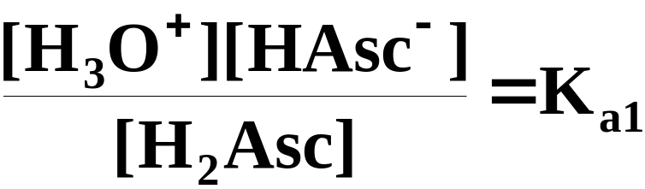
A Problem To Consider
Ascorbic acid (vitamin C) is a diprotic acid, H₂C₆H₆O₆. What is the pH of a 0.10 M solution? What is the concentration of the ascorbate ion, C₆H₆O₆²⁻ ?
The acid ionization constants are K_{a1} = 7.9 x 10-5 and K_{a2} = 1.6 x 10⁻¹².
  The equilibrium constant expression is
Copyright © Houghton Mifflin Company.All rights reserved.
Presentation of Lecture Outlines, 17–<number>
Notes:
2

Slide 40
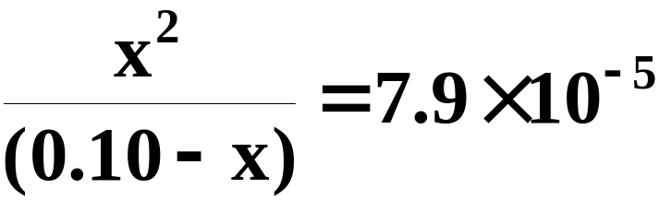
A Problem To Consider
Ascorbic acid (vitamin C) is a diprotic acid, H₂C₆H₆O₆. What is the pH of a 0.10 M solution? What is the concentration of the ascorbate ion, C₆H₆O₆²⁻ ?
The acid ionization constants are K_{a1} = 7.9 x 10-5 and K_{a2} = 1.6 x 10⁻¹².
  Substituting into the equilibrium expression
Copyright © Houghton Mifflin Company.All rights reserved.
Presentation of Lecture Outlines, 17–<number>
Notes:
2

Slide 41
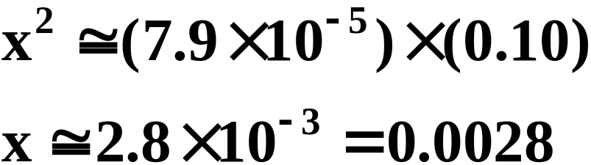
A Problem To Consider
Ascorbic acid (vitamin C) is a diprotic acid, H₂C₆H₆O₆. What is the pH of a 0.10 M solution? What is the concentration of the ascorbate ion, C₆H₆O₆²⁻ ?
The acid ionization constants are K_{a1} = 7.9 x 10-5 and K_{a2} = 1.6 x 10⁻¹².
  Assuming that x is much smaller than 0.10, you get
Copyright © Houghton Mifflin Company.All rights reserved.
Presentation of Lecture Outlines, 17–<number>
Notes:
2

Slide 42
A Problem To Consider
Ascorbic acid (vitamin C) is a diprotic acid, H₂C₆H₆O₆. What is the pH of a 0.10 M solution? What is the concentration of the ascorbate ion, C₆H₆O₆²⁻ ?
The acid ionization constants are K_{a1} = 7.9 x 10-5 and K_{a2} = 1.6 x 10⁻¹².
  The hydronium ion concentration is 0.0028 M, so
Copyright © Houghton Mifflin Company.All rights reserved.
Presentation of Lecture Outlines, 17–<number>
Notes:
2

Slide 43
A Problem To Consider
Ascorbic acid (vitamin C) is a diprotic acid, H₂C₆H₆O₆. What is the pH of a 0.10 M solution? What is the concentration of the ascorbate ion, C₆H₆O₆²⁻ ?
The acid ionization constants are K_{a1} = 7.9 x 10-5 and K_{a2} = 1.6 x 10⁻¹².
  The ascorbate ion, Asc²⁻, which we will call y, is produced only in the second ionization of H₂Asc.
Copyright © Houghton Mifflin Company.All rights reserved.
Presentation of Lecture Outlines, 17–<number>
Notes:
2

Slide 44
A Problem To Consider
Ascorbic acid (vitamin C) is a diprotic acid, H₂C₆H₆O₆. What is the pH of a 0.10 M solution? What is the concentration of the ascorbate ion, C₆H₆O₆²⁻ ?
The acid ionization constants are K_{a1} = 7.9 x 10-5 and K_{a2} = 1.6 x 10⁻¹².
  Assume the starting concentrations for HAsc⁻ and H₃O⁺ to be those from the first equilibrium.
Copyright © Houghton Mifflin Company.All rights reserved.
Presentation of Lecture Outlines, 17–<number>
Notes:
2

Slide 45
A Problem To Consider
Ascorbic acid (vitamin C) is a diprotic acid, H₂C₆H₆O₆. What is the pH of a 0.10 M solution? What is the concentration of the ascorbate ion, C₆H₆O₆²⁻ ?
The acid ionization constants are K_{a1} = 7.9 x 10-5 and K_{a2} = 1.6 x 10⁻¹².
Starting | 0.0028 |  |  | 0.0028 | 0
Change | -y |  |  | +y | +y
Equilibrium | 0.0028-x |  |  | 0.0028+y | y
Copyright © Houghton Mifflin Company.All rights reserved.
Presentation of Lecture Outlines, 17–<number>
Notes:
2

Slide 46
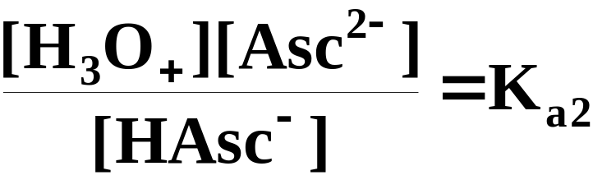
A Problem To Consider
Ascorbic acid (vitamin C) is a diprotic acid, H₂C₆H₆O₆. What is the pH of a 0.10 M solution? What is the concentration of the ascorbate ion, C₆H₆O₆²⁻ ?
The acid ionization constants are K_{a1} = 7.9 x 10-5 and K_{a2} = 1.6 x 10⁻¹².
  The equilibrium constant expression is
Copyright © Houghton Mifflin Company.All rights reserved.
Presentation of Lecture Outlines, 17–<number>
Notes:
2

Slide 47
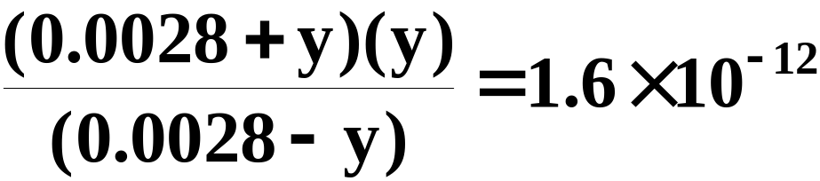
A Problem To Consider
Ascorbic acid (vitamin C) is a diprotic acid, H₂C₆H₆O₆. What is the pH of a 0.10 M solution? What is the concentration of the ascorbate ion, C₆H₆O₆²⁻ ?
The acid ionization constants are K_{a1} = 7.9 x 10-5 and K_{a2} = 1.6 x 10⁻¹².
  Substituting into the equilibrium expression
Copyright © Houghton Mifflin Company.All rights reserved.
Presentation of Lecture Outlines, 17–<number>
Notes:
2

Slide 48
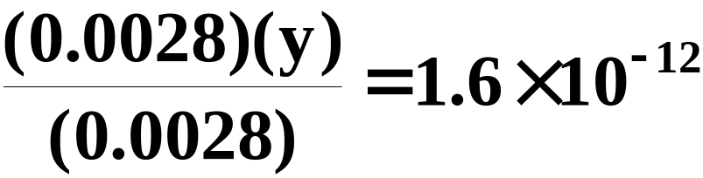
A Problem To Consider
Ascorbic acid (vitamin C) is a diprotic acid, H₂C₆H₆O₆. What is the pH of a 0.10 M solution? What is the concentration of the ascorbate ion, C₆H₆O₆²⁻ ?
The acid ionization constants are K_{a1} = 7.9 x 10-5 and K_{a2} = 1.6 x 10⁻¹².
  Assuming y is much smaller than 0.0028, the equation simplifies to
Copyright © Houghton Mifflin Company.All rights reserved.
Presentation of Lecture Outlines, 17–<number>
Notes:
2

Slide 49
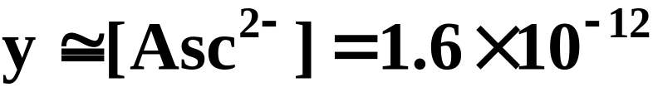
A Problem To Consider
Ascorbic acid (vitamin C) is a diprotic acid, H₂C₆H₆O₆. What is the pH of a 0.10 M solution? What is the concentration of the ascorbate ion, C₆H₆O₆²⁻ ?
The acid ionization constants are K_{a1} = 7.9 x 10-5 and K_{a2} = 1.6 x 10⁻¹².
  Hence,
  The concentration of the ascorbate ion equals K_{a2}.
Copyright © Houghton Mifflin Company.All rights reserved.
Presentation of Lecture Outlines, 17–<number>
Notes:
2

Slide 50
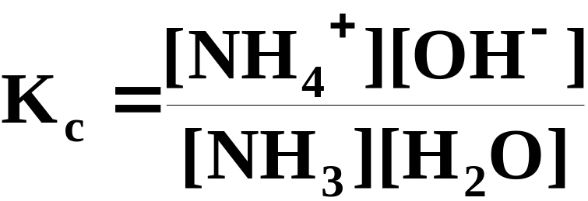
Base-Ionization Equilibria
Equilibria involving weak bases are treated similarly to those for weak acids.
  Ammonia, for example, ionizes in water as follows.
  The corresponding equilibrium constant is:
Copyright © Houghton Mifflin Company.All rights reserved.
Presentation of Lecture Outlines, 17–<number>
Notes:
2

Slide 51
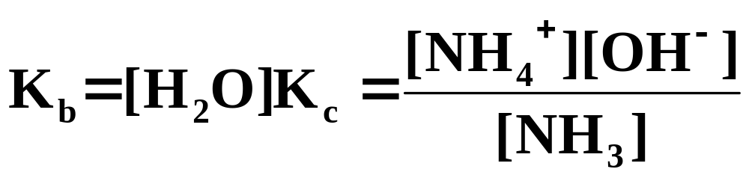
Base-Ionization Equilibria
Equilibria involving weak bases are treated similarly to those for weak acids.
  Ammonia, for example, ionizes in water as follows.
  The concentration of water is nearly constant.
Copyright © Houghton Mifflin Company.All rights reserved.
Presentation of Lecture Outlines, 17–<number>
Notes:
2

Slide 52
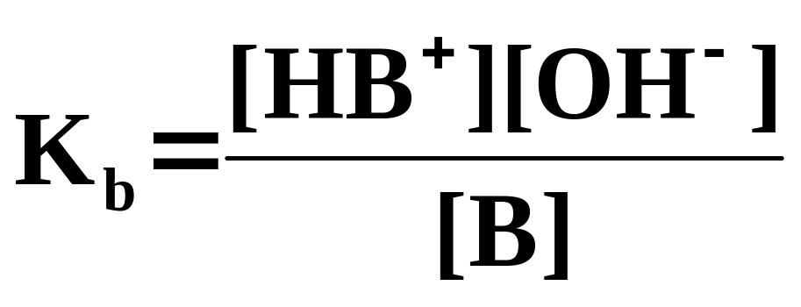
Base-Ionization Equilibria
Equilibria involving weak bases are treated similarly to those for weak acids.
  In general, a weak base B with the base ionization
    has a base ionization constant equal to
Table 17.2 lists ionization constants for some weak bases.
Copyright © Houghton Mifflin Company.All rights reserved.
Presentation of Lecture Outlines, 17–<number>
Notes:
2

Slide 53
A Problem To Consider
What is the pH of a 0.20 M solution of pyridine, C₅H₅N, in aqueous solution? The K_{b} for pyridine is 1.4 x 10-9.
  As before, we will follow the three steps in solving an equilibrium.
      Write the equation and make a table of concentrations.
      Set up the equilibrium constant expression.
      Solve for x = [OH⁻].
Copyright © Houghton Mifflin Company.All rights reserved.
Presentation of Lecture Outlines, 17–<number>
Notes:
2

Slide 54
A Problem To Consider
What is the pH of a 0.20 M solution of pyridine, C₅H₅N, in aqueous solution? The K_{b} for pyridine is 1.4 x 10⁻⁹.
  Pyridine ionizes by picking up a proton from water (as ammonia does).
Starting | 0.20 |  |  | 0 | 0
Change | -x |  |  | +x | +x
Equilibrium | 0.20-x |  |  | x | x
Copyright © Houghton Mifflin Company.All rights reserved.
Presentation of Lecture Outlines, 17–<number>
Notes:
2

Slide 55
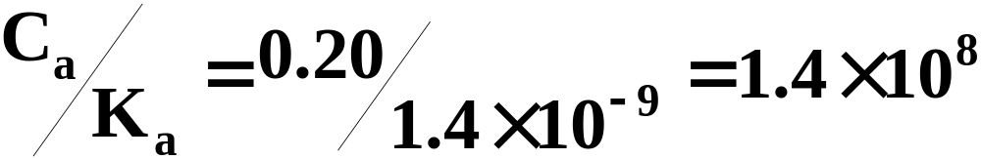
A Problem To Consider
What is the pH of a 0.20 M solution of pyridine, C₅H₅N, in aqueous solution? The K_{b} for pyridine is 1.4 x 10⁻⁹.
  Note that
    which is much greater than 100, so we may use the simplifying assumption that (0.20-x) ≅ (0.20).
Copyright © Houghton Mifflin Company.All rights reserved.
Presentation of Lecture Outlines, 17–<number>
Notes:
2

Slide 56
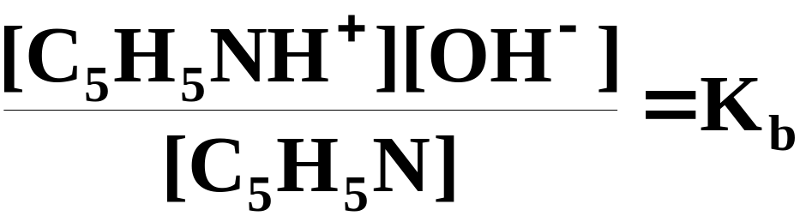
A Problem To Consider
What is the pH of a 0.20 M solution of pyridine, C₅H₅N, in aqueous solution? The K_{b} for pyridine is 1.4 x 10⁻⁹.
  The equilibrium expression is
Copyright © Houghton Mifflin Company.All rights reserved.
Presentation of Lecture Outlines, 17–<number>
Notes:
2

Slide 57
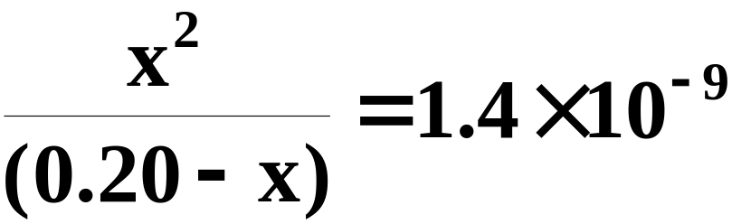
A Problem To Consider
What is the pH of a 0.20 M solution of pyridine, C₅H₅N, in aqueous solution? The K_{b} for pyridine is 1.4 x 10⁻⁹.
  If we substitute the equilibrium concentrations and the K_{b} into the equilibrium constant expression, we get
Copyright © Houghton Mifflin Company.All rights reserved.
Presentation of Lecture Outlines, 17–<number>
Notes:
2

Slide 58
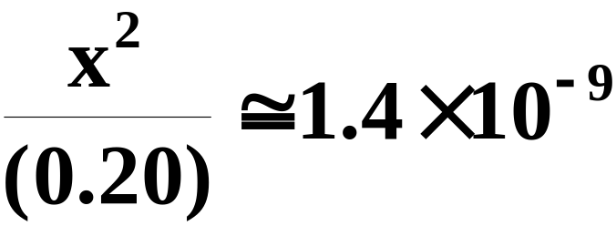
A Problem To Consider
What is the pH of a 0.20 M solution of pyridine, C₅H₅N, in aqueous solution? The K_{b} for pyridine is 1.4 x 10⁻⁹.
  Using our simplifying assumption that the x in the denominator is negligible, we get
Copyright © Houghton Mifflin Company.All rights reserved.
Presentation of Lecture Outlines, 17–<number>
Notes:
2

Slide 59
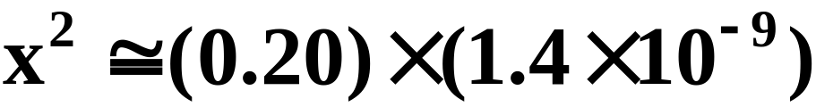
A Problem To Consider
What is the pH of a 0.20 M solution of pyridine, C₅H₅N, in aqueous solution? The K_{b} for pyridine is 1.4 x 10⁻⁹.
  Solving for x we get
Copyright © Houghton Mifflin Company.All rights reserved.
Presentation of Lecture Outlines, 17–<number>
Notes:
2

Slide 60
A Problem To Consider
What is the pH of a 0.20 M solution of pyridine, C₅H₅N, in aqueous solution? The K_{b} for pyridine is 1.4 x 10⁻⁹.
  Solving for pOH
  Since pH + pOH = 14.00
Copyright © Houghton Mifflin Company.All rights reserved.
Presentation of Lecture Outlines, 17–<number>
Notes:
2

Slide 61
Acid-Base Properties of a Salt Solution
One of the successes of the Brønsted-Lowry concept of acids and bases was in pointing out that some ions can act as acids or bases.
  Consider a solution of sodium cyanide, NaCN.
  A 0.1 M solution has a pH of 11.1 and is therefore fairly basic.
Copyright © Houghton Mifflin Company.All rights reserved.
Presentation of Lecture Outlines, 17–<number>
Notes:
2

Slide 62
Acid-Base Properties of a Salt Solution
One of the successes of the Brønsted-Lowry concept of acids and bases was in pointing out that some ions can act as acids or bases.
  Sodium ion, Na⁺, is unreactive with water, but the cyanide ion, CN⁻, reacts to produce HCN and OH⁻.
Copyright © Houghton Mifflin Company.All rights reserved.
Presentation of Lecture Outlines, 17–<number>
Notes:
2

Slide 63
Acid-Base Properties of a Salt Solution
One of the successes of the Brønsted-Lowry concept of acids and bases was in pointing out that some ions can act as acids or bases.
  From the Brønsted-Lowry point of view, the CN⁻ ion acts as a base, because it accepts a proton from H₂O.
Copyright © Houghton Mifflin Company.All rights reserved.
Presentation of Lecture Outlines, 17–<number>
Notes:
2

Slide 64
Acid-Base Properties of a Salt Solution
  You can also see that OH⁻ ion is a product, so you would expect the solution to have a basic pH. This explains why NaCN solutions are basic.
  The reaction of the CN⁻ ion with water is referred to as the hydrolysis of CN⁻.
Copyright © Houghton Mifflin Company.All rights reserved.
Presentation of Lecture Outlines, 17–<number>
Notes:
2

Slide 65
Acid-Base Properties of a Salt Solution
The hydrolysis of an ion is the reaction of an ion with water to produce the conjugate acid and hydroxide ion or the conjugate base and hydronium ion.
  The CN- ion hydrolyzes to give the conjugate acid and hydroxide.
Copyright © Houghton Mifflin Company.All rights reserved.
Presentation of Lecture Outlines, 17–<number>
Notes:
2

Slide 66
Acid-Base Properties of a Salt Solution
  The hydrolysis reaction for CN⁻ has the form of a base ionization so you writ the K_{b} expression for it.
Copyright © Houghton Mifflin Company.All rights reserved.
Presentation of Lecture Outlines, 17–<number>
Notes:
2

Slide 67
Acid-Base Properties of a Salt Solution
The hydrolysis of an ion is the reaction of an ion with water to produce the conjugate acid and hydroxide ion or the conjugate base and hydronium ion.
  The NH₄⁺ ion hydrolyzes to the conjugate base (NH₃) and hydronium ion.
Copyright © Houghton Mifflin Company.All rights reserved.
Presentation of Lecture Outlines, 17–<number>
Notes:
2

Slide 68
Acid-Base Properties of a Salt Solution
The hydrolysis of an ion is the reaction of an ion with water to produce the conjugate acid and hydroxide ion or the conjugate base and hydronium ion.
  This equation has the form of an acid ionization so you write the K_{a} expression for it.
Copyright © Houghton Mifflin Company.All rights reserved.
Presentation of Lecture Outlines, 17–<number>
Notes:
2

Slide 69
Predicting Whether a Salt is Acidic, Basic, or Neutral
How can you predict whether a particular salt will be acidic, basic, or neutral?
  The Brønsted-Lowry concept illustrates the inverse relationship in the strengths of conjugate acid-base pairs.
  Consequently, the anions of weak acids (poor proton donors) are good proton acceptors.
  Anions of weak acids therefore, are basic.
Copyright © Houghton Mifflin Company.All rights reserved.
Presentation of Lecture Outlines, 17–<number>
Notes:
2

Slide 70
Predicting Whether a Salt is Acidic, Basic, or Neutral
How can you predict whether a particular salt will be acidic, basic, or neutral?
  One the other hand, the anions of strong acids (good proton donors) have virtually no basic character, that is, they do not hydrolyze.
  For example, the Cl⁻ ion, which is conjugate to the strong acid HCl, shows no appreciable reaction with water.
Copyright © Houghton Mifflin Company.All rights reserved.
Presentation of Lecture Outlines, 17–<number>
Notes:
2

Slide 71
Predicting Whether a Salt is Acidic, Basic, or Neutral
How can you predict whether a particular salt will be acidic, basic, or neutral?
  Conversely, the cations of weak bases are acidic.
  One the other hand, the cations of strong bases have virtually no acidic character, that is, they do not hydrolyze. For example,
Copyright © Houghton Mifflin Company.All rights reserved.
Presentation of Lecture Outlines, 17–<number>
Notes:
2

Slide 72
Predicting Whether a Salt is Acidic, Basic, or Neutral
To predict the acidity or basicity of a salt, you must examine the acidity or basicity of the ions composing the salt.
  Consider potassium acetate, KC₂H₃O₂.
    The potassium ion is the cation of a strong base (KOH) and does not hydrolyze.
Copyright © Houghton Mifflin Company.All rights reserved.
Presentation of Lecture Outlines, 17–<number>
Notes:
2

Slide 73
Predicting Whether a Salt is Acidic, Basic, or Neutral
To predict the acidity or basicity of a salt, you must examine the acidity or basicity of the ions composing the salt.
  Consider potassium acetate, KC₂H₃O₂.
    The acetate ion, however, is the anion of a weak acid (HC₂H₃O₂) and is basic.
    A solution of potassium acetate is predicted to be basic.
Copyright © Houghton Mifflin Company.All rights reserved.
Presentation of Lecture Outlines, 17–<number>
Notes:
2

Slide 74
Predicting Whether a Salt is Acidic, Basic, or Neutral
These rules apply to normal salts (those in which the anion has no acidic hydrogen)
  A salt of a strong base and a strong acid.
  The salt has no hydrolyzable ions and so gives a neutral aqueous solution.
  An example is NaCl.
Copyright © Houghton Mifflin Company.All rights reserved.
Presentation of Lecture Outlines, 17–<number>
Notes:
2

Slide 75
Predicting Whether a Salt is Acidic, Basic, or Neutral
These rules apply to normal salts (those in which the anion has no acidic hydrogen)
  A salt of a strong base and a weak acid.
  The anion of the salt is the conjugate of the weak acid. It hydrolyzes to give a basic solution.
  An example is NaCN.
Copyright © Houghton Mifflin Company.All rights reserved.
Presentation of Lecture Outlines, 17–<number>
Notes:
2

Slide 76
Predicting Whether a Salt is Acidic, Basic, or Neutral
These rules apply to normal salts (those in which the anion has no acidic hydrogen)
  A salt of a weak base and a strong acid.
  The cation of the salt is the conjugate of the weak base. It hydrolyzes to give an acidic solution.
  An example is NH₄Cl.
Copyright © Houghton Mifflin Company.All rights reserved.
Presentation of Lecture Outlines, 17–<number>
Notes:
2

Slide 77
Predicting Whether a Salt is Acidic, Basic, or Neutral
These rules apply to normal salts (those in which the anion has no acidic hydrogen)
  A salt of a weak base and a weak acid.
  Both ions hydrolyze. You must compare the K_{a} of the cation with the K_{b} of the anion.
  If the K_{a} of the cation is larger the solution is acidic.
  If the K_{b} of the anion is larger, the solution is basic.
Copyright © Houghton Mifflin Company.All rights reserved.
Presentation of Lecture Outlines, 17–<number>
Notes:
2

Slide 78
The pH of a Salt Solution
To calculate the pH of a salt solution would require the K_{a} of the acidic cation or the K_{b} of the basic anion. (see Figure 17.8)
  The ionization constants of ions are not listed directly in tables because the values are easily related to their conjugate species.
  Thus the K_{b} for CN⁻ is related to the K_{a} for HCN.
Copyright © Houghton Mifflin Company.All rights reserved.
Presentation of Lecture Outlines, 17–<number>
Notes:
2

Slide 79
The pH of a Salt Solution
To see the relationship between K_{a} and K_{b} for conjugate acid-base pairs, consider the acid ionization of HCN and the base ionization of CN⁻.
K_{a}
K_{b}
K_{w}
  When these two reactions are added you get the ionization of water.
Copyright © Houghton Mifflin Company.All rights reserved.
Presentation of Lecture Outlines, 17–<number>
Notes:
2

Slide 80
The pH of a Salt Solution
To see the relationship between K_{a} and K_{b} for conjugate acid-base pairs, consider the acid ionization of HCN and the base ionization of CN⁻.
K_{a}
K_{b}
K_{w}
  When two reactions are added, their equilibrium constants are multiplied.
Copyright © Houghton Mifflin Company.All rights reserved.
Presentation of Lecture Outlines, 17–<number>
Notes:
2

Slide 81

The pH of a Salt Solution
To see the relationship between K_{a} and K_{b} for conjugate acid-base pairs, consider the acid ionization of HCN and the base ionization of CN⁻.
K_{a}
K_{b}
K_{w}
  Therefore,
Copyright © Houghton Mifflin Company.All rights reserved.
Presentation of Lecture Outlines, 17–<number>
Notes:
2

Slide 82
The pH of a Salt Solution
For a solution of a salt in which only one ion hydrolyzes, the calculation of equilibrium composition follows that of weak acids and bases.
  The only difference is first obtaining the K_{a} or K_{b} for the ion that hydrolyzes.
  The next example illustrates the reasoning and calculations involved.
Copyright © Houghton Mifflin Company.All rights reserved.
Presentation of Lecture Outlines, 17–<number>
Notes:
2

Slide 83
A Problem To Consider
What is the pH of a 0.10 M NaCN solution at 25 °C? The K_{a} for HCN is 4.9 x 10⁻¹⁰.
  Sodium cyanide gives Na⁺ ions and CN⁻ ions in solution.
  Only the CN⁻ ion hydrolyzes.
Copyright © Houghton Mifflin Company.All rights reserved.
Presentation of Lecture Outlines, 17–<number>
Notes:
2

Slide 84
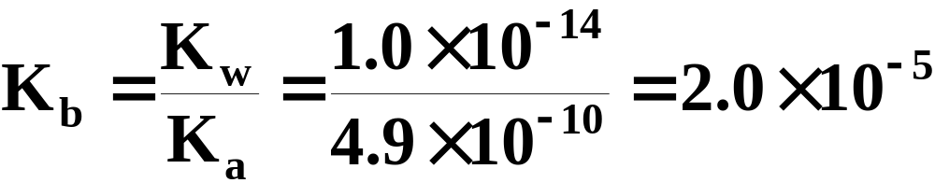
A Problem To Consider
What is the pH of a 0.10 M NaCN solution at 25 °C? The K_{a} for HCN is 4.9 x 10⁻¹⁰.
  The CN⁻ ion is acting as a base, so first, we must calculate the K_{b} for CN⁻.
  Now we can proceed with the equilibrium calculation.
Copyright © Houghton Mifflin Company.All rights reserved.
Presentation of Lecture Outlines, 17–<number>
Notes:
2

Slide 85
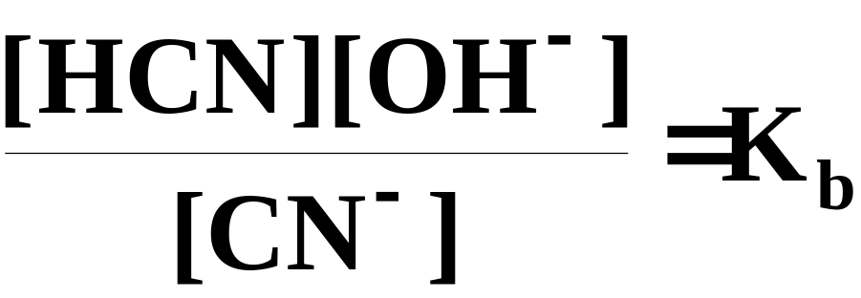
A Problem To Consider
What is the pH of a 0.10 M NaCN solution at 25 °C? The K_{a} for HCN is 4.9 x 10⁻¹⁰.
  Let x = [OH⁻] = [HCN], then substitute into the equilibrium expression.
Copyright © Houghton Mifflin Company.All rights reserved.
Presentation of Lecture Outlines, 17–<number>
Notes:
2

Slide 86
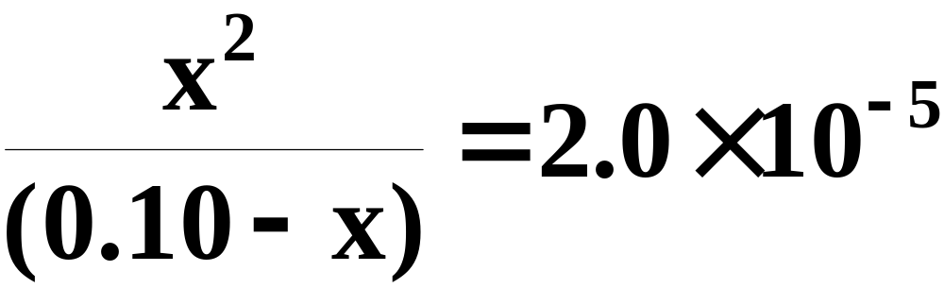
A Problem To Consider
What is the pH of a 0.10 M NaCN solution at 25 °C? The K_{a} for HCN is 4.9 x 10⁻¹⁰.
  This gives
Copyright © Houghton Mifflin Company.All rights reserved.
Presentation of Lecture Outlines, 17–<number>
Notes:
2

Slide 87
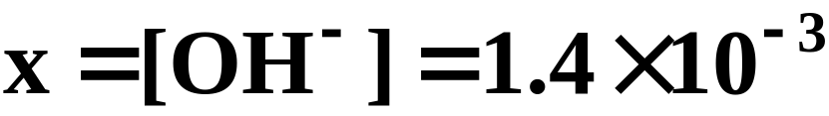
A Problem To Consider
What is the pH of a 0.10 M NaCN solution at 25 °C? The K_{a} for HCN is 4.9 x 10⁻¹⁰.
  Solving the equation, you find that
  Hence,
  As expected, the solution has a pH greater than 7.0.
Copyright © Houghton Mifflin Company.All rights reserved.
Presentation of Lecture Outlines, 17–<number>
Notes:
2

Slide 88
The Common Ion Effect
The common-ion effect is the shift in an ionic equilibrium caused by the addition of a solute that provides an ion common to the equilibrium.
  Consider a solution of acetic acid (HC₂H₃O₂), in which you have the following equilibrium.
Copyright © Houghton Mifflin Company.All rights reserved.
Presentation of Lecture Outlines, 17–<number>
Notes:
2

Slide 89
The Common Ion Effect
The common-ion effect is the shift in an ionic equilibrium caused by the addition of a solute that provides an ion common to the equilibrium.
  If we were to add NaC₂H₃O₂ to this solution, it would provide C₂H₃O₂⁻ ions which are present on the right side of the equilibrium.
Copyright © Houghton Mifflin Company.All rights reserved.
Presentation of Lecture Outlines, 17–<number>
Notes:
2

Slide 90
The Common Ion Effect
The common-ion effect is the shift in an ionic equilibrium caused by the addition of a solute that provides an ion common to the equilibrium.
  The equilibrium composition would shift to the left and the degree of ionization of the acetic acid is decreased.
Copyright © Houghton Mifflin Company.All rights reserved.
Presentation of Lecture Outlines, 17–<number>
Notes:
2

Slide 91
The Common Ion Effect
The common-ion effect is the shift in an ionic equilibrium caused by the addition of a solute that provides an ion common to the equilibrium.
  This repression of the ionization of acetic acid by sodium acetate is an example of the common-ion effect.
Copyright © Houghton Mifflin Company.All rights reserved.
Presentation of Lecture Outlines, 17–<number>
Notes:
2

Slide 92

A Problem To Consider
An aqueous solution is 0.025 M in formic acid, HCH₂O and 0.018 M in sodium formate, NaCH₂O. What is the pH of the solution. The K_{a} for formic acid is 1.7 x 10⁻⁴.
  Consider the equilibrium below.
Starting | 0.025 |  |  | 0 | 0.018
Change | -x |  |  | +x | +x
Equilibrium | 0.025-x |  |  | x | 0.018+x
Copyright © Houghton Mifflin Company.All rights reserved.
Presentation of Lecture Outlines, 17–<number>
Notes:
2

Slide 93
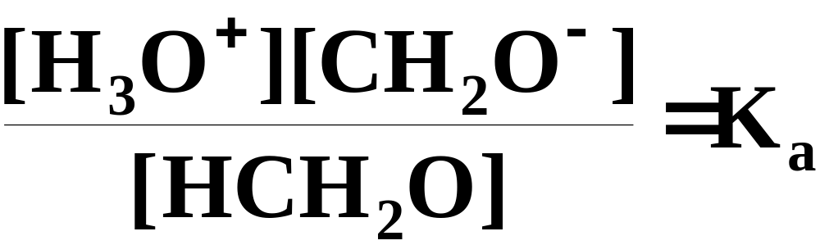
A Problem To Consider
An aqueous solution is 0.025 M in formic acid, HCH₂O and 0.018 M in sodium formate, NaCH₂O. What is the pH of the solution. The K_{a} for formic acid is 1.7 x 10⁻⁴.
  The equilibrium constant expression is:
Copyright © Houghton Mifflin Company.All rights reserved.
Presentation of Lecture Outlines, 17–<number>
Notes:
2

Slide 94
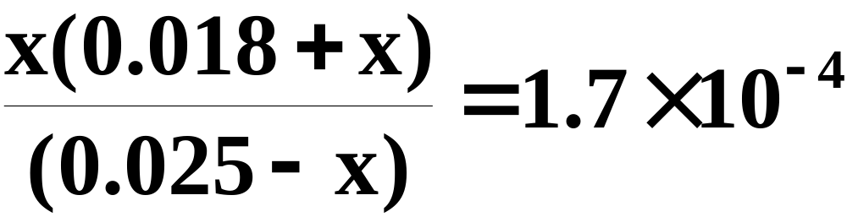
A Problem To Consider
An aqueous solution is 0.025 M in formic acid, HCH₂O and 0.018 M in sodium formate, NaCH₂O. What is the pH of the solution. The K_{a} for formic acid is 1.7 x 10⁻⁴.
  Substituting into this equation gives:
Copyright © Houghton Mifflin Company.All rights reserved.
Presentation of Lecture Outlines, 17–<number>
Notes:
2

Slide 95
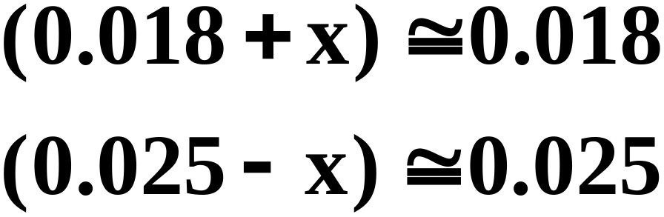
A Problem To Consider
An aqueous solution is 0.025 M in formic acid, HCH₂O and 0.018 M in sodium formate, NaCH₂O. What is the pH of the solution. The K_{a} for formic acid is 1.7 x 10⁻⁴.
  Assume that x is small compared with 0.018 and 0.025. Then
Copyright © Houghton Mifflin Company.All rights reserved.
Presentation of Lecture Outlines, 17–<number>
Notes:
2

Slide 96
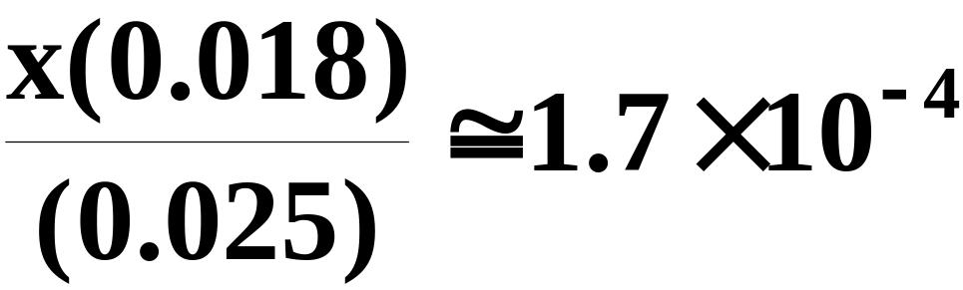
A Problem To Consider
An aqueous solution is 0.025 M in formic acid, HCH₂O and 0.018 M in sodium formate, NaCH₂O. What is the pH of the solution. The K_{a} for formic acid is 1.7 x 10⁻⁴.
  The equilibrium equation becomes
Copyright © Houghton Mifflin Company.All rights reserved.
Presentation of Lecture Outlines, 17–<number>
Notes:
2

Slide 97
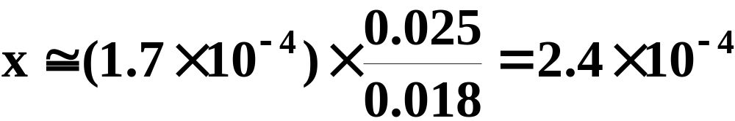
A Problem To Consider
An aqueous solution is 0.025 M in formic acid, HCH₂O and 0.018 M in sodium formate, NaCH₂O. What is the pH of the solution. The K_{a} for formic acid is 1.7 x 10⁻⁴.
  Hence,
Copyright © Houghton Mifflin Company.All rights reserved.
Presentation of Lecture Outlines, 17–<number>
Notes:
2

Slide 98
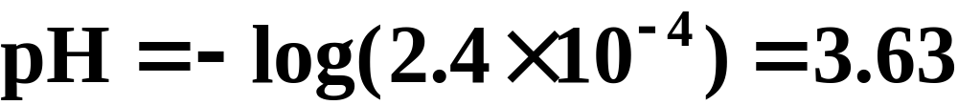
A Problem To Consider
An aqueous solution is 0.025 M in formic acid, HCH₂O and 0.018 M in sodium formate, NaCH₂O. What is the pH of the solution. The K_{a} for formic acid is 1.7 x 10⁻⁴.
  Note that x was much smaller than 0.018 or 0.025.
  For comparison, the pH of 0.025 M formic acid is 2.69.
Copyright © Houghton Mifflin Company.All rights reserved.
Presentation of Lecture Outlines, 17–<number>
Notes:
2

Slide 99
Buffers
A buffer is a solution characterized by the ability to resist changes in pH when limited amounts of acid or base are added to it.
  Buffers contain either a weak acid and its conjugate base or a weak base and its conjugate acid.
  Thus, a buffer contains both an acid species and a base species in equilibrium.
Copyright © Houghton Mifflin Company.All rights reserved.
Presentation of Lecture Outlines, 17–<number>
Notes:
2

Slide 100
Buffers
A buffer is a solution characterized by the ability to resist changes in pH when limited amounts of acid or base are added to it.
  Consider a buffer with equal molar amounts of HA and its conjugate base A⁻.
  When H₃O⁺ is added to the buffer it reacts with the base A⁻.
Copyright © Houghton Mifflin Company.All rights reserved.
Presentation of Lecture Outlines, 17–<number>
Notes:
2

Slide 101
Buffers
A buffer is a solution characterized by the ability to resist changes in pH when limited amounts of acid or base are added to it.
  Consider a buffer with equal molar amounts of HA and its conjugate base A⁻.
  When OH⁻ is added to the buffer it reacts with the acid HA.
Copyright © Houghton Mifflin Company.All rights reserved.
Presentation of Lecture Outlines, 17–<number>
Notes:
2

Slide 102
Buffers
A buffer is a solution characterized by the ability to resist changes in pH when limited amounts of acid or base are added to it.
  Two important characteristics of a buffer are its buffer capacity and its pH.
  Buffer capacity depends on the amount of acid and conjugate base present in the solution.
  The next example illustrates how to calculate the pH of a buffer.
Copyright © Houghton Mifflin Company.All rights reserved.
Presentation of Lecture Outlines, 17–<number>
Notes:
2

Slide 103
Practice Problem
#17.70 A buffer is prepared by adding 115mL of 0.30M NH₃ to 145mL of 0.15M NH₄NO₃. What is the pH of the final solution?
Ans 9.45
Copyright © Houghton Mifflin Company.All rights reserved.
Presentation of Lecture Outlines, 17–<number>

Slide 104
#17.72 A buffer is prepared by mixing 525mL of 0.50M formic acid, HCHO₂, and 475mL of 0.50M sodium formate. Calculate the pH.
What would be the pH of 85mL of the buffer to which 8.5mL of 0.15M HCl has been added?
Copyright © Houghton Mifflin Company.All rights reserved.
Presentation of Lecture Outlines, 17–<number>

Slide 105
The Henderson-Hasselbalch Equation
How do you prepare a buffer of given pH?
  A buffer must be prepared from a conjugate acid-base pair in which the K_{a} of the acid is approximately equal to the desired H₃O⁺ concentration.
  To illustrate, consider a buffer of a weak acid HA and its conjugate base A⁻.
  The acid ionization equilibrium is:
Copyright © Houghton Mifflin Company.All rights reserved.
Presentation of Lecture Outlines, 17–<number>
Notes:
2

Slide 106
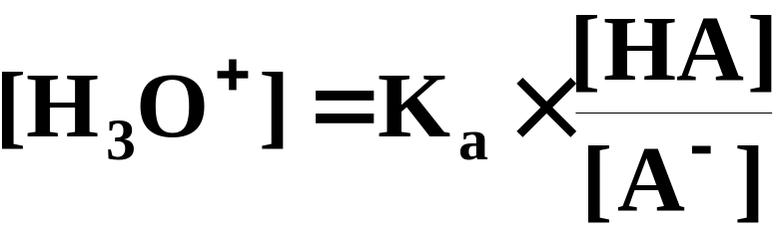
The Henderson-Hasselbalch Equation
How do you prepare a buffer of given pH?
  The acid ionization constant is:
  By rearranging, you get an equation for the H₃O⁺ concentration.
Copyright © Houghton Mifflin Company.All rights reserved.
Presentation of Lecture Outlines, 17–<number>
Notes:
2

Slide 107
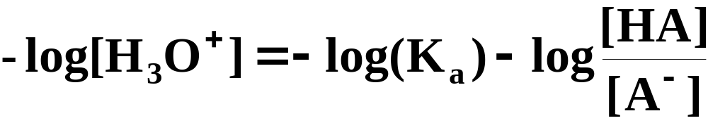
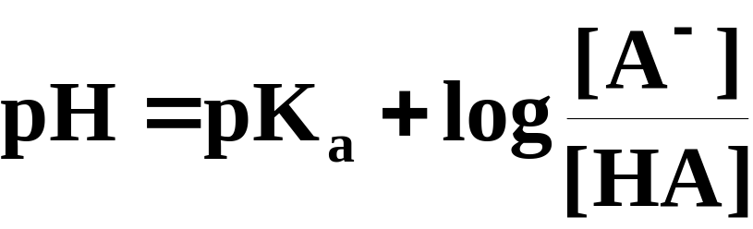
The Henderson-Hasselbalch Equation
How do you prepare a buffer of given pH?
  Taking the negative logarithm of both sides of the equation we obtain:
  The previous equation can be rewritten
Copyright © Houghton Mifflin Company.All rights reserved.
Presentation of Lecture Outlines, 17–<number>
Notes:
2

Slide 108
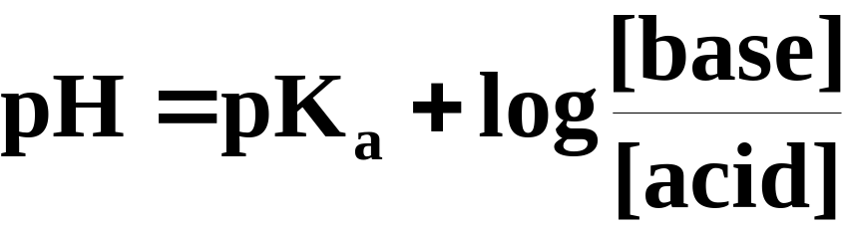
The Henderson-Hasselbalch Equation
How do you prepare a buffer of given pH?
  More generally, you can write
  This equation relates the pH of a buffer to the concentrations of the conjugate acid and base. It is known as the Henderson-Hasselbalch equation.
Copyright © Houghton Mifflin Company.All rights reserved.
Presentation of Lecture Outlines, 17–<number>
Notes:
2

Slide 109
#76 What is the pH of a buffer solution that is 0.20M methylamine and 0.15M methylammonium chloride?
Kb for methylamine is 4.4 x 10⁻⁴
Copyright © Houghton Mifflin Company.All rights reserved.
Presentation of Lecture Outlines, 17–<number>

Slide 110
The Henderson-Hasselbalch Equation
How do you prepare a buffer of given pH?
  So to prepare a buffer of a given pH (for example, pH 4.90) we need a conjugate acid-base pair with a pK_{a} close to the desired pH.
  The K_{a} for acetic acid is 1.7 x 10⁻⁵, and its pK_{a} is 4.77.
  You could get a buffer of pH 4.90 by increasing the ratio of [base]/[acid].
Copyright © Houghton Mifflin Company.All rights reserved.
Presentation of Lecture Outlines, 17–<number>
Notes:
2

Slide 111
#17.78 How many moles of HF must be added to 500.0mL of 0.30M NaF to give a buffer of pH 3.50? Ignore the volume changes due to the addition of HF.
Copyright © Houghton Mifflin Company.All rights reserved.
Presentation of Lecture Outlines, 17–<number>

Slide 112
Acid-Ionization Titration Curves
An acid-base titration curve is a plot of the pH of a solution of acid (or base) against the volume of added base (or acid).
  Such curves are used to gain insight into the titration process.
  You can use titration curves to choose an appropriate indicator that will show when the titration is complete.
Copyright © Houghton Mifflin Company.All rights reserved.
Presentation of Lecture Outlines, 17–<number>
Notes:
2

Slide 113
Titration of a Strong Acid by a Strong Base
Figure 17.12 shows a curve for the titration of HCl with NaOH.
  Note that the pH changes slowly until the titration approaches the equivalence point.
  The equivalence point is the point in a titration when a stoichiometric amount of reactant has been added.
Copyright © Houghton Mifflin Company.All rights reserved.
Presentation of Lecture Outlines, 17–<number>
Notes:
2

Slide 114

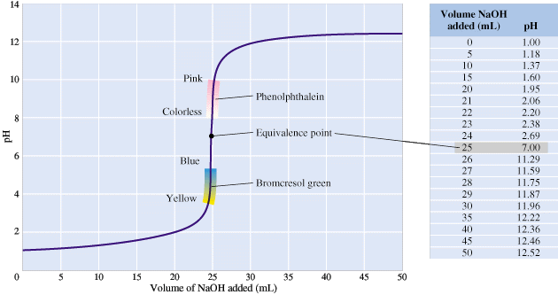
Figure 17.12: Curve for the titration of a strong acid by a strong base.
Notes:
2

Slide 115
Titration of a Strong Acid by a Strong Base
Figure 17.12 shows a curve for the titration of HCl with NaOH.
  At the equivalence point, the pH of the solution is 7.0 because it contains a salt, NaCl, that does not hydrolyze.
  However, the pH changes rapidly from a pH of about 3 to a pH of about 11.
Copyright © Houghton Mifflin Company.All rights reserved.
Presentation of Lecture Outlines, 17–<number>
Notes:
2

Slide 116
Titration of a Strong Acid by a Strong Base
Figure 17.12 shows a curve for the titration of HCl with NaOH.
  To detect the equivalence point, you need an acid-base indicator that changes color within the pH range 3-11.
  Phenolphthalein can be used because it changes color in the pH range 8.2-10. (see Figure 16.10)
Copyright © Houghton Mifflin Company.All rights reserved.
Presentation of Lecture Outlines, 17–<number>
Notes:
2

Slide 117
A Problem To Consider
Calculate the pH of a solution in which 10.0 mL of 0.100 M NaOH is added to 25.0 mL of 0.100 M HCl.
  Because the reactants are a strong acid and a strong base, the reaction is essentially complete.
Copyright © Houghton Mifflin Company.All rights reserved.
Presentation of Lecture Outlines, 17–<number>
Notes:
2

Slide 118
A Problem To Consider
Calculate the pH of a solution in which 10.0 mL of 0.100 M NaOH is added to 25.0 mL of 0.100 M HCl.
  We get the amounts of reactants by multiplying the volume of each (in liters) by their respective molarities.
Copyright © Houghton Mifflin Company.All rights reserved.
Presentation of Lecture Outlines, 17–<number>
Notes:
2

Slide 119
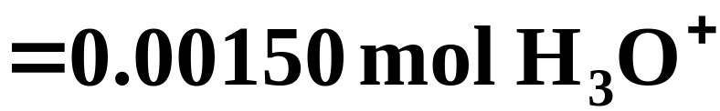
A Problem To Consider
Calculate the pH of a solution in which 10.0 mL of 0.100 M NaOH is added to 25.0 mL of 0.100 M HCl.
  All of the OH⁻ reacts, leaving an excess of H₃O⁺
Copyright © Houghton Mifflin Company.All rights reserved.
Presentation of Lecture Outlines, 17–<number>
Notes:
2

Slide 120
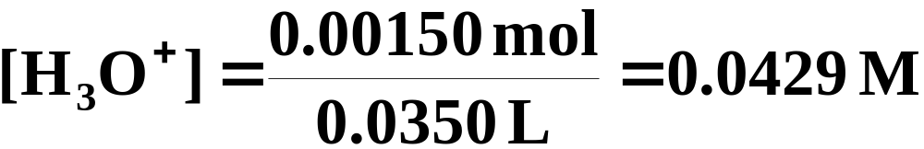
A Problem To Consider
Calculate the pH of a solution in which 10.0 mL of 0.100 M NaOH is added to 25.0 mL of 0.100 M HCl.
  You obtain the H₃O⁺ concentration by dividing the mol H₃O⁺ by the total volume of solution (=0.0250 L + 0.0100 L=0.0350 L)
Copyright © Houghton Mifflin Company.All rights reserved.
Presentation of Lecture Outlines, 17–<number>
Notes:
2

Slide 121
A Problem To Consider
Calculate the pH of a solution in which 10.0 mL of 0.100 M NaOH is added to 25.0 mL of 0.100 M HCl.
  Hence,
Copyright © Houghton Mifflin Company.All rights reserved.
Presentation of Lecture Outlines, 17–<number>
Notes:
2

Slide 122
Titration of a Strong Acid by a Strong Base
The titration of a weak acid by a strong base gives a somewhat different curve.
  The pH range of these titrations is shorter.
  The equivalence point will be on the basic side since the salt produced contains the anion of a weak acid.
  Figure 17.13 shows the curve for the titration of nicotinic acid with NaOH.
Copyright © Houghton Mifflin Company.All rights reserved.
Presentation of Lecture Outlines, 17–<number>
Notes:
2

Slide 123

Figure 17.13: Curve for the titration of a weak acid by a strong base.
Notes:
2

Slide 124
A Problem To Consider
Calculate the pH of the solution at the equivalence point when 25.0 mL of 0.10 M acetic acid is titrated with 0.10 M sodium hydroxide. The K_{a} for acetic acid is 1.7 x 10⁻⁵.
  At the equivalence point, equal molar amounts of acetic acid and sodium hydroxide react to give sodium acetate.
Copyright © Houghton Mifflin Company.All rights reserved.
Presentation of Lecture Outlines, 17–<number>
Notes:
2

Slide 125
A Problem To Consider
Calculate the pH of the solution at the equivalence point when 25.0 mL of 0.10 M acetic acid is titrated with 0.10 M sodium hydroxide. The K_{a} for acetic acid is 1.7 x 10⁻⁵.
  First, calculate the concentration of the acetate ion.
  In this case, 25.0 mL of 0.10 M NaOH is needed to react with 25.0 mL of 0.10 M acetic acid.
Copyright © Houghton Mifflin Company.All rights reserved.
Presentation of Lecture Outlines, 17–<number>
Notes:
2

Slide 126

A Problem To Consider
Calculate the pH of the solution at the equivalence point when 25.0 mL of 0.10 M acetic acid is titrated with 0.10 M sodium hydroxide. The K_{a} for acetic acid is 1.7 x 10⁻⁵.
  The molar amount of acetate ion formed equals the initial molar amount of acetic acid.
Copyright © Houghton Mifflin Company.All rights reserved.
Presentation of Lecture Outlines, 17–<number>
Notes:
2

Slide 127

A Problem To Consider
Calculate the pH of the solution at the equivalence point when 25.0 mL of 0.10 M acetic acid is titrated with 0.10 M sodium hydroxide. The K_{a} for acetic acid is 1.7 x 10⁻⁵.
  The total volume of the solution is 50.0 mL. Hence,
Copyright © Houghton Mifflin Company.All rights reserved.
Presentation of Lecture Outlines, 17–<number>
Notes:
2

Slide 128
A Problem To Consider
Calculate the pH of the solution at the equivalence point when 25.0 mL of 0.10 M acetic acid is titrated with 0.10 M sodium hydroxide. The K_{a} for acetic acid is 1.7 x 10⁻⁵.
  The hydrolysis of the acetate ion follows the method given in an earlier section of this chapter.
  You find the K_{b} for the acetate ion to be 5.9 x 10⁻¹⁰ and that the concentration of the hydroxide ion is 5.4 x 10⁻⁶. The pH is 8.73
Copyright © Houghton Mifflin Company.All rights reserved.
Presentation of Lecture Outlines, 17–<number>
Notes:
2

Slide 129
Titration of a Strong Acid by a Strong Base
The titration of a weak base with a strong acid is a reflection of our previous example.
  Figure 17.14 shows the titration of NH₃ with HCl.
  In this case, the pH declines slowly at first, then falls abruptly from about pH 7 to pH 3.
  Methyl red, which changes color from yellow at pH 6 to red at pH 4.8, is a possible indicator.
Copyright © Houghton Mifflin Company.All rights reserved.
Presentation of Lecture Outlines, 17–<number>
Notes:
2

Slide 130

Figure 17.14: Curve for the titration of a weak base by a strong acid.
Notes:
2

Slide 131
17.84 What is the pH at the equivalence point when 22mL of 0.20M hydroxylamine (NH₂OH) is titrated with 0.15M HCl?
Kb = 1.1 x 10⁻⁸
Copyright © Houghton Mifflin Company.All rights reserved.
Presentation of Lecture Outlines, 17–<number>

Slide 132
Operational Skills
Determining K_{a} (or K_{b}) from the solution pH
Calculating the concentration of a species in a weak acid solution using K_{a}
Calculating the concentration of a species in a weak base solution using K_{b}
Predicting whether a salt solution is acidic, basic, or neutral
Obtaining K_{a} from K_{b} or K_{b} from K_{a}
Calculating concentrations of species in a salt solution
Copyright © Houghton Mifflin Company.All rights reserved.
Presentation of Lecture Outlines, 17–<number>
Notes:
2

Slide 133
Operational Skills
Calculating the common-ion effect on acid ionization
Calculating the pH of a buffer from given volumes of solution
Calculating the pH of a solution of a strong acid and a strong base
Calculating the pH at the equivalence point in the titration of a weak cid with a strong base
Copyright © Houghton Mifflin Company.All rights reserved.
Presentation of Lecture Outlines, 17–<number>
Notes:
2

Slide 134
Animation: Acid Ionization Equilibrium
(Click here to open QuickTime animation)
Return to slide 3
Copyright © Houghton Mifflin Company.All rights reserved.
Presentation of Lecture Outlines, 17–<number>

Slide 135


Figure 17.3: Variation of percent ionization of a weak acid with concentration.
Return to slide 19
Copyright © Houghton Mifflin Company.All rights reserved.
Presentation of Lecture Outlines, 17–<number>

Slide 136

Figure 17.8: A pH meter reading NH₄Cl.
Photo courtesy of American Color.
Return to slide 82
Copyright © Houghton Mifflin Company.All rights reserved.
Presentation of Lecture Outlines, 17–<number>

Slide 137
Animation: Adding an Acid to a Buffer
(Click here to open QuickTime animation)
Return to slide 104
Copyright © Houghton Mifflin Company.All rights reserved.
Presentation of Lecture Outlines, 17–<number>

