Slide 1

Electrochemistry

Slide 2

Oxidation-Reduction Reactions
In Chapter 4 we introduced the half-reaction method for balancing simple oxidation-reduction reactions.
  Oxidation-reduction reactions always involve a transfer of electrons from one species to another.
  Recall that the species losing electrons is oxidized, while the species gaining electrons is reduced.
Notes:
2

Slide 3
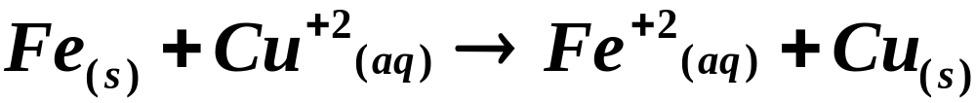
Oxidation-Reduction Reactions
Describing Oxidation-Reduction Reactions
  An oxidizing agent is a species that oxidizes another species; it is itself reduced.
  A reducing agent is a species that reduces another species; it is itself oxidized.
Loss of 2 e⁻¹ oxidation
reducing agent
oxidizing agent
Gain of 2 e⁻¹ reduction

Slide 4
Redox in acidic conditions
Balancing Redox Reactions in acidic and basic solutions.
  Assign Oxidation numbers
  Split reaction into two half reactions (oxidation and reduction)

Slide 5
Redox in acidic conditions
3. Balance each half reaction
    Balance all except O and H
    Balance O by adding H₂O to one side
    Balance H by adding H⁺
    Balance charge by adding electrons
    Multiply each half reaction to get equal number of electrons
4. Combine half reactions, cancel equal molecules on each side

Slide 6
Balance the reaction of Concentrated nitric acid and solid zinc metal.
Zn(s) + NO₃⁻ → Zn⁺² + NH₄⁺
^{PAGE 806}

Slide 7
Redox in Basic Conditions
Follow the same steps for an acid but add these two steps for a base.
5. Note number of H⁺ ions. Add equal number of OH⁻ to both sides.
6. React OH⁻ with H⁺ to give H₂O, cancel with opposite side.

Slide 8
Example Permanganate ion oxidizes sulfite ion in basic solution according to the following skeleton equation: Balance this equation.
MnO₄⁻ (aq) + SO₃²⁻→ MnO₂(s) + SO₄²⁻(aq)

Slide 9
Oxidation-Reduction Reactions
In this chapter we will show how a cell is constructed to physically separate an oxidation-reduction reaction into two half-reactions.
  The force with which electrons travel from the oxidation half-reaction to the reduction half-reaction is measured as voltage.
  Review the rules in Chapter 4 concerning the balancing of oxidation reduction reactions.
Notes:
2

Slide 10
Electrochemistry
An electrochemical cell is a system consisting of electrodes that dip into an electrolyte in which a chemical reaction either uses or generates an electric current.
  A voltaic, or galvanic, cell is an electrochemical cell in which a spontaneous reaction generates an electric current.
Notes:
2

Slide 11
Electrochemistry
An electrochemical cell is a system consisting of electrodes that dip into an electrolyte in which a chemical reaction either uses or generates an electric current.
  An electrolytic cell is an electrochemical cell in which an electric current drives an otherwise nonspontaneous reaction.
  In this chapter we will discuss the basic principles behind these cells and explore some of their commercial uses.
Notes:
2

Slide 12
Voltaic Cells
A voltaic cell consists of two half-cells that are electrically connected.
  Each half-cell is a portion of the electrochemical cell in which a half-reaction takes place.
  A simple half-cell can be made from a metal strip dipped into a solution of its metal ion.
  For example, the zinc-zinc ion half cell consists consists of a zinc strip dipped into a solution of a zinc salt.
Notes:
2

Slide 13
Voltaic Cells
A voltaic cell consists of two half-cells that are electrically connected.
  Another simple half-cell consists of a copper strip dipped into a solution of a copper salt.
  In a voltaic cell, two half-cells are connected in such a way that electrons flow from one metal electrode to the other through an external circuit.
  Figure 20.2 illustrates an atomic view of a zinc/copper voltaic cell.
Notes:
2

Slide 14
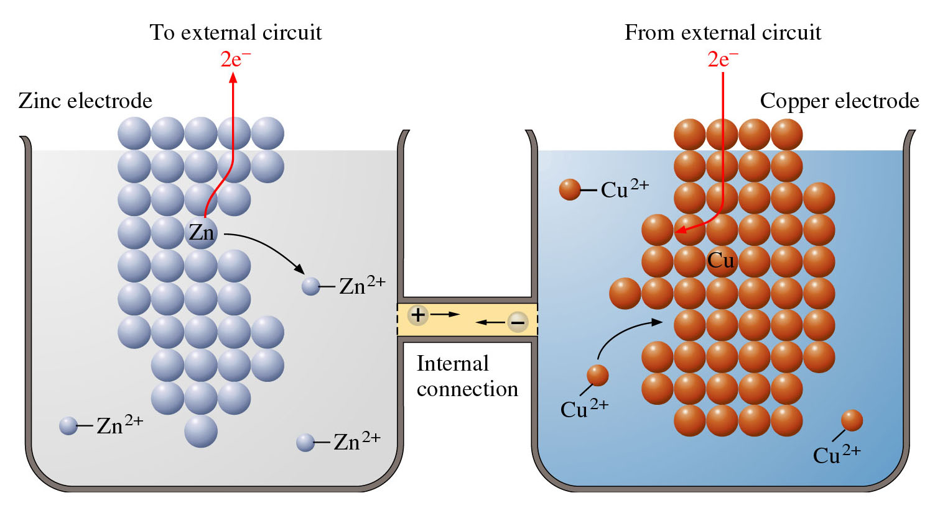
Figure 20.2: Atomic view of voltaic cell.

Slide 15
Voltaic Cells
As long as there is an external circuit, electrons can flow through it from one electrode to the other.
  Because zinc has a greater tendency to lose electrons than copper, zinc atoms in the zinc electrode lose electrons to form zinc ions.
  The electrons flow through the external circuit to the copper electrode where copper ions gain the electrons to become copper metal.
Notes:
2

Slide 16
Voltaic Cells
The two half-cells must also be connected internally to allow ions to flow between them.
  Without this internal connection, too much positive charge builds up in the zinc half-cell (and too much negative charge in the copper half-cell) causing the reaction to stop.
  Figure 20.3A and 20.3B show the two half-cells of a voltaic cell connected by salt bridge.
Notes:
2

Slide 17
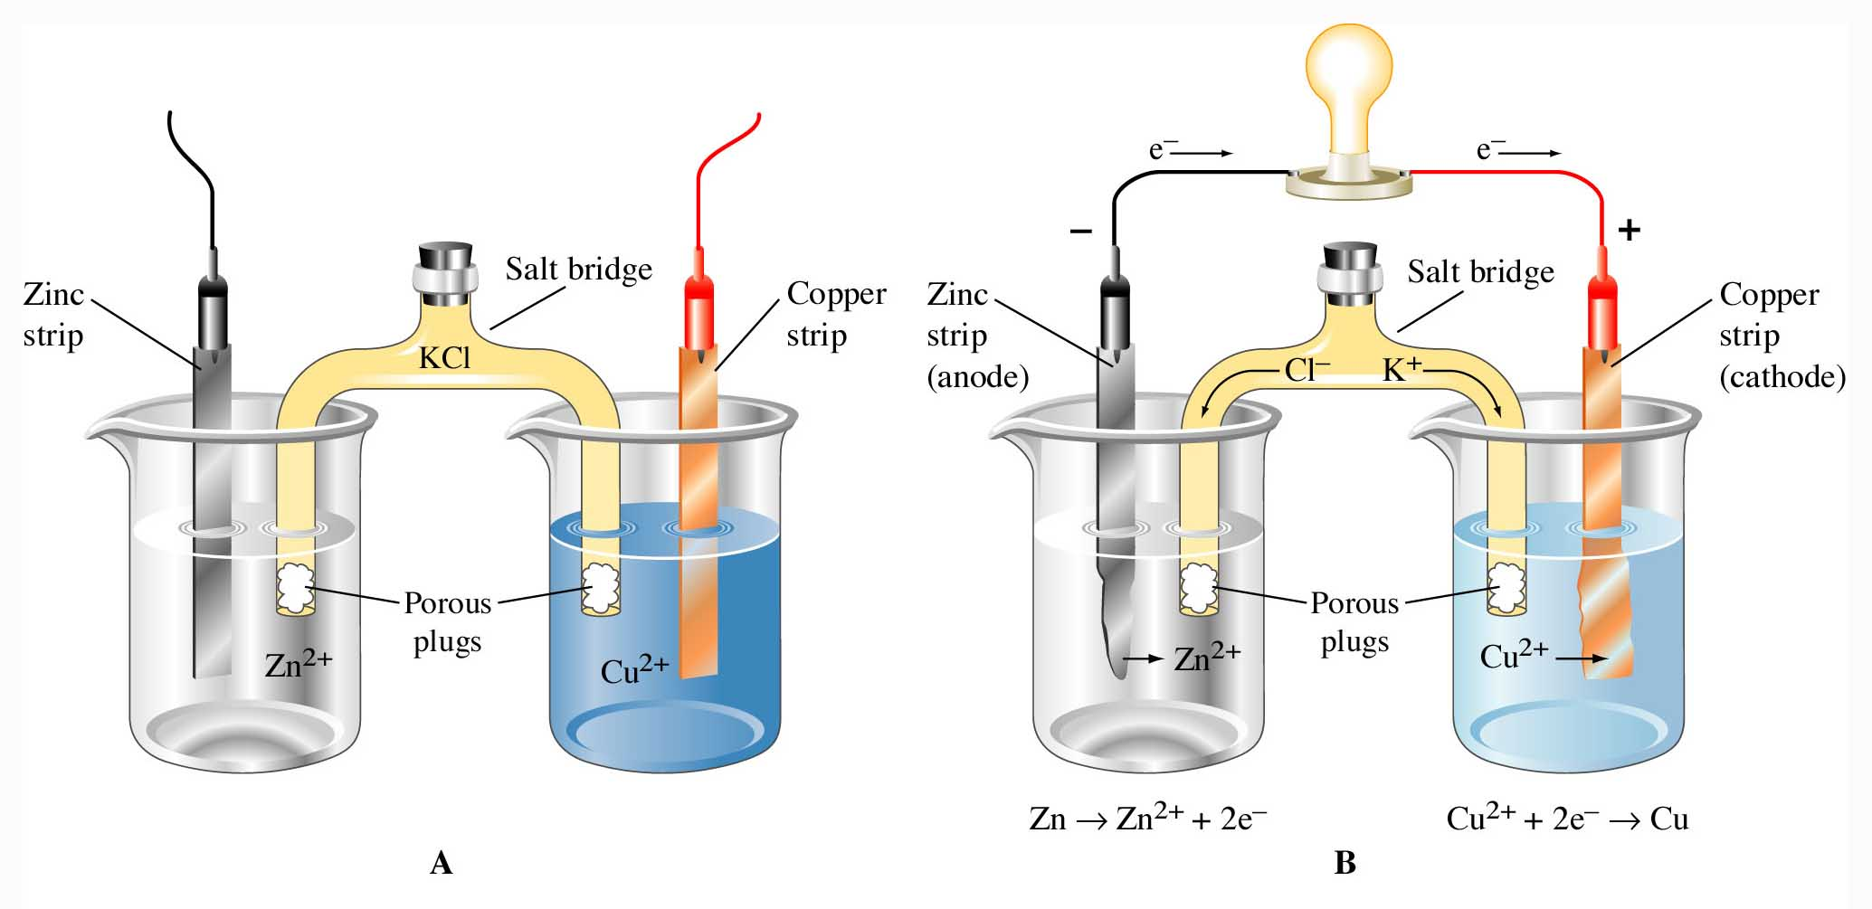
Figure 20.3: Two electrodes are connected by an external circuit.

Slide 18
Voltaic Cells
A salt bridge is a tube of an electrolyte in a gel that is connected to the two half-cells of a voltaic cell.
  The salt bridge allows the flow of ions but prevents the mixing of the different solutions that would allow direct reaction of the cell reactants.
  Figure 20.3C shows an actual setup of the zinc-copper cell.
Notes:
2

Slide 19
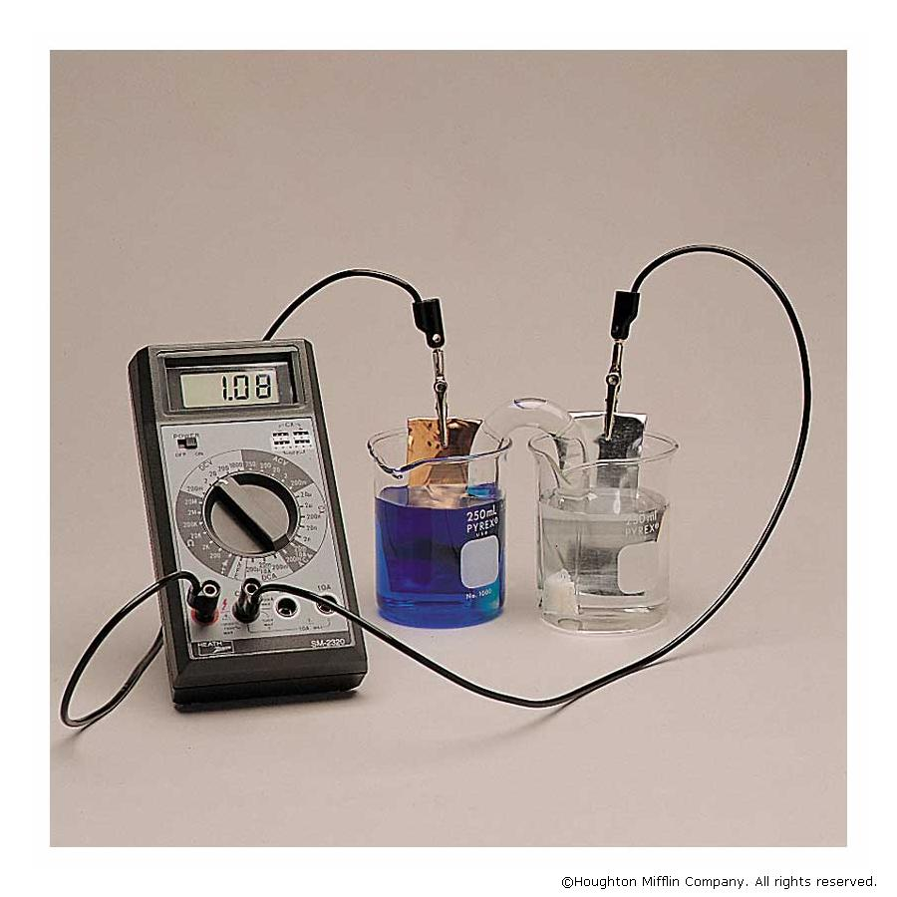

Slide 20
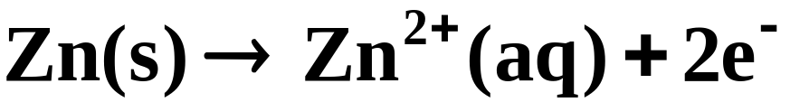

Voltaic Cells
The two half-cell reactions, as noted earlier, are:
(oxidation half-reaction)
(reduction half-reaction)
  The first reaction, in which electrons are lost, is the oxidation half-reaction.
  The electrode at which oxidation occurs is the anode.
Notes:
2

Slide 21
Voltaic Cells
The two half-cell reactions, as noted earlier, are:
(oxidation half-reaction)
(reduction half-reaction)
  The second reaction, in which electrons are gained, is the reduction half-reaction.
  The electrode at which reduction occurs is the cathode.
Notes:
2

Slide 22
A Red Cat devoured AN Ox.

Slide 23
Voltaic Cells
Note that the sum of the two half-reactions
is the net reaction that occurs in the voltaic cell; it is called the cell reaction
  Note that electrons are given up at the anode and thus flow from it to the cathode where reduction occurs.
Notes:
2

Slide 24
Voltaic Cells
Note that the sum of the two half-reactions
is the net reaction that occurs in the voltaic cell; it is called the cell reaction
  The anode in a voltaic cell has a negative sign because electrons flow from it. (See Figure 20.4)
  The cathode in a voltaic cell has a positive sign
Notes:
2

Slide 25
Notation for Voltaic Cells
It is convenient to have a shorthand way of designating particular voltaic cells.
  The cell consisting of the zinc-zinc ion half-cell and the copper-copper ion half-cell, is written
anode
cathode
Notes:
2

Slide 26
Notation for Voltaic Cells
It is convenient to have a shorthand way of designating particular voltaic cells.
  The cell consisting of the zinc-zinc ion half-cell and the copper-copper ion half-cell, is written
anode
salt bridge
cathode
  The two electrodes are connected by a salt bridge, denoted by two vertical bars.
Notes:
2

Slide 27
Notation for Voltaic Cells
It is convenient to have a shorthand way of designating particular voltaic cells.
  The cell consisting of the zinc-zinc ion half-cell and the copper-copper ion half-cell, is written
anode
salt bridge
cathode
  The cell terminals are at the extreme ends in the cell notation.
Notes:
2

Slide 28
Notation for Voltaic Cells
It is convenient to have a shorthand way of designating particular voltaic cells.
  The cell consisting of the zinc-zinc ion half-cell and the copper-copper ion half-cell, is written
anode
salt bridge
cathode
  A single vertical bar indicates a phase boundary, such as between a solid terminal and the electrode solution.
Notes:
2

Slide 29
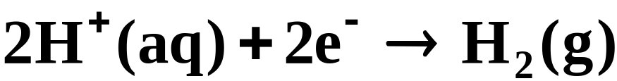
Notation for Voltaic Cells
When the half-reaction involves a gas, an inert material such as platinum serves as a terminal and an electrode surface on which the reaction occurs.
  Figure 20.5 shows a hydrogen electrode; hydrogen bubbles over a platinum plate immersed in an acidic solution.
  The cathode half-reaction is
Notes:
2

Slide 30
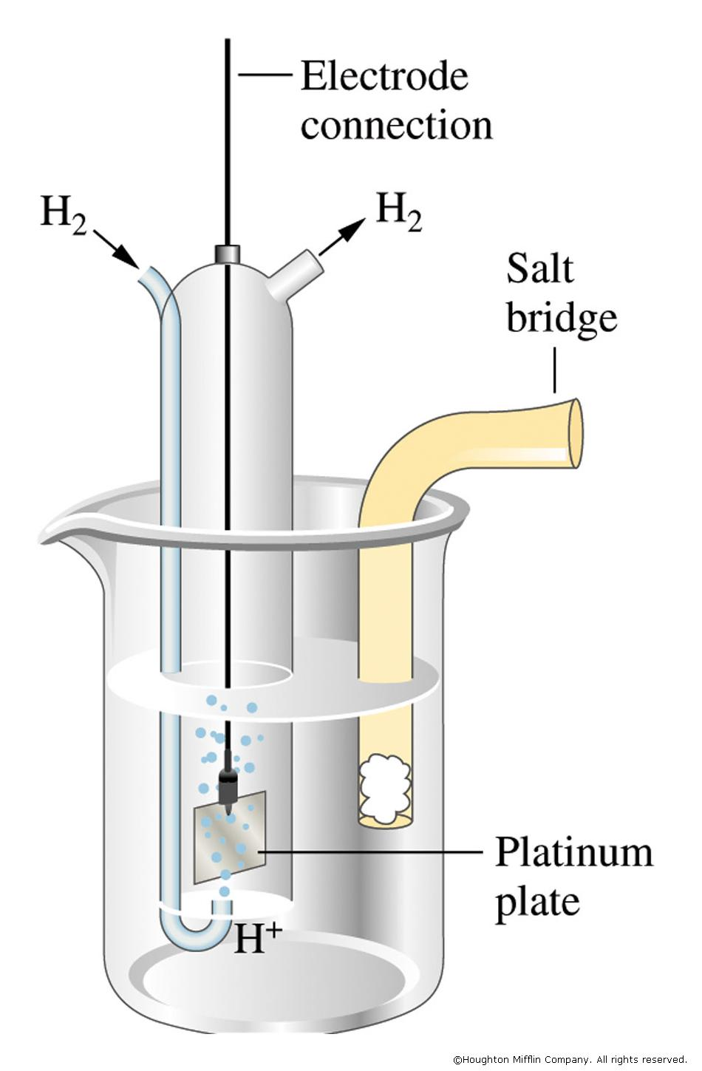

Slide 31
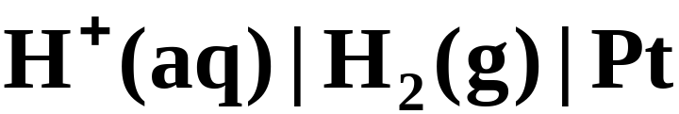
Notation for Voltaic Cells
When the half-reaction involves a gas, an inert material such as platinum serves as a terminal and an electrode surface on which the reaction occurs.
  The notation for the hydrogen electrode, written as a cathode, is
Notes:
2

Slide 32
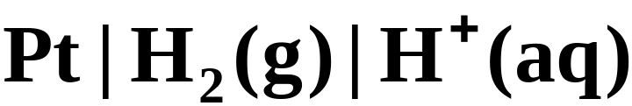
Notation for Voltaic Cells
When the half-reaction involves a gas, an inert material such as platinum serves as a terminal and an electrode surface on which the reaction occurs.
  To write such an electrode as an anode, you simply reverse the notation.
Notes:
2

Slide 33
Notation for Voltaic Cells
To fully specify a voltaic cell, it is necessary to give the concentrations of solutions and the pressure of gases.
  In the cell notation, these are written in parentheses. For example,
Notes:
2

Slide 34
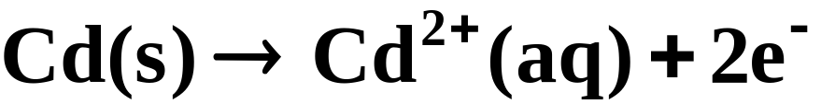
A Problem To Consider
Give the overall cell reaction for the voltaic cell
  The half-cell reactions are
Notes:
2

Slide 35
Electromotive Force
The movement of electrons is analogous to the pumping of water from one point to another.
  Water moves from a point of high pressure to a point of lower pressure. Thus, a pressure difference is required.
  The work expended in moving the water through a pipe depends on the volume of water and the pressure difference.
Notes:
2

Slide 36
Electromotive Force
The movement of electrons is analogous to the pumping of water from one point to another.
  An electric charge moves from a point of high electrical potential (high electrical pressure) to one of lower electrical potential.
  The work expended in moving the electrical charge through a conductor depends on the amount of charge and the potential difference.
Notes:
2

Slide 37

Electromotive Force
Potential difference is the difference in electric potential (electrical pressure) between two points.
  You measure this quantity in volts.
  The volt, V, is the SI unit of potential difference equivalent to 1 joule of energy per coulomb of charge.
Notes:
2

Slide 38
Electromotive Force
The Faraday constant, F, is the magnitude of charge on one mole of electrons; it equals 96,500 coulombs (9.65 x 10⁴ C).
  In moving 1 mol of electrons through a circuit, the numerical value of the work done by a voltaic cell is the product of the Faraday constant (F) times the potential difference between the electrodes.
work done by the system
Notes:
2

Slide 39
Electromotive Force
The Faraday constant, F, is the magnitude of charge on one mole of electrons; it equals 96,500 coulombs (9.65 x 10⁴ C).
  In the normal operation of a voltaic cell, the potential difference (voltage) across the electrodes is less than than the maximum possible voltage of the cell.
  The actual flow of electrons reduces the electrical pressure.
Notes:
2

Slide 40
Electromotive Force
The Faraday constant, F, is the magnitude of charge on one mole of electrons; it equals 96,500 coulombs (9.65 x 10⁴ C).
  Thus, a cell voltage has its maximum value when no current flows.
Notes:
2

Slide 41
Electromotive Force
The maximum potential difference between the electrodes of a voltaic cell is referred to as the electromotive force (emf) of the cell, or E_{cell}.
  It can be measured by an electronic digital voltmeter (Figure 20.6), which draws negligible current.
Notes:
2

Slide 42

Electromotive Force
We can now write an expression for the maximum work attainable by a voltaic cell.
  Let n be the number of (mol) electrons transferred in the overall cell reaction.
  The maximum work for molar amounts of reactants is
Notes:
2

Slide 43
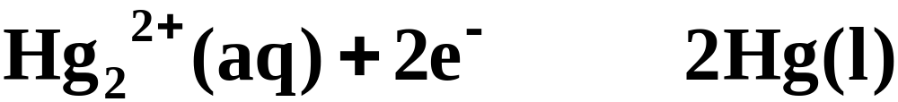
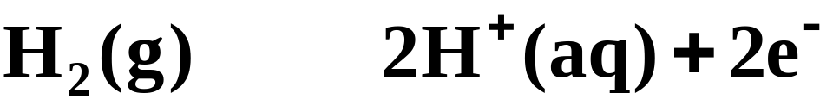
A Problem To Consider
The emf of the electrochemical cell below is 0.650 V. Calculate the maximum electrical work of this cell when 0.500 g H₂ is consumed.
  The half-reactions are
Notes:
2

Slide 44
A Problem To Consider
The emf of the electrochemical cell below is 0.650 V. Calculate the maximum electrical work of this cell when 0.500 g H₂ is consumed.
  n = 2, and the maximum work for the reaction is written as
Notes:
2

Slide 45

A Problem To Consider
The emf of the electrochemical cell below is 0.650 V. Calculate the maximum electrical work of this cell when 0.500 g H₂ is consumed.
  n = 2, and the maximum work for the reaction is written as
Notes:
2

Slide 46
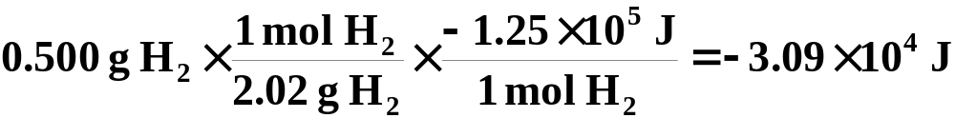
A Problem To Consider
The emf of the electrochemical cell below is 0.650 V. Calculate the maximum electrical work of this cell when 0.500 g H₂ is consumed.
  For 0.500 g H₂, the maximum work is
Notes:
2

Slide 47
Standard Cell emf’s and Standard Electrode Potentials
A cell emf is a measure of the driving force of the cell reaction.
  The reaction at the anode has a definite oxidation potential, while the reaction at the cathode has a definite reduction potential.
  Thus, the overall cell emf is a combination of these two potentials.
E_{cell} = oxidation potential + reduction potential
Notes:
2

Slide 48
Standard Cell emf’s and Standard Electrode Potentials
A cell emf is a measure of the driving force of the cell reaction.
  A reduction potential is a measure of the tendency to gain electrons in the reduction half-reaction.
  You can look at the oxidation half-reaction as the reverse of a corresponding reduction reaction.
Notes:
2

Slide 49
Standard Cell emf’s and Standard Electrode Potentials
A cell emf is a measure of the driving force of the cell reaction.
  A reduction potential is a measure of the tendency to gain electrons in the reduction half-reaction.
  The oxidation potential for an oxidation half-reaction is the negative of the reduction potential for the reverse reaction.
Notes:
2

Slide 50
Standard Cell emf’s and Standard Electrode Potentials
By convention, the Table of Standard Electrode Potentials (Table 20.1) are tabulated as reduction potentials.
  Consider the zinc-copper cell described earlier.
  The two half-reactions are
Notes:
2

Slide 51
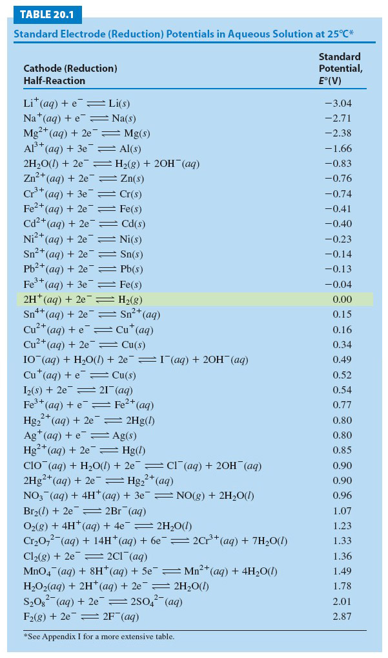

Slide 52
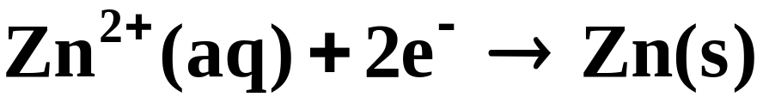
Standard Cell emf’s and Standard Electrode Potentials
By convention, the Table of Standard Electrode Potentials (Table 20.1) are tabulated as reduction potentials.
  The zinc half-reaction is an oxidation.
  If you write E_{Zn} for the reduction potential of zinc, then –E_{Zn} is the oxidation potential of zinc.
(E_{Zn})
-(E_{Zn})
Notes:
2

Slide 53
Standard Cell emf’s and Standard Electrode Potentials
By convention, the Table of Standard Electrode Potentials (Table 20.1) are tabulated as reduction potentials.
  The copper half-reaction is a reduction..
  Write E_{Cu} for the electrode potential.
(E_{Cu})
Notes:
2

Slide 54
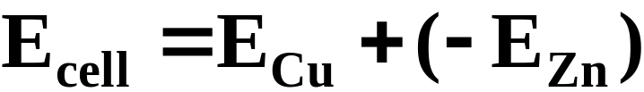
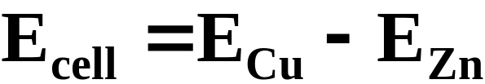
Standard Cell emf’s and Standard Electrode Potentials
By convention, the Table of Standard Electrode Potentials (Table 20.1) are tabulated as reduction potentials.
  For this cell, the cell emf is the sum of the reduction potential for the copper half-cell and the oxidation potential for the zinc half-cell.
Notes:
2

Slide 55

Standard Cell emf’s and Standard Electrode Potentials
By convention, the Table of Standard Electrode Potentials (Table 20.1) are tabulated as reduction potentials.
  Note that the cell emf is the difference between the two electrode potentials.
  In general, E_{cell} is obtained by subtracting the anode potential from the cathode potential.
Notes:
2

Slide 56
Standard Cell emf’s and Standard Electrode Potentials
By convention, the Table of Standard Electrode Potentials (Table 20.1) are tabulated as reduction potentials.
  The electrode potential is an intensive property whose value is independent of the amount of species in the reaction.
Notes:
2

Slide 57
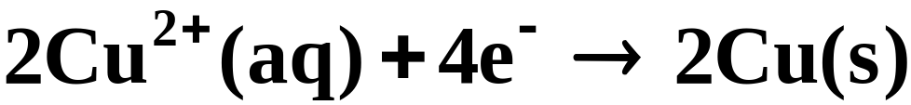
Standard Cell emf’s and Standard Electrode Potentials
By convention, the Table of Standard Electrode Potentials (Table 20.1) are tabulated as reduction potentials.
  Thus, the electrode potential for the half-reaction
  is the same as for
Notes:
2

Slide 58
Tabulating Standard Electrode Potentials
The standard emf, E°_{cell}, is the emf of a cell operating under standard conditions of concentration (1 M), pressure (1 atm), and temperature (25°C).
  By convention, the reference chosen for comparing electrode potentials is the standard hydrogen electrode. (see Figure 20.5)
  Standard electrode potentials (Table 20.1) are measured relative to this hydrogen reference.
Notes:
2

Slide 59
Strengths of Oxidizing and Reducing Agents
Standard electrode potentials are useful in determining the strengths of oxidizing and reducing agents under standard-state conditions.
  Consequently, the strongest oxidizing agents in a table of standard electrode potentials are the oxidized species corresponding to the half-reactions with the largest (most positive) Eº values. (For example F₂(g))
Notes:
2

Slide 60
Strengths of Oxidizing and Reducing Agents
Standard electrode potentials are useful in determining the strengths of oxidizing and reducing agents under standard-state conditions.
  Consequently, the strongest reducing agents in a table of standard electrode potentials are the reduced species corresponding to the half-reactions with the smallest (most negative) Eº values. (for example, Li(s))
Notes:
2

Slide 61
Calculating Cell emf’s from Standard Potentials
The emf of a voltaic cell constructed from standard electrodes is easily calculated using a table of electrode potentials.
  Consider a cell constructed of the following two half-reactions.
Notes:
2

Slide 62
Calculating Cell emf’s from Standard Potentials
The emf of a voltaic cell constructed from standard electrodes is easily calculated using a table of electrode potentials.
  You will need to reverse one of these reactions to obtain the oxidation part of the cell reaction.
Notes:
2

Slide 63
Calculating Cell emf’s from Standard Potentials
The emf of a voltaic cell constructed from standard electrodes is easily calculated using a table of electrode potentials.
  This will be Cd, because has the more negative electrode potential.
Notes:
2

Slide 64
Calculating Cell emf’s from Standard Potentials
The emf of a voltaic cell constructed from standard electrodes is easily calculated using a table of electrode potentials.
  Therefore, you reverse the half-reaction and change the sign of the half-cell potential.
Notes:
2

Slide 65
Calculating Cell emf’s from Standard Potentials
The emf of a voltaic cell constructed from standard electrodes is easily calculated using a table of electrode potentials.
  We must double the silver half-reaction so that when the reactions are added, the electrons cancel.
Notes:
2

Slide 66
Calculating Cell emf’s from Standard Potentials
The emf of a voltaic cell constructed from standard electrodes is easily calculated using a table of electrode potentials.
  This does not affect the half-cell potentials, which do not depend on the amount of substance.
Notes:
2

Slide 67
Calculating Cell emf’s from Standard Potentials
The emf of a voltaic cell constructed from standard electrodes is easily calculated using a table of electrode potentials.
  Now we can add the two half-reactions to obtain the overall cell reaction and cell emf.
Notes:
2

Slide 68
Calculating Cell emf’s from Standard Potentials
The emf of a voltaic cell constructed from standard electrodes is easily calculated using a table of electrode potentials.
  Now we can add the two half-reactions to obtain the overall cell reaction and cell emf.
Notes:
2

Slide 69
Calculating Cell emf’s from Standard Potentials
The emf of a voltaic cell constructed from standard electrodes is easily calculated using a table of electrode potentials.
  The corresponding cell notation would be
Notes:
2

Slide 70
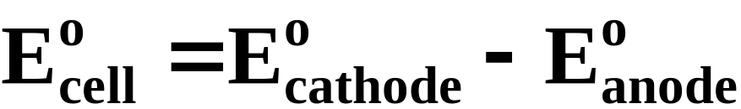
Calculating Cell emf’s from Standard Potentials
The emf of a voltaic cell constructed from standard electrodes is easily calculated using a table of electrode potentials.
  Note that the emf of the cell equals the standard electrode potential of the cathode minus the standard electrode potential of the anode.
Notes:
2

Slide 71
A Problem To Consider
Calculate the standard emf for the following voltaic cell at 25°C using standard electrode potentials. What is the overall reaction?
  The reduction half-reactions and standard potentials are
Notes:
2

Slide 72
A Problem To Consider
Calculate the standard emf for the following voltaic cell at 25°C using standard electrode potentials. What is the overall reaction, the maximum work involved and cell notation? The reaction involves Aluminum and Iron Metal.
  You reverse the first half-reaction and its half-cell potential to obtain
Notes:
2

Slide 73
A Problem To Consider
Calculate the standard emf for the following voltaic cell at 25°C using standard electrode potentials. What is the overall reaction?
  To obtain the overall reaction we must balance the electrons.
Notes:
2

Slide 74
A Problem To Consider
Calculate the standard emf for the following voltaic cell at 25°C using standard electrode potentials. What is the overall reaction?
  Now we add the reactions to get the overall cell reaction and cell emf.
Notes:
2

Slide 75

Equilibrium Constants from emf’s
Some of the most important results from electrochemistry are the relationships among E°_{cell}, free energy, and equilibrium constant.
  In Chapter 19 we saw that G equals the maximum useful work of a reaction.
  For a voltaic cell, work = -nFEº, so when reactants are in their standard states
Notes:
2

Slide 76

Equilibrium Constants from emf’s
Some of the most important results from electrochemistry are the relationships among E°_{cell}, free energy, and equilibrium constant.
  Combining the previous equation, ΔGº = -nFEº_{cell}, with the equation ΔGº = -RTlnK, we get
Notes:
2

Slide 77
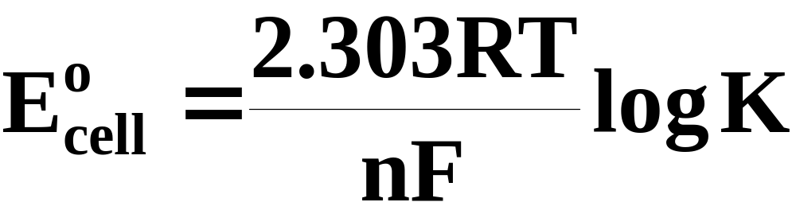
Equilibrium Constants from emf’s
Some of the most important results from electrochemistry are the relationships among E°_{cell}, free energy, and equilibrium constant.
  Or, rearranging, we get
Notes:
2

Slide 78
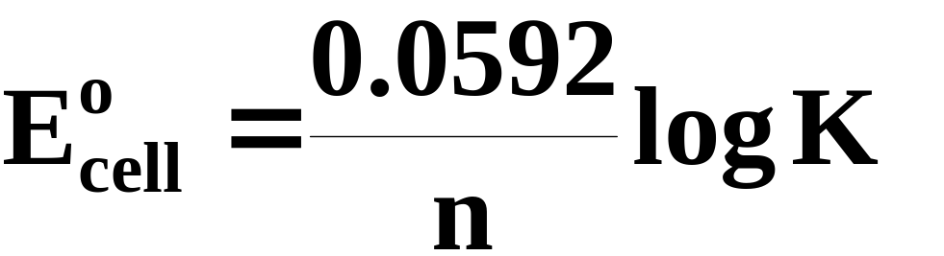
Equilibrium Constants from emf’s
Some of the most important results from electrochemistry are the relationships among E°_{cell}, free energy, and equilibrium constant.
  Substituting values for the constants R and F at 25 ºC gives the equation
(values in volts at 25 ºC)
Notes:
2

Slide 79
Equilibrium Constants from emf’s
Some of the most important results from electrochemistry are the relationships among E°_{cell}, free energy, and equilibrium constant.
  Figure 20.7 summarizes the various relationships among K, ΔGº, and Eº_{cell}.
Notes:
2

Slide 80
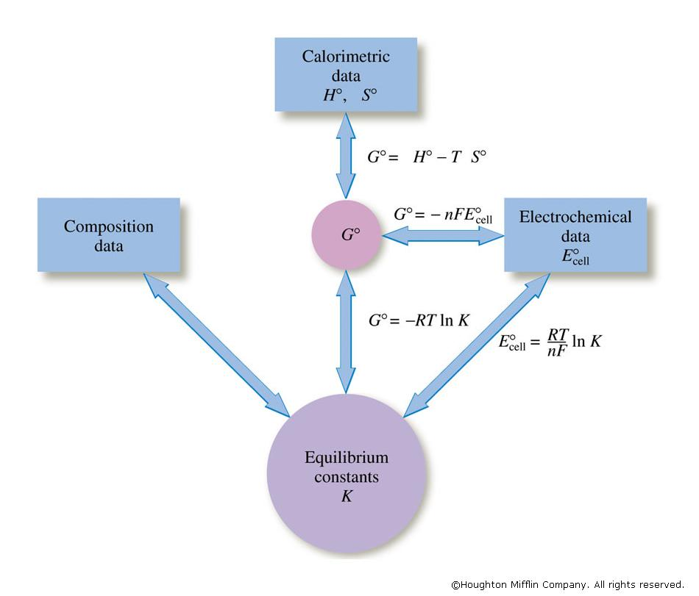

Slide 81

A Problem To Consider
The standard emf for the following cell is 1.10 V.
Calculate the equilibrium constant K_{c} for the reaction
  Note that n=2. Substituting into the equation relating Eº_{cell} and K gives
Notes:
2

Slide 82

A Problem To Consider
The standard emf for the following cell is 1.10 V.
Calculate the equilibrium constant K_{c} for the reaction
  Solving for log K_{c}, you find
Notes:
2

Slide 83
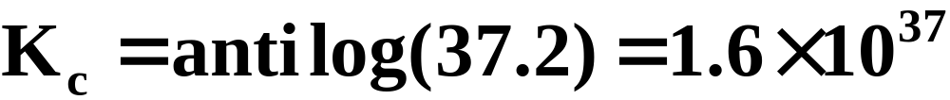
A Problem To Consider
The standard emf for the following cell is 1.10 V.
Calculate the equilibrium constant K_{c} for the reaction
  Now take the antilog of both sides:
Notes:
2

Slide 84
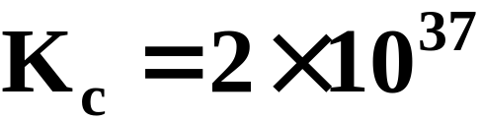
A Problem To Consider
The standard emf for the following cell is 1.10 V.
Calculate the equilibrium constant K_{c} for the reaction
  The number of significant figures in the answer equals the number of decimal places in 37.2 (one). Thus
Notes:
2

Slide 85

Dependence of emf on Concentration
Recall that the free energy change, ΔG, is related to the standard free energy change, ΔG°, by the following equation.
  Here Q is the thermodynamic reaction quotient.
Notes:
2

Slide 86

Dependence of emf on Concentration
Recall that the free energy change, ΔG, is related to the standard free energy change, ΔG°, by the following equation.
  If we substitute ΔG = -nFE_{cell} and ΔGº = -nFEº_{cell} into this equation, we get
Notes:
2

Slide 87
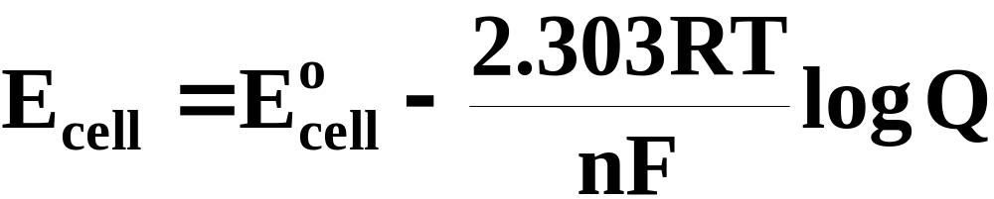
Dependence of emf on Concentration
The result rearranges to give the Nernst equation, an equation relating the cell emf to its standard emf and the reaction quotient.
Notes:
2

Slide 88
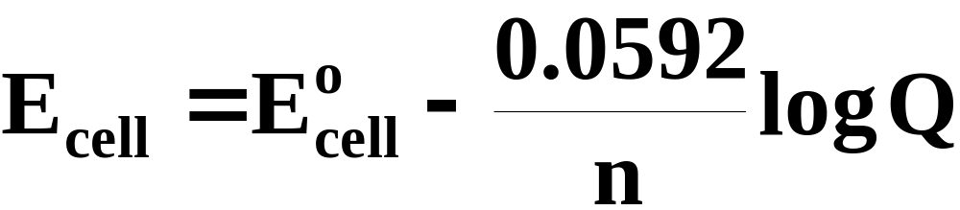
Dependence of emf on Concentration
The result rearranges to give the Nernst equation, an equation relating the cell emf to its standard emf and the reaction quotient.
  Substituting values for R and F at 25 ºC, we get
(values in volts at 25 ºC)
Notes:
2

Slide 89
Dependence of emf on Concentration
The result rearranges to give the Nernst equation, an equation relating the cell emf to its standard emf and the reaction quotient.
  The Nernst equation illustrates why cell emf decreases as the cell reaction proceeds.
  As reactant concentrations decrease and product concentrations increase, Q increases, thus increasing log Q which in turn decreases the cell emf.
Notes:
2

Slide 90
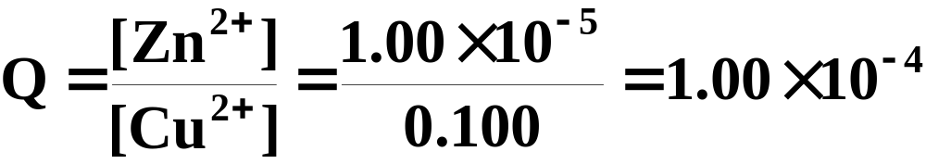
A Problem To Consider
What is the emf of the following voltaic cell at 25°C?
The standard emf of the cell is 1.10 V.
  The cell reaction is
  The number of electrons transferred is 2; hence n = 2. The reaction quotient is
Notes:
2

Slide 91
A Problem To Consider
What is the emf of the following voltaic cell at 25°C?
The standard emf of the cell is 1.10 V.
  The standard emf is 1.10 V, so the Nernst equation becomes
Notes:
2

Slide 92
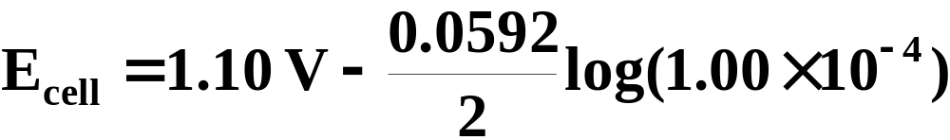
A Problem To Consider
What is the emf of the following voltaic cell at 25°C?
The standard emf of the cell is 1.10 V.
  The standard emf is 1.10 V, so the Nernst equation becomes
Notes:
2

Slide 93
A Problem To Consider
What is the emf of the following voltaic cell at 25°C?
The standard emf of the cell is 1.10 V.
  The standard emf is 1.10 V, so the Nernst equation becomes
  The cell emf is 1.22 V.
Notes:
2

Slide 94
Stoichiometry of Electrolysis
What is new in this type of stoichiometric problem is the measurement of numbers of electrons.
  You do not weigh them as you do substances.
  Rather, you measure the quantity of electric charge that has passed through a circuit.
  To determine this we must know the current and the length of time it has been flowing.
Notes:
2

Slide 95
Stoichiometry of Electrolysis
What is new in this type of stoichiometric problem is the measurement of numbers of electrons.
  Electric current is measured in amperes.
  An ampere (A) is the base SI unit of current equivalent to 1 coulomb/second.
Notes:
2

Slide 96
Stoichiometry of Electrolysis
What is new in this type of stoichiometric problem is the measurement of numbers of electrons.
  The quantity of electric charge passing through a circuit in a given amount of time is given by
Electric charge(coul) = electric current (coul/sec) × time lapse(sec)
Notes:
2

Slide 97

A Problem To Consider
When an aqueous solution of potassium iodide is electrolyzed using platinum electrodes, the half-reactions are
How many grams of iodine are produced when a current of 8.52 mA flows through the cell for 10.0 min?
  When the current flows for 6.00 x 10² s (10.0 min), the amount of charge is
Notes:
2

Slide 98
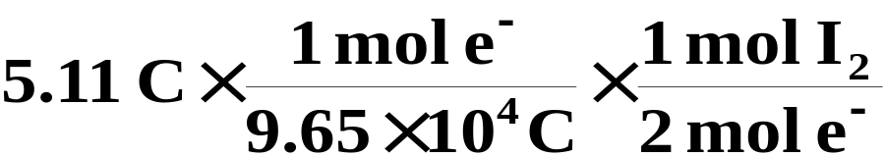
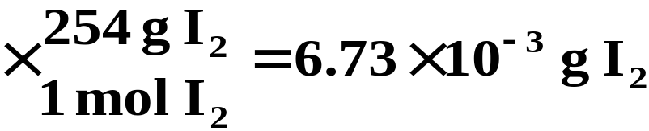
A Problem To Consider
When an aqueous solution of potassium iodide is electrolyzed using platinum electrodes, the half-reactions are
How many grams of iodine are produced when a current of 8.52 mA flows through the cell for 10.0 min?
  Note that two moles of electrons are equivalent to one mole of I₂. Hence,
Notes:
2

Slide 99
Operational Skills
Balancing oxidation-reduction reactions
Sketching and labeling a voltaic cell
Writing the cell reaction from the cell notation
Calculating the quantity of work from a given amount of cell reactant
Determining the relative strengths of oxidizing and reducing agents
Determining the direction of spontaneity from electrode potentials
Calculating the emf from standard potentials
Notes:
2

Slide 100
Operational Skills
Calculating the free-energy change from electrode potentials
Calculating the cell emf from free-energy change
Calculating the equilibrium constant from cell emf
Calculating the cell emf for nonstandard conditions
Predicting the half-reactions in an aqueous electrolysis
Relating the amounts of product and charge in an electrolysis
Notes:
2

Slide 101
Video: Galvanic Voltaic Cells
(Click here to open QuickTime animation)
Return to slide 7
Notes:
2

Slide 102
Animation: Electrochemical Half-Reactions in a Galvanic Cell
(Click here to open QuickTime animation)
Return to slide 7
Notes:
2

Slide 103

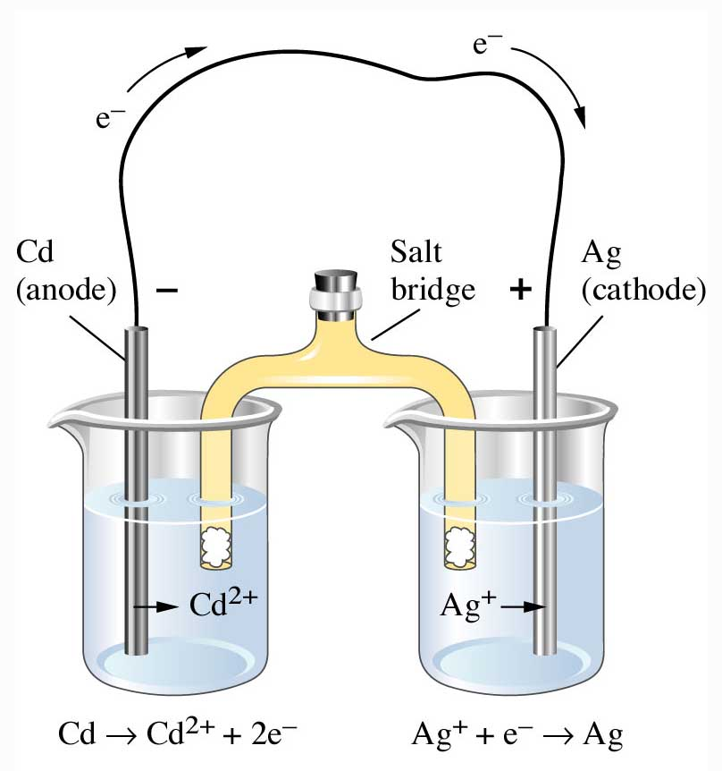
Figure 20.4: Voltaic cell consisting of cadmium and silver electrodes.
Return to slide 17

Slide 104
Animation: Anode Reaction
(Click here to open QuickTime animation)
Return to slide 17

Slide 105
Animation: Cathode Reaction
(Click here to open QuickTime animation)
Return to slide 17

Slide 106
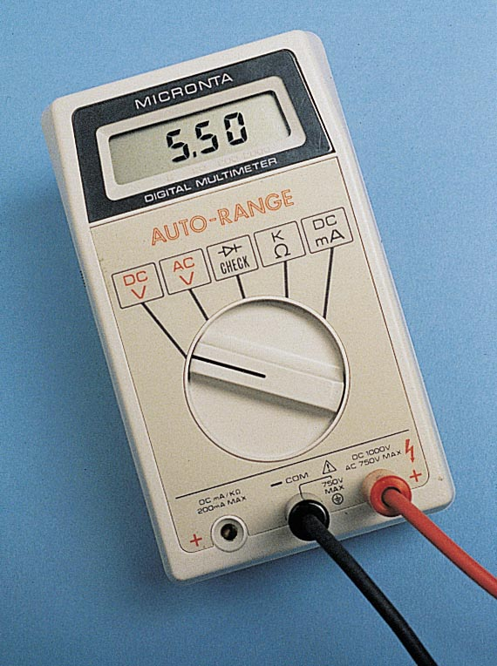
Figure 20.6:
A digital voltmeter.
Photo courtesy of American Color.
Return to slide 33

Slide 107
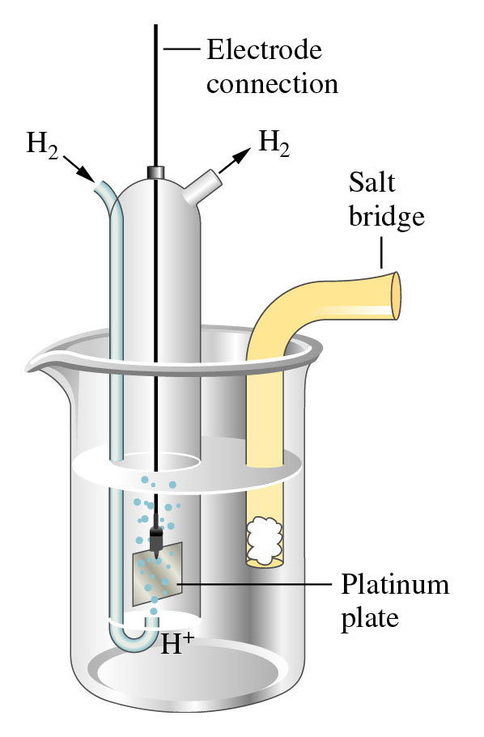
Figure 20.5: A hydrogen electrode.
Return to slide 50

Slide 108
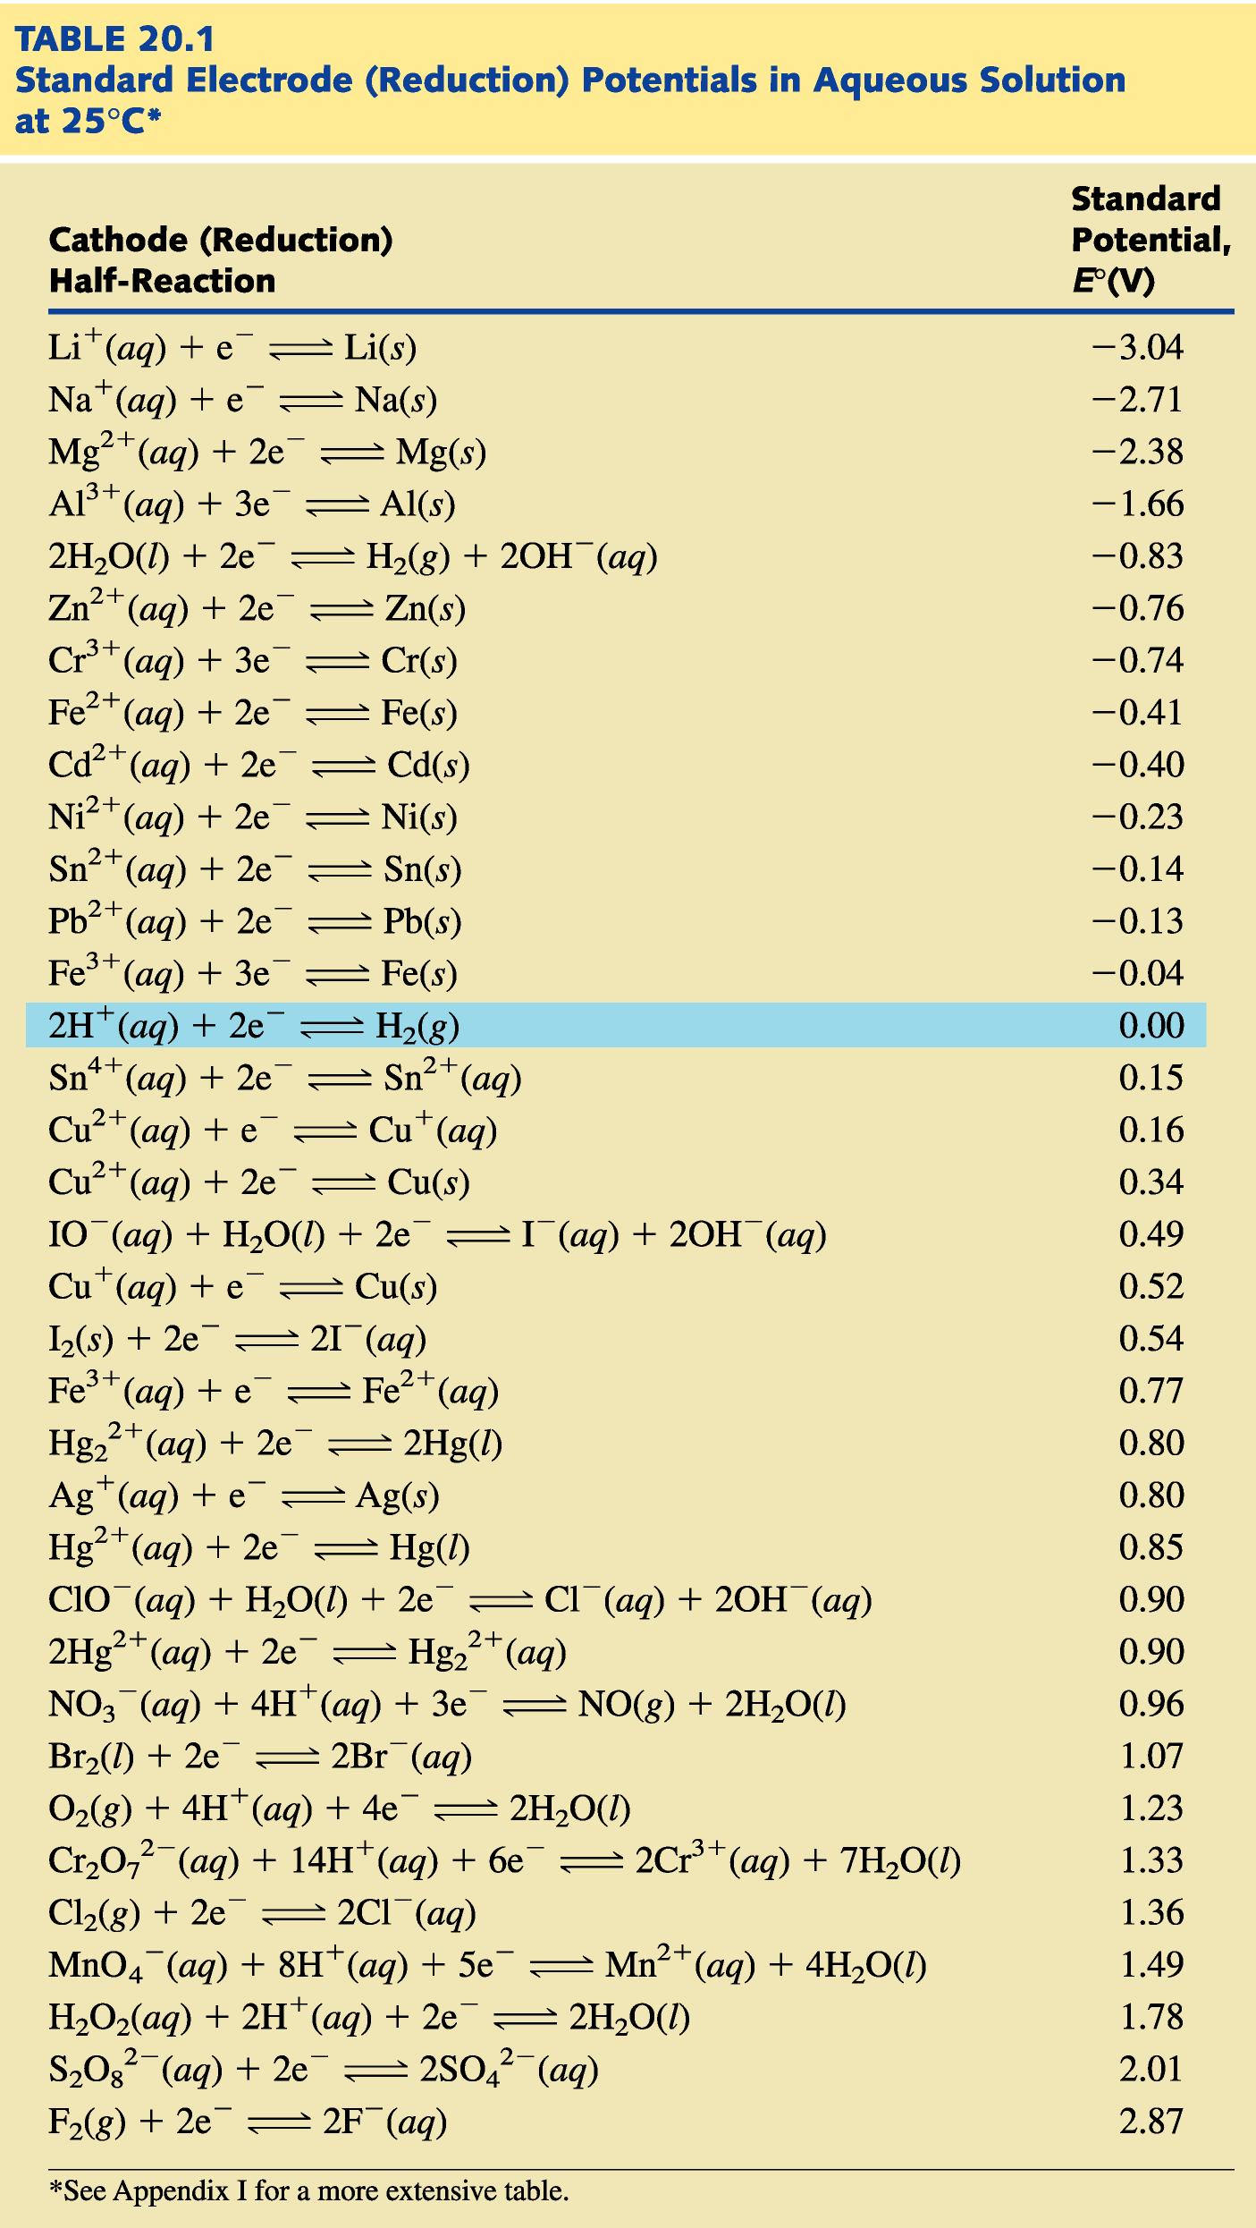
Return to slide 50

Slide 109
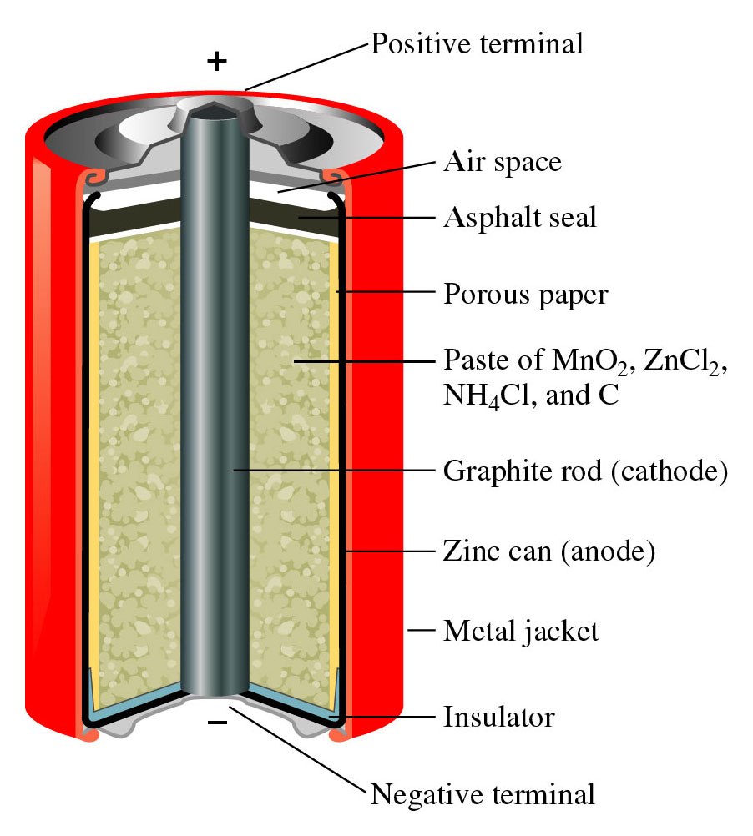
Figure 20.9:
A Leclanche dry cell.
Return to slide 89

Slide 110
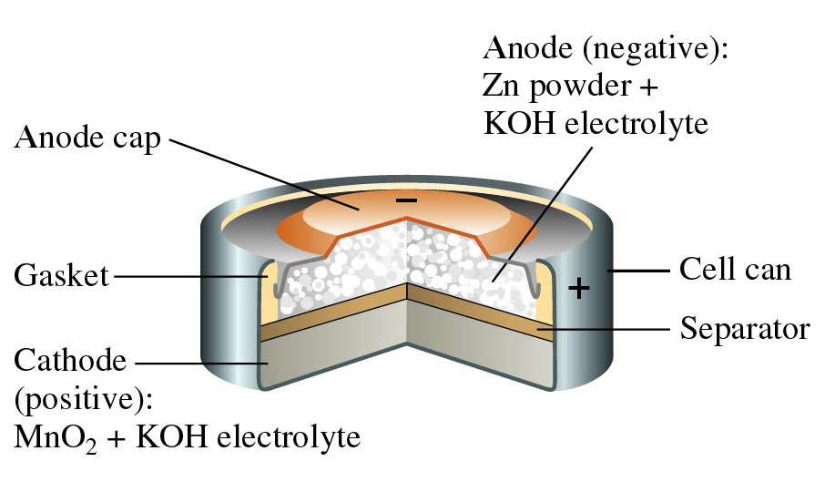
Figure 20.10: A small alkaline dry cell.
Return to slide 90

Slide 111
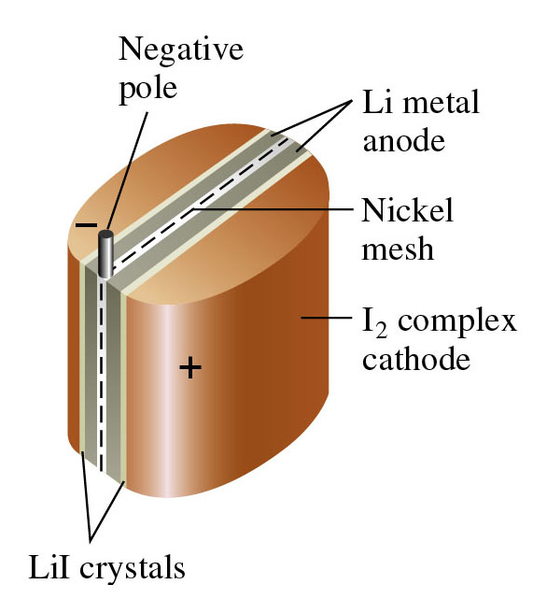
Figure 20.11:
A solid-state lithium-iodide battery.
Return to slide 91

Slide 112
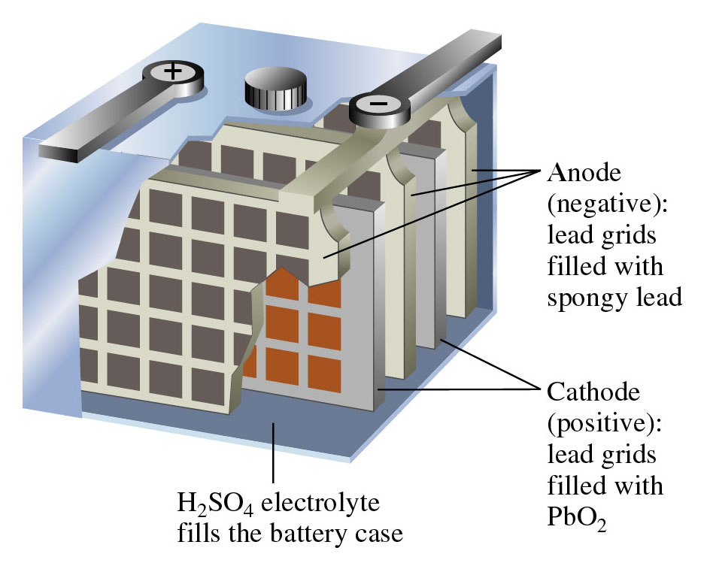
Figure 20.12: A lead storage battery.
Return to slide 92

Slide 113
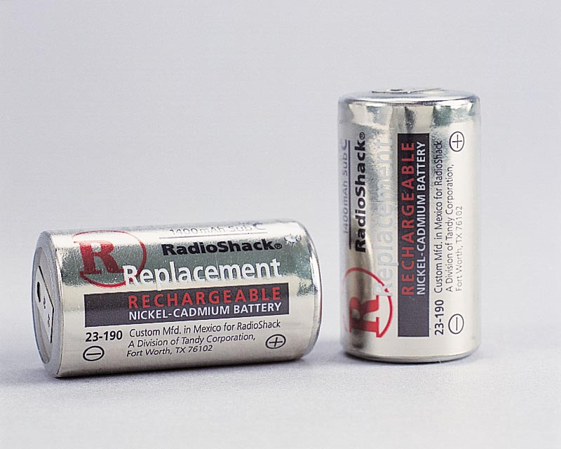
Figure 20.14: Nicad storage batteries.
Photo courtesy of American Color.
Return to slide 93

Slide 114
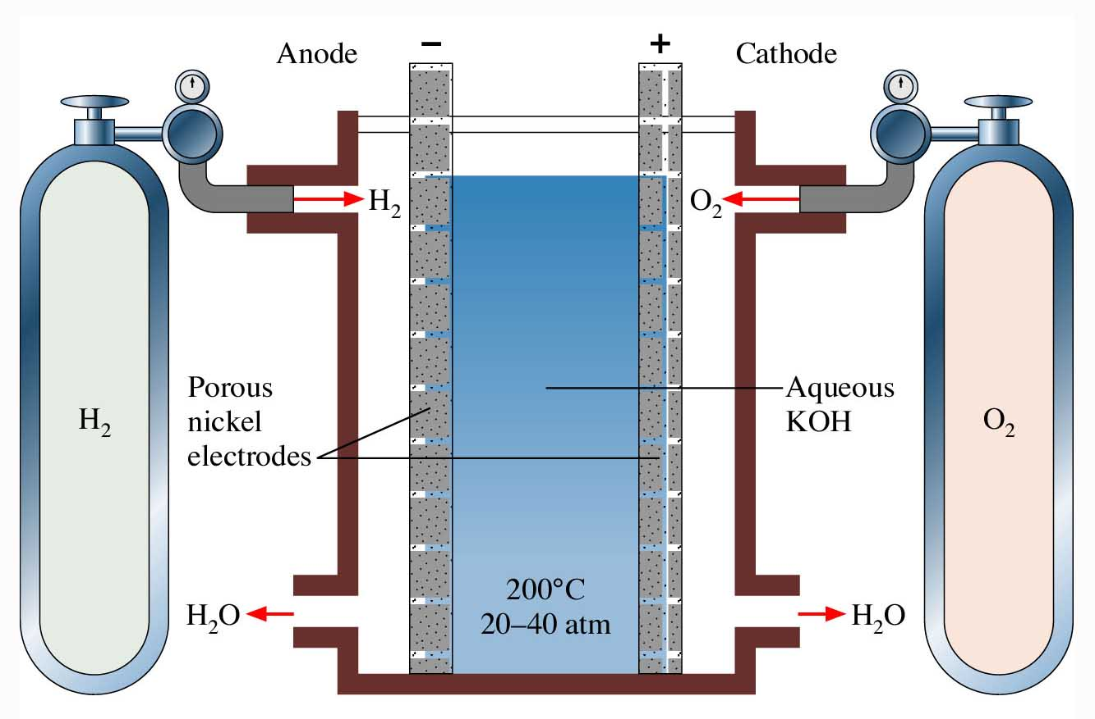
Figure 20.15: A hydrogen-oxygen fuel cell.
Return to slide 94

Slide 115
Video: Electrolysis of Water
(Click here to open QuickTime animation)
Return to slide 95

Slide 116
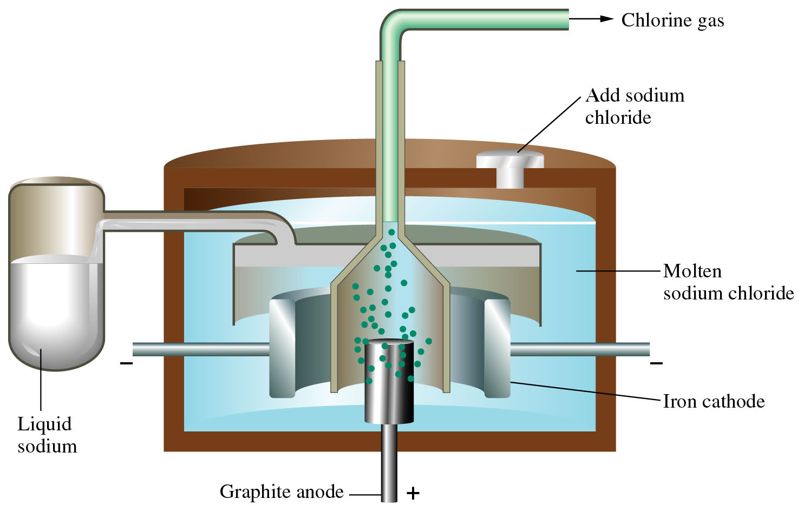
Figure 20.20: A Downs cell for the preparation of sodium metal.
Return to slide 96

