Slide 1
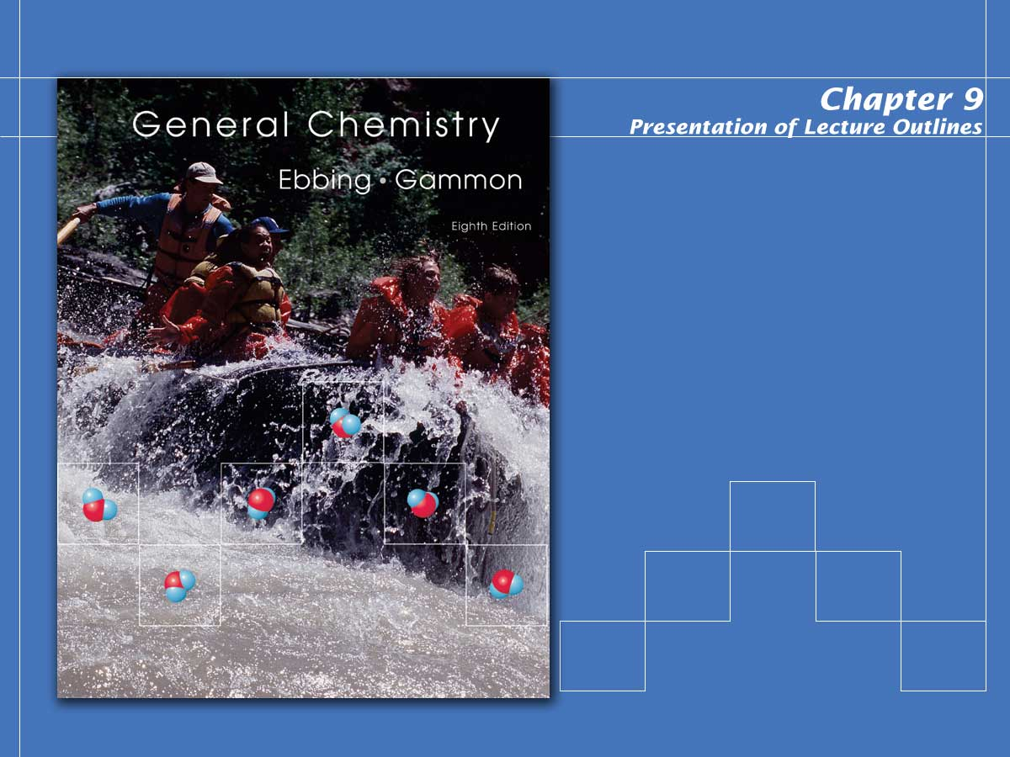
Ionic and Covalent Bonding

Slide 2
AP Problem
Consider the hydrocarbon pentane C₅H₁₂ (molar mass 72.15g).
Write the balanced equation for the combustion of pentane to yield carbon dioxide and water.
What volume of dry carbon dioxide, measured at 25 degree C and 785mm Hg, will result form the complete combustion of 2.50g of pentane?
The complete combustion of 5.00 g of pentane releases 243 kJ of heat. On the basis of this information, calculate the value of delta H for the combustion of one mole of pentane.
Under identical conditions, a sample of an unknown gas effuses into a vacuum at twice the rate that sample of pentane gas effuses. Calculate the molar mass of the unknown gas.
Copyright © Houghton Mifflin Company.All rights reserved.
Presentation of Lecture Outlines, 9–<number>

Slide 3
3C₂H₂ (g) → C₆H₆ (g)
What is the standard enthalpy change, dHº for the reaction represented above?
(DHº_{f} of C₂H₂(g) is 230kJ mol⁻¹, DHº_{f} of C₆H₆(g) is 83kJ mol⁻¹)
-607 kJ
-147 kJ
-19 kJ
+19 kJ
+773 kJ
Copyright © Houghton Mifflin Company.All rights reserved.
Presentation of Lecture Outlines, 9–<number>

Slide 4
In which of the following species does sulfur have the same oxidation number as it does in H₂SO₄?
a. H₂SO₃
S₂O₃²⁻
S²⁻
S₈
SO₂Cl₂
Copyright © Houghton Mifflin Company.All rights reserved.
Presentation of Lecture Outlines, 9–<number>

Slide 5
Describing Ionic Bonds
An ionic bond is a chemical bond formed by the electrostatic attraction between positive and negative ions.
  This type of bond involves the transfer of electrons from one atom (usually a metal) to another (usually a nonmetal).
  The number of electrons lost or gained by an atom is determined by its need to be “isoelectronic” with a noble gas.
Copyright © Houghton Mifflin Company.All rights reserved.
Presentation of Lecture Outlines, 9–<number>
Notes:
2

Slide 6
Describing Ionic Bonds
Such noble gas configurations and the corresponding ions are particularly stable.
  The atom that loses the electron becomes a cation (positive).
  The atom that gains the electron becomes an anion (negative).
Copyright © Houghton Mifflin Company.All rights reserved.
Presentation of Lecture Outlines, 9–<number>
Notes:
2

Slide 7

Describing Ionic Bonds
Consider the transfer of valence electrons from a sodium atom to a chlorine atom.
e⁻
  The resulting ions are electrostatically attracted to one another.
  The attraction of these oppositely charged ions for one another is the ionic bond.
Copyright © Houghton Mifflin Company.All rights reserved.
Presentation of Lecture Outlines, 9–<number>
Notes:
2

Slide 8
Lewis Electron-Dot Symbols
A Lewis electron-dot symbol is a symbol in which the electrons in the valence shell of an atom or ion are represented by dots placed around the letter symbol of the element.
:
:
:
:
Group I
Group II
Group III
Group IV
Group V
Group VI
Group VII
Group VIII
.
.
Na
Al
Si
P
.
Mg
.
S
Cl
Ar
.
.
.
.
.
.
.
.
:
.
:
:
:
:
:
.
.
.
  Note that the group number indicates the number of valence electrons.
Copyright © Houghton Mifflin Company.All rights reserved.
Presentation of Lecture Outlines, 9–<number>
Notes:
2

Slide 9
Lewis Electron-Dot Formulas
A Lewis electron-dot formula is an illustration used to represent the transfer of electrons during the formation of an ionic bond.
  As an example, let’s look at the transfer of electrons from magnesium to fluorine to form magnesium fluoride.
Copyright © Houghton Mifflin Company.All rights reserved.
Presentation of Lecture Outlines, 9–<number>
Notes:
2

Slide 10
Lewis Electron-Dot Formulas
The magnesium has two electrons to give, whereas the fluorines have only one “vacancy” each.
:
:
Mg
F
.
.
F
:
.
.
:
:
:
:
:
[ F ]
-
2+
[ F ]
-
:
Mg
:
:
:
:
:
  Consequently, magnesium can accommodate two fluorine atoms.
Copyright © Houghton Mifflin Company.All rights reserved.
Presentation of Lecture Outlines, 9–<number>
Notes:
2

Slide 11
Energy Involved in Ionic Bonding
The transfer of an electron from a sodium atom to a chlorine atom is not in itself energetically favorable; it requires 147 kJ/mol of energy.
  However, 493 kJ of energy is released when these oppositely charged ions come together.
  An additional 293 kJ of energy is released when the ion pairs solidify.
  This “lattice energy” is the negative of the energy released when gaseous ions form an ionic solid. The next slide illustrates this.
Copyright © Houghton Mifflin Company.All rights reserved.
Presentation of Lecture Outlines, 9–<number>
Notes:
2

Slide 12
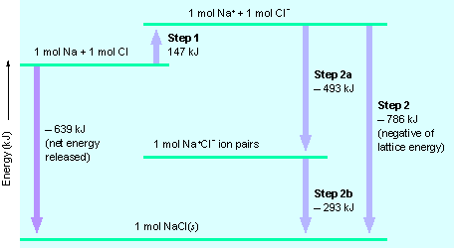
Energy Involved in Ionic Bonding
Copyright © Houghton Mifflin Company.All rights reserved.
Presentation of Lecture Outlines, 9–<number>
Notes:
2

Slide 13
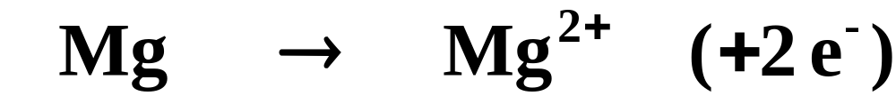
Electron Configurations of Ions
As metals lose electrons to form cations and establish a “noble gas” configuration, the electrons are lost from the valence shell first.
  For example, magnesium generally loses two electrons from its 3s subshell to look like neon.
[Ne]3s²
[Ne]
Copyright © Houghton Mifflin Company.All rights reserved.
Presentation of Lecture Outlines, 9–<number>
Notes:
2

Slide 14
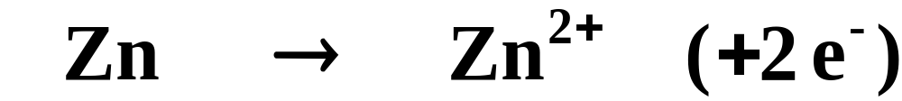
Electron Configurations of Ions
Transition metals also lose electrons from the valence shell first, which is not the last subshell to fill according to the aufbau sequence.
  For example, zinc generally loses two electrons from its 4s subshell to adopt a “pseudo”-noble gas configuration.
[Ar]4s²3d¹⁰
[Ar]3d¹⁰
Copyright © Houghton Mifflin Company.All rights reserved.
Presentation of Lecture Outlines, 9–<number>
Notes:
2

Slide 15
Ionic Radii
The ionic radius is a measure of the size of the spherical region around the nucleus of an ion within which the electrons are most likely to be found.
  Ionic radii increase down any column because of the addition of electron shells.
  In general, across any period the cations decrease in radius. When you reach the anions, there is an abrupt increase in radius, and then the radius again decreases.
Copyright © Houghton Mifflin Company.All rights reserved.
Presentation of Lecture Outlines, 9–<number>
Notes:
2

Slide 16
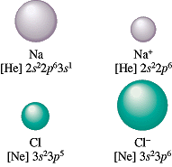
Ionic Radii
Copyright © Houghton Mifflin Company.All rights reserved.
Presentation of Lecture Outlines, 9–<number>
Notes:
2

Slide 17
Ionic Radii
Within an isoelectronic group of ions, the one with the greatest nuclear charge will be the smallest.
  For example, look at the ions listed below.
All have 18 electrons
  Note that they all have the same number of electrons, but different numbers of protons.
Copyright © Houghton Mifflin Company.All rights reserved.
Presentation of Lecture Outlines, 9–<number>
Notes:
2

Slide 18
Ionic Radii
In this group, calcium has the greatest nuclear charge and is, therefore, the smallest.
All have 18 electrons
  Sulfur has only 16 protons to attract its 18 electrons and, therefore, has the largest radius.
Copyright © Houghton Mifflin Company.All rights reserved.
Presentation of Lecture Outlines, 9–<number>
Notes:
2

Slide 19
Covalent Bonds
When two nonmetals bond, they often share electrons since they have similar attractions for them. This sharing of valence electrons is called the covalent bond.
  These atoms will share sufficient numbers of electrons in order to achieve a noble gas electron configuration (that is, eight valence electrons).
Copyright © Houghton Mifflin Company.All rights reserved.
Presentation of Lecture Outlines, 9–<number>
Notes:
2

Slide 20
Covalent Bonds
The tendency of atoms in a molecule to have eight electrons in their outer shell (two for hydrogen) is called the octet rule.
  Figure 9.10 illustrates how two electrons can be shared by bonded hydrogen atoms.
  Figure 9.11 shows the potential energy of the atoms for various distances between nuclei. The decrease in energy is a reflection of the bonding of the atoms.
Copyright © Houghton Mifflin Company.All rights reserved.
Presentation of Lecture Outlines, 9–<number>
Notes:
2

Slide 21
Lewis Structures
You can represent the formation of the covalent bond in H₂ as follows:
.
.
:
+
H
H
H
H
  This uses the Lewis dot symbols for the hydrogen atom and represents the covalent bond by a pair of dots.
Copyright © Houghton Mifflin Company.All rights reserved.
Presentation of Lecture Outlines, 9–<number>
Notes:
2

Slide 22
Lewis Structures
The shared electrons in H₂ spend part of the time in the region around each atom.
:
H
H
  In this sense, each atom in H₂ has a helium configuration.
Copyright © Houghton Mifflin Company.All rights reserved.
Presentation of Lecture Outlines, 9–<number>
Notes:
2

Slide 23
Lewis Structures
The formation of a bond between H and Cl to give an HCl molecule can be represented in a similar way.
.
.
:
:
:
:
:
H
+
Cl
H
Cl
:
:
  Thus, hydrogen has two valence electrons about it (as in He) and Cl has eight valence electrons about it (as in Ar).
Copyright © Houghton Mifflin Company.All rights reserved.
Presentation of Lecture Outlines, 9–<number>
Notes:
2

Slide 24
Lewis Structures
Formulas such as these are referred to as Lewis electron-dot formulas or Lewis structures.
:
bonding pair
:
:
H
Cl
:
lone pair
  An electron pair is either a bonding pair (shared between two atoms) or a lone pair (an electron pair that is not shared).
Copyright © Houghton Mifflin Company.All rights reserved.
Presentation of Lecture Outlines, 9–<number>
Notes:
2

Slide 25
Coordinate Covalent Bonds
When bonds form between atoms that both donate an electron, you have:
.
.
:
+
A
B
A
B
  It is, however, possible that both electrons are donated by one of the atoms. This is called a coordinate covalent bond.
:
:
+
A
B
A
B
Copyright © Houghton Mifflin Company.All rights reserved.
Presentation of Lecture Outlines, 9–<number>
Notes:
2

Slide 26
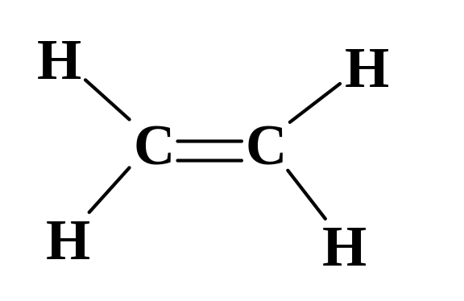
Multiple Bonds
In the molecules described so far, each of the bonds has been a single bond, that is, a covalent bond in which a single pair of electrons is shared.
  It is possible to share more than one pair. A double bond involves the sharing of two pairs between atoms.
H
:
:
H
C
:
:
C
or
:
:
H
H
Copyright © Houghton Mifflin Company.All rights reserved.
Presentation of Lecture Outlines, 9–<number>
Notes:
2

Slide 27
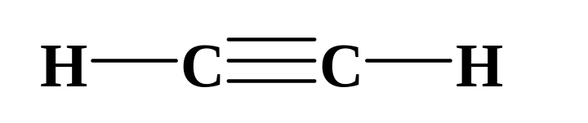
Multiple Bonds
Triple bonds are covalent bonds in which three pairs of electrons are shared between atoms.
H
:
C
:::
C
:
H
or
Copyright © Houghton Mifflin Company.All rights reserved.
Presentation of Lecture Outlines, 9–<number>
Notes:
2

Slide 28
Polar Covalent Bonds
A polar covalent bond is one in which the bonding electrons spend more time near one of the two atoms involved.
  When the atoms are alike, as in the H-H bond of H₂ , the bonding electrons are shared equally (a nonpolar covalent bond).
  When the two atoms are of different elements, the bonding electrons need not be shared equally, resulting in a “polar” bond.
Copyright © Houghton Mifflin Company.All rights reserved.
Presentation of Lecture Outlines, 9–<number>
Notes:
2

Slide 29
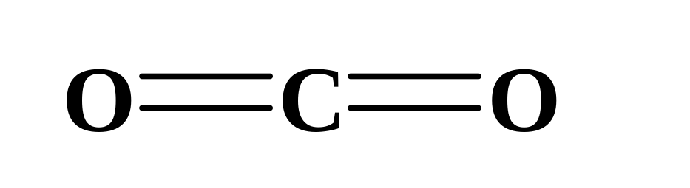
Polar Covalent Bonds
For example, the bond between carbon and oxygen in CO₂ is considered polar because the shared electrons spend more time orbiting the oxygen atoms.
:
δ⁺
:
δ⁻
δ⁻
:
:
  The result is a partial negative charge on the oxygens (denoted δ⁻) and a partial positive charge on the carbon (denoted δ⁺)
Copyright © Houghton Mifflin Company.All rights reserved.
Presentation of Lecture Outlines, 9–<number>
Notes:
2

Slide 30
Polar Covalent Bonds
Electronegativity is a measure of the ability of an atom in a molecule to draw bonding electrons to itself.
  In general, electronegativity increases from the lower-left corner to the upper-right corner of the periodic table.
  The current electronegativity scale, developed by Linus Pauling, assigns a value of 4.0 to fluorine and a value of 0.7 to cesium.
Copyright © Houghton Mifflin Company.All rights reserved.
Presentation of Lecture Outlines, 9–<number>
Notes:
2

Slide 31

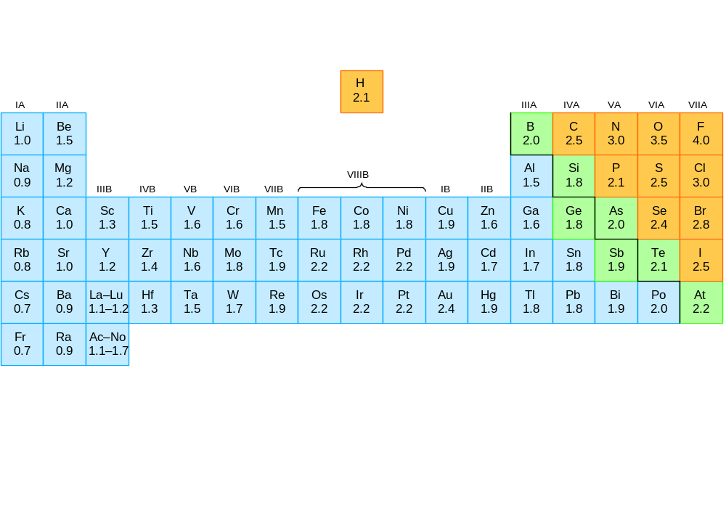
Electronegativities
Copyright © Houghton Mifflin Company.All rights reserved.
Presentation of Lecture Outlines, 9–<number>
Notes:
2

Slide 32
Polar Covalent Bonds
The absolute value of the difference in electronegativity of two bonded atoms gives a rough measure of the polarity of the bond.
  When this difference is small (less than 0.5), the bond is nonpolar.
  When this difference is large (greater than 0.5), the bond is considered polar.
  If the difference exceeds approximately 1.8, sharing of electrons is no longer possible and the bond becomes ionic.
Copyright © Houghton Mifflin Company.All rights reserved.
Presentation of Lecture Outlines, 9–<number>
Notes:
2

Slide 33
Writing Lewis Dot Formulas
The Lewis electron-dot formula of a covalent compound is a simple two-dimensional representation of the positions of electrons in a molecule.
  Bonding electron pairs are indicated by either two dots or a dash.
  In addition, these formulas show the positions of lone pairs of electrons.
Copyright © Houghton Mifflin Company.All rights reserved.
Presentation of Lecture Outlines, 9–<number>
Notes:
2

Slide 34
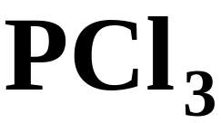
Writing Lewis Dot Formulas
The following rules allow you to write electron-dot formulas even when the central atom does not follow the octet rule.
  To illustrate, we will draw the structure of PCl₃, phosphorus trichloride.
Copyright © Houghton Mifflin Company.All rights reserved.
Presentation of Lecture Outlines, 9–<number>
Notes:
2

Slide 35
Writing Lewis Dot Formulas
Step 1: Total all valence electrons in the molecular formula. That is, total the group numbers of all the atoms in the formula.
26 e⁻ total
5 e⁻
(7 e⁻) x 3
  For a polyatomic anion, add the number of negative charges to this total.
  For a polyatomic cation, subtract the number of positive charges from this total.
Copyright © Houghton Mifflin Company.All rights reserved.
Presentation of Lecture Outlines, 9–<number>
Notes:
2

Slide 36
Writing Lewis Dot Formulas
Step 2: Arrange the atoms radially, with the least electronegative atom in the center. Place one pair of electrons between the central atom and each peripheral atom.
Cl
Cl
P
Cl
Copyright © Houghton Mifflin Company.All rights reserved.
Presentation of Lecture Outlines, 9–<number>
Notes:
2

Slide 37
Writing Lewis Dot Formulas
Step 3: Distribute the remaining electrons to the peripheral atoms to satisfy the octet rule.
:
:
:
:
:
:
Cl
Cl
P
:
:
Cl
:
Copyright © Houghton Mifflin Company.All rights reserved.
Presentation of Lecture Outlines, 9–<number>
Notes:
2

Slide 38
Writing Lewis Dot Formulas
Step 4: Distribute any remaining electrons to the central atom. If there are fewer than eight electrons on the central atom, a multiple bond may be necessary.
:
:
:
:
:
:
Cl
Cl
:
P
:
:
Cl
:
Copyright © Houghton Mifflin Company.All rights reserved.
Presentation of Lecture Outlines, 9–<number>
Notes:
2

Slide 39
Writing Lewis Dot Formulas
Try drawing Lewis dot formulas for the following covalent compound.
SCl₂
20 e⁻ total
16 e⁻ left
4 e⁻ left
:
:
:
:
Cl
S
Cl
:
:
:
:
Copyright © Houghton Mifflin Company.All rights reserved.
Presentation of Lecture Outlines, 9–<number>
Notes:
2

Slide 40
Writing Lewis Dot Formulas
Try drawing Lewis dot formulas for the following covalent compound.
COCl₂
24 e⁻ total
:
18 e⁻ left
:
:
O
0 e⁻ left
C
:
:
:
Cl
Cl
:
:
:
Copyright © Houghton Mifflin Company.All rights reserved.
Presentation of Lecture Outlines, 9–<number>
Notes:
2

Slide 41
Writing Lewis Dot Formulas
Note that the carbon has only 6 electrons.
  One of the oxygens must share a lone pair.
COCl₂
24 e⁻ total
:
18 e⁻ left
:
:
O
0 e⁻ left
C
:
:
:
Cl
Cl
:
:
:
Copyright © Houghton Mifflin Company.All rights reserved.
Presentation of Lecture Outlines, 9–<number>
Notes:
2

Slide 42
Writing Lewis Dot Formulas
Note that the carbon has only 6 electrons.
  One of the oxygens must share a lone pair.
COCl₂
24 e⁻ total
:
:
18 e⁻ left
O
0 e⁻ left
C
Note that the octet rule is now obeyed.
:
:
:
Cl
Cl
:
:
:
Copyright © Houghton Mifflin Company.All rights reserved.
Presentation of Lecture Outlines, 9–<number>
Notes:
2

Slide 43
Delocalized Bonding: Resonance
The structure of ozone, O₃, can be represented by two different Lewis electron-dot formulas.
:
:
O
O
or
:
:
:
:
:
:
O
O
O
O
:
:
:
:
  Experiments show, however, that both bonds are identical.
Copyright © Houghton Mifflin Company.All rights reserved.
Presentation of Lecture Outlines, 9–<number>
Notes:
2

Slide 44
Delocalized Bonding: Resonance
According to theory, one pair of bonding electrons is spread over the region of all three atoms.
O
O
O
  This is called delocalized bonding, in which a bonding pair of electrons is spread over a number of atoms.
Copyright © Houghton Mifflin Company.All rights reserved.
Presentation of Lecture Outlines, 9–<number>
Notes:
2

Slide 45
Delocalized Bonding: Resonance
According to the resonance description, you describe the electron structure of molecules with delocalized bonding by drawing all of the possible electron-dot formulas.
:
:
O
O
and
:
:
:
:
:
:
O
O
O
O
:
:
:
:
  These are called the resonance formulas of the molecule.
Copyright © Houghton Mifflin Company.All rights reserved.
Presentation of Lecture Outlines, 9–<number>
Notes:
2

Slide 46
Exceptions to the Octet Rule
Although many molecules obey the octet rule, there are exceptions where the central atom has more than eight electrons.
  Generally, if a nonmetal is in the third period or greater it can accommodate as many as twelve electrons, if it is the central atom.
  These elements have unfilled “d” subshells that can be used for bonding.
Copyright © Houghton Mifflin Company.All rights reserved.
Presentation of Lecture Outlines, 9–<number>
Notes:
2

Slide 47
Exceptions to the Octet Rule
For example, the bonding in phosphorus pentafluoride, PF₅, shows ten electrons surrounding the phosphorus.
:
: F :
:
F :
:
:
: F
P
:
:
F :
:
: F :
:
Copyright © Houghton Mifflin Company.All rights reserved.
Presentation of Lecture Outlines, 9–<number>
Notes:
2

Slide 48
Exceptions to the Octet Rule
In xenon tetrafluoride, XeF₄, the xenon atom must accommodate two extra lone pairs.
:
:
: F
F :
:
:
:
Xe
:
:
: F
:
F :
:
:
Copyright © Houghton Mifflin Company.All rights reserved.
Presentation of Lecture Outlines, 9–<number>
Notes:
2

Slide 49
Formal Charge and Lewis Structures
In certain instances, more than one feasible Lewis structure can be illustrated for a molecule. For example,
H
C
N
:
H
N
C
:
or
  The concept of “formal charge” can help discern which structure is the most likely.
Copyright © Houghton Mifflin Company.All rights reserved.
Presentation of Lecture Outlines, 9–<number>
Notes:
2

Slide 50
Formal Charge and Lewis Structures
The formal charge of an atom is determined by subtracting the number of electrons in its “domain” from its group number.
group number
1 e⁻
4 e⁻
5 e⁻
1 e⁻
5 e⁻
4 e⁻
H
C
N
:
H
N
C
:
or
“domain” electrons
I
IV
V
I
V
IV
  The number of electrons in an atom’s “domain” is determined by counting one electron for each bond and two electrons for each lone pair.
Copyright © Houghton Mifflin Company.All rights reserved.
Presentation of Lecture Outlines, 9–<number>
Notes:
2

Slide 51
Formal Charge and Lewis Structures
The most likely structure is the one with the least number of atoms carrying formal charge. If they have the same number of atoms carrying formal charge, choose the structure with the negative formal charge on the more electronegative atom.
formal charge
H
C
N
:
H
N
C
:
or
0
0
0
0
+1
-1
  In this case, the structure on the left is most likely correct.
Copyright © Houghton Mifflin Company.All rights reserved.
Presentation of Lecture Outlines, 9–<number>
Notes:
2

Slide 52
Bond Length and Bond Order
Bond length (or bond distance) is the distance between the nuclei in a bond.
  Knowing the bond length in a molecule can sometimes give clues as to the type of bonding present.
  Covalent radii are values assigned to atoms such that the sum of the radii of atoms “A” and “B” approximate the A-B bond length.
Copyright © Houghton Mifflin Company.All rights reserved.
Presentation of Lecture Outlines, 9–<number>
Notes:
2

Slide 53
Bond Length and Bond Order
Table 9.4 lists some covalent radii for nonmetals.
  For example, to predict the bond length of C-Cl, you add the covalent radii of the two atoms.
C
Cl
Bond length
Copyright © Houghton Mifflin Company.All rights reserved.
Presentation of Lecture Outlines, 9–<number>
Notes:
2

Slide 54
Bond Length and Bond Order
The bond order, determined by the Lewis structure, is the number of pairs of electrons in a bond.
  Bond length depends on bond order.
  As the bond order increases, the bond gets shorter and stronger.
Bond length Bond energy
C
C
154 pm
346 kJ/mol
C
C
134 pm
602 kJ/mol
C
C
120 pm
835 kJ/mol
Copyright © Houghton Mifflin Company.All rights reserved.
Presentation of Lecture Outlines, 9–<number>
Notes:
2

Slide 55
Bond Energy
We define the A-B bond energy (denoted BE) as the average enthalpy change for the breaking of an A-B bond in a molecule in its gas phase.
  The enthalpy, ΔH, of a reaction is approximately equal to the sum of the bond energies of the reactants minus the sum of the bond energies of the products.
  Table 9.5 lists values of some bond energies.
Copyright © Houghton Mifflin Company.All rights reserved.
Presentation of Lecture Outlines, 9–<number>
Notes:
2

Slide 56
Bond Energy
To illustrate, let’s estimate the H for the following reaction.
  In this reaction, one C-H bond and one Cl-Cl bond must be broken.
  In turn, one C-Cl bond and one H-Cl bond are formed.
Copyright © Houghton Mifflin Company.All rights reserved.
Presentation of Lecture Outlines, 9–<number>
Notes:
2

Slide 57

Bond Energy
Referring to Table 9.5 for the bond energies, a little simple arithmetic yields H.
Copyright © Houghton Mifflin Company.All rights reserved.
Presentation of Lecture Outlines, 9–<number>
Notes:
2

Slide 58
Operational Skills
Using Lewis symbols to represent ionic bond formation.
Writing electron configurations of ions.
Using periodic trends to obtain relative ionic radii.
Using electronegativities to obtain relative bond polarity.
Writing Lewis formulas.
Writing resonance structures.
Using formal charges to determine the best Lewis formula.
Relating bond order and bond length.
Estimating DH from bond energies.
Copyright © Houghton Mifflin Company.All rights reserved.
Presentation of Lecture Outlines, 9–<number>
Notes:
2

Slide 59
Animation: Born Haber Cycle
(Click here to open QuickTime animation)
Return to Slide 8
Copyright © Houghton Mifflin Company.All rights reserved.
Presentation of Lecture Outlines, 9–<number>
Notes:
2

