Slide 1
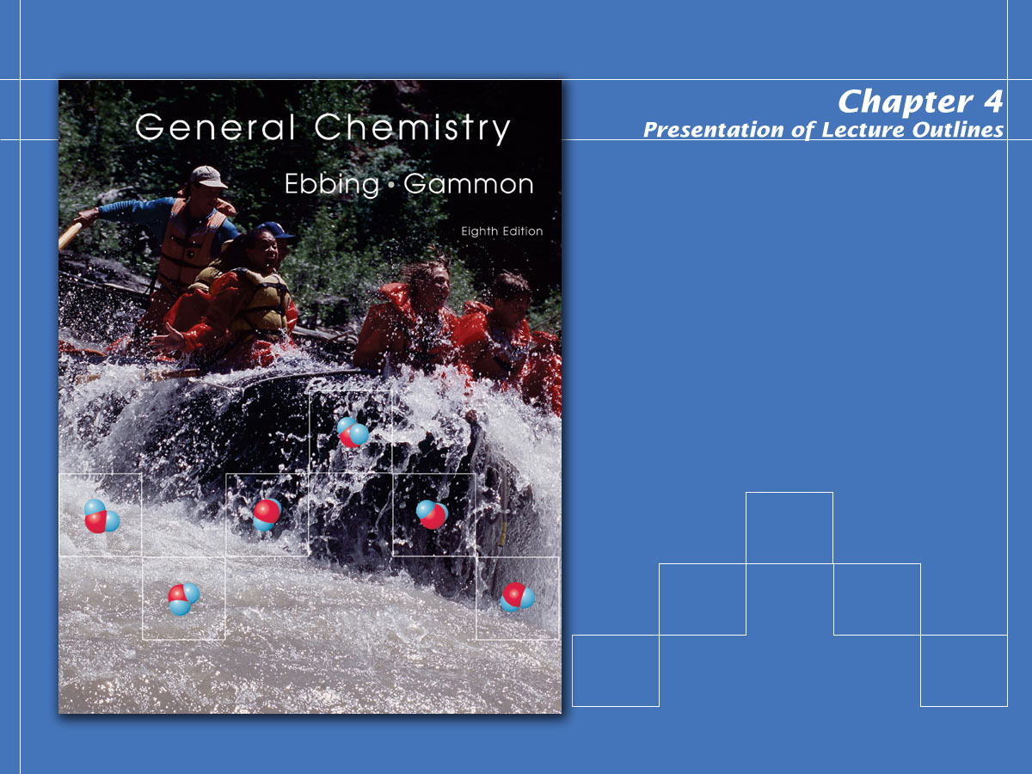
Chemical Reactions:
An Introduction

Slide 2
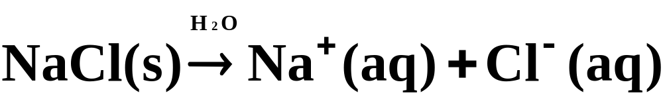
Ions in Aqueous Solution
Ionic Theory of Solutions
Many ionic compounds dissociate into independent ions when dissolved in water
  These compounds that “freely” dissociate into independent ions in aqueous solution are called electrolytes.
  Their aqueous solutions are capable of conducting an electric current. Figure 4.2 illustrates this.
Copyright © Houghton Mifflin Company.All rights reserved.
Presentation of Lecture Outlines, 4–<number>

Slide 3
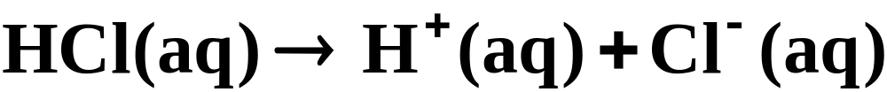
Ions in Aqueous Solution
Ionic Theory of Solutions
Not all electrolytes are ionic compounds. Some molecular compounds dissociate into ions.
  The resulting solution is electrically conducting, and so we say that the molecular substance is an electrolyte.
Copyright © Houghton Mifflin Company.All rights reserved.
Presentation of Lecture Outlines, 4–<number>

Slide 4
Ions in Aqueous Solution
Ionic Theory of Solutions
Some molecular compounds dissolve but do not dissociate into ions.
  These compounds are referred to as nonelectrolytes. They dissolve in water to give a nonconducting solution.
Copyright © Houghton Mifflin Company.All rights reserved.
Presentation of Lecture Outlines, 4–<number>

Slide 5
Ions in Aqueous Solution
Ionic Theory of Solutions
Strong and weak electrolytes.
  A strong electrolyte is an electrolyte that exists in solution almost entirely as ions.
  Most ionic solids that dissolve in water do so almost completely as ions, so they are strong electrolytes.
Copyright © Houghton Mifflin Company.All rights reserved.
Presentation of Lecture Outlines, 4–<number>

Slide 6
Ions in Aqueous Solution
Ionic Theory of Solutions
Strong and weak electrolytes.
  A weak electrolyte is an electrolyte that dissolves in water to give a relatively small percentage of ions.
Copyright © Houghton Mifflin Company.All rights reserved.
Presentation of Lecture Outlines, 4–<number>

Slide 7

Ions in Aqueous Solution
Molecular and Ionic Equations
A molecular equation is one in which the reactants and products are written as if they were molecules, even though they may actually exist in solution as ions.
Copyright © Houghton Mifflin Company.All rights reserved.
Presentation of Lecture Outlines, 4–<number>

Slide 8
Ions in Aqueous Solution
Molecular and Ionic Equations
An ionic equation, however, represents strong electrolytes as separate independent ions. This is a more accurate representation of the way electrolytes behave in solution.
Copyright © Houghton Mifflin Company.All rights reserved.
Presentation of Lecture Outlines, 4–<number>

Slide 9
Ions in Aqueous Solution
Molecular and Ionic Equations
Complete and net ionic equations.
  A net ionic equation is a chemical equation from which the spectator ions have been removed.
  A spectator ion is an ion in an ionic equation that does not take part in the reaction.
Copyright © Houghton Mifflin Company.All rights reserved.
Presentation of Lecture Outlines, 4–<number>

Slide 10

Ions in Aqueous Solution
Molecular and Ionic Equations
Complete and net ionic equations
  Let’s try an example. First, we start with a molecular equation.
    Nitric acid, HNO₃, and magnesium nitrate, Mg(NO₃)₂, are both strong electrolytes.
Copyright © Houghton Mifflin Company.All rights reserved.
Presentation of Lecture Outlines, 4–<number>

Slide 11
Types of Chemical Reactions
Most of the reactions we will study fall into one of the following categories
  Precipitation Reactions
  Acid-Base Reactions
  Oxidation-Reduction Reactions
Copyright © Houghton Mifflin Company.All rights reserved.
Presentation of Lecture Outlines, 4–<number>

Slide 12
Types of Chemical Reactions
Precipitation Reactions
A precipitation reaction occurs in aqueous solution because one product is insoluble.
  A precipitate is an insoluble solid compound formed during a chemical reaction in solution.
  For example, the reaction of sodium chloride with silver nitrate forms AgCl_{(s)}, an insoluble precipitate.
Copyright © Houghton Mifflin Company.All rights reserved.
Presentation of Lecture Outlines, 4–<number>

Slide 13
Types of Chemical Reactions
Precipitation Reactions
Predicting Precipitation Reactions.
  To predict whether a precipitate will form, we need to look at potential insoluble products.
  Table 4.1 lists eight solubility rules for ionic compounds. These rules apply to the most common ionic compounds. (See Table 4.1)
Copyright © Houghton Mifflin Company.All rights reserved.
Presentation of Lecture Outlines, 4–<number>

Slide 14

Types of Chemical Reactions
Precipitation Reactions
Predicting Precipitation Reactions.
  Suppose you mix together solutions of nickel(II) chloride, NiCl₂, and sodium phosphate, Na₃PO₄.
  How can you tell if a reaction will occur, and if it does, what products to expect?
Copyright © Houghton Mifflin Company.All rights reserved.
Presentation of Lecture Outlines, 4–<number>

Slide 15
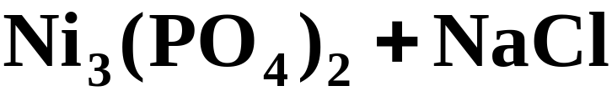
Types of Chemical Reactions
Precipitation Reactions
Predicting Precipitation Reactions.
  Precipitation reactions have the form of an “exchange reaction.”
Copyright © Houghton Mifflin Company.All rights reserved.
Presentation of Lecture Outlines, 4–<number>

Slide 16

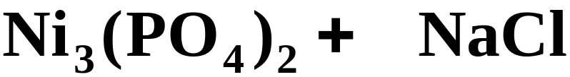
Types of Chemical Reactions
Precipitation Reactions
Predicting Precipitation Reactions.
  Now that we have predicted potential products, we must balance the equation.
3 2 6
Copyright © Houghton Mifflin Company.All rights reserved.
Presentation of Lecture Outlines, 4–<number>

Slide 17
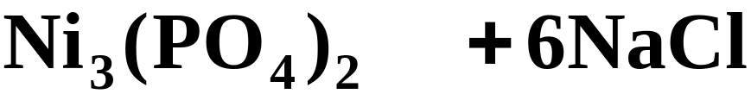
Types of Chemical Reactions
Precipitation Reactions
Predicting Precipitation Reactions.
  Table 4.1 indicates that our reactants, nickel(II) chloride and sodium phosphate are both soluble.
(aq) (aq)
(s) (aq)
  Looking at the potential products we find that nickel(II) phosphate is not soluble although sodium chloride is.
Copyright © Houghton Mifflin Company.All rights reserved.
Presentation of Lecture Outlines, 4–<number>

Slide 18
Types of Chemical Reactions
Precipitation Reactions
Predicting Precipitation Reactions.
  We predict that a reaction occurs because nickel(II) phosphate is insoluble and precipitates from the reaction mixture. (See Fig. 4.6)
  To See the reaction that occurs on the ionic level, we must rewrite the molecular equation as an ionic equation.
Copyright © Houghton Mifflin Company.All rights reserved.
Presentation of Lecture Outlines, 4–<number>

Slide 19
Types of Chemical Reactions
Precipitation Reactions
Predicting Precipitation Reactions.
  First write strong electrolytes (the soluble ionic compounds) in the form of ions to obtain the complete ionic equation
Copyright © Houghton Mifflin Company.All rights reserved.
Presentation of Lecture Outlines, 4–<number>

Slide 20
Types of Chemical Reactions
Precipitation Reactions
Predicting Precipitation Reactions.
  After canceling the spectator ions, you obtain the net ionic equation.
This equation represents the “essential” reaction.
Copyright © Houghton Mifflin Company.All rights reserved.
Presentation of Lecture Outlines, 4–<number>

Slide 21
Types of Chemical Reactions
Acid-Base Reactions
  Acids and bases are some of the most important electrolytes. (See Table 4.2)
  They can cause color changes in certain dyes called acid-base indicators.
  Household acids and bases. (See Figure 4.7)
  Red cabbage juice as an acid-base indicator. (See Figure 4.8)
Copyright © Houghton Mifflin Company.All rights reserved.
Presentation of Lecture Outlines, 4–<number>

Slide 22
Types of Chemical Reactions
Acid-Base Reactions
The Arrhenius Concept
  The Arrhenius concept defines acids as substances that produce hydrogen ions, H⁺, when dissolved in water.
Copyright © Houghton Mifflin Company.All rights reserved.
Presentation of Lecture Outlines, 4–<number>

Slide 23
Types of Chemical Reactions
Acid-Base Reactions
The Arrhenius Concept
  The Arrhenius concept defines bases as substances that produce hydroxide ions, OH⁻, when dissolved in water.
Copyright © Houghton Mifflin Company.All rights reserved.
Presentation of Lecture Outlines, 4–<number>

Slide 24
Types of Chemical Reactions
Acid-Base Reactions
The Arrhenius Concept
  The molecular substance ammonia, NH₃, is a base in the Arrhenius view,
  because it yields hydroxide ions when it reacts with water.
Copyright © Houghton Mifflin Company.All rights reserved.
Presentation of Lecture Outlines, 4–<number>

Slide 25
Types of Chemical Reactions
Acid-Base Reactions
The Brønsted-Lowry Concept
  The Brønsted-Lowry concept of acids and bases involves the transfer of a proton (H⁺) from the acid to the base.
  In this view, acid-base reactions are proton-transfer reactions.
Copyright © Houghton Mifflin Company.All rights reserved.
Presentation of Lecture Outlines, 4–<number>

Slide 26
Types of Chemical Reactions
Acid-Base Reactions
The Brønsted-Lowry Concept
  The Brønsted-Lowry concept defines an acid as the species (molecule or ion) that donates a proton (H⁺) to another species in a proton-transfer reaction.
  A base is defined as the species (molecule or ion) that accepts the proton (H⁺) in a proton-transfer reaction.
Copyright © Houghton Mifflin Company.All rights reserved.
Presentation of Lecture Outlines, 4–<number>

Slide 27
Types of Chemical Reactions
Acid-Base Reactions
The Brønsted-Lowry Concept
In the reaction of ammonia with water,
H⁺
the H₂O molecule is the acid because it donates a proton. The NH₃ molecule is a base, because it accepts a proton.
Copyright © Houghton Mifflin Company.All rights reserved.
Presentation of Lecture Outlines, 4–<number>

Slide 28
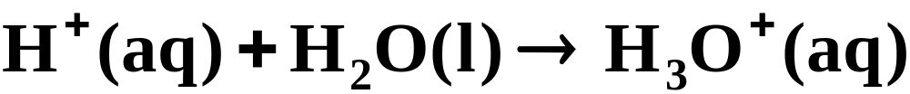
Types of Chemical Reactions
Acid-Base Reactions
The Brønsted-Lowry Concept
The H⁺_{(aq)} ion associates itself with water to form H₃O⁺_{(aq)}.
This “mode of transportation” for the H⁺ ion is called the hydronium ion.
Copyright © Houghton Mifflin Company.All rights reserved.
Presentation of Lecture Outlines, 4–<number>

Slide 29
Types of Chemical Reactions
Acid-Base Reactions
In summary, the Arrhenius concept and the Brønsted-Lowry concept are essentially the same in aqueous solution.
The Arrhenius concept
    acid: proton (H⁺) donor
    base: hydroxide ion (OH⁻) donor
Copyright © Houghton Mifflin Company.All rights reserved.
Presentation of Lecture Outlines, 4–<number>

Slide 30
Types of Chemical Reactions
Acid-Base Reactions
In summary, the Arrhenius concept and the Brønsted-Lowry concept are essentially the same in aqueous solution.
The Brønsted-Lowry concept
    acid: proton (H⁺) donor
    base: proton (H⁺) acceptor
Copyright © Houghton Mifflin Company.All rights reserved.
Presentation of Lecture Outlines, 4–<number>

Slide 31
Types of Chemical Reactions
Acid-Base Reactions
Strong and Weak Acids and Bases
  A strong acid is an acid that ionizes completely in water; it is a strong electrolyte.
  Table 4.3 lists the common strong acids.
Copyright © Houghton Mifflin Company.All rights reserved.
Presentation of Lecture Outlines, 4–<number>

Slide 32
Types of Chemical Reactions
Acid-Base Reactions
Strong and Weak Acids and Bases
  A weak acid is an acid that only partially ionizes in water; it is a weak electrolyte.
  The hydrogen cyanide molecule, HCN, reacts with water to produce a small percentage of ions in solution.
Copyright © Houghton Mifflin Company.All rights reserved.
Presentation of Lecture Outlines, 4–<number>

Slide 33
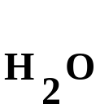
Types of Chemical Reactions
Acid-Base Reactions
Strong and Weak Acids and Bases
  A strong base is a base that is present entirely as ions, one of which is OH⁻; it is a strong electrolyte.
  The hydroxides of Group IA and IIA elements, except for beryllium hydroxide, are strong bases. (See Table 4.3)
Copyright © Houghton Mifflin Company.All rights reserved.
Presentation of Lecture Outlines, 4–<number>

Slide 34
Types of Chemical Reactions
Acid-Base Reactions
Strong and Weak Acids and Bases
  A weak base is a base that is only partially ionized in water; it is a weak electrolyte.
  Ammonia, NH₃, is an example.
Copyright © Houghton Mifflin Company.All rights reserved.
Presentation of Lecture Outlines, 4–<number>

Slide 35
Types of Chemical Reactions
Acid-Base Reactions
Strong and Weak Acids and Bases
  You will find it important to be able to identify an acid or base as strong or weak.
  When you write an ionic equation, strong acids and bases are represented as separate ions.
  Weak acids and bases are represented as undissociated “molecules” in ionic equations.
Copyright © Houghton Mifflin Company.All rights reserved.
Presentation of Lecture Outlines, 4–<number>

Slide 36
Types of Chemical Reactions
Acid-Base Reactions
Neutralization Reactions
  One of the chemical properties of acids and bases is that they neutralize one another.
  A neutralization reaction is a reaction of an acid and a base that results in an ionic compound and water.
  The ionic compound that is the product of a neutralization reaction is called a salt.
acid
base
salt
Copyright © Houghton Mifflin Company.All rights reserved.
Presentation of Lecture Outlines, 4–<number>

Slide 37
Types of Chemical Reactions
Acid-Base Reactions
Neutralization Reactions
  The net ionic equation for each acid-base neutralization reaction involves a transfer of a proton.
  Consider the reaction of the strong acid , HCl(aq) and a strong base, KOH(aq).
Copyright © Houghton Mifflin Company.All rights reserved.
Presentation of Lecture Outlines, 4–<number>

Slide 38
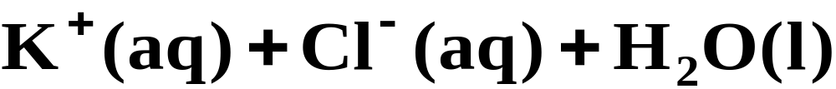
Types of Chemical Reactions
Acid-Base Reactions
Neutralization Reactions
  Writing the strong electrolytes in the form of ions gives the complete ionic equation.
Copyright © Houghton Mifflin Company.All rights reserved.
Presentation of Lecture Outlines, 4–<number>

Slide 39
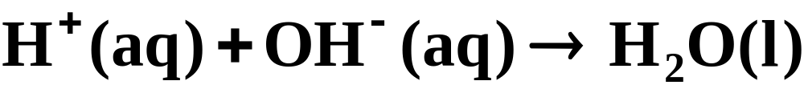
Types of Chemical Reactions
Acid-Base Reactions
Neutralization Reactions
  Canceling the spectator ions results in the net ionic equation. Note the proton transfer.
H⁺
Copyright © Houghton Mifflin Company.All rights reserved.
Presentation of Lecture Outlines, 4–<number>

Slide 40
Types of Chemical Reactions
Acid-Base Reactions
Neutralization Reactions
  In a reaction involving HCN(aq), a weak acid, and KOH(aq), a strong base, the product is KCN, a strong electrolyte.
  The net ionic equation for this reaction is
Note the proton transfer.
H⁺
Copyright © Houghton Mifflin Company.All rights reserved.
Presentation of Lecture Outlines, 4–<number>

Slide 41
Types of Chemical Reactions
Acid-Base Reactions
Acid-Base Reactions with Gas Formation
  Carbonates react with acids to form CO₂, carbon dioxide gas.
  Sulfites react with acids to form SO₂, sulfur dioxide gas.
Copyright © Houghton Mifflin Company.All rights reserved.
Presentation of Lecture Outlines, 4–<number>

Slide 42
Types of Chemical Reactions
Acid-Base Reactions
Acid-Base Reactions with Gas Formation
  Sulfides react with acids to form H₂S, hydrogen sulfide gas.
  These reactions are summarized in Table 4.4.
Copyright © Houghton Mifflin Company.All rights reserved.
Presentation of Lecture Outlines, 4–<number>

Slide 43
Quantitative Analysis
Volumetric Analysis
An important method for determining the amount of a particular substance is based on measuring the volume of the reactant solution.
  Titration is a procedure for determining the amount of substance A by adding a carefully measured volume of a solution with known concentration of B until the reaction of A and B is just complete (See Figure 4.23).
  Volumetric analysis is a method of analysis based on titration.
Copyright © Houghton Mifflin Company.All rights reserved.
Presentation of Lecture Outlines, 4–<number>

Slide 44
Quantitative Analysis
Volumetric Analysis
Consider the reaction of sulfuric acid, H₂SO₄, with sodium hydroxide, NaOH:
  Suppose a beaker contains 35.0 mL of 0.175 M H₂SO₄. How many milliliters of 0.250 M NaOH must be added to completely react with the sulfuric acid?
Copyright © Houghton Mifflin Company.All rights reserved.
Presentation of Lecture Outlines, 4–<number>

Slide 45
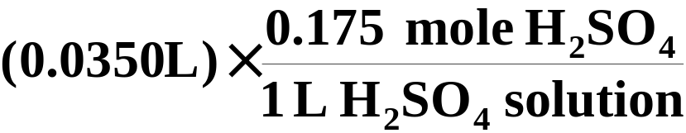
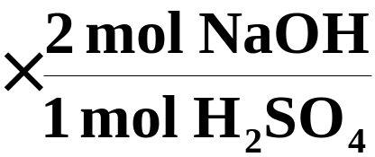
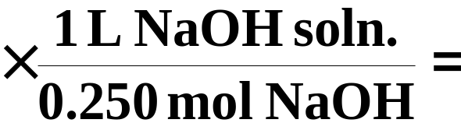
Quantitative Analysis
Volumetric Analysis
  First we must convert the 0.0350 L (35.0 mL) to moles of H₂SO₄ (using the molarity of the H₂SO₄).
  Then, convert to moles of NaOH (from the balanced chemical equation).
  Finally, convert to volume of NaOH solution (using the molarity of NaOH).
Copyright © Houghton Mifflin Company.All rights reserved.
Presentation of Lecture Outlines, 4–<number>

Slide 46
Types of Chemical Reactions
Oxidation-Reduction Reactions
  Oxidation-reduction reactions involve the transfer of electrons from one species to another.
  Oxidation is defined as the loss of electrons.
  Reduction is defined as the gain of electrons.
  Oxidation and reduction always occur simultaneously.
Copyright © Houghton Mifflin Company.All rights reserved.
Presentation of Lecture Outlines, 4–<number>

Slide 47
Types of Chemical Reactions
Oxidation-Reduction Reactions
  The reaction of an iron nail with a solution of copper(II) sulfate, CuSO₄, is an oxidation- reduction reaction (See Figure 4.11).
  The molecular equation for this reaction is:
Copyright © Houghton Mifflin Company.All rights reserved.
Presentation of Lecture Outlines, 4–<number>

Slide 48
Types of Chemical Reactions
Oxidation-Reduction Reactions
  The net ionic equation shows the reaction of iron metal with Cu²⁺_{(aq)} to produce iron(II) ion and copper metal.
Loss of 2 e⁻¹ oxidation
Gain of 2 e⁻¹ reduction
Copyright © Houghton Mifflin Company.All rights reserved.
Presentation of Lecture Outlines, 4–<number>

Slide 49
Types of Chemical Reactions
Oxidation-Reduction Reactions
Oxidation Numbers
  The concept of oxidation numbers is a simple way of keeping track of electrons in a reaction.
  The oxidation number (or oxidation state) of an atom in a substance is the actual charge of the atom if it exists as a monatomic ion.
  Alternatively, it is hypothetical charge assigned to the atom in the substance by simple rules.
Copyright © Houghton Mifflin Company.All rights reserved.
Presentation of Lecture Outlines, 4–<number>

Slide 50
Types of Chemical Reactions
Oxidation-Reduction Reactions
Oxidation Number Rules
Rule | Applies to | Statement
1 | Elements | The oxidation number of an atom in an element is zero.
2 | Monatomic ions | The oxidation number of an atom in a monatomic ion equals the charge of the ion.
3 | Oxygen | The oxidation number of oxygen is –2 in most of its compounds. (An exception is O in H₂O₂ and other peroxides, where the oxidation number is –1.)
Copyright © Houghton Mifflin Company.All rights reserved.
Presentation of Lecture Outlines, 4–<number>

Slide 51
Types of Chemical Reactions
Oxidation-Reduction Reactions
Oxidation Number Rules
Rule | Applies to | Statement
4 | Hydrogen | The oxidation number of hydrogen is +1 in most of its compounds.
5 | Halogens | Fluorine is –1 in all its compounds. The other halogens are –1 unless the other element is another halogen or oxygen.
6 | Compounds and ions | The sum of the oxidation numbers of the atoms in a compound is zero. The sum in a polyatomic ion equals the charge on the ion.
Copyright © Houghton Mifflin Company.All rights reserved.
Presentation of Lecture Outlines, 4–<number>

Slide 52
Types of Chemical Reactions
Oxidation-Reduction Reactions
Describing Oxidation-Reduction Reactions
  Look again at the reaction of iron with copper(II) sulfate.
  We can write this reaction in terms of two half-reactions.
Copyright © Houghton Mifflin Company.All rights reserved.
Presentation of Lecture Outlines, 4–<number>

Slide 53
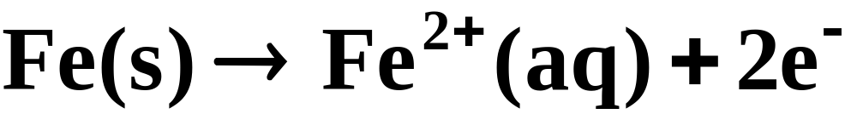
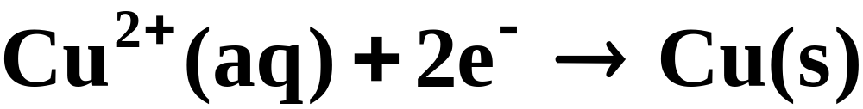
Types of Chemical Reactions
Oxidation-Reduction Reactions
Describing Oxidation-Reduction Reactions
  A half-reaction is one of the two parts of an oxidation-reduction reaction. One involves the loss of electrons (oxidation) and the other involves the gain of electrons (reduction).
oxidation half-reaction
reduction half-reaction
Copyright © Houghton Mifflin Company.All rights reserved.
Presentation of Lecture Outlines, 4–<number>

Slide 54
Types of Chemical Reactions
Oxidation-Reduction Reactions
Describing Oxidation-Reduction Reactions
  An oxidizing agent is a species that oxidizes another species; it is itself reduced.
  A reducing agent is a species that reduces another species; it is itself oxidized.
Loss of 2 e⁻ oxidation
reducing agent
oxidizing agent
Gain of 2 e⁻ reduction
Copyright © Houghton Mifflin Company.All rights reserved.
Presentation of Lecture Outlines, 4–<number>

Slide 55
Types of Chemical Reactions
Oxidation-Reduction Reactions
Some Common Oxidation-Reduction Reactions
  Most of the oxidation-reduction reactions fall into one of the following simple categories:
        Combination Reaction
        Decomposition Reactions
        Displacement Reactions
        Combustion Reactions
Copyright © Houghton Mifflin Company.All rights reserved.
Presentation of Lecture Outlines, 4–<number>

Slide 56
Types of Chemical Reactions
Oxidation-Reduction Reactions
Combination Reactions
  A combination reaction is a reaction in which two substances combine to form a third substance.
  Combination reaction of sodium and chlorine (See Figure 4.14).
Copyright © Houghton Mifflin Company.All rights reserved.
Presentation of Lecture Outlines, 4–<number>

Slide 57
Types of Chemical Reactions
Oxidation-Reduction Reactions
Combination Reactions
  Other combination reactions involve compounds as reactants.
Copyright © Houghton Mifflin Company.All rights reserved.
Presentation of Lecture Outlines, 4–<number>

Slide 58
Types of Chemical Reactions
Oxidation-Reduction Reactions
Decomposition Reactions
  A decomposition reaction is a reaction in which a single compound reacts to give two or more substances.
  Decomposition reaction of mercury(II) oxide
  (See Figure 4.15)
Copyright © Houghton Mifflin Company.All rights reserved.
Presentation of Lecture Outlines, 4–<number>

Slide 59
Types of Chemical Reactions
Oxidation-Reduction Reactions
Displacement Reactions
  A displacement reaction (also called a single- replacement reaction) is a reaction in which an element reacts with a compound, displacing an element from it.
  Displacement reaction of zinc and hydrochloric acid (See Figure 4.16).
Copyright © Houghton Mifflin Company.All rights reserved.
Presentation of Lecture Outlines, 4–<number>

Slide 60
Types of Chemical Reactions
Oxidation-Reduction Reactions
Combustion Reactions
  A combustion reaction is a reaction in which a substance reacts with oxygen, usually with the rapid release of heat to produce a flame.
  Combustion reaction of iron wool
  (See Figure 4.17).
Copyright © Houghton Mifflin Company.All rights reserved.
Presentation of Lecture Outlines, 4–<number>

Slide 61
Types of Chemical Reactions
Oxidation-Reduction Reactions
Balancing Simple Oxidation-Reduction Reactions
  At first glance, the equation representing the reaction of zinc metal with silver(I) ions might appear to be balanced.
  However, a balanced equation must have a charge balance as well as a mass balance.
Copyright © Houghton Mifflin Company.All rights reserved.
Presentation of Lecture Outlines, 4–<number>

Slide 62
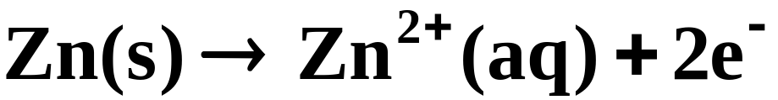
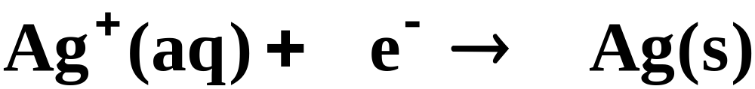
Types of Chemical Reactions
Oxidation-Reduction Reactions
Balancing Simple Oxidation-Reduction Reactions
  Since the number of electrons lost in the oxidation half-reaction must equal the number gained in the reduction half-reaction,
oxidation half-reaction
2 2 2
reduction half-reaction
  we must double the reaction involving the reduction of the silver.
Copyright © Houghton Mifflin Company.All rights reserved.
Presentation of Lecture Outlines, 4–<number>

Slide 63
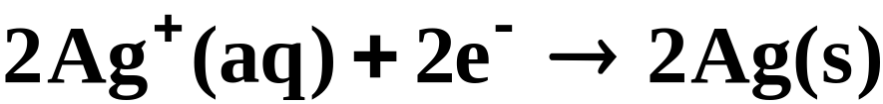
Types of Chemical Reactions
Oxidation-Reduction Reactions
Balancing Simple Oxidation-Reduction Reactions
  Adding the two half-reactions together, the electrons cancel,
oxidation half-reaction
reduction half-reaction
  which yields the balanced oxidation-reduction reaction.
Copyright © Houghton Mifflin Company.All rights reserved.
Presentation of Lecture Outlines, 4–<number>

Slide 64
Complex ion reactions
Reactions Sheet
2007 FRQ #4
Scoring Guidelines
Stats
2008 FRQ #4
Scoring Guidelines
Stats
Copyright © Houghton Mifflin Company.All rights reserved.
Presentation of Lecture Outlines, 4–<number>

Slide 65
Working with Solutions
Molar Concentration
When we dissolve a substance in a liquid, we call the substance the solute and the liquid the solvent.
  The general term concentration refers to the quantity of solute in a standard quantity of solution.
Copyright © Houghton Mifflin Company.All rights reserved.
Presentation of Lecture Outlines, 4–<number>

Slide 66
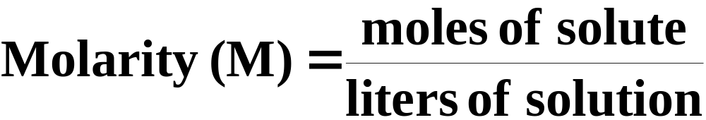
Working with Solutions
Molar Concentration
Molar concentration, or molarity (M), is defined as the moles of solute dissolved in one liter (cubic decimeter) of solution.
Copyright © Houghton Mifflin Company.All rights reserved.
Presentation of Lecture Outlines, 4–<number>

Slide 67
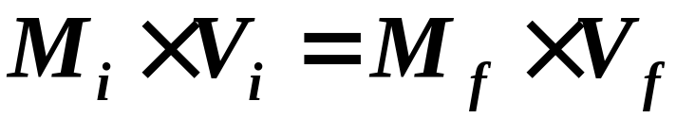
Working with Solutions
Molar Concentration
The molarity of a solution and its volume are inversely proportional. Therefore, adding water makes the solution less concentrated.
  This inverse relationship takes the form of:
  So, as water is added, increasing the final volume, V_{f}, the final molarity, M_{f}, decreases.
Copyright © Houghton Mifflin Company.All rights reserved.
Presentation of Lecture Outlines, 4–<number>

Slide 68
Quantitative Analysis
Analytical chemistry deals with the determination of composition of materials-that is, the analysis of materials.
  Quantitative analysis involves the determination of the amount of a substance or species present in a material.
Copyright © Houghton Mifflin Company.All rights reserved.
Presentation of Lecture Outlines, 4–<number>

Slide 69
Quantitative Analysis
Gravimetric Analysis
Gravimetric analysis is a type of quantitative analysis in which the amount of a species in a material is determined by converting the species into a product that can be isolated and weighed.
  Precipitation reactions are often used in gravimetric analysis.
  The precipitate from these reactions is then filtered, dried, and weighed.
Copyright © Houghton Mifflin Company.All rights reserved.
Presentation of Lecture Outlines, 4–<number>

Slide 70
Quantitative Analysis
Gravimetric Analysis
Suppose a 1.00 L sample of polluted water was analyzed for lead(II) ion, Pb2+, by adding an excess of sodium sulfate to it. The mass of lead(II) sulfate that precipitated was 229.8 mg. What is the mass of lead in a liter of the water? Express the answer as mg of lead per liter of solution.
Copyright © Houghton Mifflin Company.All rights reserved.
Presentation of Lecture Outlines, 4–<number>

Slide 71
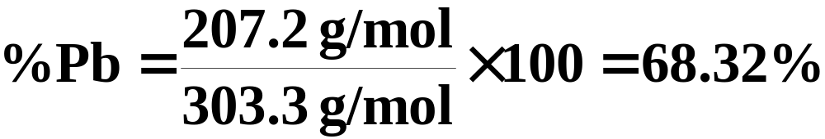
Quantitative Analysis
Gravimetric Analysis
First we must obtain the mass percentage of lead in lead(II) sulfate, by dividing the molar mass of lead by the molar mass of PbSO₄, then multiplying by 100.
  Then, calculate the amount of lead in the PbSO₄ precipitated.
Copyright © Houghton Mifflin Company.All rights reserved.
Presentation of Lecture Outlines, 4–<number>

Slide 72
Chemical Reactions
Summary
Reactions often involve ions in aqueous solution. Many of these compounds are electrolytes.
We can represent these reactions as molecular equations, complete ionic equations (with strong electrolytes represented as ions), or net ionic equations (where spectator ions have been canceled).
Most reactions are either precipitation reactions, acid-base reactions, or oxidation-reduction reactions.
Acid-base reactions are proton-transfer reactions.
Oxidation-reduction reactions involve a transfer of electrons from one species to another.
Copyright © Houghton Mifflin Company.All rights reserved.
Presentation of Lecture Outlines, 4–<number>

Slide 73
Chemical Reactions
Summary
Oxidation-reduction reactions usually fall into the following categories: combination reactions, decomposition reactions, displacement reactions, and combustion reactions.
Molarity is defined as the number of moles of solute per liter of solution. Knowing the molarity allows you to calculate the amount of solute in a given volume of solution.
Quantitative analysis involves the determination of the amount of a species in a material.
Copyright © Houghton Mifflin Company.All rights reserved.
Presentation of Lecture Outlines, 4–<number>

Slide 74
Chemical Reactions
Summary
In gravimetric analysis, you determine the amount of a species by converting it to a product you can weigh.
In volumetric analysis, you determine the amount of a species by titration.
Copyright © Houghton Mifflin Company.All rights reserved.
Presentation of Lecture Outlines, 4–<number>

Slide 75
Operational Skills
Using solubility rules.
Writing net ionic equations.
Deciding whether precipitation occurs.
Classifying acids and bases as weak or strong.
Writing an equation for a neutralization.
Writing an equation for a reaction with gas formation.
Assigning oxidation numbers.
Balancing simple oxidation-reduction reactions.
Calculating molarity from mass and volume.
Using molarity as a conversion factor.
Diluting a solution.
Determining the amount of a substance by gravimetric analysis.
Calculating the volume of reactant solution needed.
Calculating the quantity of a substance by titration.
Copyright © Houghton Mifflin Company.All rights reserved.
Presentation of Lecture Outlines, 4–<number>

Slide 76


Figure 4.5: Limestone Formations.Photo ©Corbis.
Return to Slide 21
Copyright © Houghton Mifflin Company.All rights reserved.
Presentation of Lecture Outlines, 4–<number>

Slide 77
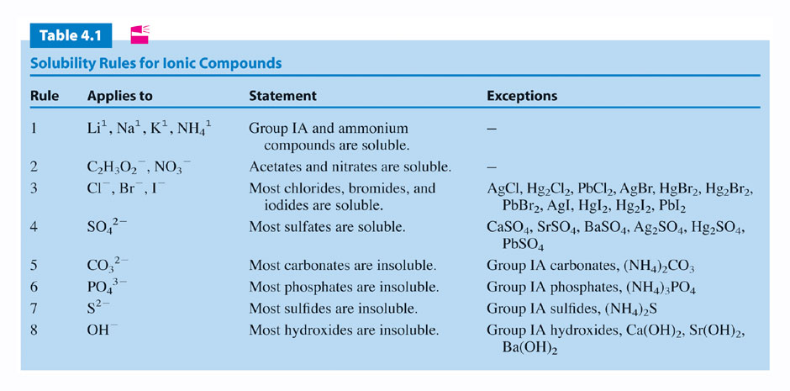
Return to Slide 22
Copyright © Houghton Mifflin Company.All rights reserved.
Presentation of Lecture Outlines, 4–<number>

Slide 78
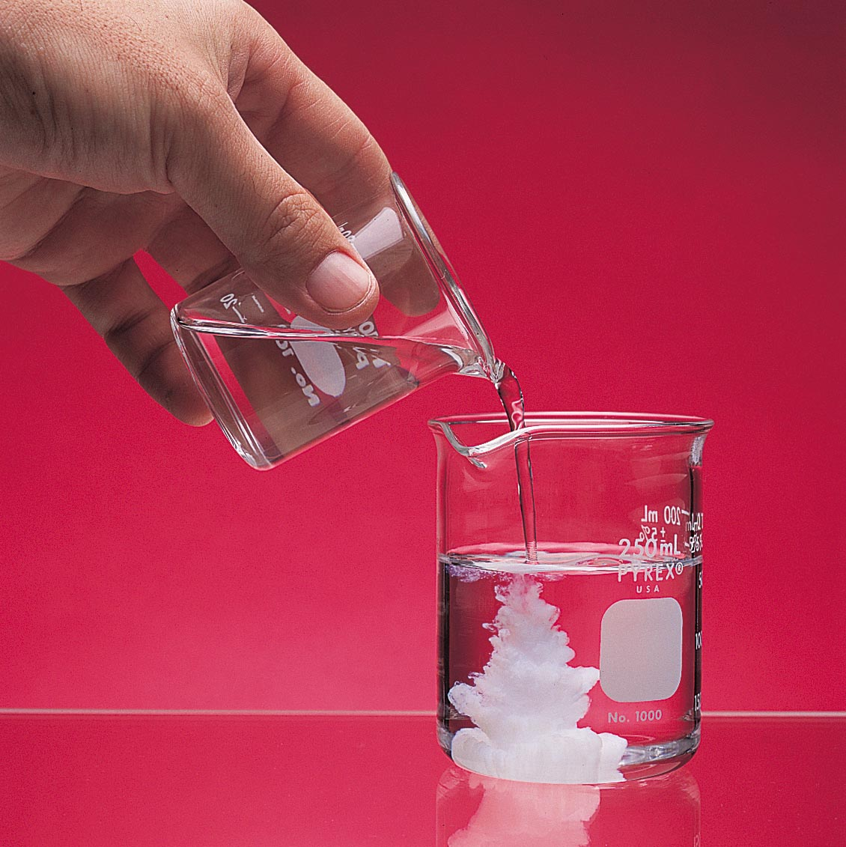
Figure 4.6:
Reaction of magnesium chloride and silver nitrate.
Photo courtesy of American Color.
Return to Slide 27
Copyright © Houghton Mifflin Company.All rights reserved.
Presentation of Lecture Outlines, 4–<number>

Slide 79
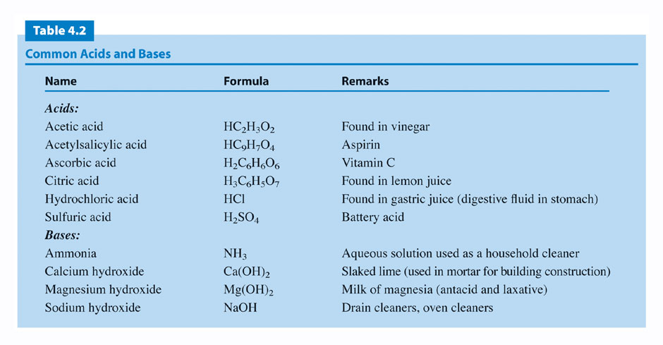
Return to Slide 30
Copyright © Houghton Mifflin Company.All rights reserved.
Presentation of Lecture Outlines, 4–<number>

Slide 80
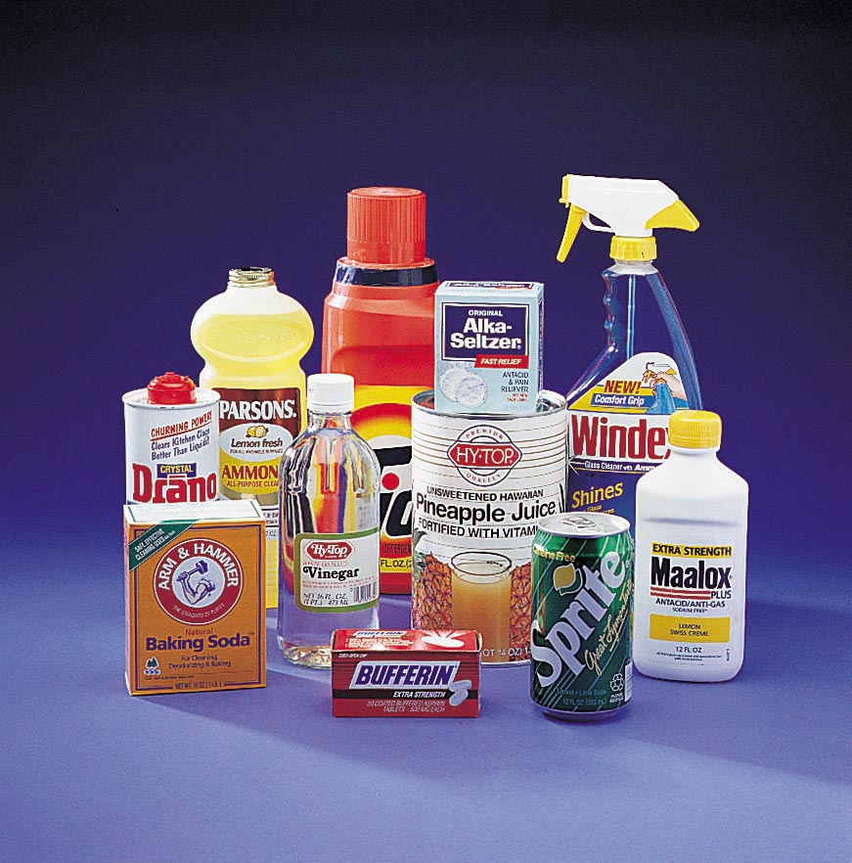
Figure 4.7: Household acids and bases. Photo courtesy of American Color.
Return to Slide 30
Copyright © Houghton Mifflin Company.All rights reserved.
Presentation of Lecture Outlines, 4–<number>

Slide 81
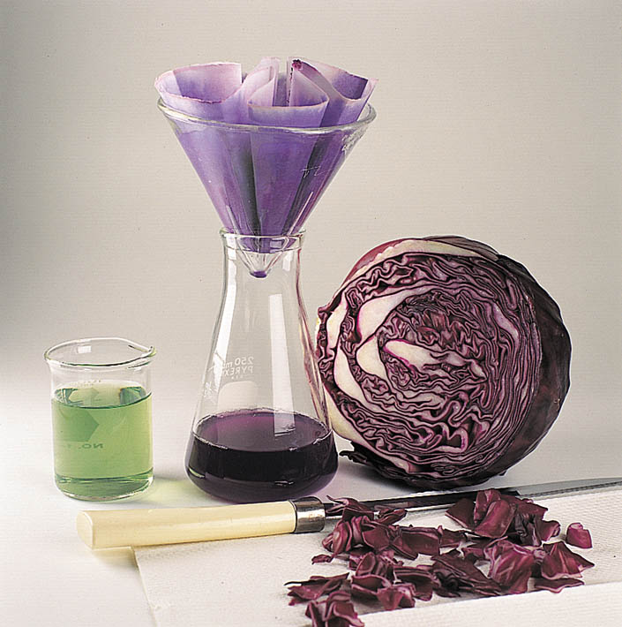
Figure 4.8: Preparation of red cabbage juice as an acid-base indicator.Photo courtesy of James Scherer.
Return to Slide 30
Copyright © Houghton Mifflin Company.All rights reserved.
Presentation of Lecture Outlines, 4–<number>

Slide 82
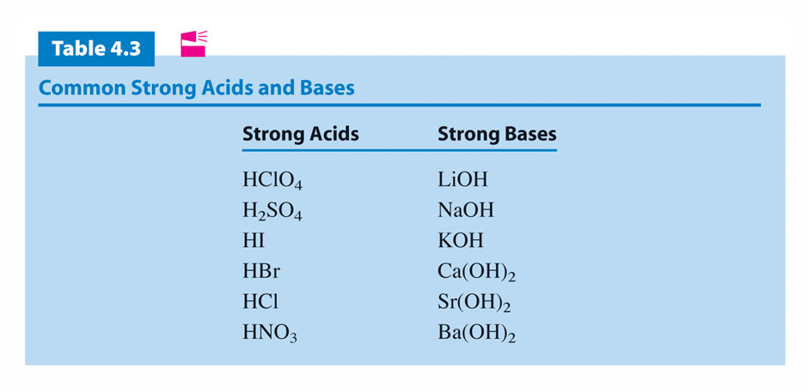
Return to Slide 41
Copyright © Houghton Mifflin Company.All rights reserved.
Presentation of Lecture Outlines, 4–<number>

Slide 83
Return to Slide 43
Copyright © Houghton Mifflin Company.All rights reserved.
Presentation of Lecture Outlines, 4–<number>

Slide 84
Animation: Brønsted Lowry Reaction
(Click here to open QuickTime animation)
Return to Slide 36
Copyright © Houghton Mifflin Company.All rights reserved.
Presentation of Lecture Outlines, 4–<number>

Slide 85
Animation: Neutralization of a Strong Acid by a Strong Base
(Click here to open QuickTime animation)
Return to Slide 47
Copyright © Houghton Mifflin Company.All rights reserved.
Presentation of Lecture Outlines, 4–<number>

Slide 86
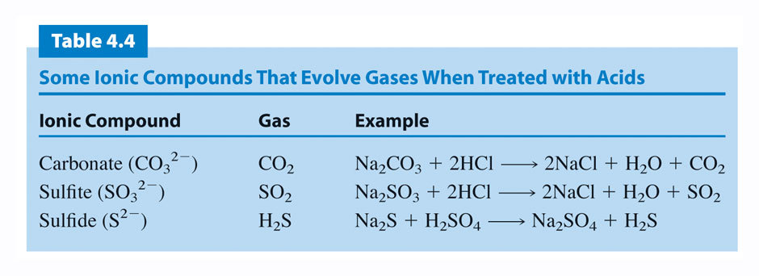
Return to Slide 52
Copyright © Houghton Mifflin Company.All rights reserved.
Presentation of Lecture Outlines, 4–<number>

Slide 87
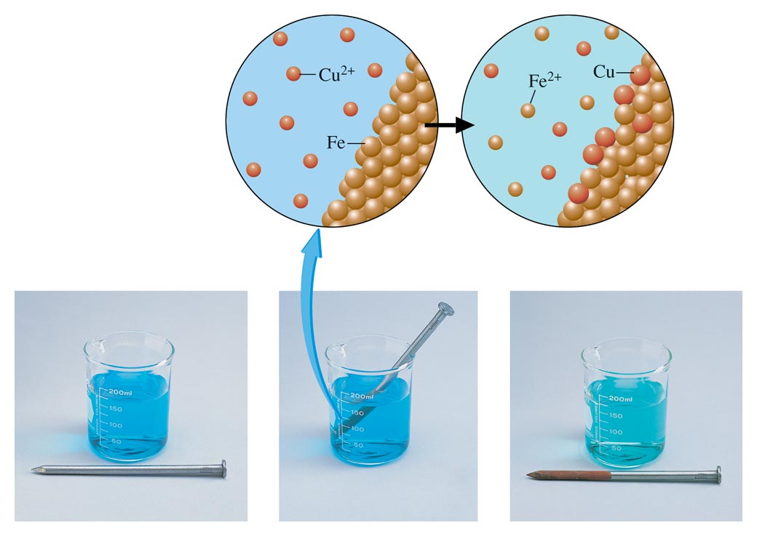
Figure 4.11: Reaction of iron with Cu2+ (aq).
Photo Courtesy of American Color.
Return to Slide 54
Copyright © Houghton Mifflin Company.All rights reserved.
Presentation of Lecture Outlines, 4–<number>

Slide 88
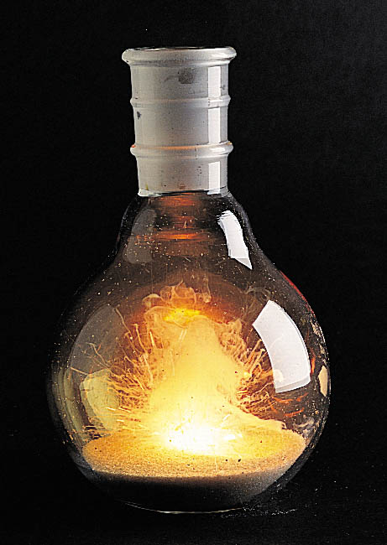
Figure 4.13: The burning of calcium metal in chlorine.
Photo courtesy of James Scherer.
Return to Slide 62
Copyright © Houghton Mifflin Company.All rights reserved.
Presentation of Lecture Outlines, 4–<number>

Slide 89
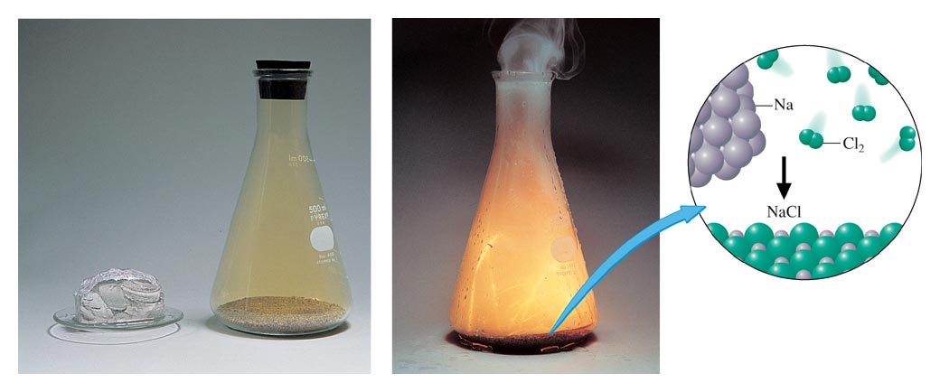
Figure 4.14: Combination reaction.
Return to Slide 63
Copyright © Houghton Mifflin Company.All rights reserved.
Presentation of Lecture Outlines, 4–<number>

Slide 90
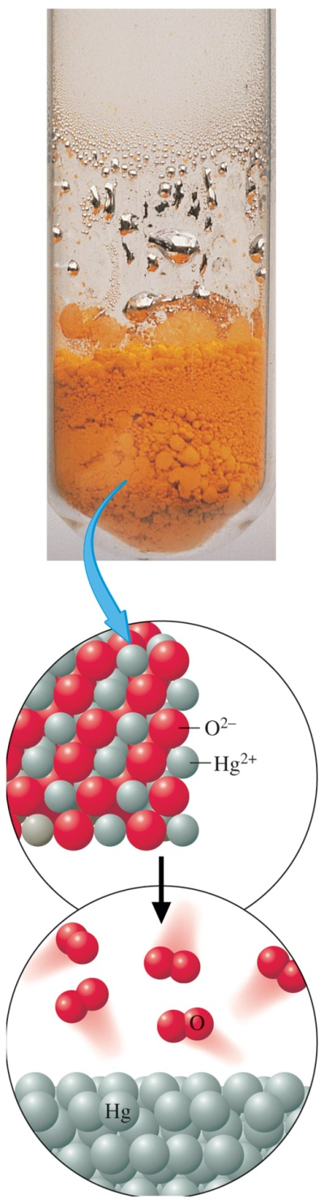
Figure 4.15: Decomposition reaction. Photo courtesy of James Scherer.
Return to Slide 65
Copyright © Houghton Mifflin Company.All rights reserved.
Presentation of Lecture Outlines, 4–<number>

Slide 91
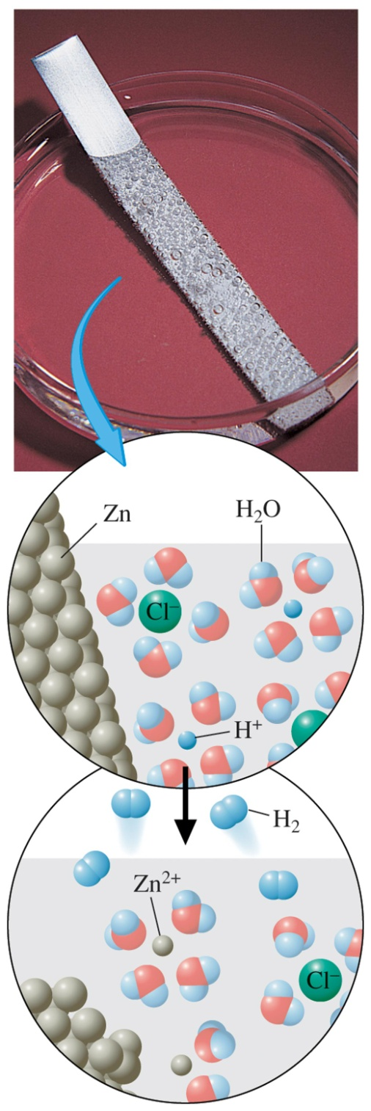
Figure 4.16: Displacement reaction. Photo courtesy of American Color.
Return to Slide 66
Copyright © Houghton Mifflin Company.All rights reserved.
Presentation of Lecture Outlines, 4–<number>

Slide 92
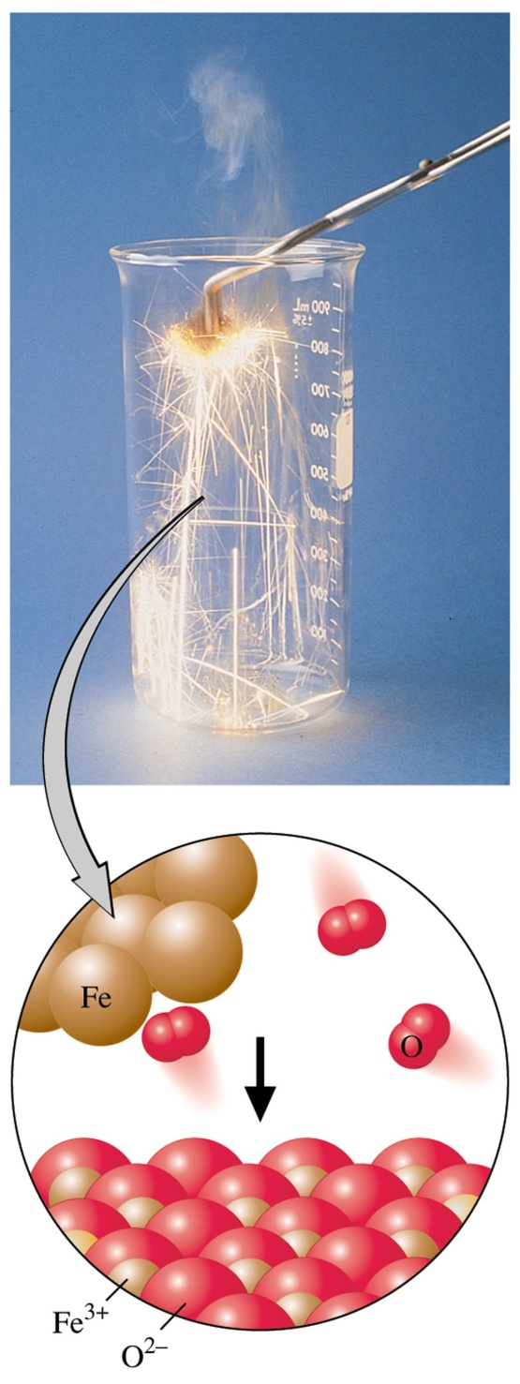
Figure 4.17: Combustion reaction. Photo courtesy of James Scherer.
Return to Slide 67
Copyright © Houghton Mifflin Company.All rights reserved.
Presentation of Lecture Outlines, 4–<number>

Slide 93
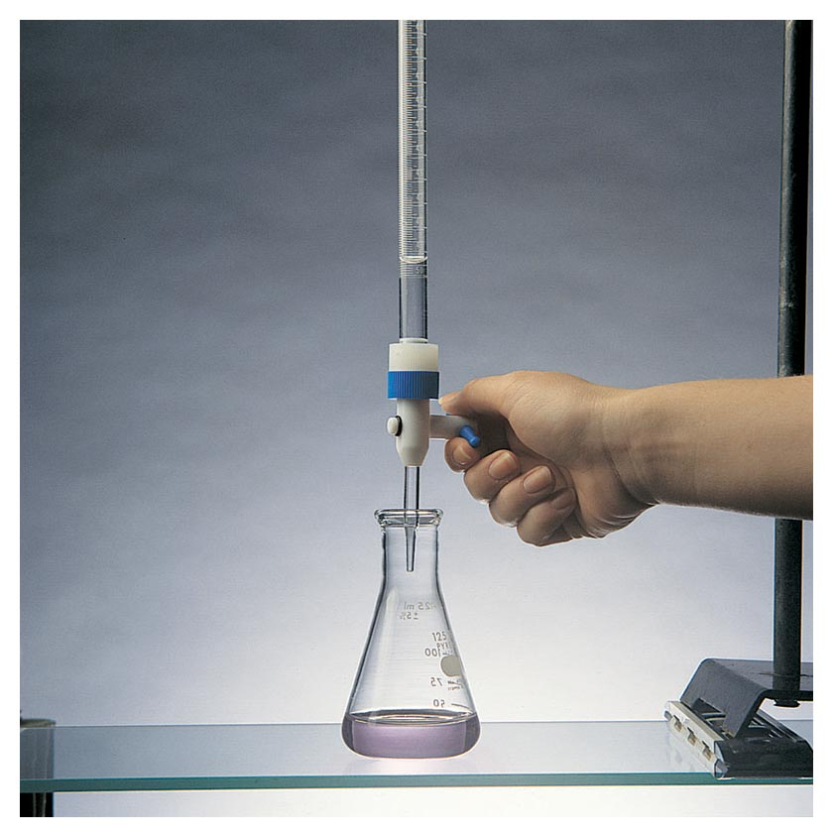
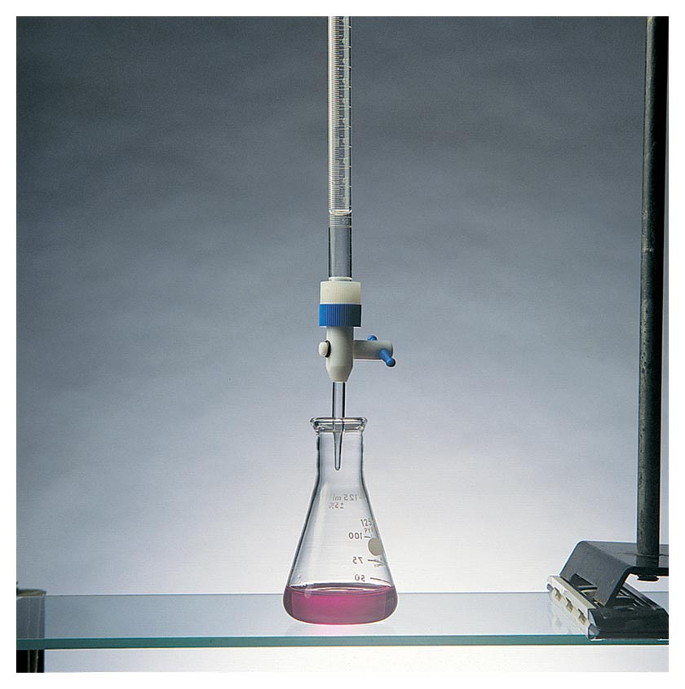
Figure 4.23: Titration of an unknown amount of HCl with NaOH. Photo courtesy of James Scherer.
Return to Slide 81
Copyright © Houghton Mifflin Company.All rights reserved.
Presentation of Lecture Outlines, 4–<number>

