Slide 1
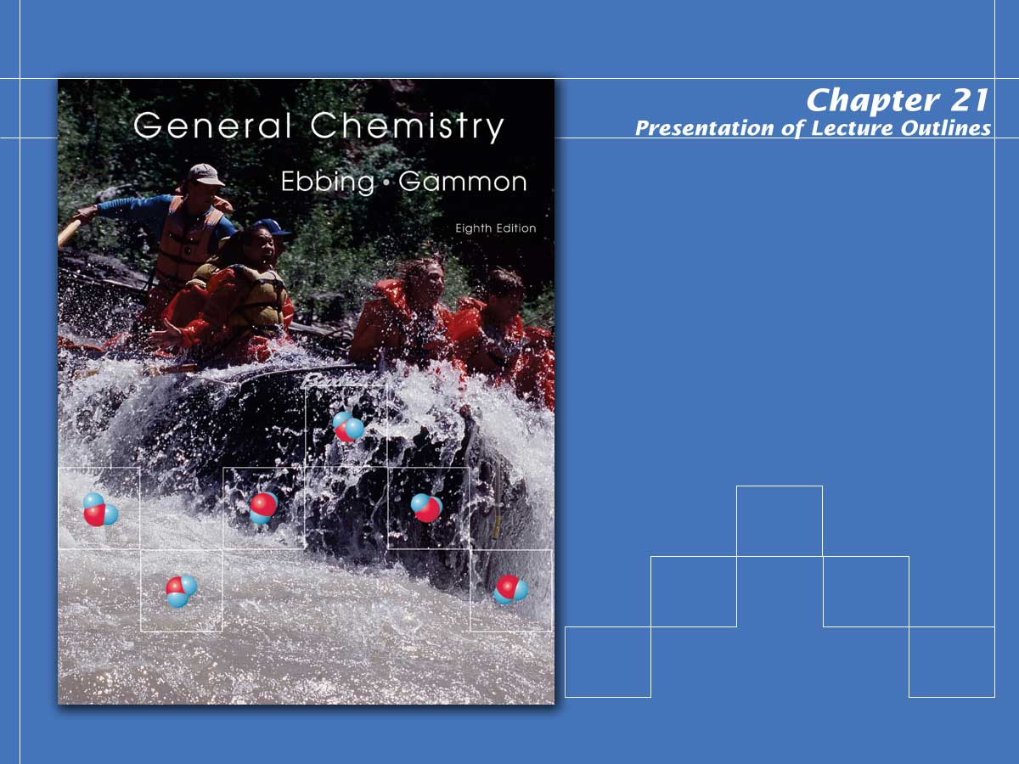
Nuclear Chemistry

Slide 2

Nuclear Chemistry
In this chapter we will look at two types of nuclear reactions.
  Radioactive decay is the process in which a nucleus spontaneously disintegrates, giving off radiation.
  Nuclear bombardment reactions are those in which a nucleus is bombarded, or struck, by another nucleus or by a nuclear particle.
Notes:
2

Slide 3
Radioactivity
The phenomena of radioactivity was discovered by Antoine Henri Becquerel in 1896.
  His work with uranium salts lead to the conclusion that the minerals gave off some sort of radiation.
  This radiation was later shown to be separable by electric (and magnetic) fields into three types; alpha (α), beta (β), and gamma (γ) rays.
Notes:
2

Slide 4
Radioactivity
The phenomena of radioactivity was discovered by Antoine Henri Becquerel in 1896.
  Alpha rays bend away from a positive plate indicating they are positively charged.
  They are known to consist of helium-4 nuclei (nuclei with two protons and two neutrons).
Notes:
2

Slide 5
Radioactivity
The phenomena of radioactivity was discovered by Antoine Henri Becquerel in 1896.
  Beta rays bend in the opposite direction indicating they have a negative charge.
  They are known to consist of high speed electrons.
Notes:
2

Slide 6
Radioactivity
The phenomena of radioactivity was discovered by Antoine Henri Becquerel in 1896.
  Gamma rays are unaffected by electric and magnetic fields. (see Figure 21.2)
  They have been shown to be a form of electromagnetic radiation similar to x rays, but higher in energy and shorter in wavelength.
Notes:
2

Slide 7
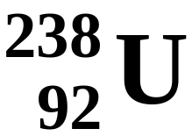
Nuclear Equations
A nuclear equation is a symbolic representation of a nuclear reaction using nuclide symbols.
  For example, the nuclide symbol for uranium-238 is
Notes:
2

Slide 8

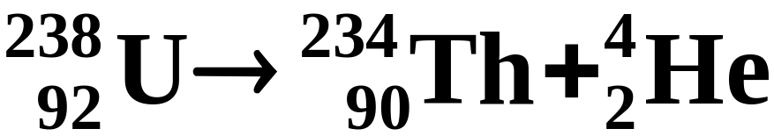
Nuclear Equations
A nuclear equation is a symbolic representation of a nuclear reaction using nuclide symbols.
  The radioactive decay of by alpha-particle emission (loss of a nucleus) is written
Notes:
2

Slide 9
Nuclear Equations
A nuclear equation is a symbolic representation of a nuclear reaction using nuclide symbols.
  Reactant and product nuclei are represented in nuclear equations by their nuclide symbol.
Notes:
2

Slide 10








Nuclear Equations
A nuclear equation is a symbolic representation of a nuclear reaction using nuclide symbols.
  Other particles are given the following symbols.
Proton
or
Neutron
Electron
or
Positron
or
Gamma photon
Notes:
2

Slide 11
Nuclear Equations
A nuclear equation is a symbolic representation of a nuclear reaction using nuclide symbols.
  The total charge is conserved during a nuclear reaction.
  This means that the sum of the subscripts for the products must equal the sum of the subscripts for the reactants.
Notes:
2

Slide 12
Nuclear Equations
A nuclear equation is a symbolic representation of a nuclear reaction using nuclide symbols.
  The total number of nucleons is also conserved during a nuclear reaction.
  This means that the sum of the superscripts for the products must equal the sum of the superscripts for the reactants.
Notes:
2

Slide 13
Nuclear Equations
A nuclear equation is a symbolic representation of a nuclear reaction using nuclide symbols.
  Note that if all reactants and products but one are known in a nuclear equation, the identity of the missing nucleus (or particle) is easily obtained.
  This is illustrated in the next example.
Notes:
2

Slide 14
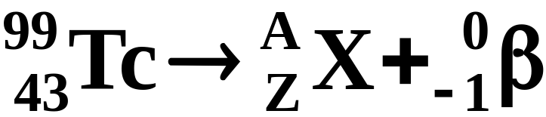
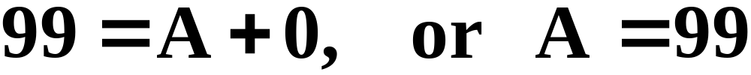
A Problem To Consider
Technetium-99 is a long-lived radioactive isotope of technetium. Each nucleus decays by emitting one beta particle. What is the product nucleus?
  The nuclear equation is
  From the superscripts, you can write
Notes:
2

Slide 15
A Problem To Consider
Technetium-99 is a long-lived radioactive isotope of technetium. Each nucleus decays by emitting one beta particle. What is the product nucleus?
  The nuclear equation is
  Similarly, from the subscripts, you get
Notes:
2

Slide 16
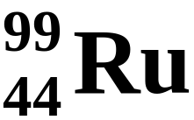
A Problem To Consider
Technetium-99 is a long-lived radioactive isotope of technetium. Each nucleus decays by emitting one beta particle. What is the product nucleus?
  The nuclear equation is
  Hence A = 99 and Z = 44, so the product is
Notes:
2

Slide 17
Nuclear Stability
The existence of stable nuclei with more than one proton is due to the nuclear force.
  The nuclear force is a strong force of attraction between nucleons that acts only at very short distances (about 10⁻¹⁵ m).
  This force can more than compensate for the repulsion of electrical charges and thereby give a stable nucleus.
Notes:
2

Slide 18
Nuclear Stability
Several factors appear to contribute the stability of a nucleus.
  The shell model of the nucleus is a nuclear model in which protons and neutrons exist in levels, or shells, analogous to the shell structure exhibited in electron configurations.
  Experimentally, note that nuclei with certain numbers of protons and neutrons appear to be very stable.
Notes:
2

Slide 19
Nuclear Stability
Several factors appear to contribute the stability of a nucleus.
  These numbers, called magic numbers, are the numbers of nuclear particles in a completed shell of protons or neutrons.
  Because nuclear forces differ from electrical forces, these numbers are not the same as those for electrons is atoms.
Notes:
2

Slide 20
Nuclear Stability
Several factors appear to contribute the stability of a nucleus.
  For protons, the magic numbers are
      2, 8, 20, 28, 50, and 82
  For neutrons, the magic numbers are
      2, 8, 20, 28, 50, 82, and 126
Notes:
2

Slide 21
Nuclear Stability
Several factors appear to contribute the stability of a nucleus.
  Evidence also points to the special stability of pairs of protons and pairs of neutrons.
Notes:
2

Slide 22
Nuclear Stability
Several factors appear to contribute the stability of a nucleus.
  The table below (Table 21.1) lists the number of stable isotopes that have an even number of protons and an even number of neutrons.
 | Number of Stable Isotopes
 | 157 | 52 | 50 | 5
Number of protons | Even | Even | Odd | Odd
Number of neutrons | Even | Odd | Even | Odd
Notes:
2

Slide 23
Nuclear Stability
Several factors appear to contribute the stability of a nucleus.
  Finally, when you plot each stable nuclide on a graph of protons vs. neutrons, these stable nuclei fall in a certain region, or band.
  The band of stability is the region in which stable nuclides lie in a plot of number of protons against number of neutrons. (see Figure 21.3)
Notes:
2

Slide 24
Nuclear Stability
Several factors appear to contribute the stability of a nucleus.
  No stable nuclides are known with atomic numbers greater than 83.
  On the other hand, all elements with Z equal to 83 or less have one or more stable nuclides.
Notes:
2

Slide 25

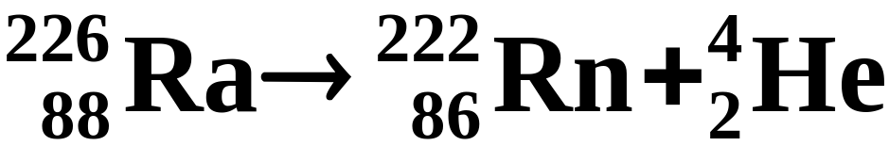
Types of Radioactive Decay
There are six common types of radioactive decay.
  Alpha emission (abbreviated a): emission of a nucleus, or alpha particle, from an unstable nucleus.
  An example is the radioactive decay of radium-226.
Notes:
2

Slide 26
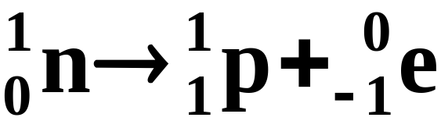
Types of Radioactive Decay
There are six common types of radioactive decay. (see Table 21.2)
  Beta emission (abbreviated β or β⁻): emission of a high speed electron from a stable nucleus.
  This is equivalent to the conversion of a neutron to a proton.
Notes:
2

Slide 27
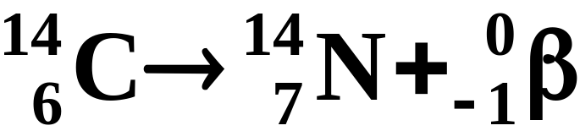
Types of Radioactive Decay
There are six common types of radioactive decay. (see Table 21.2)
  Beta emission (abbreviated β or β⁻): emission of a high speed electron from a stable nucleus.
  An example is the radioactive decay of carbon-14.
Notes:
2

Slide 28
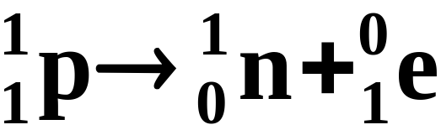
Types of Radioactive Decay
There are six common types of radioactive decay.
  Positron emission (abbreviated β⁺): emission of a positron from an unstable nucleus.
  This is equivalent to the conversion of a proton to a neutron.
Notes:
2

Slide 29
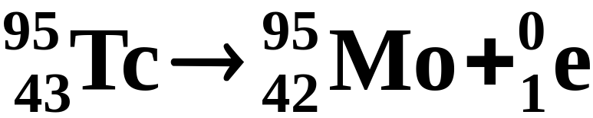
Types of Radioactive Decay
There are six common types of radioactive decay.
  Positron emission (abbreviated β⁺): emission of a positron from an unstable nucleus.
  The radioactive decay of techencium-95 is an example of positron emission.
Notes:
2

Slide 30
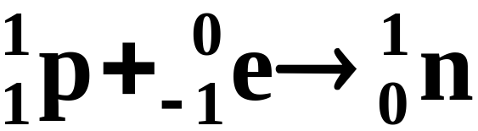
Types of Radioactive Decay
There are six common types of radioactive decay.
  Electron capture (abbreviated EC): the decay of an unstable nucleus by capturing, or picking up, an electron from an inner orbital of an atom.
  In effect, a proton is changed to a neutron, as in positron emission.
Notes:
2

Slide 31

Types of Radioactive Decay
There are six common types of radioactive decay.
  Electron capture (abbreviated EC): the decay of an unstable nucleus by capturing, or picking up, an electron from an inner orbital of an atom.
  An example is the radioactive decay of potassium-40.
Notes:
2

Slide 32
Types of Radioactive Decay
There are six common types of radioactive decay.
  Gamma emission (abbreviated γ): emission from an excited nucleus of a gamma photon, corresponding to radiation with a wavelength of about 10⁻¹² m.
  In many cases, radioactive decay produces a product nuclide in a metastable excited state.
Notes:
2

Slide 33
Types of Radioactive Decay
There are six common types of radioactive decay.
  Gamma emission (abbreviated γ): emission from an excited nucleus of a gamma photon, corresponding to radiation with a wavelength of about 10⁻¹² m.
  The excited state is unstable and emits a gamma photon and goes to a lower energy state.
Notes:
2

Slide 34
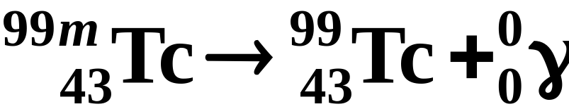
Types of Radioactive Decay
There are six common types of radioactive decay.
  Gamma emission (abbreviated γ): emission from an excited nucleus of a gamma photon, corresponding to radiation with a wavelength of about 10⁻¹² m.
  An example is metastable technetium-99.
Notes:
2

Slide 35
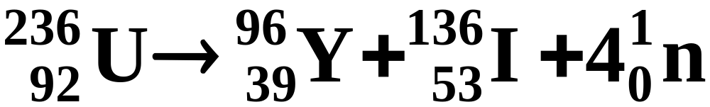
Types of Radioactive Decay
There are six common types of radioactive decay.
  Spontaneous fission: the spontaneous decay of an unstable nucleus in which a heavy nucleus of mass number greater than 89 splits into lighter nuclei and energy is realeased.
  For example, uranium-236 undergoes spontaneous fission.
Notes:
2

Slide 36
Predicting the Type of Radioactive Decay
Nuclides outside the band of stability are generally radioactive.
  Nuclides to the left of the band have more neutrons than that needed for a stable nucleus.
  These nuclides tend to decay by beta emission because it reduces the neutron-to-proton ratio.
Notes:
2

Slide 37
Predicting the Type of Radioactive Decay
Nuclides outside the band of stability (Figure 21.3) are generally radioactive.
  In contrast, nuclides to the right of the band of stability have a neutron-to-proton ratio smaller than that needed for a stable nucleus.
  These nuclides tend to decay by positron emission or electron capture because it increases the neutron to proton ratio.
Notes:
2

Slide 38
Predicting the Type of Radioactive Decay
Nuclides outside the band of stability are generally radioactive.
  In the very heavy elements, especially those with Z greater than 83, radioactive decay is often by alpha emission.
Notes:
2

Slide 39
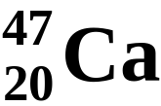
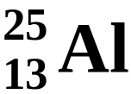
A Problem To Consider
Predict the expected type of radioactive decay for each of the following radioactive nuclides.
  The atomic weight of calcium is 40.1 amu, so you expect calcium-40 to be a stable isotope.
  Calcium-47 has a mass number greater than that of the stable isotope, so you would expect it to decay by beta emission.
Notes:
2

Slide 40
A Problem To Consider
Predict the expected type of radioactive decay for each of the following radioactive nuclides.
  The atomic weight of aluminum is 27.0 amu, so you expect aluminum-27 to be a stable isotope.
  Aluminum-25 has a mass number less than that of the stable isotope, so you would expect it to decay by positron emission or electron capture.
Notes:
2

Slide 41
Nuclear Bombardment Reactions
In 1919, Ernest Rutherford discovered that it is possible to change the nucleus of one element into the nucleus of another element.
  Transmutation is the change of one element to another by bombarding the nucleus of the element with nuclear particles or nuclei.
Notes:
2

Slide 42
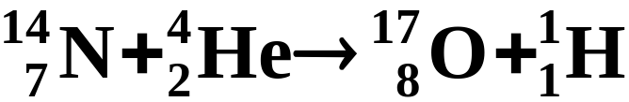
Nuclear Bombardment Reactions
In 1919, Ernest Rutherford discovered that it is possible to change the nucleus of one element into the nucleus of another element.
  Rutherford used a radioactive alpha source to bombard nitrogen nuclei.
  He discovered that protons are ejected in the process.
Notes:
2

Slide 43
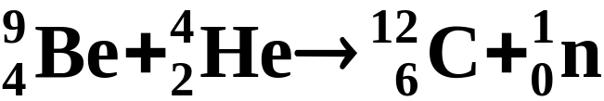
Nuclear Bombardment Reactions
The British physicist James Chadwick suggested in 1932 that the radiation from beryllium consists of neutral particles, each with a mass approximately that of a proton.
  Chadwick’s suggestion led to the discovery of the neutron.
Notes:
2

Slide 44
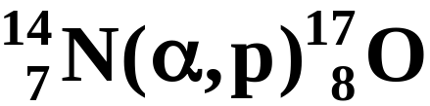
Nuclear Bombardment Reactions
Nuclear bombardment reactions are often referred to by an abbreviated notation.
  For example, the reaction
  is abbreviated
Notes:
2

Slide 45
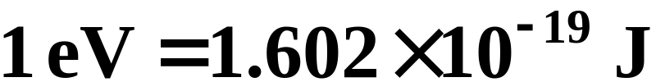
Nuclear Bombardment Reactions
Bombardment of heavy nuclei require accelerated particles for successful transmutation reactions.
  A particle accelerator is a device used to accelerate electrons, protons, and alpha particles and other ions to very high speeds.
  It is customary to measure the kinetic energy of these particles in units of electron volts.
Notes:
2

Slide 46
Nuclear Bombardment Reactions
Bombardment of heavy nuclei require accelerated particles for successful transmutation reactions.
  Figure 21.5 shows a diagram of a cyclotron, a type of particle accelerator consisting of two hollow, semicircular metal electrodes in which charged particles are accelerated in stages.
Notes:
2

Slide 47
Transuranium Elements
The transuranium elements are elements with atomic number greater than that of uranium (Z=92), the naturally occurring element of greatest Z.
  The first transuranium element was produced at the University of California at Berkley in 1940 by E. M. McMillan and P. H. Abelson.
  They produced an isotope of element 93, which they named neptunium.
Notes:
2

Slide 48
Transuranium Elements
The transuranium elements are elements with atomic number greater than that of uranium (Z=92), the naturally occurring element of greatest Z.
  Recent work (described in the essay at the end of Section 1.5) has yielded other elements including the heaviest to date, 118.
Notes:
2

Slide 49
Radiations and Matter: Detection
Two types of devices, ionization counters and scintillation counters, are used to count particles emitted from radioactive nuclei.
  A Geiger counter (Figure 21.9), a kind of ionization counter used to count particles emitted by radioactive nuclei, consists of a metal tube filled with gas, such as argon.
Notes:
2

Slide 50
Radiations and Matter: Detection
Two types of devices, ionization counters and scintillation counters, are used to count particles emitted from radioactive nuclei. (See Animation: Geiger-Counter-Sim)
  A scintillation counter (Figure 21.10) is a device that detects nuclear radiation from flashes of light generated in a material by the radiation.
Notes:
2

Slide 51
Radiations and Matter: Detection
The activity of a radioactive source is the number of nuclear disintegrations per unit time occurring in a radioactive material.
  A Curie (Ci) is a unit of activity equal to 3.700 x 10¹⁰ disintegrations per second (dps).
  A sample of technetium having an activity of 1.0 x 10⁻² Ci is decaying at a rate of
Notes:
2

Slide 52
Biological Effects and Radiation Dosage
To monitor the effect of nuclear radiations on biological tissue, it is necessary to have a measure of radiation dosage.
  The rad (from radiation absorbed dose) is the dosage of radiation that deposits 1 x 10⁻² J of energy per kilogram of tissue.
  However, the biological effect of radiation not only on the energy deposited but also on the type of radiation.
Notes:
2

Slide 53

Biological Effects and Radiation Dosage
To monitor the effect of nuclear radiations on biological tissue, it is necessary to have a measure of radiation dosage.
  The rem is a unit of radiation dosage used to relate various kinds of radiation in terms of biological destruction.
  It equals the rad times a factor for the type of radiation, called the relative biological effectiveness (RBE).
Notes:
2

Slide 54
Biological Effects and Radiation Dosage
To monitor the effect of nuclear radiations on biological tissue, it is necessary to have a measure of radiation dosage.
  Beta and gamma radiations have an RBE of about 1, where neutron radiation has an RBE about 5 and alpha radiation an RBE of about 10.
  A single dose of about 500 rems is fatal to most people.
Notes:
2

Slide 55

Rate of Radioactive Decay
The rate of radioactive decay, that is the number of disintegrations per unit time, is proportional to the number of radioactive nuclei in the sample.
  You can express this rate mathematically as
  where N_{t} is the number of radioactive nuclei at time t, and k is the radioactive decay constant.
Notes:
2

Slide 56
Rate of Radioactive Decay
The rate of radioactive decay, that is the number of disintegrations per unit time, is proportional to the number of radioactive nuclei in the sample.
  All radioactive decay follows first order kinetics as outlined in Chapter 14.
  Therefore, the half-life of a radioactive sample is related only to the radioactive decay constant.
Notes:
2

Slide 57
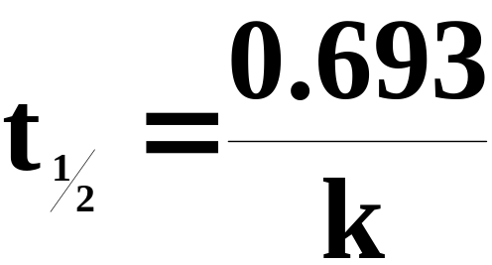
Rate of Radioactive Decay
The half-life, t½ ,of a radioactive nucleus is the time required for one-half of the nuclei in a sample to decay. (see Figure 21.11)
  The first-order relationship between t_{½} and the decay constant k is
Notes:
2

Slide 58
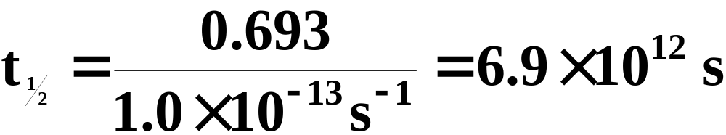
A Problem To Consider
The decay constant for the beta decay of technetium-99 is 1.0 x 10-13 s-1. What is the half-life of this isotope in years?
  Substitute the value of k into our half-life equation.
Notes:
2

Slide 59
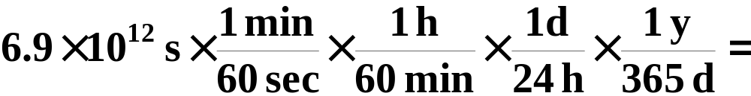

A Problem To Consider
The decay constant for the beta decay of technetium-99 is 1.0 x 10-13 s-1. What is the half-life of this isotope in years?
  Then convert from seconds to years.
Notes:
2

Slide 60
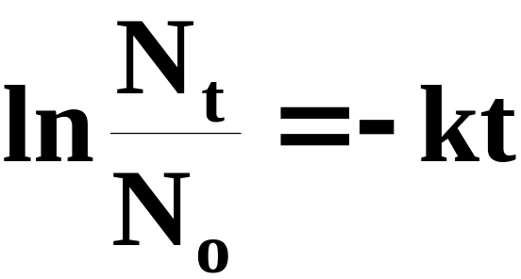
Rate of Radioactive Decay
Once you know the decay constant, you can calculate the fraction of radioactive nuclei remaining after a given period of time.
  The first-order time-concentration equation is
Notes:
2

Slide 61
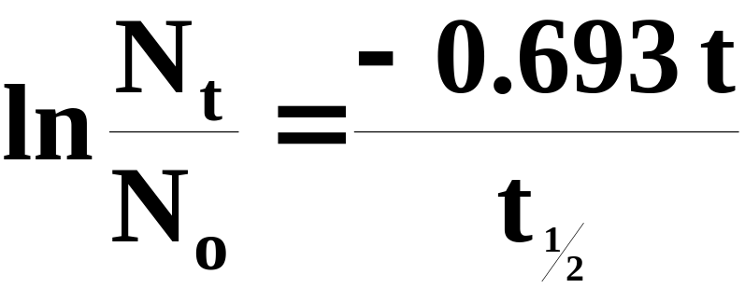
A Problem To Consider
Phosphorus-32 has a half-life of 14.3 days. What fraction of a sample of phosphorus-32 would remain after 5.5 days?
  If we substitute k = 0.693/t_{½} we get
Notes:
2

Slide 62
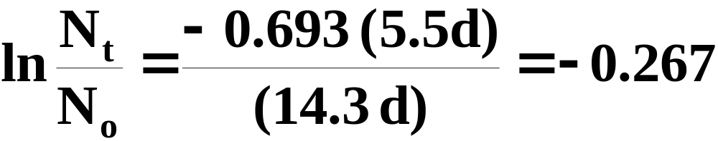
A Problem To Consider
Phosphorus-32 has a half-life of 14.3 days. What fraction of a sample of phosphorus-32 would remain after 5.5 days?
  Substituting t = 5.5 d and t_{½} = 14.3 d, you obtain
Notes:
2

Slide 63
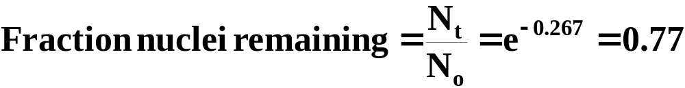
A Problem To Consider
Phosphorus-32 has a half-life of 14.3 days. What fraction of a sample of phosphorus-32 would remain after 5.5 days?
  Hence,
Notes:
2

Slide 64
Applications of Radioactive Isotopes
A radioactive tracer is a very small amount of radioactive isotope added to a chemical, biological, or physical system to study the system.
  A series of experiments using tracers was carried out in the 1950s by Melvin Calvin at the University of California at Berkley, to discover the mechanism of photosynthesis in plants.
Notes:
2

Slide 65
Applications of Radioactive Isotopes
Another example of radioactive tracers is isotopic dilution, a technique to determine the quantity of a substance in a mixture.
  Human blood volumes are determined using the technique of isotopic dilution.
Notes:
2

Slide 66
Applications of Radioactive Isotopes
Neutron activation analysis is an analysis of elements in a sample based on the conversion of stable isotopes to radioactive isotopes by bombarding a sample with neutrons.
  Human hair samples are identified by neutron activation analysis.
Notes:
2

Slide 67
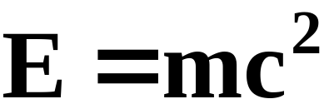
Mass-Energy Calculations
When nuclei decay, they form products of lower energy.
  The change of energy is related to the change in mass, according to the mass-energy equivalence relation derived by Albert Einstein in 1905.
  Energy and mass are equivalent and related by the equation
  Here c is the speed of light, 3.00 x 10⁸ m/s.
Notes:
2

Slide 68
Mass-Energy Calculations
When nuclei decay, they form products of lower energy.
  If a system loses energy, it must also lose mass.
  Though mass loss in chemical reactions is small (10⁻¹² kg), the mass changes in nuclear reactions are approximately a million times larger.
Notes:
2

Slide 69
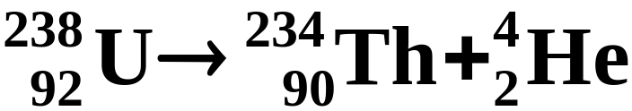
Mass-Energy Calculations
When nuclei decay, they form products of lower energy.
  Consider the alpha decay of uranium-238 to thorium-234.
238.05078
234.04359
4.00260
  We have written the atomic mass (in amu) beneath each nuclide symbol. (see Table 21.3)
Notes:
2

Slide 70
Mass-Energy Calculations
When nuclei decay, they form products of lower energy.
  The change in mass for this reaction, in molar amounts is
238.05078
234.04359
4.00260
Notes:
2

Slide 71

Mass-Energy Calculations
When nuclei decay, they form products of lower energy.
  The change in mass for this reaction, in molar amounts is
238.05078
234.04359
4.00260
  The energy change for 1 mol of uranium-238 is
Notes:
2

Slide 72
Mass-Energy Calculations
The equivalence of mass and energy explains the fact that the mass of an atom is always less than the sum of the masses of its constituent particles.
  When nucleons come together to form a stable nucleus, energy is released.
  According to Einstein’s equation, there must be a corresponding decrease in mass.
Notes:
2

Slide 73
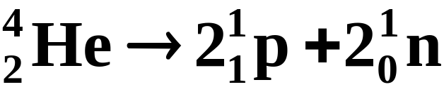

Mass-Energy Calculations
The binding energy of a nucleus is the energy needed to break a nucleus into its individual protons and neutrons.
  Thus the binding energy of the helium-4 nucleus is the energy change for the reaction
4.00260
2(1.00728)
2(1.008665)
  Both binding energy and the corresponding mass defect are reflections of the stability of the nucleus.
Notes:
2

Slide 74
Mass-Energy Calculations
The binding energy of a nucleus is the energy needed to break a nucleus into its individual protons and neutrons.
  Figure 21.16 shows the values of binding energy per nucleon plotted against the mass number for various nuclides.
  Note that nuclides near mass number 50 have the largest binding energies per nucleon.
Notes:
2

Slide 75
Mass-Energy Calculations
The binding energy of a nucleus is the energy needed to break a nucleus into its individual protons and neutrons.
  For this reason, heavy nuclei might be expected to split to give lighter nuclei, while light nuclei might be expected to combine to form heavier nuclei.
Notes:
2

Slide 76

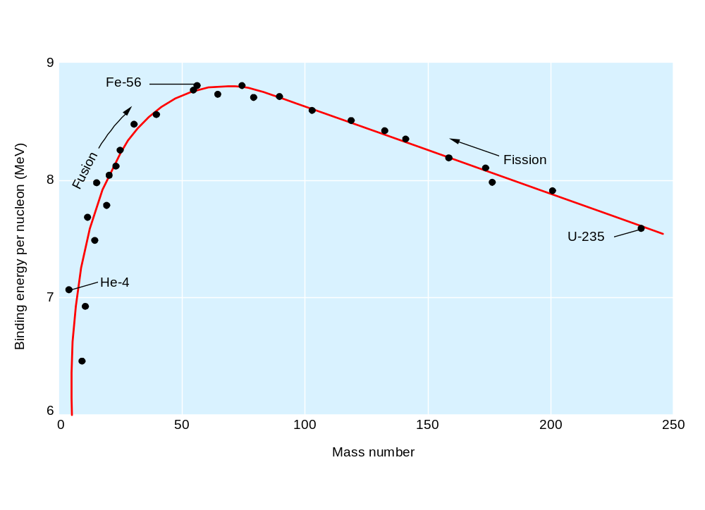
Figure 21.16 Plot of binding energy per nucleon versus mass number
Notes:
2

Slide 77
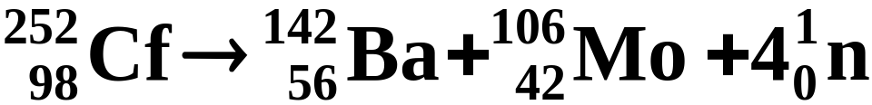
Nuclear Fission and Nuclear Fusion
Nuclear fission is a nuclear reaction in which a heavy nucleus splits into lighter nuclei and energy is released. (See Animation: Nuclear Fission)
  For example, one of the possible mechanisms for the decay of californium-252 is
Notes:
2

Slide 78
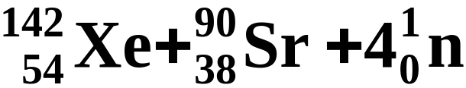
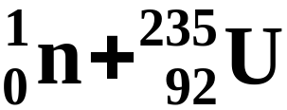
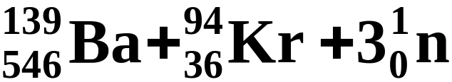
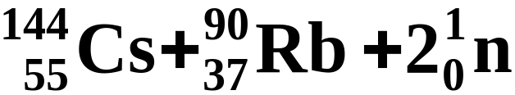
Nuclear Fission and Nuclear Fusion
Nuclear fission is a nuclear reaction in which a heavy nucleus splits into lighter nuclei and energy is released.
  In some cases a nucleus can be induced to undergo fission by bombardment with neutrons.
Notes:
2

Slide 79
Nuclear Fission and Nuclear Fusion
Nuclear fission is a nuclear reaction in which a heavy nucleus splits into lighter nuclei and energy is released.
  When uranium-235 undergoes fission, more neutrons are released creating the possibility of a chain reaction.
  A chain reaction is a self-sustaining series of nuclear fissions caused by the absorption of neutrons released from previous nuclear fissions.
Notes:
2

Slide 80
Nuclear Fission and Nuclear Fusion
Nuclear fission is a nuclear reaction in which a heavy nucleus splits into lighter nuclei and energy is released.
  Figure 21.17 shows how such a chain reaction occurs.
  To sustain a nuclear chain reaction you must achieve a critical mass, which is the smallest mass of fissionable material required for a chain reaction.
Notes:
2

Slide 81
Nuclear Fission and Nuclear Fusion
Nuclear fission is a nuclear reaction in which a heavy nucleus splits into lighter nuclei and energy is released.
  A supercritical mass of fissionable material decays so rapidly as to cause a nuclear explosion (see Figure 21.18).
Notes:
2

Slide 82
Nuclear Fission and Nuclear Fusion
Nuclear fission is a nuclear reaction in which a heavy nucleus splits into lighter nuclei and energy is released.
  A nuclear fission reactor is a device that permits a controlled chain reaction of nuclear fissions. (see Figure 21.19)
Notes:
2

Slide 83
Nuclear Fission and Nuclear Fusion
Nuclear fission is a nuclear reaction in which a heavy nucleus splits into lighter nuclei and energy is released.
  The fuel rods are the cylinders that contain fissionable material.
  Control rods are cylinders composed of substances that absorb neutrons and can therefore slow the chain reaction.
Notes:
2

Slide 84
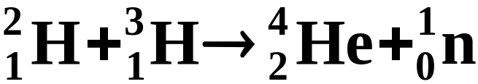
Nuclear Fission and Nuclear Fusion
Nuclear fusion is a nuclear reaction in which a light nuclei combine to give a stabler heavy nucleus plus possibly several neutrons, and energy is released. (See Animation: Nuclear Fusion)
  An example of nuclear fusion is
Notes:
2

Slide 85
Nuclear Fission and Nuclear Fusion
Nuclear fusion is a nuclear reaction in which a light nuclei combine to give a stabler heavy nucleus plus possibly several neutrons, and energy is released.
  Such fusion reactions have been observed in the laboratory using particle accelerators.
  Sustainable fusion reactions require temperatures of about 100 million ºC.
Notes:
2

Slide 86
Nuclear Fission and Nuclear Fusion
Nuclear fusion is a nuclear reaction in which a light nuclei combine to give a stabler heavy nucleus plus possibly several neutrons, and energy is released.
  At these elevated temperature, a plasma resuts, that is, an electrically neutral gas of ions and electrons.
  A magnetic fusion reactor uses a magnetic field to hold the plasma (see Figure 21.20).
Notes:
2

Slide 87
Operational Skills
Writing a nuclear equation
Deducing a product or reactant in a nuclear equation
Predicting the relative stability of nuclides
Predicting the type of radioactive decay
Using the notation for a bombardment reaction
Calculating the decay constant from the activity
Relating the decay constant, half-life, and activity
Determining the fraction of nuclei remaining after a specified time
Applying the carbon-14 dating method
Calculating the energy change for a nuclear reaction
Notes:
2

Slide 88
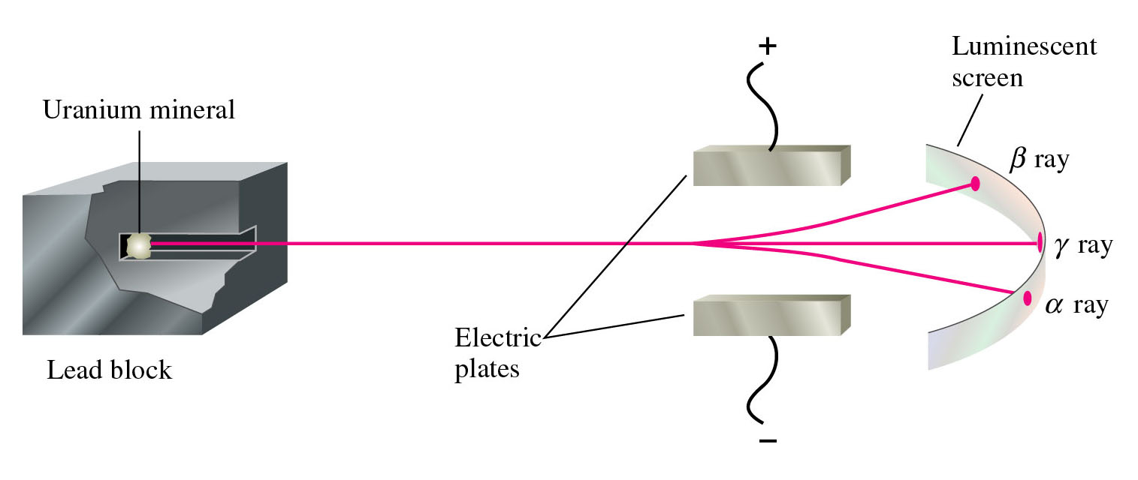
Figure 21.2: Separation of the radiation from a radioactive material.
Return to slide 6

Slide 89

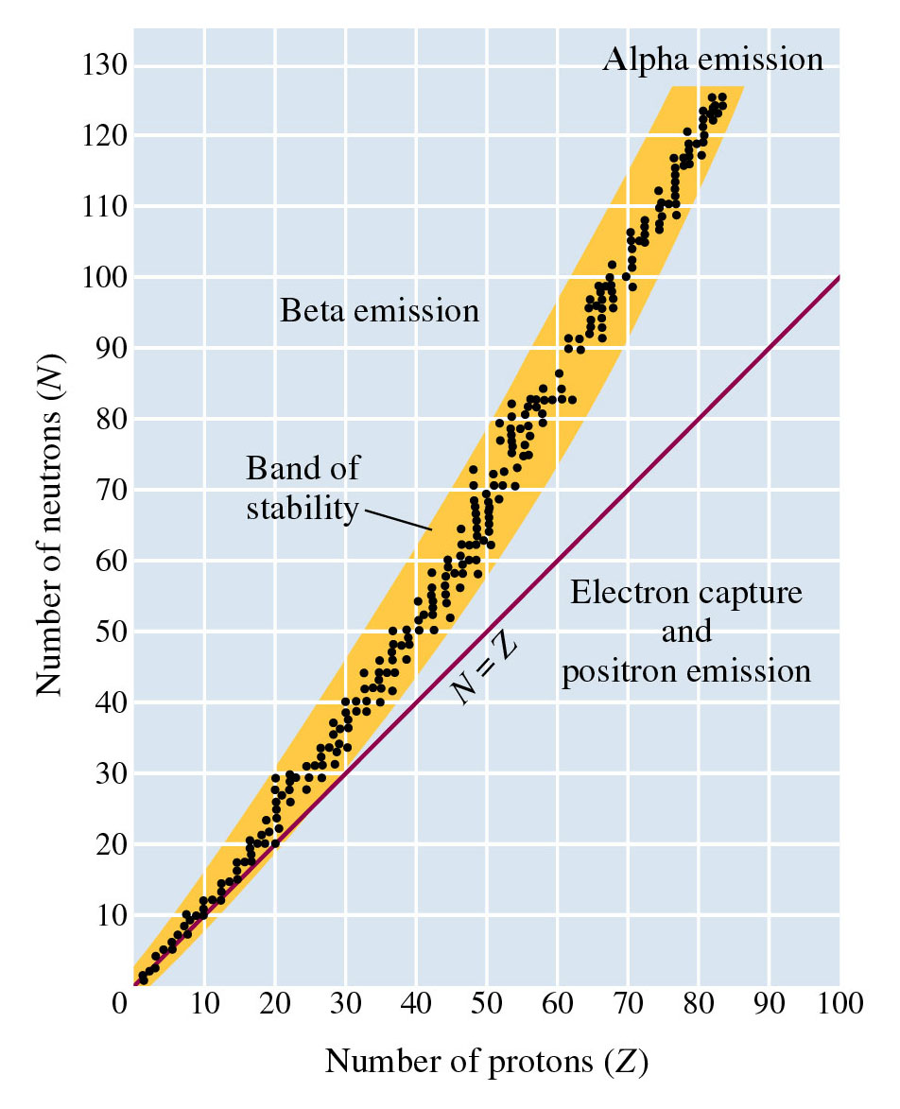
Figure 21.3:
Band of stability.
Return to slide 23

Slide 90
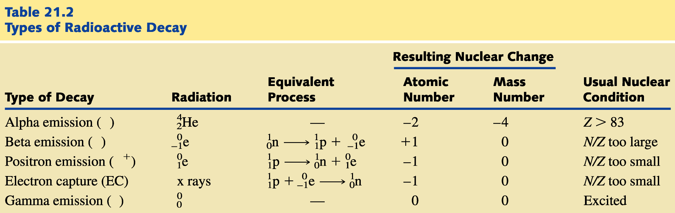
Return to slide 26

Slide 91
Return to slide 27

Slide 92
Figure 21.3:
Band of stability.
Return to slide 37

Slide 93
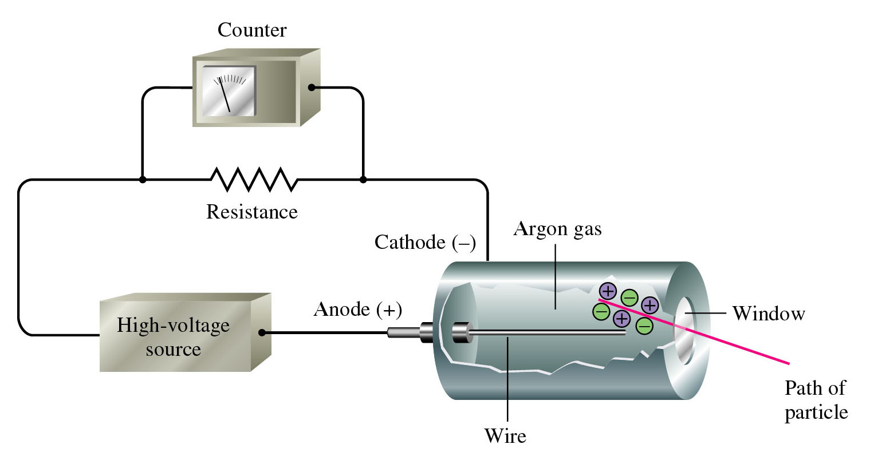
Figure 21.9: A Geiger counter.
Return to slide 49

Slide 94
Animation: Geiger-Counter-Sim
(Click here to open QuickTime animation)
Return to slide 50

Slide 95
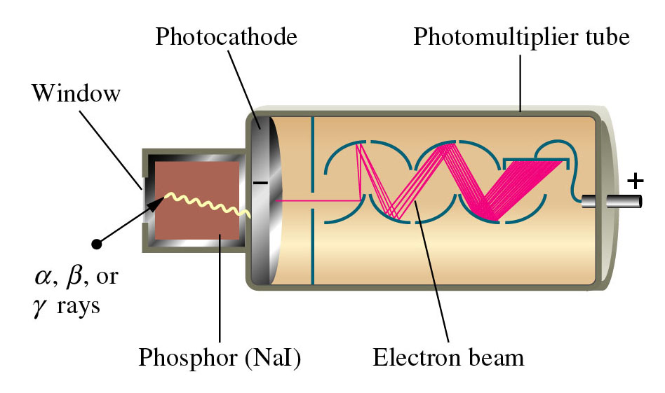
Figure 21.10: A diagram of how a scintillation probe works.
Return to slide 50

Slide 96
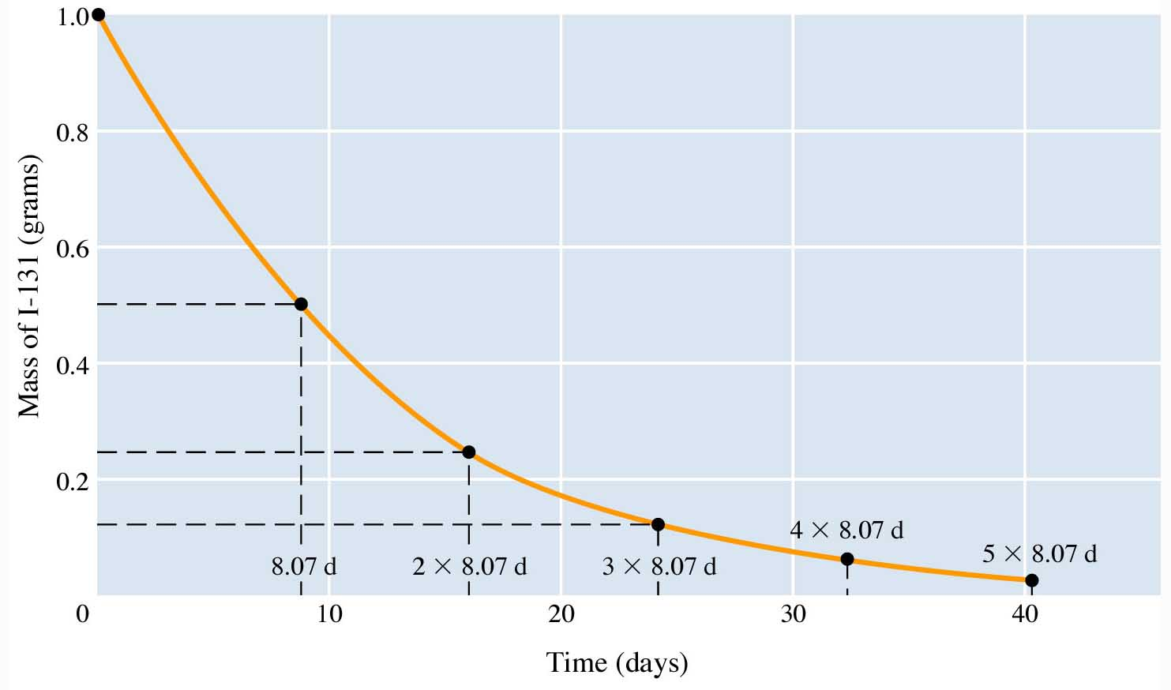
Figure 21.11: Radioactive decay of a 1.000-g sample of iodine-131.
Return to slide 57

Slide 97
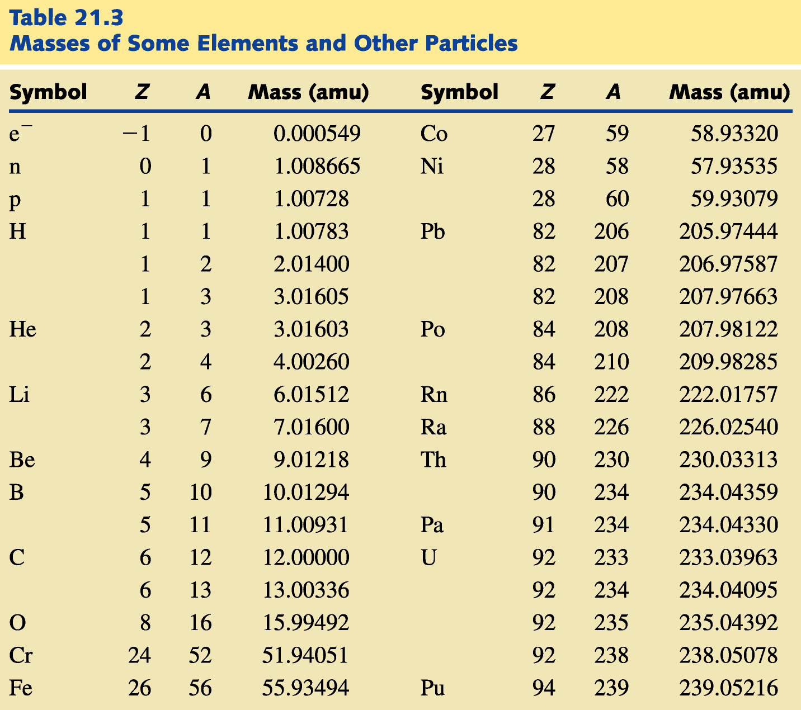
Return to slide 69

Slide 98
Animation: Nuclear Fission
(Click here to open QuickTime animation)
Return to slide 77

Slide 99
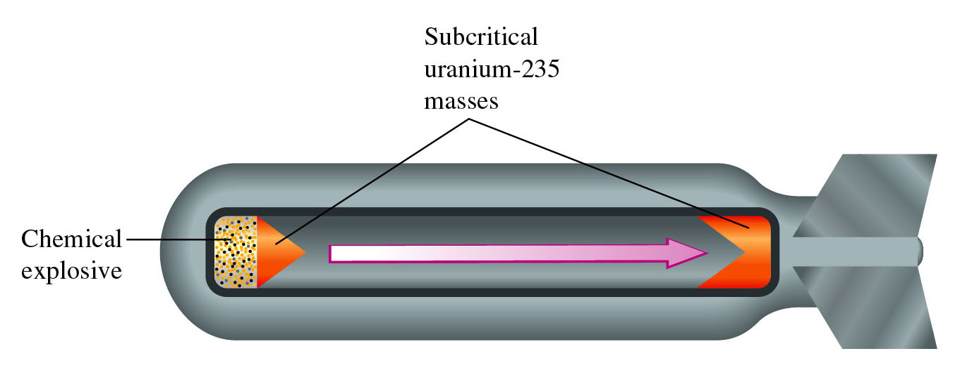
Figure 21.18: An atomic bomb.
Return to slide 81

Slide 100
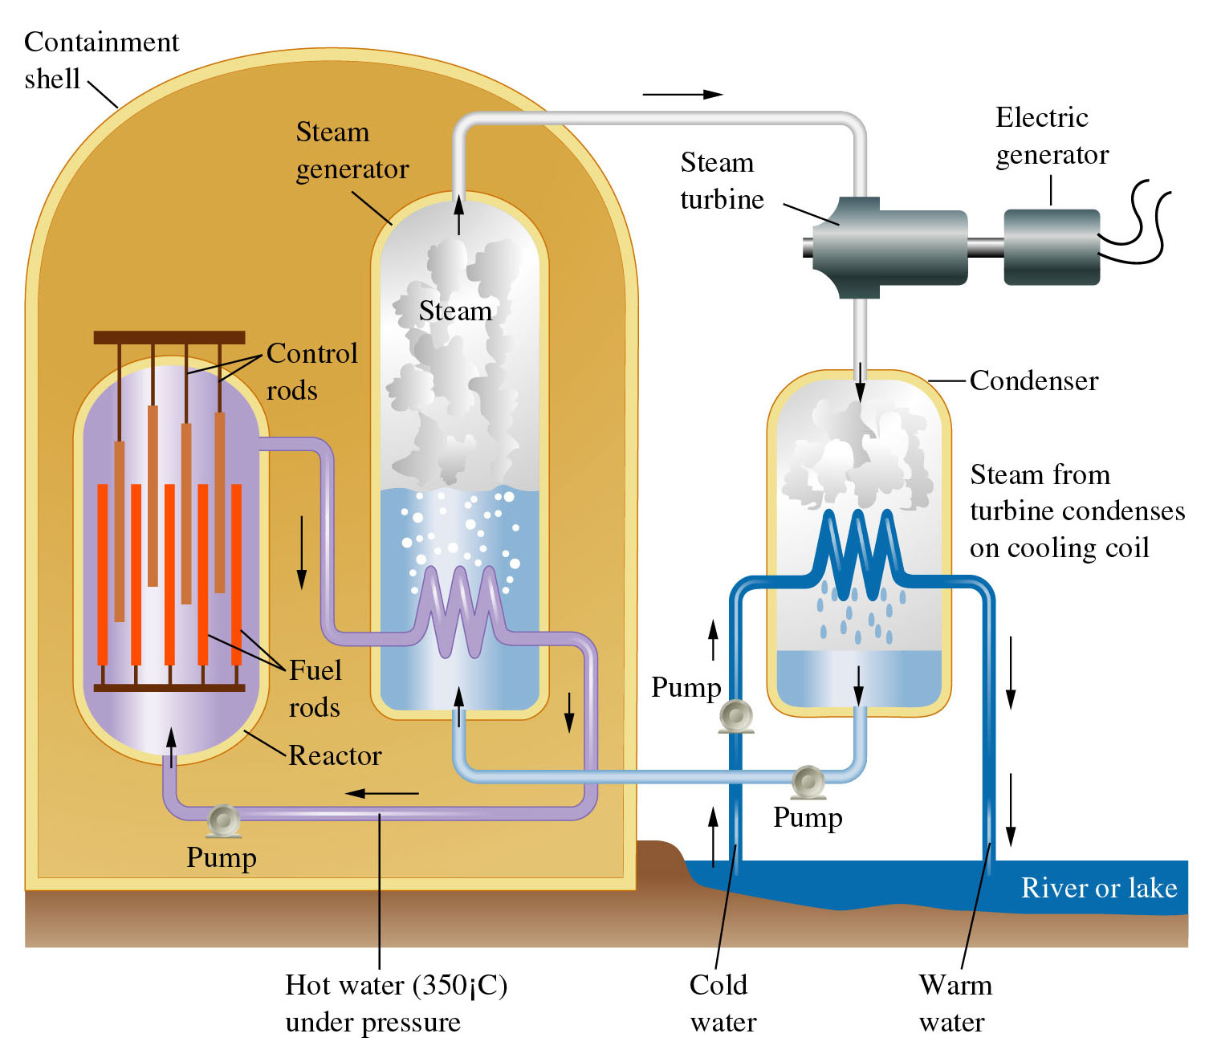
Figure 21.19:
Light-water nuclear reactor.
Return to slide 82

Slide 101
Animation: Nuclear Fusion
(Click here to open QuickTime animation)
Return to slide 84

Slide 102
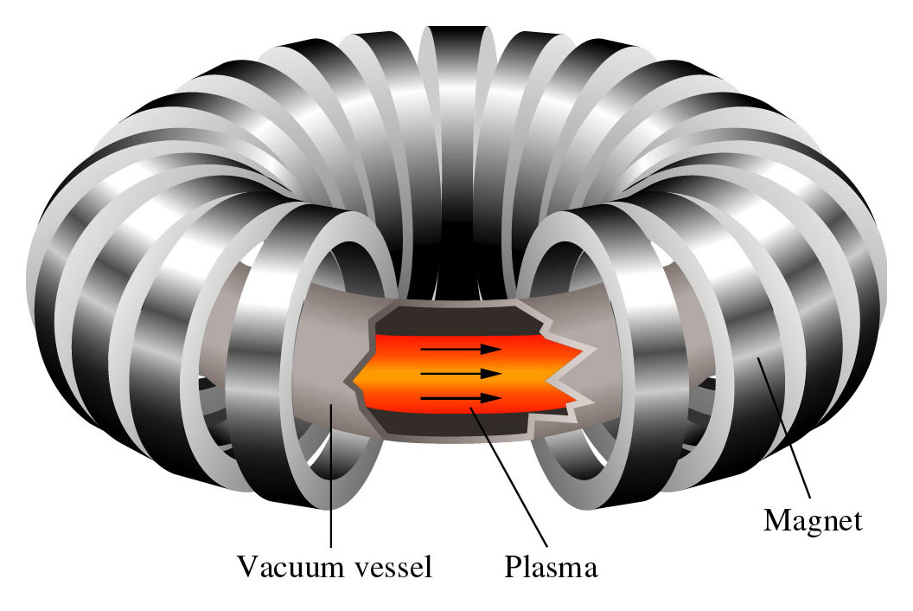
Figure 21.20: Plasma confinement in a tokamak reactor. Courtesy of Princeton Plasma Physics Laboratory.
Return to slide 86

