Slide 1

What do you know? Quiz
What will happen to the volume of a container if the pressure is increased?
What are 3 possible units of pressure?
What is conversion for Kelvin to Celsius?
What are three characteristics of an ideal gas?
What is STP? What are the values for STP?
How many Liters are in one mole of gas at STP?
If the temperature of a gas increases what do you expect to happen to the volume of the container?

Slide 2
Warm Up
A mixture of three gases A, B and C is at a total pressure of 6.11 atm. The partial pressure of a gas A is 1.68 atm; that of gas B is 3.89 atm. What is the partial pressure of C?

Slide 3
166.190 torr
a. 93.3mL b. 588 K c. 29.9mL
142mL
3.41L
38.8kPa
27. 6.05 x 10⁵mL
260. K
243L
33. 9.98m³/day

Slide 4
a. 100.0 mL b. 1.4 mm Hg
121K
0.360 atm
127 ºC
a. 225.0 mL b. 1800. mL
540K
-16ºC
32. -43ºC

Slide 5
a. 1.00 mol N₂ b. .250 mol c. 5.58 x 10⁻³ mol d. 3.13 x10⁻³mol
42. a. 1.01 g N₂ b. 5.50 g CO₂ c. 0.0429 g SO₂ d. 5.77 x 10^{-3g}
43. a. 5.6 L b. 2.80L c. 0.0122L d. 2.96 x 10⁸L
45. a. 0.250 mol H₂ b. 0.250mol c. 15.9g
50. a. 39.4L H₂ b. 14.9L c. 3.81L
51. a. 0.0646 mol b. 0.030mol c. 0.0377mol
52. a. 15.3 g b. 2.23g c. 0.299g

Slide 6

Chapter 11
Section 1 Gases and Pressure
Pressure and Force
Pressure (P) is defined as the force per unit area
on a surface.
Gas pressure is caused by collisions of the gas molecules with each other and with surfaces with which they come into contact.
The pressure exerted by a gas depends on volume, temperature, and the number of molecules present.
  The greater the number of collisions of gas molecules,
  the higher the pressure will be.

Slide 7
Chapter 11
Section 1 Gases and Pressure
Pressure and Force
Pressure is force per unit area, so the pressure of a 500 N person on an area of the floor that is 325 cm² is:
500 N ÷ 325 cm² = 1.5 N/cm²
The greater the force on a given area, the greater
the pressure.
The smaller the area is on which a given force acts, the greater the pressure.

Slide 8

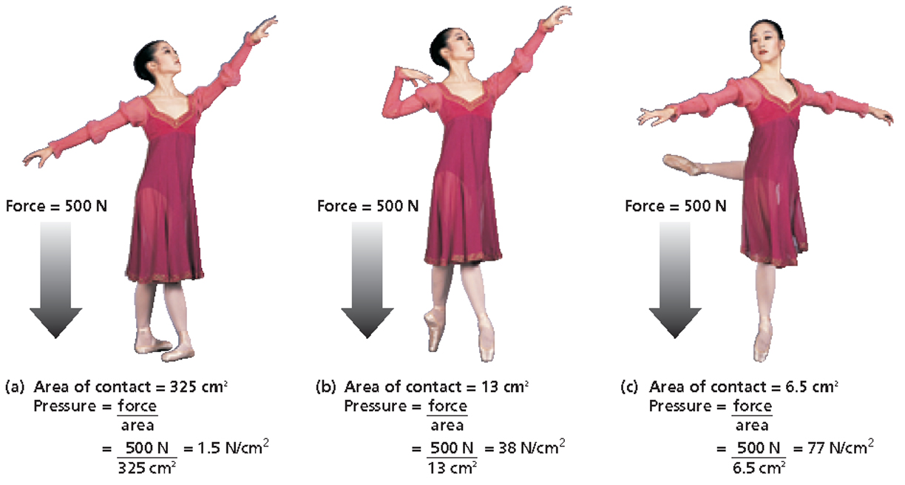
Chapter 11
Section 1 Gases and Pressure
Relationship Between Pressure, Force, and Area

Slide 9
Chapter 11
Section 1 Gases and Pressure
Pressure and Force, continued
Measuring Pressure
A barometer is a device used to measure atmospheric pressure. The first barometer was introduced by Evangelista Torricelli in the early 1600s.

Slide 10
Chapter 11
Section 1 Gases and Pressure
Pressure and Force, continued
Measuring Pressure, continued
The common unit of pressure is millimeters of mercury, symbolized mm Hg.
  A pressure of 1 mm Hg is also called 1 torr in honor of Torricelli for his invention of the barometer.
Pressures can also be measured in units of atmospheres. Because the average atmospheric pressure at sea level at 0°C is 760 mm Hg, one atmosphere of pressure (atm) is defined as being exactly equivalent to 760 mm Hg.

Slide 11
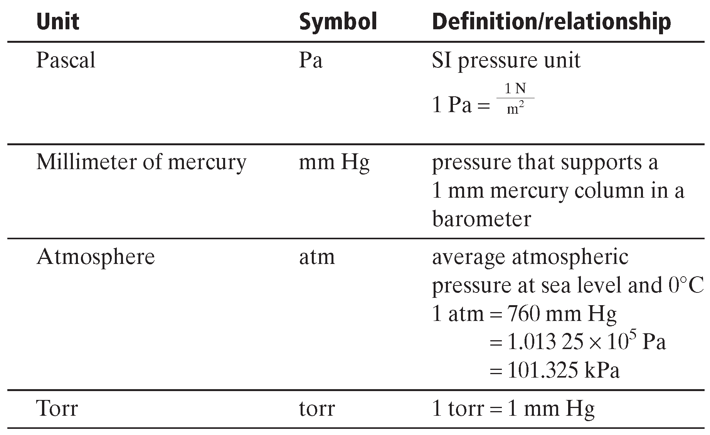
Chapter 11
Section 1 Gases and Pressure
Units of Pressure

Slide 12
STP – Standard Temperature and Pressure
Temperature is 0⁰ C
Pressure is 1 atm

Slide 13
Pressure and Force, continued
Chapter 11
Section 1 Gases and Pressure
Sample Problem A
The average atmospheric pressure in Denver, Colorado is 0.830 atm. Express this pressure in
a. millimeters of mercury (mm Hg) and
b. kilopascals (kPa)

Slide 14
Pressure and Force, continued
Chapter 11
Section 1 Gases and Pressure
Sample Problem A Solution
Given: atmospheric pressure = 0.830 atm
Unknown: a. pressure in mm Hg
b. pressure in kPa
Solution:
conversion factor
a.
b.

Slide 15

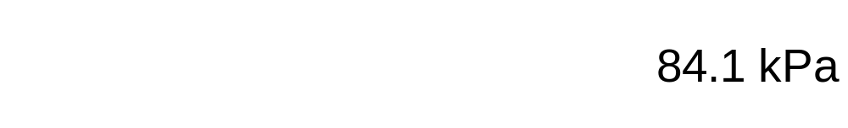
Pressure and Force, continued
Chapter 11
Section 1 Gases and Pressure
Sample Problem A Solution, continued
conversion factor
a.
b.

Slide 16
Chapter 11
Section 1 Gases and Pressure
Dalton’s Law of Partial Pressures
The pressure of each gas in a mixture is called the partial pressure of that gas.
Dalton’s law of partial pressures states that the total pressure of a gas mixture is the sum of the partial pressures of the component gases.

Slide 17
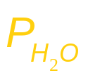
Chapter 11
Section 1 Gases and Pressure
Dalton’s Law of Partial Pressures, continued
Gases Collected by Water Displacement, continued
To determine the pressure of a gas inside a collection bottle, you would use the following equation, which is an instance of Dalton’s law of partial pressures.
P_{atm} = P_{gas} +

Slide 18
Dalton’s Law of Partial Pressures, continued
Chapter 11
Section 1 Gases and Pressure
Sample Problem B
Oxygen gas from the decomposition of potassium chlorate, KClO₃, was collected in a flask under water. The barometric pressure and the temperature during the experiment were 731.0 torr and 20.0°C. respectively. What was the partial pressure of the oxygen collected?

Slide 19
Dalton’s Law of Partial Pressures, continued
Chapter 11
Section 1 Gases and Pressure
Sample Problem B Solution
Given: P_{T} = P_{atm} = 731.0 torr
= 17.5 torr (vapor pressure of water at 20.0°C, from table A-8 in your book)
P_{atm} =
Unknown: in torr
Solution:
start with the equation:
rearrange algebraically to:

Slide 20
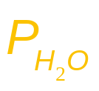

Dalton’s Law of Partial Pressures, continued
Chapter 11
Section 1 Gases and Pressure
Sample Problem B Solution, continued
substitute the given values of P_{atm} and into the equation:

Slide 21
Chapter 11
Section 2 The Gas Laws
Boyle’s Law: Pressure-Volume Relationship
P₁V₁ = P₂V₂
P₁ and V₁ represent initial conditions, and P₂ and V₂ represent another set of conditions.
Given three of the four values P₁, V₁, P₂, and V₂, you can use this equation to calculate the fourth value for a system at constant temperature.

Slide 22
Boyle’s Law: Pressure-Volume Relationship, continued
Chapter 11
Section 2 The Gas Laws
Sample Problem C
A sample of oxygen gas has a volume of 150.0 mL when its pressure is 0.947 atm.
What will the volume of the gas be at a pressure of 0.987 atm if the temperature remains constant?

Slide 23
Chapter 11
Section 2 The Gas Laws
Charles’s Law: Volume-Temperature Relationship,
The temperature –273.15°C is referred to as absolute zero, and is given a value of zero in the Kelvin temperature scale. The relationship between the two temperature scales is K = 273.15 + °C.

Slide 24
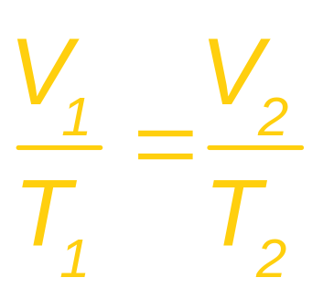
Chapter 11
Section 2 The Gas Laws
Charles’s Law: Volume-Temperature Relationship, continued
The form of Charles’s law that can be applied directly to most volume-temperature gas problems is:
V₁ and T₁ represent initial conditions, and V₂ and T₂ represent another set of conditions.

Slide 25
Charles’s Law: Volume-Temperature Relationship, continued
Chapter 11
Section 2 The Gas Laws
Sample Problem D
A sample of neon gas occupies a volume of 752 mL at 25°C. What volume will the gas occupy at 50°C if the pressure remains constant?

Slide 26
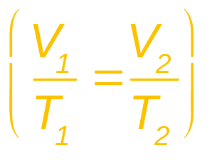
Charles’s Law: Volume-Temperature Relationship, continued
Chapter 11
Section 2 The Gas Laws
Sample Problem D Solution
Given: V₁ of Ne = 752 mL
T₁ of Ne = 25°C + 273 = 298 K
T₂ of Ne = 50°C + 273 = 323 K
Unknown: V₂ of Ne in mL
Solution:
Rearrange the equation for Charles’s law to obtain V₂.

Slide 27

Charles’s Law: Volume-Temperature Relationship, continued
Chapter 11
Section 2 The Gas Laws
Sample Problem D Solution, continued
Substitute the given values of V₁, T₁, and T₂ into the equation to obtain the final volume, V₂:

Slide 28
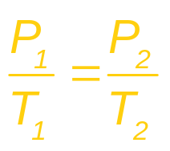
Chapter 11
Section 2 The Gas Laws
Gay-Lussac’s Law: Pressure-Temperature Relationship, continued
The form of Gay-Lussac’s law that can be applied directly to most pressure-temperature gas problems is:
P₁ and T₁ represent initial conditions, and P₂ and T₂ represent another set of conditions.
Given three of the four values P₁, T₁, P₂, and T₂, you can use this equation to calculate the fourth value for
a system at constant pressure.

Slide 29
Gay-Lussac’s Law: Volume-Temperature Relationship, continued
Chapter 11
Section 2 The Gas Laws
Sample Problem E
The gas in a container is at a pressure of 3.00 atm at 25°C. Directions on the container warn the user not to keep it in a place where the temperature exceeds 52°C. What would the gas pressure in the container be at 52°C?

Slide 30
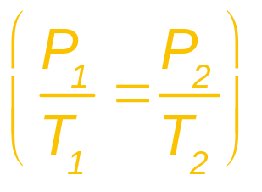
Gay-Lussac’s Law: Volume-Temperature Relationship, continued
Chapter 11
Section 2 The Gas Laws
Sample Problem E Solution
Given: P₁ of gas = 3.00 atm
T₁ of gas = 25°C + 273 = 298 K
T₂ of gas = 52°C + 273 = 325 K
Unknown: P₂ of gas in atm
Solution:
Rearrange the equation for Gay-Lussac’s law
to obtain V₂.

Slide 31

Gay-Lussac’s Law: Volume-Temperature Relationship, continued
Chapter 11
Section 2 The Gas Laws
Sample Problem E Solution, continued
Substitute the given values of P₁, T₁, and T₂ into the equation to obtain the final volume, P₂:

Slide 32
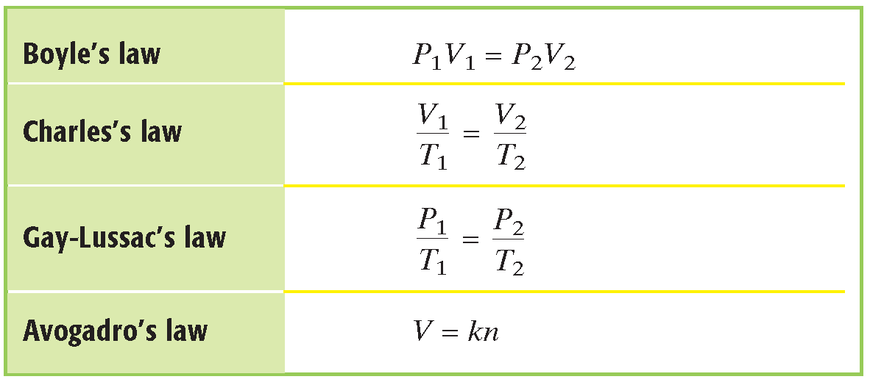
Chapter 11
Section 2 The Gas Laws
Summary of the Basic Gas Laws

Slide 33
Chapter 11
Section 2 The Gas Laws
The Combined Gas Law
Boyle’s law, Charles’s law, and Gay-Lussac’s law can be combined into a single equation that can be used for situations in which temperature, pressure, and volume, all vary at the same time.
The combined gas law expresses the relationship between pressure, volume, and temperature of a fixed amount of gas.

Slide 34
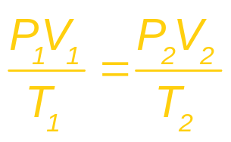
Chapter 11
Section 2 The Gas Laws
The Combined Gas Law, continued
The combined gas law can also be written as follows.
  The subscripts 1 and 2 represent two different sets of conditions. As in Charles’s law and Gay-Lussac’s law,
  T represents Kelvin temperature.
Each of the gas laws can be obtained from the combined gas law when the proper variable is
kept constant.

Slide 35
The Combined Gas Law, continued
Chapter 11
Section 2 The Gas Laws
Sample Problem F
A helium-filled balloon has a volume of 50.0 L at 25°C and 1.08 atm. What volume will it have at 0.855 atm and 10.0°C?

Slide 36
The Combined Gas Law, continued
Chapter 11
Section 2 The Gas Laws
Sample Problem F Solution
Given: V₁ of He = 50.0 L
T₁ of He = 25°C + 273 = 298 K
T₂ of He = 10°C + 273 = 283 K
P₁ of He = 1.08 atm
P₂ of He = 0.855 atm
Unknown: V₂ of He in L

Slide 37
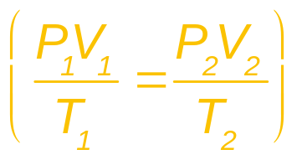
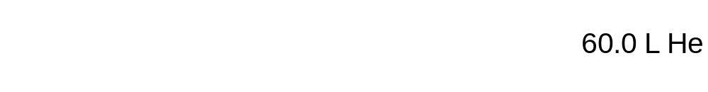
The Combined Gas Law, continued
Chapter 11
Section 2 The Gas Laws
Sample Problem F Solution, continued
Solution:
Rearrange the equation for the combined gas law
to obtain V₂.
Substitute the given values of P₁, T₁, and T₂ into the equation to obtain the final volume, P₂:

Slide 38
Section 3 Gas Volumes and the Ideal Gas Law
Chapter 11
Lesson Starter
Write balanced chemical equations for the two chemical reactions indicated below.
  hydrogen gas + oxygen gas → water vapor
  (2 liters) (1 liter) (2 liters)
  hydrogen gas + chlorine gas → hydrogen chloride
  (1 liter) (1 liter) (2 liters)
Compare the balanced equations with the expressions above. What do you notice?

Slide 39
WARM UP
A gas tank is initially at STP, what will be the new pressure on the tank if we heat up the tank to 518 ºC? Will this tank explode if the pressure limit is 8.00atm?

Slide 40
Section 3 Gas Volumes and the Ideal Gas Law
Chapter 11
Molar Volume of a Gas
Recall that one mole of a substance contains a number of particles equal to Avogadro’s constant (6.022 × 10²³).
  example: one mole of oxygen, O₂, contains 6.022 × 10²³ diatomic molecules.
One mole of any gas will occupy the same volume as one mole of any other gas at the same conditions, despite mass differences.
The volume occupied by one mole of gas at STP is known as the standard molar volume of a gas,
which is 22.414 10 L (rounded to 22.4 L).

Slide 41

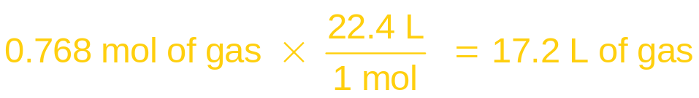
Section 3 Gas Volumes and the Ideal Gas Law
Chapter 11
Molar Volume of a Gas, continued
Knowing the volume of a gas, you can use the conversion factor 1 mol/22.4 L to find the moles (and therefore also mass) of a given volume of gas at STP.
  example: at STP,
You can also use the molar volume of a gas to find the volume, at STP, of a known number of moles or a known mass of gas.
  example: at STP,

Slide 42
Molar Volume of a Gas, continued
Section 3 Gas Volumes and the Ideal Gas Law
Chapter 11
Sample Problem G
What volume does 0.0685 mol of gas occupy at STP?
What quantity of gas, in moles, is contained in 2.21 L at STP?

Slide 43
Gas Stoichiometry, continued
Section 3 Gas Volumes and the Ideal Gas Law
Chapter 11
Sample Problem H
Propane, C₃H₈, is a gas that is sometimes used as a fuel for cooking and heating. The complete combustion of propane occurs according to the following balanced equation.
C₃H₈(g) + 5O₂(g) → 3CO₂(g) + 4H₂O(g)
(a) What will be the volume, in liters, of oxygen required for the complete combustion of 0.350 L of propane?
(b) What will be the volume of carbon dioxide produced in the reaction? Assume that all volume measurements are made at the same temperature and pressure.

Slide 44
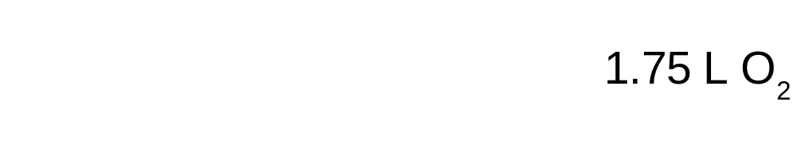
Section 3 Gas Volumes and the Ideal Gas Law
Chapter 11
Gas Stoichiometry, continued
Sample Problem H Solution
a.
Given: balanced chemical equation;
V of propane = 0.350 L
Unknown: V of O₂
Solution: Because all volumes are to be compared at
the same conditions, volume ratios can be used like mole ratios.

Slide 45
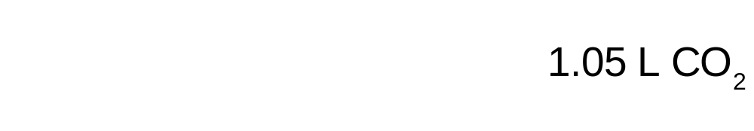
Section 3 Gas Volumes and the Ideal Gas Law
Chapter 11
Gas Stoichiometry, continued
Sample Problem H Solution, continued
b.
Given: balanced chemical equation;
V of propane = 0.350 L
Unknown: V of CO₂
Solution: Because all volumes are to be compared at
the same conditions, volume ratios can be used like mole ratios.

Slide 46
#44 Acetylene gas, C₂H₂, undergoes combustion to produce carbon dioxide and water vapor. If 75.0L CO₂ is produced at STP, How many liters of Acetylene gas reacted?

Slide 47
Section 3 Gas Volumes and the Ideal Gas Law
Chapter 11
The Ideal Gas Law
All of the gas laws you have learned thus far can be combined into a single equation, the ideal gas law: the mathematical relationship among pressure, volume, temperature, and number of moles of a gas.
It is stated as shown below, where R is a constant:
PV = nRT

Slide 48
Section 3 Gas Volumes and the Ideal Gas Law
Chapter 11
The Ideal Gas Law, continued
The Ideal Gas Constant
In the equation representing the ideal gas law, the constant R is known as the ideal gas constant.
  Its value depends on the units chosen for pressure, volume, and temperature in the rest of the equation.

Slide 49
Section 3 Gas Volumes and the Ideal Gas Law
Chapter 11
The Ideal Gas Law, continued
The Ideal Gas Constant, continued
The calculated value of R is usually rounded to 0.0821 (L•atm)/(mol•K).
  Use this value in ideal gas law calculations when the
  volume is in liters, the pressure is in atmospheres, and
  the temperature is in kelvins.

Slide 50
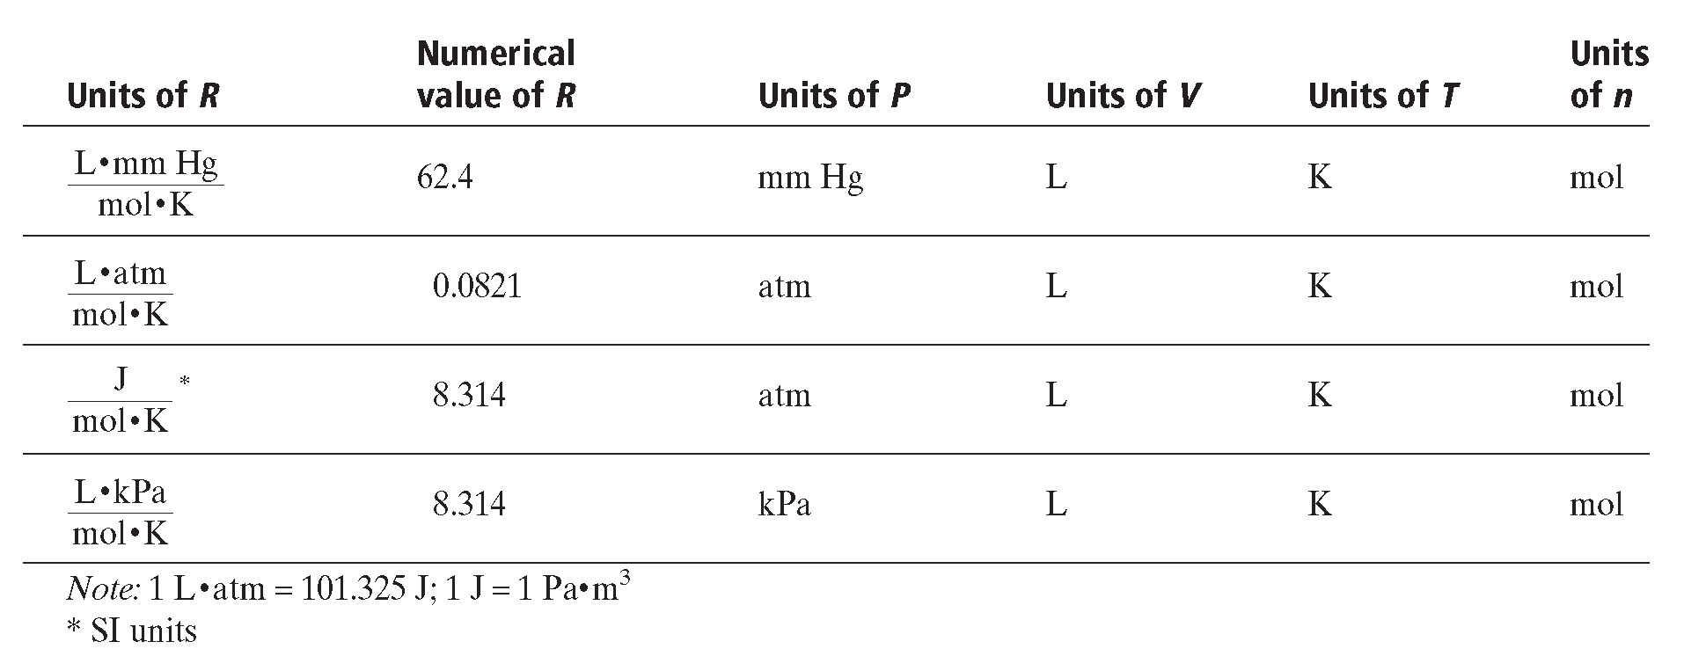
Section 3 Gas Volumes and the Ideal Gas Law
Chapter 11
Numerical Values of the Gas Constant

Slide 51
The Ideal Gas Law, continued
Section 3 Gas Volumes and the Ideal Gas Law
Chapter 11
Sample Problem I
What is the pressure in atmospheres exerted by a 0.500 mol sample of nitrogen gas in a 10.0 L container at 298 K?

Slide 52
Section 3 Gas Volumes and the Ideal Gas Law
Chapter 11
The Ideal Gas Law, continued
Sample Problem I Solution
Given: V of N₂ = 10.0 L
n of N₂ = 0.500 mol
T of N₂ = 298 K
Unknown: P of N₂ in atm
Solution: Use the ideal gas law, which can be rearranged to find the pressure, as follows.

Slide 53

Section 3 Gas Volumes and the Ideal Gas Law
Chapter 11
The Ideal Gas Law, continued
Sample Problem I Solution, continued
Substitute the given values into the equation:

Slide 54
Section 3 Gas Volumes and the Ideal Gas Law
Chapter 11
The Ideal Gas Law, continued
Sample Problem 2
#52 c. Find the mass of SO₂ gas if you have 125mL at 743 mm Hg and -5ºC.

Slide 55

End of Chapter 11 Show

Slide 56
Chapter 11
Standardized Test Preparation
Multiple Choice
1. Pressure can be measured in
A. grams.
B. meters.
C. pascals.
D. liters.

Slide 57
Chapter 11
Standardized Test Preparation
Multiple Choice
1. Pressure can be measured in
A. grams.
B. meters.
C. pascals.
D. liters.

Slide 58
Chapter 11
Standardized Test Preparation
Multiple Choice
2. A sample of oxygen gas has a volume of 150 mL when its pressure is 0.923 atm. If the pressure is increased to 0.987 atm and the temperature remains constant, what will the new volume be?
A. 140 mL
B. 160 mL
C. 200 mL
D. 240 mL

Slide 59
Chapter 11
Standardized Test Preparation
Multiple Choice
2. A sample of oxygen gas has a volume of 150 mL when its pressure is 0.923 atm. If the pressure is increased to 0.987 atm and the temperature remains constant, what will the new volume be?
A. 140 mL
B. 160 mL
C. 200 mL
D. 240 mL

Slide 60
Chapter 11
Standardized Test Preparation
Multiple Choice
3. What is the pressure exerted by a 0.500 mol sample of nitrogen in a 10.0 L container at 20°C?
A. 1.2 kPa
B. 10 kPa
C. 0.10 kPa
D. 120 kPa

Slide 61
Chapter 11
Standardized Test Preparation
Multiple Choice
3. What is the pressure exerted by a 0.500 mol sample of nitrogen in a 10.0 L container at 20°C?
A. 1.2 kPa
B. 10 kPa
C. 0.10 kPa
D. 120 kPa

Slide 62
Chapter 11
Standardized Test Preparation
Multiple Choice
4. A sample of gas in a closed container at a temperature of 100.0°C and 3.0 atm is heated to 300.0°C. What is the pressure of the gas at the higher temperature?
A. 35 atm
B. 4.6 atm
C. 59 atm
D. 9.0 atm

Slide 63
Chapter 11
Standardized Test Preparation
Multiple Choice
4. A sample of gas in a closed container at a temperature of 100.0°C and 3.0 atm is heated to 300.0°C. What is the pressure of the gas at the higher temperature?
A. 35 atm
B. 4.6 atm
C. 59 atm
D. 9.0 atm

Slide 64
Chapter 11
Standardized Test Preparation
Multiple Choice
5. An unknown gas effuses twice as fast as CH₄. What is the molar mass of the gas?
A. 64 g/mol
B. 32 g/mol
C. 8 g/mol
D. 4 g/mol

Slide 65
Chapter 11
Standardized Test Preparation
Multiple Choice
5. An unknown gas effuses twice as fast as CH₄. What is the molar mass of the gas?
A. 64 g/mol
B. 32 g/mol
C. 8 g/mol
D. 4 g/mol

Slide 66
Chapter 11
Standardized Test Preparation
Multiple Choice
6. If 3 L N₂ and 3 L H₂ are mixed and react according to the equation below, how many liters of unreacted gas remain? Assume temperature and pressure remain constant.
N₂(g) + 3H₂(g) → 2NH₃(g)
A. 4 L
B. 3 L
C. 2 L
D. 1 L

Slide 67
Chapter 11
Standardized Test Preparation
Multiple Choice
6. If 3 L N₂ and 3 L H₂ are mixed and react according to the equation below, how many liters of unreacted gas remain? Assume temperature and pressure remain constant.
N₂(g) + 3H₂(g) → 2NH₃(g)
A. 4 L
B. 3 L
C. 2 L
D. 1 L

Slide 68
Chapter 11
Standardized Test Preparation
Multiple Choice
7. Avogadro’s law states that
A. equal numbers of moles of gases at the same conditions occupy equal volumes, regardless of the identity of the gases.
B. at constant pressure, gas volume is directly proportional to absolute temperature.
C. the volume of a gas is inversely proportional to its amount in moles.
D. at constant temperature, gas volume is inversely proportional to pressure.

Slide 69
Chapter 11
Standardized Test Preparation
Multiple Choice
7. Avogadro’s law states that
A. equal numbers of moles of gases at the same conditions occupy equal volumes, regardless of the identity of the gases.
B. at constant pressure, gas volume is directly proportional to absolute temperature.
C. the volume of a gas is inversely proportional to its amount in moles.
D. at constant temperature, gas volume is inversely proportional to pressure.

Slide 70
Chapter 11
Standardized Test Preparation
Short Answer
8. Give a molecular explanation for the observation
that the pressure of a gas increases when the gas
volume is decreased.

Slide 71
Chapter 11
Standardized Test Preparation
Short Answer
8. Give a molecular explanation for the observation
that the pressure of a gas increases when the gas
volume is decreased.
Answer: The molecules are closer together, so they strike the walls of the container more often.

Slide 72
Chapter 11
Standardized Test Preparation
Short Answer
9. The graph on the next slide shows a plot of volume versus pressure for a particular gas sample at constant pressure. Answer the following questions by referring to the graph. No calculation is necessary.
a. What is the volume of this gas sample at
standard pressure?
b. What is the volume of this gas sample at
4.0 atm pressure?
c. At what pressure would this gas sample occupy a volume of 5.0 L?

Slide 73
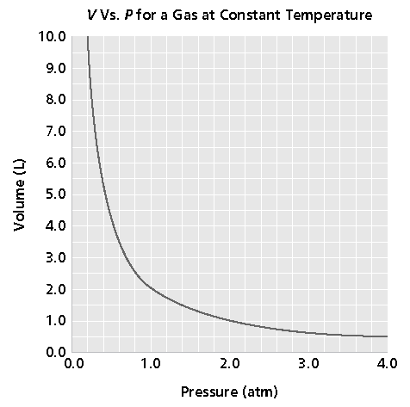
Chapter 11
Standardized Test Preparation
Short Answer
9. continued

Slide 74
Chapter 11
Standardized Test Preparation
Short Answer
9. continued
Answer:
a. 2.0 L
b. 0.5 L
c. 0.4 atm

Slide 75
Chapter 11
Standardized Test Preparation
Extended Response
10. Refer to the plot in question 9. Suppose the same gas sample were heated to a higher temperature and a new graph of V versus P were plotted. Would the new plot be identical to this one? If not, how would it differ?

Slide 76
Chapter 11
Standardized Test Preparation
Extended Response
10. Refer to the plot in question 9. Suppose the same gas sample were heated to a higher temperature and a new graph of V versus P were plotted. Would the new plot be identical to this one? If not, how would it differ?
Answer:
The plot would not be identical to this one. It would have a similar shape, but would appear higher on the graph. This is because at any pressure, the volume would be higher at the higher temperature.

