Slide 1


Chapter 12
Section 1 Types of Mixtures
Solutions
You know from experience that sugar dissolves in water. Sugar is described as “soluble in water.” By soluble we mean capable of being dissolved.
When sugar dissolves, all its molecules become uniformly distributed among the water molecules. The solid sugar is no longer visible.
Such a mixture is called a solution. A solution is a homogeneous mixture of two or more substances in
a single phase.

Slide 2
Chapter 12
Section 1 Types of Mixtures
Solutions, continued
The dissolving medium in a solution is called the solvent, and the substance dissolved in a solution is called the solute.
Solutions may exist as gases, liquids, or solids. There are many possible solute-solvent combinations between gases, liquids, and solids.
  example: Alloys are solid solutions in which the atoms of two or more metals are uniformly mixed.
    Brass is made from zinc and copper.
    Sterling silver is made from silver and copper.

Slide 3
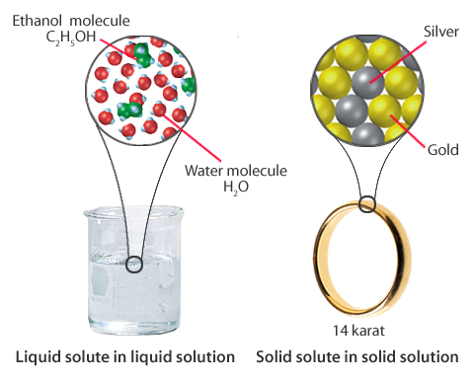
Chapter 12
Visual Concepts
Types of Solutions

Slide 4

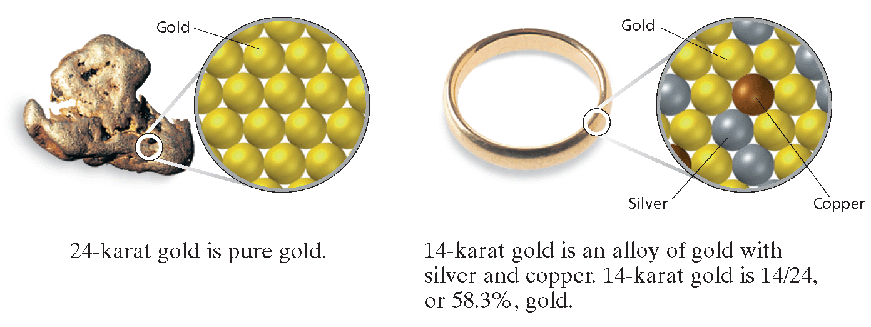
Particle Models for Gold and Gold Alloy
Chapter 12
Section 1 Types of Mixtures

Slide 5
Chapter 12
Section 1 Types of Mixtures
Solutes: Electrolytes Versus Nonelectrolytes, continued
A substance that dissolves in water to give a
solution that does not conduct electric current is
called a nonelectrolyte.
Sugar is an example of a nonelectrolyte.
Neutral solute molecules do not contain mobile charged particles, so a solution of a nonelectrolyte cannot conduct electric current.

Slide 6
Chapter 12
Section 1 Types of Mixtures
Solutes: Electrolytes Versus Nonelectrolytes
A substance that dissolves in water to give a solution that conducts electric current is called an electrolyte.
Any soluble ionic compound, such as sodium chloride, NaCl, is an electrolyte.
The positive and negative ions separate from
each other in solution and are free to move, making
it possible for an electric current to pass through
the solution.

Slide 7
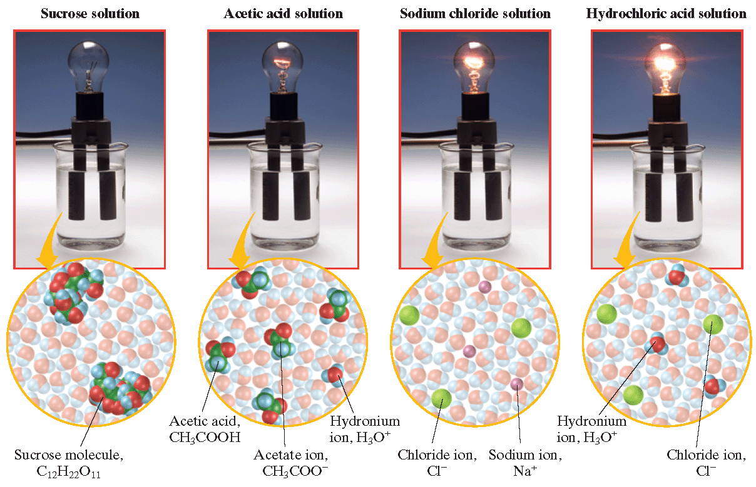
Electrical Conductivity of Solutions
Chapter 12
Section 1 Types of Mixtures

Slide 8
Chapter 12
Section 2 The Solution Process
Objectives
List and explain three factors that affect the rate at which a solid solute dissolves in a liquid solvent.
Explain solution equilibrium, and distinguish among saturated, unsaturated, and supersaturated solutions.
Explain the meaning of “like dissolves like” in terms of polar and nonpolar substances.

Slide 9
Chapter 12
Section 2 The Solution Process
Objectives, continued
List the three interactions that contribute to the enthalpy of a solution, and explain how they combine to cause dissolution to be exothermic or endothermic.
Compare the effects of temperature and pressure on solubility.

Slide 10
Chapter 12
Section 2 The Solution Process
Factors Affecting the Rate of Dissolution
Because the dissolution process occurs at the surface of the solute, it can be speeded up if the surface area of the solute is increased.
Stirring or shaking helps to disperse solute particles and increase contact between the solvent and solute surface. This speeds up the dissolving process.
At higher temperatures, collisions between solvent molecules and solvent are more frequent and of higher energy. This helps to disperse solute molecules among the solvent molecules, and speed up the dissolving process.

Slide 11
Chapter 12
Section 2 The Solution Process
Solubility
If you add spoonful after spoonful of sugar to tea, eventually no more sugar will dissolve.
This illustrates the fact that for every combination
of solvent with a solid solute at a given temperature, there is a limit to the amount of solid that can
be dissolved.
The point at which this limit is reached for any solute-solvent combination depends on the nature of the solute, the nature of the solvent, and the temperature.

Slide 12
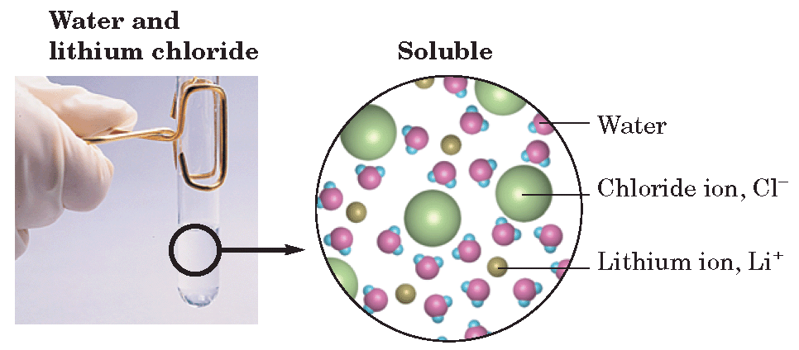
Chapter 12
Section 2 The Solution Process
Particle Model for Soluble and Insoluble Substances

Slide 13
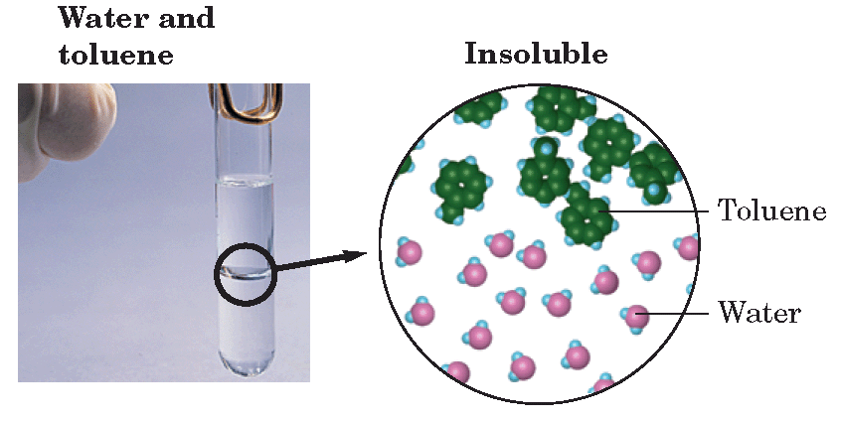
Chapter 12
Section 2 The Solution Process
Particle Model for Soluble and Insoluble Substances

Slide 14
Chapter 12
Section 2 The Solution Process
Solubility, continued
When a solute is first added to a solvent, solute molecules leave the solid surface and move about at random in the solvent.
As more solute is added, more collisions occur between dissolved solute particles. Some of the solute molecules return to the crystal.
When maximum solubility is reached, molecules are returning to the solid form at the same rate at which they are going into solution. (Solution equilibrium )

Slide 15
Chapter 12
Section 2 The Solution Process
Solubility, continued
Solution equilibrium is the physical state in which the
opposing processes of dissolution and crystallization of a solute occur at the same rates.

Slide 16
Chapter 12
Section 2 The Solution Process
Solubility, continued
Saturated Versus Unsaturated Solutions
A solution that contains the maximum amount of dissolved solute is described as a saturated solution.
  If more solute is added to a saturated solution, it falls to the bottom of the container and does not dissolve.
  This is because an equilibrium has been established between ions leaving and entering the solid phase.
A solution that contains less solute than a
saturated solution under the same conditions is
an unsaturated solution.

Slide 17
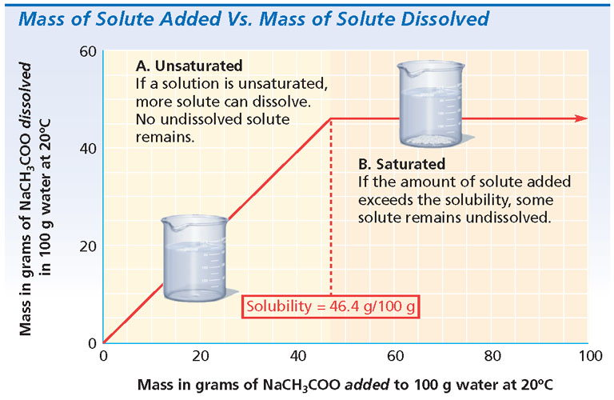
Mass of Solute Added Versus Mass of Solute Dissolved
Chapter 12
Section 2 The Solution Process

Slide 18
Chapter 12
Section 2 The Solution Process
Solubility, continued
Supersaturated Solutions
When a saturated solution is cooled, the excess solute usually comes out of solution, leaving the solution saturated at the lower temperature.
But sometimes the excess solute does not separate, and a supersaturated solution is produced, which is a solution that contains more dissolved solute than a saturated solution contains under the same conditions.

Slide 19
Chapter 12
Section 2 The Solution Process
Solute-Solvent Interactions
“Like dissolves like” is a rough but useful rule
for predicting whether one substance will dissolve
in another.
  polar substance dissolves a polar substance
  Polar substance does not dissolve nonpolar (oil and water)
What makes substances similar depends on:
  type of bonding
  polarity or nonpolarity of molecules
  intermolecular forces between the solute and solvent

Slide 20
Chapter 12
Section 2 The Solution Process
Solute-Solvent Interactions, continued
Dissolving Ionic Compounds in Aqueous Solution
The polarity of water molecules plays an important role in the formation of solutions of ionic compounds
in water.
The slightly charged parts of water molecules attract the ions in the ionic compounds and surround them, separating them from the crystal surface and drawing them into the solution.

Slide 21
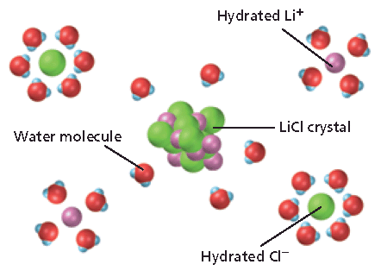
Chapter 12
Section 2 The Solution Process
Solute-Solvent Interactions, continued
Dissolving Ionic Compounds in Aqueous Solution
The hydration of the ionic solute lithium chloride is shown below.

Slide 22
Chapter 12
Section 2 The Solution Process
Solute-Solvent Interactions, continued
Nonpolar Solvents
Ionic compounds are generally not soluble in nonpolar solvents such as carbon tetrachloride, CCl₄, and toluene, C₆H₅CH₃.
The nonpolar solvent molecules do not attract the ions of the crystal strongly enough to overcome the forces holding the crystal together.
Ionic and nonpolar substances differ widely in bonding type, polarity, and intermolecular forces,
so their particles cannot intermingle very much.

Slide 23
Chapter 12
Section 2 The Solution Process
Solute-Solvent Interactions, continued
Liquid Solutes and Solvents
Oil and water do not mix because oil is nonpolar whereas water is polar. The hydrogen bonding between water molecules squeezes out whatever oil molecules may come between them.
Two polar substances, or two nonpolar substances, on the other hand, form solutions together easily because their intermolecular forces match.
Liquids that are not soluble in each other are immiscible. Liquids that dissolve freely in one
another in any proportion are miscible.

Slide 24
Warm Up
Explain how each of the following will increase or decrease solubility.
a. Surface area of solute
b. Temperature
What is a saturated solution? Explain how a saturated solution is also at solution equilibrium.
Will the following dissolve in water? Which will dissolve in acetone? (nonpolar)
  KCl 4) Toulene (C₆H₅CH₃) non polar
  NH₃ (polar) 5) Benzene nonpolar
  CCl₄ (non polar) 6) MgSO₄

Slide 25
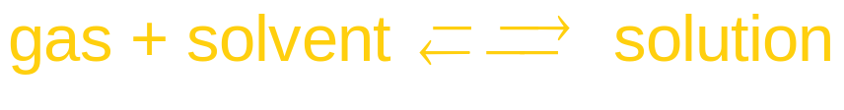
Chapter 12
Section 2 The Solution Process
Solute-Solvent Interactions, continued
Effects of Pressure on Solubility
Increases in pressure increase gas solubilities in liquids.
An equilibrium is established between a gas above a liquid solvent and the gas dissolved in a liquid.

Slide 26


Chapter 12
Section 2 The Solution Process
Solute-Solvent Interactions, continued
Effects of Pressure on Solubility, continued
Increasing the pressure of the solute gas above the solution causes gas particles to collide with the liquid surface more often. This causes more gas particles to dissolve in the liquid.
Decreasing the pressure of the solute gas above the solution allows more dissolved gas particles to escape from solution.

Slide 27
Chapter 12
Section 2 The Solution Process
Solute-Solvent Interactions, continued
Effects of Temperature on Solubility
Increasing the temperature usually decreases gas solubility.
  As temperature increases, the average kinetic energy of molecules increases.

Slide 28
Chapter 12
Section 2 The Solution Process
Solute-Solvent Interactions, continued
Effects of Temperature on Solubility
Increasing the temperature usually increases solubility of solids in liquids, as mentioned previously.
A few solid solutes are actually less soluble at
higher temperatures.

Slide 29
Section 3 Concentration of Solutions
Chapter 12
Concentration
The concentration of a solution is a measure of
the amount of solute in a given amount of solvent
or solution.
Concentration is a ratio: any amount of a given solution has the same concentration.
The opposite of concentrated is dilute.
These terms are unrelated to the degree to which a solution is saturated: a saturated solution of a solute that is not very soluble might be very dilute.

Slide 30
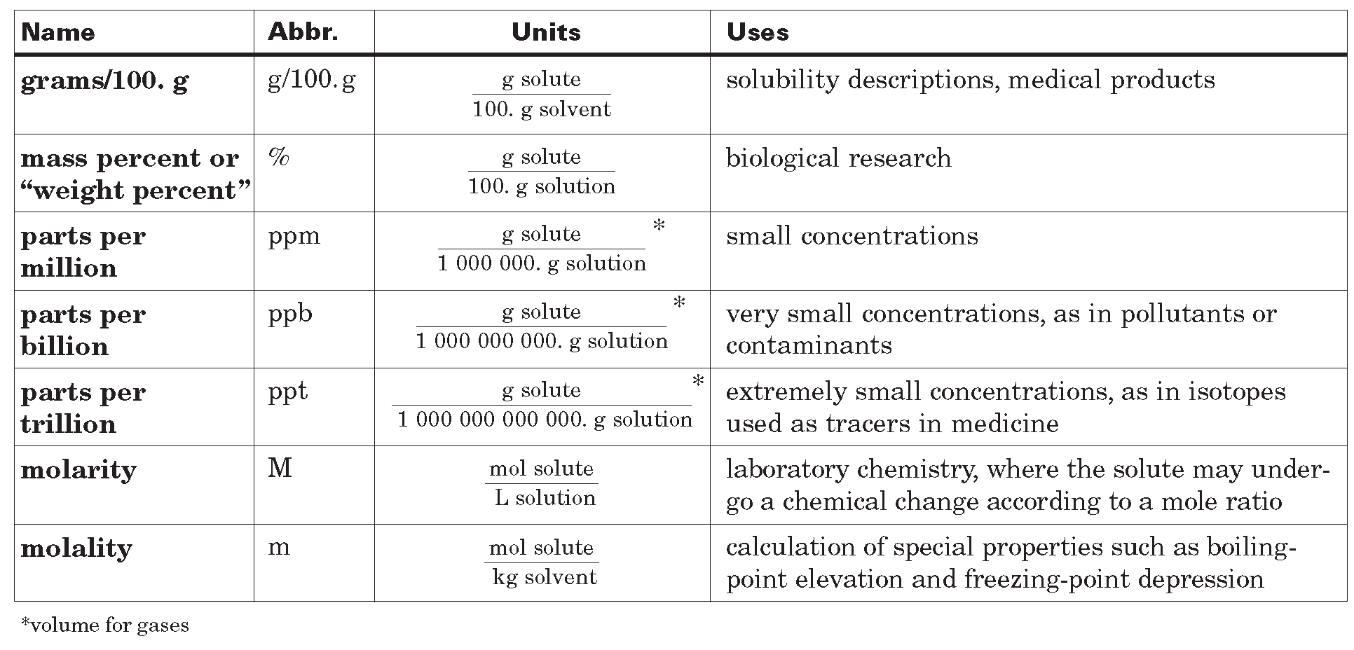
Concentration Units
Section 3 Concentration of Solutions
Chapter 12

Slide 31
Section 3 Concentration of Solutions
Chapter 12
Molarity
Molarity is the number of moles of solute in one liter of solution.
For example, a “one molar” solution of sodium hydroxide contains one mole of NaOH in every liter
of solution.
The symbol for molarity is M. The concentration of a one molar NaOH solution is written 1 M NaOH.

Slide 32
Section 3 Concentration of Solutions
Chapter 12
Molarity, continued
To calculate molarity, you must know the amount of solute in moles and the volume of solution in liters.
When weighing out the solute, this means you will need to know the molar mass of the solute in order to convert mass to moles.
  example: One mole of NaOH has a mass of
  40.0 g. If this quantity of NaOH is dissolved in enough water to make 1.00 L of solution, it is a 1.00 M solution.

Slide 33
Section 3 Concentration of Solutions
Chapter 12
Molarity, continued
The molarity of any solution can be calculated by dividing the number of moles of solute by the number of liters of solution:

Slide 34
Molarity, continued
Section 3 Concentration of Solutions
Chapter 12
Sample Problem A
You have 3.50 L of solution that contains 90.0 g of sodium chloride, NaCl. What is the molarity of that solution?

Slide 35
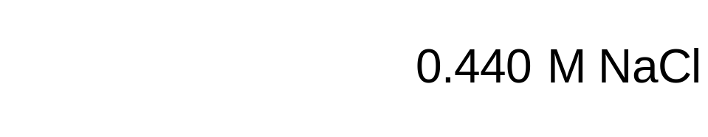
Molarity, continued
Section 3 Concentration of Solutions
Chapter 12
Sample Problem A Solution
Given: solute mass = 90.0 g NaCl
solution volume = 3.50 L
Unknown: molarity of NaCl solution
Solution:

Slide 36
Molarity, continued
Section 3 Concentration of Solutions
Chapter 12
Sample Problem B
You have 0.8 L of a 0.5 M HCl solution. How many moles of HCl does this solution contain?

Slide 37
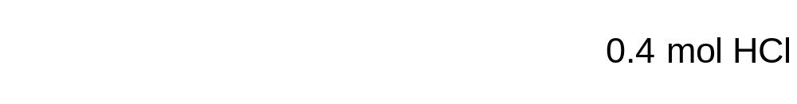
Molarity, continued
Section 3 Concentration of Solutions
Chapter 12
Sample Problem B Solution
Given: volume of solution = 0.8 L
concentration of solution = 0.5 M HCl
Unknown: moles of HCl in a given volume
Solution:

Slide 38
Molarity, continued
Section 3 Concentration of Solutions
Chapter 12
Sample Problem C
To produce 40.0 g of silver chromate, you will need at least 23.4 g of potassium chromate in solution as a reactant. All you have on hand is 5 L of a 6.0 M K₂CrO₄ solution. What volume of the solution is needed to give you the 23.4 g K₂CrO₄ needed for the reaction?

Slide 39
Molarity, continued
Section 3 Concentration of Solutions
Chapter 12
Sample Problem C Solution
Given: volume of solution = 5 L
concentration of solution = 6.0 M K₂CrO₄
mass of solute = 23.4 K₂CrO₄
mass of product = 40.0 g Ag₂CrO₄
Unknown: volume of K₂CrO₄ solution in L

Slide 40

Molarity, continued
Section 3 Concentration of Solutions
Chapter 12
Sample Problem C Solution, continued
Solution:

Slide 41
Section 3 Concentration of Solutions
Chapter 12
Molality
Molality is the concentration of a solution expressed in moles of solute per kilogram of solvent.
A solution that contains 1 mol of solute dissolved in 1 kg of solvent is a “one molal” solution.
The symbol for molality is m, and the concentration of this solution is written as 1 m NaOH.

Slide 42
Section 3 Concentration of Solutions
Chapter 12
Molality, continued
The molality of any solution can be calculated by dividing the number of moles of solute by the number of kilograms of solvent:
Unlike molarity, which is a ratio of which the denominator is liters of solution, molality is per kilograms of solvent.
  Molality is used when studying properties of solutions related to vapor pressure and temperature changes,
  because molality does not change with temperature.

Slide 43
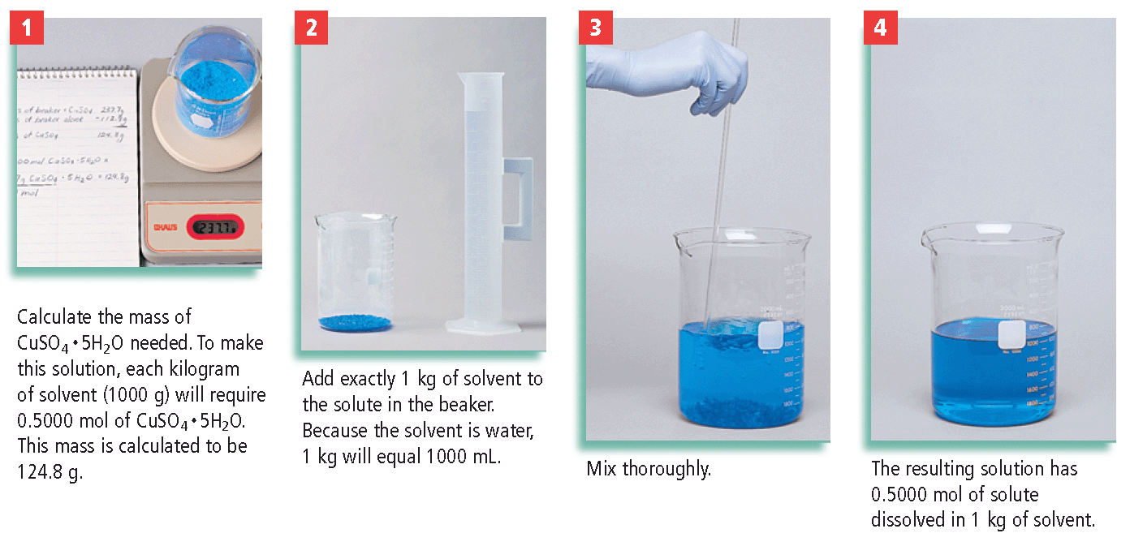
Making a Molal Solution
Section 3 Concentration of Solutions
Chapter 12

Slide 44
Molality, continued
Section 3 Concentration of Solutions
Chapter 12
Sample Problem D
A solution was prepared by dissolving 17.1 g of sucrose (table sugar, C₁₂H₂₂O₁₁) in 125 g of water. Find the molal concentration of this solution.

Slide 45
Molality, continued
Section 3 Concentration of Solutions
Chapter 12
Sample Problem D Solution
Given: solute mass = 17.1 C₁₂H₂₂O₁₁
solvent mass = 125 g H₂O
Unknown: molal concentration
Solution: First, convert grams of solute to moles and grams of solvent to kilograms.

Slide 46
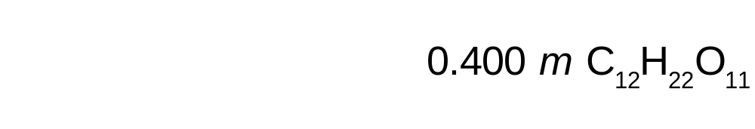
Molality, continued
Section 3 Concentration of Solutions
Chapter 12
Sample Problem D Solution, continued
Then, divide moles of solute by kilograms of solvent.

Slide 47
Molality, continued
Section 3 Concentration of Solutions
Chapter 12
Sample Problem E
A solution of iodine, I₂, in carbon tetrachloride, CCl₄, is used when iodine is needed for certain chemical tests. How much iodine must be added to prepare a 0.480 m solution of iodine in CCl₄ if 100.0 g of CCl₄ is used?

Slide 48
Molality, continued
Section 3 Concentration of Solutions
Chapter 12
Sample Problem E Solution
Given: molality of solution = 0.480 m I₂
mass of solvent = 100.0 g CCl₄
Unknown: mass of solute
Solution: First, convert grams of solvent to kilograms.

Slide 49
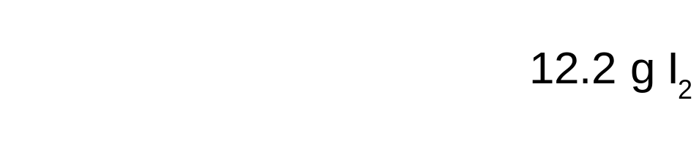
Molality, continued
Section 3 Concentration of Solutions
Chapter 12
Sample Problem E Solution, continued
Solution, continued: Then, use the equation for molality to solve for moles of solute.
Finally, convert moles of solute to grams of solute.

Slide 50

Parts Per Million (Weight/Weight), or ppm(w/w)
The grams of a pure analyte in 106 g of sample is calculated using equation 10.

Slide 51
Multiple Choice
Chapter 12
Standardized Test Preparation
1. Water is an excellent solvent because
A. it is a covalent compound.
B. it is a nonconductor of electricity.
C. its molecules are quite polar.
D. it is a clear, colorless liquid.

Slide 52
Multiple Choice
Chapter 12
Standardized Test Preparation
1. Water is an excellent solvent because
A. it is a covalent compound.
B. it is a nonconductor of electricity.
C. its molecules are quite polar.
D. it is a clear, colorless liquid.

Slide 53
Multiple Choice
Chapter 12
Standardized Test Preparation
2. Two liquids are likely to be immiscible if
A. both have polar molecules.
B. both have nonpolar molecules.
C. one is polar and the other is nonpolar.
D. one is water and the other is methyl alcohol, CH₃OH.

Slide 54
Multiple Choice
Chapter 12
Standardized Test Preparation
2. Two liquids are likely to be immiscible if
A. both have polar molecules.
B. both have nonpolar molecules.
C. one is polar and the other is nonpolar.
D. one is water and the other is methyl alcohol, CH₃OH.

Slide 55
Multiple Choice
Chapter 12
Standardized Test Preparation
3. The solubility of a gas in a liquid would be increased
by an
A. addition of an electrolyte.
B. addition of an emulsifier.
C. agitation of the solution.
D. increase in its partial pressure.

Slide 56
Multiple Choice
Chapter 12
Standardized Test Preparation
3. The solubility of a gas in a liquid would be increased
by an
A. addition of an electrolyte.
B. addition of an emulsifier.
C. agitation of the solution.
D. increase in its partial pressure.

Slide 57
Multiple Choice
Chapter 12
Standardized Test Preparation
4. Which of the following types of compounds is most likely to be a strong electrolyte?
A. a polar compound
B. a nonpolar compound
C. a covalent compound
D. an ionic compound

Slide 58
Multiple Choice
Chapter 12
Standardized Test Preparation
4. Which of the following types of compounds is most likely to be a strong electrolyte?
A. a polar compound
B. a nonpolar compound
C. a covalent compound
D. an ionic compound

Slide 59
Multiple Choice
Chapter 12
Standardized Test Preparation
5. A saturated solution can become supersaturated under which of the following conditions?
A. It contains electrolytes.
B. The solution is heated and then allowed to cool.
C. More solvent is added.
D. More solute is added.

Slide 60
Multiple Choice
Chapter 12
Standardized Test Preparation
5. A saturated solution can become supersaturated under which of the following conditions?
A. It contains electrolytes.
B. The solution is heated and then allowed to cool.
C. More solvent is added.
D. More solute is added.

Slide 61
Multiple Choice
Chapter 12
Standardized Test Preparation
6. Molarity is expressed in units of
A. moles of solute per liter of solution.
B. liters of solution per mole of solute.
C. moles of solute per liter of solvent.
D. liters of solvent per mole of solute.

Slide 62
Multiple Choice
Chapter 12
Standardized Test Preparation
6. Molarity is expressed in units of
A. moles of solute per liter of solution.
B. liters of solution per mole of solute.
C. moles of solute per liter of solvent.
D. liters of solvent per mole of solute.

Slide 63
Multiple Choice
Chapter 12
Standardized Test Preparation
7. What mass of NaOH is contained in 2.5 L of a 0.010 M solution?
A. 0.010 g
B. 1.0 g
C. 2.5 g
D. 0.40 g

Slide 64
Multiple Choice
Chapter 12
Standardized Test Preparation
7. What mass of NaOH is contained in 2.5 L of a 0.010 M solution?
A. 0.010 g
B. 1.0 g
C. 2.5 g
D. 0.40 g

Slide 65
Multiple Choice
Chapter 12
Standardized Test Preparation
8. Which one of the following statements is false?
A. Gases are generally more soluble in water under high pressures than under low pressures.
B. As temperature increases, the solubilities of some solids in water increase and the solubilities of other solids in water decrease.
C. Water dissolves many ionic solutes because of its ability to hydrate ions in solution.
D. Many solids dissolve more quickly in a cold solvent than in a warm solvent.

Slide 66
Multiple Choice
Chapter 12
Standardized Test Preparation
8. Which one of the following statements is false?
A. Gases are generally more soluble in water under high pressures than under low pressures.
B. As temperature increases, the solubilities of some solids in water increase and the solubilities of other solids in water decrease.
C. Water dissolves many ionic solutes because of its ability to hydrate ions in solution.
D. Many solids dissolve more quickly in a cold solvent than in a warm solvent.

Slide 67
Short Answer
Chapter 12
Standardized Test Preparation
9. Several experiments are carried out to determine the solubility of cadmium iodide, CdI₂, in water. In each experiment, a measured mass of CdI₂ is added to 100 g of water at 25°C and the mixture is stirred. Any undissolved CdI₂ is then filtered off and dried, and its mass is determined. Results for several such experiments are shown in the table on the next slide. What is the solubility of CdI₂ in water at this temperature?

Slide 68
Short Answer
Chapter 12
Standardized Test Preparation
9. continued
Mass of CdI₂ added, g | Mass of undissolved CdI₂ recovered, g
17.9 | 0.0
38.2 | 0.0
53.6 | 0.0
79.3 | 0.0
93.6 | 7.4
104.3 | 18.1

Slide 69
Short Answer
Chapter 12
Standardized Test Preparation
9. Answer: 86.2 g
Mass of CdI₂ added, g | Mass of undissolved CdI₂ recovered, g
17.9 | 0.0
38.2 | 0.0
53.6 | 0.0
79.3 | 0.0
93.6 | 7.4
104.3 | 18.1

Slide 70
Extended Response
Chapter 12
Standardized Test Preparation
10. Explain why oil and water do not mix.

Slide 71
Extended Response
Chapter 12
Standardized Test Preparation
10. Explain why oil and water do not mix.
Answer: Water is polar, and oil is nonpolar. When the two are combined, the strong hydrogen bonding between water molecules squeezes out the oil droplets, forming separate layers.

Slide 72
Extended Response
Chapter 12
Standardized Test Preparation
11. Write a set of instructions on how to prepare a solution that is 0.100 M KBr, using solid KBr (molar mass 119 g/mol) as the solute. Your instructions should include a list of all materials and equipment needed.

Slide 73
Extended Response
Chapter 12
Standardized Test Preparation
11. Write a set of instructions on how to prepare a solution that is 0.100 M KBr, using solid KBr (molar mass 119 g/mol) as the solute. Your instructions should include a list of all materials and equipment needed.
Answer: Your answer should summarize the steps using 11.9 g of KBr in a 1.00 L volumetric flask (or values proportional to these).

