Slide 1


Section 1 The Kinetic-Molecular Theory of Matter
Chapter 10
Lesson Starter
Why did you not smell the odor of the vapor immediately?
Explain this event in terms of the motion of molecules.

Slide 2
Goals for today
1) Identify properties of gases using the kinetic molecular theory.
2) Identify the differences between diffusion and effusion.
3) Identify properties of liquids and solids

Slide 3
Section 1 The Kinetic-Molecular Theory of Matter
Chapter 10
The kinetic-molecular theory is based on the idea that particles of matter are always in motion.
The theory can be used to explain the properties of solids, liquids, and gases in terms of the energy of particles and the forces that act between them.

Slide 4
Section 1 The Kinetic-Molecular Theory of Matter
Chapter 10
The Kinetic-Molecular Theory of Gases
An ideal gas is a hypothetical gas that perfectly fits all the assumptions of the kinetic-molecular theory.
The kinetic-molecular theory of gases is based on the following five assumptions:
  Gases consist of large numbers of tiny particles that are far apart relative to their size.
    Most of the volume occupied by a gas is empty space

Slide 5
Section 1 The Kinetic-Molecular Theory of Matter
Chapter 10
The Kinetic-Molecular Theory of Gases, continued
  Collisions between gas particles and between particles and container walls are elastic collisions.
    An elastic collision is one in which there is no net loss of total kinetic energy.
  Gas particles are in continuous, rapid, random motion. They therefore possess kinetic energy, which is energy of motion.

Slide 6
Section 1 The Kinetic-Molecular Theory of Matter
Chapter 10
The Kinetic-Molecular Theory of Gases, continued
  There are no forces of attraction between gas particles.
  The temperature of a gas depends on the average kinetic energy of the particles of the gas.

Slide 7
Section 1 The Kinetic-Molecular Theory of Matter
Chapter 10
The Kinetic-Molecular Theory and the Nature of Gases
Expansion
Gases do not have a definite shape or a definite volume.
  They completely fill any container in which they are enclosed.

Slide 8
Section 1 The Kinetic-Molecular Theory of Matter
Chapter 10
The Kinetic-Molecular Theory and the Nature of Gases, continued
Expansion, continued
Gas particles move rapidly in all directions (assumption 3) without significant attraction between them (assumption 4).
Fluidity
Because the attractive forces between gas particles are insignificant (assumption 4), gas particles glide easily past one another.
  Because liquids and gases flow, they are both referred to as fluids.

Slide 9
Section 1 The Kinetic-Molecular Theory of Matter
Chapter 10
The Kinetic-Molecular Theory and the Nature of Gases, continued
Low Density
The density of a gaseous substance at atmospheric pressure is about 1/1000 the density of the same substance in the liquid or solid state.
  The reason is that the particles are so much farther apart in the gaseous state (assumption 1).
Compressibility
During compression, the gas particles, which are initially very far apart (assumption 1), are crowded closer together.

Slide 10
Section 1 The Kinetic-Molecular Theory of Matter
Chapter 10
The Kinetic-Molecular Theory and the Nature of Gases, continued
Diffusion and Effusion
Gases spread out and mix with one another, even without being stirred.
  The random and continuous motion of the gas molecules (assumption 3) carries them throughout the available space.
Such spontaneous mixing of the particles of two substances caused by their random motion is called diffusion.

Slide 11
Section 1 The Kinetic-Molecular Theory of Matter
Chapter 10
The Kinetic-Molecular Theory and the Nature of Gases, continued
Diffusion and Effusion, continued
Effusion is a process by which gas particles pass through a tiny opening.
The rates of effusion of different gases are directly proportional to the velocities of their particles.
  Molecules of low mass effuse faster than molecules of high mass.

Slide 12
Chapter 10
Section 2 Liquids
Lesson Starter
How are you able to tell that the container is filled with a liquid?
Liquids have definite volume but take the shape of their container.
How is this different from gases?
Gases do not have a fixed shape or a fixed volume.

Slide 13
Chapter 10
Section 2 Liquids
Objectives
Describe the motion of particles in liquids and the properties of liquids according to the kinetic-molecular theory.
Discuss the process by which liquids can change into a gas. Define vaporization.
Discuss the process by which liquids can change into a solid. Define freezing.

Slide 14
Chapter 10
Section 2 Liquids
Properties of Liquids and the Kinetic-Molecular Theory
A liquid can be described as a form of matter that has a definite volume and takes the shape of its container.
The attractive forces between particles in a liquid are more effective than those between particles in a gas.
This attraction between liquid particles is caused by the intermolecular forces:
  dipole-dipole forces
  London dispersion forces
  hydrogen bonding

Slide 15
Chapter 10
Section 2 Liquids
Properties of Liquids and the Kinetic-Molecular Theory, continued
The particles in a liquid are not bound together in fixed positions. Instead, they move about constantly.
A fluid is a substance that can flow and therefore take the shape of its container.
Relatively High Density
At normal atmospheric pressure, most substances are hundreds of times denser in a liquid state than in a gaseous state.

Slide 16
Chapter 10
Section 2 Liquids
Properties of Liquids and the Kinetic-Molecular Theory, continued
Relative Incompressibility
Liquids are much less compressible than gases because liquid particles are more closely packed together.
Ability to Diffuse
Any liquid gradually diffuses throughout any other liquid in which it can dissolve.
  The constant, random motion of particles causes diffusion in liquids.

Slide 17
Chapter 10
Section 2 Liquids
Properties of Liquids and the Kinetic-Molecular Theory, continued
Ability to Diffuse
Diffusion is much slower in liquids than in gases.
  Liquid particles are closer together.
  The attractive forces between the particles of a
  liquid slow their movement.
  As the temperature of a liquid is increased, diffusion occurs more rapidly.

Slide 18

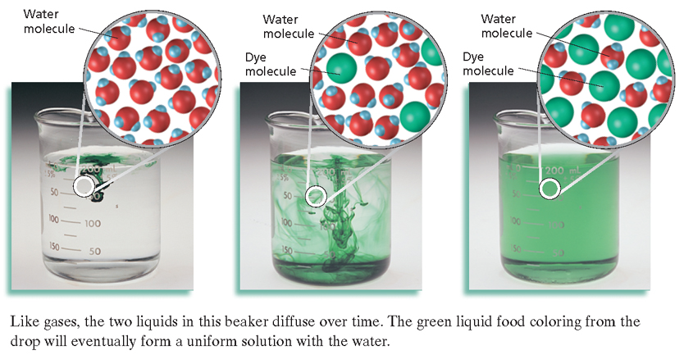
Diffusion
Chapter 10
Section 2 Liquids

Slide 19
Chapter 10
Section 2 Liquids
Properties of Liquids and the Kinetic-Molecular Theory, continued
Surface Tension
A property common to all liquids is surface tension, a force that tends to pull adjacent parts of a liquid’s surface together, thereby decreasing surface area to the smallest possible size.
The higher the force of attraction between the particles of a liquid, the higher the surface tension.

Slide 20
Chapter 10
Section 2 Liquids
Properties of Liquids and the Kinetic-Molecular Theory, continued
Surface Tension, continued
Capillary action is the attraction of the surface of a liquid to the surface of a solid.
This attraction tends to pull the liquid molecules upward along the surface and against the pull of gravity.
The same process is responsible for the concave liquid surface, called a meniscus, that forms in a test tube or graduated cylinder.

Slide 21
Chapter 10
Section 2 Liquids
Properties of Liquids and the Kinetic-Molecular Theory, continued
Evaporation and Boiling
The process by which a liquid or solid changes to a gas is vaporization.
Evaporation is the process by which particles escape from the surface of a nonboiling liquid and enter the gas state.
  Boiling is the change of a liquid to bubbles of vapor that appear throughout the liquid.
Evaporation occurs because the particles of a liquid have different kinetic energies.

Slide 22
Chapter 10
Section 2 Liquids
Properties of Liquids and the Kinetic-Molecular Theory, continued
Formation of Solids
When a liquid is cooled, the average energy of its particles decreases.
The physical change of a liquid to a solid by removal of energy as heat is called freezing or solidification.

Slide 23
Chapter 10
Section 3 Solids
Properties of Solids and the Kinetic-Molecular Theory
The particles of a solid are more closely packed than those of a liquid or gas.
All inter particle attractions exert stronger effects in solids than in the corresponding liquids or gases.
Attractive forces tend to hold the particles of a solid in relatively fixed positions.
  Solids are more ordered than liquids and are much more ordered than gases.

Slide 24
Chapter 10
Section 3 Solids
Properties of Solids and the Kinetic-Molecular Theory, continued
There are two types of solids: crystalline solids and amorphous solids.
Most solids are crystalline solids—they consist of crystals.
  A crystal is a substance in which the particles are arranged in an orderly, geometric, repeating pattern.
An amorphous solid is one in which the particles are arranged randomly.

Slide 25
Chapter 10
Section 3 Solids
Properties of Solids and the Kinetic-Molecular Theory, continued
Definite Melting Point
Melting is the physical change of a solid to a liquid by the addition of energy as heat.
The temperature at which a solid becomes a liquid is its melting point.
  At this temperature, the kinetic energies of the particles within the solid overcome the attractive forces holding them together.

Slide 26
Chapter 10
Section 3 Solids
Properties of Solids and the Kinetic-Molecular Theory, continued
High Density and Incompressibility
In general, substances are most dense in the solid state.
  The higher density results from the fact that the particles of a solid are more closely packed than those of a liquid or a gas.
For practical purposes, solids can be considered incompressible.

Slide 27
Chapter 10
Section 3 Solids
Properties of Solids and the Kinetic-Molecular Theory, continued
Low Rate of Diffusion
The rate of diffusion is millions of times slower in solids than in liquids

Slide 28
Chapter 10
Section 3 Solids
Crystalline Solids, continued
Binding Forces in Crystals, continued
Ionic crystals—The ionic crystal structure consists of positive and negative ions arranged in a regular pattern.
  Generally, ionic crystals form when Group 1 or Group 2 metals combine with Group 16 or Group 17 nonmetals or nonmetallic polyatomic ions.
  These crystals are hard and brittle, have high melting points, and are good insulators.

Slide 29
Chapter 10
Section 3 Solids
Crystalline Solids, continued
Binding Forces in Crystals, continued
Covalent network crystals—In covalent network crystals, each atom is covalently bonded to its nearest neighboring atoms.
  The covalent bonding extends throughout a network that includes a very large number of atoms.
  The network solids are very hard and brittle, have high melting points and are usually nonconductors or semiconductors.

Slide 30
Chapter 10
Section 3 Solids
Crystalline Solids, continued
Binding Forces in Crystals, continued
Metallic crystals—The metallic crystal structure consists of metal cations surrounded by a sea of delocalized valence electrons.
  The electrons come from the metal atoms and belong to the crystal as a whole.
  The freedom of these delocalized electrons to move throughout the crystal explains the high electric conductivity of metals.

Slide 31
Chapter 10
Section 3 Solids
Crystalline Solids, continued
Binding Forces in Crystals, continued
Covalent molecular crystals—The crystal structure of a covalent molecular substance consists of covalently bonded molecules held together by intermolecular forces.
  If the molecules are nonpolar, then there are only weak London dispersion forces between molecules.
  In a polar covalent molecular crystal, molecules are held together by dispersion forces, by dipole-dipole forces, and sometimes by hydrogen bonding.

Slide 32
Chapter 10
Section 4 Changes of State
Lesson Starter
Why does the balloon inflate after the solid dry ice is added?
The solid CO₂ sublimes to form CO₂ gas.
The gas occupies more volume than the solid.

Slide 33
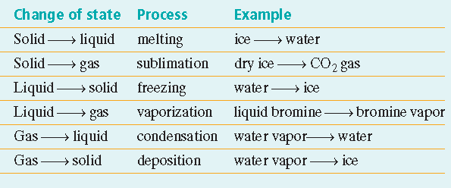
Chapter 10
Section 4 Changes of State
Possible Changes of State

Slide 34
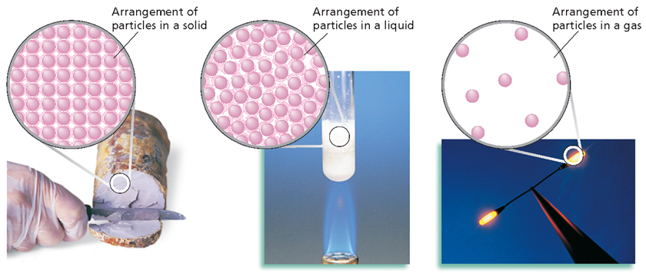
Sodium as a Solid, Liquid, and Gas
Chapter 10
Section 3 Solids

Slide 35
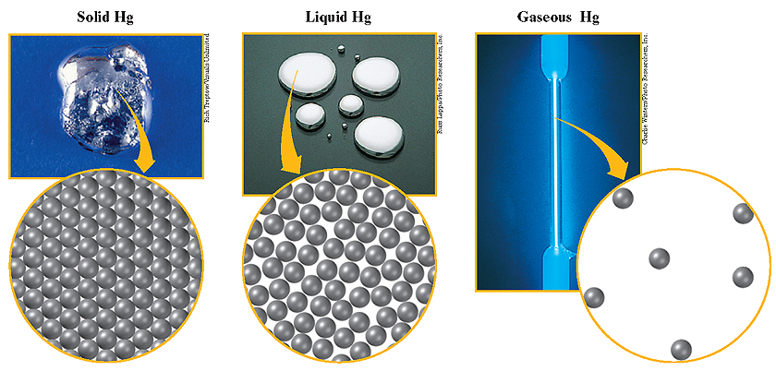
Mercury in Three States
Chapter 10
Section 4 Changes of State

Slide 36
Chapter 10
Section 4 Changes of State
Changes of State and Equilibrium
A phase is any part of a system that has uniform composition and properties.
Condensation is the process by which a gas changes to a liquid.
A gas in contact with its liquid or solid phase is often called a vapor.
Equilibrium is a dynamic condition in which two opposing changes occur at equal rates in a closed system.

Slide 37
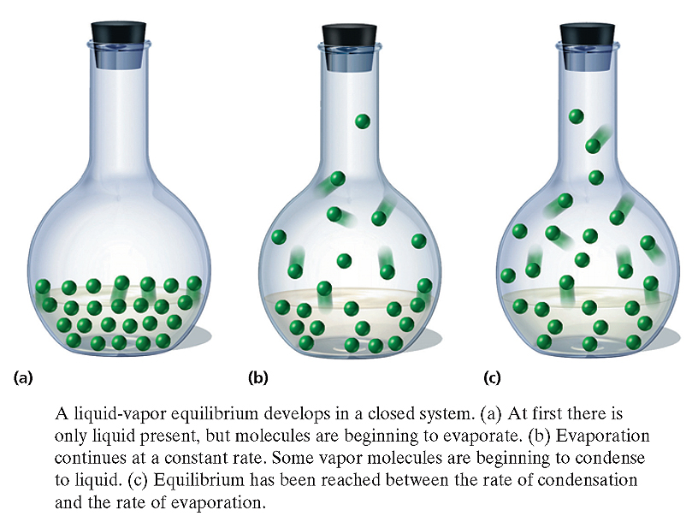
Liquid-Vapor Equilibrium System
Chapter 10
Section 4 Changes of State

Slide 38
Chapter 10
Section 4 Changes of State
Equilibrium Vapor Pressure of a Liquid
The pressure exerted by a vapor in equilibrium with its corresponding liquid at a given temperature is called the equilibrium vapor pressure of the liquid.

Slide 39
Chapter 10
Section 4 Changes of State
Equilibrium Vapor Pressure of a Liquid, continued
Every liquid has a specific equilibrium vapor pressure at a given temperature.
  All liquids have characteristic forces of attraction between their particles.
Volatile liquids are liquids that evaporate readily.
  They have relatively weak forces of attraction between their particles.
  example: ether

Slide 40
Chapter 10
Section 4 Changes of State
Equilibrium Vapor Pressure of a Liquid, continued
Nonvolatile liquids do not evaporate readily.
  They have relatively strong attractive forces between their particles.
  example: molten ionic compounds

Slide 41
Chapter 10
Section 4 Changes of State
Boiling
Boiling is the conversion of a liquid to a vapor within the liquid as well as at its surface.
The boiling point of a liquid is the temperature at which the equilibrium vapor pressure of the liquid equals the atmospheric pressure.
  The lower the atmospheric pressure is, the lower the boiling point is.

Slide 42
Chapter 10
Section 4 Changes of State
Boiling, continued
Molar Enthalpy of Vaporization
The amount of energy as heat that is needed to vaporize one mole of liquid is called the liquid’s molar enthalpy of vaporization, ∆H_{v}.
The magnitude of the molar enthalpy of vaporization is a measure of the attraction between particles of the liquid.
  The stronger this attraction is, the higher molar enthalpy of vaporization.

Slide 43
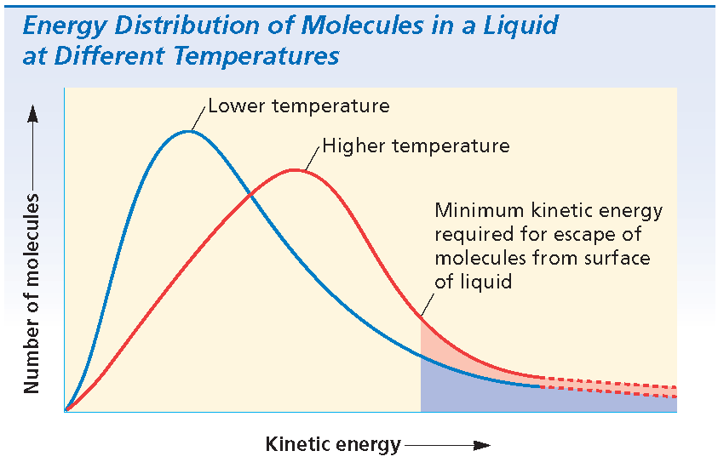
Chapter 10
Section 4 Changes of State
Boiling, continued
Molar Enthalpy of Vaporization, continued
Each liquid has a characteristic molar enthalpy of vaporization.
  Water has an unusually high molar enthalpy of vaporization due to hydrogen bonding in liquid water.

Slide 44
Chapter 10
Section 4 Changes of State
Freezing and Melting
The physical change of a liquid to a solid is called freezing.
Freezing involves a loss of energy in the form of heat by the liquid.
liquid solid + energy
In the case of a pure crystalline substance, this change occurs at constant temperature.

Slide 45
Chapter 10
Section 4 Changes of State
Freezing and Melting, continued
The normal freezing point is the temperature at which the solid and liquid are in equilibrium at 1 atm (760 torr, or 101.3 kPa) pressure.
  At the freezing point, particles of the liquid and the solid have the same average kinetic energy.
Melting, the reverse of freezing, also occurs at constant temperature.
solid + energy liquid

Slide 46
Chapter 10
Section 4 Changes of State
Freezing and Melting, continued
At equilibrium, melting and freezing proceed at equal rates.
solid + energy liquid
At normal atmospheric pressure, the temperature of a system containing ice and liquid water will remain at 0.°C as long as both ice and water are present.
  Only after all the ice has melted will the addition of energy increase the temperature of the system.

Slide 47
Chapter 10
Section 4 Changes of State
Freezing and Melting, continued
Molar Enthalpy of Fusion
The amount of energy as heat required to melt one mole of solid at the solid’s melting point is the solid’s molar enthalpy of fusion, ∆H_{f}.
The magnitude of the molar enthalpy of fusion depends on the attraction between the solid particles.

Slide 48
Chapter 10
Section 4 Changes of State
Freezing and Melting, continued
Sublimation and Deposition
At sufficiently low temperature and pressure conditions, a liquid cannot exist.
  Under such conditions, a solid substance exists in equilibrium with its vapor instead of its liquid.
solid + energy vapor
The change of state from a solid directly to a gas is known as sublimation.
The reverse process is called deposition, the change of state from a gas directly to a solid.

Slide 49
Chapter 10
Section 4 Changes of State
Phase Diagrams
A phase diagram is a graph of pressure versus temperature that shows the conditions under which the phases of a substance exist.
The triple point of a substance indicates the temperature and pressure conditions at which the solid, liquid, and vapor of the substance can coexist at equilibrium.
The critical point of a substance indicates the critical temperature and critical pressure.

Slide 50
Chapter 10
Section 4 Changes of State
Phase Diagrams
The critical temperature (t_{c}) is the temperature above which the substance cannot exist in the liquid state.
  Above this temperature, water cannot be liquefied, no matter how much pressure is applied.
The critical pressure (P_{c} ) is the lowest pressure at which the substance can exist as a liquid at the critical temperature.

Slide 51

Phase Diagram
Chapter 10
Visual Concepts
Click below to watch the Visual Concept.
Visual Concept

Slide 52
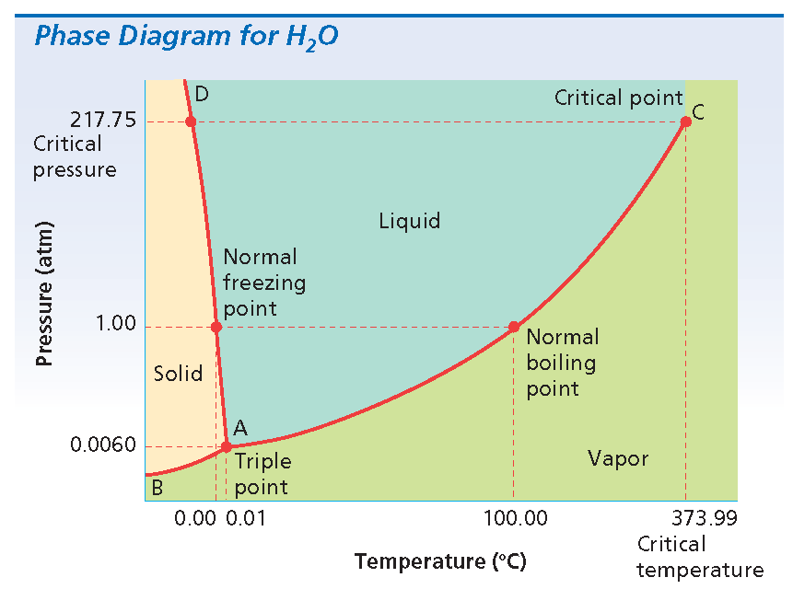
Chapter 10
Section 4 Changes of State
Phase Diagram for Water

Slide 53
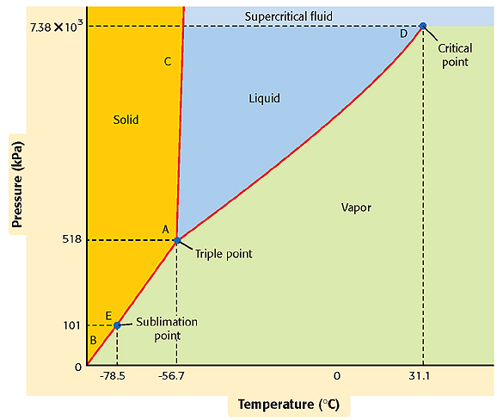
Phase Diagram for CO₂
Chapter 10
Section 4 Changes of State

Slide 54
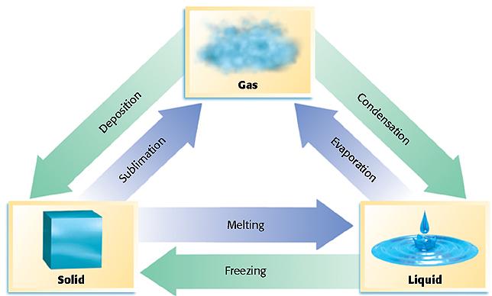
Changes of State
Chapter 10
Section 4 Changes of State

Slide 55
Chapter 10
Section 5 Water
Lesson Starter
How would the water molecule’s structure affect the properties of water?
How will hydrogen bonding influence the properties of water?

Slide 56
Chapter 10
Section 5 Water
Objectives
Describe the structure of a water molecule.
Discuss the physical properties of water. Explain how they are determined by the structure of water.
Calculate the amount of energy absorbed or released when a quantity of water changes state.

Slide 57
Chapter 10
Section 5 Water
Structure of Water
Water molecules consist of two atoms of hydrogen and one atom of oxygen united by polar-covalent bonds.
The molecules in solid or liquid water are linked by hydrogen bonding.
  The number of linked molecules decreases with increasing temperature.
Ice consists of water molecules in the hexagonal arrangement.

Slide 58
Structure of a Water Molecule
Chapter 10
Visual Concepts
Click below to watch the Visual Concept.
Visual Concept

Slide 59
Chapter 10
Section 5 Water
Structure of Water, continued
The hydrogen bonds between molecules of liquid water at 0.°C are fewer and more disordered than those between molecules of ice at the same temperature.
  Liquid water is denser than ice.
As the temperature approaches the boiling point, groups of liquid water molecules absorb enough energy to break up into separate molecules.

Slide 60
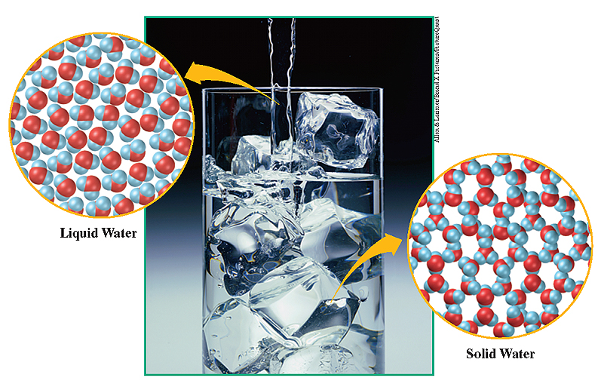
Ice and Water
Chapter 10
Section 5 Water

Slide 61
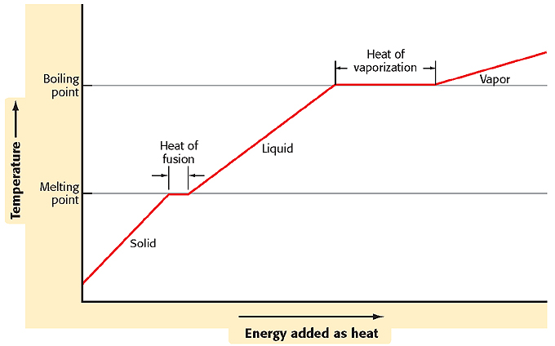
Heating Curve for Water
Chapter 10
Section 5 Water

Slide 62
Chapter 10
Section 5 Water
Physical Properties of Water
At room temperature, pure liquid water is transparent, odorless, tasteless, and almost colorless.
The molar enthalpy of fusion of ice is relatively large compared with the molar enthalpy of fusion of other solids.
Water expands in volume as it freezes, because its molecules form an open rigid structure.
  This lower density explains why ice floats in liquid water.

Slide 63
Chapter 10
Section 5 Water
Physical Properties of Water, continued
Both the boiling point and the molar enthalpy of vaporization of water are high compared with those of nonpolar substances of comparable molecular mass.
  The values are high because of the strong hydrogen bonding that must be overcome for boiling to occur.
Steam (vaporized water) stores a great deal of energy as heat.

Slide 64
Chapter 10
Section 5 Water
Physical Properties of Water, continued
Sample Problem A
How much energy is absorbed when 47.0 g of
Ice melts at STP? How much energy is absorbed
when this same mass of liquid water boils?

Slide 65
Chapter 10
Section 5 Water
Physical Properties of Water, continued
Sample Problem A Solution
Given: mass of H2O(s) = 47.0 g;
mass of H2O(l) = 47.0 g;
molar enthalpy of fusion of ice = 6.009 kJ/mol;
molar enthalpy of vaporization = 40.79 kJ/mol
Unknown: energy absorbed when ice melts;
energy absorbed when liquid water boils
Solution:
Convert the mass of water from grams to moles.

Slide 66
Chapter 10
Section 5 Water
Physical Properties of Water, continued
Sample Problem A Solution, continued
Use the molar enthalpy of fusion of a solid to calculate the amount of energy absorbed when the solid melts.
Calculate the amount of energy absorbed when water boils by using the molar enthalpy of vaporization.
2.61 mol × 6.009 kJ/mol = 15.7 kJ (on melting)
2.61 mol × 40.79 kJ/mol = 106 kJ (on vaporizing or boiling)

Slide 67

End of Chapter 10 Show

Slide 68
Multiple Choice
Chapter 10
Standardized Test Preparation
1. Surface tension is
A. skin on the surface of a liquid.
B. the tendency of the surface of liquids to
decrease the area.
C. the spontaneous mixing of two substances.
D. the same as vapor pressure.

Slide 69
Multiple Choice
Chapter 10
Standardized Test Preparation
1. Surface tension is
A. skin on the surface of a liquid.
B. the tendency of the surface of liquids to
decrease the area.
C. the spontaneous mixing of two substances.
D. the same as vapor pressure.

Slide 70
Multiple Choice
Chapter 10
Standardized Test Preparation
2. Pure liquids boil at higher temperatures under high pressures than they do under low pressures, because
A. the molecules of liquid are closer together under
higher pressures.
B. it takes a higher temperature for the vapor pressure
to equal the higher external pressure.
C. the molecules of vapor are farther apart under
higher pressures.
D. the vapor diffuses more rapidly at higher pressures.

Slide 71
Multiple Choice
Chapter 10
Standardized Test Preparation
2. Pure liquids boil at higher temperatures under high pressures than they do under low pressures, because
A. the molecules of liquid are closer together under
higher pressures.
B. it takes a higher temperature for the vapor pressure
to equal the higher external pressure.
C. the molecules of vapor are farther apart under
higher pressures.
D. the vapor diffuses more rapidly at higher pressures.

Slide 72
Multiple Choice
Chapter 10
Standardized Test Preparation
3. The formation of frost is an example of
A. condensation.
B. evaporation.
C. freezing point.
D. melting point.

Slide 73
Multiple Choice
Chapter 10
Standardized Test Preparation
3. The formation of frost is an example of
A. condensation.
B. evaporation.
C. freezing point.
D. melting point.

Slide 74
Multiple Choice
Chapter 10
Standardized Test Preparation
4. The graph that shows the pressure and temperature conditions under which the phases of a substance exist is called
A. a phase diagram.
B. a vapor pressure curve.
C. a unit cell.
D. the kinetic-molecular theory of matter.

Slide 75
Multiple Choice
Chapter 10
Standardized Test Preparation
4. The graph that shows the pressure and temperature conditions under which the phases of a substance exist is called
A. a phase diagram.
B. a vapor pressure curve.
C. a unit cell.
D. the kinetic-molecular theory of matter.

Slide 76
Multiple Choice
Chapter 10
Standardized Test Preparation
5. Water boils at 100°C. Ethanol boils at 78.5°C. Which of the following statements is true?
A. Water has the higher vapor pressure at 78.5°C.
B. Ethanol has the higher vapor pressure at 78.5°C.
C. Both have the same vapor pressure at 78.5°C.
D. Vapor pressure is not related to boiling point.

Slide 77
Multiple Choice
Chapter 10
Standardized Test Preparation
5. Water boils at 100°C. Ethanol boils at 78.5°C. Which of the following statements is true?
A. Water has the higher vapor pressure at 78.5°C.
B. Ethanol has the higher vapor pressure at 78.5°C.
C. Both have the same vapor pressure at 78.5°C.
D. Vapor pressure is not related to boiling point.

Slide 78
Multiple Choice
Chapter 10
Standardized Test Preparation
6. Which of the following is not a property of typical solids?
A. definite melting point
B. high density
C. easily compressible
D. low rate of diffusion

Slide 79
Multiple Choice
Chapter 10
Standardized Test Preparation
6. Which of the following is not a property of typical solids?
A. definite melting point
B. high density
C. easily compressible
D. low rate of diffusion

Slide 80
Multiple Choice
Chapter 10
Standardized Test Preparation
7. The kinetic-molecular theory states that ideal gas molecules
A. are in constant, rapid, random motion.
B. have mass and take up space.
C. exert forces of attraction and repulsion on each
other.
D. have high densities compared with liquids and
solids.

Slide 81
Multiple Choice
Chapter 10
Standardized Test Preparation
7. The kinetic-molecular theory states that ideal gas molecules
A. are in constant, rapid, random motion.
B. have mass and take up space.
C. exert forces of attraction and repulsion on each
other.
D. have high densities compared with liquids and
solids.

Slide 82
Chapter 10
Standardized Test Preparation
Short Answer
9. It is found that 60.0 J of energy are required to melt 15 g of a substance. The molar mass of the substance is 120 g/mol. Calculate the enthalpy of fusion of the substance in kilojoules per mole.

Slide 83
Chapter 10
Standardized Test Preparation
Short Answer
9. It is found that 60.0 J of energy are required to melt
15 g of a substance. The molar mass of the substance is 120 g/mol. Calculate the enthalpy of fusion of the substance in kilojoules per mole.
Answer: 0.48 kJ/mol

Slide 84
Extended Response
Chapter 10
Standardized Test Preparation
10. Describe how a pressure cooker works.

Slide 85
Extended Response
Chapter 10
Standardized Test Preparation
10. Describe how a pressure cooker works.
Answer: In the sealed cooker, steam pressure builds up in the space above the boiling water. At this higher pressure, the water boils at a higher temperature. Like all chemical reactions, the cooking of the food takes place more rapidly at this higher temperature, so cooking times are decreased.

Slide 86
Extended Response
Chapter 10
Standardized Test Preparation
11. What is meant by the statement that a liquid and its vapor in a closed container are in a state of dynamic equilibrium?

Slide 87
Extended Response
Chapter 10
Standardized Test Preparation
11. What is meant by the statement that a liquid and its vapor in a closed container are in a state of dynamic equilibrium?
Answer: At a given temperature, molecules are continually leaving the surface at a constant rate of evaporation. Molecules of the vapor striking the surface can rejoin the liquid at some rate of condensation. When there are enough molecules in the vapor, the rate of condensation equals the rate of evaporation. At this point, molecules are entering and leaving the liquid at the same rate, so no net change in the amount of either phase is observed. This is a condition of dynamic equilibrium.

